Slide 1
(Sub) 10 Ps TOF R&D with MRPC Technology
Mickey Chiu
Brookhaven National Laboratory
Matthias Grosse-Perdekamb, IhnJea Choi
University of Illinois at Urbana-Champaign
EIC PID Meeting 03,23,2015

Slide 2
Outline
Status of MRPC prototype at UIUC
Configuration of the prototype
PCB design and electrode
Insulation for HV and stack of glass plates
Assembly
Setup for cosmic ray test
Current issue and plan

Slide 3
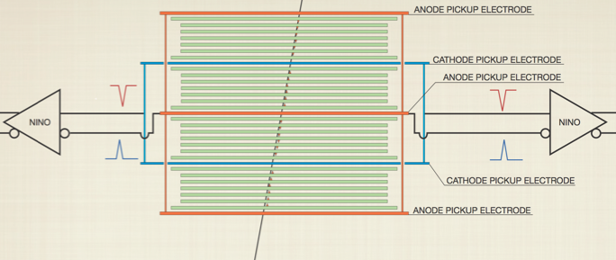
Signal Readout of MRPC
-6 kV HV
Glass plate
Gas gap
+6 kV HV
Differential
Preamp.
Smaller gas gap width -> Better timing resolution : Required many glass stacks

Slide 4
Configuration of Prototype MRPC
PCB
glass
Crispin Williams
BNL&UIUC Prototype
4 x
4 x
Gas gap width : 160um
(16ps timing resolution)
Gas gap
Gas gap width : 105um
 | MRPC ( C. Williams et al. ) | MRPC ( UIUC & BNL)
Gas Gap Width | 160um (fishing line) | 105um (fishing line, and 165, 125, 75um)
# of Gas Gaps | 4 stack x 6 layers = 24 | 4 stack x 9 layers = 36
# of thin glass layers | 4 stacks x 5 layers = 20 (250um thick glass) | 4 stack x 8 layers = 32 (210um thick glass)
Preamplifier | Differential type, NINO chip | LMH6554 2.8-GHz + Evaluation Board
TDC and DAQ | Oscilloscope (10Gs) | DRS4-V5(5Gs) + PC
Time resolution | 16ps obtained | ?

Slide 5
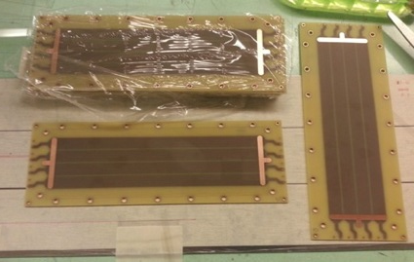
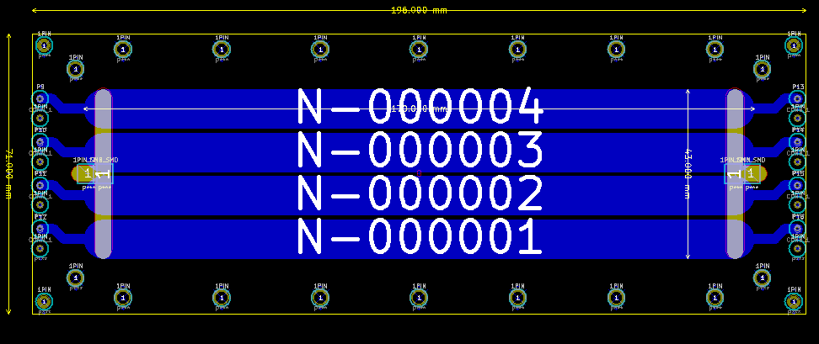
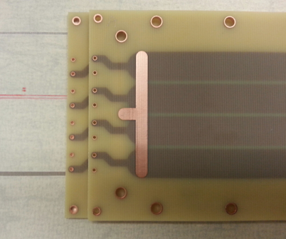
PCB for Electrode and Signal Pickup
PCB Design
12 PCBs
PCBs (3 layers)
- One board flavor – interchangeable
- HV connection integrated on board
- Rounded readout strips
- Outer dimension : 196mm x 70mm x 1.5mm
- Readout strip : 4 strips, 170mm x 10mm
- The strips are placed in the middle layer
A MRPC needs 5 PCBs
Post for spacers
+ fishing line
ch1
ch2
ch3
ch4
HV feed pad

Slide 6
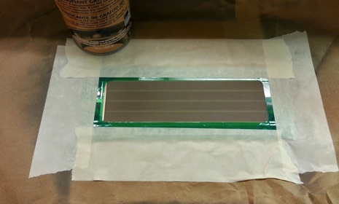
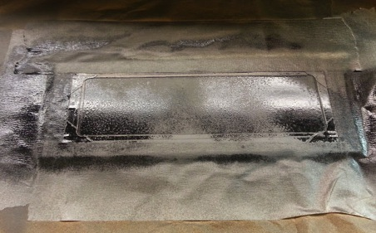
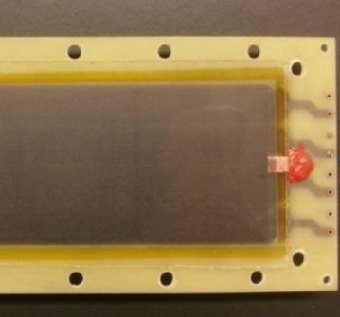
Electrodes on the PCB Surface
Preparing carbon painting
Carbon coating with carbon spray
Polished the surface with soft paper
Measured the resistivity
( 0.5 ~ 1.5 M Ohm/Square)
Thick glass plate (550um) for a insulation
Double sided Kapton tape
Carbon electrode
HV connection pad
Silicon (RTV 159)

Slide 7
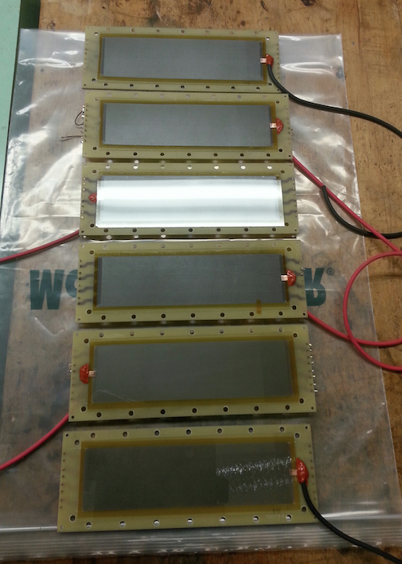
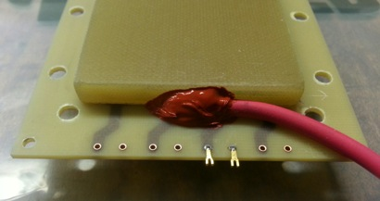
Electrode PCBs
Electrode coating ✔
Electricity Insulation ✔
Cable connection ✔
10 PCBs for two MRPCs(4 stacks)
Silicon (RTV 159)

Slide 8
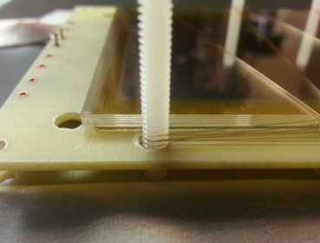
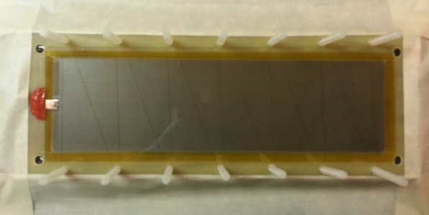
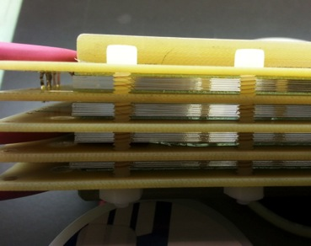
Wiring of Fishing Line for Gas Gap
105um diameter of fishing line
Stacking glass plates and fishing lines
4 stacks

Slide 9
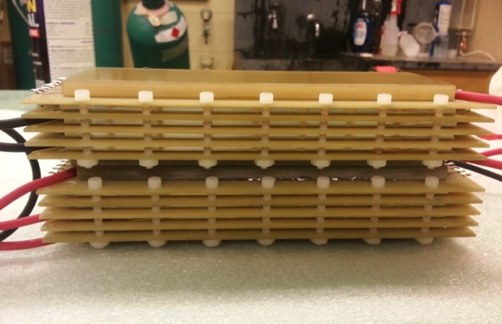
MRPCs
Two MRPCs assembled
Close view of glass plates

Slide 10
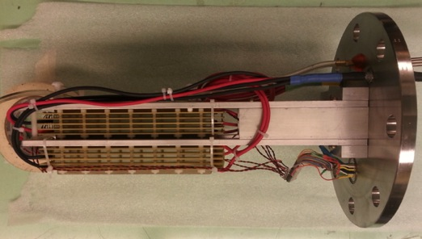
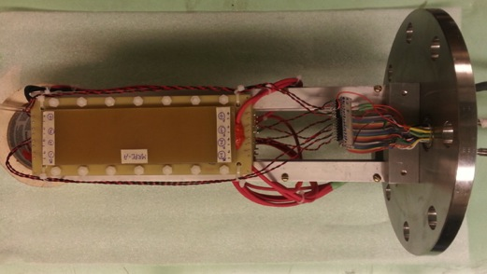
Two MRPCs Mounted
MRPC-A
Side view
MRPC-B
Note:
10ps ~ 3mm of
light travel!
Top view

Slide 11
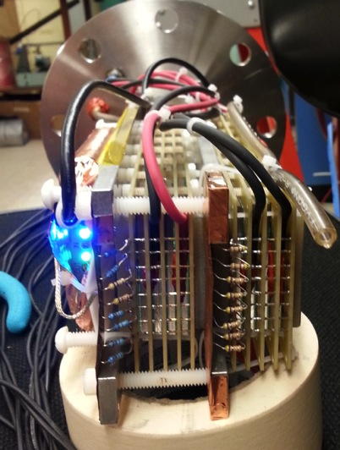
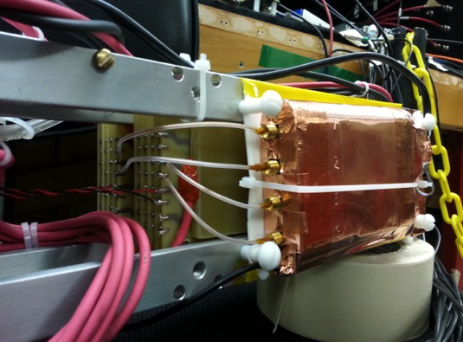
Placed DRS4 Board Next to MRPCs
DRS4 Board
No preamp yet!

Slide 12
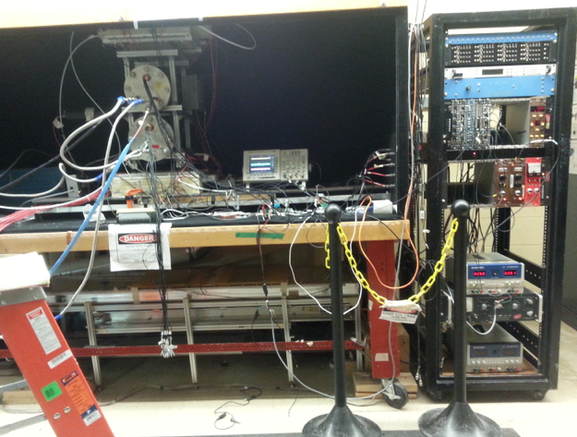
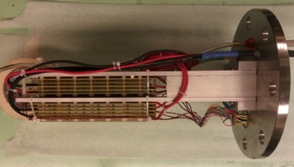
Cosmic Ray Test Stand
Trigger Modules
LV (Backup)
Tsinghua MRPC
Counter
PMT HV
LV
MRPCs

Slide 13
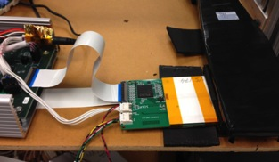
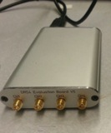
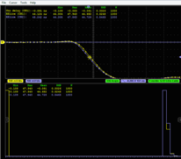
Time Resolution Measurement
Hodoscope
Silicon Tracker
(x and y strips,
500um pitch)
Muon trigger
Gas Cylinder
Track positions from Si-Trackers
preamp
50 Ohm cable (<1m)
MRPC-A
ch2
DRS4-V5
(Wave form digitiger)
USB
PC
(DAQ)
MRPC-B
ch2
preamp
Silicon Tracker
(x and y strips)
Hodoscope
Gas Mixture : Freon(I134a) 90% : Iso 5% : SF6 5%
Drift Chambers also available for the tracking

Slide 14
Setup
Still working on the preamplifiers
-> Connected signals to the wave form analyzer
without preamps.
Two MRPCs ( Top cylinder)
Tsinghua Univ. MRPCs (Bottom cylinder)
DRS4 Board (Wave form Analyzer)
USB extender, Connected Win8 PC
DRS4 Channel
Connection
Top MRPC
ch2
+(ch2),- (ch2)
Bottom MRPC
ch2
+(ch2),- (ch2)

Slide 15
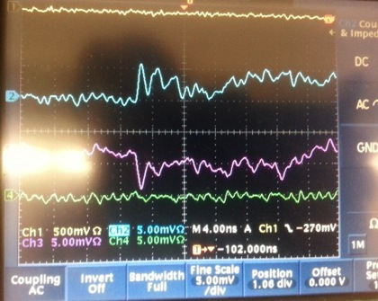
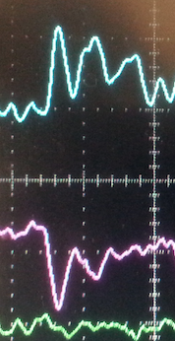
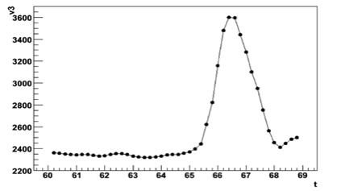
Cosmic Ray Signal and Comparison
4ns/div, 5mV/div
+
-
Cosmic ray signal from 2nd Prototype MRPC (No Preamp)
2ns
Signal from 1st Prototype MRPC
with preamp (Beam Test @ FNAL, 2014)
ns

Slide 16
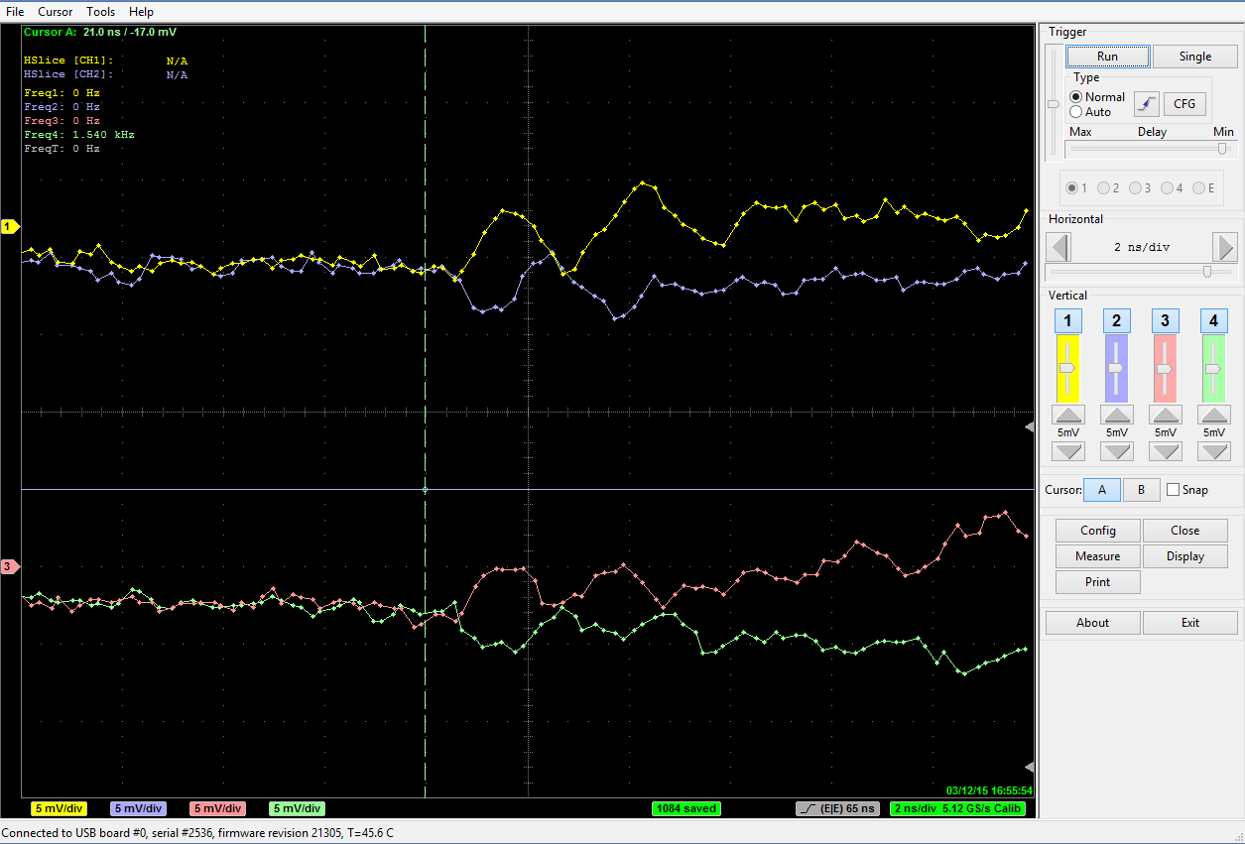
Coincidence Signals Seen at DRS4
5mV/div, 2ns/div
2ns
Cosmic Ray Triggered
Data Taking Speed
500Event/ S
1024 samplings / Event
=(~200ns period)
+,ch2 from MRPC(Top)
5mV
-,ch2 from MRPC(Top)
+,ch2 from MRPC(Bottom)
Accumulated 10k events
last night
(Trigger rate : ~ 0.2Hz)
-> will analyze the signals
-,ch2 from MRPC(Bottom)

Slide 17
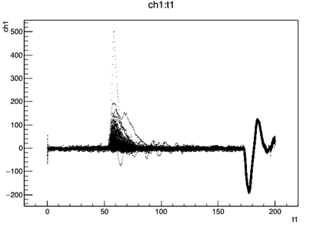
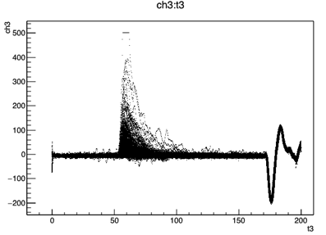
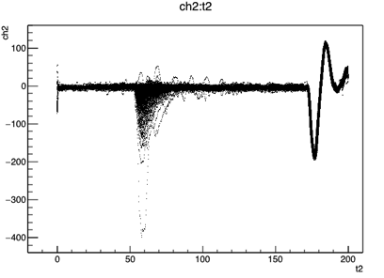
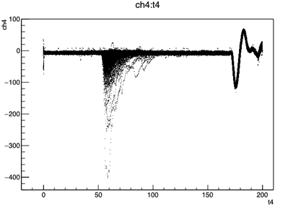
Accumulated Cosmic Ray Events
Decoding code
from Mickey.
[mv] vs [ns]
w/o Preamp
Top MRPC
Ch2 +
Bottom MRPC
Ch2 +
Top MRPC
Bottom MRPC
Top MRPC
Ch2 -
Bottom MRPC
Ch2 +
+-9kV(18kV)

Slide 18
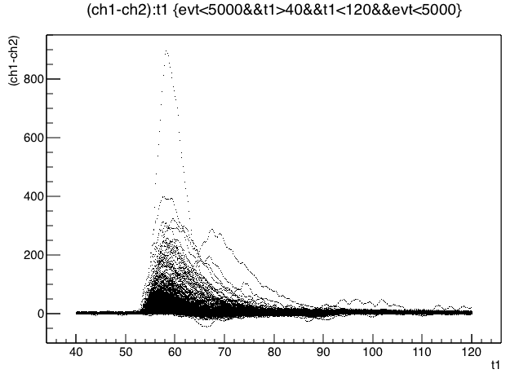
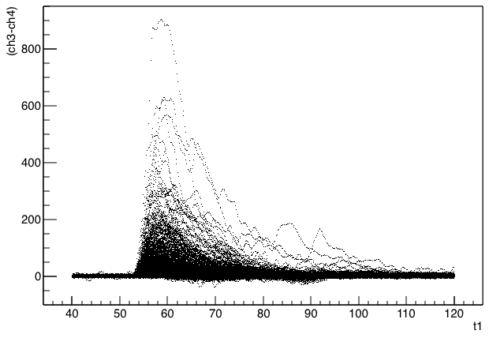
Top MRPC : Ch2(+) – Ch2(-)
Bottom MRPC Ch3(+) – Ch4(-)

Slide 19
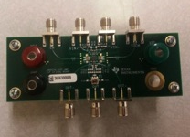
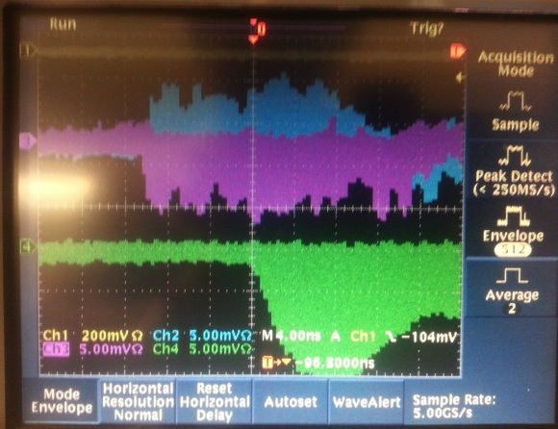
Issue on the preamplifier
LMH6554 2.8-GHz
+ Evaluation Board
Without preamp
(From Top MRPC)
Differential Inputs
Gain : 200/50 = 4.
Negative output
(From Bottom MRPC)
-> Rising time is slow..
A preamp,LMH6881 (Gain ~ 7), has been ordered for testing.

Slide 20
Plan
Gas simulation is required to optimize the gas gap width for the best time performance.
Time resolution measurement with gas gap width of 105um and other size (125um, others)
Use a different gas mixture
Searching for other materials for replacing the glass plate
(Plastic, Kapton/Mylar, etc.)
Cosmic ray test for efficiency and time resolution measurement
Beam test
(Rate capability, Scanning of momentum, dependence of Incident
angle of particle, etc.)

Slide 21
backup

Slide 22
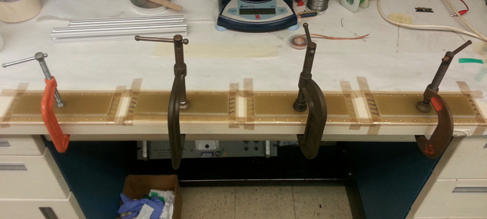
Gluing G10 plates on the PCBs
Used G10s for stiffening the cover PCB plates
instead of Al honeycomb plate.
(Gas in the honeycomb cell uncertain..)
5cm x 17cm
Thickness : 6mm,

Slide 23
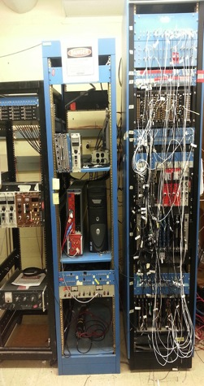
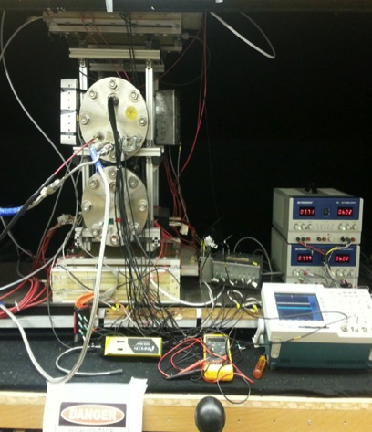
NPL Lab at UIUC
HV system
DAQ & NIM Modules
Gas Mixing Rack
Cosmic Ray Test Stand
MRPCs will be here
Mix up to four gases
HV(CAEN), CAMAC, NIM
Five drift Chambers for a muon tracking
Two Gas cylinders

Slide 24
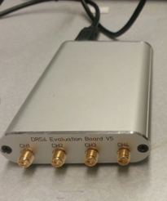
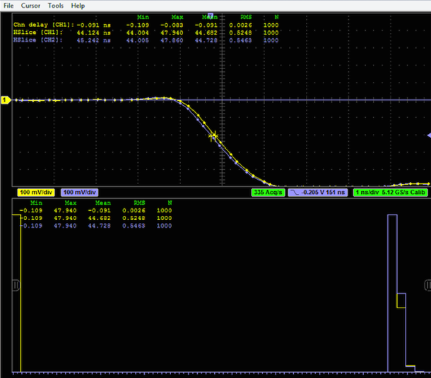
Time Jitter of the DRS4-Verion 5 (PSI Co.)
DRS4-V5
Scintillator signal -> NIM Disc. -> Split into two signals -> DRS4 (ch1, ch2)
Two copied NIM signals connected to ch1 and ch2
Measured time between chs on the DRS4-V5.
(With time calibration ON)
RMS of T1 – T2
(1ns/Div, 100mV/div)
RMS of T1 – T2
-> 2.6ps
2.6/√2 = 1.83ps !
(With time calibration OFF)
DRS4 Oscilloscope Screen on PC
RMS of T1 – T2
-> 23ps

