Slide 1
TPC survey
Survey of TPC , Magnet external
iTPC survey of pad planes
Other Detectors that are can/are be used
GMT ( space charge effects)
EPD (collision time fixed target)
TOF ( QA check)
BEMC (vertex selection)
F.Videbæk
BNL
DRAFT 2/12/2021

Slide 2
TPC surveys
Yuri wrote a detailed note* on the 2013 survey and results. It is attached to the indico page Its main finding are given in the next couple of slides.
STAR survey was done 4 times:
1. 1998. The TPC was measured twice:
once standing alone in the assembly hall, and
once after TPC was installed in the magnet.
This survey has been used as reference for the following ones.
2. September 15-16, 2003, Magnet survey, TPC in magnet coordinate system, TPC Wheel
3. August 2004, more complete survey for Magnet, TPC and SVT.
4. January 2013, survey of the magnet and TPC wheels.
*Note that several of the references in this note is not (easily) accessible

Slide 3
Method
In the present survey data analysis we use measurement of fiducials and form a plane (z0, α, beta) by fitting fiducial measurement. The measurements of TPC precision holes in the corresponding wheel coordinate system were fitted by circle for each ring (A, B, and D), and centers of circle and offsets in phi with respect to nominal sector position were estimated. Using the plane parameters we formed transformation matrices between different system of coordinate. There is difference between the 2013 and previous analysis that now we use the East Wheel as reference for the TPC coordinate system instead of average of East and West wheels used previously.

Slide 4
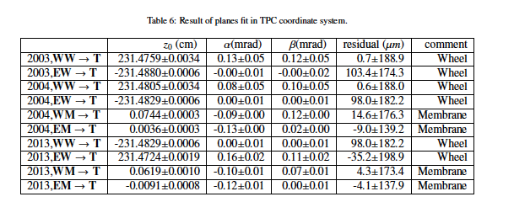
The survey provides the tpc planes for each-west
Deviation from plane has RMS of ~200 micron.
Syst error (difference) from drawing ~ 70 microns.

Slide 5
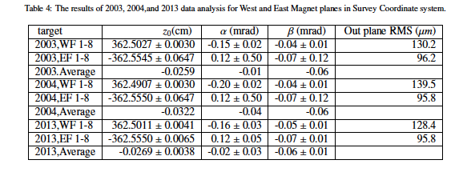
Magnet Survey
For STAR magnet survey we used 8 fiducial marks on West (WF) and East (EF) sides. The results of magnet fiducial marks fits for plane are presented in Table.4.
Finding: The survey done previously are very consistent.
TPC wheel planes are known to better than 200 microns.

Slide 6
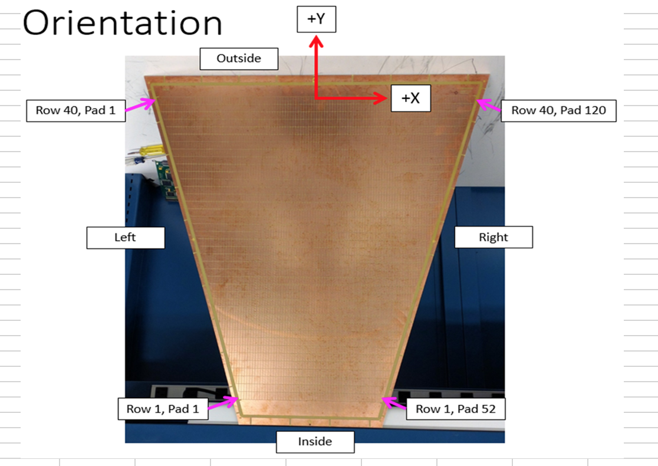
ITPC survey
Mechanical construction of iTPC sectors
Surveys
Aim to measured pad positions relative to precision tooling ball
Measured a number of pads (2 corners to get value of center, and lines). Details in padplanesurvey.pdf
Approximate pad blops shown to right
Done at LBL CMM machine
JT worked with Howard Wieman to get final rotation/shrinkage

Slide 7
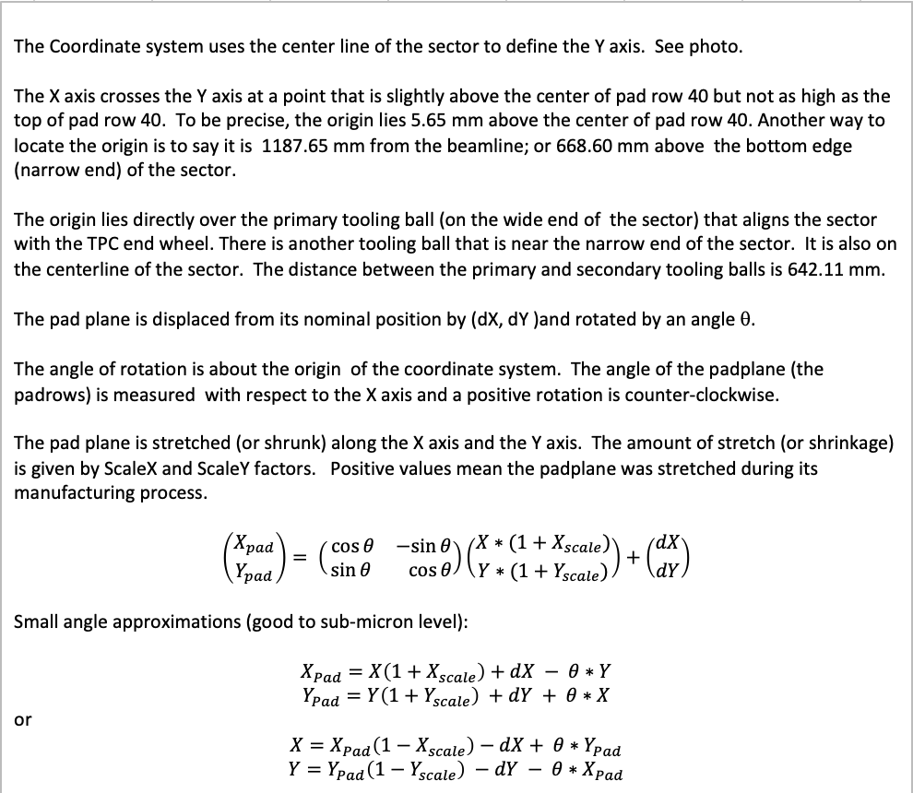
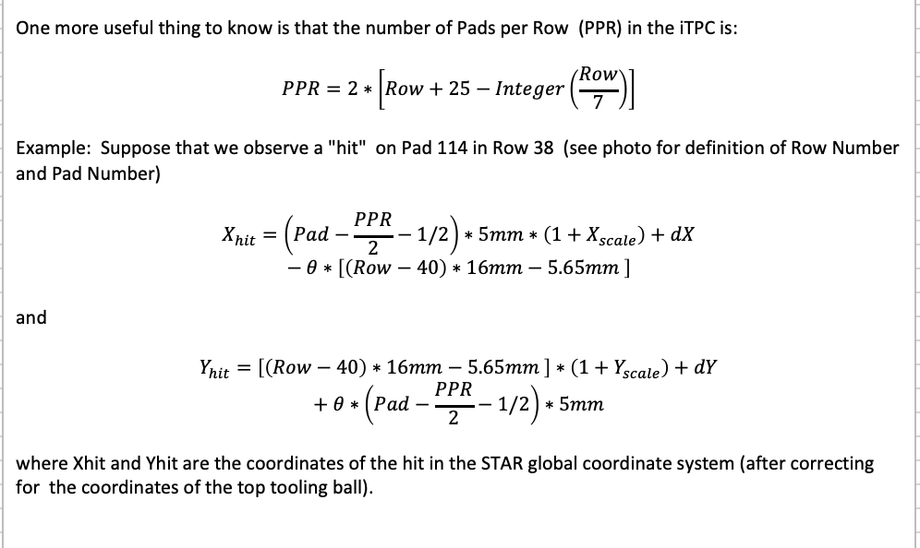

Slide 8
Results
Results were given to Yuri and incorporated into geometry for inner sectors
Not aware that such survey was done for original sectors

Slide 9
GMT proposal (2007)
Deliverables
Eight GEM based tracking chambers to be placed in eight locations at the TOF/CTB radius to monitor the TPC tracking calibrations. The system will include the chambers, readout to STAR DAQ, trigger interface and suitable spares.
Benefit
Having precise points measured at the outer radius of the TPC in strategic locations will provide a strong constraint on the space charge distortion corrections. This will be increasingly vital as RHIC luminosity increases and as the TPC tracking resolution becomes more important for physics goals.
It will also allow for fast calibration of drift velocities

Slide 10
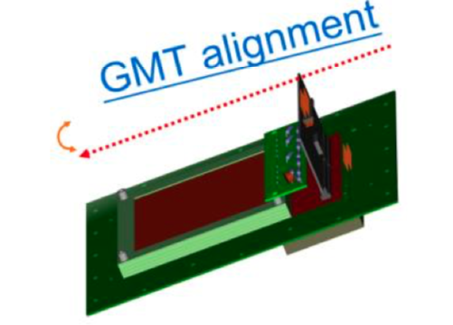
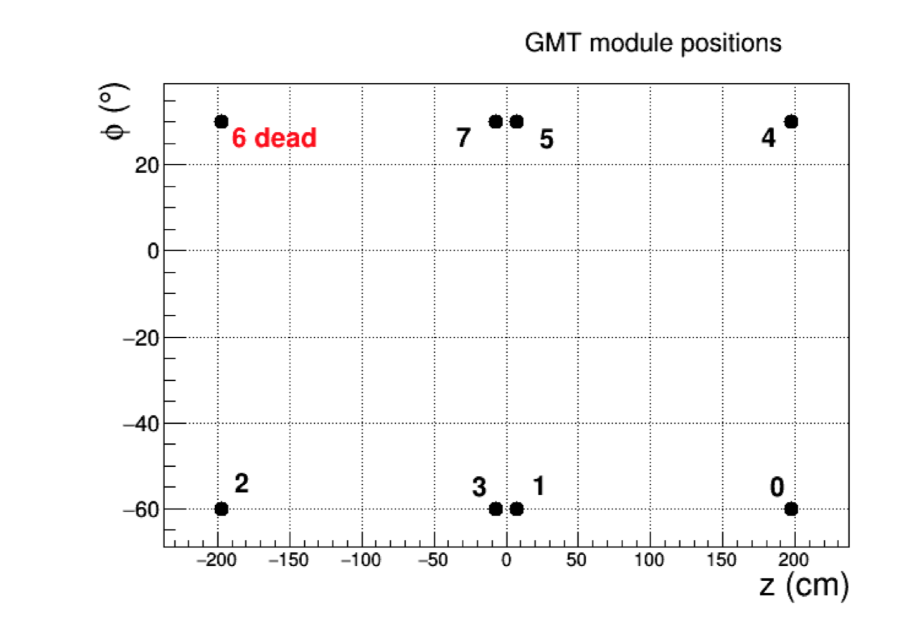
Operation parameters
8 GEM ~10*10 cm with x-y strip readout
Placed in TOF trays
Get ~100 micron resolution

Slide 11
Example of alignment (2016) cosmics

Slide 12
Status
GMT was installed and is operated routinely
There has been efforts lead by Grigory and Yuri to understand and calibrate i.e. determine position from lower luminosity runs and cosmics in different configurations
Gene and trigger group has implemented new cosmic trigger that will help with calibrations of GMT
Efforts has so far been lacking in person power.
The current status is that Egor Alpatov and Grigory are trying to add GMT to DEV. Timeline is not very obvious. Hopefully a week or two weeks depending on differences between DEV2 and DEV.
Then anyone could use it to perform calibrations. I believe Gene has already mentioned two main usage; examples:
Check of distortion corrections
Check if GMT will be able to improve tracking efficiency when it is used as a precise outside-TPC detector.
The latter was mentioned a couple of times during the Tracking Efficiency Task Force.

Slide 13
Other detectors (TOF BEMC)
Not used for TPC calibration as such but for QA checks
TOF calibrations relies on good TPC calibration and
TOF is very important in QA/QC of initial production
K⁰_{S} mass distributions
Positive negative (p, pbar)
STAR has developed efficient TOF response both with star (VPD) timing and start-less timing; important for low energy and peripheral where VPD efficiency is low
Feedback comes later in production process though first results are available in fast HLT, offline and express production
BEMC and TOF are/can be used to tag primary vertex

Slide 14
Summary
The surveys from different years are in good agreement.
TPC group decided ahead of RUN-19 that since the end-wheels are well known that a survey would not add significant knowledge.
This applies to the TPC relative to magnet, and TPC coordinate system. The carriage as such can be different when STAR is rolled in and out.
It would be very helpful if GMT calibration task could be picked up as a service task.

Slide 15
Backup info GMT-
GMT
Here is the GMT proposal from 2007:
https://drupal.star.bnl.gov/STAR/system/files/Proposal-to-Install-GEM-Chambers-GMT_0.pdf
Here's a document regarding aligning the GMT in 2014 AuAu15 data:
https://drupal.star.bnl.gov/STAR/system/files/GmtAlignmentHowTo.pdf
This is a document about using 2016 cosmics to further align the GMT under different magnetic fields:
https://drupal.star.bnl.gov/STAR/system/files/GmtAlignmentWithCosmics_20170222.pdf
Here are some supporting materials:
https://drupal.star.bnl.gov/STAR/blog/gnigmat/gmt-alignment

