Slide 1
Final Design of the INTT Ladder and Production Readiness Review (PRR)
Ladders Evaluation and Classification
WBS: 3.01
Milan Stojanovic, Purdue University
March 2nd , 2021
March 2nd, 2021

Slide 2
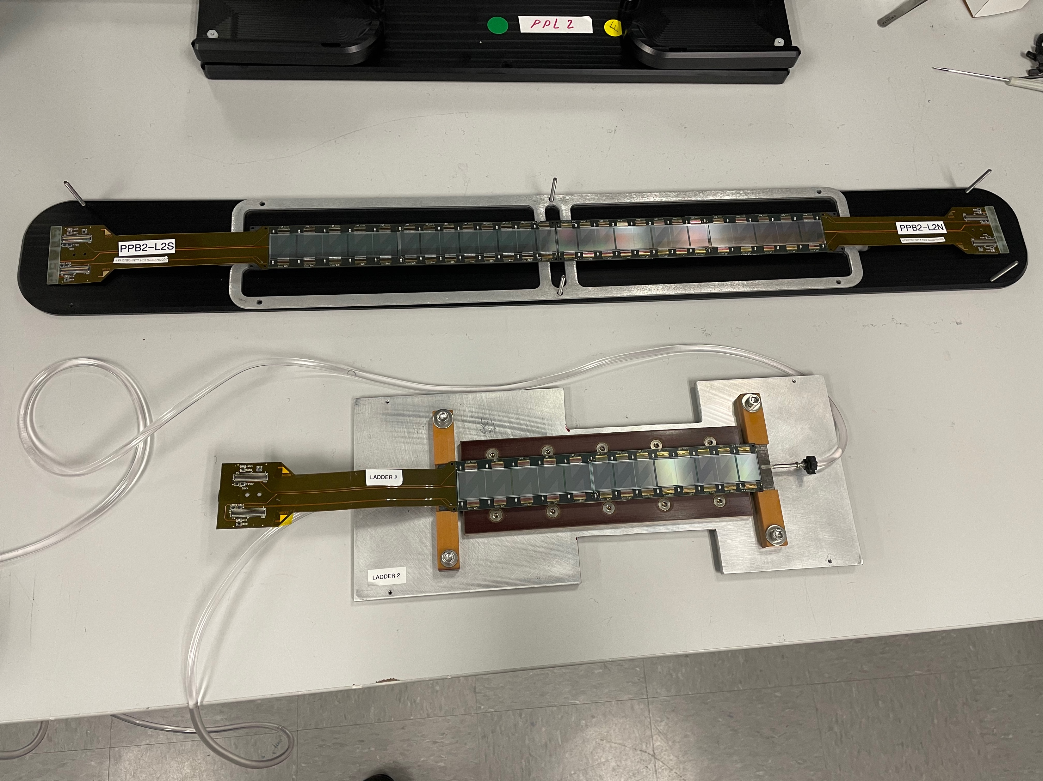
Overview
1 HDI
26 chips
2 Sensors
Evolution
  2017 – Half-ladders Prototype 1
  2019 – Half-ladders Prototype 2
2021 – Ladder Pre-Production
Ladder testing & performance
  Monitoring
Half-ladder
2 HDIs
52 chips
4 Sensors
Ladder
March 2nd, 2021

Slide 3
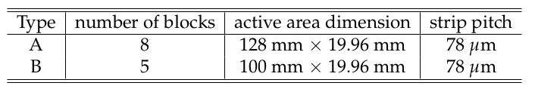
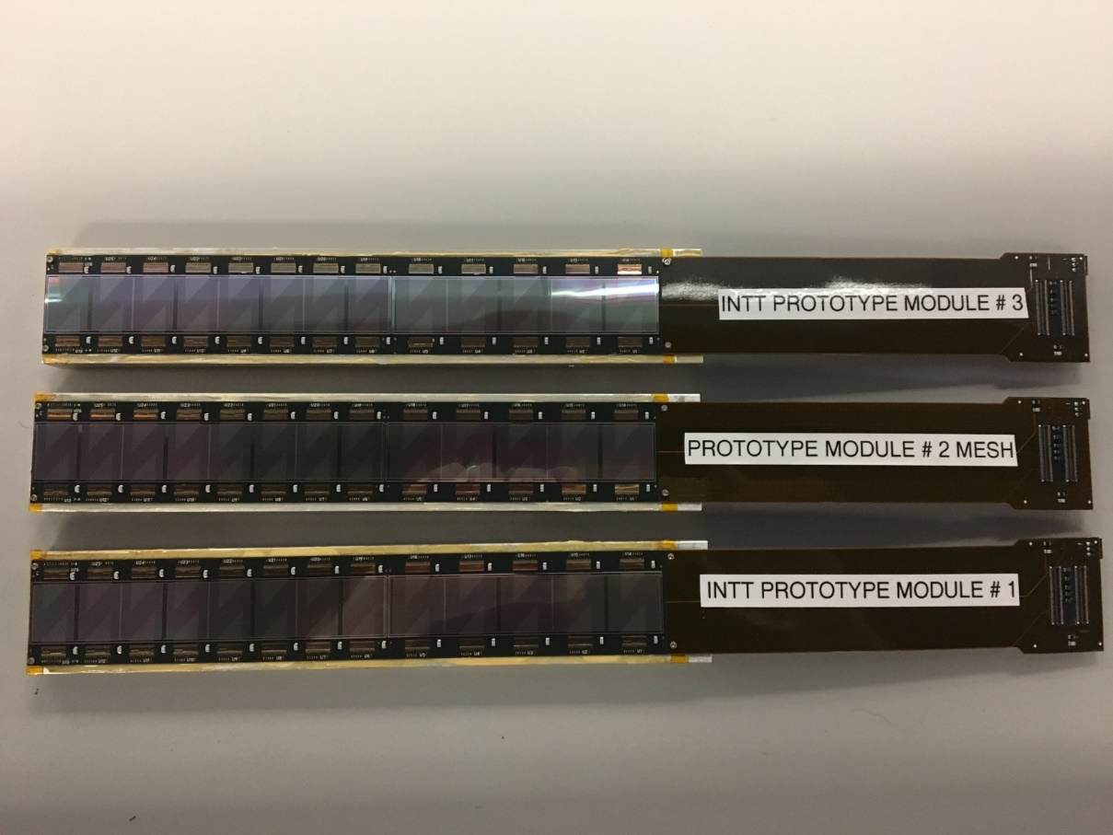
2017 – Prototype Half-ladder
3 Half-ladders built at BNL
Stave is aluminum plate
Sensors Table
Sensor A
Sensor B
HDI
Testing achieved:
Source test
External Trigger Scintillator
Beam test
Chips
March 2nd, 2021

Slide 4
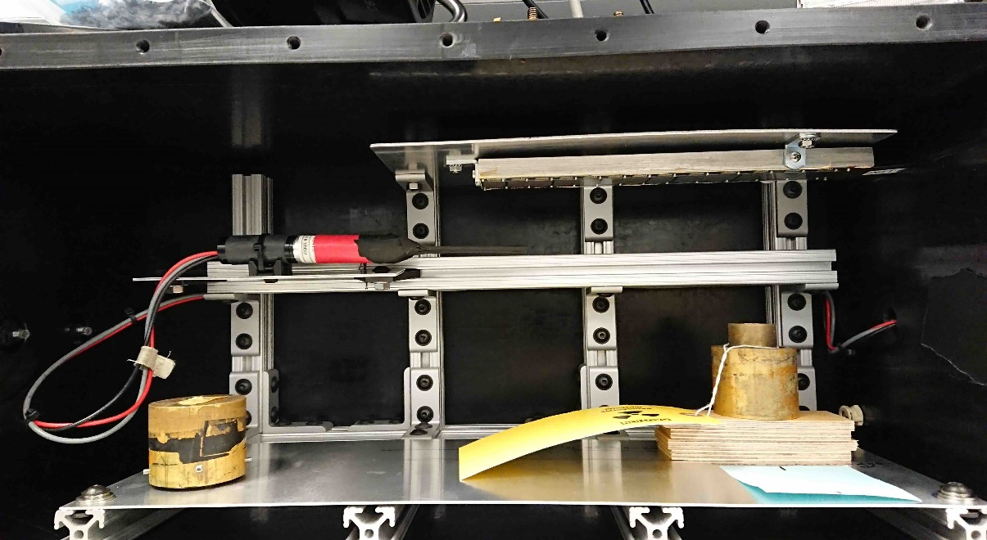
2017 – Prototype Half-ladder
Source Test Setup at BNL
Module#3
Half-ladder#3
⁹⁰Sr illumination focuses on Chip16.
  3mm-thick scintillator was put
  in front of half-ladder.
Scintillator
⁹⁰Sr
Sensors
March 2nd, 2021

Slide 5

2017 – Prototype: Source test
⁹⁰Sr Source
Chip26
Chip25
Chip24
Chip23
Chip22
Chip21
Chip20
Chip19
Chip18
Chip17
Chip16
Chip15
Chip14
Chip13
Chip12
Chip11
Chip10
Chip9
Chip8
Chip7
Chip6
Chip5
Chip4
Chip3
Chip2
Chip1
0
0
127
masked
masked
127
127
127
0
0
hits versus channel id for each strip
March 2nd, 2021

Slide 6
2017 – Prototype: External Trigger Scintillator
⁹⁰Sr Source + Scintillator
Chip26
Chip25
Chip24
Chip23
Chip22
Chip21
Chip20
Chip19
Chip18
Chip17
Chip16
Chip15
Chip14
Chip13
Chip12
Chip11
Chip10
Chip9
Chip8
Chip7
Chip6
Chip5
Chip4
Chip3
Chip2
Chip1
0
0
127
masked
masked
127
127
127
0
0
hits versus channel id for each strip
March 2nd, 2021

Slide 7
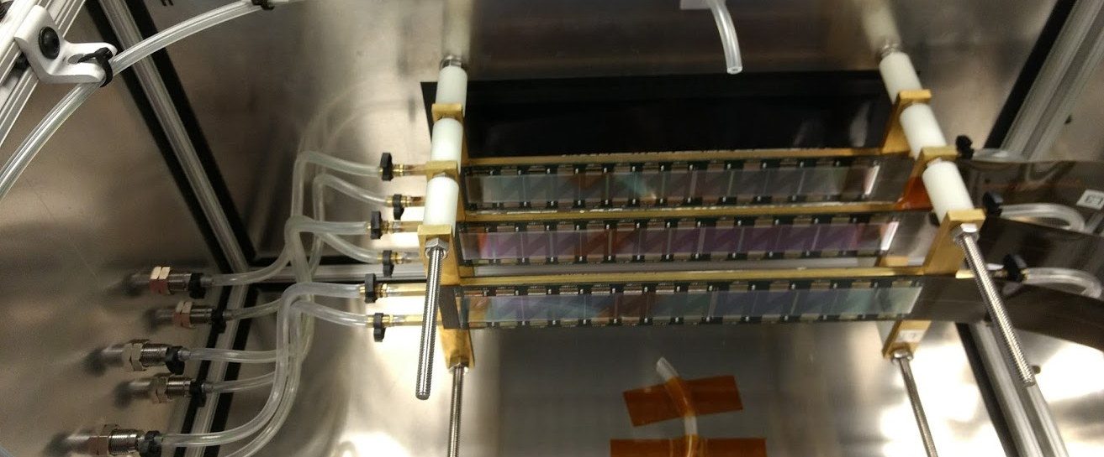
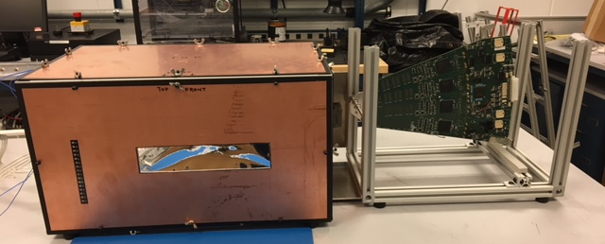
Beam Test 2018
First prototypes built on aluminum plates.
March 2nd, 2021

Slide 8
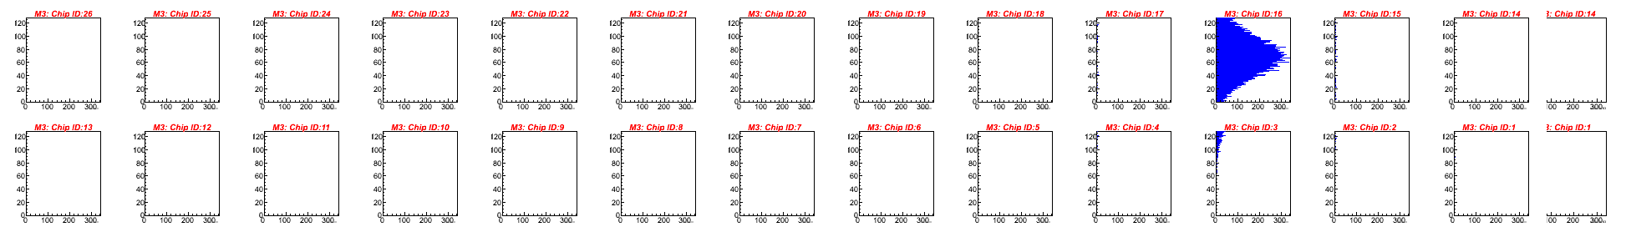
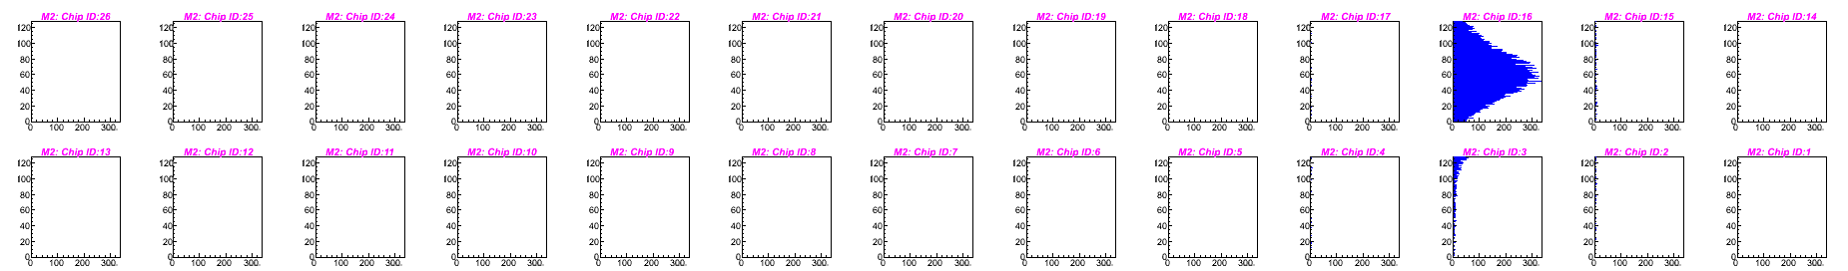
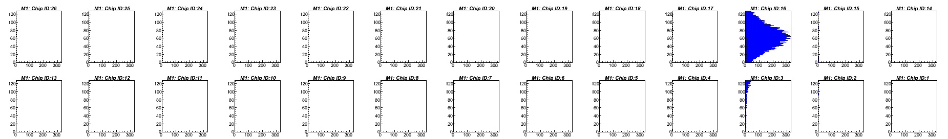
Beam Test 2018
Proton beam – 120 GeV
X-axis: # of hits
Y-axis: channel number
Very good signal observed
Half-ladder #3
Half-lader #2
Half-ladder #1
March 2nd, 2021

Slide 9
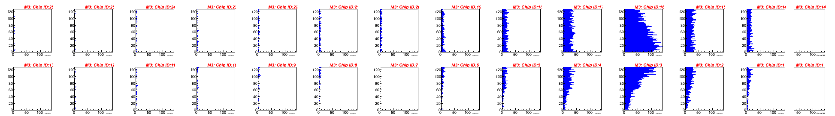
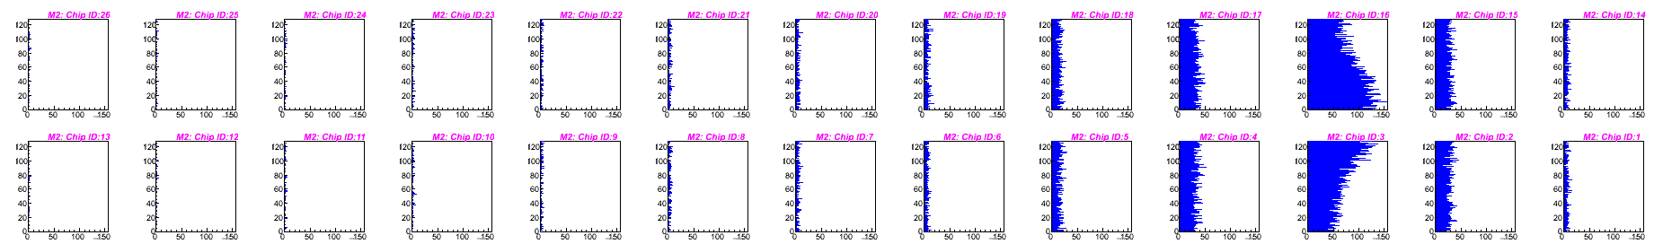
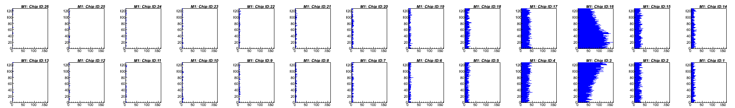
Beam Test 2018
Proton beam – 120 GeV
X-axis: # of hits
Y-axis: channel number
Very good signal observed
With bricks
Half-ladder #3
Half-lader #2
Half-ladder #1
March 2nd, 2021

Slide 10
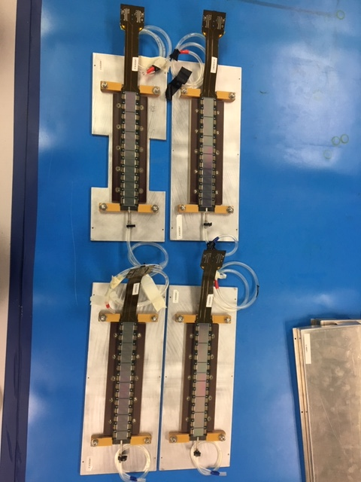
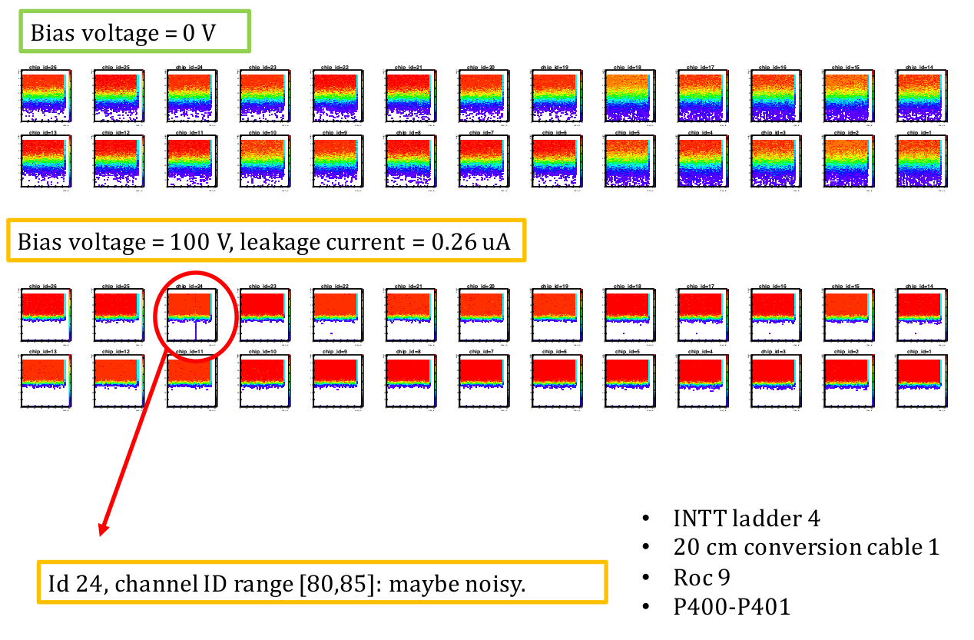
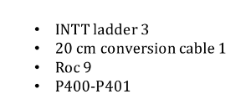
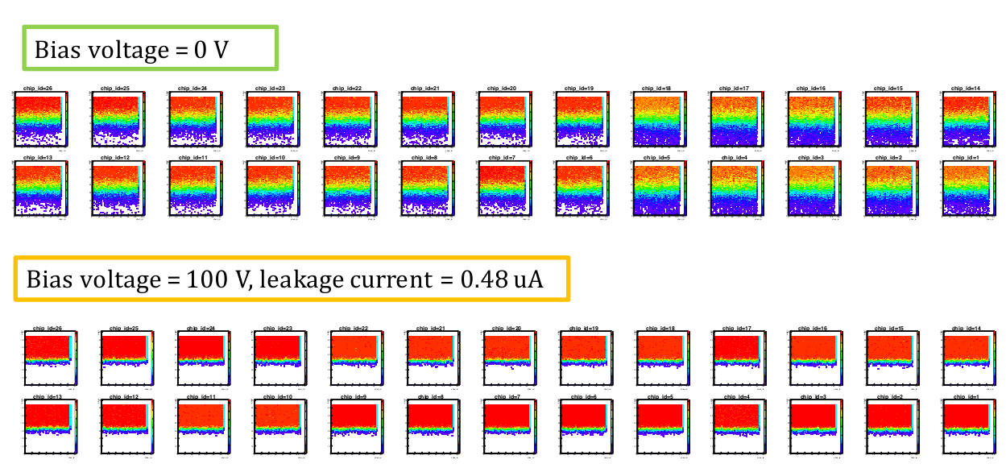
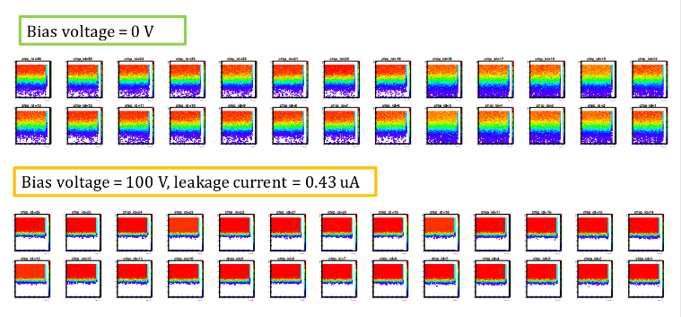
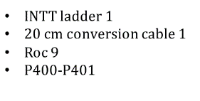
2019 – Prototype Half-ladders
4 half-ladders built on carbon fiber plates.
March 2nd, 2021

Slide 11
2021 Ladder Pre-production
March 2nd, 2021

Slide 12
2021 Pre-production
Tracking System: MVTX+INTT+TPC
7 Ladders were built at BNL
Three stages of measurement:
  HDIs-Chips (regulator 2.5V)
  HDIs-Chips-Sensors (regulator 2.5V)
  Encapsulated (regulator 3.0V)
March 2nd, 2021

Slide 13
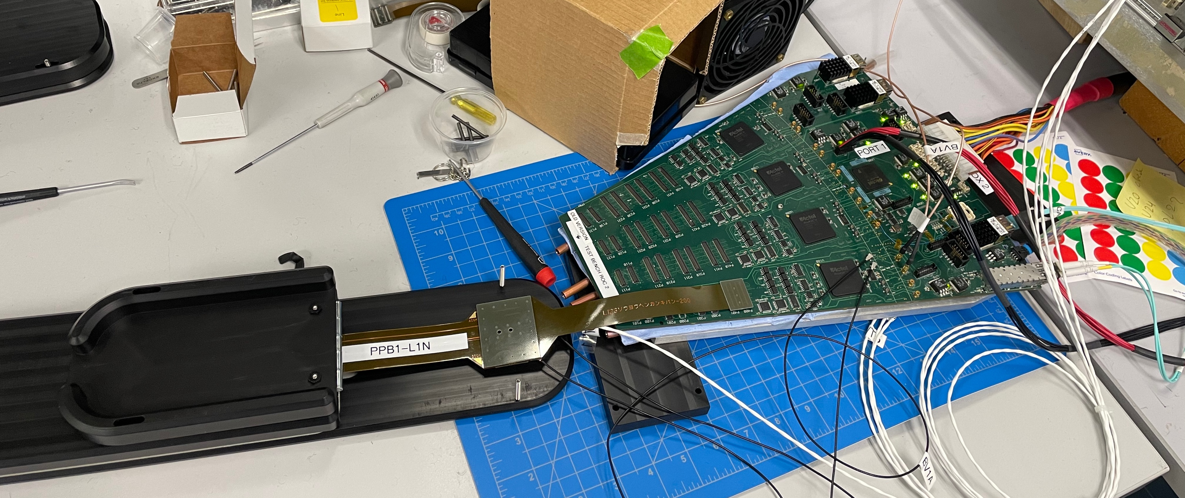
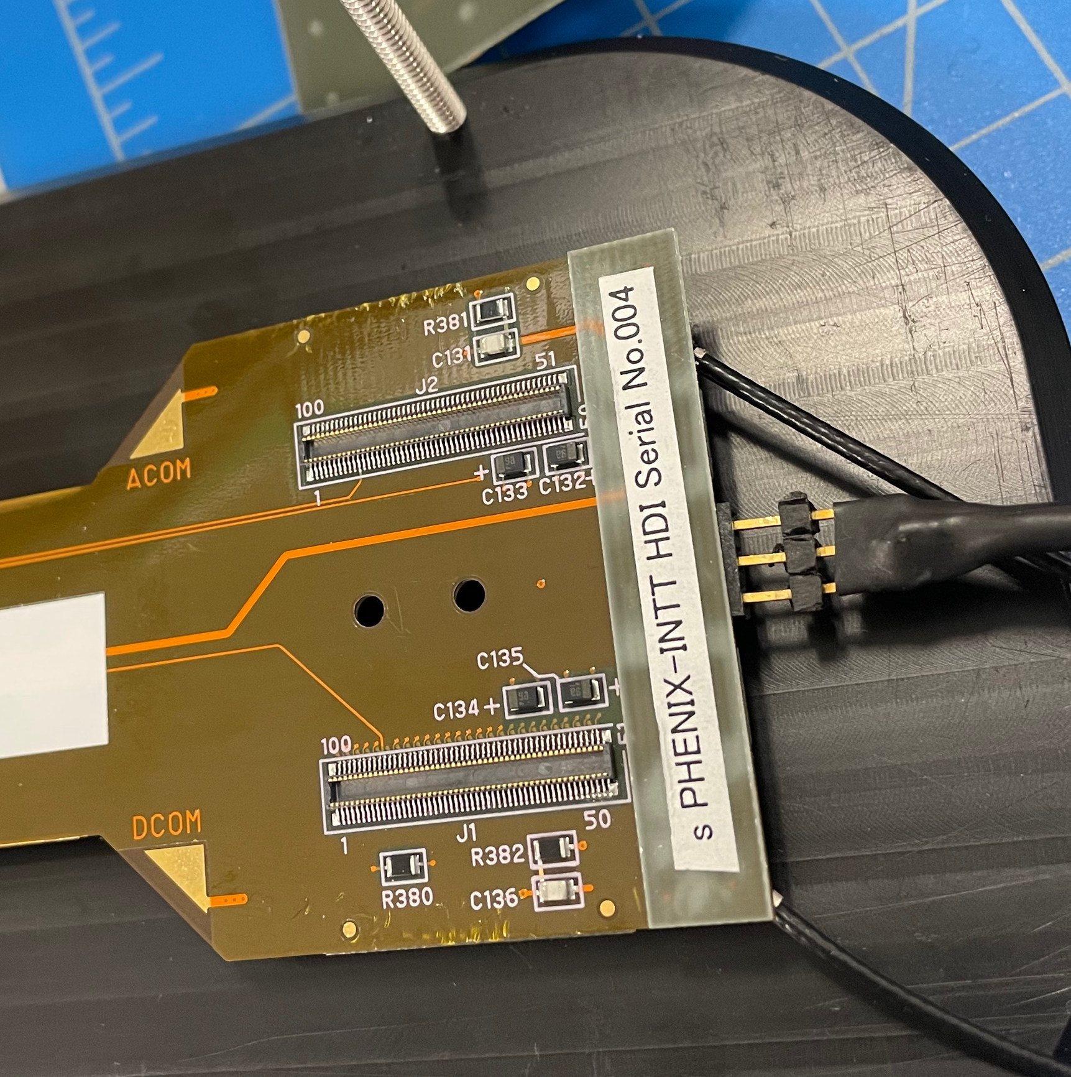
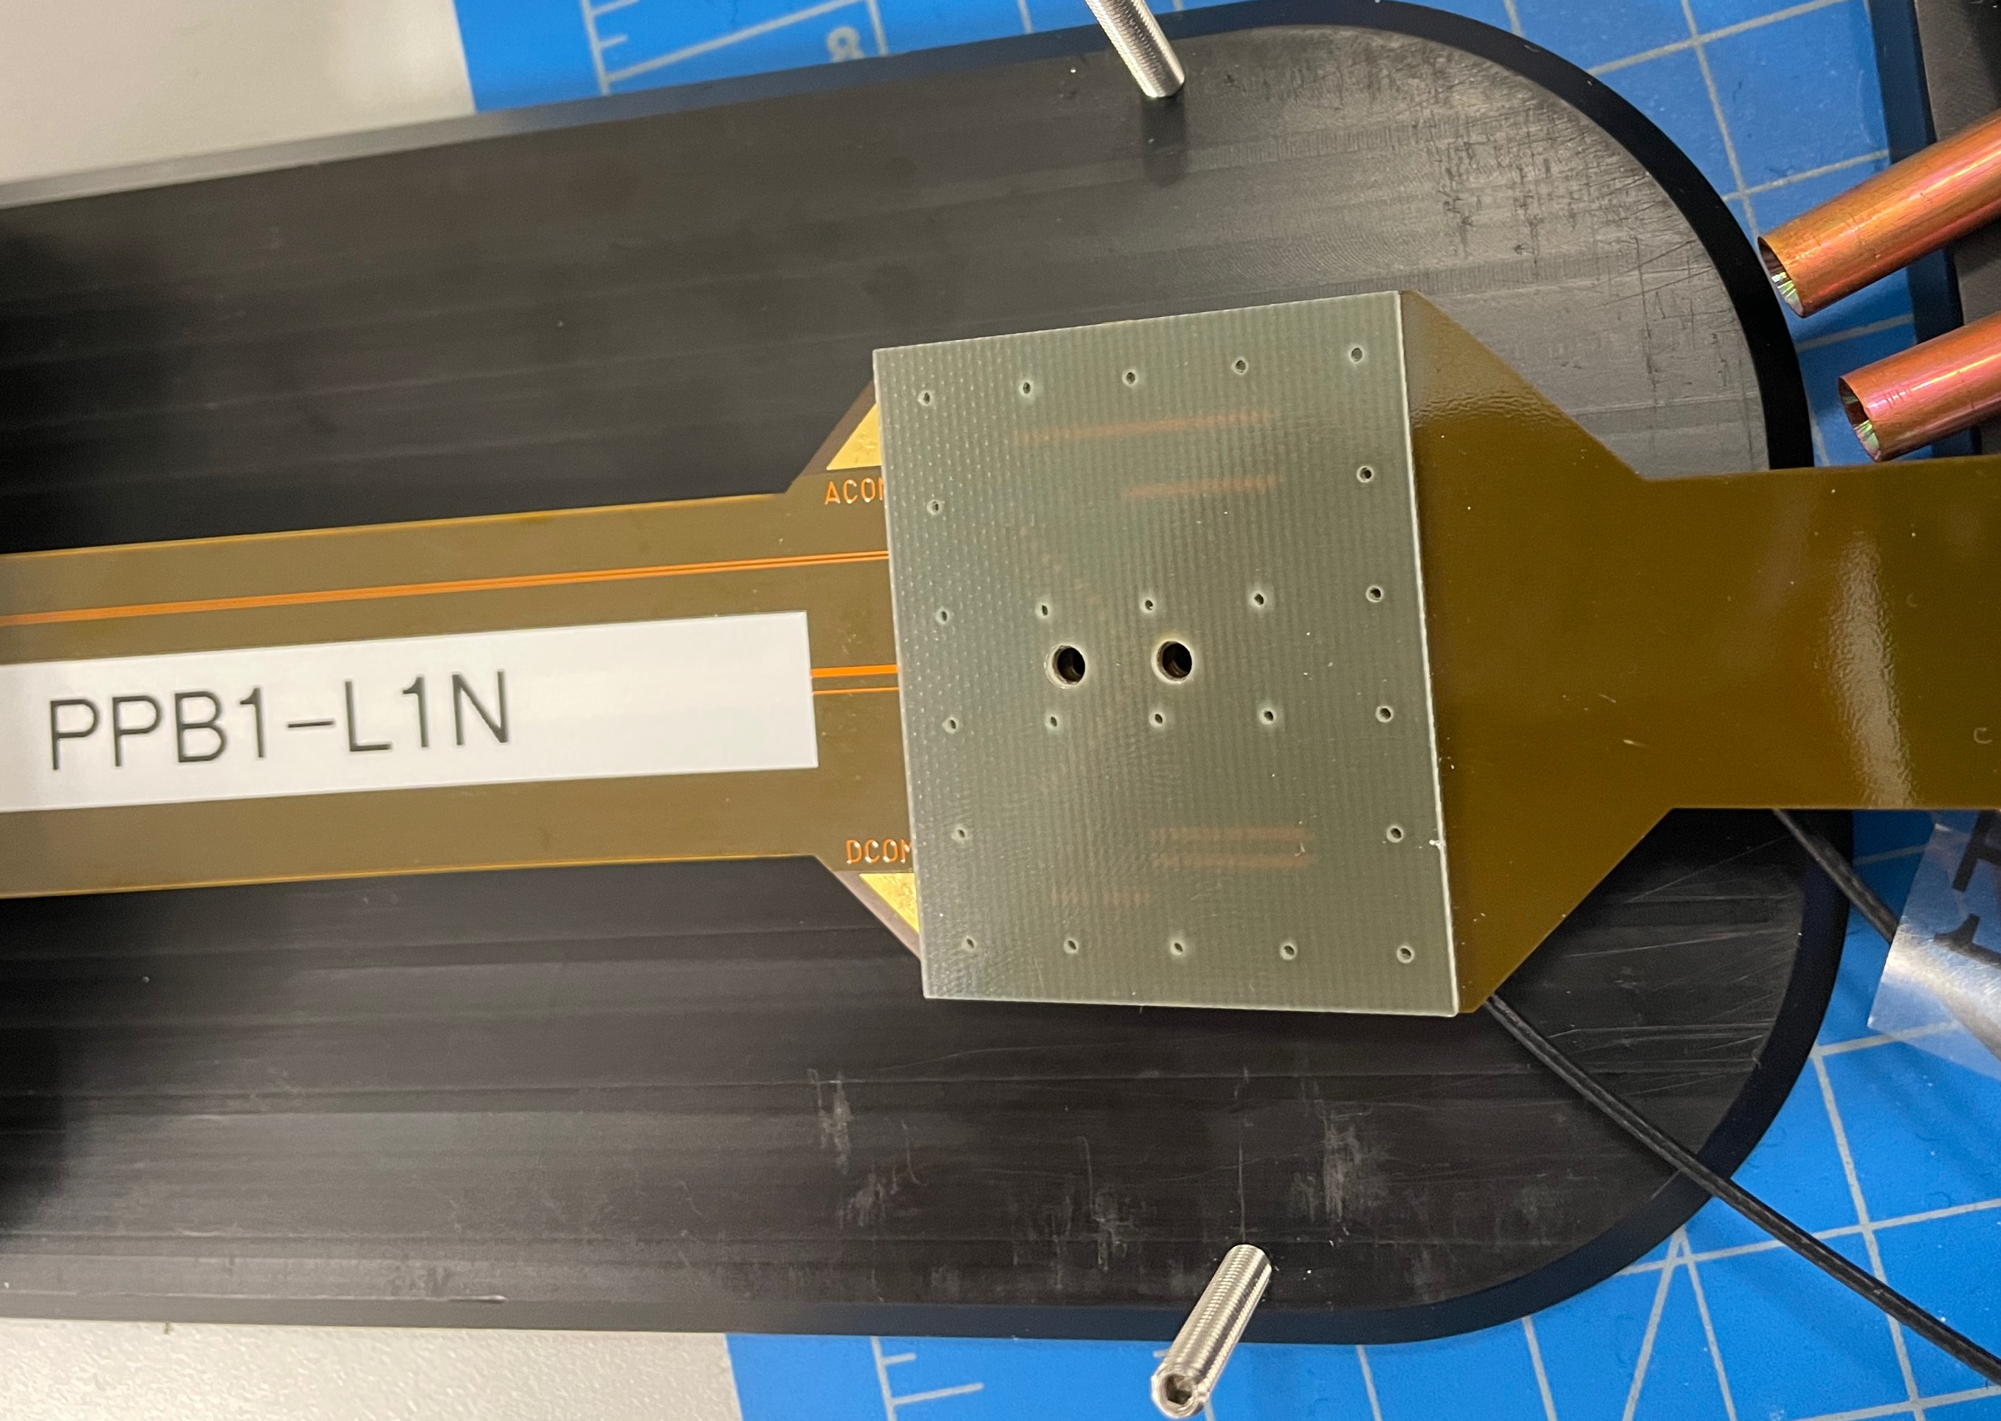
2021 Ladder testing
ROC
Temperature
Conversion
cable
BV1B
BV1A
March 2nd, 2021

Slide 14
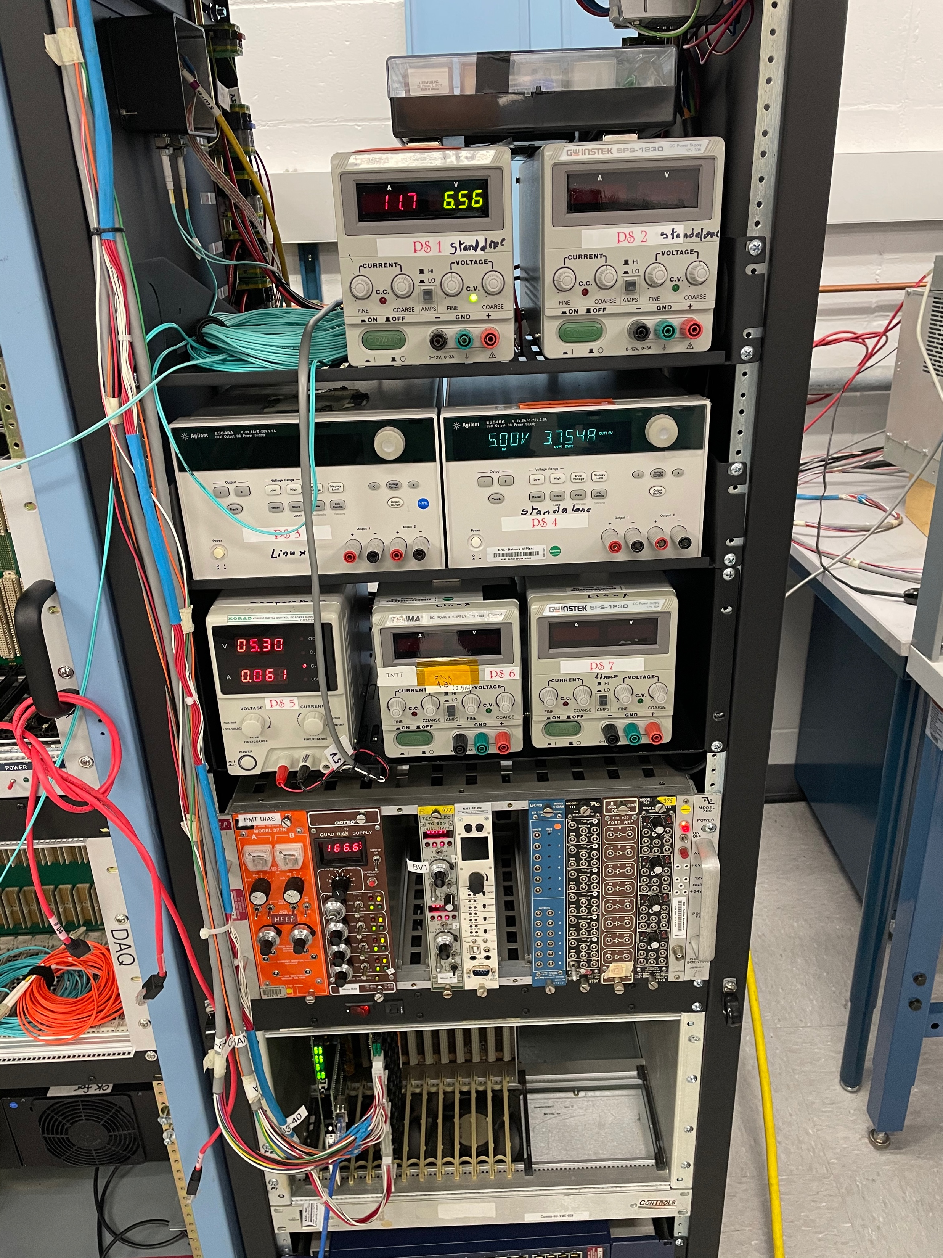
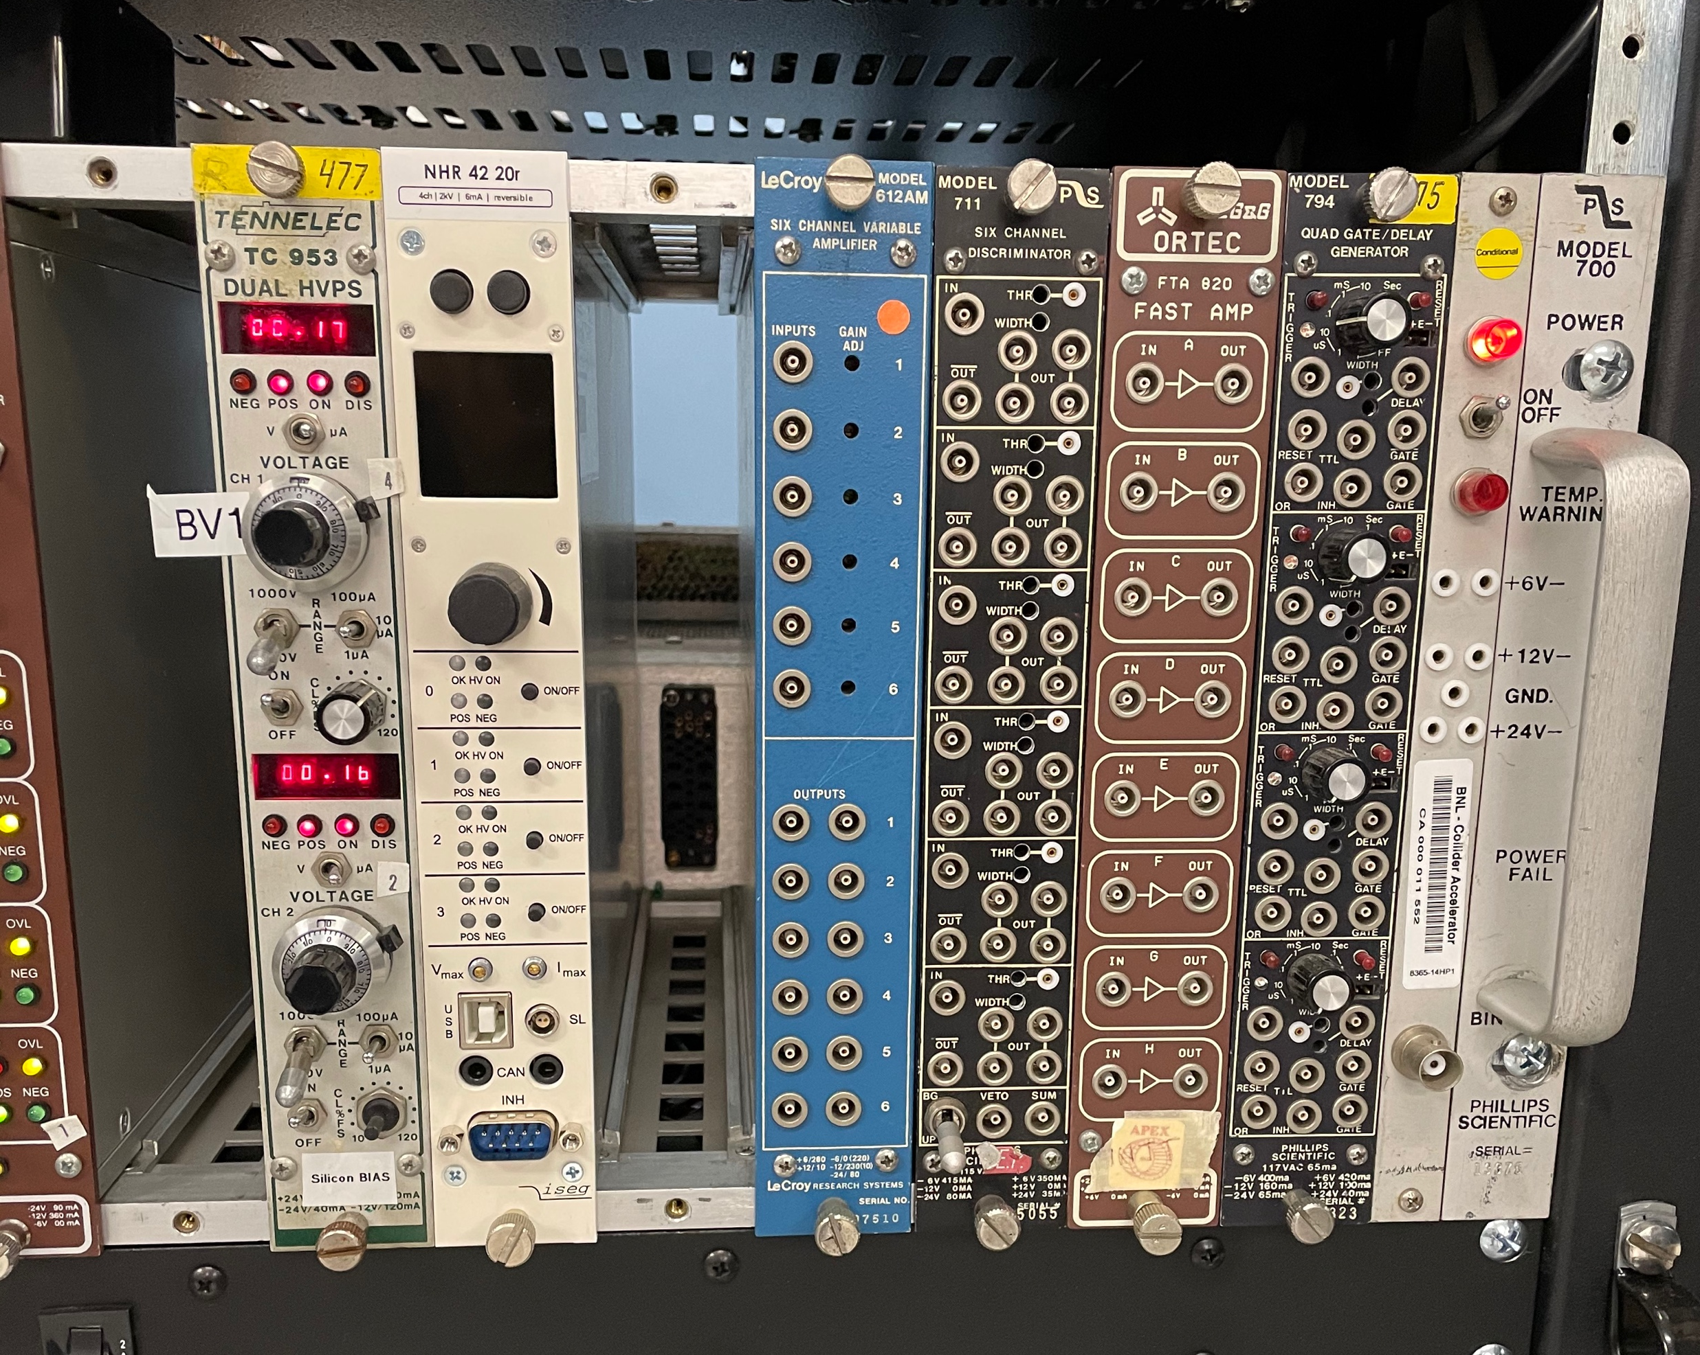
2021 Ladder testing
Temperature
Silicon Bias
BV1A
BV1B
March 2nd, 2021

Slide 15
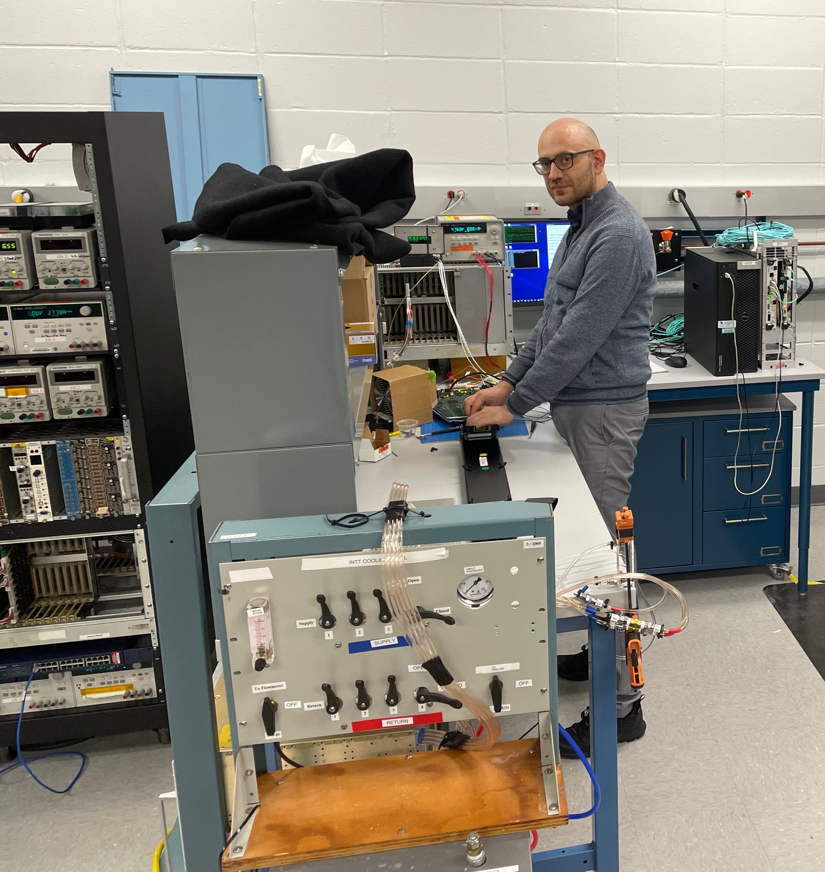
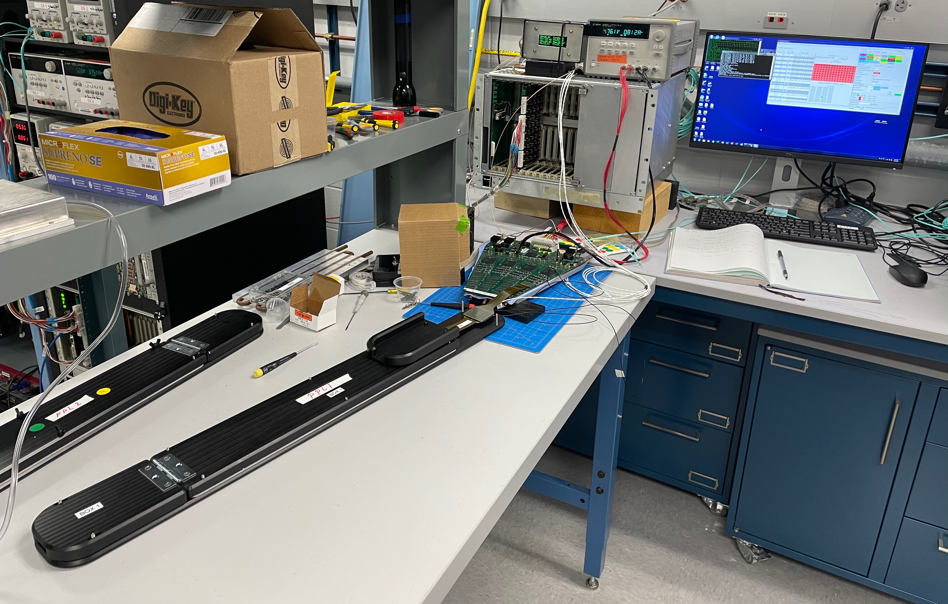
2021 Ladder testing
March 2nd, 2021

Slide 16
2021 Pre-production Status of the Ladder
March 2nd, 2021

Slide 17
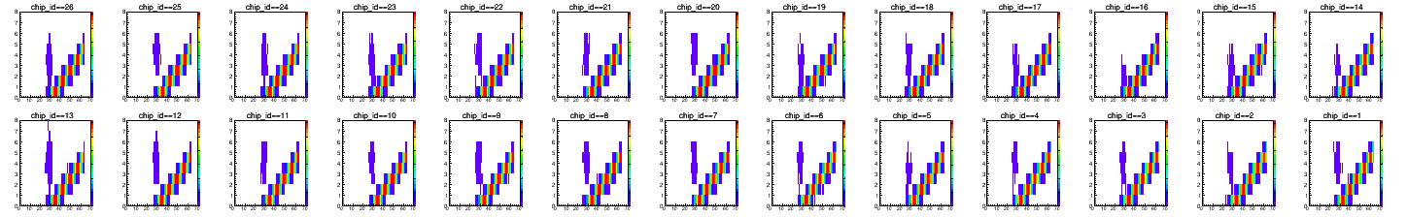
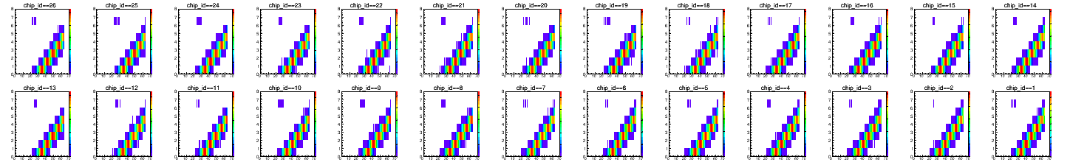
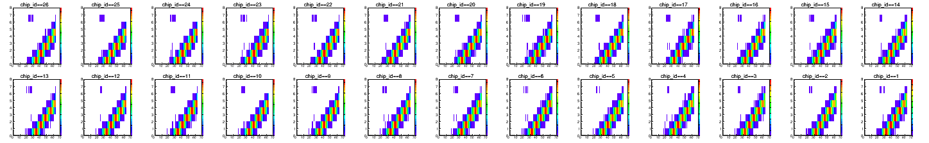
2021 Bench Test Performance
PPB2-L5 South - Calibration plots
x – amplitude; y – ADC
HDIs-Chips
HDIs-Chips-Sensors
Encapsulated
March 2nd, 2021

Slide 18
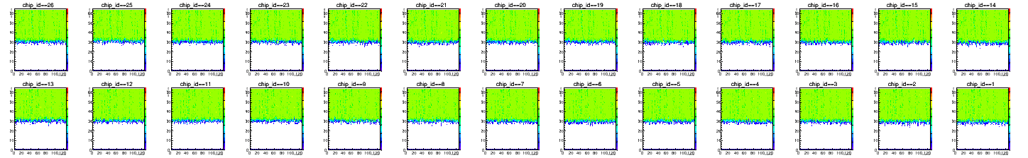
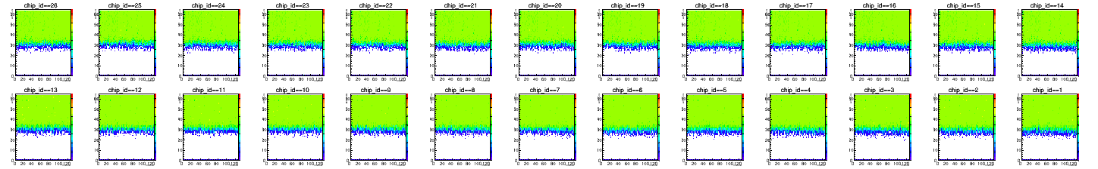
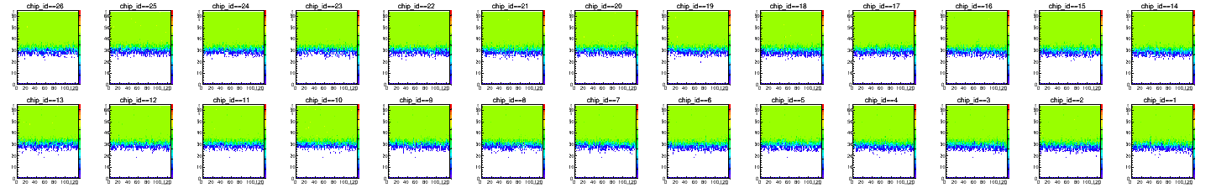
2021 Bench Test Performance
PPB2-L5 South - Calibration plots
x – Channel; y – amplitude
HDIs-Chips
HDIs-Chips-Sensors
Encapsulated
March 2nd, 2021

Slide 19
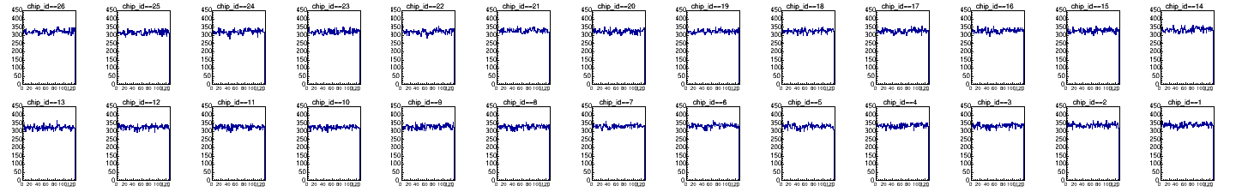
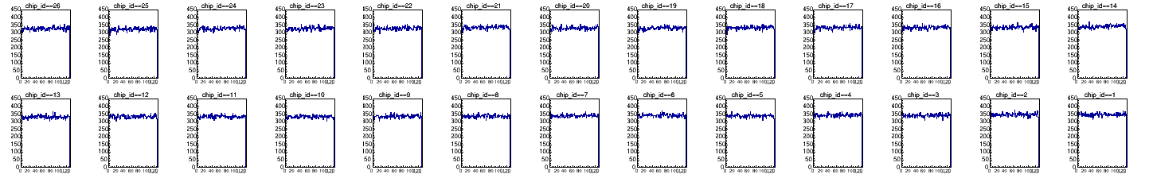
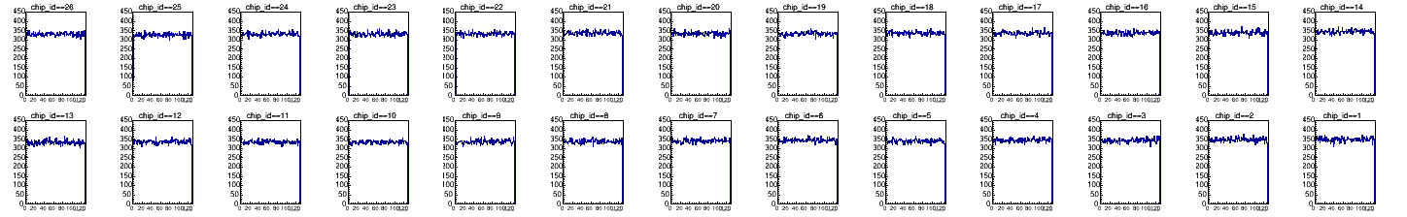
2021 Bench Test Performance
PPB2-L5 South - Calibration plots
x – channel; y – # of entries
HDIs-Chips
HDIs-Chips-Sensors
Encapsulated
March 2nd, 2021

Slide 20
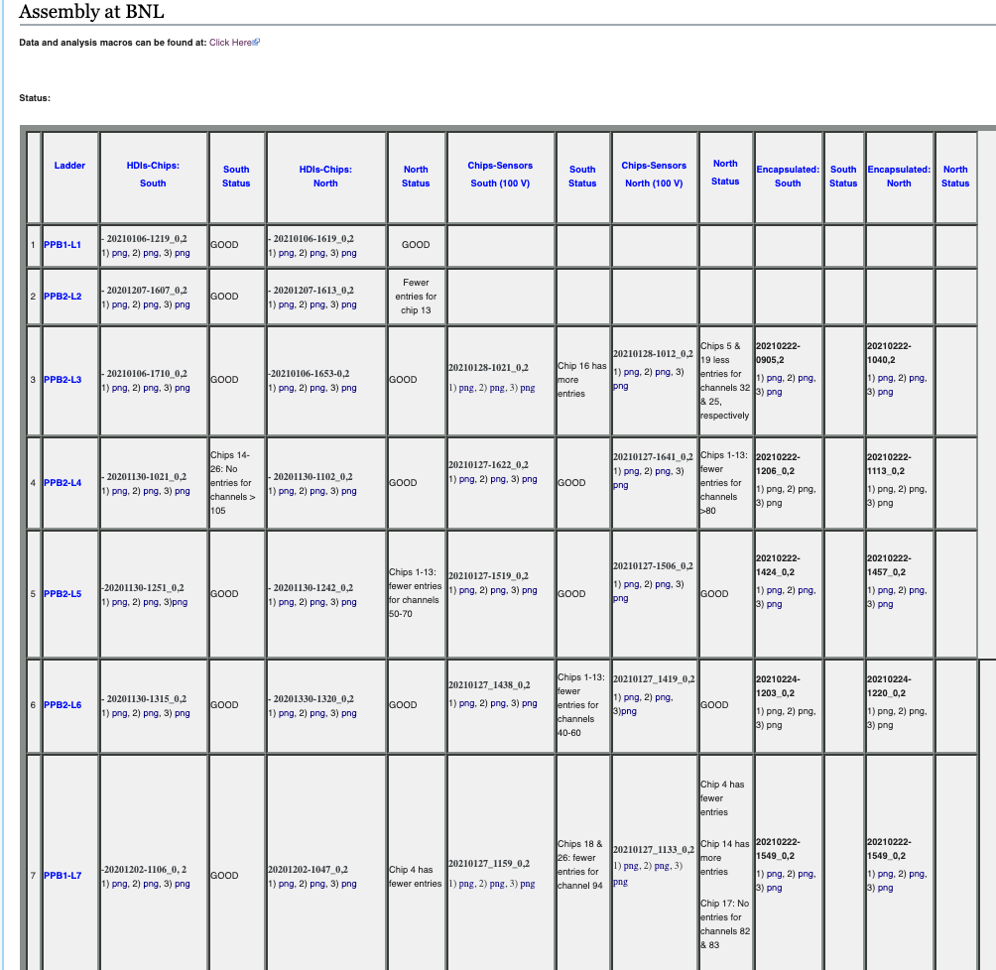
2021 Test Web Monitoring
Wiki page for test monitoring: https://wiki.bnl.gov/sPHENIX/index.php/Assembly_at_BNL
March 2nd, 2021

Slide 21
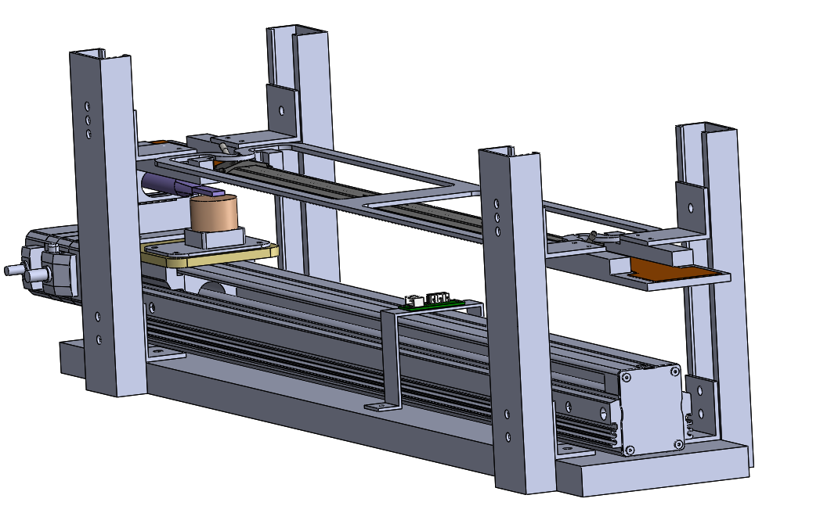
2021 Automatic Source Test Design
PMT and Scintillator
Stave + ladder
PMT support
Aluminum frame
Ladder support and holder
Linear slide rail and stepper motor
Radiation source
Removable endstop
March 2nd, 2021

Slide 22
Ladder Evaluation
Ladder evaluation is based:
Calibration
Amplitude vs Channel ID
# of entries for each Channel
Automatic source test (not performed yet)
Classification is based on working live/dead channels from evaluation test
March 2nd, 2021

Slide 23
Summary
7 ladders produced
All tests showed ladder work properly
Consistent performance in every assembly step
Status and test monitoring available on-line
For final evaluation we need automatic source test
Ready for ladder mass-production
March 2nd, 2021

