Slide 1
Final Design and Safety Review of the INTT Ladder and Barrels
Ladder Electronic Components
WBS: 3.01
Itaru Nakagawa, RIKEN
March 2, 2021

Slide 2
Ladder Electric Components Overview
Tracking System: MVTX+INTT+TPC
INTT Full Ladder
Type-B
Type-A
1. Silicon strip sensors
2. FPHX Chips
3. HDI Readout Cable
Type-B
Type-A
Wirebonding
(silicon-FPHX)
FPHX Chip
Wirebonding
(FPHX-HDI)
HDI

Slide 3
Silicon Strip Sensors (Hamamatsu)
Type-A (8 x 2 cells)
Type-B (5 x 2 cells)
Tracking System: MVTX+INTT+TPC
19.97mm
128mm
100mm
φ-direction
9.984mm
Single cell
A: 16 mm (B:20 mm)
Single cell geometry (active region):
128 strips (better resolution in φ-direction)
Strip width = 78 μm
φ-length = 78 μm x 128 strips x 2 cells =19.97 mm
z-length = A: 16 mmx 8=128 mm
B: 20 mm x5=100 mm
Type-A
Type-B

Slide 4
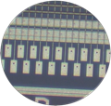
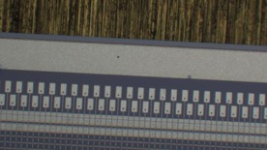
Silicon Strip Sensors (Hamamatsu)
Tracking System: MVTX+INTT+TPC
Type-A
Type-B
40 % of pad
60 % of pad are secured for wirebonding
Strip orientation
probe trace
AC readout pads
Read out orientation

Slide 5
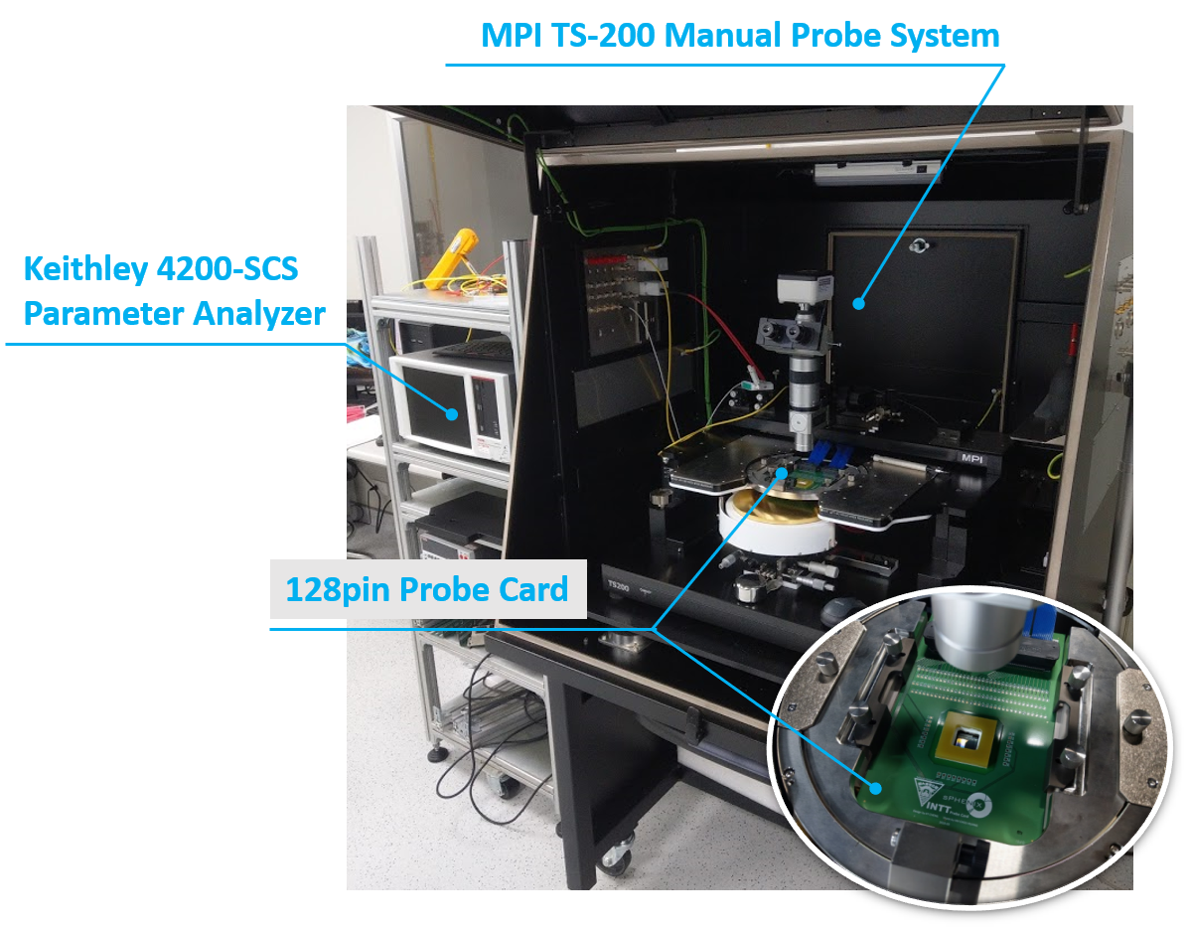
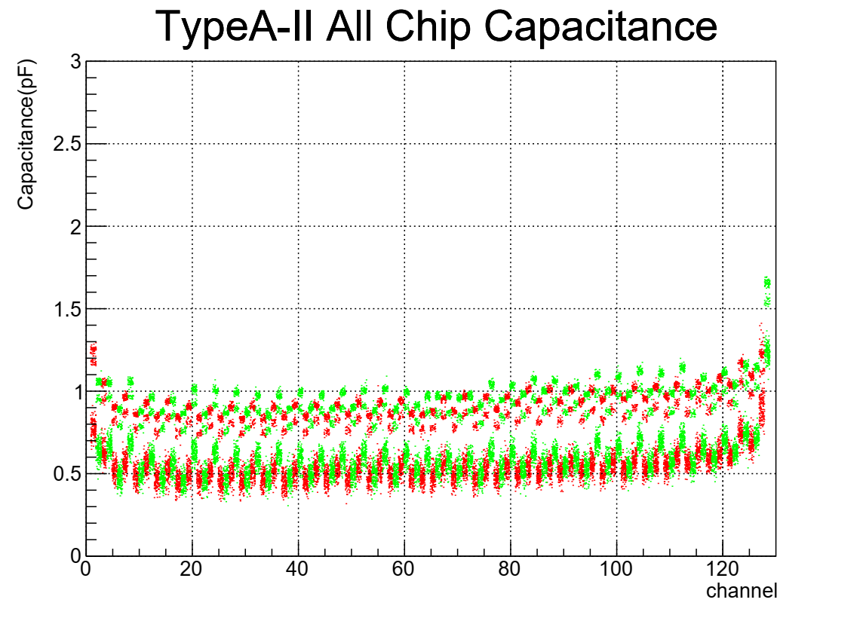
Silicon Quality Assurance (HPK/NCU)
STEP1 Sensor by sensor performances (IV, CV) are measured Hamamatsu co. before delivery.
STEP2 Strip by strip performances are further evaluated in Taiwan for 20% fraction of silicon sensors
STEP3 QA results are kept in DB to be referred to rank ladder performance. So far most of silicons are confirmed to be good quality.
nA
Hamamatsu’s QA
Silicon QA in Taiwan

Slide 6
FPHX Chip/Produced by FNAL
Developed for Forward Vertex Detector for PHENIX at Fermi Lab.
Tracking System: MVTX+INTT+TPC
Specification | FPHX
ADC/channel | 3 bits
Operation Voltage | 2.5V
Power Consumption | 64 mW
Number of channels | 128
Data Transmission | 200Mbps
Front end
(Analog section)
Each FPHX chip integrates and shapes (CR-RC) signals, digitizes and sparsifies the hit channels each beam crossing (106ns beam clock), and serially pushes out the digitized data.
Production 13k FPHX Chips in 2018&2019 while 3k needed for 56 ladders.

Slide 7
FPHX Chip (Analog Section)
Tracking System: MVTX+INTT+TPC
T-peak ~ 60 ns (programmable)
128 channel
46, 50, 60, 67, 85, 100, 150, or 200 mV/fC
60 ns peak time (rt- pgmbl)
3—bit ADC (th-pgmbl)
Optimized to 1 to 2.5 pf input
115e + 134e/pf
~ 70 to 140 μW/ch (dep. gain)
Program gain and Vref
Disc outputs
3-bit ADC
Vref
+
Shaper
Integrator
_
Comp
Input
Vth0
Comp
At max. input transistor bias of 38uA: 115e + 134e/pF
Silicon strip + readout line capacitance ~ 6pF
Predicted noise ~ 115e + 134e/pF * 6pF ~ 1,000e
Signal ~ 20,000e
Expected S/N ~ 20/1
Vth1
Comp
Programmable Thresholds
Vth7

Slide 8
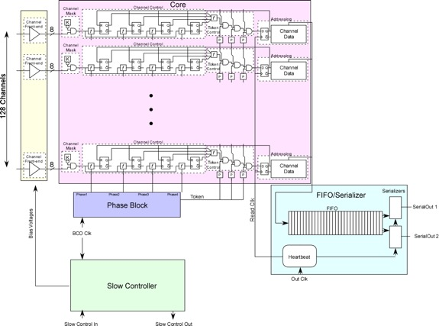

FPHX Chip (Digital Section)
Analog
Tracking System: MVTX+INTT+TPC
Data Processing
Data Output
20 bit Serial data word structure

Slide 9
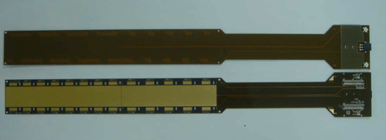
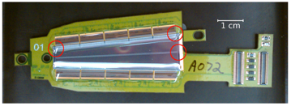
High Density Interconnect (HDI) Cable
INTT HDI (Manufactured by Yamashita co., Japan)
Tracking System: MVTX+INTT+TPC
Dedicated Bias connectors each side
Thermistats
M20-7910342R
2 Thermistats 3pin readout
Hirose DF18 connector
Data, slow control, FPHX power
Analog GND pad
 | FVTX | INTT
# Layers | 7 | 7
Length [cm] | ~20 | 40
Pitch [μm] | 40 | 60
The design is based on HDI’s of FVTX. The cable length is longer, but the pitch of the signal line is somewhat relaxed 60 [μm] instead of 40 [μm].
FVTX HDI
Analog and digital pads are used for grounding in case we need them.
Digital GND pad
Notes:
Conservative copy of FVTX HDI.
Length, pitch are difference.
New themostat readout.
2 bias lines is new feature. Even one line dies, the other one can survive.

Slide 10
High Density Interconnect (HDI) Cable
7 cupper layers
High signal line density in 2 layers
Solid ground outer layers to shield signal layers
Tracking System: MVTX+INTT+TPC
L1
Bias
L2
Analog GND
L3
Clock Signal
L4
Power
L5
Signal
L6
Digital GND
L7
Cross Section of HDI
Thermistats & RF

Slide 11
High Density Interconnect (HDI) Cable
7 cupper layers
High signal line density in 2 layers
Solid ground outer layers to shield signal layers
Tracking System: MVTX+INTT+TPC
Copper Fraction
L1
71.3%
Bias
L2
93.5%
Analog GND
L3
6.50%
Clock Signal
L4
94.0%
Power
L5
7.2%
Signal
L6
93.2%
Digital GND
L7
4.7%
Thermistats & RF

Slide 12
High Density Interconnect (HDI) Cable
Tracking System: MVTX+INTT+TPC
Material Budget of HDI Cable
Effective Thickness
[μm]
Copper Fraction
HDI | Thickness [μm] | X/X₀ [%]
Copper | 38 | 0.26
Polymide | 380 | 0.14
Total | 432 | 0.40
Major contribution to the radiation length comes from 7 copper layers
Signal layers are effectively thin.
Total radiation length is 0.40%.

Slide 13
Successful Performance
INTT Ladders have been tested extensively in NWU/BNL/NTU test benches and beam tests at FNAL in 2018 and 2019.
Calibration responses are confirmed to be very similar to those of FVTX’s. We understood by now minor difference in response from the design difference between FVTX and INTT.
Overall satisfactory performance was confirmed from INTT ladders.

Slide 14
Summary
• The INTT Ladder consisted of Silicon strip sensors, FPHX chips, HDIs and stave.
• The INTT Silicon strip sensors are manufactured by Hamamatsu photonics. Basic design is based on FVTX silicon strip sensors. The primary difference is the dimension of the strip and sensors. The thickness is standard 320μm. → Ready
• The HDI cable is also designed based on the one of FVTX and manufactured in Yamashita co in Japan. The cable consisted of 7 layers and signal layers are kept inner layers to be shielded by ground or bias layers. The radiation length is kept to be as low as 0.40%. Demonstrated good performance through two beam tests in 2018 and 2019. → Ready
• FPHX chips are developed by Fermi lab for FVTX detector for PHENIX. Sufficient enough FPHX chips are produced for INTT needs. Some programmable parameters will be uniquely optimized for INTT. → Ready
We are ready for the ladder mass production.

Slide 15
Back Up

Slide 16


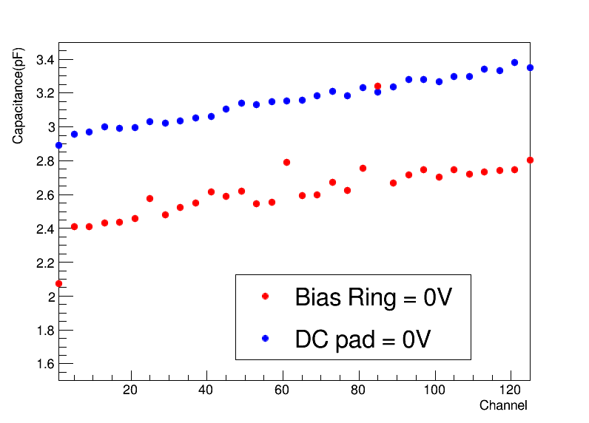
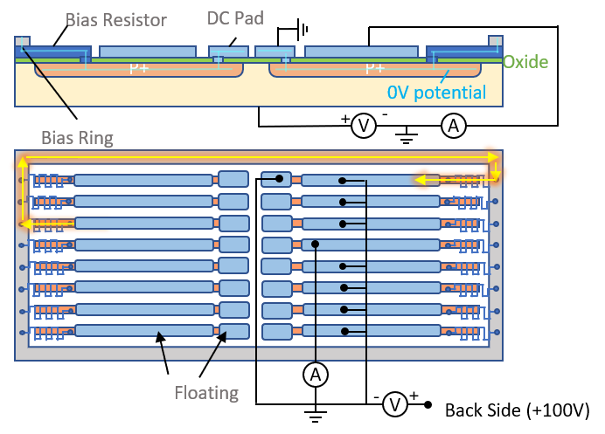
The CV Measurement Circuit of INTT Sensor Testing
Measure the capacitance of single channel from AC readout pad to check the status of each channels.
Supply bias voltage to the backside of sensor. The AC signal also send to backside and measure current variety form AC pad on front side. To sure we only measure the single channel capacitance, relay matrix will ground all channels except target channel. The system and circuit are showed in right plots.
Ground the DC pad to sure the sensors are full depletion, because grounding bias ring are difficult during all chips measurement. The bottom left plot shows the difference between grounding bias ring and DC pads. The value of DC pad situation is little higher, but the trend are the same, so ground some DC pads to supply same voltage is expedient method.
AC readout
AC readout
AC readout
…
A
+
Backside
-

Slide 17
Scratch by Probing Pads

Slide 18
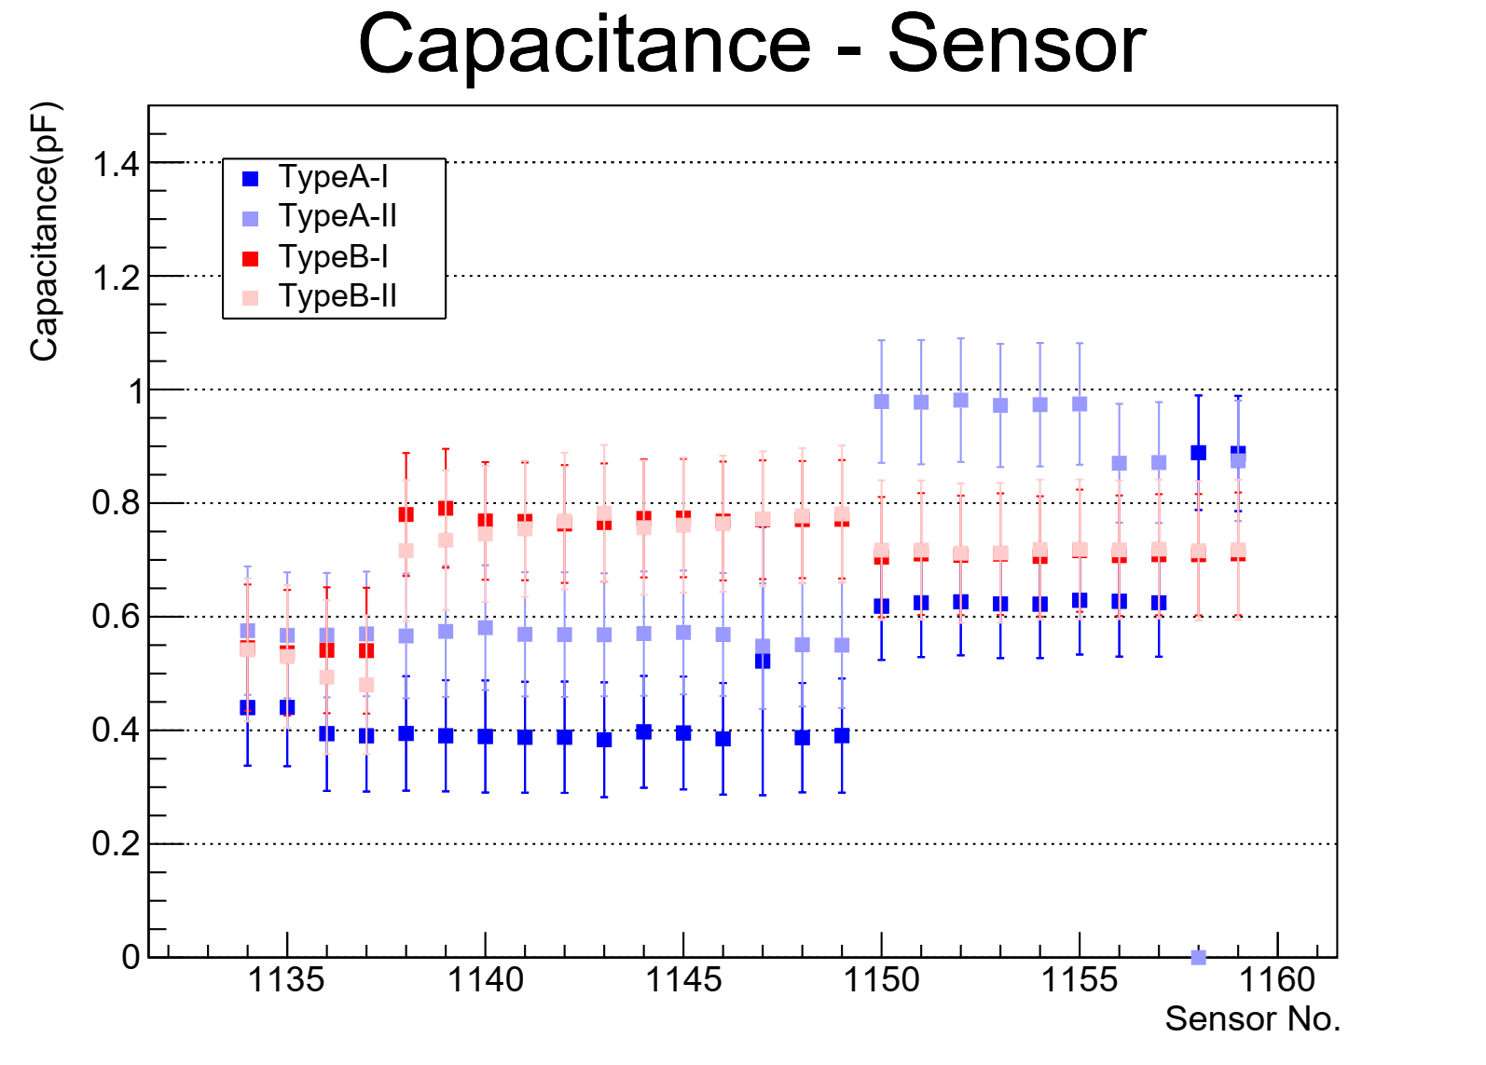
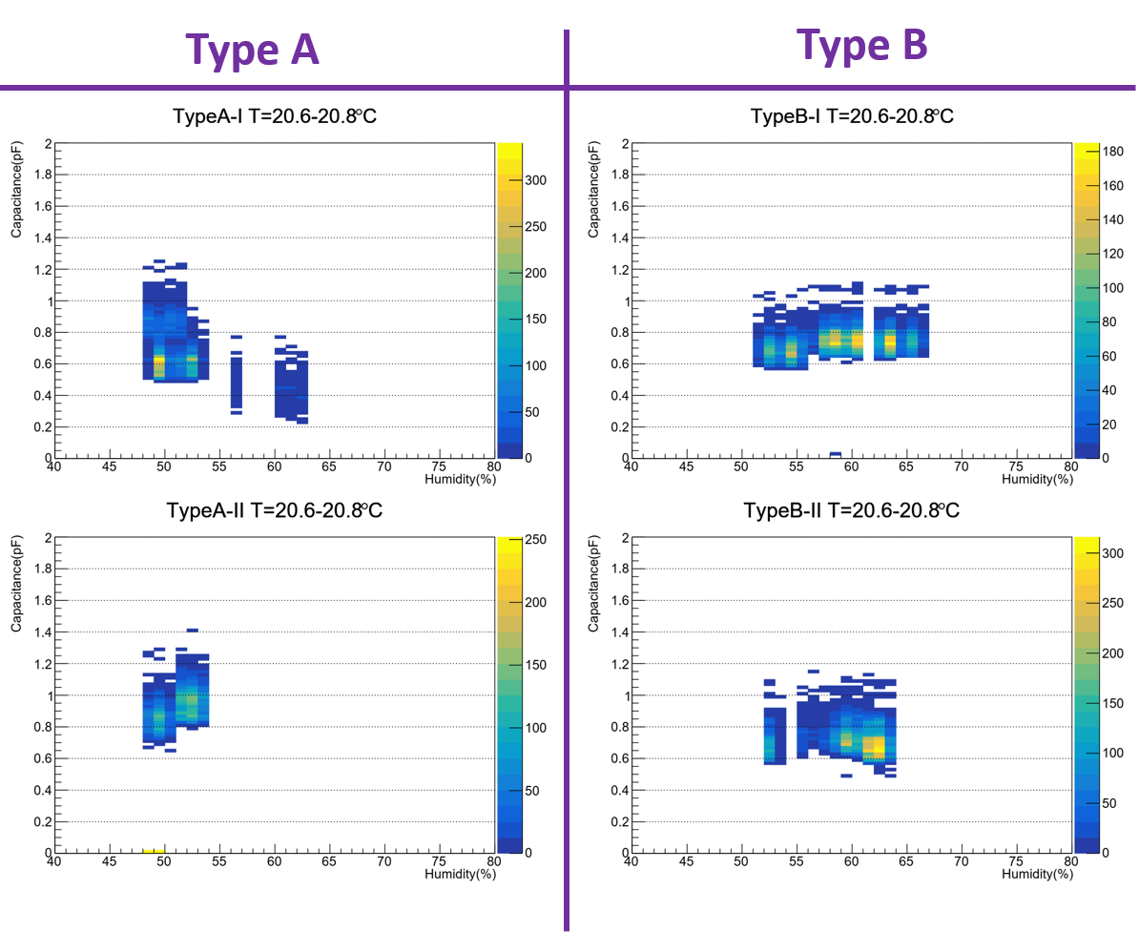
The Measurement Result of INTT Sensor Testing
Because the layout of sensor, each module is divided into four parts in the measurement. The left plot show one part result of sensor 1133-1159. All capacitance of channels are gaussian distribution, so we can identify the broken and functional channels from measurement. The left plot obviously show there are two different distributions. These differences could match to measuring period that be showed in middle plot.
The capacitance of signal channel showed in left plots is about 0.5pF, so total capacitance is about 1000pF. Compared with total sensor from HAMAMATSU’s inspection only has 7% difference. Therefore, this method could measure the capacitance of single channel.
To check why capacitances are different in periods, we analyze the relation between environment and measurement. The right plots shows the variety of capacitance with humidity at same temperature. The result shows the measurement is not obviously affected by humidity, so maybe this effect come from the status of sensor or measure system.
Period I
Period II
Two chips are remeasured in period II
Broken

Slide 19
Summary
Even if can’t ground bias ring during whole measurement, grounding from the DC pads also could get single channel capacitance to check status od each channels.
However, the capacitance of single channel is too fine (<1.5pF), so the value could be affected by environment. From humidity study, the humidity didn’t has obvious effect, so maybe this effect come from the status of sensor or measure system.
If the capacitance are measured in short period, the values is stable. The RMS of gaussian distribution in same channel is about 0.05. Therefore, we still can use data that come from same measurement period to identify character of channels.
In first branch, all channels in sensor 1131-1159 are good. We don’t see any channel has very strange value.
The secondary branch check had started.
19

Slide 20
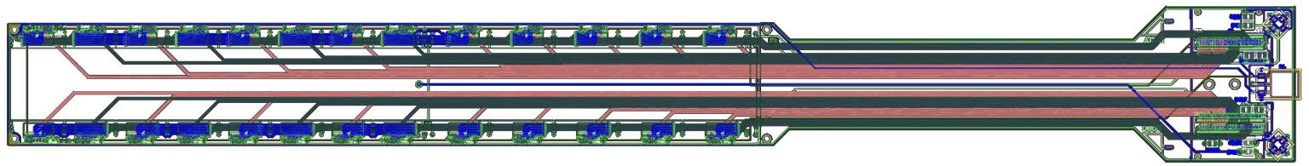
HDI Material Budget
HDI | Thickness [μm] | X/X₀ [%]
Copper* | 38 | 0.26
Polymide | 380 | 0.14
Total** | 432 | 0.40
*Copper thickness is not physical thickness, but average thickness.
**Total thickness is not 473μm, because of the copper average thickness.
Radiation length of each layer.

Slide 21
Ladder Material Budget
Material | Thickness [μm] | X/X₀ [%]
Silicon Sensor | 320 | 0.34
HDI | 473 | 0.39
Stave | 600 | 0.33
Total |  | 1.06
HDI | Thickness [μm] | X/X₀ [%]
Copper* | 38 | 0.26
Polymide | 380 | 0.14
Total** | 432 | 0.40
*Copper thickness is not physical thickness, but average thickness.
**Total thickness is not 473μm, because of copper average thickness.

Slide 22
High Density Interconnect (HDI) Cable
Due to spatial limit of signal layers, some part of signal lines have to run unshielded layer-7 for a few cm.
Tracking System: MVTX+INTT+TPC
Cu Layer-1
The corresponding frequency is 10 – 30GHz, which is at least an order of magnitude higher frequency than the highest frequency (100×2MHz BCLK) signal transmits layer-7.
Cu Layer-7
No problem has found in the past 2 beam test.
~1cm
100×2MHz BCLK

Slide 23
Voltage Drop for FPHX Power
ΔV
Bus extender
Conversion cable
 | V@ROC | HDI [mW] | Bus Extender [mW] | Conversion Cable [mW] | ΔV [V] | V@FPHX
INTT | 2.5V | 135 ~ 185 | 145 | 185 | 0.20~0.25 | 2.30~2.25V
FVTX | 2.5V | 70 | 70 | N/A | ~0.1 | 2.4V
Due to the long readout cable chain of INTT, the voltage drop for FPHX power line is rather severe compared to FVTX. The FPHX is designed to be operated at 2.5V.

Slide 24
ΔV for FPHX Power Solution
FPHX regulators
(total 32/ROC)
 | V@ROC | ΔV [V] | V@FPHX
INTT | 3.0V | 0.20~0.25 | 2.80~2.75V
FVTX | 2.5V | ~0.1 | 2.4V
The plan is to replace all 2.5V regulators by 3.0V ones on the backplane of the ROC. Further voltage drop is expected due to higher LVDS current operation (To be discussed by Takashi).

