Slide 1
Final Design of the INTT Ladder and Production Readiness Review (PRR)
Stave Quality Verification Testing at BNL
Robert Pisani, BNL
March 2nd , 2021

Slide 2
Overview
Each Stave goes through a multi-step testing and inspection process to ensure the staves are of high quality.
Inspection
Leak test
Pressurized test
Submersion test
Flow consistency test
Flatness measurement
Long Term flow testing

Slide 3
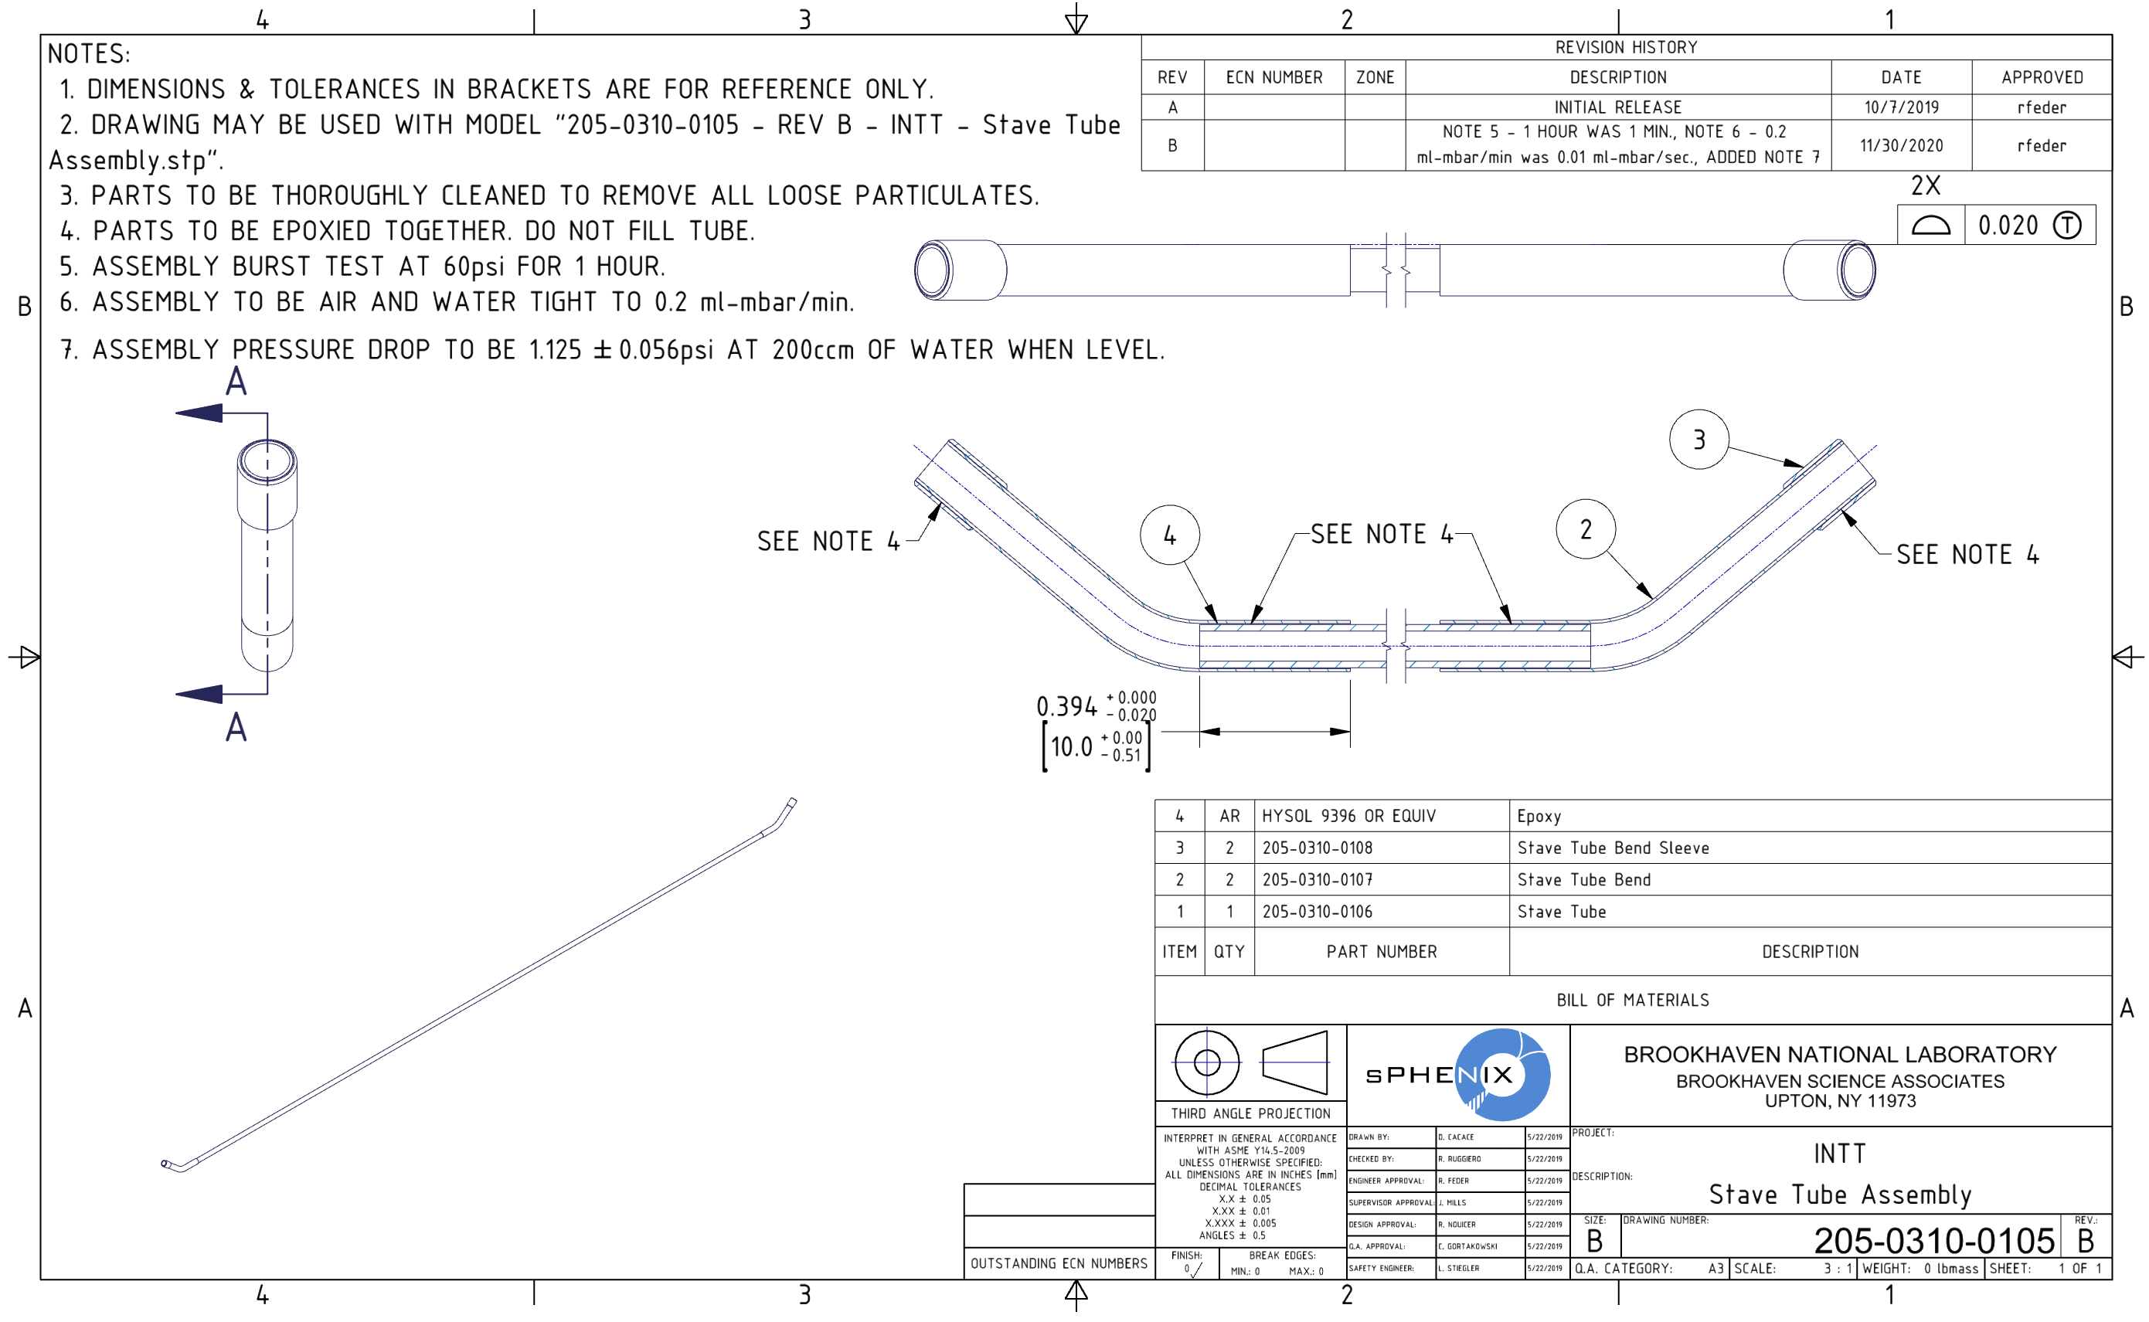
Design from Dan’s Talk
Specification stated on Drawings

Slide 4
Design from Dan’s Talk
Specification and tolerances stated on Drawings
Barrel 1
Barrel 2

Slide 5
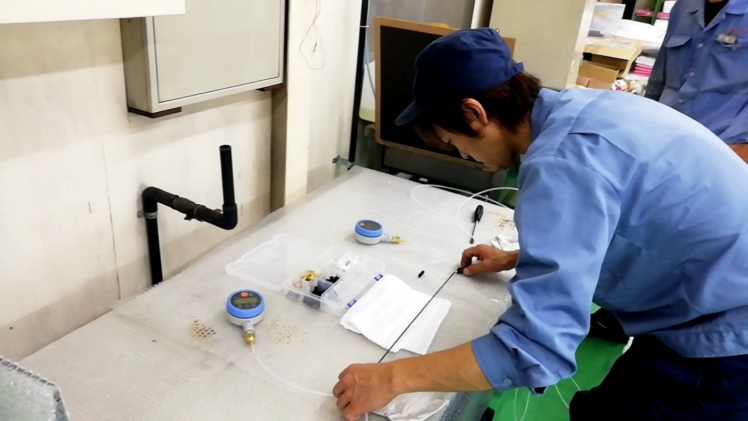
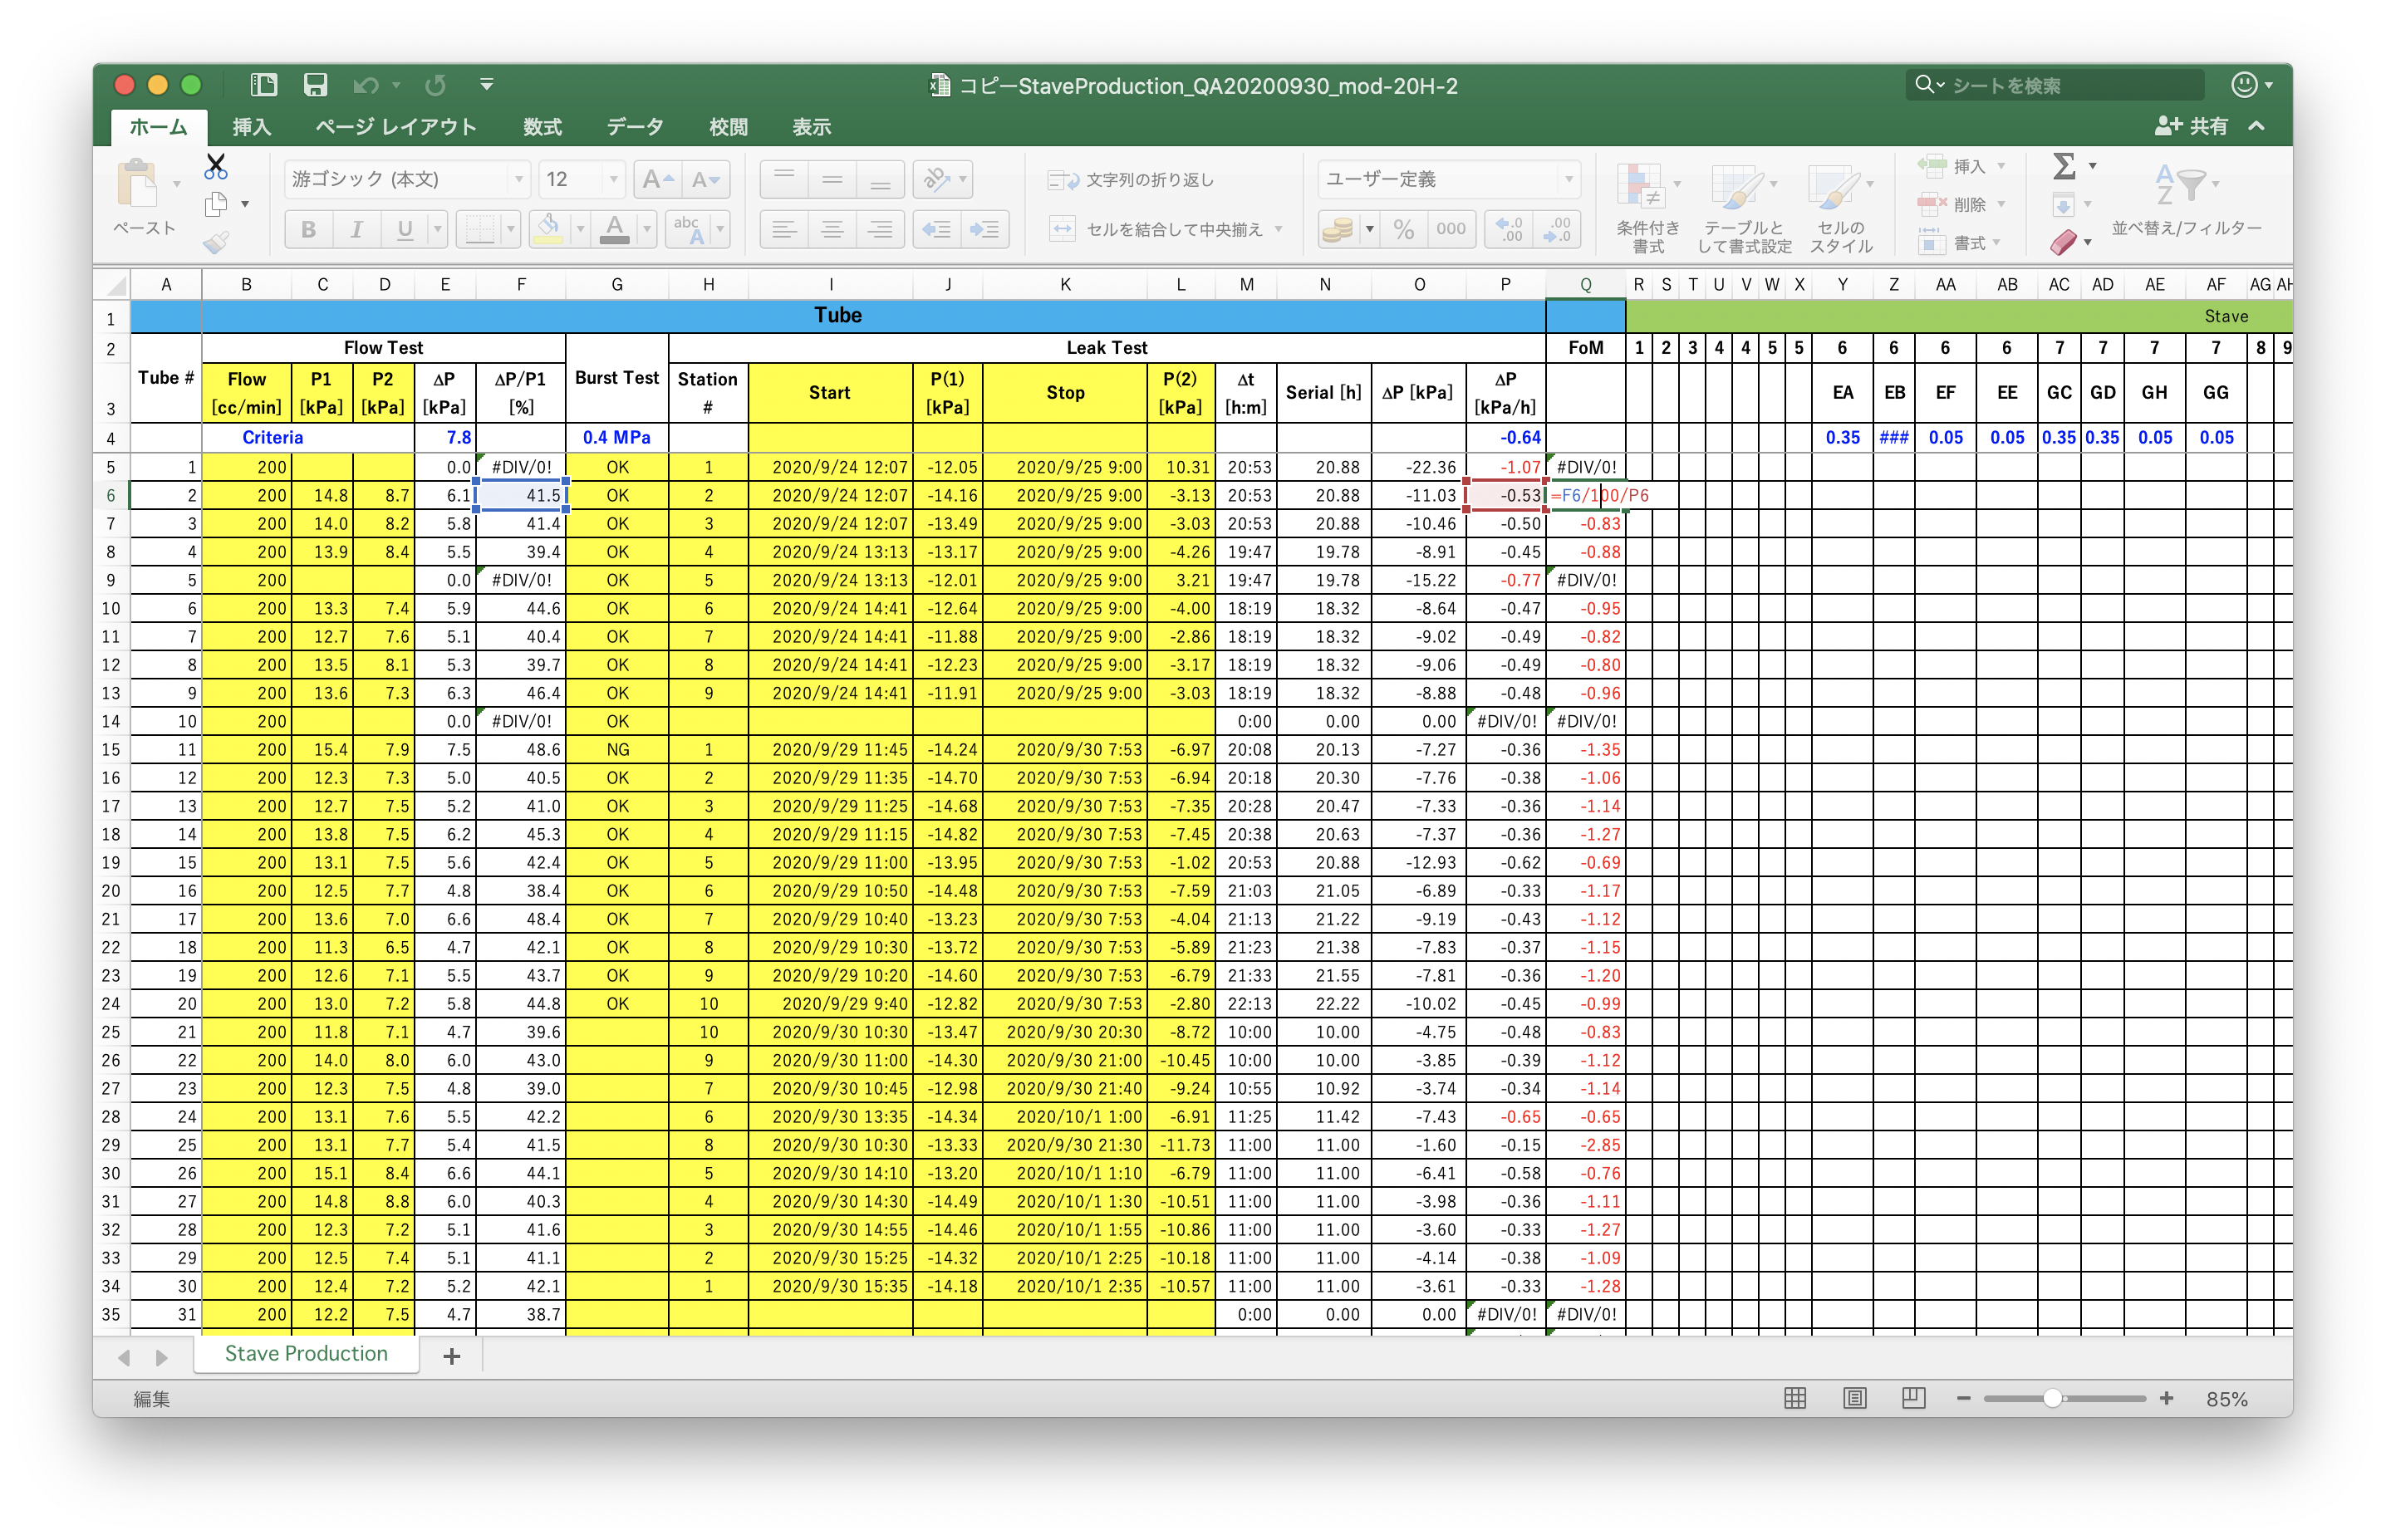
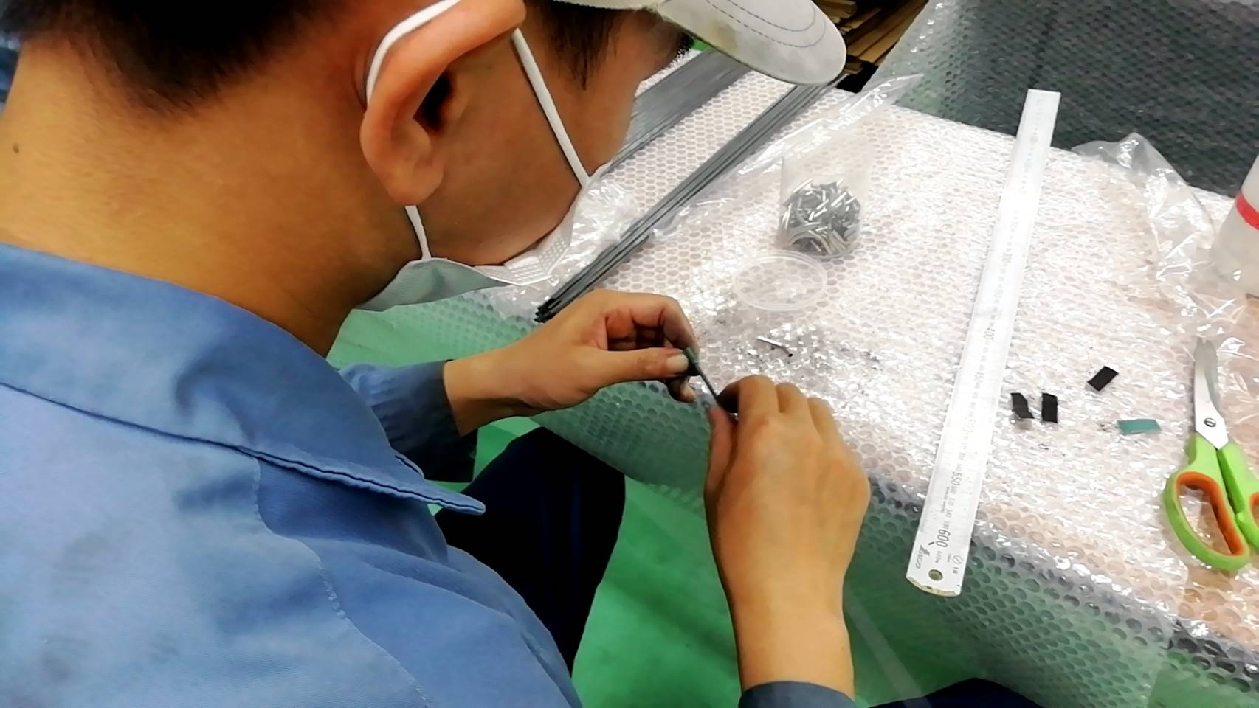
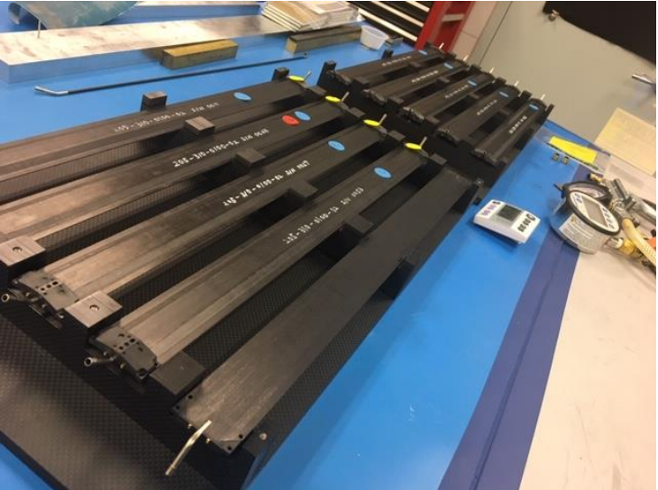
Made By Asuka Co. in Japan
Staves are being made by Asuka Co. in Japan to specification on previous drawings. Asuka Co. tests and verifies staves are built to specifications on drawings.
BNL receives the completed tested staves and we retest them before ladder assembly to confirm staves are OK after transportation.

Slide 6
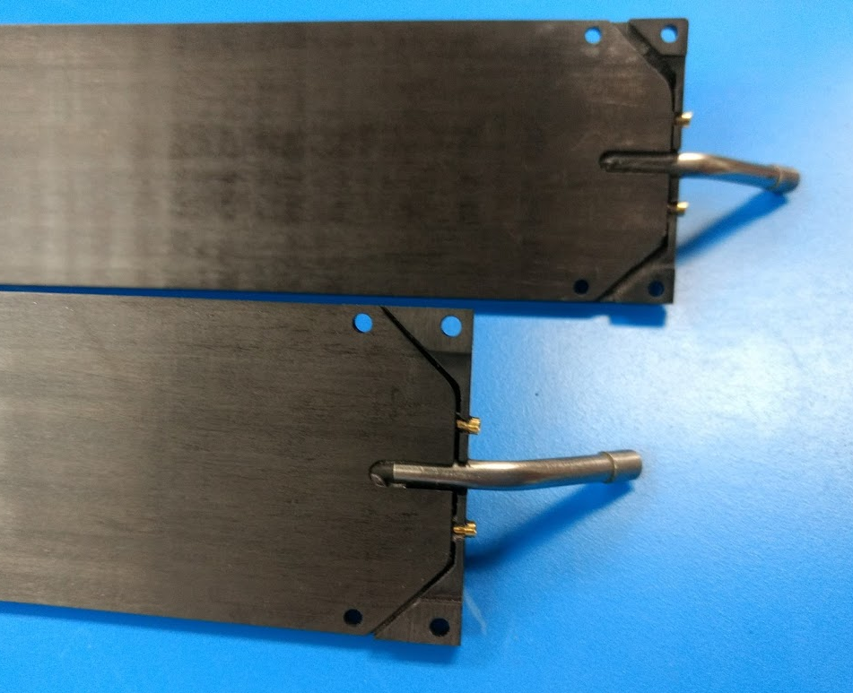
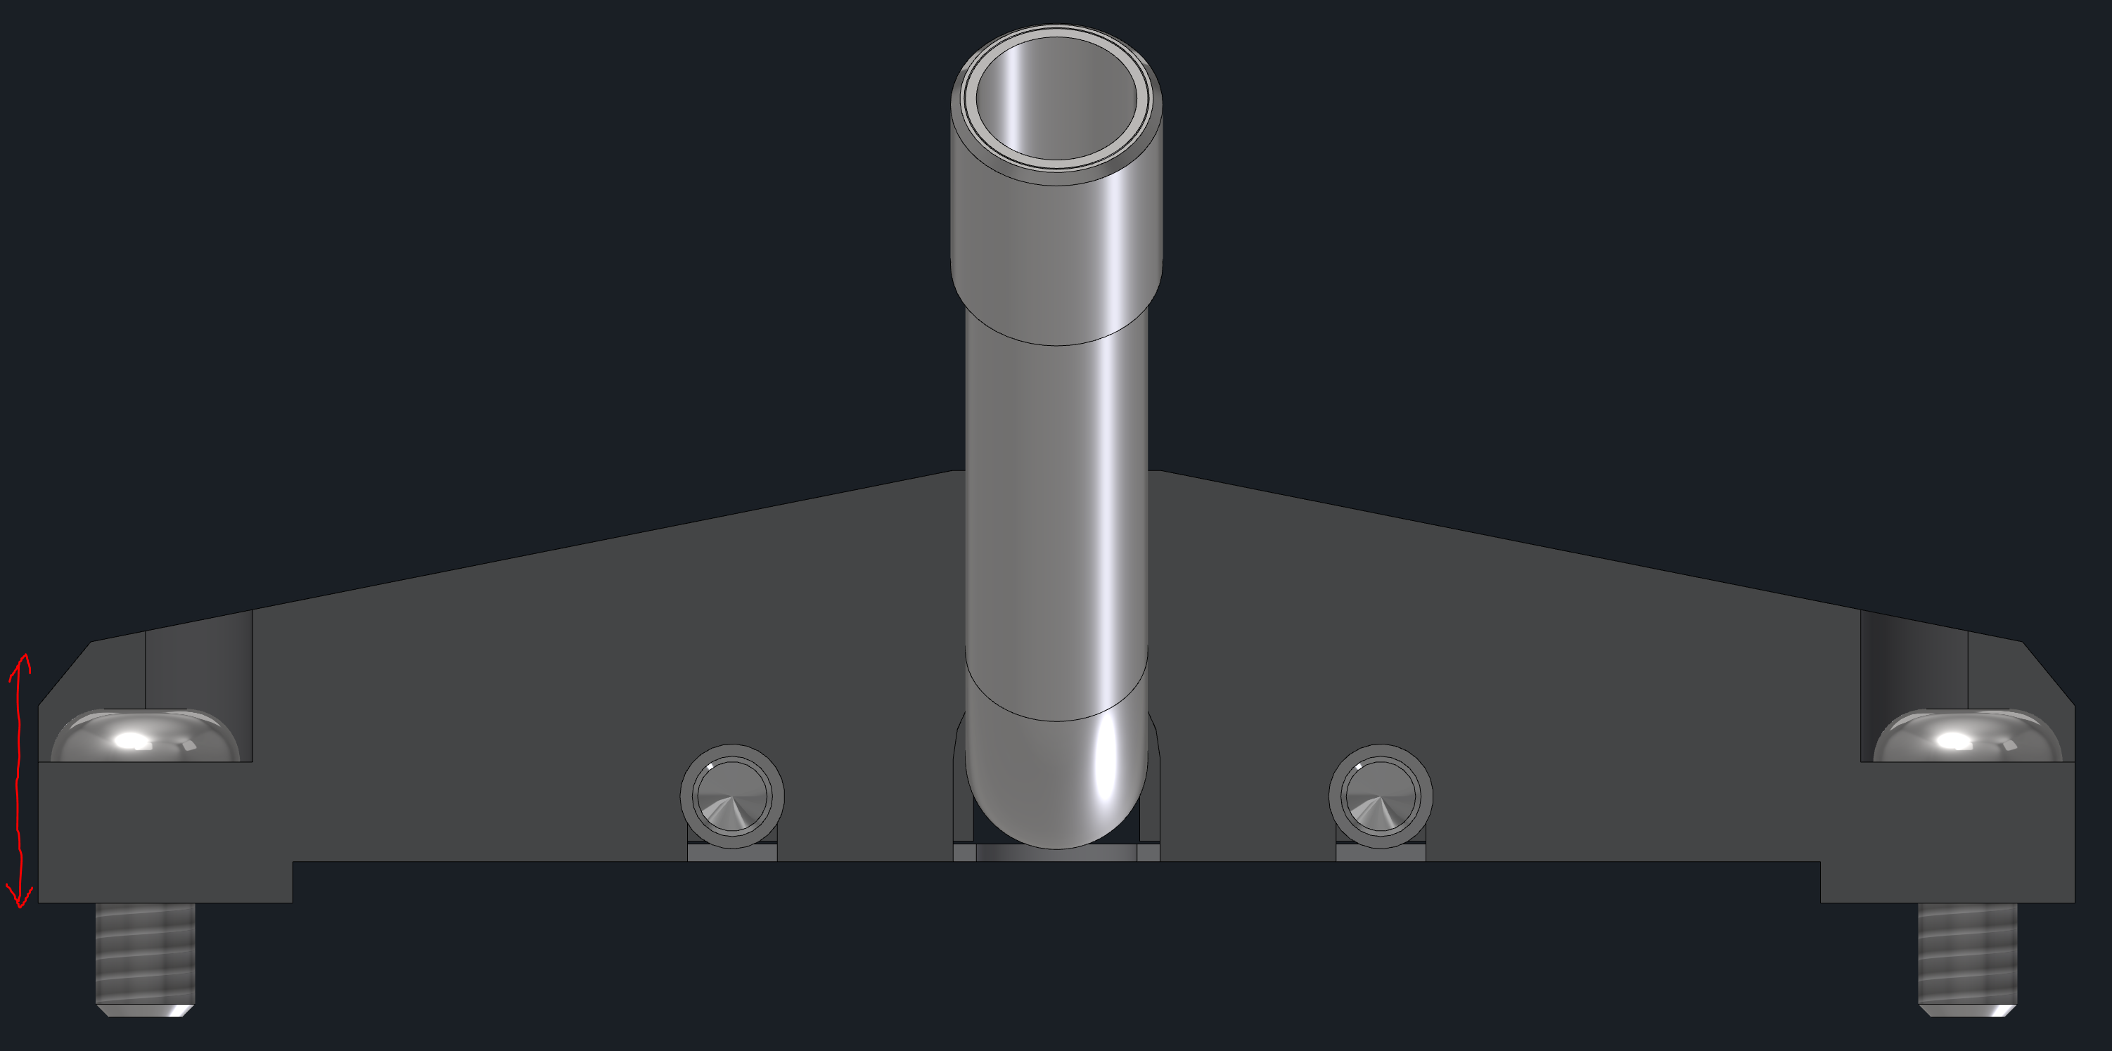
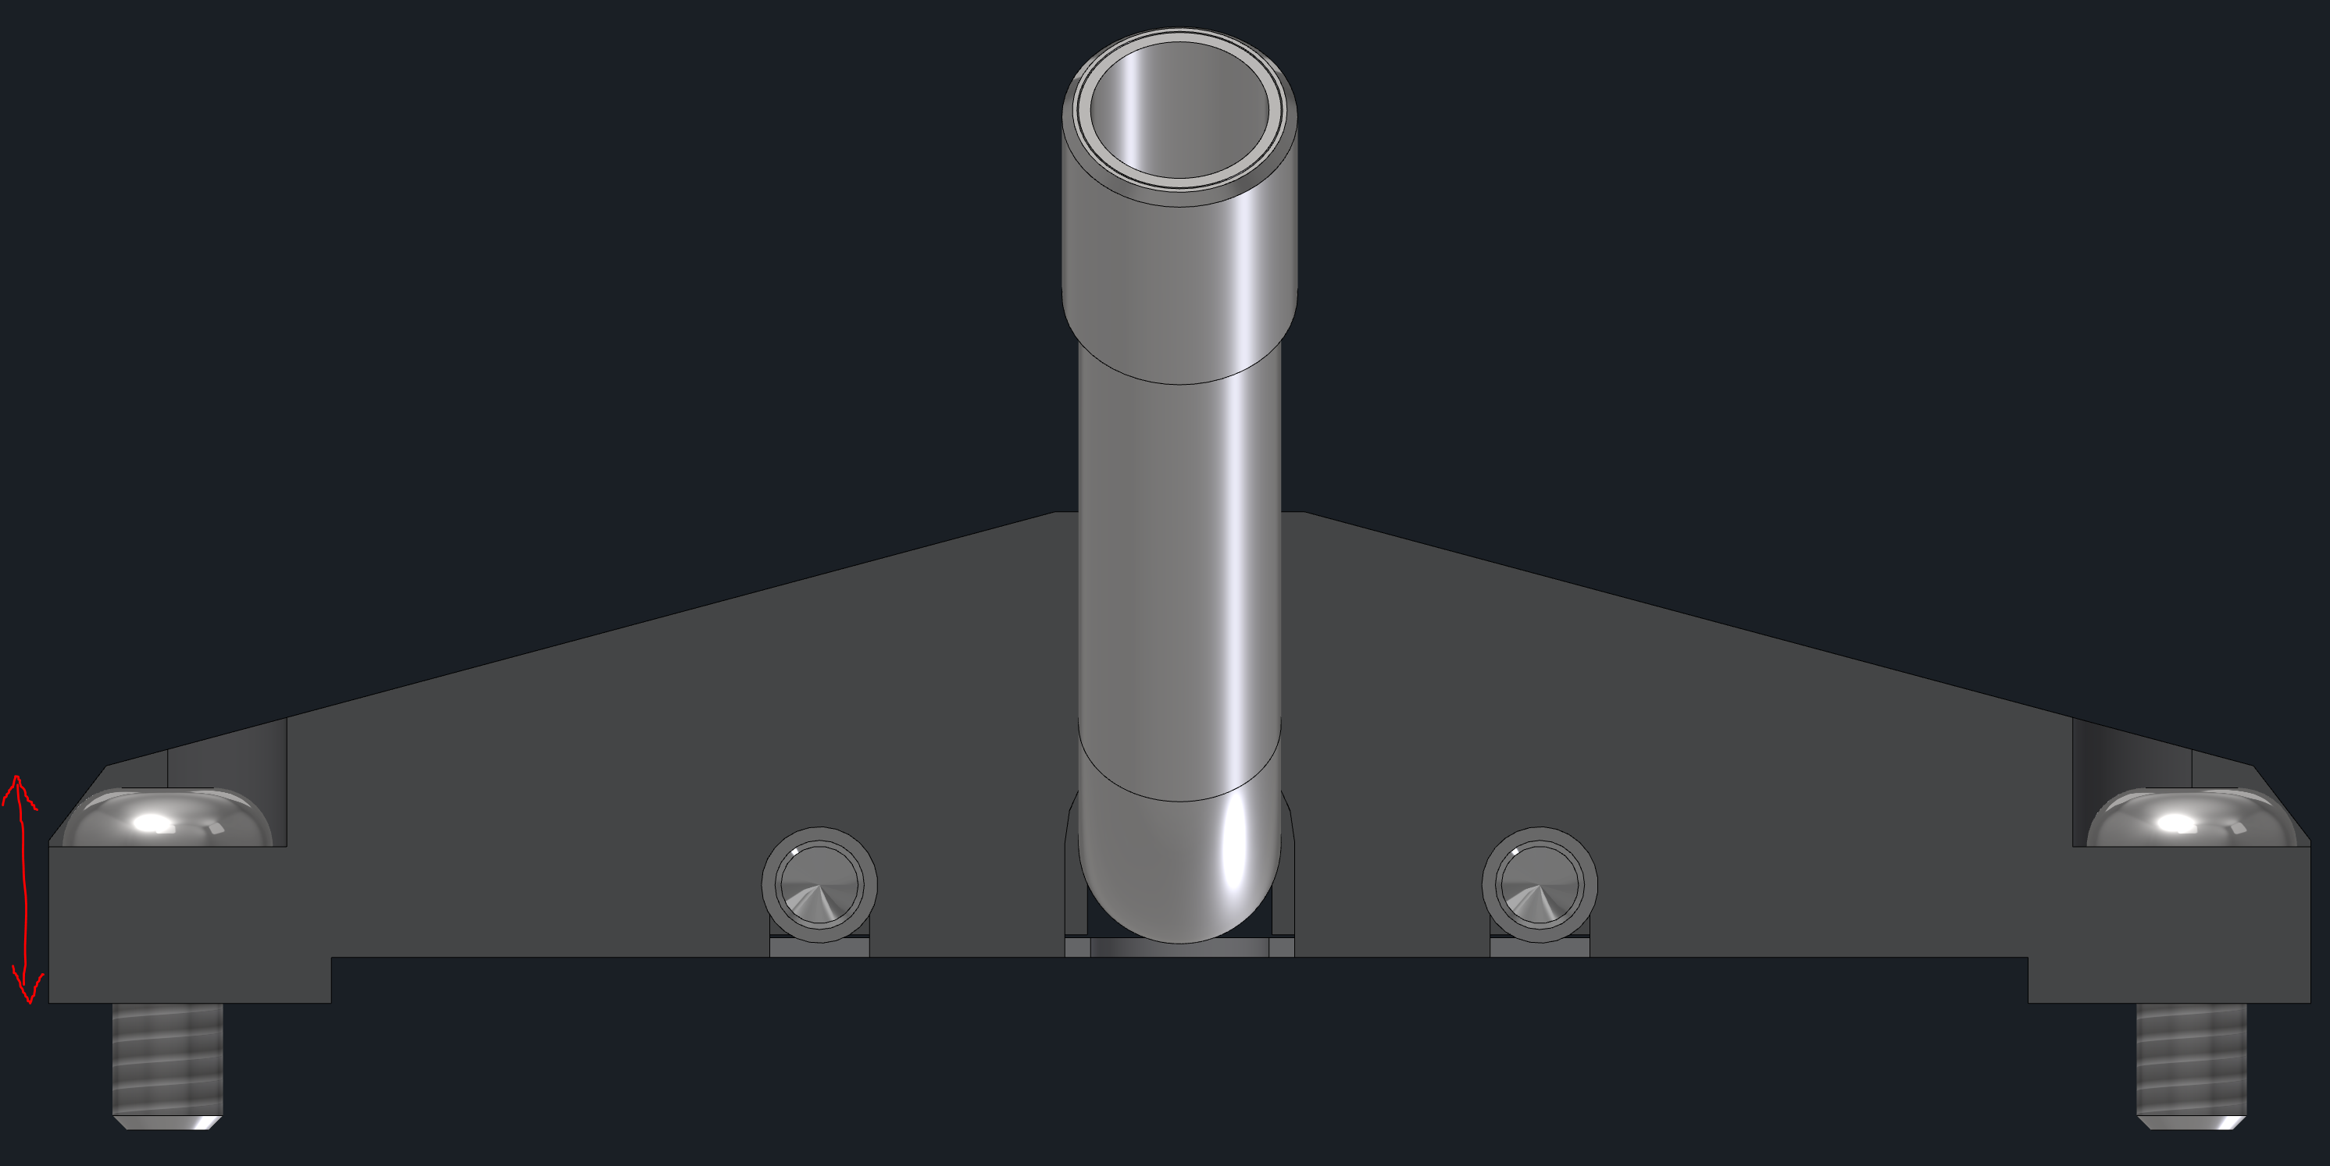
Inspection
Inspect tube for symmetry
Inspect Endcaps for Barrel 1 and 2 ends.
Test peek caps securely attached
Inspect gaps and epoxy potting
Check Conductivity
Bad
Fits in fixture
Good
End Cap
Barrel 2
Barrel 1
Bad
Good
Check Electrical Conductivity of Pins and Tube

Slide 7
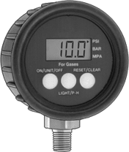
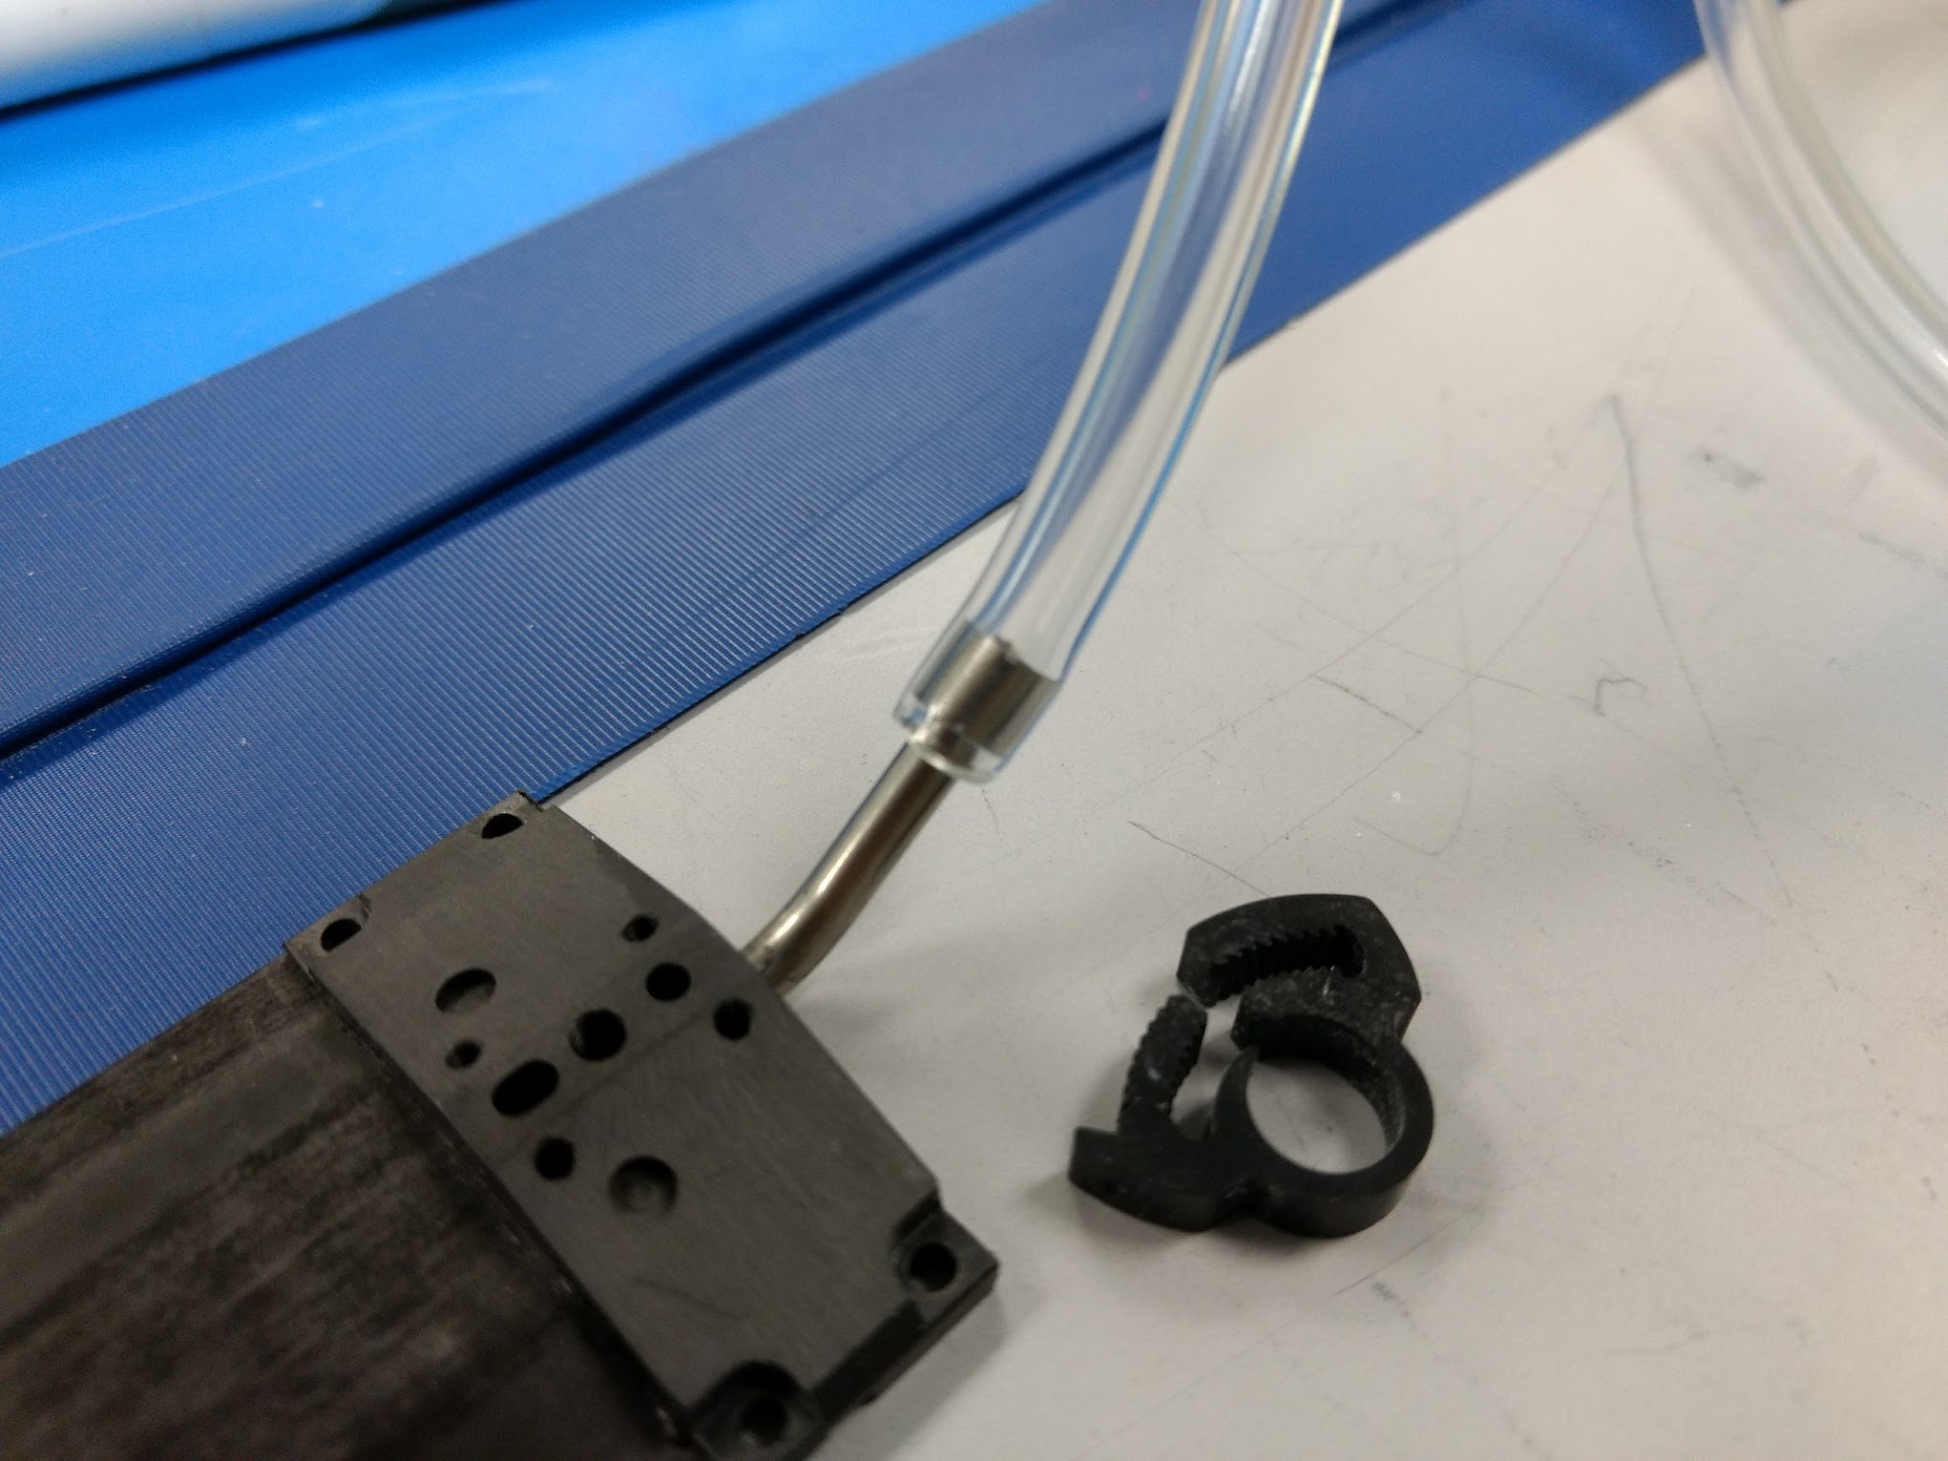
Pressure test of Stave
Specification given for production is
0.2 ml-mbar/min
Volume of stave 1.87ml
Setup has a max leak rate of 0.050psi for 10 min.
With our set up, The leak of a good stave should be less than 0.090 psi drop in 10 minutes.
Tygon tube with metal Plug
0.05% Gauge
Stave
Pressure Source
20psi
Each Stave is pressurized to 20psi and tested for 20 minutes. The pressure drop between 10 and 20 minutes is recorded and used for our leak rate.
0.05% Gauge
Tygon tube with metal Plug
Hardware:
Ashcroft digital High Precision Gauge
3032089SD02L30
30 psi 0.05%
2 isolated channels that are used independently.
Single ladder is tested at at a time to keep system simple and accurate.
Tygon connected directly to SS tube and clamped (0.25” OD 1/8” ID)
Isolation Valve

Slide 8
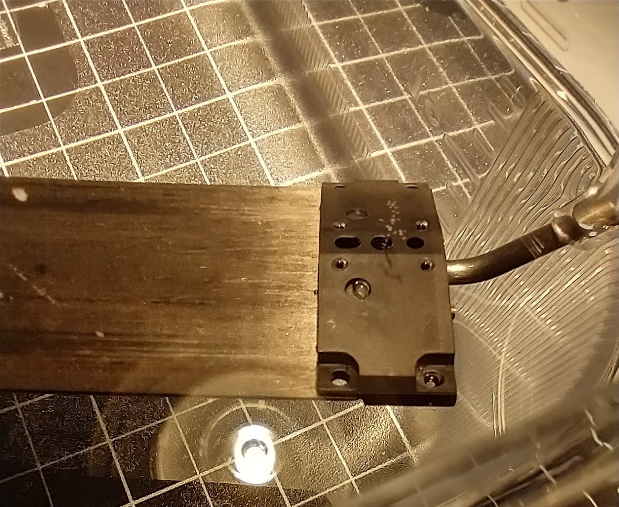
Submersion test (Looking for Bubbles)
In addition to the pressurized leak measurement, we have also been submerging staves in water to look for the location of leaks. We will continue this in production.
Stave is pressurized to ~20 psi with air.
Example of a leaking Staves below:
Bubbles

Slide 9
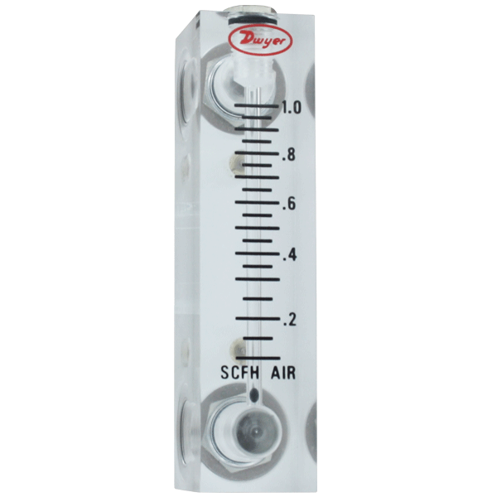
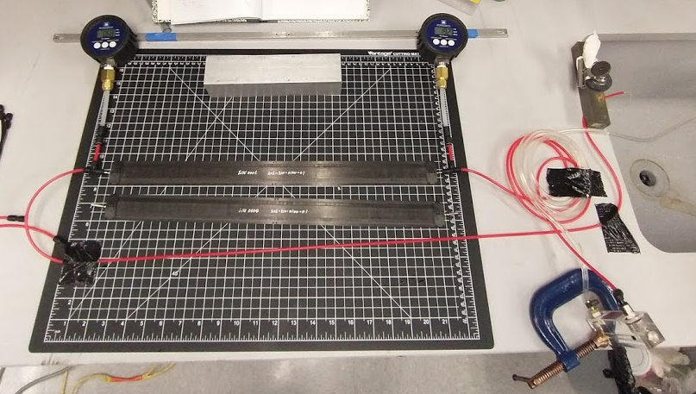
Flow Test
Digital High-Accuracy Pressure Gauges
1% at 15 psi
Zero PSI
1
50” 2.7mm ID
2
3
50” 2.7mm ID
4
Sink
200 ccm flow meter for water
To ensure a balanced flow and stable temperature, each stave is being tested for flow and pressure drop at 200ccm with water. This test is also preformed during tube production to ensure a constant pressure drop across staves.
Specification:
Pressure drop of stave at 200ccm should be around 1.125psi +/- 0.056psi
Gauges, tube and stave must all be at the same level

Slide 10
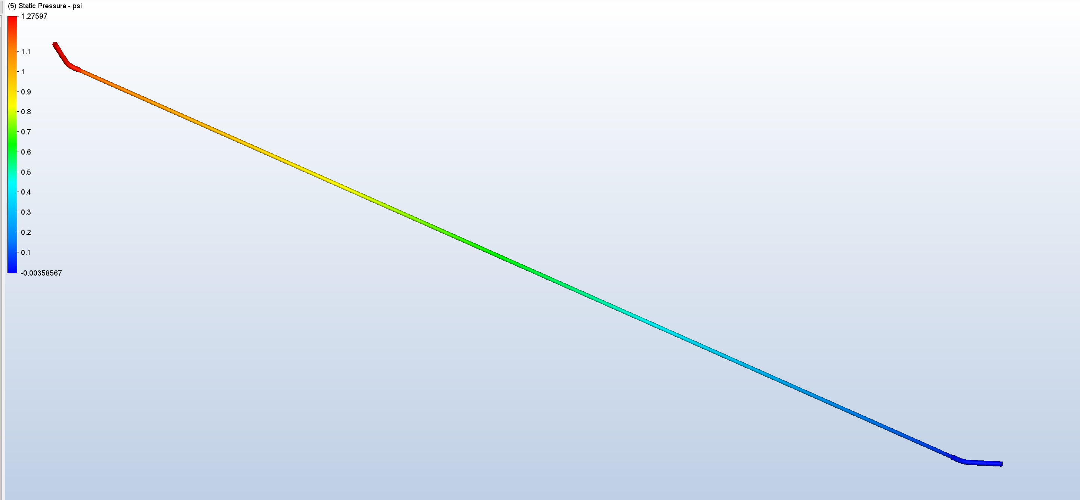
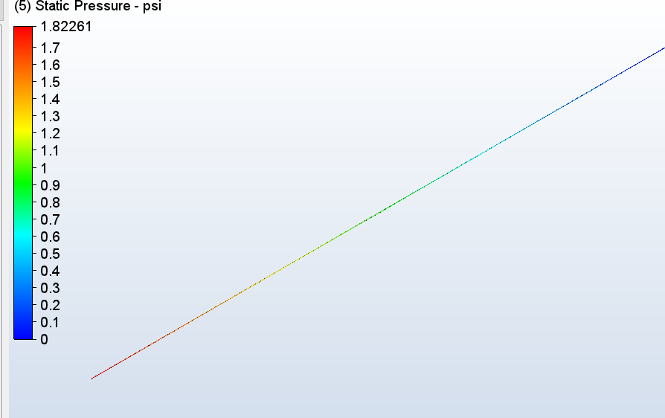
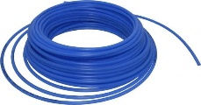
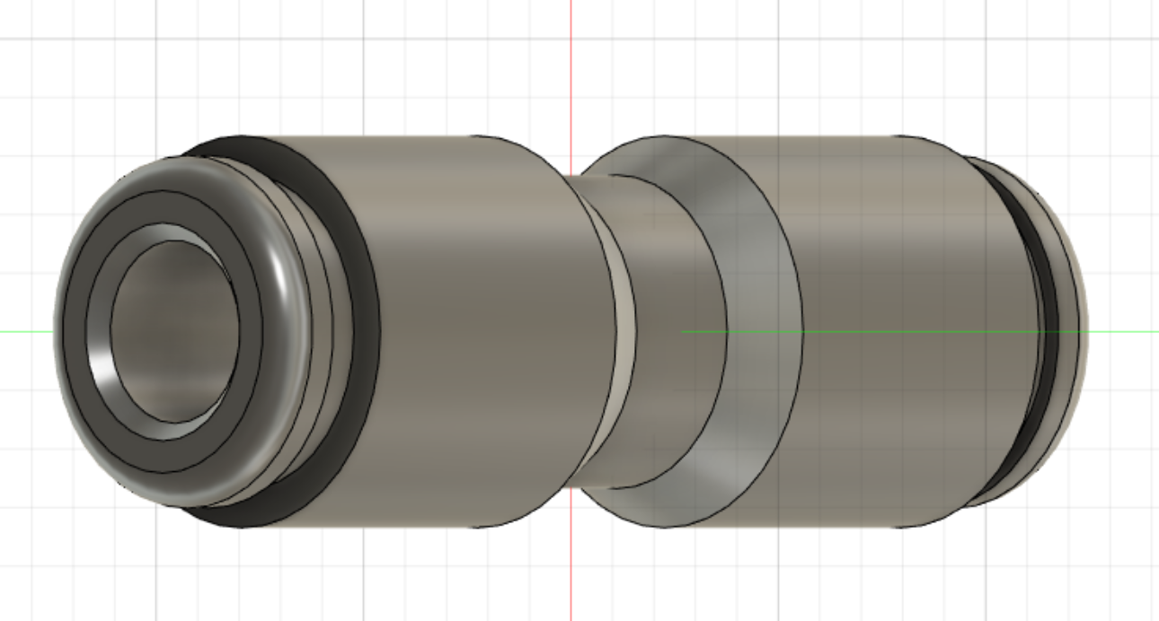
Pressures and flow analysis
Flow and pressure drop analysis was done with Autodesk CFD. From the analysis, 1.3psi is needed to flow of 120ccm through the ladder. Additional 1.8psi is needed for the 2.8m I.D. Poly Tubing.
These calculations were confirmed with out from test setup.
4mm OD
2.8m ID Polyethylene
Tubing
Coupling with 2.8mm bore

Slide 11
Example Of Measurement
Digital High-Accuracy Pressure Gauges
1% at 15 psi
Agrees with analysis
calculations
Zero PSI
1
50” 2.7mm ID
2
3
50” 2.7mm ID
4
Sink
Location | Stave 1 | Stave 2 | Stave 3 | Stave 4 | Stave 5 | Stave 6
1 | 2.5 | 2.95 | 2.9 | 2.75 | 2.85 | 2.8
2 | 1.75 | 2.16 | 2.15 | 1.97 | 1.95 | 2
3 | 1.01 | 1.11 | 1.08 | 1.04 | 1.05 | 1.02
4 | 0 | 0 | 0 | 0 | 0 | 0
4 points were used to confirm Calculations.
For stave testing, point 2 and 3 are used to measure pressure drop across stave at 200ccm.
Pressure in PSI Flow set to 200 CCM water
Tube ID 2.7
Stave ID 2.0mm

Slide 12
Thermal Calculation from Dan- Temperatures
Stave ΔT – 5.1 °C (9.2 °F)
Sensors ΔT – 1.6 °C (2.9 °F)
Flow 120ccm
Higher Chip Density
52 Chips + HDI components → 2.6 Watts per ladder
Each FVTX chip → ~0.05W

Slide 13
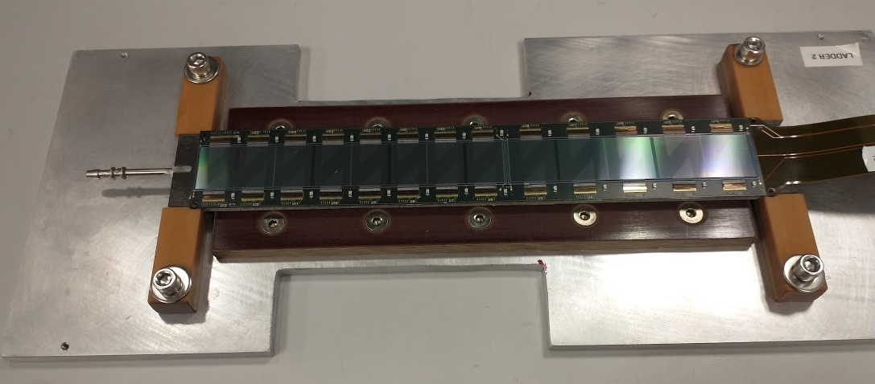
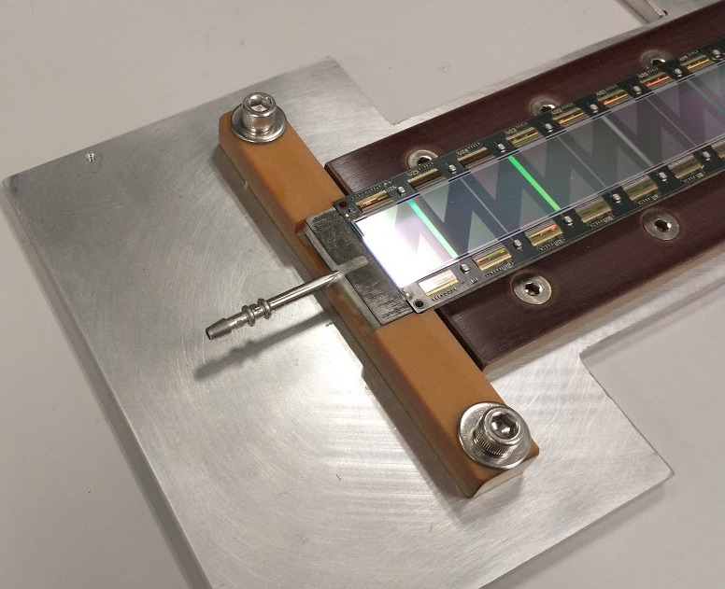
2019 Prototype Half Ladder
4 half ladders (2nd prototype) with cooling tube tested at FERMI Lab in 2019. Temperature was read out.
Confirmed ANSYS calculations withing 10%
Ladder temps were within 4C of input coolant temperature.
Confirmed with thermal camera (next slide)

Slide 14
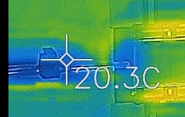
Half Ladder
Cooling ON, 120ccm 20C input
Start, not cooling, Bad Chip
1
5
22C
31.7C
2
6
23.6C
25.4C
3
26.2C
7
23.9C
4
33.5C
From Analysis
Stave ΔT – 5.1 °C
Thermal images agree well with Model

Slide 15
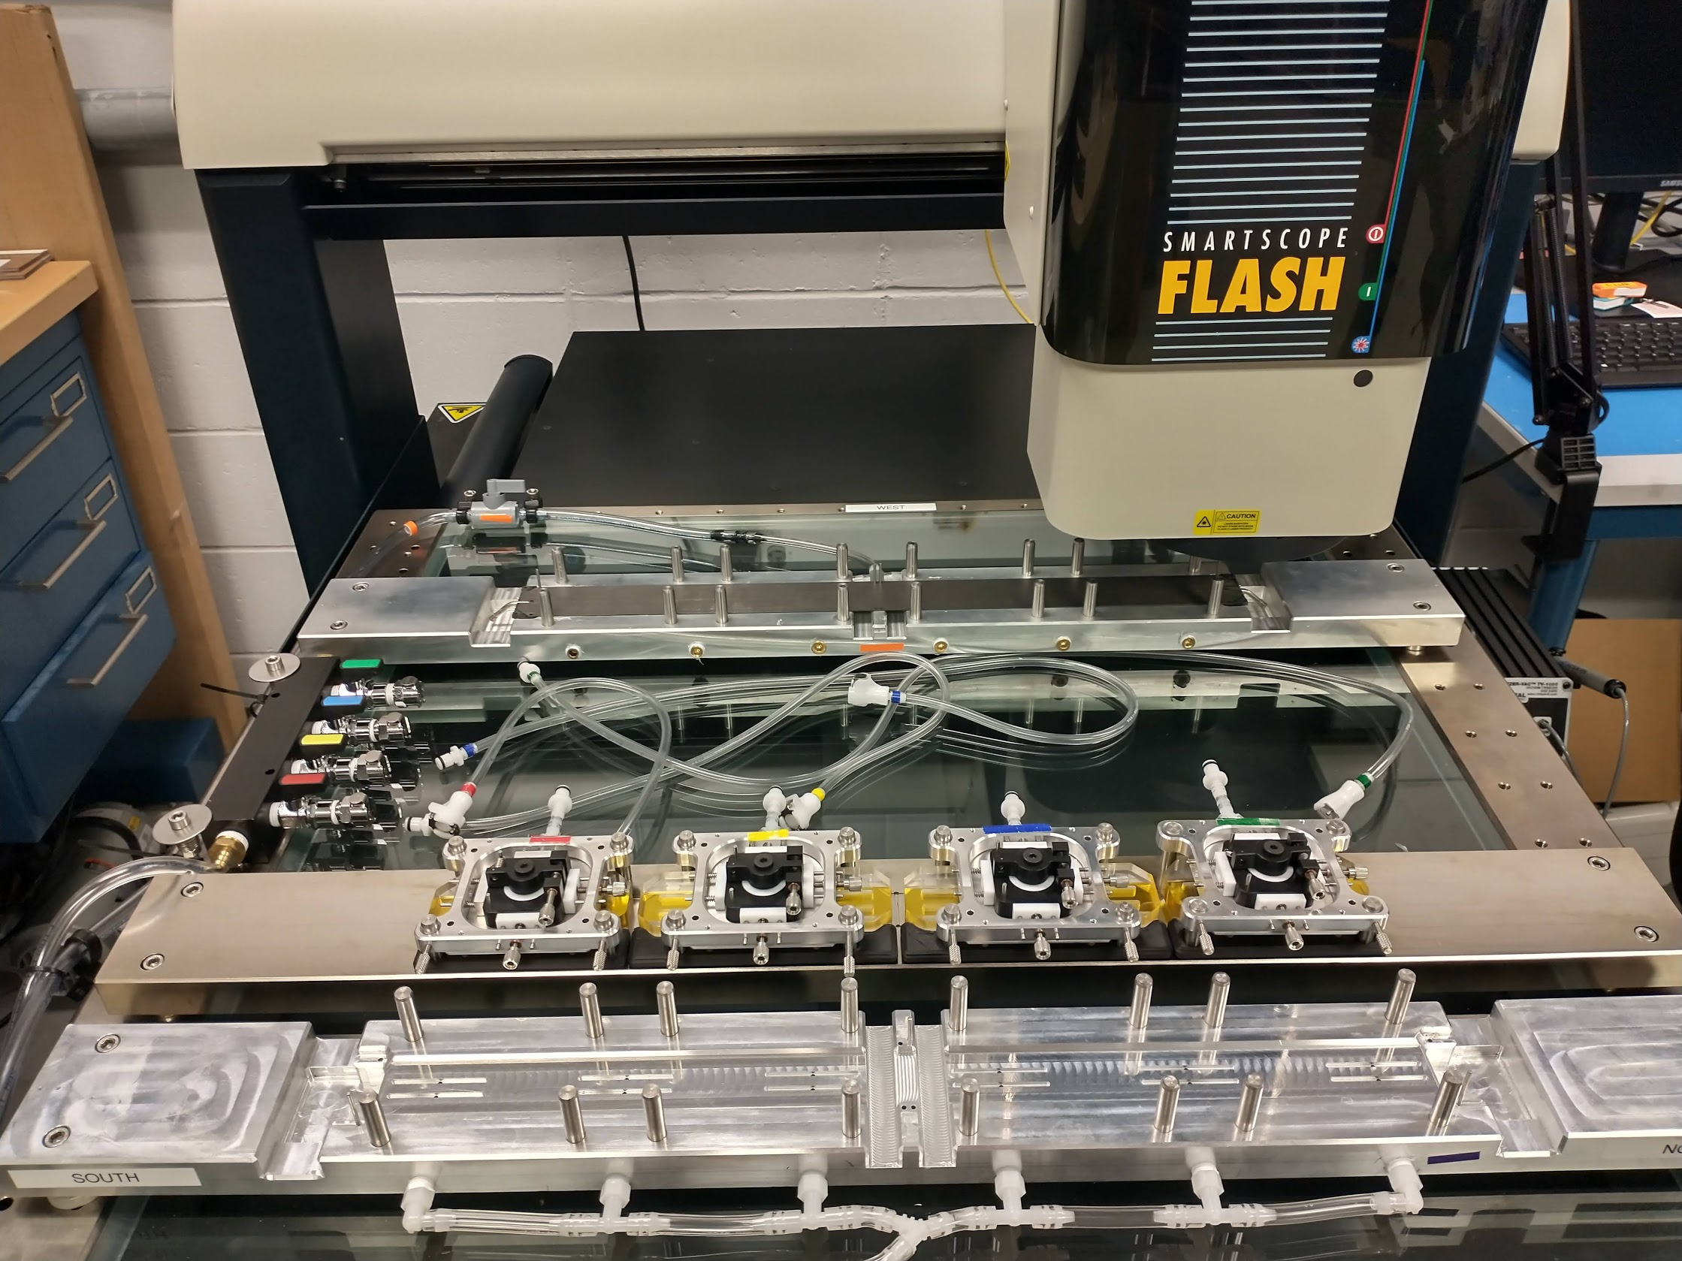
Flatness measurement
Stave
At BNL, we use a no contact OGP SmartScope Multisensor Measurement Systems to measure stave flatness. Fully Automated
OGP takes measurements at several points across the whole stave.
Measurement taken relative to plan made by mounting holes. Report gives us average deviation from the points made by the plan.
Sample of a report below.
100micron

Slide 16
Long Term Flow Testing
Pre-
Production
We are also conduction long term flow testing on the staves. We have placed 2 pre-production and 2 Batch 1 staves under circulation (cooling fluid is water plus a corrosion inhibitor). Recently we added 8 batch one staves to the loop. We will retest flow and pressure after 1-2 weeks.
Batch 1 Staves
The original a pre-productions and Batch One staves will remain on the loop as long as possible. We will retest every few weeks to look for changes.

Slide 17
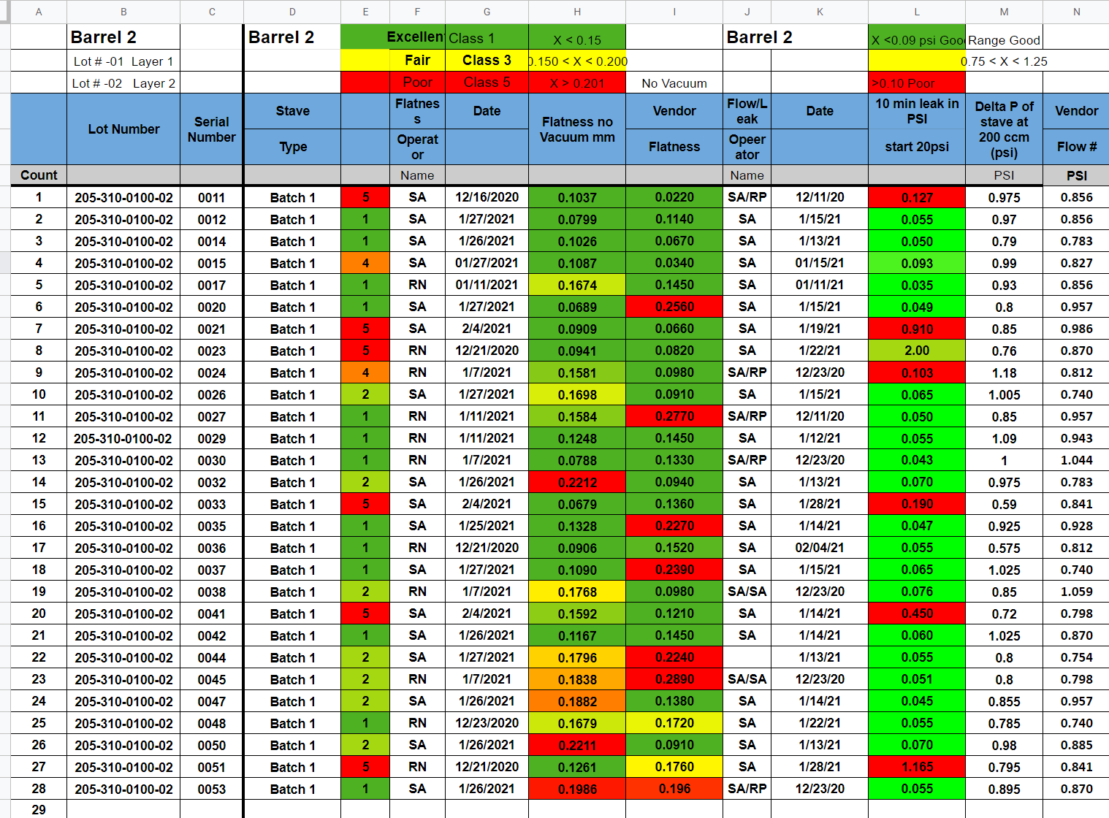
Batch 1 (Pre-Production) Stave Testing Documentation
Barrel Two Staves
All Batch 1 (pre-production) staves being retested after shipping to BNL
Flow rate, flatness and leak rated are tested for every stave.
All testing is logged into an online database
After testing, staves are given a Class number. Currently, only class 1 staves will be used.

Slide 18
Conclusion
All staves that are delivered to BNL will be tested as follows:
Inspection ✓
Leak test ✓
Pressurized test ✓
Submersion test ✓
Flow consistency test ✓
Flatness measurement ✓
Long term flow test ✓
Stave Classification ✓
The above testing ensures the highest quality ladders are built at
BNL for INTT Ladders.

Slide 19
Backup

Slide 20
Reference
Endcap
(Carbon PEEK)
CFC Formed
(K13C2U +
20301A 34 GSM)
What we care about for Cooling
Rohacell 110 RIST Foam
(polymethacrylimide)
CFC Tube (OD: 3mm,
ID: 2mm) (T700)
CFC Flat
(K13C2U + 20301A 34 GSM)
Graphite Epoxy (EP75-1)
3M Thermal Epoxy
TC2810
Loctite 2902
(Silver Epoxy)
Tube Sleeve
(316 Stainless)

Slide 21
Thermal – Midplane Cross Section
Silver Epoxy
Chip-(Heat Source)
Temperature
Sensor
HDI
3M Thermal Epoxy
Carbon Fiber
Graphite Epoxy
Carbon Fiber
Carbon Tube
Graphite Epoxy
Rohacell
Water
The heat is applied as a 0.0055 W/mm^3, which is about 0.05W per chip, or 2.6W total. There is also convection in the model, which adds about a 0.4W load. Flow Rate is 120ccm of water in the model.

