Slide 1
Contents

Slide 2
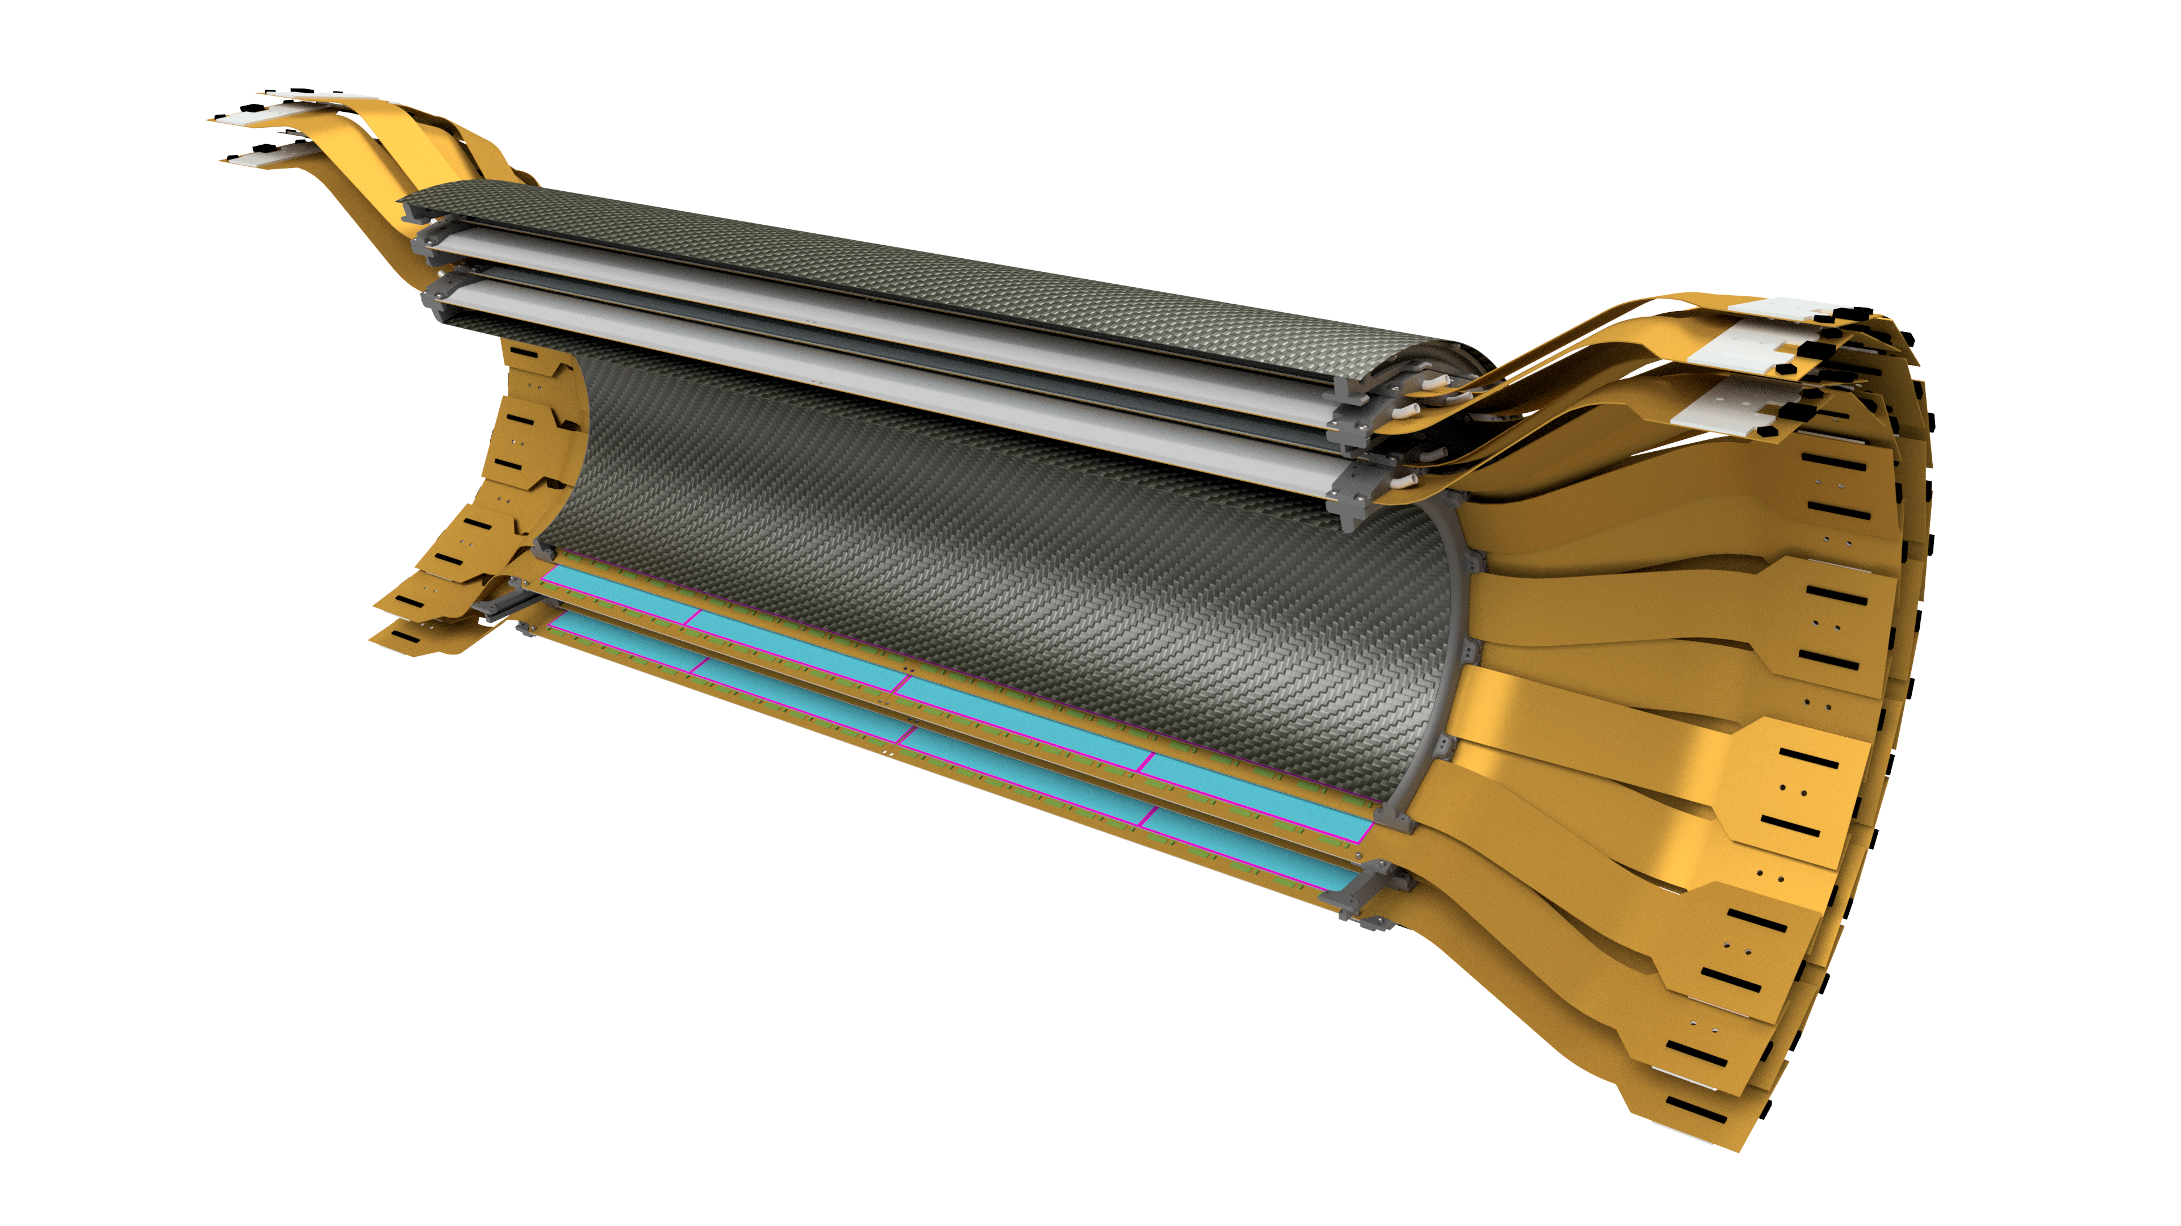
Stave and Barrel Design and FEA Analysis Daniel Cacace Brookhaven National Laboratory

Slide 3
Motivation
Stave
The stave design was based on HDI geometry.
The HDI needs rigidity and cooling (3W).
The stave supports two HDIs (4 sensors and 52 chips).
Barrel
The barrels supports 56 staves (L1: 24 and L2: 32) (224 sensors and 2912 chips).
The barrel design was based on stave design and requirements.
Both
The stave needs sufficient clearances between adjacent staves.
The stave needs to accommodate the MVTX (cone).

Slide 4
Requirements
Physics
Mechanics
|η| ≥ 1.0 @ |Z_{vertex}|= 10 cm
100% φ coverage
X/X˳ ≤ 1.25% per ladder
15°C ≤ T ≤ 22°C
δ ≤ 0.005”
ω ≥ 100Hz

Slide 5
Ladder

Slide 6
HDI – Design and Radiation Length
HDI Thickness: 473 um
Width: 38.0 mm
z-length total: 400 mm Sensor thickness: 320 um
FPHX chip thickness: 320 um
HDI Material | Thickness [μm] | $X/{X_{0}}$
Copper | 38 | 0.26%
Polyimide | 380 | 0.14%
 | Total | 0.40%
The HDI is composed of 7 copper layers. 4 solid ground or power layers and 3 signal line layers.

Slide 7
Stave – Average Radiation Length
Material | Thickness [μm] | Radiation Length (mm) | $X/{X_{0}}$
CFC Flat | 0.3300 | 256.4122 | 0.1287
CFC Formed | 0.3411 | 256.4122 | 0.1330
CFC Tube | 0.1033 | 282.2909 | 0.0366
Foam | 1.4740 | 3771.3741 | 0.0391
Epoxy | 0.1016 | 298.7463 | 0.0340
Water | 0.0826 | 356.7854 | 0.0231
 |  | Total | 0.3946
Material | Fraction | Radiation Length (mm)
CFC | 0.6 | 194.0909
Epoxy | 0.4 | 349.8941
 | Total | 256.4122
Water | 0.7 | 360.8000
Glycol | 0.3 | 349.2849
 | Total | 356.7854
Notes:
7
Le plan de l’expose se presente de la manière suivante :

Slide 8
Ladder – Stave + Two HDIs and Radiation Length
Material | Thickness [μm] | $X/{X_{0}}$
Silicon | 320 | 0.30%
HDI | 473 | 0.40%
Stave | 3620 | 0.40%
 | Total | 1.10%
All components are averaged over the area of the stave in the active region.
Estimated Weight: 0.1lb. (0.445N)

Slide 9
Stave Design

Slide 10
Stave Design – Assembly
Thickness: 0.76 mm
Height: 3.76 mm
Width: 38.00 mm
Length: 497 mm
Material: Carbon Fiber, Polymethacrylimide (PMI),
Stainless Steel and Epoxy
(radiation length = 0.40% )

Slide 11
Stave Design – Parts
Endcap
(Carbon PEEK)
Epoxy
(Hysol 9396)
CFC Formed
(NT91500-520S + 25R + 20301A 34 GSM)
Epoxy
(EP75-1)
Between all parts
Rohacell 110 RIST Foam
(polymethacrylimide)
Tube Sleeve
(316 Stainless)
Tube Bend
(316 Stainless)
CFC Tube OD: 3mm,
ID: 2mm (T700)
Pin Receptacle
(Copper)
CFC Flat
(NT91500-520S + 25R
+ 20301A 34 GSM)

Slide 12
Stave Tube – Assembly Drawing

Slide 13
Stave – Assembly Drawing

Slide 14
Stave FEA Analysis

Slide 15
Structural – Under its Own Weight
Deflection – MAX: 0.0001 in (2.5 um)
Stress – MAX: 110 psi (0.6 MPa)
Boundary Conditions: Endcaps simply supported, HDI weight added

Slide 16
Vibration – Natural Frequencies
First Mode – 453 Hz
Second Mode – 796 Hz
Boundary Conditions: Endcaps simply supported

Slide 17
Thermal – Temperatures
Stave ΔT – 5.1 °C (9.2 °F)
Sensors ΔT – 1.6 °C (2.9 °F)
Boundary Conditions: Inlet temp 15C, flow rate 0.12l/m, natural convection, chips dissipate 3W total

Slide 18
Thermal – Midplane Cross Section
Temperature
Heat Flux
Boundary Conditions: Inlet temp 15C, flow rate 0.12l/m, natural convection, chips dissipate 3W total

Slide 19
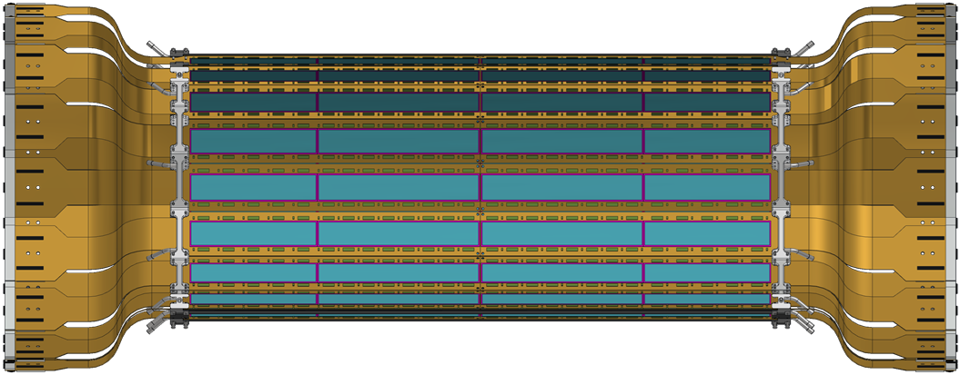
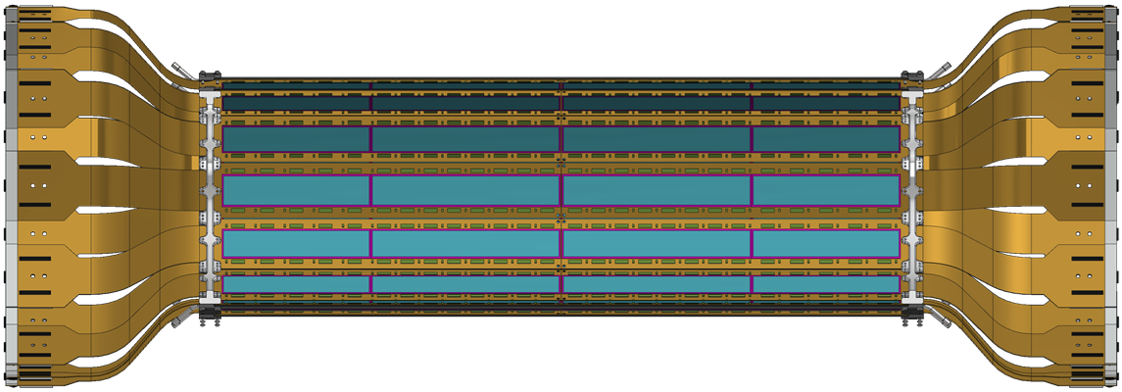
Barrel Configuration

Slide 20
Barrel – Two Layers
Full Detector
Half Barrel
Outer Layer
Inner Layer

Slide 21
Barrel – Two Layer Configuration Staves
1a (Inner)
1b (Outer)
2a (Inner)
Water Cooling
2b (Outer)

Slide 22
Barrel – Two Layer Configuration Active Area
1a (Inner)
The width of the active area is 52.6% of the total width of the ladder. In order to have overlap for full PHI coverage and have a reasonable stave thickness, the ladders were stager radially with no tilt.
1b (Outer)
2a (Inner)
2b (Outer)

Slide 23
Barrel – Two Layer Configuration Numbers
|η| α | Z_{Si} - Z_{vertex}| / Radius
|η| ≥ 1.0 @ |Z_{vertex}|= 10 cm
Ladder Concept
BUS Extender
HDI
Silicon Module
Silicon Module
HDI
BUS Extender
465.5 mm
Signal
Signal
Barrel | Center of Sensor Tangent Radius (mm) | Pseudo rapidity | QTY of Ladders | Angle (deg) | Coverage (PHI) (%) | Overlap (%) | Clearance (mm) | Chip Power Dissipation (W) | Stave Rad Length (%) | Barrel Rad Length (%)
1 | - | - | 24 | - | 100 | 2 | 2.00 | 62.30 | 0.80 | 2.20
1a (Inner) | 71.88 | 1.37 | 12 | 0 | 53 | 0 | 0.60 | 31.15 | 0.40 | 1.10
1b (Outer) | 77.32 | 1.31 | 12 | 0 | 49 | 0 | 3.80 | 31.15 | 0.40 | 1.10
2 | - | - | 32 | - | 100 | 2 | 2.22 | 83.07 | 0.80 | 2.20
2a (Inner) | 96.80 | 1.12 | 16 | 0 | 53 | 0 | 0.60 | 41.53 | 0.40 | 1.10
2b (Outer) | 102.62 | 1.07 | 16 | 0 | 49 | 0 | 3.12 | 41.53 | 0.40 | 1.10
Total | - | - | 56 | - | - | 100 | 11.22 | 145.37 | 1.60 | 4.40
Notes:
23
Le plan de l’expose se presente de la manière suivante :

Slide 24
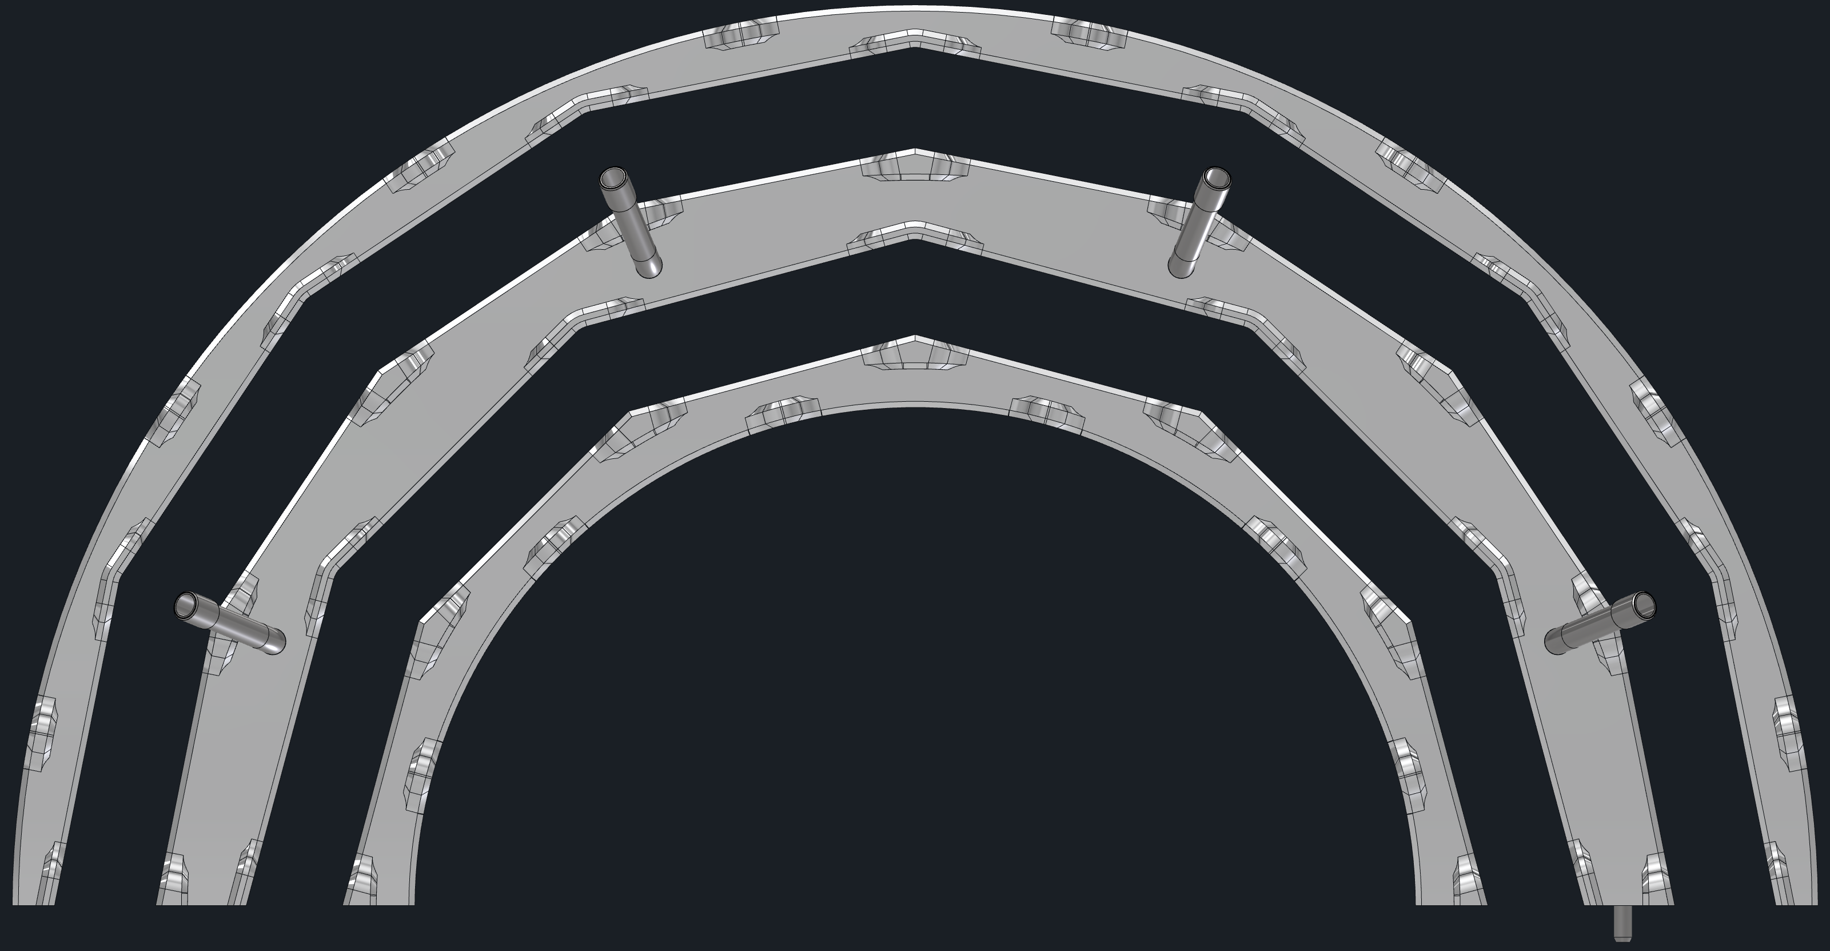
Barrel Design

Slide 25
End Rings - Half Barrel, One Side
End Ring 3
Gap for layers 2a and 2b
End Ring 2
Gap for layers 1a and 1b
End Ring 1
Dry Air/Nitrogen

Slide 26
Barrel – Cooling and Extension Connection
Ladders – No Connections
Ladders – Both Connections

Slide 27
Barrel – Carbon Fiber Skins and Cones
Skin Thickness: 0.010” (0.25mm)
Cone Thickness: 0.063” (1.60mm)
Estimated Weight: 10lb. (44.5N)
Both Sides Total: 20lb. (89N)

Slide 28
Barrel - Assembly

Slide 29
Barrel - Services
With Inner Carbon Fiber
Without Inner Carbon Fiber

Slide 30
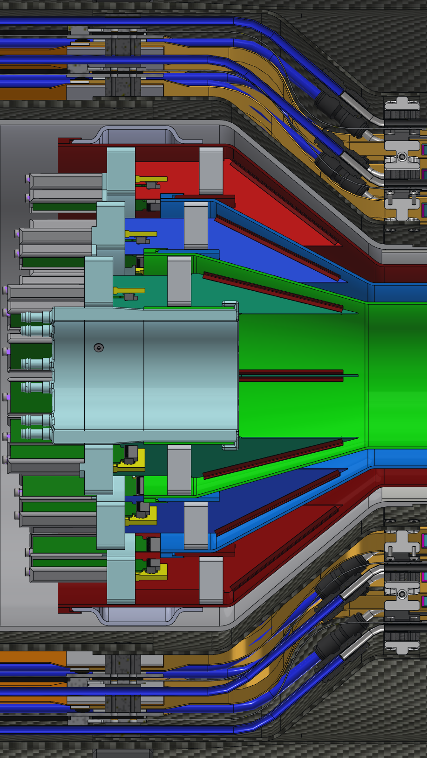
Barrel - Integration

Slide 31
Barrel FEA Analysis

Slide 32
Structural – Under its Own Weight
Deflection – MAX: 0.0002 in (5 um)
Stress – MAX: 12 psi (0.08 MPa)
Boundary Conditions: Carbon fiber cones fixed-fixed, HDI weight added

Slide 33
Structural – Under its Own Weight
Deflection – MAX: 0.0025 in (63.5 um)
Stress – MAX: 170 psi (1.17 MPa)
Boundary Conditions: Carbon fiber cones fixed-fixed, HDI weight added

Slide 34
Vibration – Natural Frequencies
First Mode – 83 Hz
Second Mode – 85 Hz
Boundary Conditions: Carbon fiber cones fixed-fixed

Slide 35
Summary

Slide 36
Pre-Production

Slide 37
Summary
The Design of the stave meets all requirements for:
HDI ✓
Coverage ✓
Radiation Length ✓
Rigidity ✓
Stress ✓
Modes ✓
Cooling ✓
Geometry ✓
Clearances ✓
Tolerances ✓
Ready for ladder production!

Slide 38
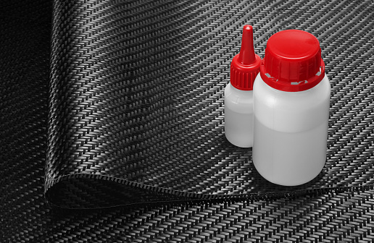
Technical Data Sheets

Slide 39
Carbon Fiber - K13C2U

Slide 40
Carbon Fiber - XN-90-60S

Slide 41
Carbon Fiber - T700

Slide 42
PEEK - CA30

Slide 43
Foam - Rohacell 110 RIST

Slide 44
Epoxy - 25R

Slide 45
Epoxy - EP75-1

Slide 46
Epoxy - Hysol EA 9396

Slide 47
Epoxy - TC2810

Slide 48
Epoxy - ABLESTIK 2902

