Slide 1
Final Design of the INTT Ladder and Production Readiness Review
Ladder Performance
WBS: 3.01
Takashi Hachiya,
Nara Women’s University & RIKEN BNL Research Center
March 2nd, 2021

Slide 2
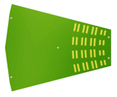
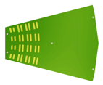
The INTT ladders
Ladder
Tracking System: MVTX+INTT+TPC
Data
Silicon module
Silicon module
Data
CC
BEX
HDI
SSS
SSS
SSS
SSS
HDI
BEX
CC
ROC
ROC
Si : 320um thick
Channel size : 78um x 16mm(20mm),
Nchannels : 128 x 26 x 2 = 6656
Ch / chip = 128
Readout Chip (FPHX) = 26 x 2

Slide 3
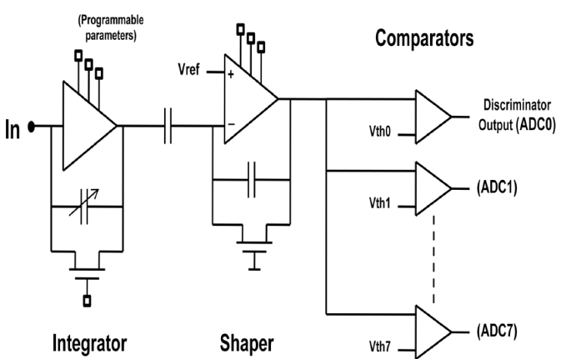
Sensor + Readout Schematics
Readout Chip (FPHX)
Digital data processing
h⁺
V_{bias}
Analog
ADC
ROC
+
FEM
Test Pulse
Performance is studied using:
Charged particle by beam test, cosmic ray and RI sources
Test pulse for Readout electronics
Notes:
Practical
Condition of readout chain

Slide 4
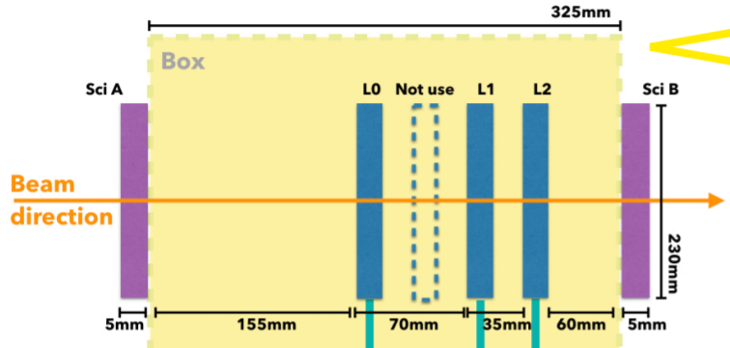
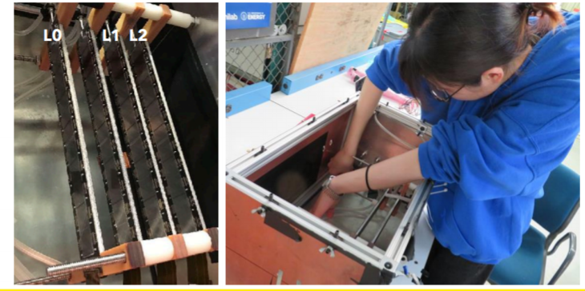
Beam Test Setup in 2019
prototype half ladder
Beam test at FNAL 2019
Proton beam w/ 120 GeV
prototype ladder
Beam position is clearly seen
MIP peak
Efficiency

Slide 5
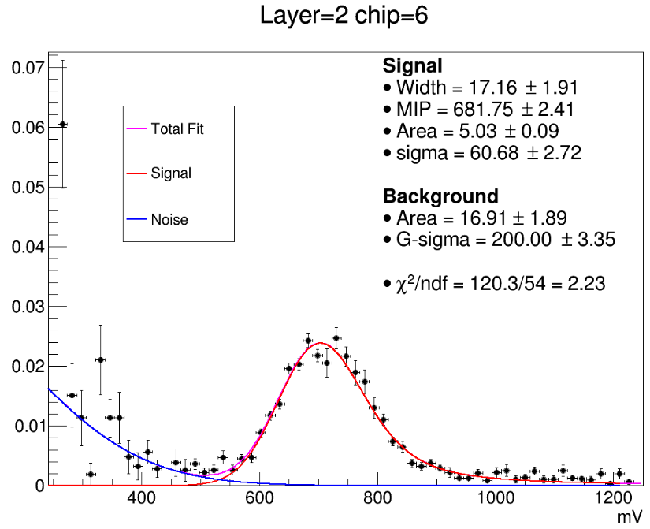
MIP peak in the beam test
MIP peak measurement with 3bit ADC
Scan with fine ADC threshold
MIP peak clearly seen
separated from noise
MIP peak puzzle
The peak is ~700mV from the beam test and cosmic ray.
E_{loss} ~ 100keV in 320um Si
Expected ~ 600mV
Conversion formula from Eloss to the measured voltage fixed
Conversion formula (Eloss/strip → V)
$$V\left(mV/strip\right)=G∗\frac{E_{loss}}{3.6eV}+O$$
Gain value (G) (mV/fC)
Offset (O) (mV)

Slide 6
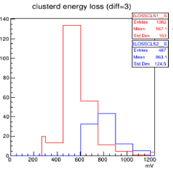
MIP peak by cosmic ray
$$V=G∗\frac{E_{loss}}{3.6eV}+O$$
Single hit
Double hits
Gain (mV/fC) | 100 (85~100)
Offset (mV) | 198
Pulse height after clustering
MIP peak ~ 600mV
Double hits are ~200mV higher from single hit
Double hit : V1 + V2 = MIP + offset * 2
Single hit : V1 = MIP + offset
MIP peak is nicely reproduced by ToyMC & GEANT w/ Gain + Offset
Raw ADC have ~200mV offset
Confirmed by test pulse
Single hit
Double hits

Slide 7
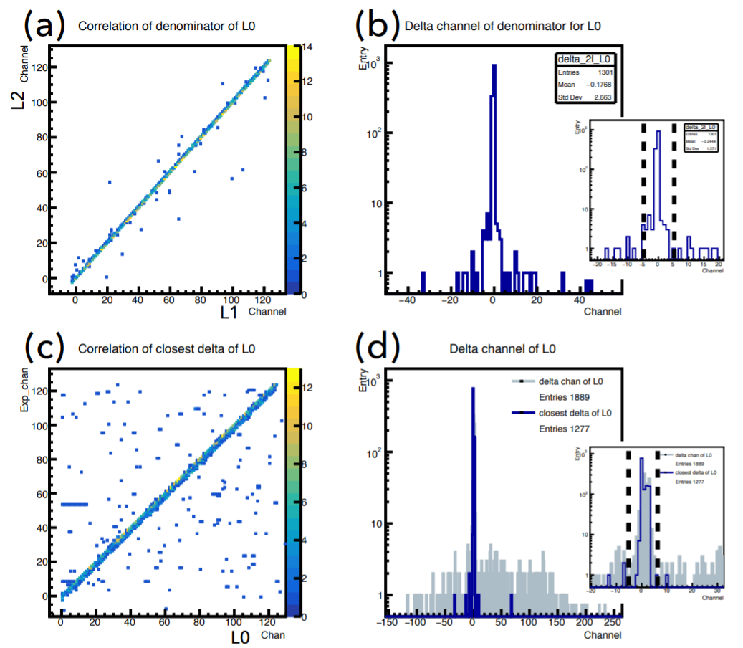
Efficiency in beam test 2019
Exp. vs L0
Exp – L0
Analysis cuts
For L1&L2: single hit & ADC>3
L0 : multiple hits & No ADC cuts
Correlated hits in 3 layers
Efficiency
$ε(L0)=\frac{N(L0+L1+L2)}{N(L1+L2)}$
Efficiency ε(L0)=96.0 ± 0.6 %
consistent w/ result in 2018 (95.8 ± 0.2 %)
S/N from MIP suggests higher efficiency
Investigating why the efficiency drop occurs
Hypothesis is the timing of signal processing

Slide 8
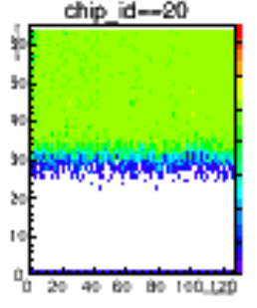
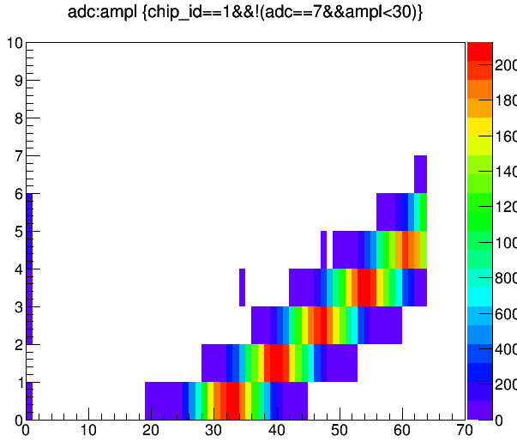
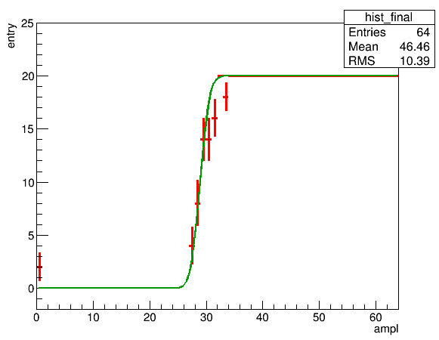
Test pulse response
Scan ADC with changing TP input amplitude
Bias voltage is applied to Sensor
Results:
ADC threshold clearly seen
Linearity between ADC (output) vs amplitude (input)
Single ch : 20 TP inputs
ADC
Threshold
Linear
Outputs (max =20)
Amplitude (input)
Working as is expected
Channels
Amplitude (input)
All thresholds works
Amplitude (input)

Slide 9
TP response for one ladder
Amplitude vs Channels
ADC vs Amplitude
All channels work nicely
TP is useful for health check of the readout chain

Slide 10
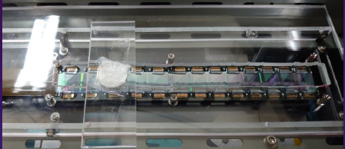
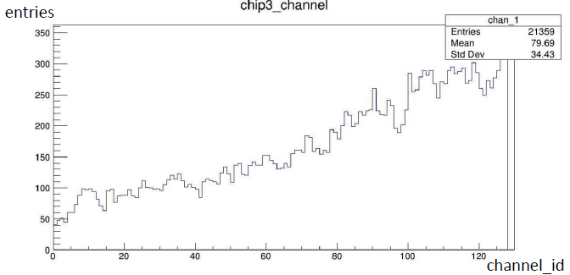
⁹⁰Sr response
⁹⁰Sr on Chip=3 and 16
⁹⁰Sr
Trigger scintillator is placed behind the sensor
Chip3
Chip16
e– from ⁹⁰Sr is also seen.
Good to use for sanity check during the mass production

Slide 11
Performance summary
MIP measurement
Mip peak clearly seen from beam test and cosmic ray
MIP peak is consistent with the expected value with the gain + offset
Efficiency in beam test
96.0 ± 0.6% due to the readout timing
Investigating the time scan in the readout chain using cosmic ray
Test pulse is used for ch-by-ch health check of the readout
RI source is also useful to check the sensor + RO
Evaluation test will be used for the mass production of the ladder

Slide 12
Back Up

Slide 13
TP response for one ladder
Amplitude vs Channels
ADC vs Amplitude
All channels work nicely
TP is useful for health check of the readout chain

Slide 14
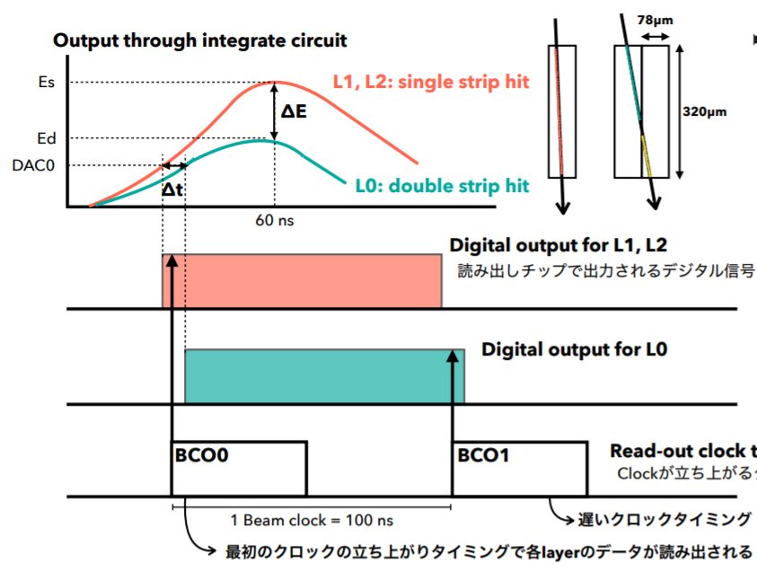
Slowing Effect on Efficiency
Slewing effect may cause the efficiency loss
If Data0 pulse is small, data0 can be latched by one clock later than Data1.
To study this effect, we calculate the efficiency with the different clock timing
Timing can be changed by ADC
Efficiency
Different timing : 97.2 ± 1.0 %
Default : 96.0 ± 0.6 %
Slewing effect = readout timing is an possible cause of the efficiency loss.
Data1
Data0
B-Clock
We will study the timing effect at the next beam test.
This effect will be cross-checked by Cosmic ray measurement.

Slide 15
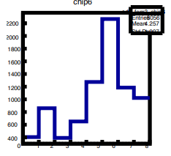
MIP measurement with FPHX chip
3 bit ADC but these threshold can be set 8 bit DAC width.
MIP Scan
Took data with changing DAC value to cover the full MIP range
ADC (3bit) | DAC (8bit)
0 | 20
1 | 25
2 | 48
3 | 98
4 | 148
5 | 172
6 | 223
7 | 248
SCAN0
SCAN1
SCAN2
SCAN3
SCAN4
charge

Slide 16
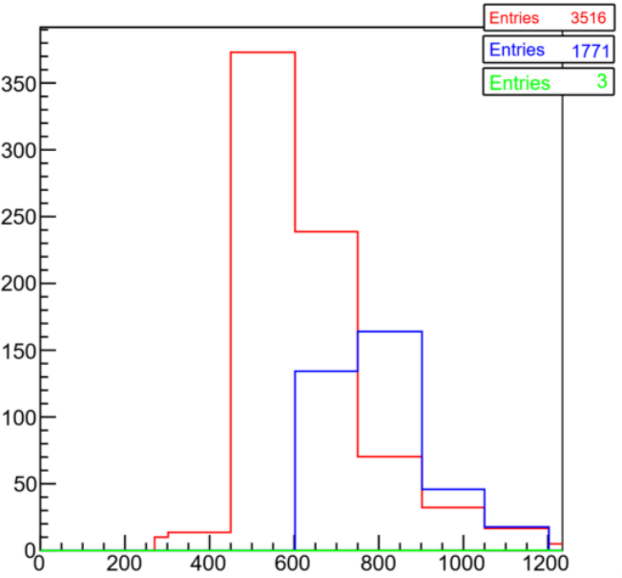
MIP peak by cosmic ray
Pulse height after clustering
by Mika
Cosmic ray data
Toy MC
Single hit
Double hits
Single hit
Double hits
$$V=G∗\frac{E_{loss}}{3.6eV}+O$$
 | Original | NEW
Gain (mV/fC) | 300 | 100 (85~100)
Offset (mV) | 0 | 198
Double hits are shifted ~200mV higher from single hit
If no offset, these should be the same
Data is nicely reproduced by ToyMC w/ Gain + Offset
Single and double hits peaks are nicely consistent
GEANT model also reproduce the MIP peak
MIP peak puzzle is fixed with new conversion formula

Slide 17
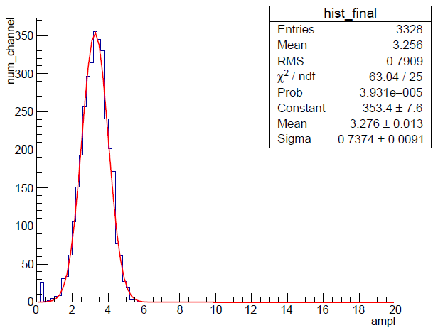
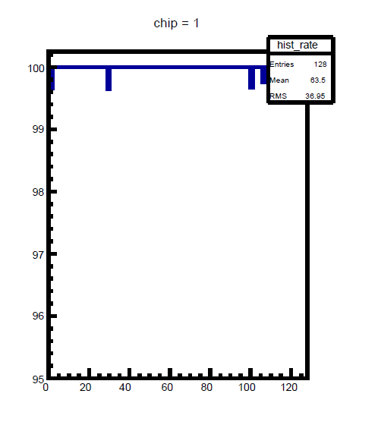
Result2: noise and data error rate
Noise: check the slope of the threshold
Width represents noise level
Transfer efficiency: check if all the data comes with high amplitude
These tests should used for the ladder (readout) QA for the mass production
Single ch : 20 TP input
Noise : Width of the slope
100
Threshold
99
Outputs (max =20)
efficiency ~ 100%
98
Avg: 3.3±0.7
97
96
95
Ch
Pulse height

Slide 18
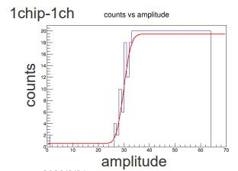
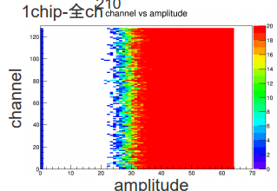
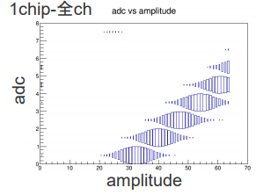
Readout Check by Test pulse
TP injected to a channel with changing pulse heights
10 TP for an amplitude (Amplitude : unit of TP pulse height (1-64))
Results
Data comes out above the threshold for 128 channels
Linearity of ADC comfirmed
TP for a chip (128ch)
ADC vs Amplitude
TP response for a channel

Slide 20
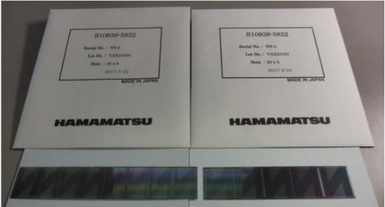
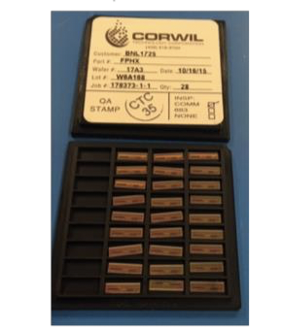
The INTT Components
Ladder
Tracking System: MVTX+INTT+TPC
Data
Silicon module
Silicon module
Data
CC
BEX
HDI
SSS
SSS
SSS
SSS
HDI
BEX
CC
ROC
ROC
Silicon Pre-production
HDI Pre-production
FPHX Production
1.2 m Bus Extender (BEX) Prototype-II
Conversion Cable (CC) Pre-Production

Slide 21
INTT module
Si : 320um thick
Channel size : 78 x 1200um(),
Nchannels : 128 x 26 = 3328
Ch / chip = 128
Readout Chip (FPHX) = 26

