Slide 1
sPHENIX Calendar
FDR MBD D/S electronics Feb 8
DOE NP Budget Briefing Feb 17
FDR LL1 Trigger Electronics Mar 1
ESRC Review of Carriage/Cradle/OHCal/Solenoid installation (Dry Run/Review) Mar 9/15
1008 I&F Status Review Apr 7-8
ESRC Safety systems/electrical power distribution(Dry Run/Review) Apr 12/19
ESRC Magnet(Dry Run/Review) May 3/17
ESRC TPC(Dry Run/Review) Jun 7/21
ESRC Calorimeters(Dry Run/Review) Jul 12/26
ESRC IHCal/EMCal/TPC/MVTX/INTT Installation(Dry Run/Review) Sep 13/27
ESRC MBD and beam pipe(Dry Run/Review) Oct 4/18
ESRC MVTX/INTT(Dry Run/Review) Nov 1/15

Slide 2
MIE Project Status
Eleven months of float from early completion to PD-4. The Early Completion date was unchanged in January.
CPI is 1.01, SPI=0.79, Contingency 22.0%, 61.1% Complete, 82.9% Costed and Committed
We have lost 3 months in schedule contingency since the pandemic impact began in March 2020. The first 2.5 months were lost March-July. Lost an additional 2 weeks off the early completion in December due to the COVID spike in the US.
The COVID spike in the US from Nov-Feb has had an impact on project schedule performance. The Negative Schedule Variance increased in January partly due to late deliveries from vendors and partly due to a decrease in existing positive schedule variance.
PCR approved to move the Early Project Completion date to January 2022 and add technical labor for WBS 1.2 – Time Projection Chamber.
FDR/PRR for EMCal/HCal Signal Cable complete.
EVMS processing complete.
Cobra and P6 monthly reports uploaded to IPD.
Variance reports approved for January
Continue monthly EVMS process and Change Control.
Continue to hold reviews as designs are completed and procurements are made.
Implementing corrective actions to improve schedule performance. Adding labor.

Slide 3
sPHENIX MIE Technical Status
100% of long lead (CD-3A) procurements received: 100% of SiPMs, 100% of tungsten powder, 100% of scintillator tiles, 100% of scintillating fibers.
19/32 OHCal sectors (59%) complete, tested and calibrated. Assembly ongoing on OHCal Sectors 20-28.
EMCal blocks for 1st 22/64 sectors complete at UIUC, blocks for sector 23+ underway. EMCal Sectors 1-13 (20%) assembled, tested and calibrated, assembly of sectors 14-17 underway. High eta blocks from Fudan Univ continue to arrive at BNL.
TPC Inner field cage complete and tested. Outer field cage fab underway at SBU.
GEM Modules for TPC under fab at WSU, Vanderbilt, Temple, Weizmann.
30+ TPC Fee preproduction boards at BNL for testing. TPC Fee slice test (26 board system test) will be performed at BNL within the next 3 weeks. Order submitted for the assembly of the production TPC DAM (FELIX) cards.
All production Calorimeter Electronics (except cables) exist or under contract for production.
All Calorimeter Digitizer preproduction boards (20%) at Columbia U/Nevis for testing.
Production computer servers, GL1 and Timing modules on order for DAQ/Trigger.
FDR and PRR for the Min Bias Detector electronics held in February. Approved for production.
All MVTX Readout Units tested at ORNL. Minor RU debugging underway. 49/84 of staves completed and tested good, with additional 11 undergoing testing at CERN (48 working staves needed). (MVTX)

Slide 4
1008 I&F Status
3.5 months of float from early completion to start of RHIC 2023 run Feb 1, 2023. The Early Completion date was unchanged in January.
CPI is 1.07, SPI=0.94, Contingency 21.4%, 54.4% complete, 61.3% Costed and Committed
All 1008 2020 shutdown tasks successfully completed on schedule.
1008 Track reinforcement contract is awarded.
Work in 1008 Assembly Hall starts March 1. To be completed by May 3.
Work in the 1008 IR starts after the beginning of the 2021 shutdown in mid-July.
I&F early completion dates remain unchanged for January. 3.5 months of float for the I&F.
COVID impact on schedule mitigated stable for now.
Schedule impact of RHIC Run 2022 not yet integrated into the I&F P6 schedule
Engineering design work continues at a fast pace
Magnet flux return Pole tip/end cap awarded to vendor.
sPHENIX Beam Pipe at vendor for modification.
LN2 piping, XY Carriage tables, Carriage Hydraulics, Carriage Platform ordered or in BNL Procurement system
Met with CERN group that will be performing the magnet mapping in 2022.
Holding remote reviews for major orders
Continue monthly status, EV, PCR for 1008 I&F

Slide 5
sPHENIX Operations During the Pandemic
BNL was in min safe mode from the end of Mar 2020 to mid-June 2020. During that period no sPHENIX work took place on BNL site.
We have gradually increased the sPHENIX on BNL-site workforce from mid-June to late Sept.
sPHENIX FTE threshold has been at 30 FTEs since late Sept with the total including sPHENIX visitors. We have ~80% of our workforce approved to be on site. However managers, engineers and designers that can work remotely continue to do so.
We have recently increased the threshold to 35 FTEs to accommodate the influx of visitors to BNL working on sPHENIX.
COVID mitigation plans continue to be implemented
sPHENIX has assigned a Task Coordinator to optimized the personnel on site and tasks performed each day.
We’re in daily communication with BNL safety personnel to make sure that all continues to go smoothly.
All institutions with sPHENIX fab responsibilities have reopened with low density labor practices implemented.

Slide 6
High Priority Issues
We need to keep the EMCal and OHCal on schedule.
EMCal preamp is the current supply chain issue for the EMCal sectors assembly.
Prep for installation of the HCal sectors on the carriage in the late spring 2021.
Reinforce tracks in the 1008 Assembly Hall. Starts next week.
Complete TPC Fee slice test and order the TPC Fee production boards.
Complete remaining engineering design tasks and order components
We must finish the designs and move our attention to assembly, installation and testing.
Can’t allow the final design tasks to get delayed.
Schedule and hold remaining reviews
Place Remaining procurements

Slide 7
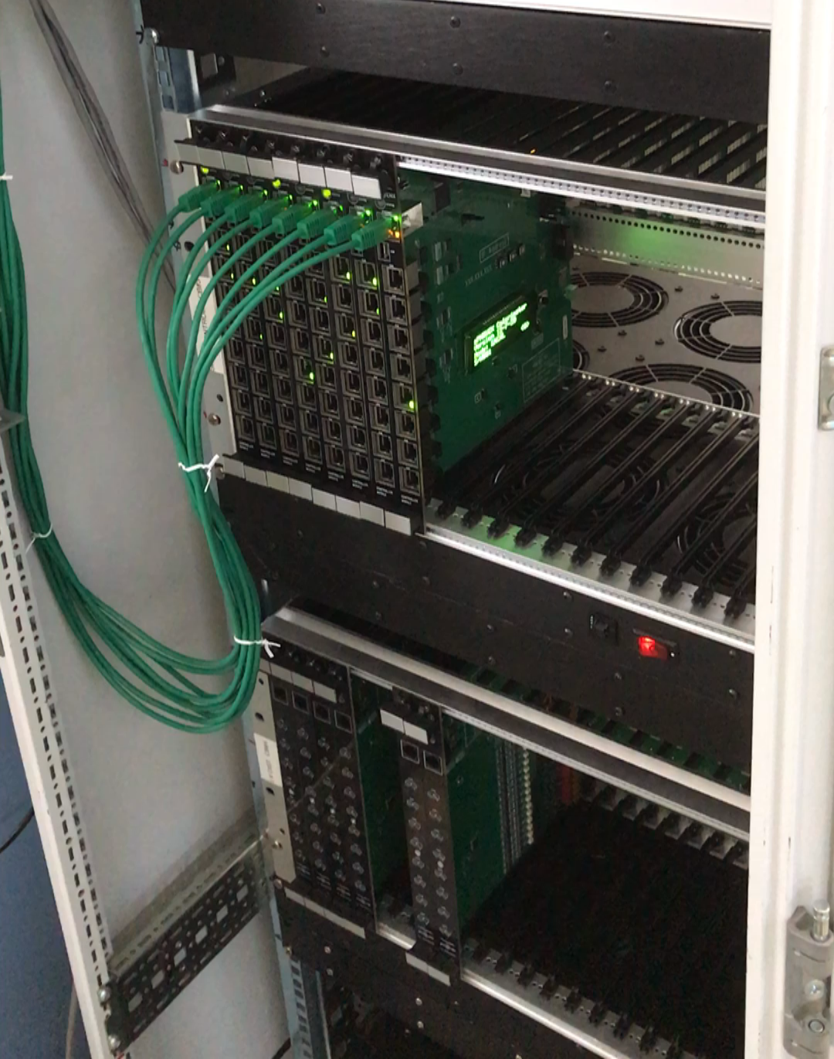
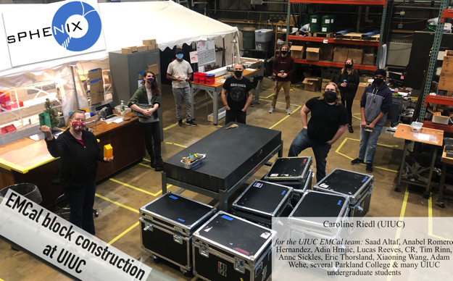
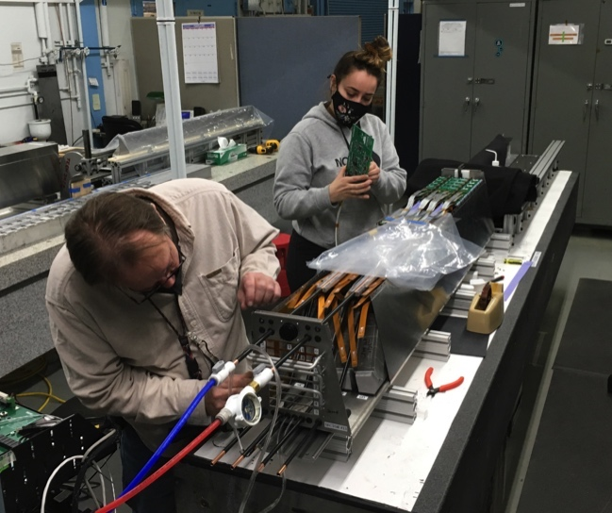
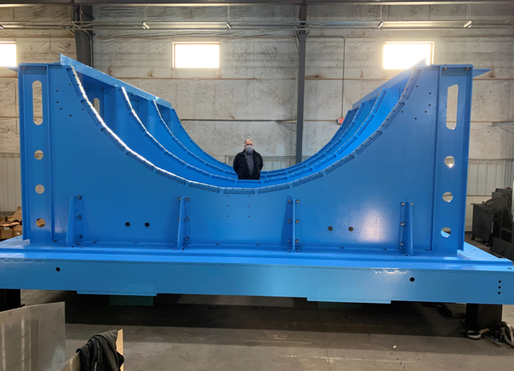
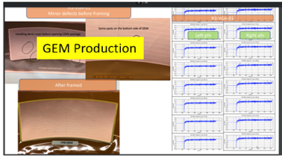
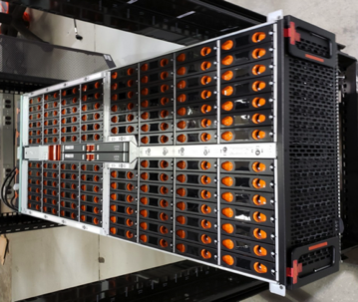
sPHENIX in Photos
Cal Electronics
BNL EMCal Sectors
EMCal Blocks at UIUC
GEM Module Production at WSU
BNL OHCal Factory
Carriage/Cradle at vendor
DAQ/Trigger Buffer Box

Slide 8
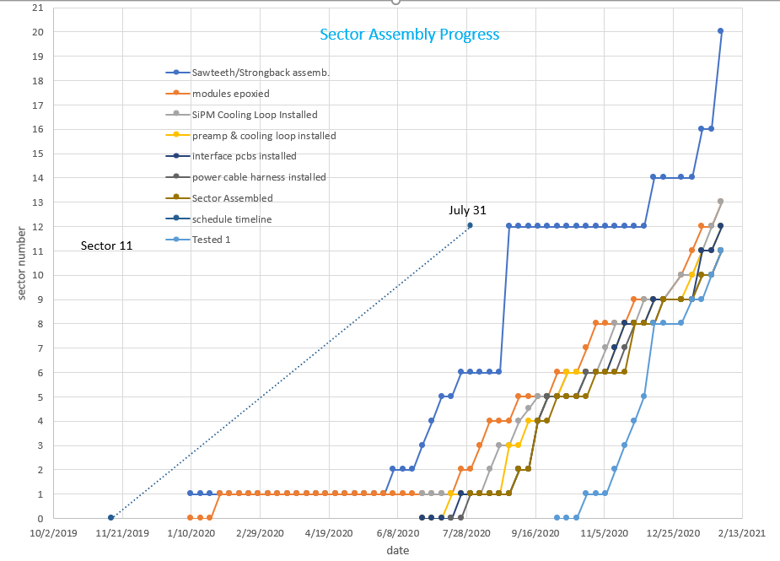
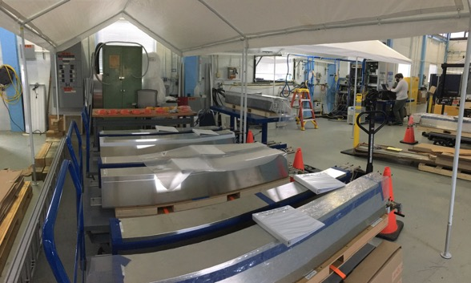
EMCal Status (20% Sectors complete)
Rate of sector production needed to meet P6 early completion
Completed EMCal Sectors stored at BNL
EMCal Blocks: 36% complete (end of Jan)
EMCal Modules: 25% complete
EMCal Sectors: 20% complete and tested
5% under construction

Slide 9
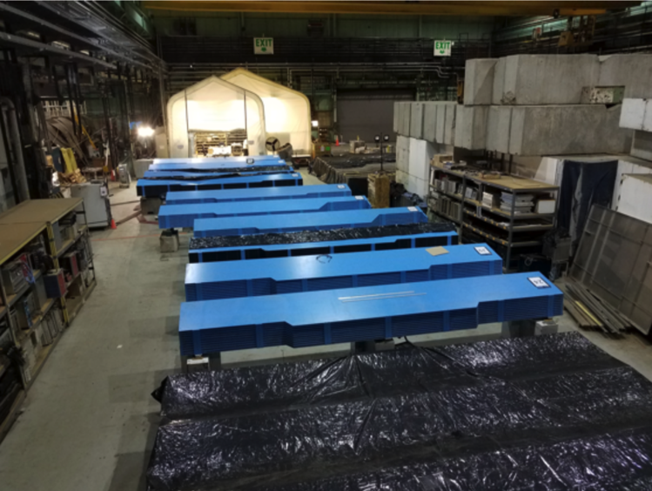
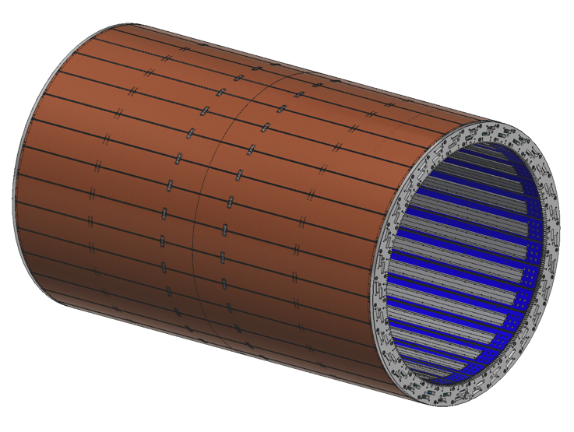
OHCal Status (59% complete and tested)
BNL HCal Factory in Bldg 912
19/32 sectors assembles, tested, calibrated and stored
9/32 sectors on tables
Being assembled and cabled
Production joining plates, pins and pucks have started to arrive from vendor.
IHCal frame has been ordered from vendor
Grad student cabling OHCal at BNL
3-D Model of IHCal Frame

Slide 10
sPHENIX 2 PEMP Notables in 2021
NP: Complete infrastructure and facility upgrades in Building 1008 to enable the planned start of installation of the sPHENIX calorimeters. (Objective 2.3)
Requires completion of 1008 Assembly Hall track reinforcement by the end of May 2021.
Track reinforcement contract awarded. Work by vendor will begin next week and is scheduled to complete by 1 week of May.
BHSO/SC: Effectively plan, execute, and successfully deliver SC projects equal to or less than $50 million that have been delegated to the Laboratory Director by SC under DOE O 413.3B [Super Pioneering High Energy Nuclear Interaction (sPHENIX)]. Clearly demonstrate successful accomplishment of key milestones in FY 2021 (adjusted for schedule impacts created by the COVID-19 pandemic) in accordance with SC guidance. (Objective 7.1)
EMCal Preproduction Blocks complete 1-Dec -2020 ✔ Completed ahead of schedule
1st OHCal Sector ready to install 15-Apr-2021
EMCal Scintillating Fiber Acquisition complete 31-May-2021 ✔ Complete ahead of schedule
EMCal Sector Assembly 50% Complete 15- Aug-2021
We are on track to complete both PEMP notables in 2021, though COVID impacts are possible.

Slide 11
Summary
All long lead procurements at CD-3A have arrived.
Early completion dates remain unchanged for MIE and 1008 I&F in January.
Construction is proceeding on sPHENIX final detector components at a wide variety of sites.
Continued great progress in sPHENIX factories. 59% OHCal sectors and 20% EMCal sectors complete. TPC, electronic, DAQ/Trigger all making good progress.
Good technical progress continues to be made on all MIE subsystems.
Approximately 80% of the sPHENIX staff is authorized to work on site at BNL. sPHENIX authorized to have 35 FTEs (including visitors) working on site. All sPHENIX institutions with major project roles in sPHENIX have reopened under low density work conditions. We typically have 25-30 people working at BNL on any one day
sPHENIX Visitors to BNL approved to be on site for Mission Critical work (SBU, Baruch, Rutgers, ISU, Lehigh, U Colorado.. . )
We have a large team of engineers and designers working remotely, and effectively on the design of the sPHENIX MIE.
We have seen a recent slow down in vendor deliveries due to the pandemic.
The sPHENIX CPI continues to be very good at 1.01. The SPI is 0.79 primarily due to late deliveries from vendors due to the pandemic. SPI will improvement as COVID spike subsides and as deliveries arrive.
Early completion remain unchanged for January. COVID mitigation is working at BNL.
PD-4 date of Dec 2022 will be unaffected due to the 11.0 months of float between early completion and PD-4.
Concerns: Delays in vendor delivery schedule. Continuing COVID issues resulting in a reduced sPHENIX workforce.

Slide 12
Back Up – EV and Variance Reports

Slide 13
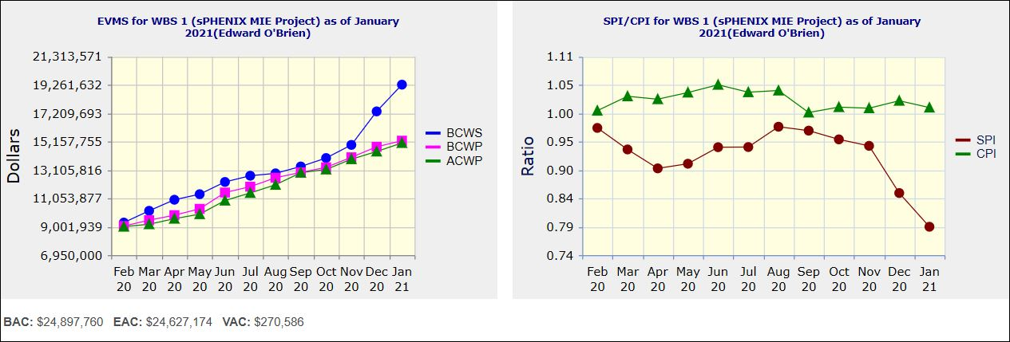
Performance Indices – sPHENIX MIE
Cumulative SPI | Cumulative CPI
0.79 | 1.01
Cumulative BCWS (Scheduled) | $19,269,073
Cumulative BCWP (Performed) | $15,220,528
Cumulative ACWP (Actual) | $15,057,075
DOE SPI or CPI Value Thresholds
0.90 to 1.15
0.85 to 0.89 or 1.16 to 1.25
<0.85 or >1.25

Slide 14
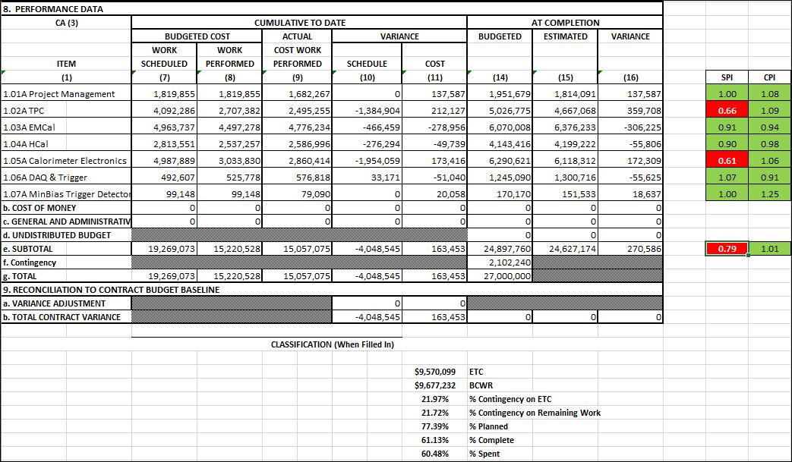
Cost Performance Report (CPR) – sPHENIX MIE
DOE SPI or CPI Value Thresholds
0.90 to 1.15
0.85 to 0.89 or 1.16 to 1.25
<0.85 or >1.25
*Highlights in table above takes variance $ into consideration, not just Indices

Slide 15
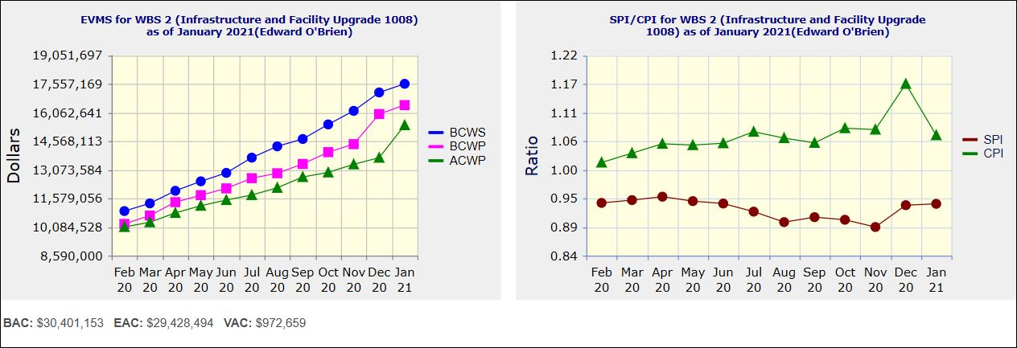
Performance Indices – 1008 Infra and Facility Upgrade
Cumulative SPI | Cumulative CPI
0.94 | 1.07
Cumulative BCWS (Scheduled) | $17,558,772
Cumulative BCWP (Performed) | $16,447,006
Cumulative ACWP (Actual) | $15,399,457
DOE SPI or CPI Value Thresholds
0.90 to 1.15
0.85 to 0.89 or 1.16 to 1.25
<0.85 or >1.25

Slide 16
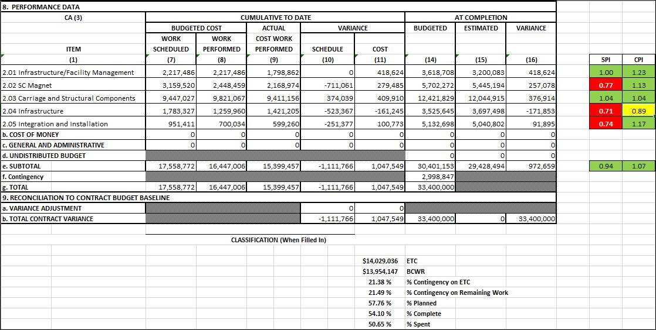
Cost Performance Report (CPR) – 1008 Infra and Facility Upgrade
DOE SPI or CPI Value Thresholds
0.90 to 1.15
0.85 to 0.89 or 1.16 to 1.25
<0.85 or >1.25
*Highlights in table above takes variance $ into consideration, not just Indices

Slide 17
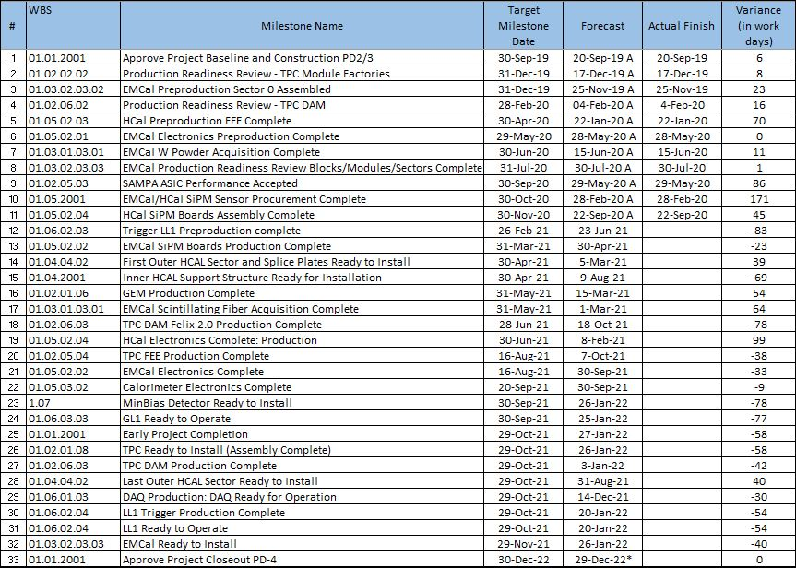
Milestones Status – sPHENIX MIE

Slide 18
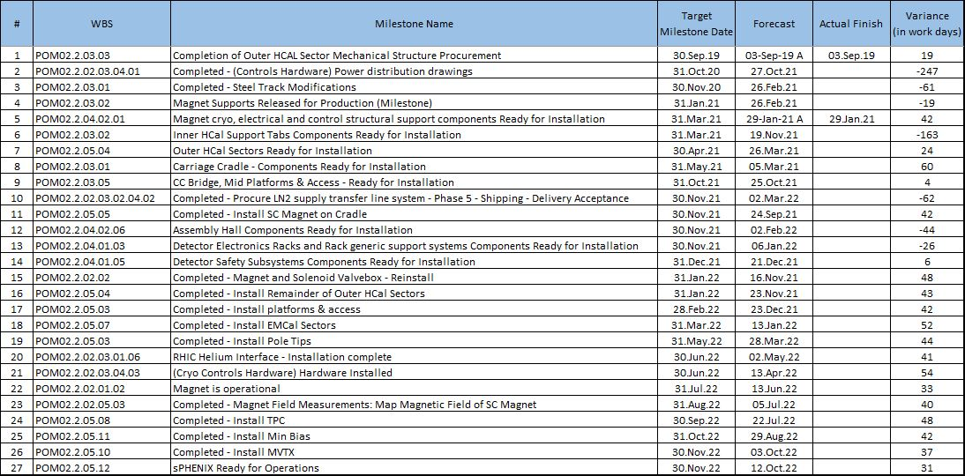
Milestones Status – 1008 Infra and Facility Upgrade

Slide 19
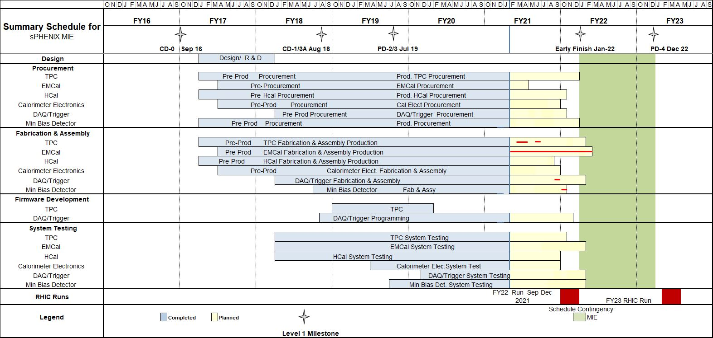
Summary Schedule – sPHENIX MIE

Slide 20
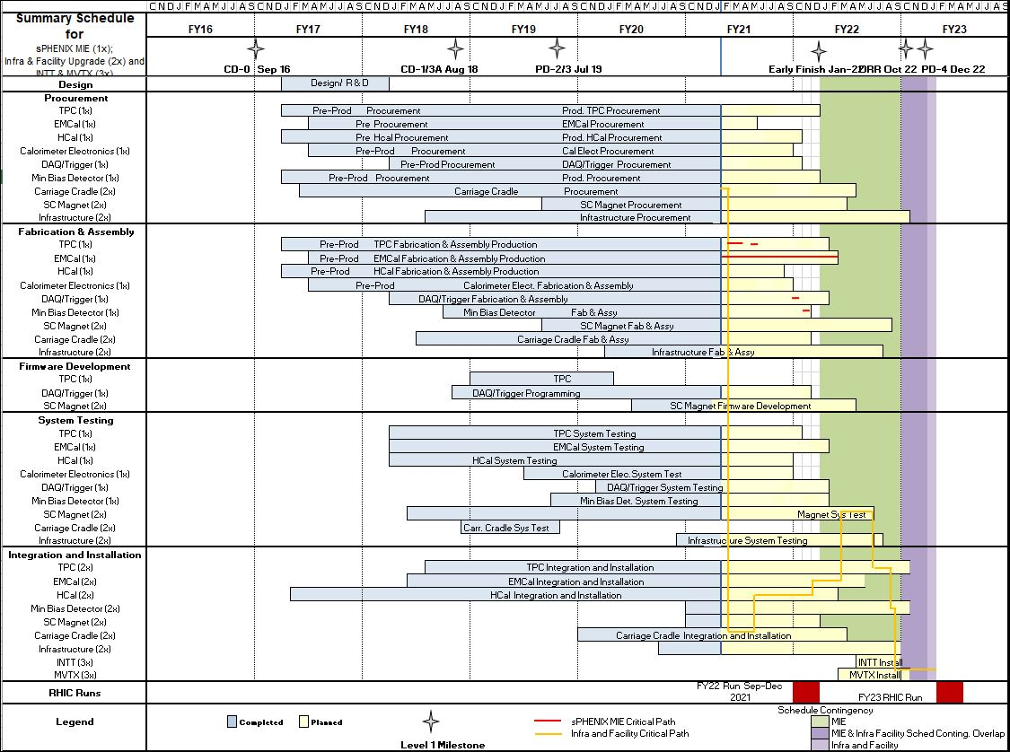
Summary Schedule – sPHENIX MIE and 1008 Infra and Facility Upgrade

Slide 21
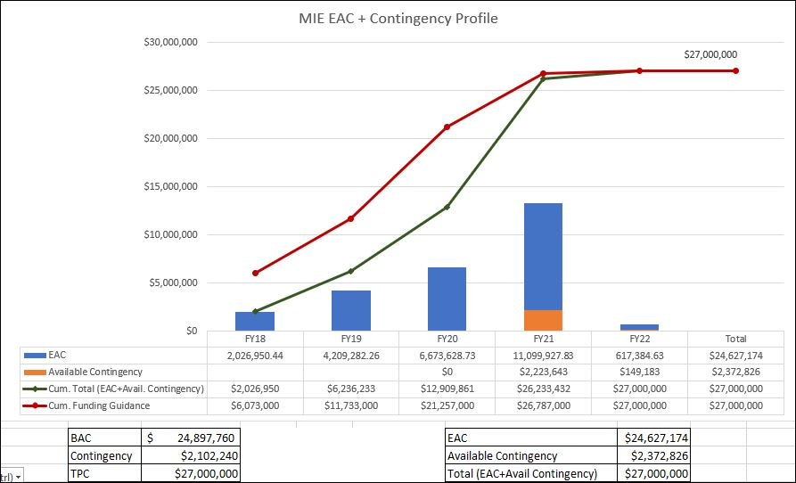
EAC and Contingency Profile – sPHENIX MIE

Slide 22
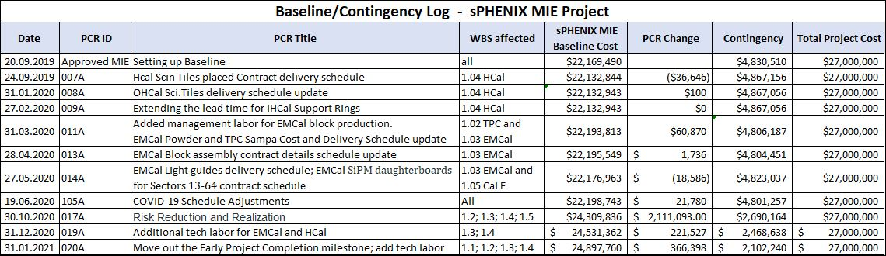
Baseline/Contingency Log - MIE

Slide 23
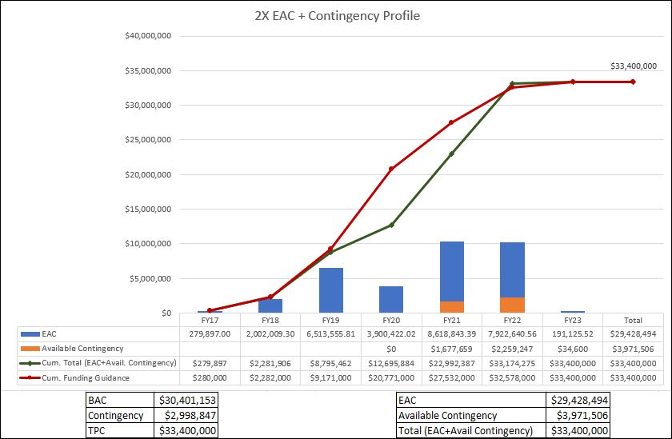
EAC and Contingency Profile – 1008 Infra and Facility Upgrade

Slide 24
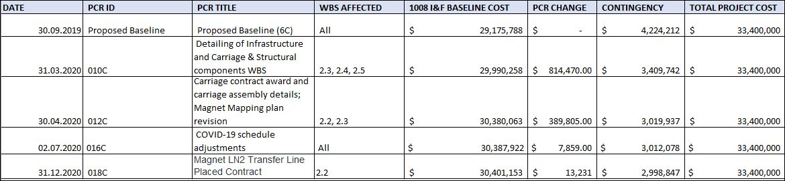
Baseline/Contingency Log - 1008 Infra and Facility Upgrade

Slide 25
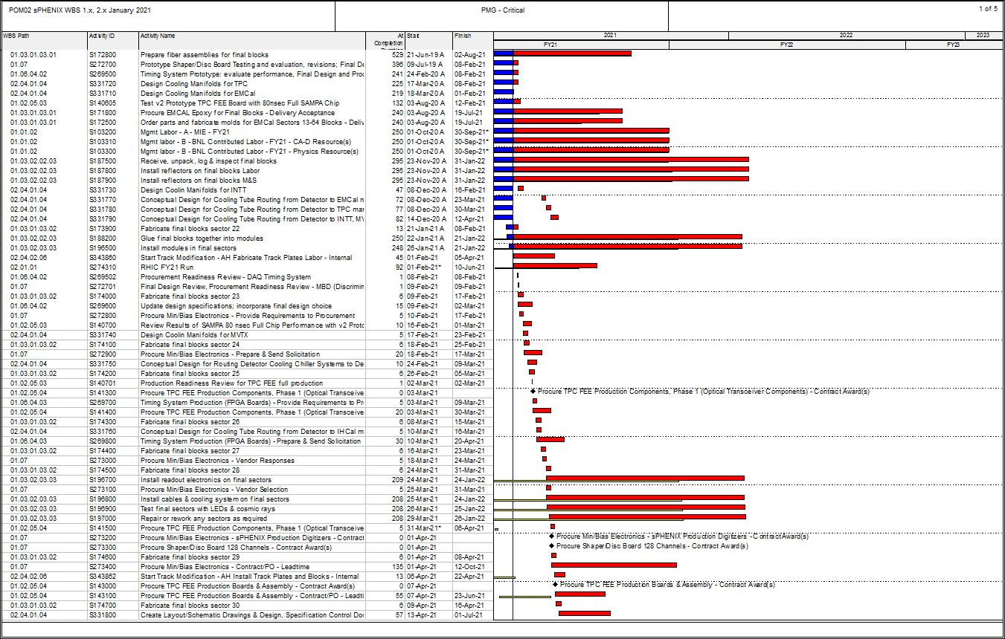
Critical Path (1x, 2x and 3x Combined)

Slide 26
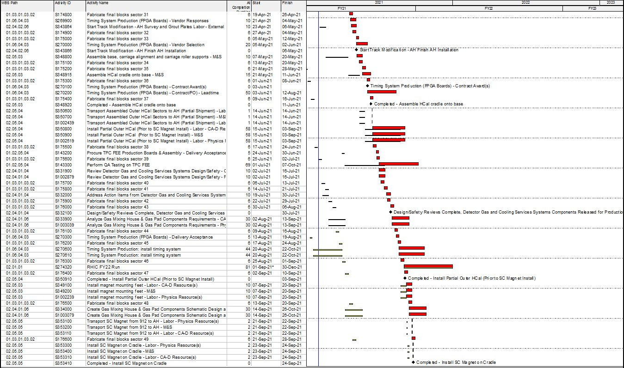
Critical Path (1x, 2x and 3x Combined)

Slide 27
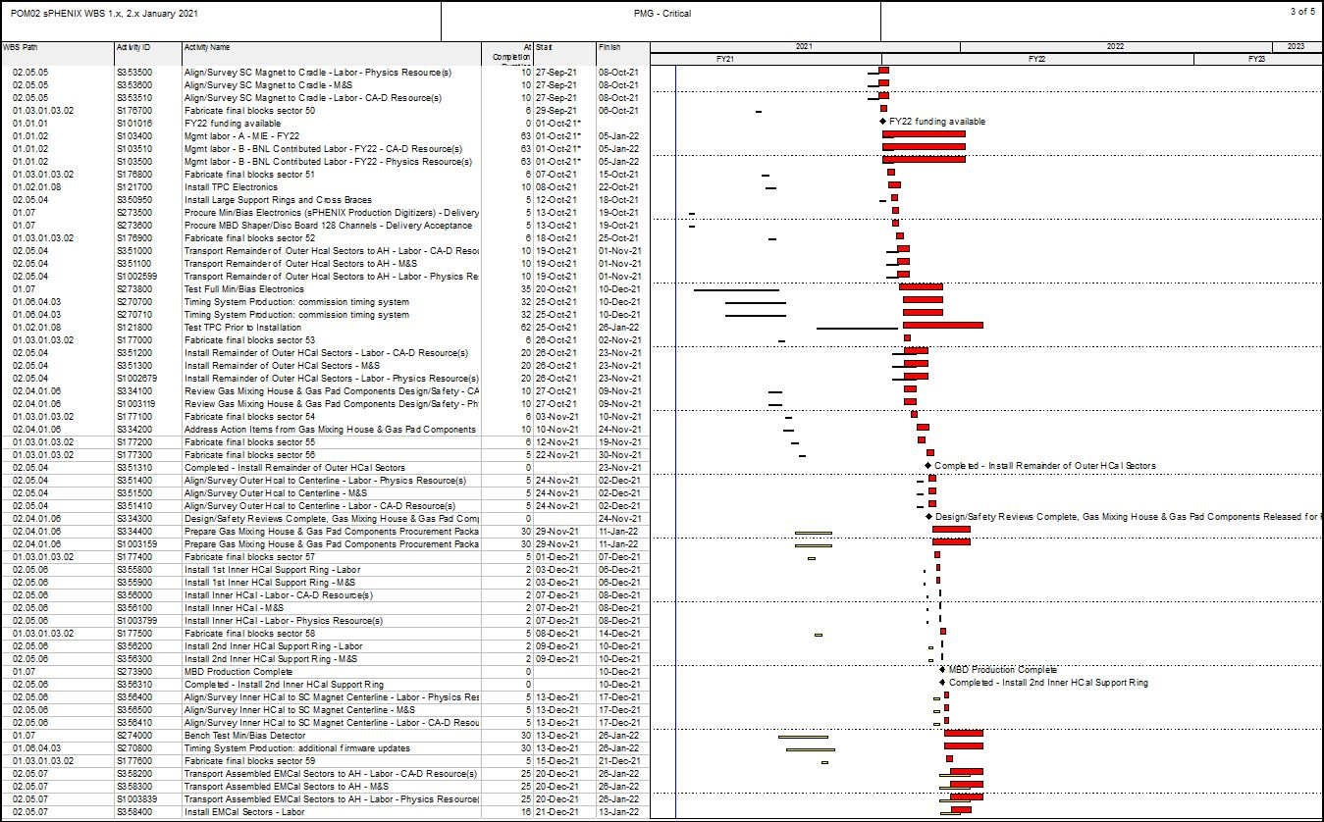
Critical Path (1x, 2x and 3x Combined)

Slide 28
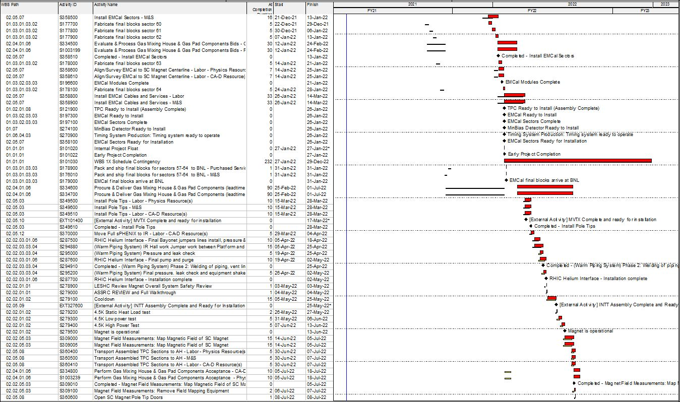
Critical Path (1x, 2x and 3x Combined)

Slide 29
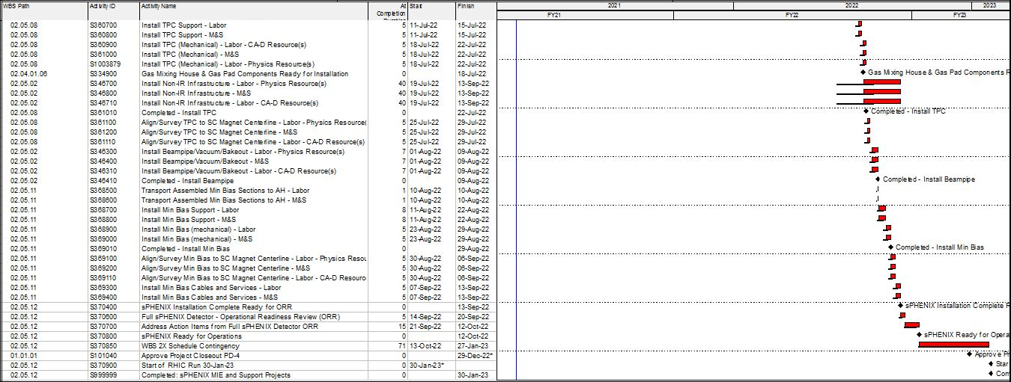
Critical Path (1x, 2x and 3x Combined)

Slide 30
Variance Report – TPC
January 2021
Cumulative BCWS $19,269,073
Cumulative BCWP $15,220,528
Cumulative ACWP $15,057,075
SV = -$4,048,545
CV = +$163,453 SPI = 0.7899
CPI = 1.0109
The following report discusses the major sources of schedule variance, including all items comprising 1% of the total schedule variance, plus a few select other items, and discusses the impact as well as the corrective actions taken. The analysis is done at level 3 of the Work Breakdown Structure. An accompanying Excel file shows BCWS, BCWP, SV and status for the various item noted in the following text.
WBS 1.2.1 TPC Mechanics
Description – One activity, S120100 Production of GEM foils, has an SV of -$84,619, due to late delivery of GEM foils manufactured at CERN. The delay is due to a COVID-related shutdown of the CERN factory and a subsequent four-month delay in GEM foil manufacture.
Impact – None as yet. All delivered GEM foils, some 29% to date, have been mounted on frames and prepared for assembly into readout modules for the TPC.
Corrective – The order remains in progress. We are supporting a full-time technician at CERN to speed manufacture of remaining foils. The revised delivery schedule provided by CERN will meet our assembly schedule for the TPC readout modules.

Slide 31
Variance Report - TPC
WBS 1.2.2 TPC GEM Modules R1
Description – One activity S125100 TPC R1 pad planes is not complete, with an SV of -$50,113. This in turn delays two successor activities, S125500 TPC R1 modules build, with SV = -$28,980 and S125600 TPC R1 Modules test, with SV = -$23,966. The total SV resulting is -$103,058. The layout of the R1 padplane, the smallest of the three types, was hampered by signal trace routing issues which did not conform to design rules required by the printed-circuit board manufacturer.
Impact – None as yet. The rest of R1 module construction is proceeding. Pad planes are to be attached to the modules as a late step in the module assembly sequence. Positive float remains. Corrective – The signal trace routing issue has been resolved, the routing of the board is complete, and the contract for the manufacture of the pad-plane circuit cards has been placed with the same vendor who successfully built all the pad-plane circuit cards for R2 and R3 modules. The vendor has quoted a delivery time compatible with the schedule for R1 module assembly.
WBS 1.2.5 TPC Front End Electronics. Description – There are five activities with significant SV. They are:
activity S136500 TPC FEE Cooling System, SV = -$69,821,
activity S141500 TPC FEE Production components (optical transceivers), SV =-$34,429,
activity S141800 TPC FEE Production Components, SV = -$61,910,
activity S142500 TPC FEE Low Voltage Power system, SV = -$209,565,
and activity S143250, TPC FEE protective elements/diodes, SV = -$67,983.
The net SV is -$443,708.
Impact – None as yet. The key activity is the FEE Production, which is ahead of schedule.
Corrective – All the items covered by these activities are being ordered, with one exception, the optical transceivers, which are being tested in February for operation in magnetic field. The required design and procurement reviews are complete. The cooling system requires a series of machined parts, for which the procurement is started. The TPC FEE production components are on order. The TPC FEE Low Voltage power supplies are under contract with the vendor scheduling all deliveries over the next three months. The TPC FEE Protection elements/diodes are on order and scheduled to be delivered in February.

Slide 32
Variance Report - TPC
WBS 1.2.6 TPC Data Aggregator Modules
Description – Three activities contribute to the SV:
activity S147300 FELIX 2.0 production board, SV = $30,262,
activity S147370 FELIX 2.0 board optical components, SV =-$93,719, and
activity S138400 EBDC computers and peripherals, SV =-$244,769. All these items have delivery dates in January thus all three are new additions to the negative SV.
Impact – None
Corrective – The EBDC computer prototype passed all tests. The production order is being prepared for submission to Procurement. The FELIX production board order is submitted; the components are in hand and thus the activity is 80% complete, and only board preparation and assembly remains. The FELIX optical components are fiber optics and specialized connectors to group and route signals from the TPC FEE cards (WBS 1.2.5) to the FELIX boards. The topology of these connectors must accommodate a board used to reprogram the FEE cards in case of radiation-induced single event upsets (SEUs). It has just been realized this topology needs an update, meaning the bill of materials for the fiber optic components must be revised. This revision will be completed in February.
WBS 1.2.7 TPC Support Systems
Description – There are three areas of effort. The TPC Lasers delivery has started but only the first article has been delivered, SV =-$210,418. The TPC Gas System has procured and received 25% of the components but still needs to place requisitions for the balance, SV =-$97,008. The TPC Cooling system has not procured the high value elements including the chiller, SV =-$76,175.
The total SV for these key items is -$383,601.
Impact – These are all items being procured well ahead of their needed installation in order to allow for more time to test them on the bench and adjust settings.
Corrective – The Preliminary Design reviews are complete and all three of these subsystems have moved to acquiring first articles. Proper operation is to be demonstrated prior to holding the Final Design reviews and the Procurement Readiness reviews, which are expected by March.

Slide 33
Variance Report - EMCal
WBS 1.3.1 EMCal Blocks
Description – There are four main items causing the SV. The S171800 Epoxy is only 32% complete, SV =-$31,987. Molds S172500 and fiber assemblies S172800 are behind schedule, SV =-$27,995. The S174000-S175500 Blocks for Sectors 23-38 are not complete, SV =-$82,202, nor is their shipping to BNL, SV =-$18,694.
The total SV for these items is -$160,878.
Impact – None
Corrective – The Epoxy must be bought within a few weeks of use, due to shelf-life issues. It is a commodity item and is purchased on an as-needed basis. The delayed Blocks were caused by personnel absences due to the COVID-19 pandemic. Block production resumed over the summer of 2020 and returned to planned production rates in the Fall. This particular SV will persist until about 2 weeks before the Project is complete, at which time Block production will be complete. The Early Completion date for the MIE project has been adjusted to reflect this.
WBS 1.3.2 EMCal Modules and Sectors
Description – The S187400 Production Light Guide contract is not complete, SV = -$204,110. The S195400 Mechanical parts for Final Sectors are not yet all received, SV = $102,111. The total of these SVs is -$306,221.
Impact – None
Corrective – The light guide production was suspended at the vendor until QA and tooling-fixture issues were examined and resolved. These issues were addressed over October-December and production deliveries have resumed at the planned rate and ahead of when they are needed to produce sectors. The light guide vendor has qualified more machine shops supplying him to further improve his delivery rate in the future. The mechanical parts are being delivered somewhat ahead of schedule, with all but the sawteeth/strongback in fact being complete; the sawteeth delivery schedule is about a month ahead of need-by date.

Slide 34
Variance Report - HCal
WBS 1.4.2 Outer HCal Mechanics
Description – The S205100 Splice Plates are not yet delivered, SV = -$303,325.
Impact – None, the current delivery schedule is still 3 months ahead of need.
Corrective – Continued contact with the vendor. The vendor had to reject some of the initial parts due to an issue of cracks developing in the steel after heat treating and subsequent machining. The technique for heat treating was changed, a different method of machining the precision holes was selected and employed, and the problem has not recurred. Delivery of first parts is planned for February and delivery of the balance of the contract is planned for March.

Slide 35
Variance Report –Cal Electronics
WBS 1.5.2 Calorimeter Front End Electronics
Description – Eight separate activities contribute substantially to this SV. They are:
activity S226400 EMCal external bias power system for sectors 1-12, SV =-$29,456,
activity S227605 EMCal SiPM daughter boards part 2, SV = -$18,565,
activity S229300 EMCal preamplifiers not delivered, SV = -$549,642,
activity S231800 EMCal internal cables are only 45% complete, SV = -$158,506,
activity S233250 EMCal trunk signal cables are not complete, SV = -$189,831,
activity S234100 EMCal LV power system sectors 13-64 only 20% complete, SV =-$31,416,
activity S244400 HCal External cables are only 20% complete, SV = -$81,552, and
activity S244450 HCal trunk signal cables not complete, SV =-$36,439. The total SV for these activities is -$1,095,407.
Impact – none except for the EMCal preamps, which will be needed by the EMCal sector production line starting in early March.
Correctives – The contract is placed for the EMCal preamplifiers. We have negotiated with the vendor to deliver a first batch, adequate to instrument more than 3 sectors, as soon as possible to help with completion of EMCal sectors. The vendor anticipates being able to meet the March schedule for these first preamplifier units using parts in hand. The vendor is also currently obtaining all the long-lead-time parts for the main EMCal preamplifier production.
The vendor for the EMCal internal cables has been delivering them regularly on a schedule well in advance of the need for them during EMCal sector construction. The Procurement readiness review was held in January for the external/trunk cable orders, EMCal and HCal, and procurement documents are being prepared. Potential vendors indicate they can meet the requested delivery schedule for these cables.

Slide 36
Variance Report - Cal Electronics
WBS 1.5.3 Calorimeter Digitizers
Description – There are two activities contributing to this SV. One is S252700 Digitizer Parts, SV = -$678,538 and the other is S252800 Digitizer Boards, SV = - $149,785. Impact – None presently. The EMCal and OHCal sector production lines have an adequate number of digitizers to perform all needed QA during remaining detector construction. Thus the remaining digitizers are only needed by the completion of the MIE project.
Corrective – The contract for the production digitizers is placed. The vendor indicates they are placing orders for production quantities of all parts but that world-wide supply chains have led to more lead time than foreseen pre-COVID. We continue to monitor the progress by this vendor.

Slide 37
Variance Report – DAQ/Trigger
WBS 1.6.1 Data Acquisition
Description – Three activities have been completed ahead of schedule, resulting in a positive SV = $203,950. These activities are S257600 Sub-Event-Buffer board production, SV = $47,634, S258400 Assembly and Trigger Processor board production, SV = $113,823, and finally S259500 Buffer Box procurement, SV = $41,513.
Impact – None
Corrective – None, activities were completed early.
WBS 1.6.2 Local Level-1 Trigger
Description – Activity, S263600 Preproduction Local Level-1 trigger, is not complete, resulting in SV = -$69,641.
Impact – None
Corrective – The prototype Local Level-1 trigger board has been under full-speed testing for several months. Results to date indicate it will meet all requirements, completing the above activity. It is anticipated the tests will continue until late February, at which point a review will be conducted. It is expected based on results to date that this review will determine that the production Local Level-1 trigger boards can be manufactured during 2021 based on the present design using the existing board assembly house and Bill of Materials. That production will complete this level-3 WBS.

Slide 38
Variance Report – DAQ/Trigger
WBS 1.6.3 Global Level-1 Trigger
Description – Activity S267600 Production of final GL1 is not complete, SV =-$32,673.
Impact – None
Corrective – The prototype Global Level-1 Trigger is being used as part of an extended test of electronics for sPHENIX. This test requires multiple front-end cards to operate, respond to triggers and timing signals, and send data to the production DAQ computers correctly over an extended period. This test is planned to last until early March. Assuming a positive outcome, the production Global Level-1 Trigger will be assembled using the existing blueprints.
WBS 1.6.4 Timing System
Description – Activity S270300 Production of Timing System is not complete, SV =-$48,284.
Impact – None
Corrective – The prototype Timing System is being used as part of an extended test of electronics for sPHENIX. This test requires multiple front-end cards to operate, respond to triggers and timing signals, and send data to the production DAQ computers correctly over an extended period. This test is planned to last until early March. Assuming a positive outcome, the production Timing System will be assembled using the existing blueprints.

