Slide 1
EIC IP6 IR Design Overview
Holger Witte
March 12-13, 2021

Slide 2
Outline
Overview
Requirements
General constraints
Present IR
Luminosity
Focusing
Crab crossing
IR Magnets
Apertures and Challenges
Engineering

Slide 3
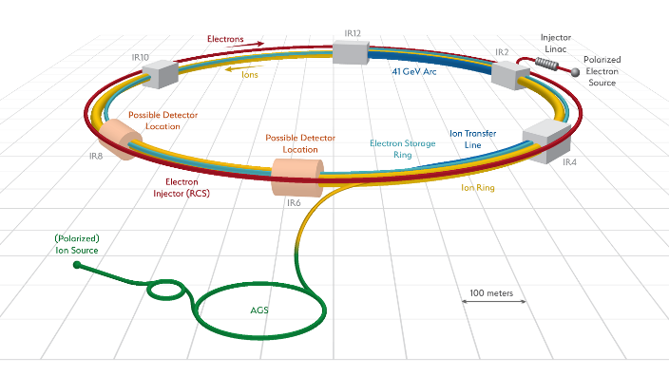
EIC IR: Overview
Rear
Forward
RHIC yellow ring: EIC hadron ring
Add electron storage ring in existing tunnel (and the RCS)
IR location: IR6

Slide 4
IR Requirements
EIC IR designed to meet physics requirements
Machine element free region: +/- 4.5m main detector
(Efforts underway to increase this to -4.5/+5m)
ZDC: 60cm x 60cm x 2m @ ~30 m
Scattered proton/neutron detection
Protons 0.2 GeV < p_{t} < 1.3 GeV
Neutron cone +/- 4 mrad
Machine requirements
Small β*_{y}: quads close to IP, high gradients for hadron quads
Crossing angle: as small as possible to minimize crab voltage and beam dynamics issues
Choice: 25 mrad
Synchrotron radiation background
No bending upstream for leptons (up to ~35m from IP)
Rear lepton magnets: aperture dominated by sync fan

Slide 5
Considerations
Geometry
RHIC tunnel (injection, RHIC magnets, RCS, eSR)
Experimental hall (IR6)
Space for detector
Physics considerations
See requirements, other talks
Accelerator/optics
Match into existing machine
Dispersion, chromaticity

Slide 6
Considerations (cont.)
Crab cavities
Location
Geometry
Phase advance
Engineering
Magnets: feasibility
Cryostating
Utilities
Project
Cost, risk
R&D required
Vendors

Slide 7
EIC IR: Forward Direction
Hadrons
Interleaved magnet scheme
Adding magnets is challenging
Why are these magnets difficult?
Required field
Aperture
Geometric constraints
Field
Accelerator physics
Hall/ring geometry
Magnet technology constraints
Large apertures of magnets
Proton forward: physics
Rear electron: Synrad
IP
Electrons
Superconducting
Name | R1 | length | B | grad | B pole
 | [m] | [m] | [T] | [T/m] | [T]
B0ApF | 0.043 | 0.6 | -3.3 | 0 | -3.3
Q1ApF | 0.056 | 1.46 | 0 | -72.608 | -4.066
Q1BpF | 0.078 | 1.61 | 0 | -66.18 | -5.162
Q2pF | 0.131 | 3.8 | 0 | 40.737 | 5.357
B1pF | 0.135 | 3 | -3.4 | 0 | -3.4

Slide 8
Hadron Forward - Apertures
Magnet aperture optimization:
Magnets tilted and displaced
Magnets split in two (e.g. Q1A and Q1B)
275 GeV
41 GeV
100 GeV
275 GeV
41 GeV
100 GeV
275 GeV +1.3 GeV p_{x}
275 GeV -1.3 GeV p_{x}

Slide 9
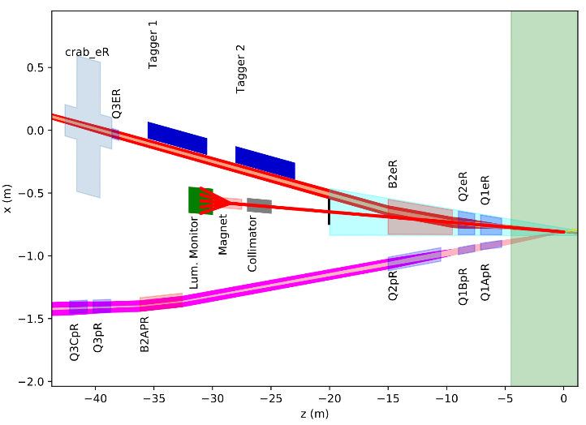
EIC IR: Rear Direction
2-in-1 magnets
Common yokes
Main issue: space between magnets
Crossing angle
Large aperture due to synrad fan
Comes from low-beta quads
Electrons
Hadrons
Bethe Heitler
Superconducting
Name | R1 | R2 | length | grad | B pole
 | [mm] | [mm] | [m] | [T/m] | [T]
Q1ApR | 20 | 26 | 1.8 | 78.4 | 2.0
Q1BpR | 28 | 28 | 1.4 | 78.4 | 2.2
Q2pR | 54 | 54 | 4.5 | 33.8 | 1.8
Name | R1 | R2 | length | B | grad | B pole
 | [mm] | [mm] | [m] | [T] | [T/m] | [T]
Q1eR | 66 | 79 | 1.8 | 0 | 14 | -1.1
Q2eR | 83 | 94 | 1.4 | 0 | 14.1 | 1.3
B2eR | 97 | 139 | 5.5 | 0.2 | 0 | -0.2

Slide 10
Luminosity and Focusing
Luminosity ~ 1/cross section
A smaller spot size at the IP means more luminosity
At the IP, (beam size)X(beam divergence)= const. in each plane (emittance)
For a given beam (= fixed emittance), a smaller IP beam size means larger divergence
A larger beam divergence leads to a larger beam size at the nearest focusing magnets – (size at magnet)=(divergence)X(distance)
Magnets need to have larger aperture while gradient (= focusing strength) remains the same – peak field at magnet poles is technically limited (also: crosstalk)
Strong focusing β_{y} =5 cm
Focusing elements for both beams need to be as close as possible to the IP
Divergence: ‘spread’ of the beam away from the central trajectory.

Slide 11
Crossing Angle
25 mrad
Crossing angle: 25 mrad
Hadrons: 17 mrad
Electrons: 8 mrad
Smaller crossing angle: beams less separated, magnet issues
Larger crossing angle: magnet issues, crab cavities, beam dynamic issues

Slide 12
Crossing Angle and Luminosity
In head-on collisions, every beam particle in one beam can potentially interact with every particle in the other beam
Long (~+/-6 cm), skinny (100 um) bunches colliding at an angle have very little overlap
With 25 mrad crossing angle, each particle can only interact with a +/-4 mm thick slice of the +/-6 cm long oncoming bunch

Slide 13
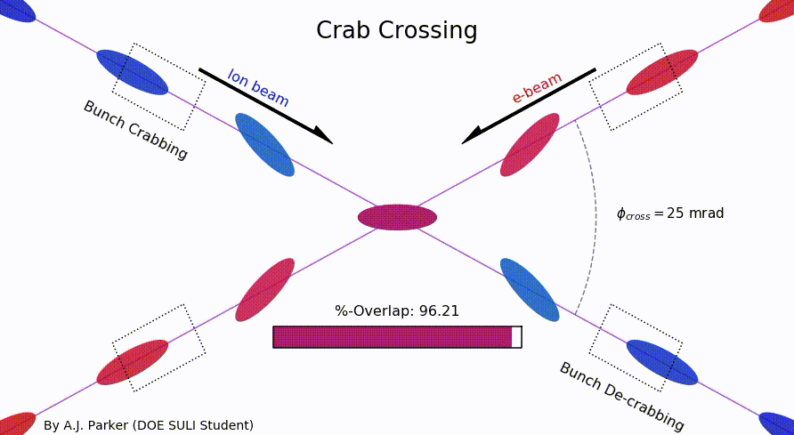
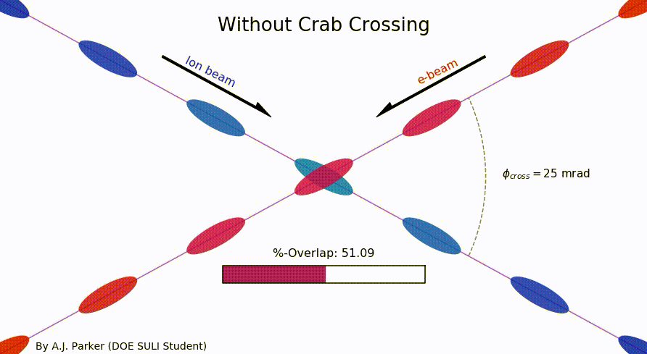
Crab crossing to the rescue
Head-on collision geometry is restored by rotating the bunches before colliding (“crab crossing”)
Bunch rotation (“crabbing”) is accomplished by transversely deflecting RF resonators (“crab cavities”)
Actual collision point moves laterally during bunch interaction
Challenges
Bunch rotation (crabbing) is not linear due to finite wavelength of RF resonators (crab cavities)
Severe beam dynamics effects
Physical size of crab cavities

Slide 14
EIC IR
Note: forward magnet cryostat is 94” dia
Rear
Forward
Electrons
Hadrons
Larger crossing angle:
Cannot do more in hadron line (field/space issues)
Electrons: Synrad issues (kW of power already)

Slide 15
Detector Solenoid Effects
Coherent orbit distortion
Transverse coupling
Rotation of the crabbing plane
Polarization tilt

Slide 16
Coherent Distortion of Ion Orbit
Particles traveling at angle through solenoid: orbit distortion due to end fields
Top view
Ions
Side view
Ions
$$e^{−}$$
$$e^{−}$$
$$B_{z}$$
$$B_{x}$$
$$\vec{B}$$
End view
Ions
Vertical kicks by the solenoid fringe fields
$\frac{θ}{2}=\frac{1}{2}\frac{B_{sol}L}{2Bρ}<22$ mrad (41 GeV)
$$⊗$$
Horizontal orbit distortion due to coupling
Rotation of the interaction plane inversely proportional to the beam energy

Slide 17
Correction of Ion Orbit
The closer the kicks to the IP, the smaller the orbit excursion
Orbit excursion inversely proportional to the beam momentum
Concern for field non-linearity at large offsets
Side view
Ions
$<9$ mm
(41 GeV)
$$e^{−}$$
Vertical kick #1 (radial magnetic field)
Vertical kick #2

Slide 18
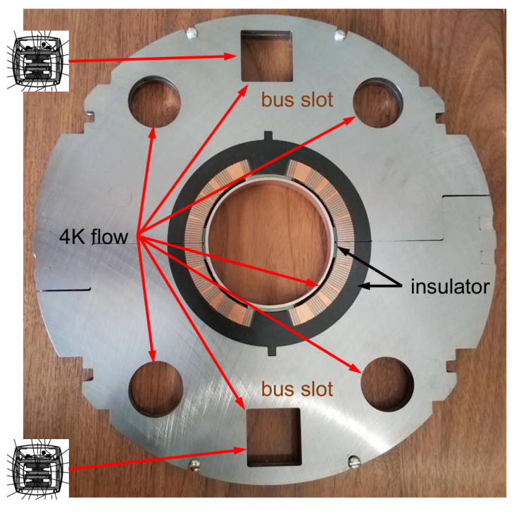
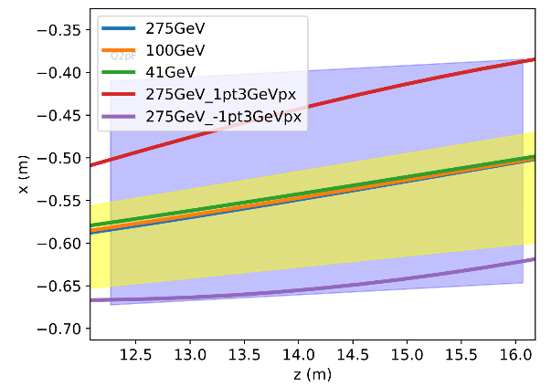
Q2pF – Collared Magnet
Hadron quadrupole
Gradient: 41 T/m
3.8m long
Aperture 262 mm
Coil R=140mm
Pole tip field: 5.74T
e-beam: 36-42cm distance
Field-free region for electrons
Magnet limitations
Gradient/field
Aperture
Stray field
Particle Orbits
Neutron cone

Slide 19
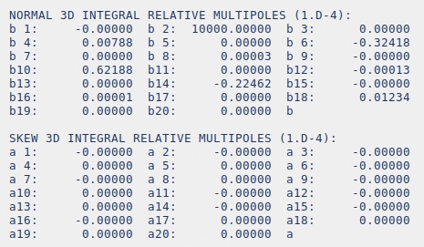
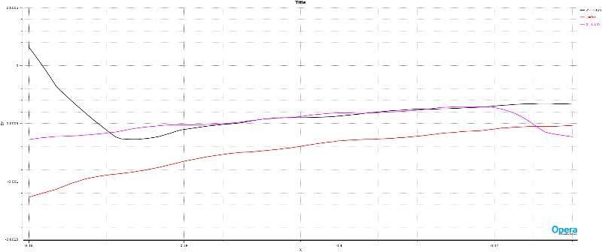
Q2pF Simulation Results
Peak field on wire: 7.6T
Field-free region: <1mT
Can be shielded with mu-metal

Slide 20
Crosstalk
Electrons: field free
Hadrons: quadrupole magnet
Q2pF
B
Iron
≈40 cm
Refers to flux from one magnet leaking into the other
Leads to field quality issues
Depends on geometry and field/flux
Common issue for all IR magnets

Slide 21
Magnet Engineering
Q1BpF
Q1eF
B0pF
B0ApF
Q1ApF
Q2pF
B1pF
B1ApF
Common split cryostat
Cold mass adjustments within cryostat
Each cold mass independently anchored
Common helium vessel, with bellows between all magnets
Standalone 48” cryostat

Slide 22
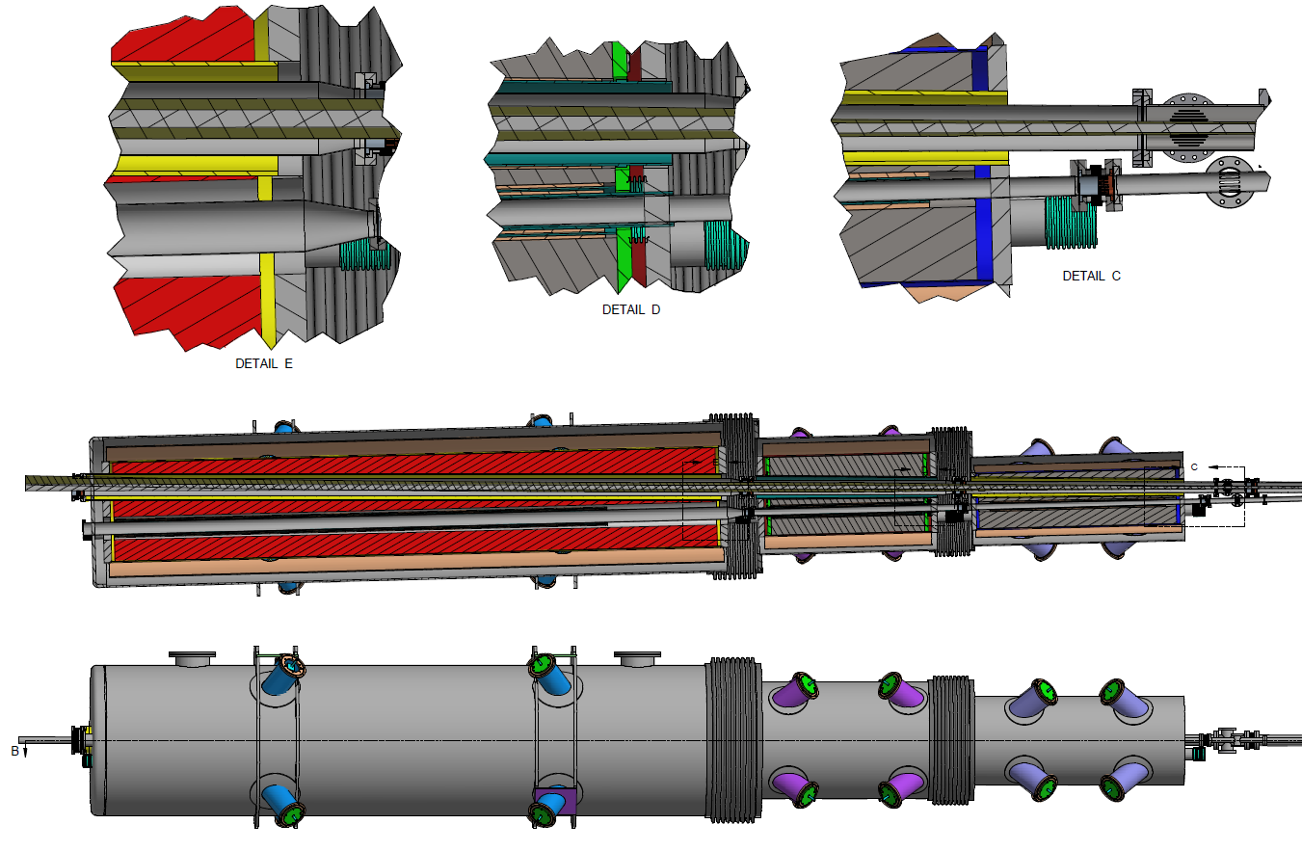
Rear Side Integration / Beampipe
Separate cold masses - helium vessels
Separate circular cryostats with decreasing OD’s toward IP
IP
e⁻
p⁺
Ø66”
Q2pR – B2eR
Ø54”
Q1BpR – Q2eR
Ø42”
Q1ApR – Q1eR

Slide 23
IR Layout
IR quadrants not independent of each other
Rear
Forward
Hadrons
Electrons
Changing one sector implies changing another one
Also: need to get back to RHIC ring (HSR)

Slide 24
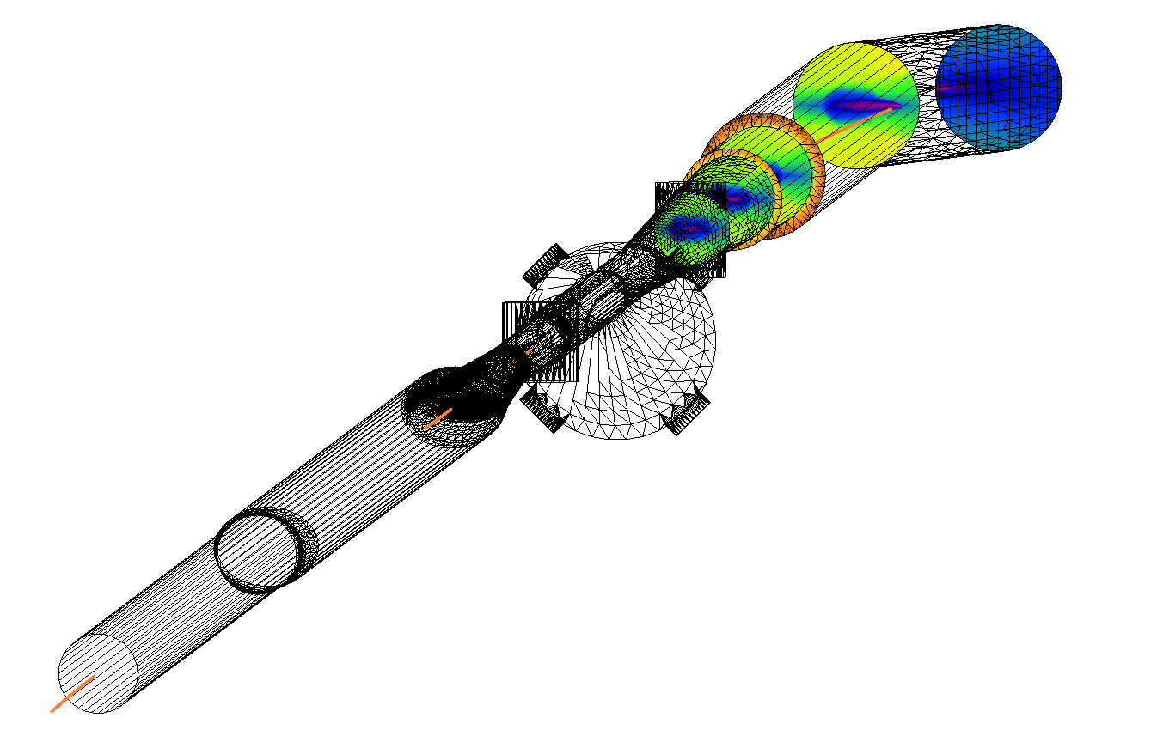
Synchrotron Radiation
B2eR exit
Origin: quads and bending magnet upstream
Tails: can produce hard radiation
Non-Gaussian
Pumps
Central chamber
Beam pipe envelope and synrad heating
Even with masking: significant heating to deal with
Courtesy C. Hetzel

Slide 25
EIC IR Effort
Ongoing effort for >4 years
This is when I got involved…
Involves >40 people
Part/full-time
Work split into several sub-groups/task forces
Synrad, magnets, spin rotators, correctors
Connections with multiple other areas/groups
Devil is in the details
Total effort?

Slide 26
IR Design Choices
High Lumi
Large Pt acceptance
Small Emittance
Strong Focusing
Small beam divergence at IP
Complicated magnetic shields
Magnets close to IP
Large chromaticity, unstable beam
Quick separation
Crossing Angle reduced lumi instab.
Reduced Acceptance
Synchrotron radiation generation
Crab cavity
Expensive, beam blow-up
Detector damage/backgrounds
Courtesy of F. Willeke

Slide 27
What are we working on?
Implementing 0.5m shift forward side
Affects layout, re-optimizing magnet apertures/positions
Needs to be approved by Change Control Board
Implement correctors
Skew-quadrupoles, solenoid compensation
Orbit correction
Magnet design work
Lots of challenging detailed work to be done
Beampipe
BPMs

Slide 28
Summary
IR developed to meet physics requirements
Meets requirements of ‘white paper’
See Alex Jentsch’s talk
Is there anything we have been missing?
Many considerations went into this IR
Geometric constraints
Engineering feasibility
Magnets, cryostating

Slide 29
Acknowledgements
J. Adam, M. D. Anerella, J.S. Berg, W. Christie, J. Cozzolino, C. Montag, E. C. Aschenauer, A. Blednykh, A. Drees, D. Gassner, K. Hamdi, C. Hetzel, H. M. Hocker, D. Holmes, A. Jentsch, H. Lovelace III, A. Kiselev, G. McIntyre, R. B. Palmer, G. Mahler, B. Parker, S. Peggs, S. Plate, V. Ptitsyn, G. Robert-Demolaize, K. S. Smith, S. Tepikian, P. Thieberger, J. Tuozzolo, F. J. Willeke, M. Blaskiewicz , J. Tuozzolo, Y. Luo, H. Witte, Q. Wu, Z. Zhang, M. Stutzman, R. Gamage, P. Ghoshal, T. Michalski, V. Morozov, W. Wittmer, M. K. Sullivan, Y. Nosochkov, A. Novokhatski
… and many more!

Slide 30
Additional Slides

Slide 31
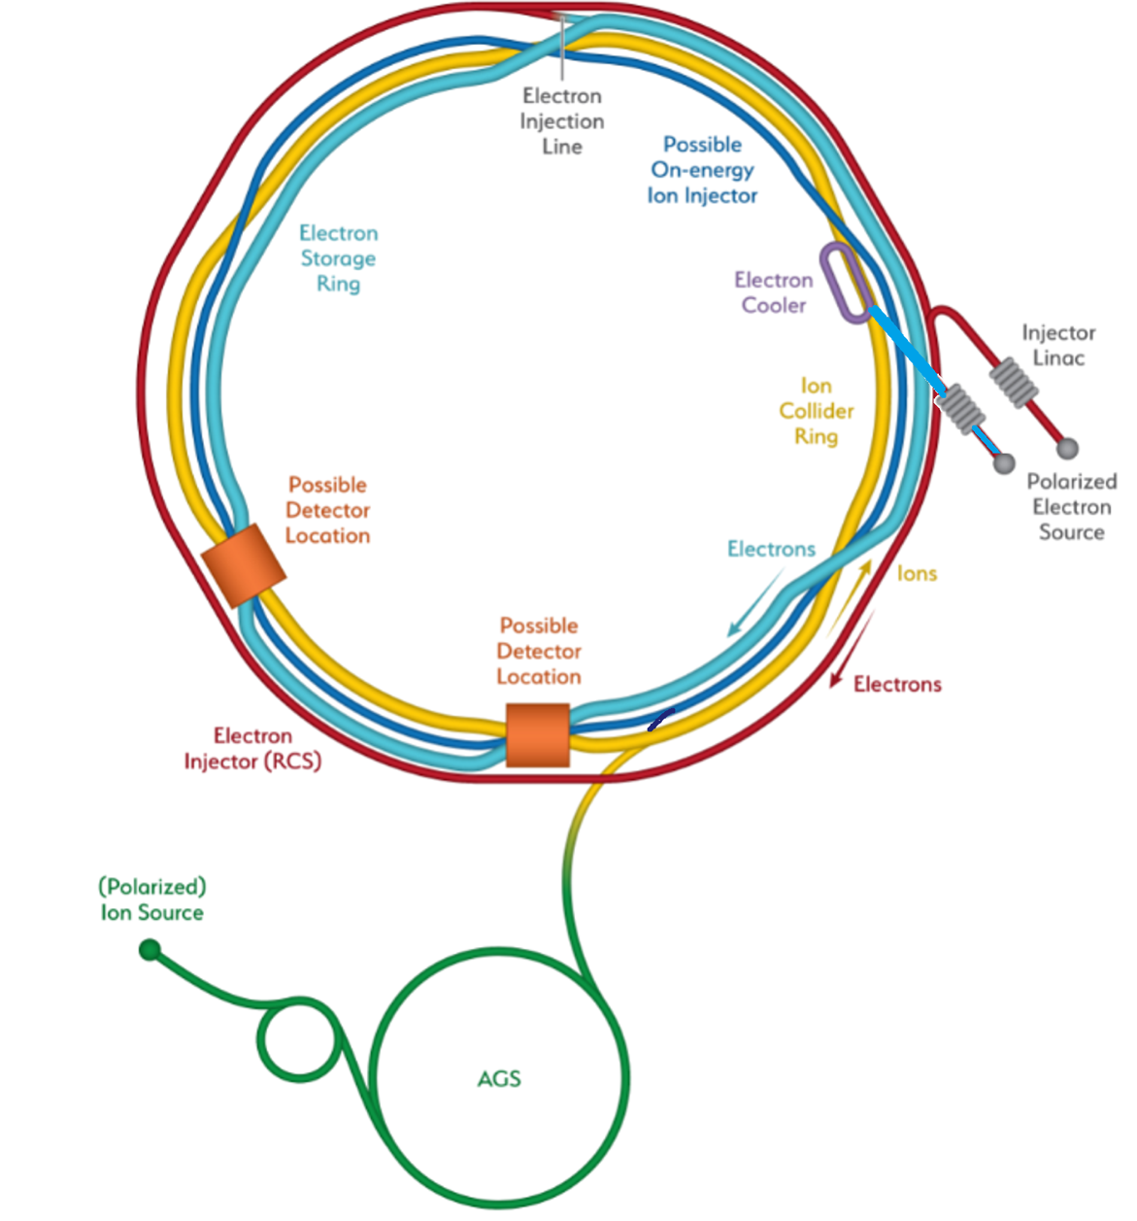
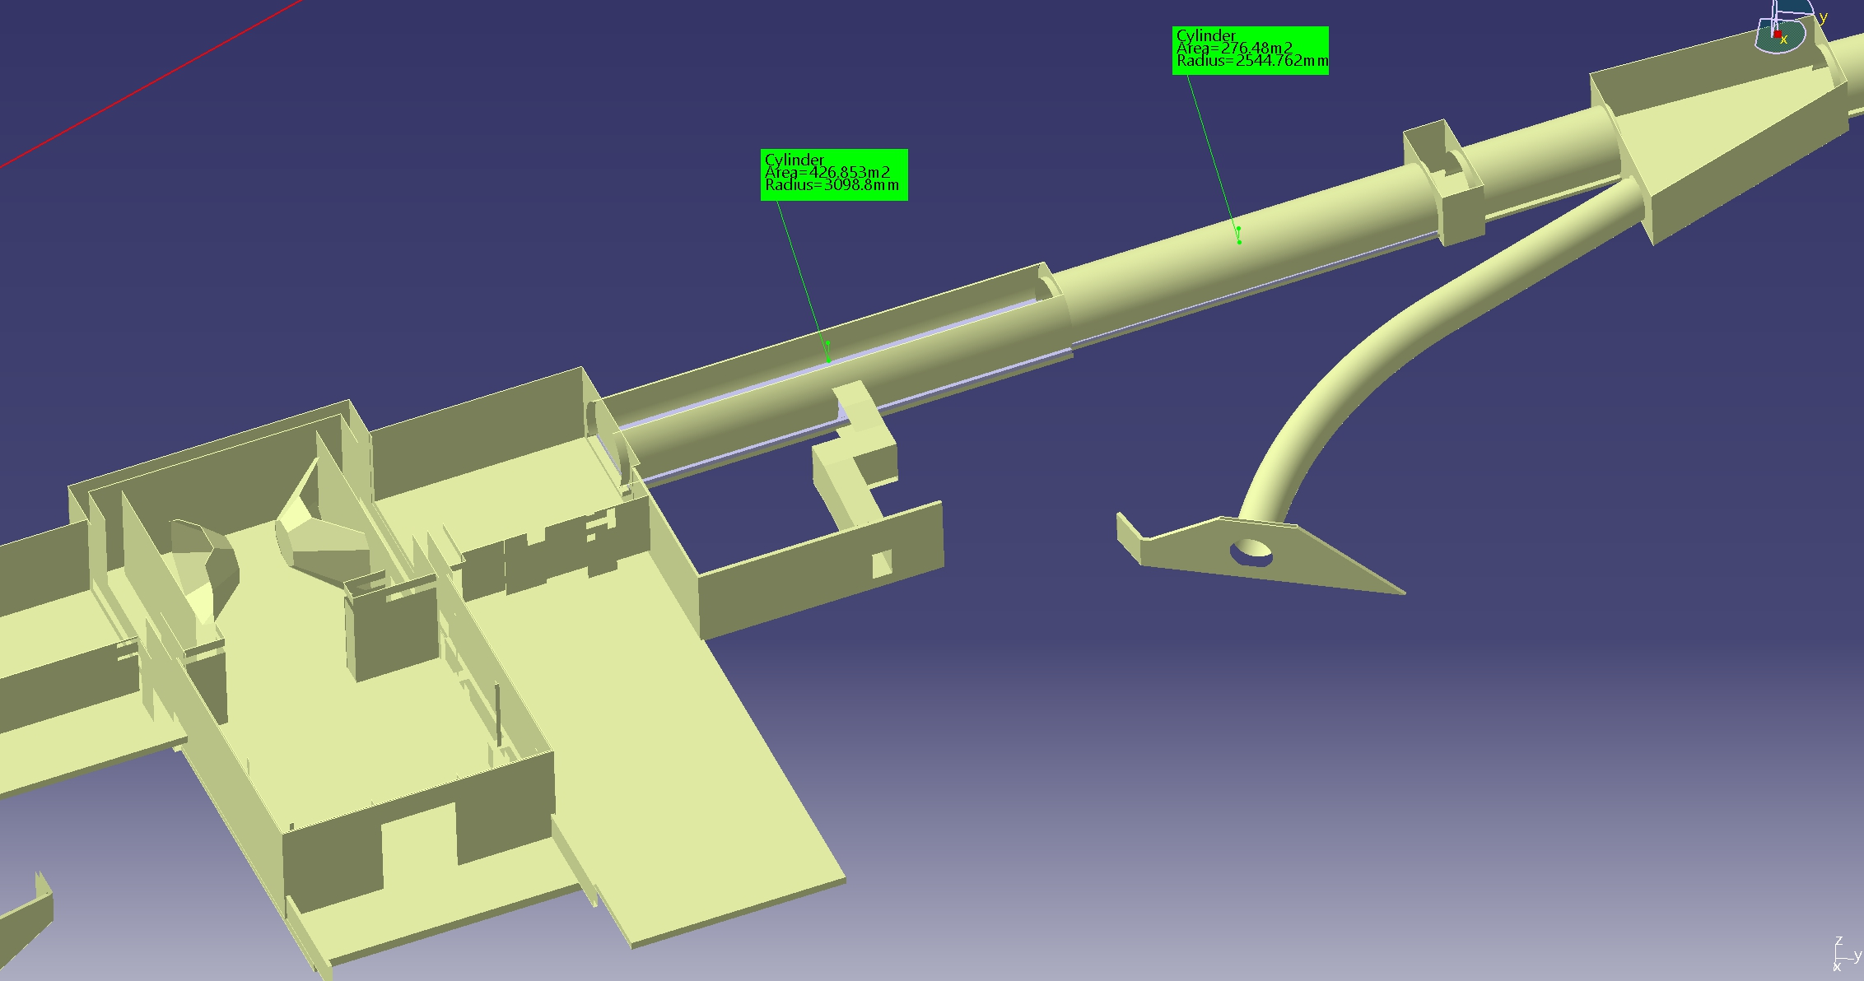
Considerations IP8
Going from outer arc into inner arc
IP6: from inner to outer arc
Present IR not portable to IR8
Geometric issues
60m
IR8: Tunnel dia. 6.3m to 60m (then 5.3m dia)
IR6: 7m dia. +/- 140m

Slide 32
Considerations IP8
If using IP6 forward dipole configuration (HSR bends away from ESR)
Beam is bent further inside
Can't bend back until we reach the crabs
Requires creating a roughly 2 m transverse displacement over around 50 m length; lots of extra dipoles, issues with dispersion matching
If we put ZDC on the outside, bending HSR toward the ESR
25 mrad crossing angle not possible: lines diverge slowly, crab cavity transverse size creates collision between HSR/ESR lines

Slide 33
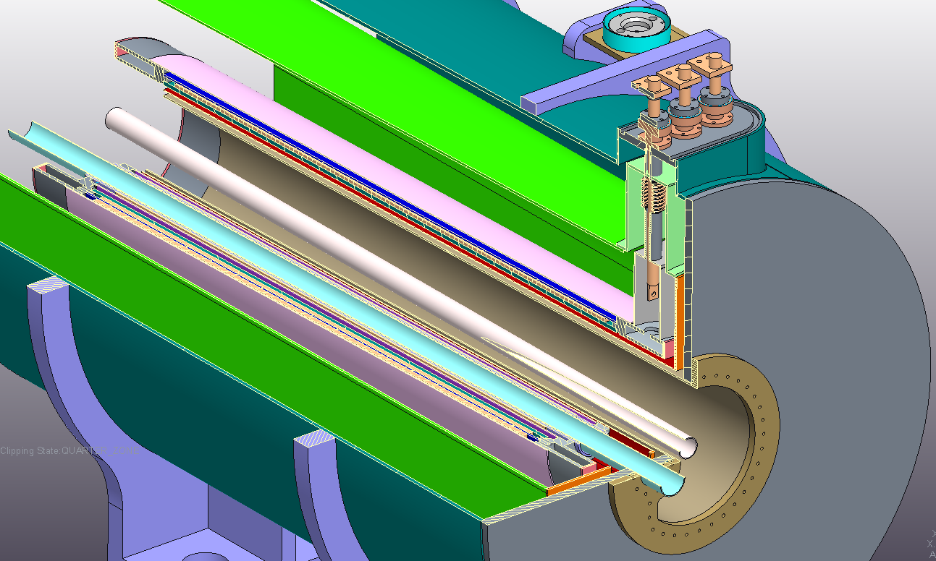
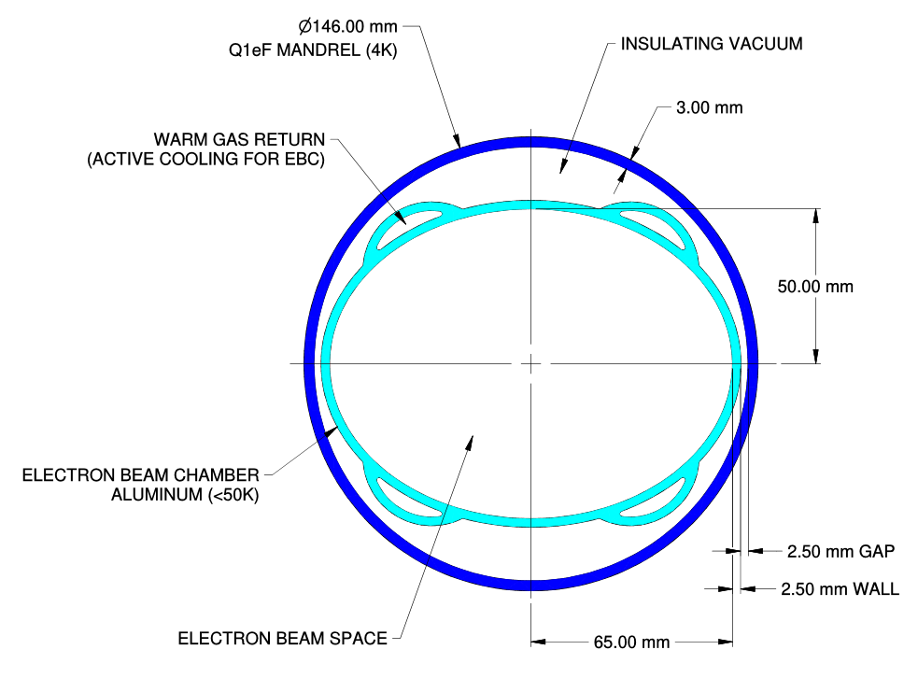
Heat Load in Cold Magnets
22.5W
Q0eF
704W
Taper
87W
Q1eF
450W

Slide 34
Crossing angle collisions
Beam energies of electrons and hadrons are vastly different in EIC
Focusing elements for electrons would have only little effect on hadrons, while hadron magnets would overfocus electrons
Beams need to be separated into their respective focusing systems as close as possible to the IP
A separator dipole would have to deflect the (“weaker”) electrons and would therefore generate a wide synchrotron radiation fan that would need to pass through the detector – requires large beam pipe diameter (HERA-II)
Best solution: Crossing angle collisions!

Slide 35
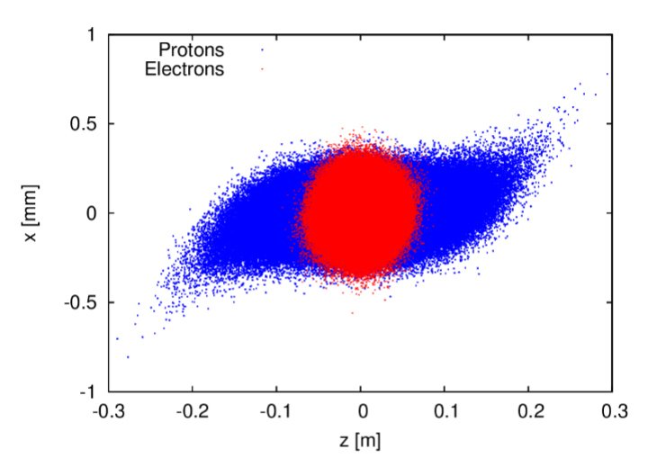
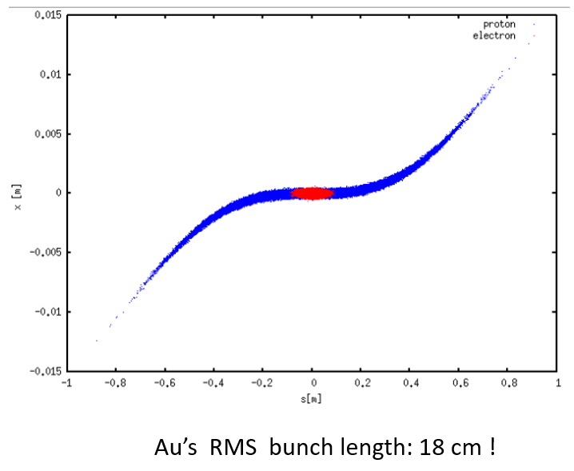
Nobody’s perfect
Bunch rotation (crabbing) is not linear due to finite wavelength of RF resonators (crab cavities)
Long hadron bunches are “S”-shaped during collision
Distorted shape results in transverse offset between electron bunch and head and tail of proton bunch – reduced luminosity and severe beam dynamics effects
Longer bunches, skinnier bunches, or increased crossing angle all make this worse
Higher harmonic crab cavities can “straighten out” the kick and therefore the bunch, but at a cost – space and money
EIC already plans on 197 MHz crab cavities, plus 394 MHz harmonics
197 MHz as low as technically feasible (niobium sheets for cavity production, cavity size in tunnel)

Slide 36
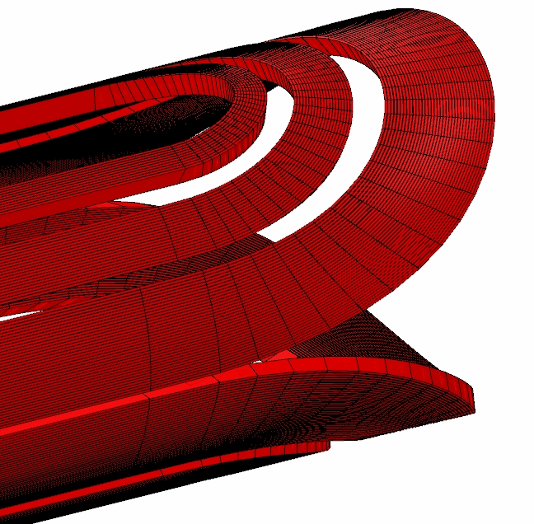
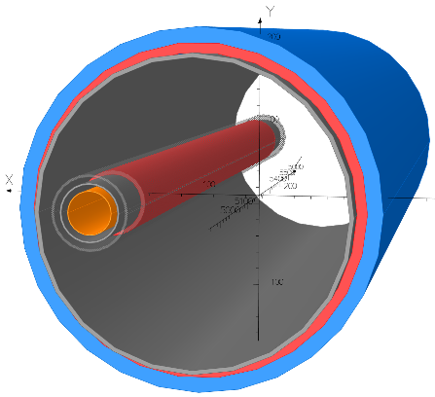
IR Magnets - Overview
Three groups of superconducting magnets
All NbTi
(Also: normal conducting magnets, not addressed here)
9 Direct Wind Magnets (S-MD)
6 Collared Magnets
1 Special Magnet

Slide 37
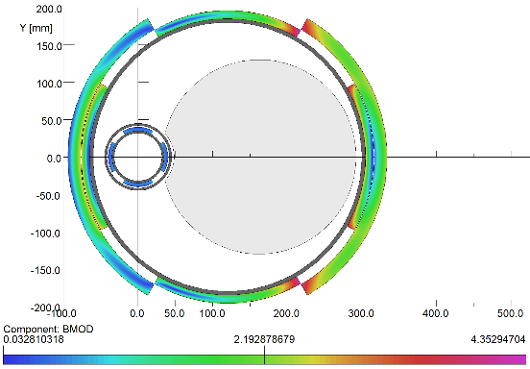
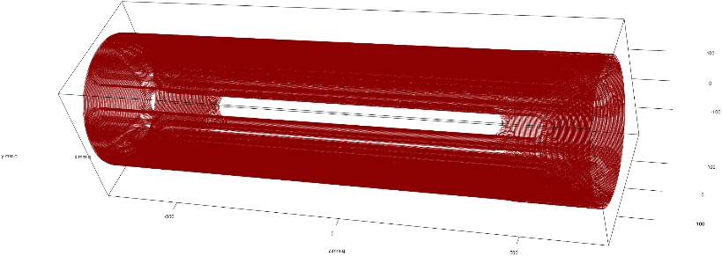
B0pF Spectrometer Magnet
Main dipole & quad coils
Superconducting combined function magnet
1.3T for hadrons
Created by quadrupole magnet
Inner clear aperture of 180 mm radius
Electrons: 15T/m gradient
In B0pF aperture
Use dipole to create zero dipole field for electrons
Use electron quad to tune gradient
Electron quad coil
Warm beam tube
20 mrad Cone
Quadrupole

