Slide 1
Status Report on EoIs
E.C. Aschenauer (BNL)
R. Ent (JLab)
Co-Associate Directors for the Experimental Program
Kick-off Meeting for an EIC Detector at IP6
January 12th & 13th, 2020
Electron Ion Collider

Slide 2

Expression of Interest
Dear prospective Electron-Ion Collider users,
Brookhaven National Laboratory (BNL), in association with Thomas Jefferson National Accelerator Facility (TJNAF), would like to invite interested groups to submit an Expression of Interest (EOI) for their potential cooperation on the experimental equipment in support of a broad and successful science program at the Electron-Ion Collider (EIC).
We encourage interested groups to work together within their country, their geographical region, or as a general consortium, to submit such EOIs.
This call focuses on all detector components to facilitate the diverse EIC science program, including those integrated in the interaction region.
Please visit https://www.bnl.gov/eic/EOI.php to see further details about this call and how to submit an Expression of Interest.
Best regards,
Elke Aschenauer and Rolf Ent for the EIC Project Team
Call was issued May 2020
Deadline: November 1st 2020
Call has been advertised worldwide
  https://www.bnl.gov/eic/EOI.php
Received 47 EoIs have been made public: https://indico.bnl.gov/event/8552/

Slide 3
Expression of Interest – Assessment
Asked Detector Advisory Committee for input on “Advice on the process of assessment of the received Expressions of Interest (EOI), …”
  “The reference detector and the broad EOI input should allow matching of groups with detector needs. The laboratory management and users group representatives are expected to help resolve duplicate proposals, identify holes and determine where funds are needed to further develop promising technologies. Given the short timeline to full detector proposals, this process could be challenging and may require careful attention to governance and transparency.”
After deadline of November 1, group of people representing EIC Project and EIC User Group, started an early assessment process.
  Elke Aschenauer (BNL, EIC Project)
  Rolf Ent (JLab, EIC Project)
  Christine Aidala (U Michigan, EICUG IB Chair)
  Marco Contalbrigo (INFN Ferrara, EICUG representative)
  Rosi Reed (Lehigh U, EICUG representative)
  Bernd Surrow (Tempe U, EICUG SC Chair)

Slide 4
Expressions of Interest – Distribution
Total = 47
Note: some arbitrariness in categorization, like two national labs (and one international lab) came in together with universities, and one national lab came in as detector consortium, etc.

Slide 5
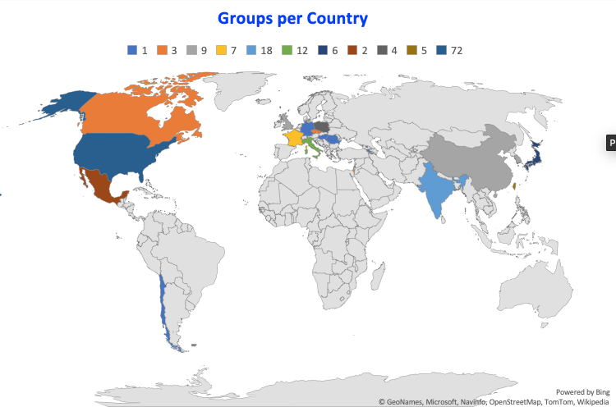
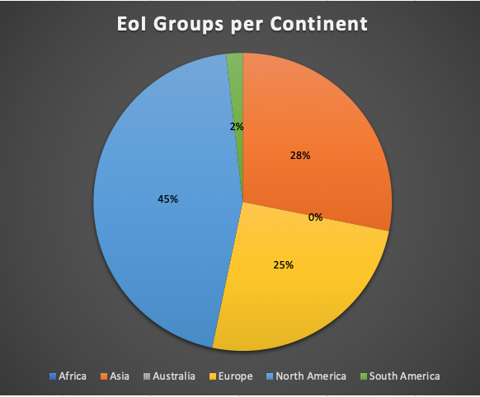
Expressions of Interest – Geographically

Slide 6
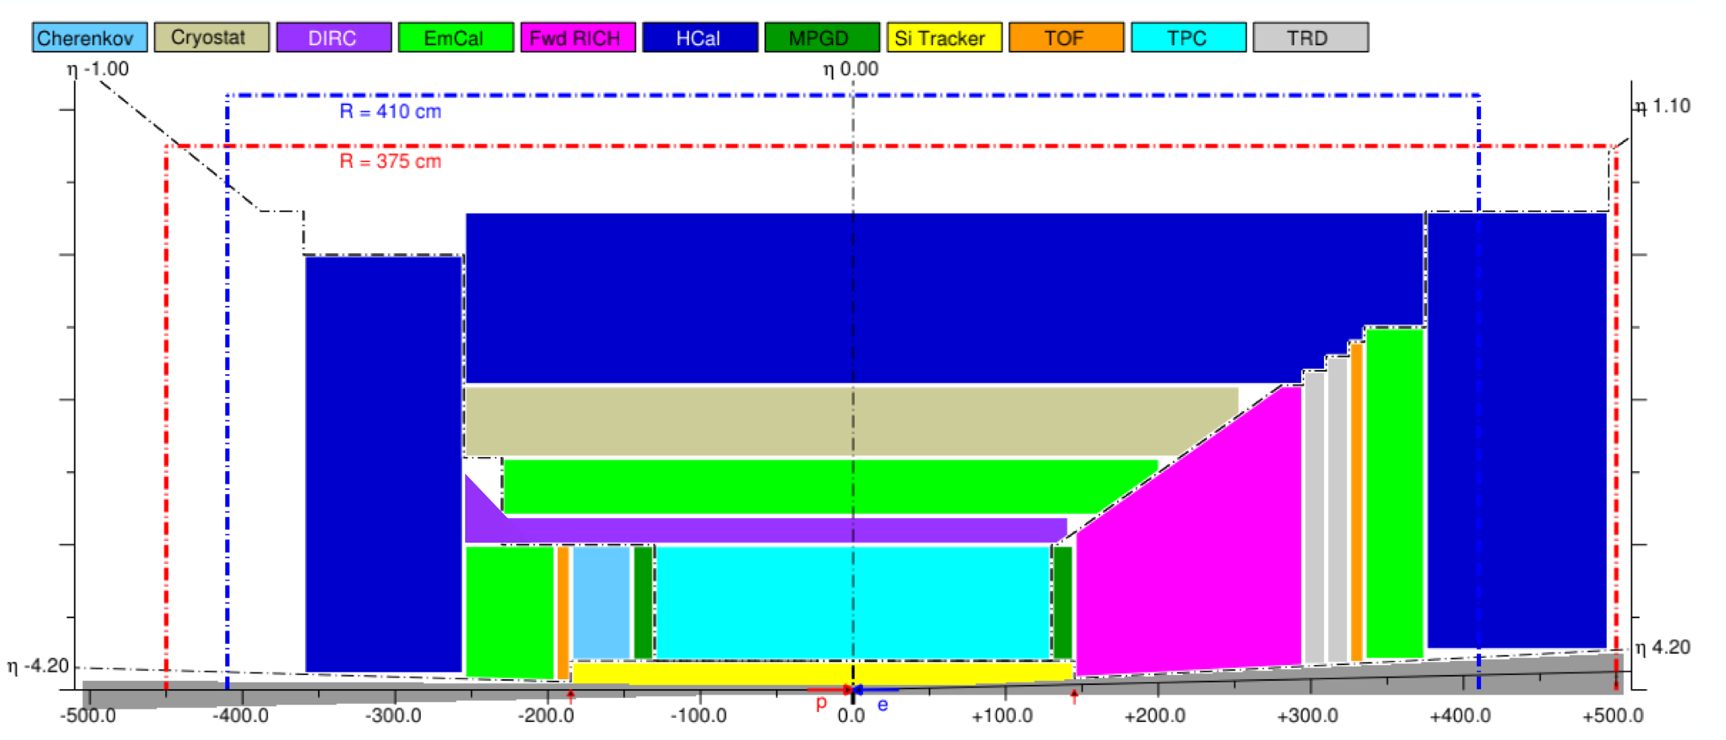
EIC Detector Scope
Solenoid
3 ECal
3 HCal
2 RICH + 1 DIRC
Tracking:
Barrel tracking
Barrel + 2 endcap μ-vertex tracker
2 endcap MPGD tracking
h-endcap TRD
→ 16 subdetectors
DAQ
Electronics
Ancillary Detectors:
low-Q2 tagger
ZDC
Roman Pots
Off-momentum det.
B0-trackers
Lumi-detector
Lepton polarimetry
hadron polarimetry
→ 10 subsystems
Backward
p/A beam
electron beam
Forward

Slide 7
Expressions of Interest – Equipment Interest
Barrel
subdetectors
Ancillary
subdetectors
eEndcap
subdetectors
hEndcap
subdetectors
Note: some double counting in numbers, e.g., interest expressed by a detector consortium could be echo’ed in EoIs of countries, universities, etc. participating in this consortium.

Slide 8
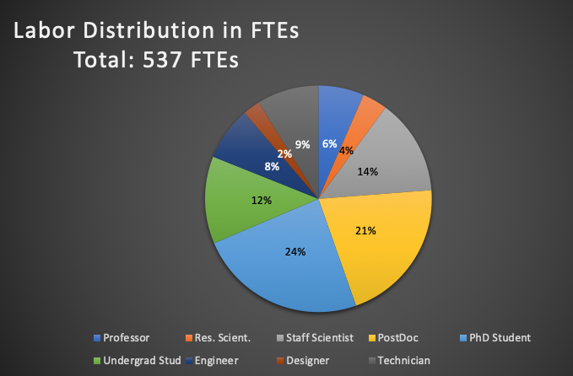
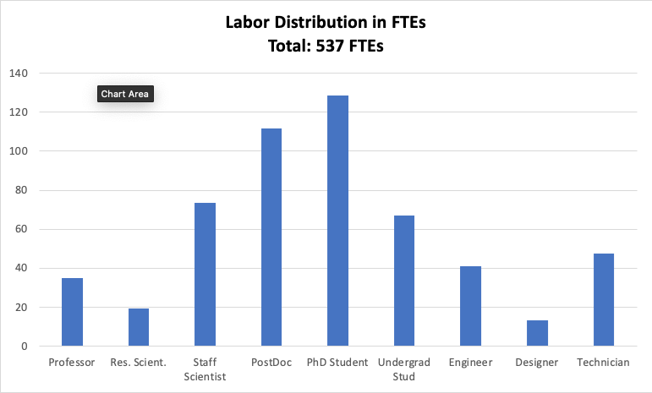
Expressions of Interest – Labor
EIC User Group:
1262 members
254 institutions
34 countries (6 world regions)
Experiment Scientists: 772,
Theory Scientists: 318,
Accelerator Scientists: 162,
Computer Scientists: 6, Support: 4, Other: 2

Slide 9
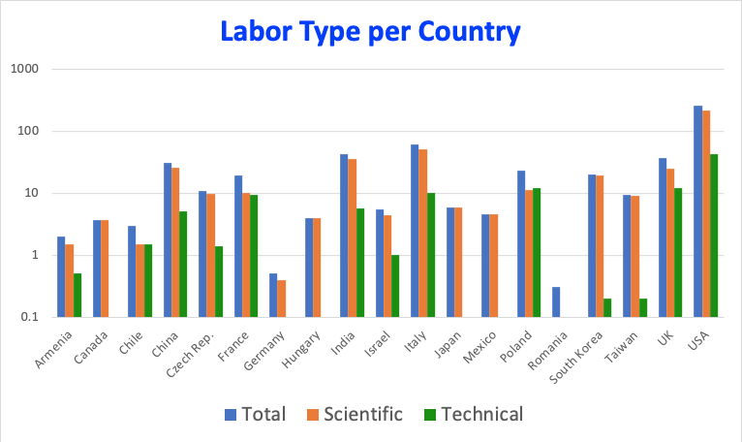
Expressions of Interest – Labor (scientific vs technical)

Slide 10
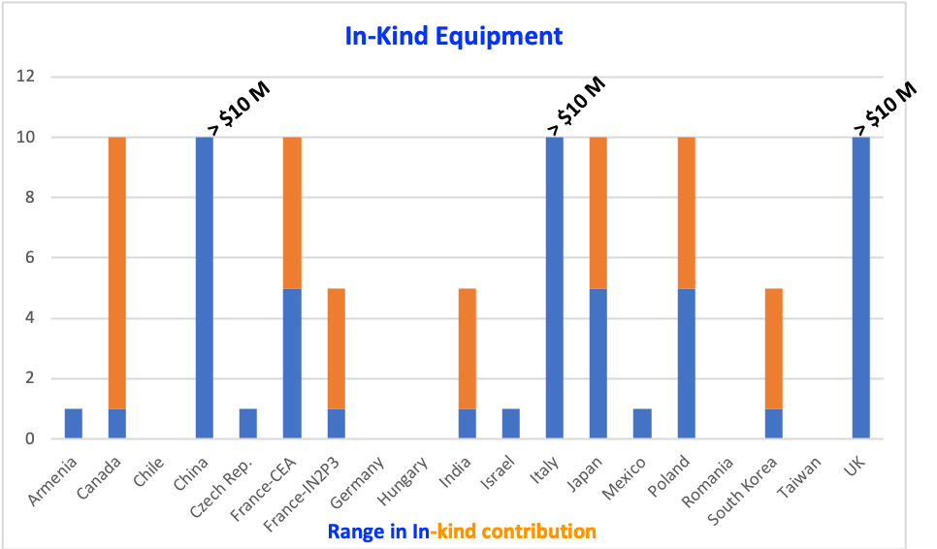
Expressions of Interest – In-Kind Equipment (non-US)
Ranges have some judgement factor involved
Country | Comments
Italy-INFN | Clearly indicate this level of possible contribution to detector in EoI.
France-CEA | Exact level needs further clarification. Did commit to PED until CD-2 for magnet already.
UK | Level needs further clarified, but they did submit phase-I R&D proposal to STFC already. Also interest in both detector and accelerator.
China | We are aware this is difficult, but this is the level they indicate they may contribute in-kind.
Canada | Level of in-kind for detector $1M-5M may be augmented by $5M-10M accelerator in-kind from TRIUMF.
Japan | Level indicated at EoI as possible request to their agencies.
France – IN2P3 | States $1M in EoI for backward calorimetry, but other topics seem possible. Further clarification under way
India | Mostly commits to (lot of) labor for scientific tasks, some small requests possible.
Poland | Level of in-kind contribution that may be possible.
Czech Republic | Do not explicitly indicate in-kind non-labor contribution, but some seems likely.
Korea | Do not explicitly indicate in-kind but hint at possibility.
Mexico | Mostly labor, small in-kind only
Israel | A $1M contribution seems possible
Armenia | Mostly labor, small in-kind only
Does not include separate strong interest by
academia-industry consortium in Spain to accelerator scope.
Also, for countries like Canada and UK folded in some separate accelerator scope interest in the estimates.

Slide 11
Meetings with International Partners
Following the EIC call for EOIs– a lot of interest for bi-lateral meetings
  Respond to requests from countries for bi-lateral discussion, i.e., technical and informative
  Proactively reaching out to potential partners for detailed bi-lateral discussions for possible in-kind contribution scope
  As of today, met with Poland, Czech, Italy/INFN, IRFU/Saclay, UK, and Canada
  Discussions evolve EIC Level 1 (management)
Plan is to meet with more countries (Argentina, Mexico, Chile, India, France/IN2P3, Korea, Japan, etc.) following the call for detector proposals

Slide 12
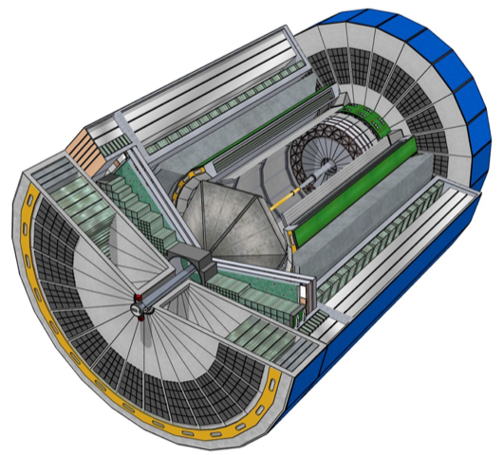
Conclusions
EoIs testament to large and growing national and international interest in EIC.
The call for Expression of Interest was a crucial step to get guidance on EIC detector scope.
  The EoIs show a strong community interest and support the assumptions on material and labor in-kind contributions
    The EIC community has been and continues to be very influential in determining the trajectory of the EIC detector.
Strong community and international engagement efforts – goal is to have DOE ONP, EIC project and EIC User Group to go hand in hand.
  Today’s DOE NP International Funding Agencies Meeting

Slide 13


