Slide 1
Polarimetry
Oleg Eyser (BNL, USA)
Ciprian Gal (Stony Brook University, CFNS, USA)
Dave Gaskell (JLab, USA)
Subsystem Interest Session, EIC@IP6 Meeting, 03/12/2021 – 03/13/2021

Slide 2
Subsystem Interest – Local Hadron Polarimetry
Please indicate the name of the contact person:
Oleg Eyser (keyser@bnl.gov)
Bill Schmidke (wschmidke@bnl.gov)
Please indicate all institutions collectively involved in this subsystem interest:
Brookhaven National Laboratory (Physics, CAD)
Are you interested in joining a new consortia towards a new EIC experiment at IP6:
Yes
Are you interested in actively participating in the detector proposal preparation for a new EIC experiment at IP6:
Yes
Please indicate the items of interest for potential equipment cooperation:
Local hadron polarimeter will be very similar to setup at IP-12 (absolute and relative polarimetry)
Vacuum chambers:
Vacuum chambers exist for single and double polarimeter setup
Modifications may be necessary
Si strip detectors
Improved design for inelastic background rejection
May affect the vacuum chambers
Readout & DAQ
Collision rate will require better resolution of waveform analysis (ASIC)
DAQ will need to be upgraded / replaced
Subsystem Interest Session, EIC@IP6 Meeting, 03/12/2021 – 03/13/2021

Slide 3
Subsystem Interest – Local Hadron Polarimetry
Opportunities for engagement of other groups / institutions or areas where help is needed:
Readout & DAQ is currently assuming to take advantage of general EIC developments
Detector modifications will be tested in RHIC Runs 2022/2024
Production of Si layers with minimally invasive support frames
Simulation and data analysis
Target development will be crucial for high luminosity measurements
Collaboration with BNL Center for Functional Nanomaterials to study target materials and production
Any additional information you think may be useful for the community to know about your subsystem interest for a new EIC experiment at IP6 (Prior experience, R&D programs, institutional infra-structure, in-kind contributions etc.):
Local polarimetry is very similar to polarimetry at IP-12 and BNL has experience from 20+ years of RHIC operations
EIC luminosities are a challenge
Target lifetime from sublimation is problematic
Potentially other physics processes are being discussed
Forward neutron production (requirements for local polarimetry less stringent, but space may be an issue)
R&D efforts are supported by CAD until 2024
Detector modifications
Feasibility studies of He3 polarimetry (beam break-up, size of analyzing power)
Subsystem Interest Session, EIC@IP6 Meeting, 03/12/2021 – 03/13/2021

Slide 4
Subsystem Interest –Polarimetry
Please indicate the name of the contact person:
Gal, Ciprian, Stony Brook University, ciprian.gal@stonybrok.edu
Please indicate all institutions collectively involved in this subsystem interest:
BNL, JLab, SBU, University of Massachusetts Amherst, University of Virginia
Are you interested in joining a new consortia towards a new EIC experiment at IP6:
Yes; we are interested to participate in polarimetry efforts regardless of location (IP12, IP6)
Are you interested in actively participating in the detector proposal preparation for a new EIC experiment at IP6:
Yes (as above); for IP6 specifically we also have an interest in local polarimetry
Please indicate the items of interest for potential equipment cooperation:
Subsystem 1: Compton Laser system
Variable frequency pulsed laser system needed to be able to measure polarization bunch by bunch
High power needed to reach statistics for 1% precision in short amount of time
Subsystem 2: Compton photon/electron detector system
Depending on electron beam polarization direction the detector characteristics will need to be different
Careful consideration should be given to design and integration of the detectors to minimize backgrounds
Subsystem 3: Hadron polarimetry
Hadron polarimetry setup and detectors are going to be crucial to high precision EIC measurements
Local polarimetry at the IP has been crucial in setting up RHIC in the past
Subsystem Interest Session, EIC@IP6 Meeting, 03/12/2021 – 03/13/2021

Slide 5
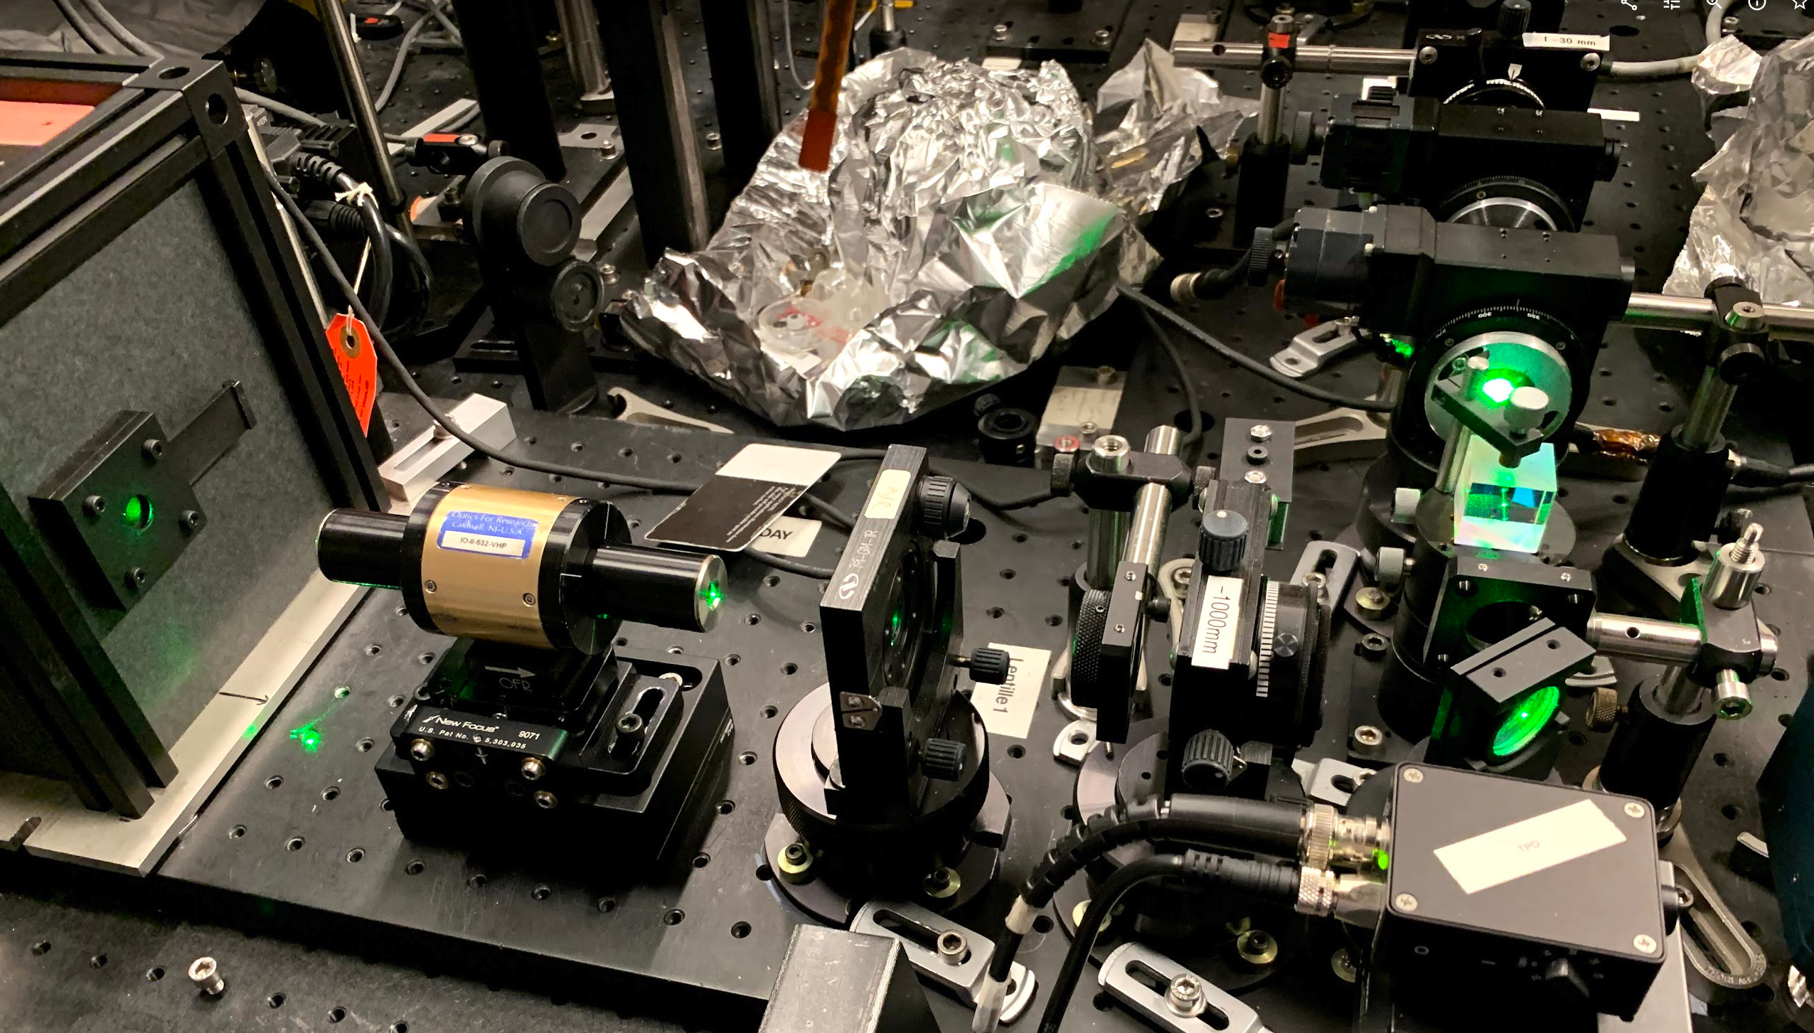
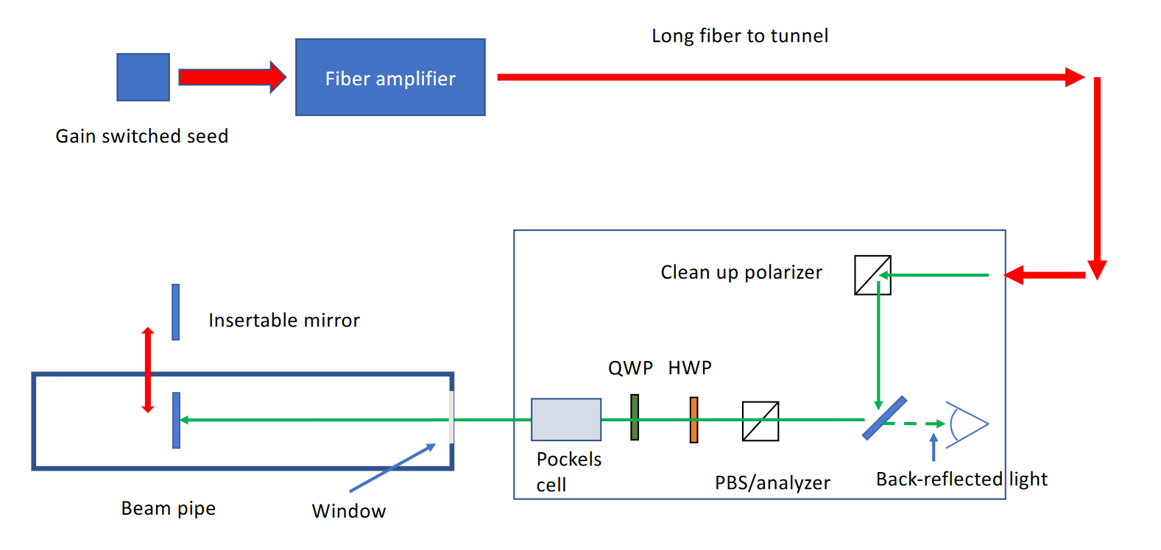
Subsystem Interest – Polarimetry
Opportunities for engagement of other groups / institutions or areas where help is needed:
Detailed simulations of Compton interaction region and backgrounds
Design and engineering for detectors
Any additional information you think may be useful for the community to know about your subsystem interest for a new EIC experiment at IP6 (Prior experience, R&D programs, institutional infra-structure, in-kind contributions etc.):
SBU has a long history of hadron polarimetry analysis at RHIC and were part of the group that discovered the principle of, and setting up, the RHIC local polarimeters
SBU contributed significantly to electron polarimetry at Jlab (both Moller and Compton)
eRD26: Compton Laser System
SBU (in partnership with JLab and Uva) is constructing a laser system that can show that the requirements for the EIC can be met
eRD26 proposed EIC laser system
Hall A (JLab) Compton laser setup
Subsystem Interest Session, EIC@IP6 Meeting, 03/12/2021 – 03/13/2021

Slide 6
Subsystem Interest – Electron Polarimetry
Please indicate the name of the contact person:
Aschenauer, Elke, BNL, elke@bnl.gov
Gaskell, Dave, JLab, gaskelld@jlab.org
Please indicate all institutions collectively involved in this subsystem interest:
List of institutions
Argonne National Lab, Brookhaven National Lab, Jefferson Lab, Stony Brook University, University of Kansas, University of Manitoba, University of Massachusetts, Amherst, University of Virginia
Are you interested in joining a new consortia towards a new EIC experiment at IP6:
Yes
Are you interested in actively participating in the detector proposal preparation for a new EIC experiment at IP6:
TBD
Please indicate the items of interest for potential equipment cooperation:
Compton Polarimeter Laser System
Stony Brook, UVa, JLab (support and advice)
Calorimeter
UMass
Segmented position-sensitive detector
ANL, Manitoba
DAQ/readout
Kansas, UMass, BNL (support and advice)
Subsystem Interest Session, EIC@IP6 Meeting, 03/12/2021 – 03/13/2021

Slide 7
Subsystem Interest – Electron Polarimetry
Opportunities for engagement of other groups / institutions or areas where help is needed:
Collaboration on any of the relevant systems (laser, calorimeter, segmented position-sensitive detector, software) is welcome. Electronics for fast readout of the position sensitive detectors will be especially challenging.
There will be multiple polarimeters (IP6 and RCS), so polarimeters with multiple technological choices feasible
Any additional information you think may be useful for the community to know about your subsystem interest for a new EIC experiment at IP6 (Prior experience, R&D programs, institutional infra-structure, in-kind contributions etc.):
Members of this group have extensive experience with electron polarimetry at JLab and HERA
Development of candidate laser system underway at Stony Brook under eRD26
U. Manitoba efforts synergistic with efforts for SuperKEKB upgrade
Superconducting nanowire detector R&D being carried out at Argonne under eRD28
Subsystem Interest Session, EIC@IP6 Meeting, 03/12/2021 – 03/13/2021

