Slide 1
DAQ / Readout
Marco Battaglieri (INFN Genova, Italy)
Jan Bernauer (Stony Brook University, USA)
Irakli Mandjavidze (Irfu, CEA Saclay, France)
Subsystem Interest Session, EIC@IP6 Meeting, 03/12/2021 – 03/13/2021

Slide 2
Subsystem Interest – DAQ Streaming readout
Please indicate the name of the contact person:
Temporarily (while considering the EIC@IP6 option and the potential INFN contribution):
Battaglieri, Marco, INFN Genova - Italy / Jlab - US, battaglieri@ge.infn.it
Please indicate all institutions collectively involved in this subsystem interest:
INFN, potentially with the following Units of the Institute involved in the EoI submission:
Sezione di Genova
Sezione di Bologna
Sezione di Roma 1
Sezione di Catania
Sezione di Roma 2
Universita di Roma Tor Vergata
More units can join later
Are you interested in joining a new consortia towards a new EIC experiment at IP6:
We are considering the EIC@IP6 option and internally discussing it. Relevant aspects are physics reach and technology prospects..
Are you interested in actively participating in the detector proposal preparation for a new EIC experiment at IP6:
We plan to actively contributing if EIC@IP6 will be our selected option
Please indicate the items of interest for potential equipment cooperation:
Streaming readout framework:
Development of the front-end electronics Streaming RO-compatible;
Development of the backend software including high-level algorithms for tagging and selecting data
Prototyping and on-beam test
Facilitate contacts with Italian hi-tech companies (e.g. CAEN)
Subsystem Interest Session, EIC@IP6 Meeting, 03/12/2021 – 03/13/2021

Slide 3
Subsystem Interest – DAQ Streaming readout
Opportunities for engagement of other groups / institutions or areas where help is needed:
We would provide our contribution within the framework of the EIC R&D Streaming RO Consortium, in collaboration with the other institutions therein
Any additional information you think may be useful for the community to know about your subsystem interest for a new EIC experiment at IP6 (Prior experience, R&D programs, institutional infra-structure, in-kind contributions etc.):
Some of the INFN groups participating to the EoI submission have consolidated expertise in development of front-end boards (e.g. digitizers, trigger and readout boards) and backend software (e.g. TriDAS for underwater neutrino telescopes)
We established a strong connection with the ERSAOP group at JLab to develop and test a streaming RO system with the Hall-B CLAS12 detector
We are currently developing a SiPM-based readout chain for the EM Calorimeter and testing it on a lead-tungstate prototype (in collaboration with EIC eRD1 Consortium) in Hall-D at JLab
The INFN activities in all the Units are supported by the local available facilities: mechanical workshops, electronics laboratories, clean rooms.
Subsystem Interest Session, EIC@IP6 Meeting, 03/12/2021 – 03/13/2021

Slide 4
Subsystem Interest – DAQ/Readout
Please indicate the name of the contact person:
Bernauer, Jan, Stony Brook University, jan.bernauer@stonybrook.edu
Please indicate all institutions collectively involved in this subsystem interest:
SBU, MIT, U Mass Amherst, INFN, JLAB, BNL,
Are you interested in joining a new consortia towards a new EIC experiment at IP6:
Yes
Are you interested in actively participating in the detector proposal preparation for a new EIC experiment at IP6:
Yes
Please indicate the items of interest for potential equipment cooperation:
Subsystem 1: Streaming readout transport network
Data flow management in readout network
Data protocols
Subsystem 2: Front end electronics
In close collaboration with detector groups
Subsystem 3: Software stack
Firmware and software framework for concentrator and process nodes
Support for online/offline event building, quality monitoring
Subsystem Interest Session, EIC@IP6 Meeting, 03/12/2021 – 03/13/2021

Slide 5
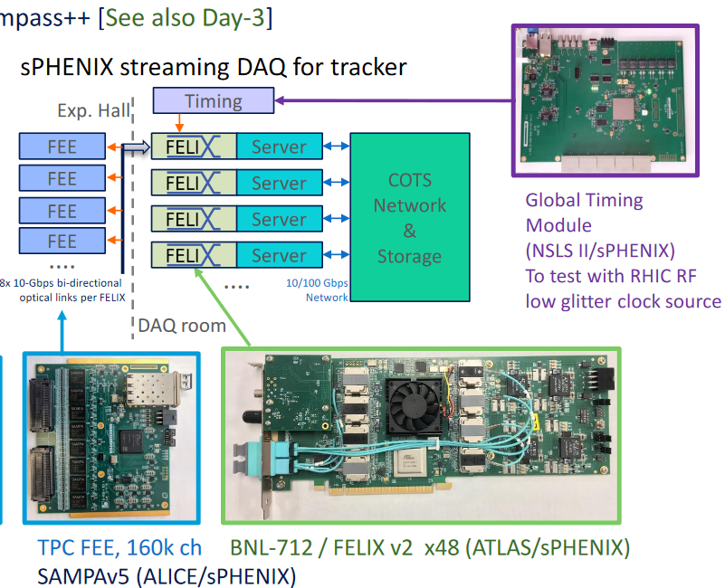
Subsystem Interest – DAQ/Readout
Opportunities for engagement of other groups / institutions or areas where help is needed:
FEE development for specific detectors, interface to software efforts for QC, run monitoring etc
Any additional information you think may be useful for the community to know about your subsystem interest for a new EIC experiment at IP6 (Prior experience, R&D programs, institutional infra-structure, in-kind contributions etc.):
SBU is a leading contributor to sPHENIX:
sPHENIX will use a hybrid triggered/streaming design
Data rates similar to EIC
SBU involved in DAQ design work
eRD23: Streaming readout for an EIC
Founding member of eRD23, JCB is PI
(together with Marco Battaglieri from INFN/JLAB)
Forged community around streaming readout,
bridged gaps between institutes
Yellow Report:
SBU cowrote sections relevant to DAQ/electronics
Figure from Martin Purschke
Figure from Jin Huang
Subsystem Interest Session, EIC@IP6 Meeting, 03/12/2021 – 03/13/2021

Slide 6
Subsystem Interest – DAQ/Readout
Please indicate the name of the contact person:
Neyret, Damien, Irfu, CEA Saclay, damien.neyret@cea.fr
Irakli Mandjavidze, Irfu, CEA Saclay, irakli.mandjavidze@cea.fr
Please indicate all institutions collectively involved in this subsystem interest:
Open for collaboration
Are you interested in joining a new consortia towards a new EIC experiment at IP6:
Yes
Are you interested in actively participating in the detector proposal preparation for a new EIC experiment at IP6:
Yes
Please indicate the items of interest for potential equipment cooperation:
Frontend electronics
Contribution to a versatile frontend ASIC design for MPGD detectors: programmable analogue stage, PLL, O(5ps) TDC
Collaboration to (common?) frontend board design: digital signal processing, clock synchronous links
System-level synchronization
Collaboration on precision clock distribution
Preferably working for a sub-system together with Irfu detector engineers and physicists
Opportunities for engagement of other groups / institutions or areas where help is needed:
Open for collaboration
e.g. Frontend ASIC design: ASIC architecture, ADC IP, on-chip DSP
e.g. Frontend board design: common FE specification, board + test bench design

Slide 7
Subsystem Interest – DAQ/Readout
Any additional information you think may be useful for the community… Expertise
Substantial experience in the design of readout systems
Among major contributors to HEP experiments world-wide
Gaseous TPC / trackers, active sensors, calorimeters, muon spectrometers
Concentration of know-how
Analog / digital ASIC and electronics board design
Turnkey system development: detector-readout-software-infrastructure
e.g. Clas12 Micromegas vertex tracker
Close access to advanced machinery for prototyping, production, validation
In-situ and within the scientific-industrial pole of the Plateau de Paris-Saclay
Successful history of co-developments
ASICs, boards, trigger/DAQ systems
TDC IP block in CMS 72-channel HgCRoc ASIC (Omega, CERN, Krakow, Irfu)
Atlas liquid Argon calorimeter LTDB (BNL-Irfu)
Long term involvement in longevity experiments
e.g. T2K ND280 TPC (2012) and its on-going upgrade; Alice, Atlas, CMS @LHC and their upgrades
On-going R&D on precision clock distribution
CMS phase 2 upgrade @ LHC, HyperKamiokande

