Slide 1
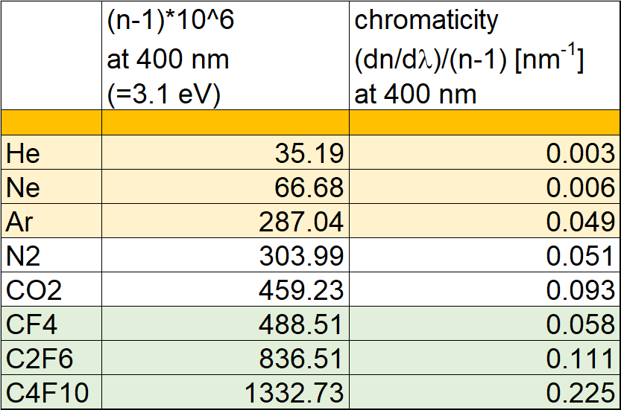
An eco-friendly gaseous RICH @ EIC
Why C-F gases are the most used ?
You need as high as possible photon rate:
N_{photons} sin²θ 2 (n-1) at saturation, in gas
You need as small as possible chromatic dispersion
This is the intrinsic error affecting the measurement of the Cherenkov angle that cannot be recovered
proportional
to N_{photons}
Proportional to
chromatic dispersion

Slide 2
An eco-friendly gaseous RICH @ EIC
ISSUES with C-F gases
From YR and related comments
by external readers
Comment by H. Montgomery:
These gasses are not eco-friendly
They attack O₃
They have high Global Warming Power
C₄F₁₀: 9200 (100y horizon)
CF₄: 6600
CO₂: 1 (by definition)
CH₄: 28 (for comparison)
A system ensuring no emissions and losses (if feasible) adds complexity to the gas handing system
The cost is growing and availability is difficult
Most recent C₄F₁₀ procurement for COMPASS RICH (2019-2020)
One single producer for large quantities identified
Delivery after 1y from issuing the order
Cost: 208 GBP per kg for large quantity (630 kg)

Slide 3
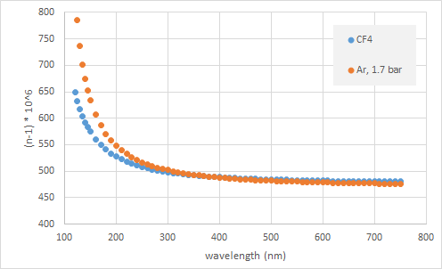
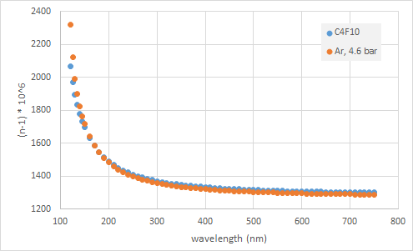
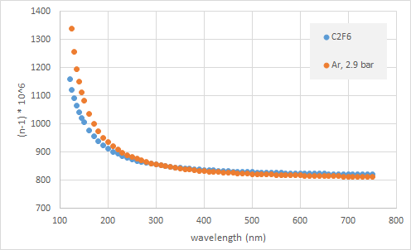
An eco-friendly gaseous RICH @ EIC
Use an innocent gas with good chromaticity and
tune its refractive index using pressure
visible range
Of course,
a vessel standing pressure is needed
Engineering approach required:
The vessel can be light using high-tech up-to-date approaches
Some preliminary design studies initiated in Italy; the help of the hosting labs is a necessity

