Slide 1
sPHENIX Computing Needs

Slide 2
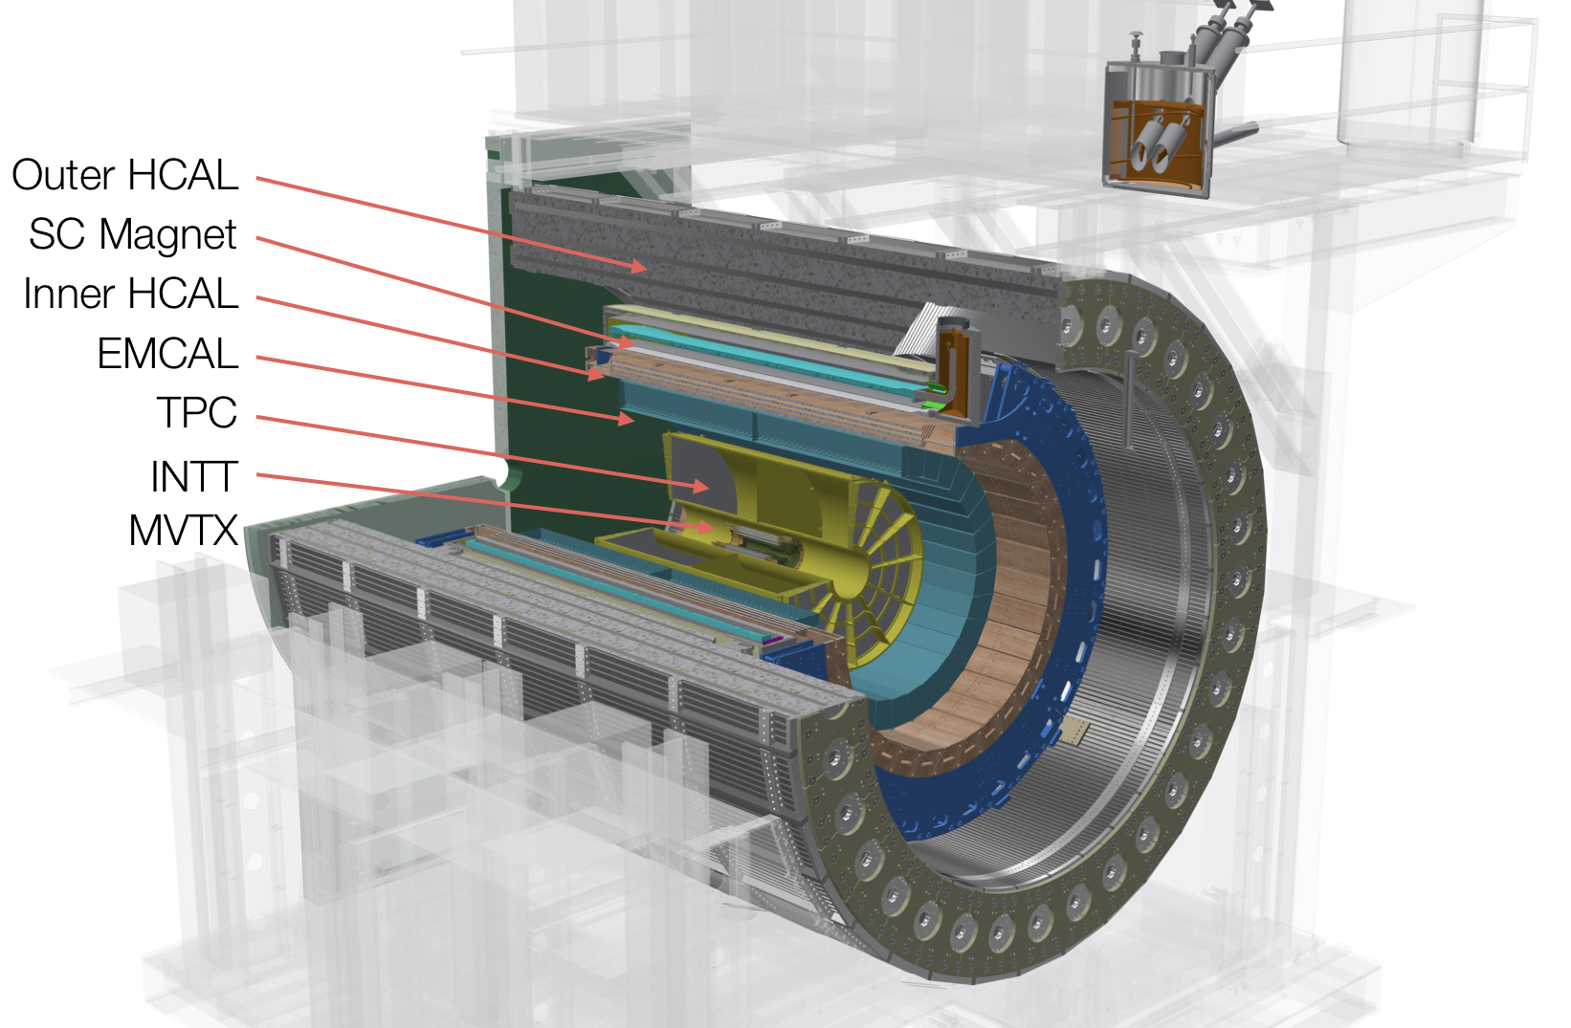
sPHENIX is
A standard collider detector
Coverage |η| < 1.1 (<1 fiducial volume)
Full em and hadronic calorimetry
Full tracking
No PID
Physics Program
Unbiased Jets (calorimetry)
Upsilons (tracking)

Slide 3
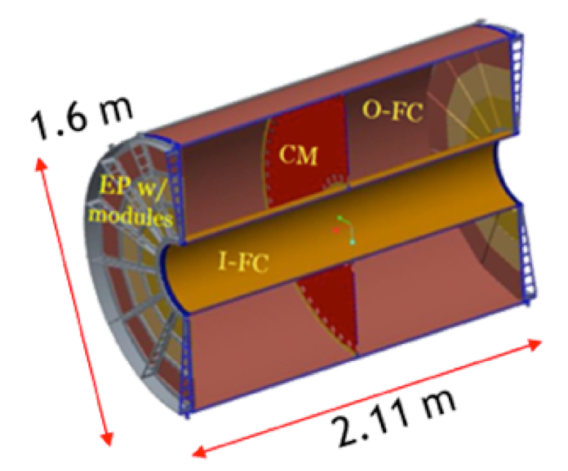
sPHENIX tracking detectors
TPC Continuous readout TPC
SAMPA based front-end card
Quad-GEM readout chambers
Close relation to ALICE TPC
INTT Silicon strips, 2 layers
MVTX Monolithic Active Pixel Sensors (MAPS),
3 layers, based on ALICE ITS detector

Slide 4
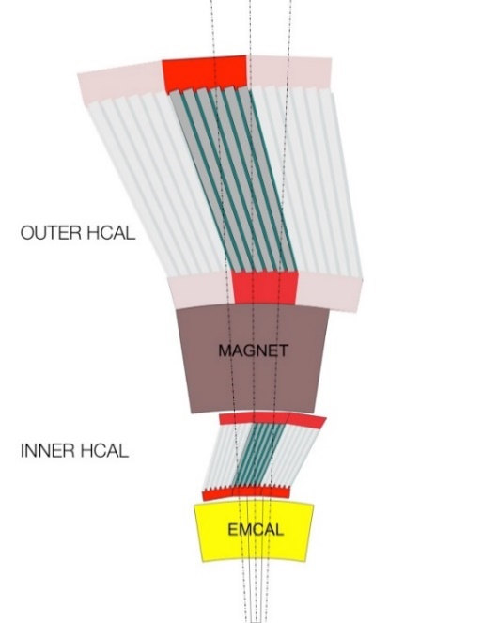
sPHENIX calorimetry
Tilted and tapered steel plates with scintillator tiles between them
Extruded polystyrene scintillator with wavelength shifting fiber in grooves
Each tile read out by a 3x3 mm SiPM
Five tiles analog summed to a Δ𝜂xΔ𝜑∼0.1 tower

Slide 5
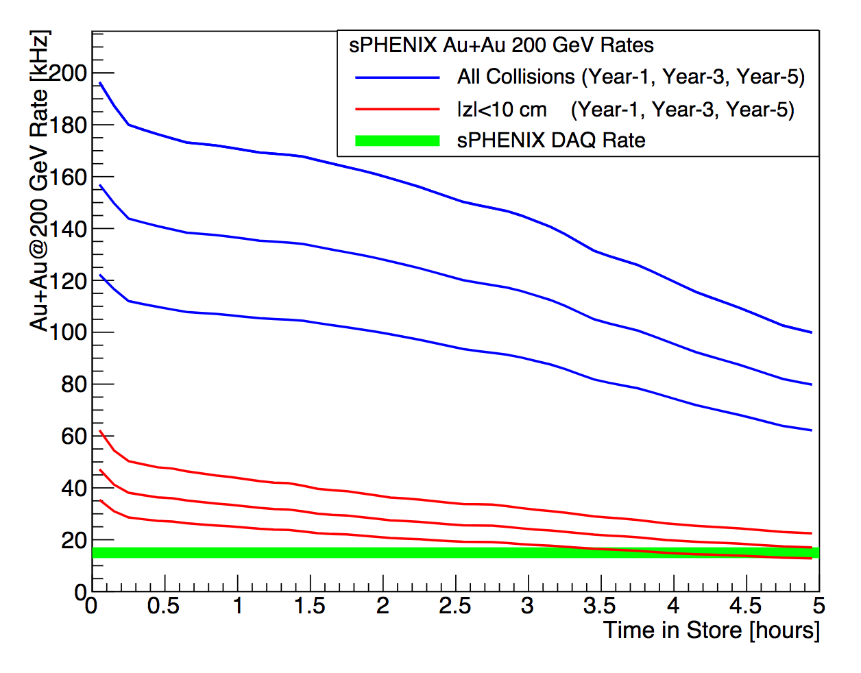
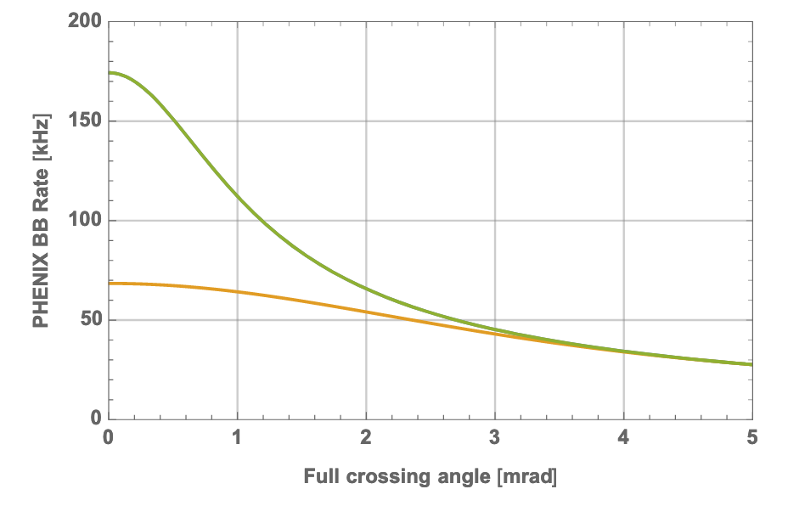
Status of ongoing discussions with C-AD
Focus on a beam crossing angle to narrow the vertex distribution
For a calculation of overall and desired luminosity as a function of crossing angle:
All Vertices
Year 5 (2027)
Year 3 (2025)
Year 1 (2023)
Total luminosity
Luminosity within +- 10cm
Naïve view of the collison of beam bunches:
Collisions can happen anywhere along the overlap
No crossing angle
50kHz “reasonable” background in the TPC
Small crossing angle
The overlap region is reduced

Slide 6
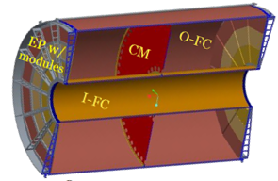
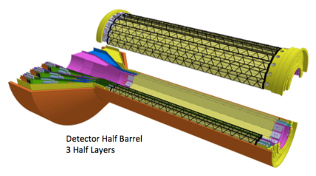
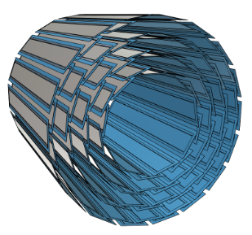
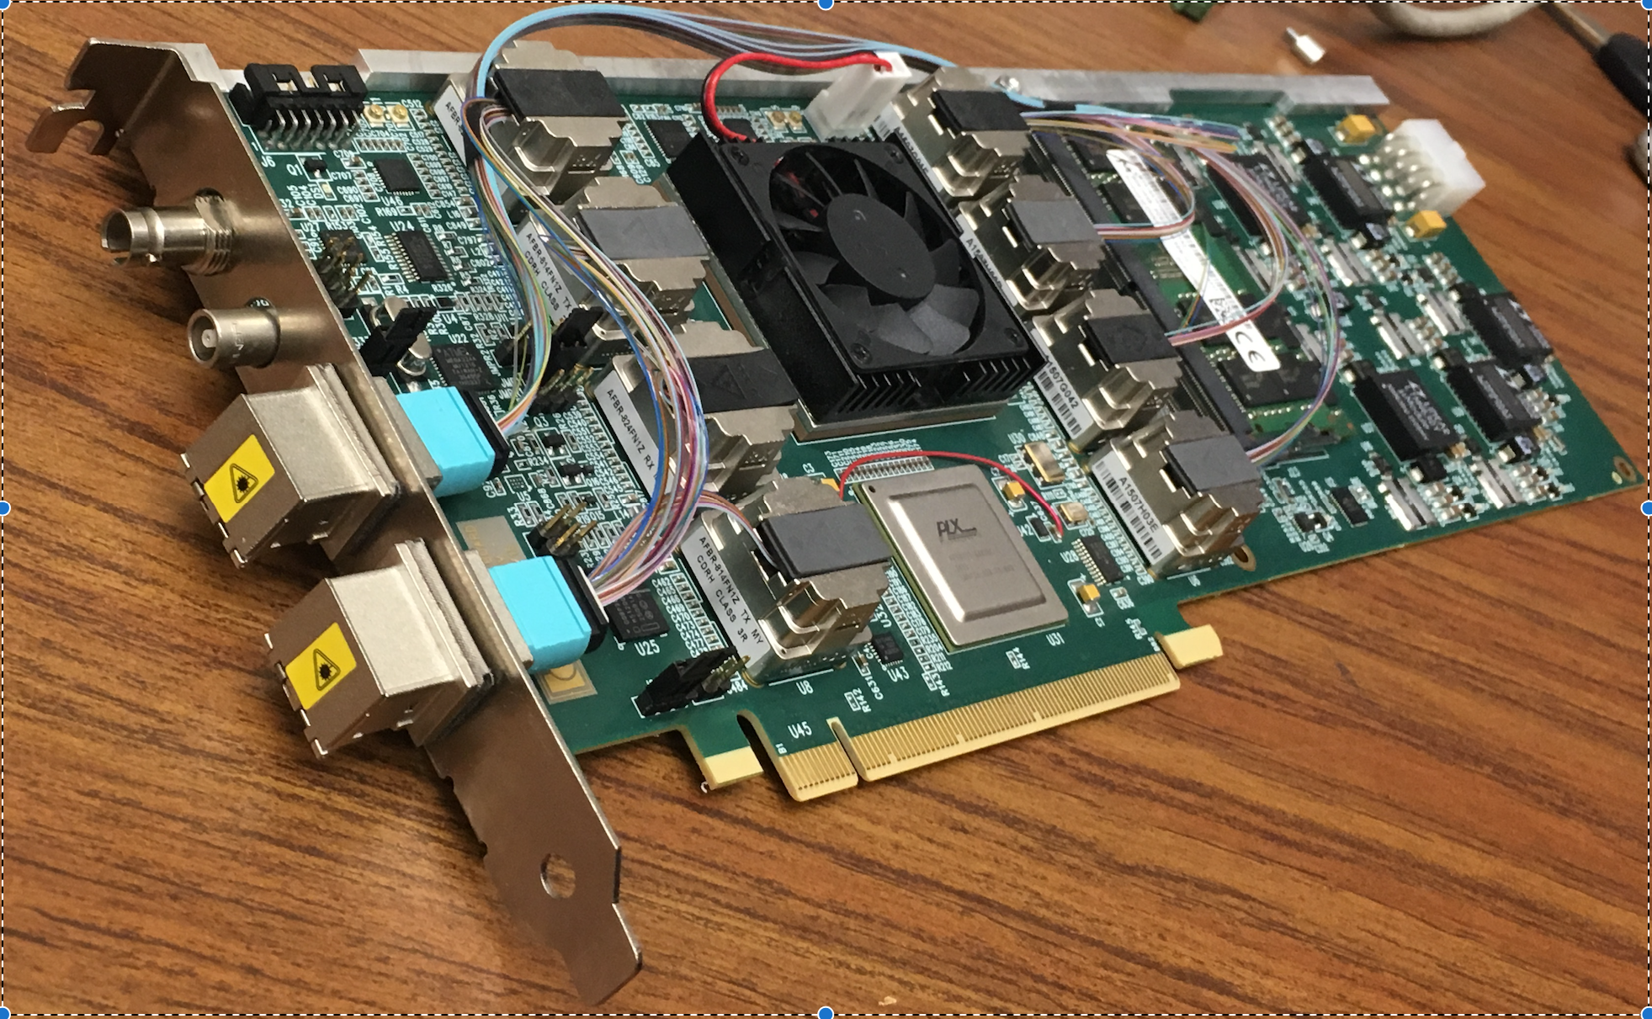
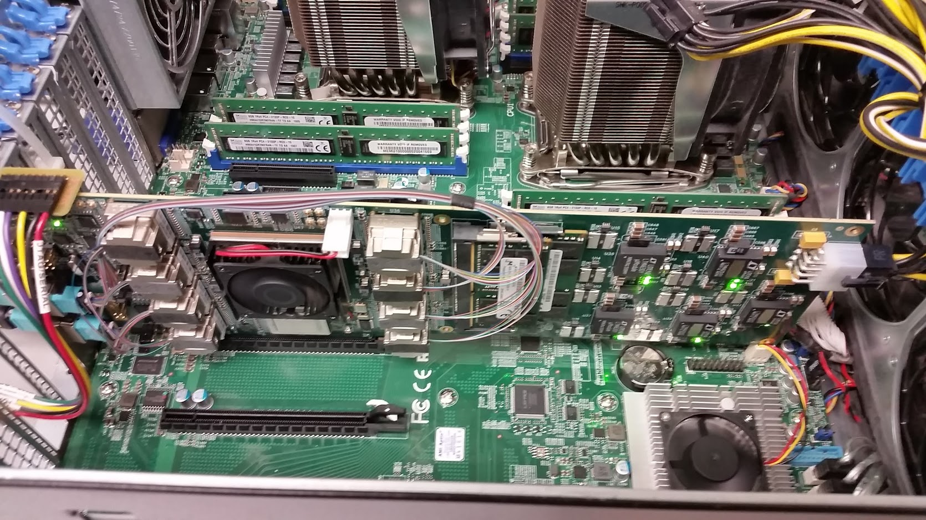
Hybrid of triggered and streaming readout
The calorimeters and the MBD re-use the PHENIX “Data Collection Modules” (v2)
FEM
DCM
DCM2
DCM
DCM
DCM
DCM
FEM
DCM
DCM
DCM
DCM2
DCM
DCM
DCM
Triggered readout
FEM
DCM
DCM
DCM
DCM
DCM2
Calorimeters, MBD
DCM
DCM
DCM
FEE
The TPC, the MVTX, and the INTT are read out through the ATLAS “FELIX” card directly into a standard PC
DCM
DCM
FELIX
PC
DCM
FEE
DCM
DCM
FELIX
PC
DCM
TPC, MVTX, INTT
FEE
DCM
FELIX
PC
DCM
DCM
Rack Room
Streaming readout
ATLAS FELIX Card
Installed in a PC

Slide 7
DAQ Architecture
FEM
DCM
DCM2
DCM
DCM
DCM
DCM
Network
Switch
Buffer Box
FEM
DCM
SEB
DCM
DCM
DCM2
DCM
DCM
DCM
Buffer Box
FEM
DCM
SEB
DCM
DCM
DCM
DCM2
Buffer Box
DCM
SEB
Calorimeters, MBD
DCM
To the
RACF/HPSS
DCM
Buffer Box
FEE
DCM
DCM
FELIX
EBDC
DCM
Buffer Box
TPC, MVTX, INTT
FEE
DCM
DCM
FELIX
EBDC
Buffer Box
DCM
FEE
DCM
FELIX
EBDC
DCM
Buffer Box
DCM
Rack Room
Large buffer space on buffer boxes to make use of RHIC downtimes
FELIX cards match streaming readout to triggers, drop data not correlated to trigger (some discussion to extend this window to take minbias pp)

Slide 8
Streaming Readout + Triggered Events (concept)
Chunks correlated with triggered events

Slide 9
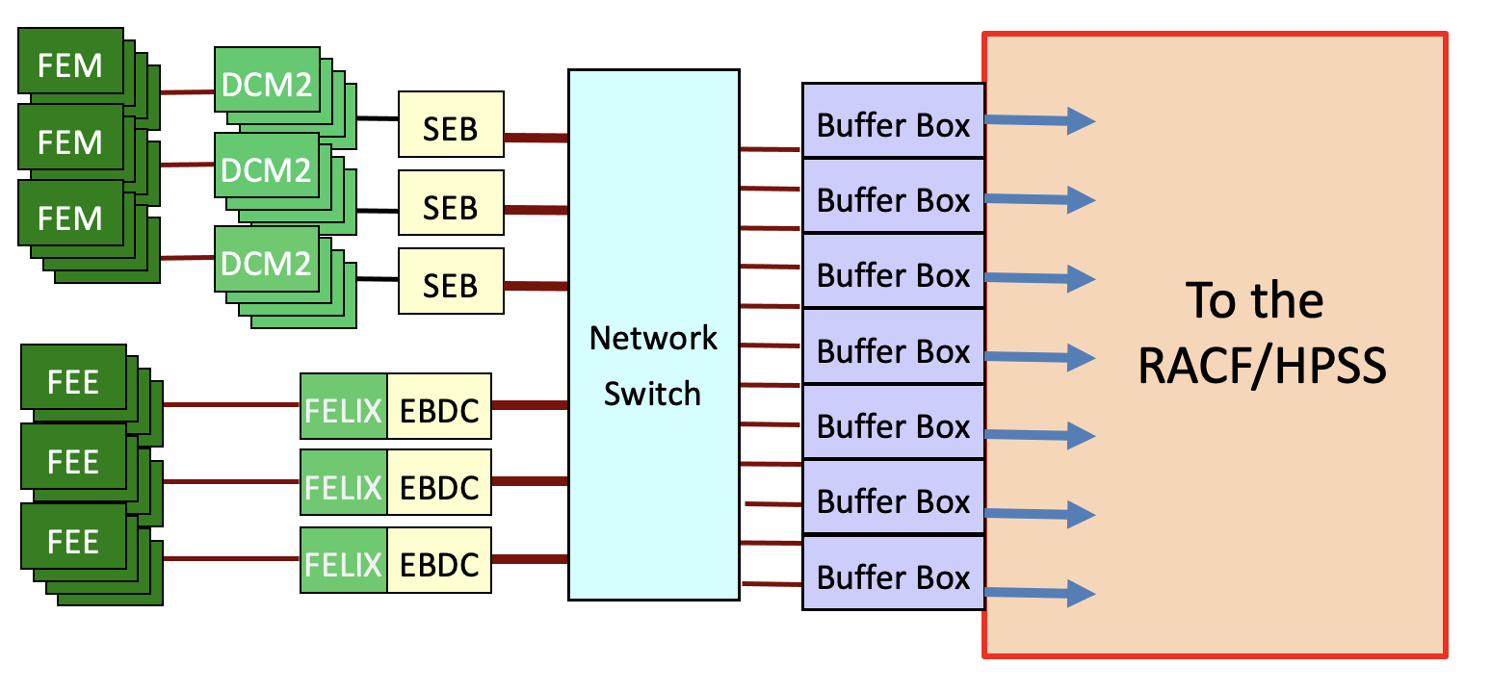
sPHENIX online/offline computing
The sPHENIX detector construction is nearing completion
Most of the detector (by weight) rolls into the IR right after RHIC Run 22 (about one year from now, spring 2022)
One year later (February 2023), it begins its commissioning run at RHIC
Mature online software is essential to success
There are many areas of software that we can use contribution (or better, commitment)
Offline event building is new to us (and everyone else)
At least some of our detectors use “streaming” readout
Time-averaged data rates of 150 Gbps, peak data rates of 300 Gbps
Technology areas where we could use help
Databases
User interfaces
Middleware for distributed control and monitoring
System management and monitoring

Slide 10
sPHENIX Raw Data
No high level trigger based on events → no online Event builder needed, events are assembled during reconstruction
We are slaughtering a sacred cow!!!!!!!!
might become standard in streaming readout for EIC
Events are distributed over ~60 separate files
But events are time ordered
Streaming readout needs special treatment
Very likely files contain different numbers of events (subevent sizes vastly different+ streaming)
Need to estimate data loss due to broken tapes
Traditional loss of events changes to loss of efficiency for many more events (parts of events are missing)
Use Lumi block concept for validation/calibration
Almost impossible to guarantee stability of detector over long time
Daq is rate limited to 15 kHz, same rate in pp as in AuAu

Slide 11
Reconstruction in a nutshell
Will be done in racf (not a lot of grid processing, phew)
Offline event builder
Event number (triggered) + crossing counter (streaming) used for identifying event
difference to regular processing: 60 fopen calls instead of one
We have been doing this multiple file reading in PHENIX for analysis files since 2003 (proposed offline eventbuilder idea in 2010 for PHENIX - I planned to kill the cow a long time ago)
Also standard for mock data challenge
Reco time budget 25sec/evt
TPC reco needs 2 distinct passes for distortion correction
Maybe run calorimeter reco as separate pass
Either run offline event builder 2(3) times or store intermediate event file
Reco job length ~ 24 hours, 25sec/ev → 4000 events in one job (or 12000 for 3 separate passes)
2MB/evt → 8 (24) GB close to PHENIX (10GB), nice size to work with
@15kHz daq rate – 250 (750) ms of data

Slide 12
Reconstruction + Analysis Flow
Hpss
Buffer
boxes
135Gb/s
HPSS
disk cache
Raw
HPSS
disk cache
DST
Tape
Raw Disk cache
20PB (2 weeks)
DST Disk cache
Calibration + Q/A
Size reduction + calibration pass
1st pass TPC tracking
Conditions DB
Analysis
Taxi
2nd pass TPC tracking + reconstruction
Online monitoring
Data
Calibrations

Slide 13
What is the problem?
Code speed – need to get to 25s/evt
Not only tracking – calorimeter (5s) blows its budget as well (pulse shape fitting)
Memory – has gotten cheaper but 10GB/job won’t fly
Unlike CERN Simulation needs “small” sim size is a secondary problem
Scale
Rate is constant 20GB/sec in AuAu in year 3 (averaged by buffer boxes)
200,000 cores need to be fed
Ramp up vs steady state, deliver data to those cores
Storage which can handle that abuse
Reconstruction has to happen quasi online
Once data is deleted from buffer it will be very expensive to fetch from hpss
Data spread over 60 files is not helpful here
Need to be ready, no time for debugging – we will get hit on day 1 by an accelerator (and crew) with 20 years of experience delivering high luminosity

Slide 14
Matching experience in NPPS
Calibrations Database
We know our current DB approach does not scale – Belle II DB looks like a good solution (calibrations in files, metadata in DB)
Nice standalone task which doesn’t require deep knowledge of sPHENIX
DB Maintenance
Data reconstruction and movement choreography
All done locally – we have influence on hardware
PanDa and Ruccio?
Data Production Manager
Refining TPC simulations (electron drift)
Tracking next talk
GEANT4 (physics lists, calorimeters), ATLAS has interesting developments

