Slide 1
FF region in g4e
Julia Furletova

Slide 2
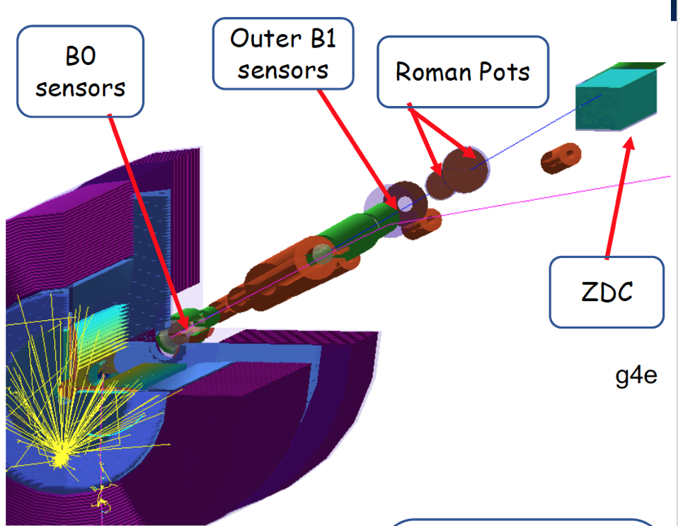
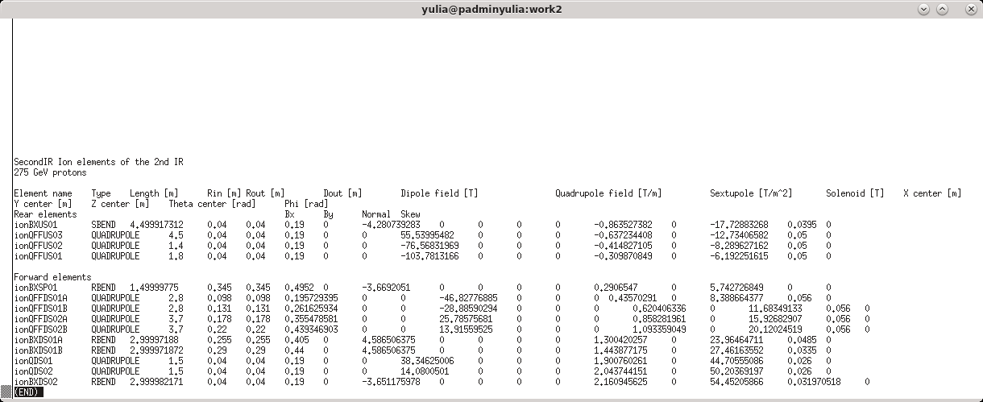
G4e FF implementation
Currently implemented:
switch between IPs via control card
Text file from accelerator lattice with main parameters ( Size, field, position, rotation) is converted into the geant4 objects with a corresponding magnetic field (QUADs, DIPOLE)
Particle gun ( cone of particles with smeared vertex, or initial angle, or momenta) to mimic accelerator parameters at IP
g4e can run PYTHIA, HEPMC, BEAGLE file types of event generators (need a proper crossing angle for FF area studies)
Si sensitive detectors for B0, OFFM and RPs ;
EMCAL/HCAL for ZDC ( two EMCAL versions Glass and FoCAL)

Slide 3
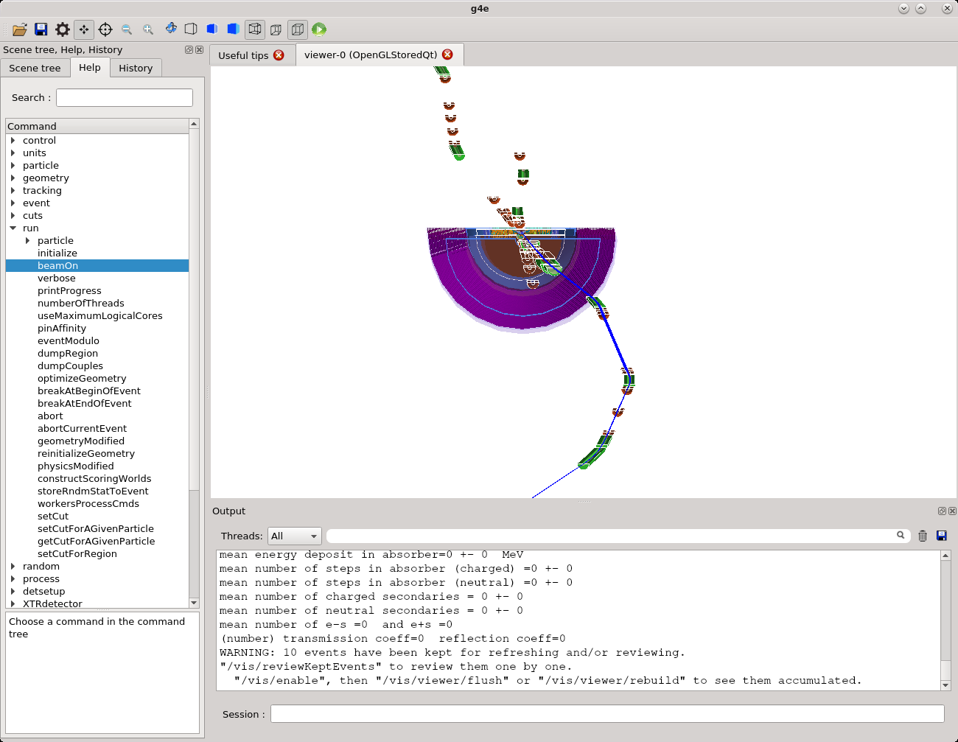
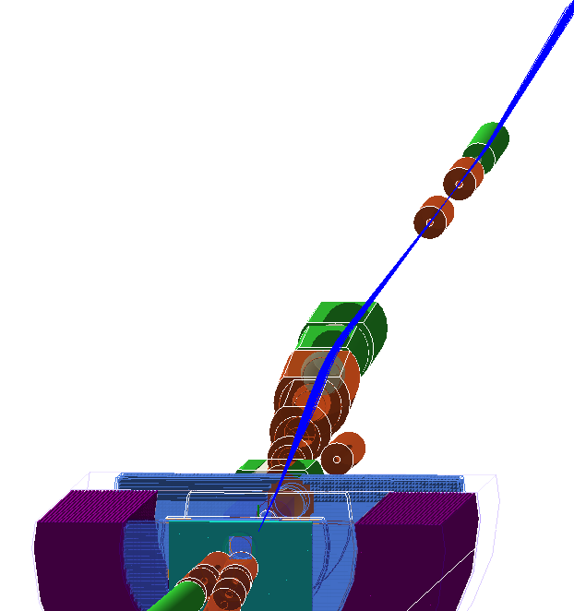
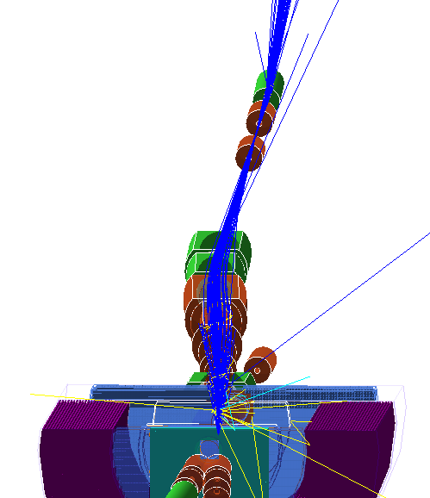
G4e FF implementation
Initial/ beam particles follow the expected trajectory
Some improvements are needed to compensate edge effects ( including solenoid effect )
Second focus for ip8

Slide 4
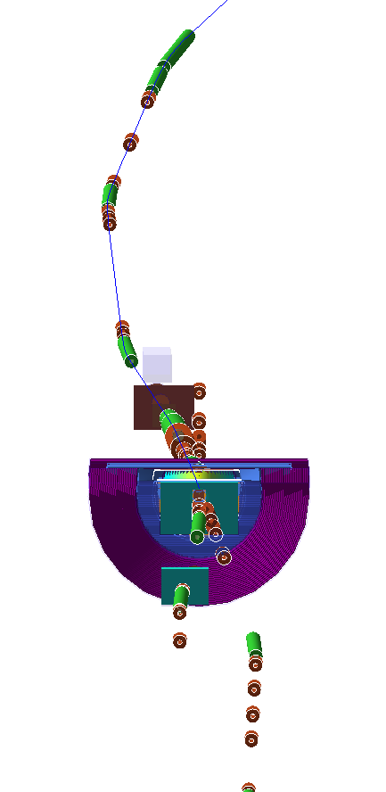
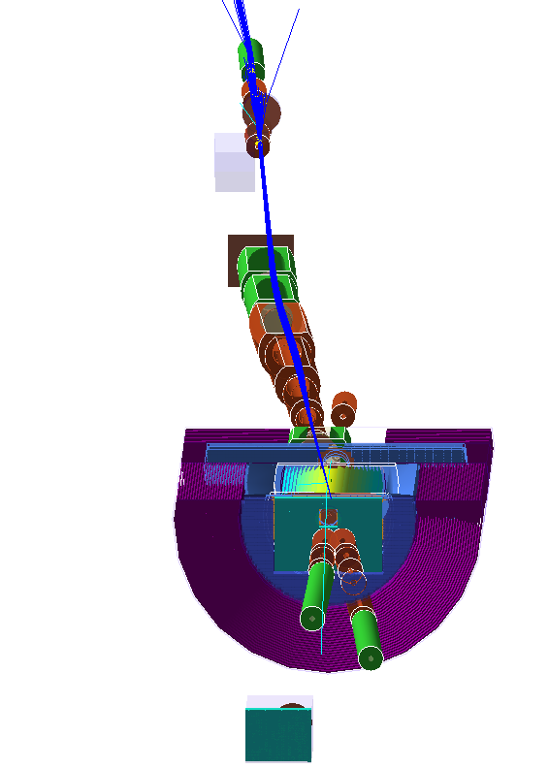
G4e beamline IP switch via control card
/eic/beamline/name ip6
/eic/beamline/name ip8

Slide 5
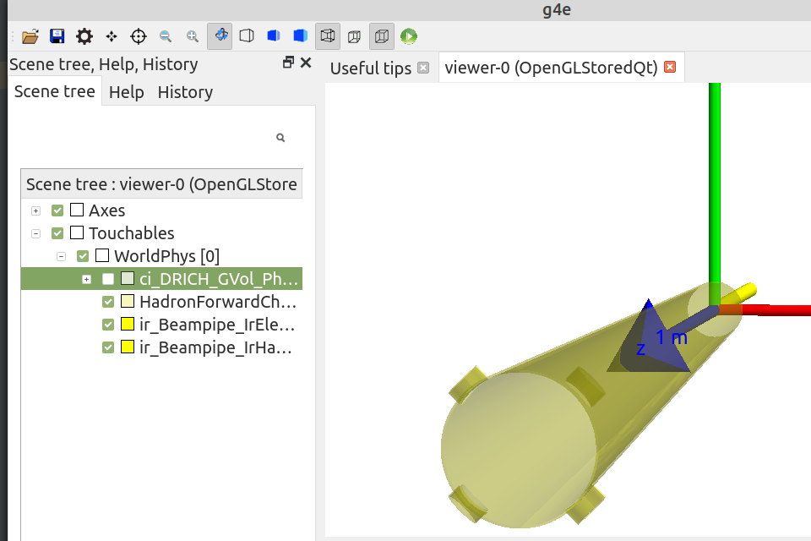
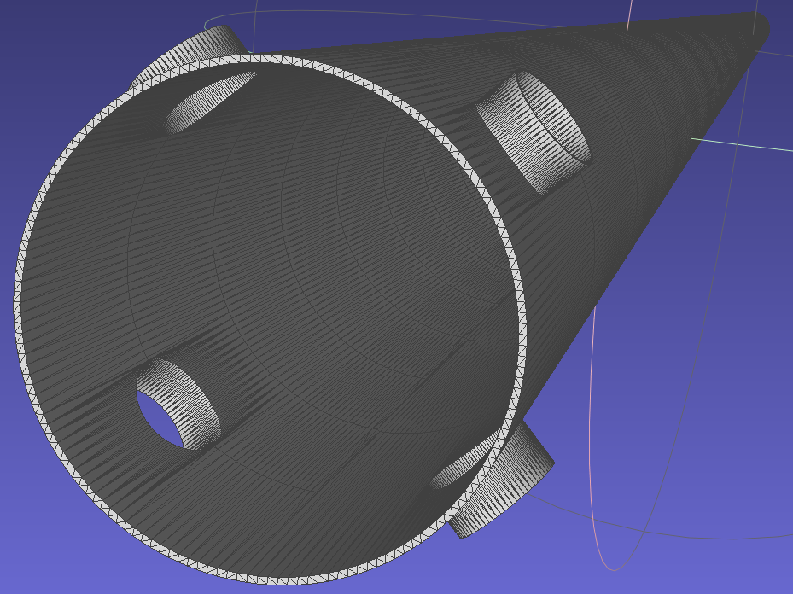
CADMesh for g4e ( Beampipe implementation)
D. Romanov
STEP file – the whole assembly
CADMesh
Boundary Representation (BREP) tessellation

Slide 6
Conclusions and plans
Import volumes of modules and support structures, of different sub-detectors from CAD and assign a sensitive elements to sub-volumes.

