Slide 1
Beam Shape Effects in Pythia8

Slide 2
Intro and Motivation
Detailed evaluation of physics observables and detector performance at the EIC will require accurate simulation of beam conditions at the IR: beam energy spread, z-vertex distribution, crossing angle, angular divergence, and z-dependent crabbing induced pT kick
Want to implement these effects in Pythia8 using native BeamShape functionality
Stand-alone Pythia implementation (few lines of code in executable and steering file) could be useful for theorists / independent researchers not familiar with whatever framework is put in place and also for quick studies
Pythia automatically takes into account all boosts and rotations associated with change in beam momenta and can thus be used as a cross check to schemes which boost the final state particles after they have been generated
Drawback is of course that this only works for Pythia8
Slides below explain implementation of vertex smearing, energy smearing, crossing angle, crabbing momentum kicks, and beam angular divergence: Beam Energies are 18x275

Slide 3
Energy (Pz) Variation
Pythia BeamShape class allows variation in z-component of beam momentum (assume change is small enough that physics processes or cross sections do not appreciably change)
ΔPz = (Beam Pz)*sigma*randomGauss
Sigma is taken as 10⁻⁴ and randomGauss is a random number from a gaussian distribution centered at zero
Actually, it looks like from table 3.3 in CDR that deltaP/P is 6.8 / 10.1 x 10^-4 for hadron / lepton – will add this in next iteration

Slide 4
Crossing Angle
The lepton and hadron beams will cross at an angle (use 25 milliradian) w.r.t each other
Take lepton beam as z-axis as it will align with the center of the detector and apply momentum modifications to hadron beam only
Assume crossing angle imparts momentum kick only in x (horizontal) direction
ΔPx = (Beam Pz + PzSmear)*Sin(Crossing Angle)
ΔPz = (Beam Pz + PzSmear)*Cos(Crossing Angle) – (Beam Pz) (Here PzSmear is Pz variation of the beam)
x
Lab Frame
Beam Pz + PzSmear
Lepton
ΔPx
z
θ
ΔPz
Hadron

Slide 5
Beam Divergence
Will get transverse momentum kicks from beam angular divergence in horizontal and vertical directions
Use angular divergence (Δθ) from table 3.3 in CDR: h/v 150/150 (Hadron) and 202/187 (Lepton)
Assume that momentum kicks in the horizontal and vertical direction are with respect to the beam. The beam will be rotated in the x direction due to the crossing angle – need to translate transverse momentum kick in horizontal direction into lab frame
ΔPx += (Beam Pz + PzSmear)*Sin(Divergence Angle_h)*Cos(Crossing Angle) (Hadron Beam only, lepton beam has no xing angle)
ΔPy += (Beam Pz + PzSmear)*Sin(Divergence Angle_v)
X_lab
(Beam Pz + PzSmear)*Sin(θ_d)
ΔPz += (Beam Pz + PzSmear)*Sin(Divergence Angle_h)*Sin(Crossing Angle) (For hadron beam only; for horizontal (x) divergence only as crossing is purely in x direction)
Θ_c
Θ_d
Beam Pz + PzSmear
(Beam Pz + PzSmear)*Sin(θ_d)*Cos(θ_c)
Θ_c
Z_lab

Slide 6
Crabbing Effects on Vertex Position
Determine the x, y, and z vertex of the collision along with the time of collision
Assume each bunch is rotated through half the beam crossing angle and assume it stays in a fixed orientation throughout the colliding region
Assume particles in bunch are distributed along z as a gaussian with a sigma of the RMS bunch length cited in CDR table 3.3, 3.4. Correct collision distribution should follow automatically
Assume particles in bunch are distributed in x,y as a gaussian with sigma given by Sqrt(RMS emittance x beta*) as given in CDR table 3.3, 3.4
Procedure:
Chose z (in in-bunch coordinates) of colliding particle in hadron and lepton bunch
Propagate bunches until colliding particles overlap – this sets collision z, t, and a central x offset
Randomly sample an x value according to beam widths and add to central x offset. Randomly sample a y value
Rotate system from ‘accelerator frame’ into ‘detector frame’

Slide 7
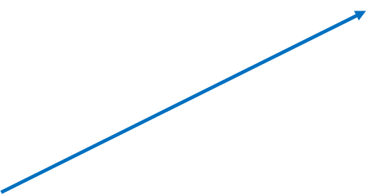
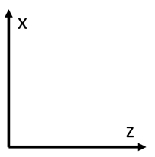
Crab Cavities rotate proton and electron bunches through half the crossing angle
Assume orientation of bunches is constant through course of bunch interaction – Think they rotate somewhat, but ignore this for now
Increasing Time
Increasing Time
Choose random position in z of each bunch to collide. Assume gaussian distribution with sigma = RMS bunch length
θ
In-bunch z
(θ/2k)*sin(kz) = (θ/2)*z

Slide 8
Once interacting particle positions are chosen, determine time of collision, x y & z of collision, and z of center of hadron bunch at time of collision
Solve set of equations below
Increasing Time
Increasing Time
Z_hpart
Z_hbunch
t
Z_hpart = Cos(θ/2)*t + Z_hbunch
Z_lpart = -Cos(θ/2)*t + Z_lbunch

Slide 9
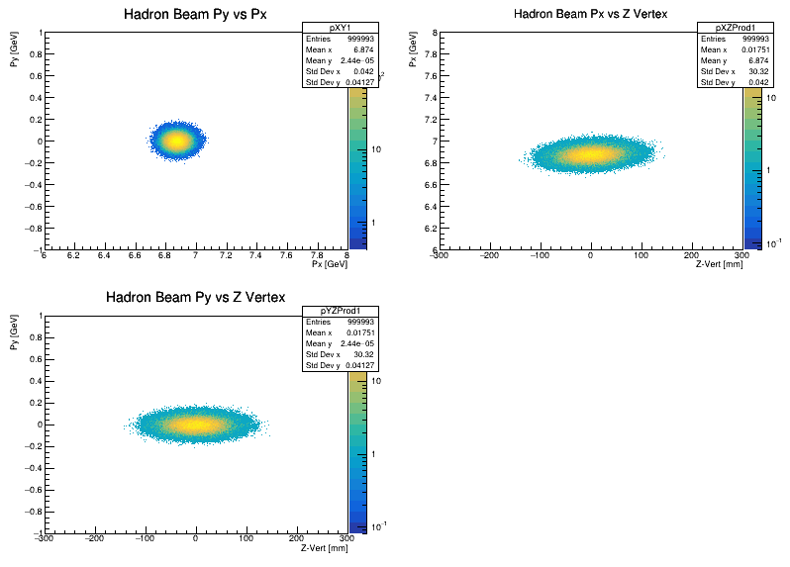
Hadron Beam Momentum: 18x275 25mRad

Slide 10
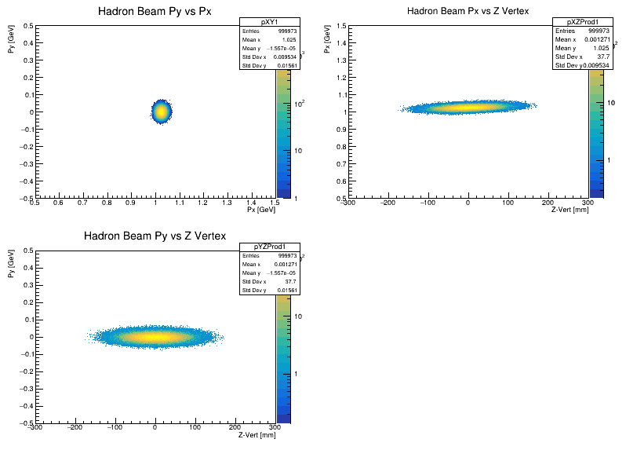
Hadron Beam Momentum: 5x41 25mRad

Slide 11
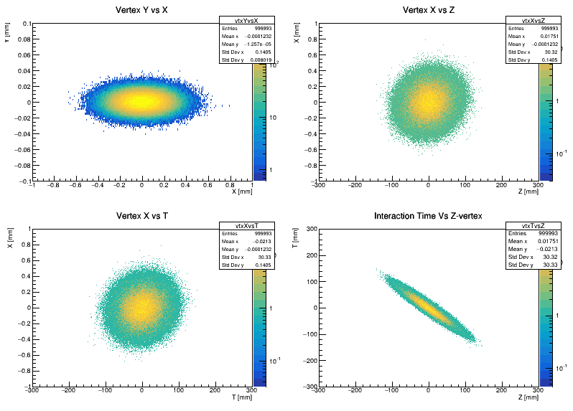
Vertex Correlations: 18x275 25mRad

Slide 12
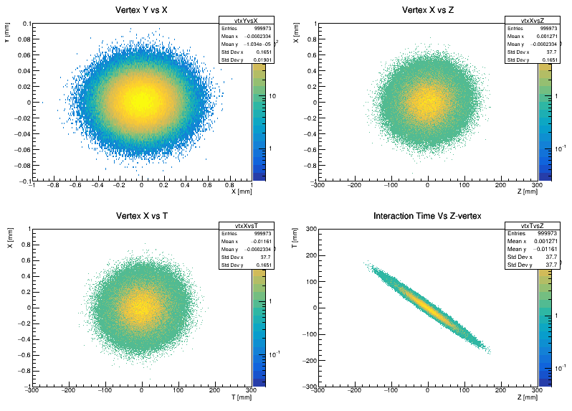
Vertex Correlations: 5x41 25mRad

Slide 13
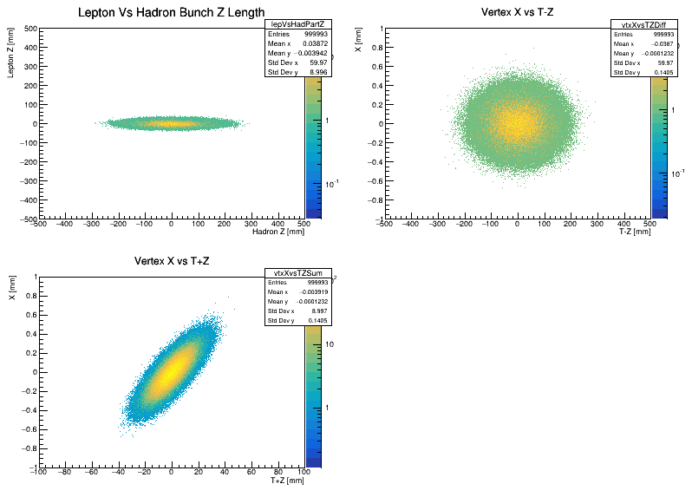
Vertex XZT Correlations: 18x275 25mRad

Slide 14
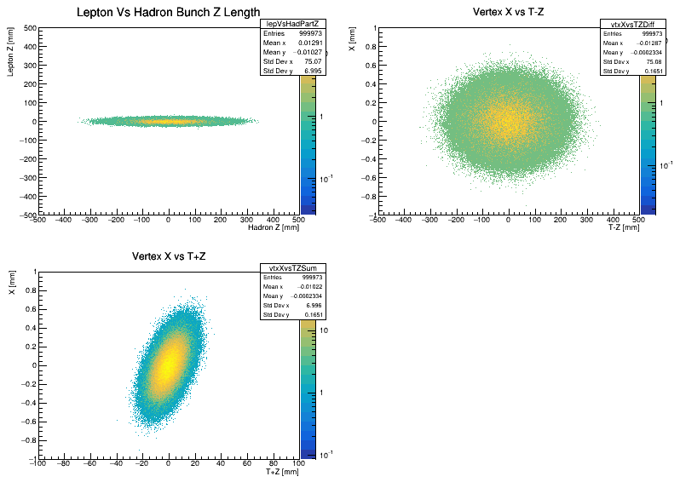
Vertex XZT Correlations: 5x41 25mRad

Slide 15
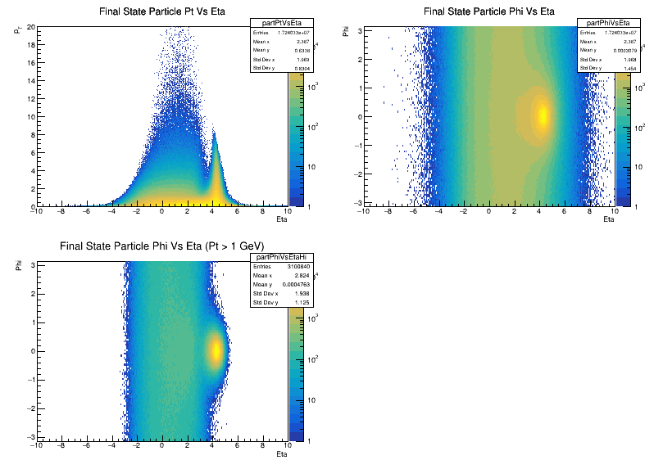
Particle Pt Eta Phi: 18x275 25mRad

Slide 16
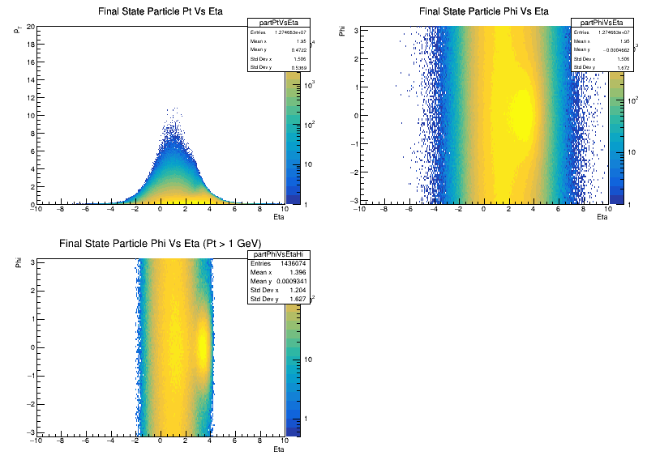
Particle Pt Eta Phi: 5x41 25mRad

Slide 17
Particle Pt Eta Phi: 18x275 25mRad

Slide 18
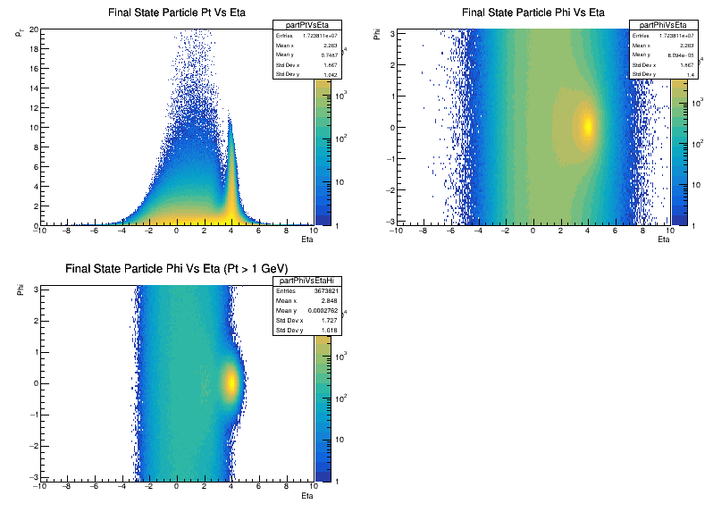
Particle Pt Eta Phi: 18x275 35mRad

Slide 19
Particle Pt Eta Phi: 5x41 25mRad

Slide 20
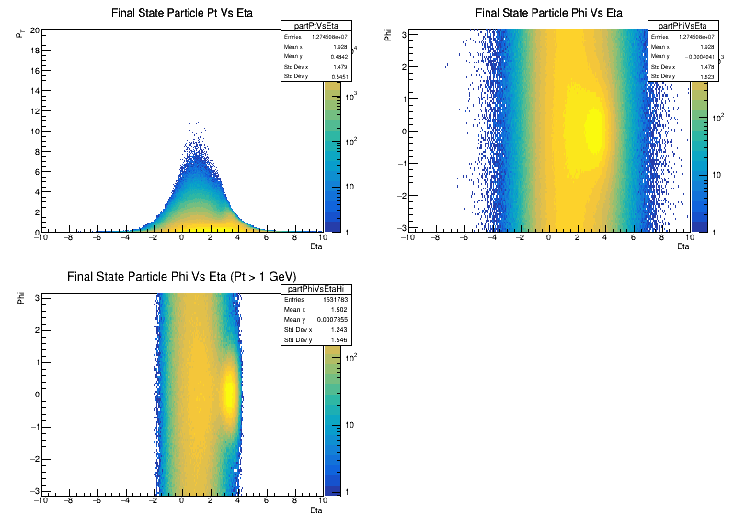
Particle Pt Eta Phi: 5x41 35mRad

Slide 22
Effects on Beam Properties
Slides below show how different beam effects change beam parameters
Each effect is shown independently of the others:
Default – Pythia8 with no changes
Beam Xing Only – Implements crossing angle with beam energy smearing
Crab Only – Implements z vertex dependent transverse momentum kick with beam energy smearing
Divergence Only – Implements transverse momentum kicks due to angular beam divergence with beam energy smearing
Crab + Divergence – Combines the effects from z vertex dependent transverse momentum kicks and beam divergence with beam energy smearing
All Effects – Combines all effects

Slide 23
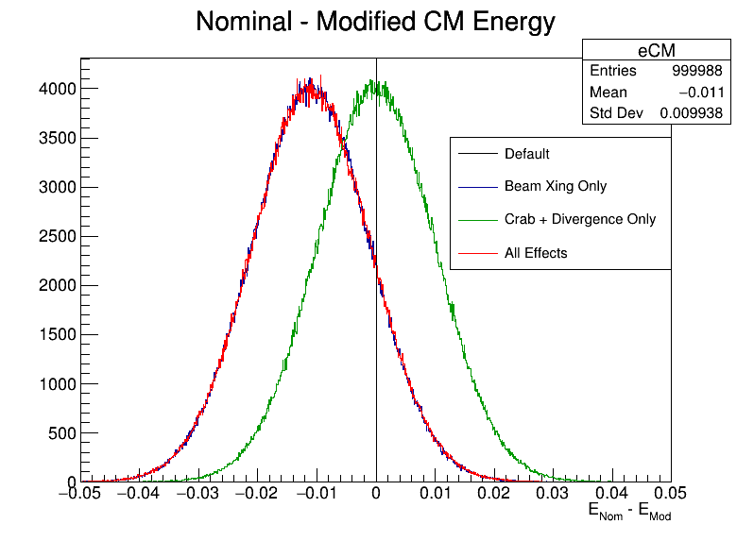
Change in COM Energy

Slide 24
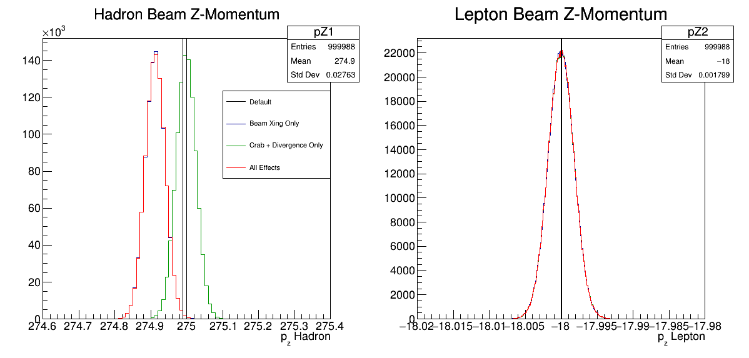
Change in Beam Longitudinal Momentum
Width = Beam energy x 10⁻⁴
Offset due to introduction of crossing angle

Slide 25
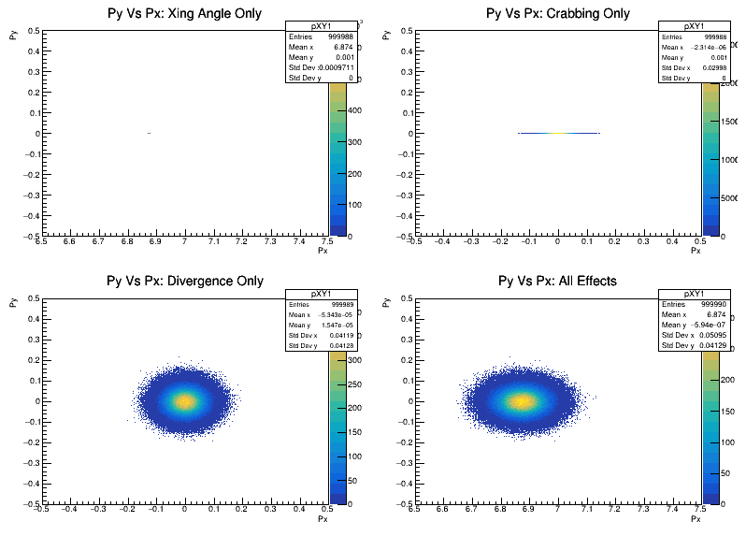
Change in Hadron Beam Transverse Momentum
Crossing angle gives ~6.8 GeV kick in the x direction
Crabbing momentum kick only in x direction now
Angular divergence gives transverse momentum kicks in x and y

Slide 26
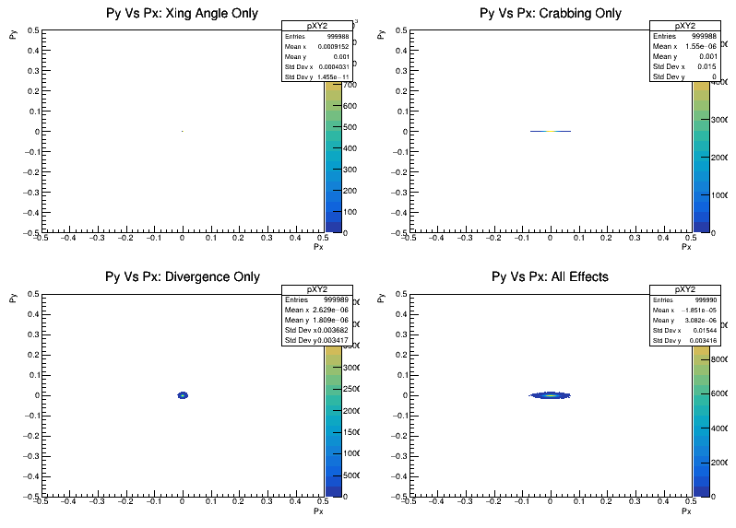
Change in Lepton Beam Transverse Momentum
Effects are smaller than hadron beam due to lower energies
No momentum offset due to crossing angle

Slide 27
Effects on Final State Particles
Above slides show effects of momentum spread, crossing angle, crabbing angle, and beam divergence on center of mass energy and beam momenta
How are the kinematics of the hadronic final state altered?
Look at pT, eta, and phi of final state particles
Compare Default Pythia sample with All Effects sample
18x275, Q² > 10 GeV², 0.01 < y < 0.95, -10 < eta < 10

Slide 28
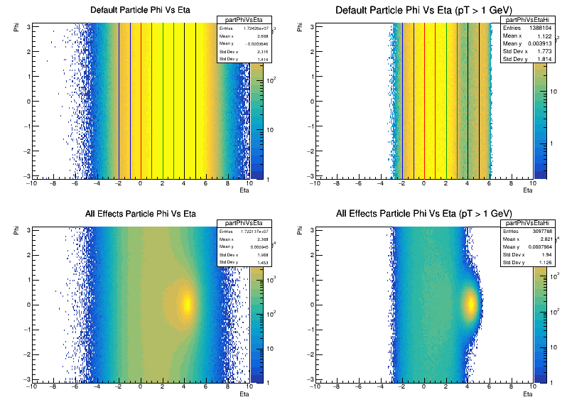
Final State Particle Phi Vs Eta
All Particles
High pT Particles
Compare particle phi spectra from different eta slices in next slide
Unaltered PYTHIA
Obvious hot-spot at eta ~4.5 – seems to be populated from higher eta particles
PYTHIA with all beam effects

Slide 29
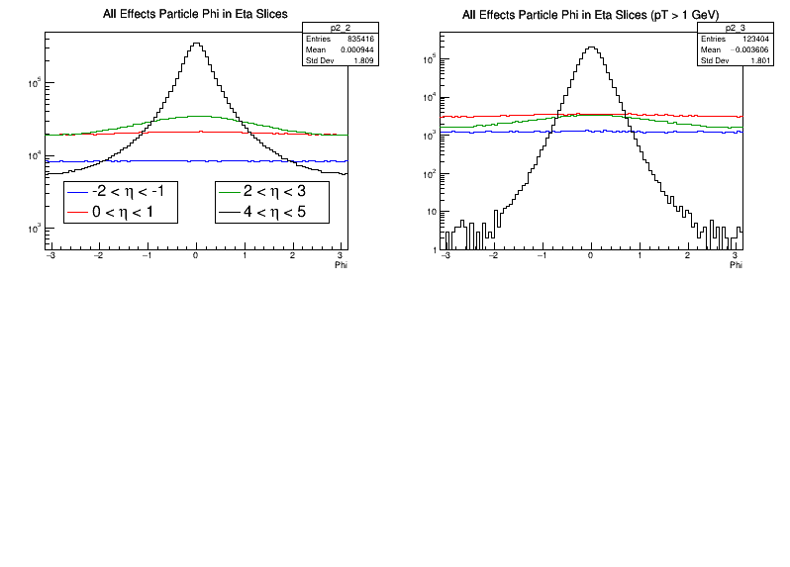
Phi Projection for Eta Slices
All Particles
High pT Particles
PYTHIA with all beam effects
Note suppressed 0
Obvious from previous plots that anisotropy in phi is concentrated at large eta
At backward eta phi distribution is flat

Slide 30
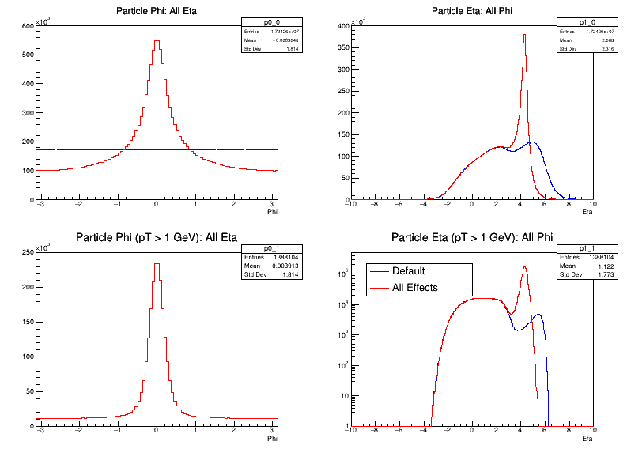
Phi and Eta Projections
Large increase in particle concentration around eta of 4.5 being fed by redistribution of higher eta particles
Spectra at lower eta values match almost exactly
There are roughly 2.25 times more particles above 1 GeV in the All Effects sample compared to default

Slide 31
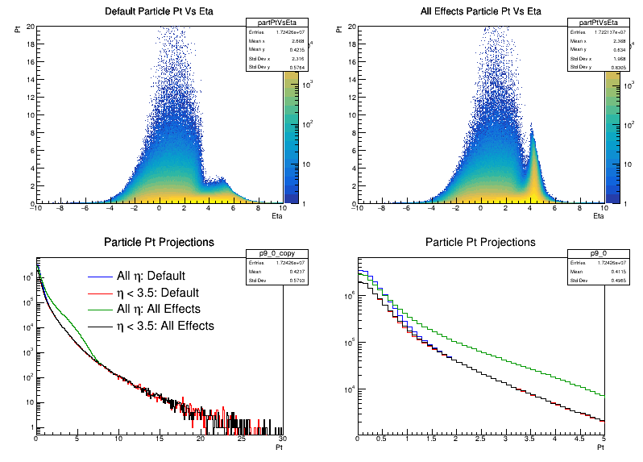
Transverse Momentum Kick
Unaltered PYTHIA
All Effects
Excess of particles at eta = 4.5 also show an excess in pT
Excess of particles with pT between 1 and 7 GeV seen
pT spectra of Default and All Effects samples match for eta < 3.5 and match full Default sample for pT > 1.5 GeV

