Slide 1
Crabbing Effects On Vertex Position and Momentum

Slide 2
Crabbing Effects on Vertex Position
Determine the x, y, and z vertex of the collision along with the time of collision
Assume each bunch is rotated through half the beam crossing angle and assume it stays in a fixed orientation throughout the colliding region
Assume particles in bunch are distributed along z as a gaussian with a sigma of the RMS bunch length cited in CDR table 3.3, 3.4. Correct collision distribution should follow automatically
Assume particles in bunch are distributed in x,y as a gaussian with sigma given by Sqrt(RMS emittance x beta*) as given in CDR table 3.3, 3.4
Procedure:
Chose z (in in-bunch coordinates) of colliding particle in hadron and lepton bunch
Propagate bunches until colliding particles overlap – this sets collision z, t, and a central x offset
Randomly sample an x value according to beam widths and add to central x offset. Randomly sample a y value
Rotate system from ‘accelerator frame’ into ‘detector frame’

Slide 3
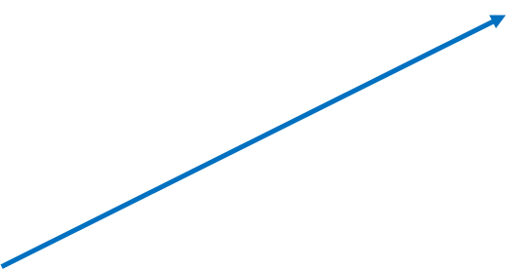
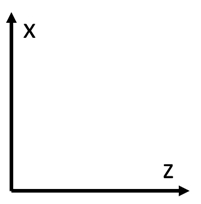
Crab Cavities rotate proton and electron bunches through half the crossing angle
Assume orientation of bunches is constant through course of bunch interaction – Think they rotate somewhat, but ignore this for now
Increasing Time
Increasing Time
Choose random position in z of each bunch to collide. Assume gaussian distribution with sigma = RMS bunch length
θ
In-bunch z
(θ/2k)*sin(kz) = (θ/2)*z

Slide 4
Once interacting particle positions are chosen, determine time of collision, x y & z of collision, and z of center of hadron bunch at time of collision
Solve set of equations below
Increasing Time
Increasing Time
Z_hpart
Z_hbunch
t
Z_hpart = Cos(θ/2)*t + Z_hbunch
Z_lpart = -Cos(θ/2)*t + Z_lbunch

Slide 8
Configuration at collision
Collision time is when Z_hpart = Z_lpart
Z_hCenter
t_col = (z_lbunch – z_hbunch)/(2*Cos(θ/2))
Z_col = (z_lbunch + z_hbunch)/2.0
Z_hCenter = Cos(θ/2)*t_col
X_col = Z_hCenter*Tan(θ/2) or Sin(θ/2)*t_col

Slide 11

$$σ_{x}= \frac{σ_{px}σ_{ex}}{\sqrt{σ_{px}^{2}+ σ_{ex}^{2}}}$$
The x position of the collision calculated previously assumes the interacting particle sits along the centerline of the bunch – in principle this actually follows a gausian with a width given by beam emittance and beta function
Randomly sample this gaussian and add to calculated x position to get actual x of collision
Sample gaussian to get y

Slide 12
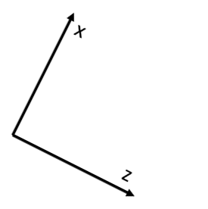
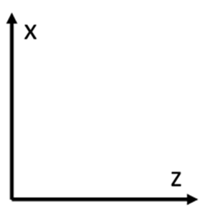

$$R_y= \begin{matrix}Cos(\frac{θ}{2}) & 0 & Sin(\frac{θ}{2}) \\ 0 & 1 & 0 \\ −Sin(\frac{θ}{2}) & 0 & Cos(\frac{θ}{2})\end{matrix}$$
Detector Frame
Accelerator Frame
We now have the x, y, and z position of the collision in the ‘accelerator frame’
Remember that the central detector will be aligned along the lepton beam
Rotate around y-axis from accelerator frame to detector frame

Slide 13
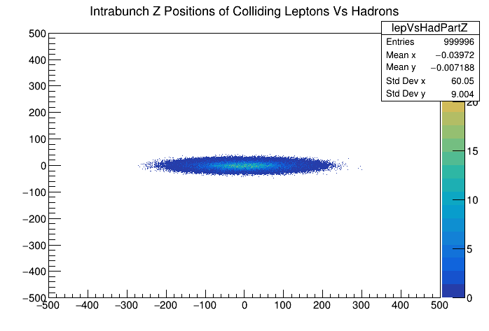
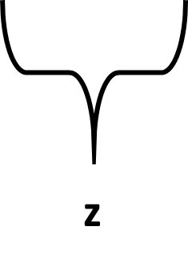
Bunch Z Extent
Z-Position of particle within the hadron (x-axis) and lepton (y-axis) bunches
Reconstructed from collision time and z-vertex
Input hadron bunch RMS z = 60 mm
Input lepton bunch RMS z = 9 mm

Slide 14
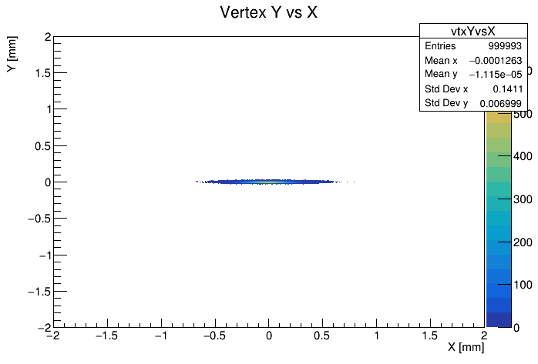
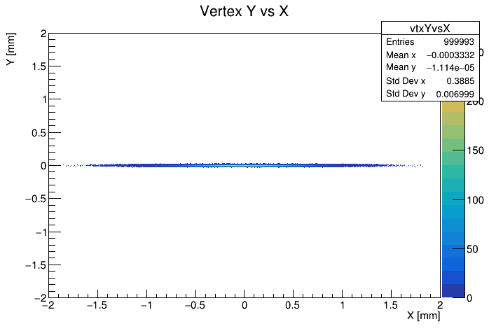
Interaction Vertex Position (X-Y)
Rotated ‘Detector Frame’
Unrotated ‘Accelerator Frame’
Extent of vertex distribution in Y is given purely by spread in bunch Y
X vertex extent is convolution of bunch X distribution and range over which collisions can occur
Rotation into ‘detector frame’ narrows x distribution

Slide 15
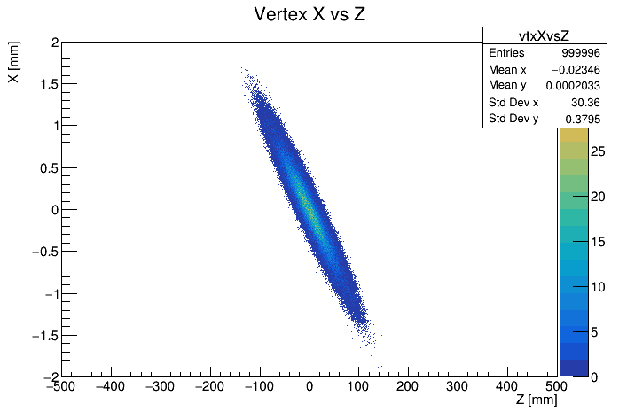
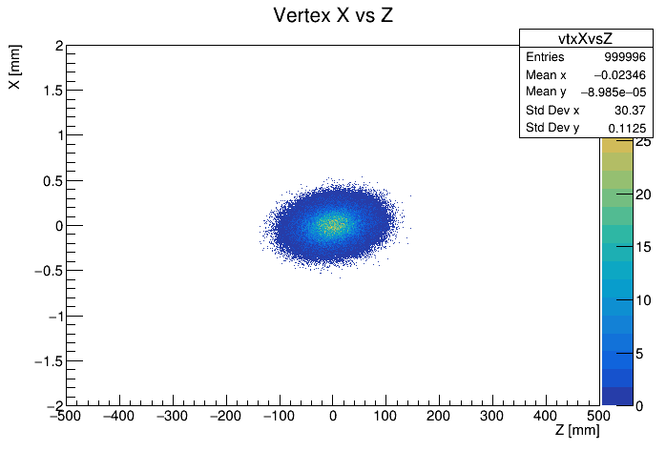
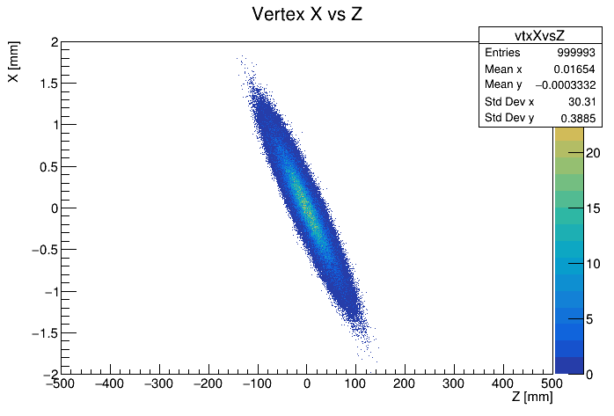
Interaction Vertex Position (X-Z)
Even for bunches with no x width, x and z are not perfectly correlated – width due to time spread of collisions
Rotation to ‘detector frame’ narrows observed vertex x distribution – but breaks x-z correlation
‘Accelerator Frame’ No X Distribution
‘Detector Frame’ With X Distribution
‘Accelerator Frame’ With X Distribution

Slide 16
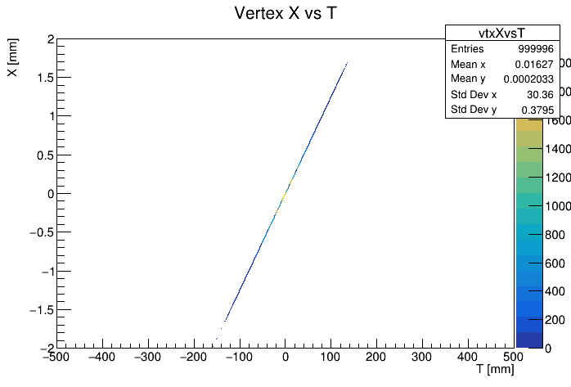
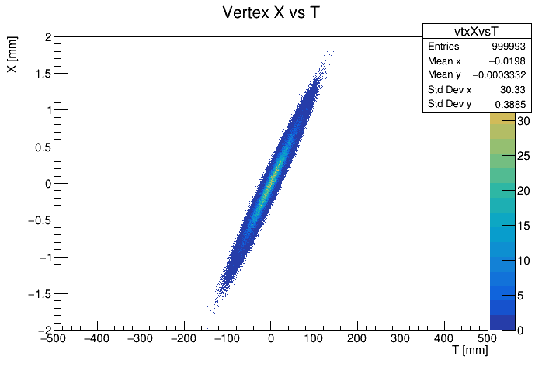
Interaction Vertex Position (X-T)
Assuming no x width of bunch, x position of collision is perfectly correlated with collision time
Width of bunch in x is exactly reflected in x vs t plot
Rotation to ‘detector frame’ narrows observed vertex x distribution – but breaks x-t correlation
‘Accelerator Frame’ No X Distribution
‘Detector Frame’ With X Distribution
‘Accelerator Frame’ With X Distribution

Slide 17
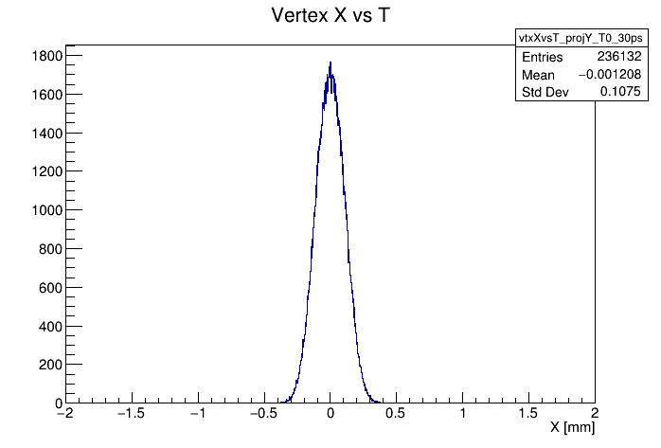
X Vertex and Timing Resolution
Plots are made setting c = 1, so time is in mm (unit of choice of Pythia)
c = 0.3 mm/ps -> 9 mm = 30 ps
A +/- 9 mm or 30 ps timing determination leads to a roughly 110 micron resolution on the x position of the collision
This is all for the accelerator frame

Slide 18
Crabbing Effects on Vertex Momentum Kick

Slide 19
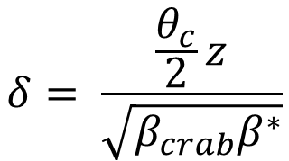
$$δ= \frac{\frac{θ_{c}}{2}z}{\sqrt{β_{crab}β^{∗}}}$$
ΔPx = Beam Mom * Sin(δ)
Beam Momentum
ΔPx
δ
For Beam Momentum = 275, z = 10 cm -> ΔPx = 0.01 GeV
Rotate this into detector frame: ΔPx` = ΔPx*Cos(θ/2) and ΔPz` = -ΔPx*Sin(θ/2)
z

Slide 20
Animation of Beam Crossing Without Crabbing

