Slide 1
Frame Investigation

Slide 2
Introduction
My previous studies have shown what the distribution of particles will look like in the detector in the presence of a crossing angle (and other beam effects)
This is relevant because this is what the detector will see and therefore will define the resolutions and acceptances we work with
As Alexander pointed out though, the lab/detector frame is not necessarily the one in which we will do analyses as it is in principle possible to transform to a frame in which the crossing angle effects are negated
Below, I describe this transformation and look at a few relevant issues
TL;DR: Transformation from lab frame to frame where anisotropies due to crossing angle disappear is relatively well behaved in central detector; need to be aware of some acceptance effects; good PID/energy measurements will help

Slide 3
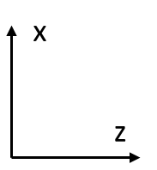
Boost
(6.896/293.29,0.022/293.29,257.15/293.29)
(0.003,-0.001,-18.026,18.026)
(6.892,0.023,275.176,275.264)
Initial Configuration in the Lab Frame

Slide 4
(-1.402,-0.006,-70.420,70.434)
(1.402,0.006,70.420,70.440)
Initial Configuration in the Lab Frame
Boost by sum of beam 4-momenta to get to CM Frame

Slide 5
(0.0,-0.006,-70.434,70.434)
(0.0,0.006,70.434,70.440)
Initial Configuration in the Lab Frame
Boost by sum of beam 4-momenta to get to CM Frame
Rotate about y-axis to eliminate x-component of momentum

Slide 6
Boost
(0.0,0.0,-257.15/293.29)
(0.0,0.0,-18.048,18.048)
(0.0,0.0,274.890,274.891)
Initial Configuration in the Lab Frame
Boost by sum of beam 4-momenta to get to CM Frame
Rotate about y-axis to eliminate x-component of momentum
Rotate about x-axis to eliminate y-component of momentum (not shown)
Boost back along z to (nearly) restore original beam energies

Slide 7
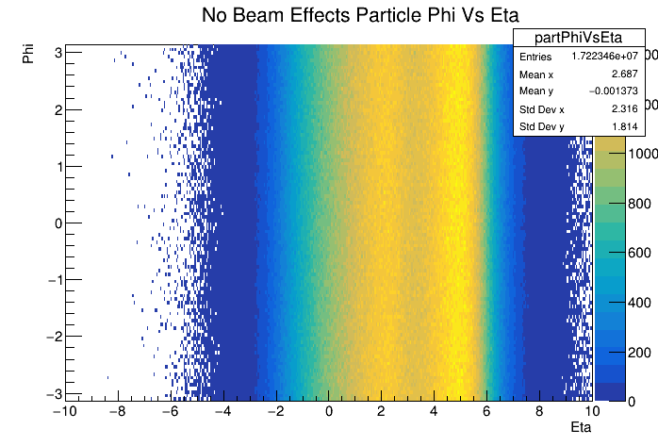
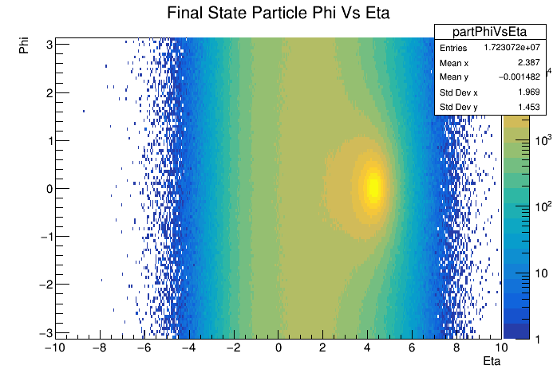
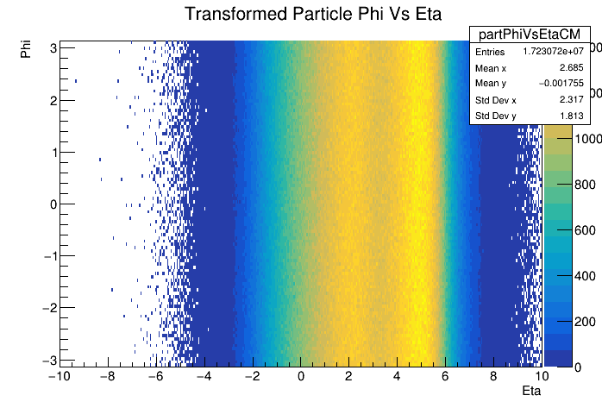
Frame Comparison: Phi Vs Eta
Transform
Crossing angle introduces a hot-spot at phi = 0 and eta = ~4.2 in the lab frame (top left)
Transformation described above removes phi modulation and smooths out eta (bottom right)
Matches very well with distribution obtained from default Pythia with no beam effects included (top right)

Slide 8
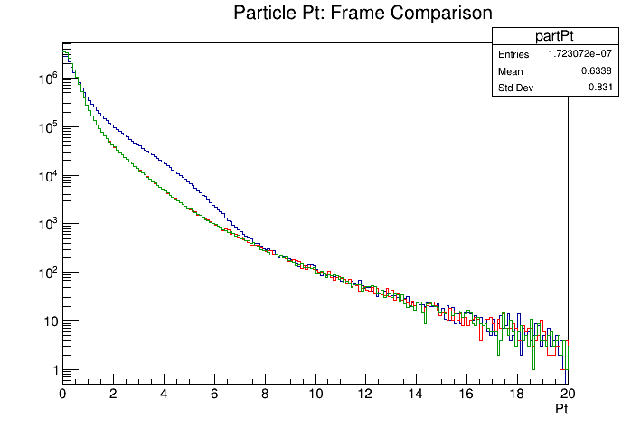
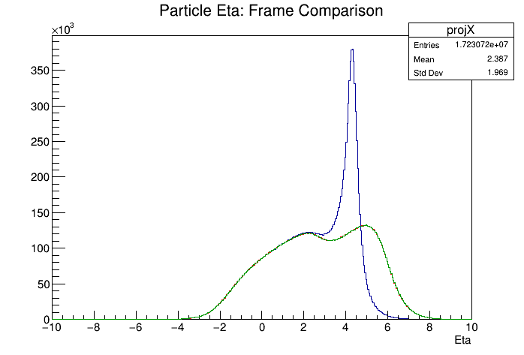
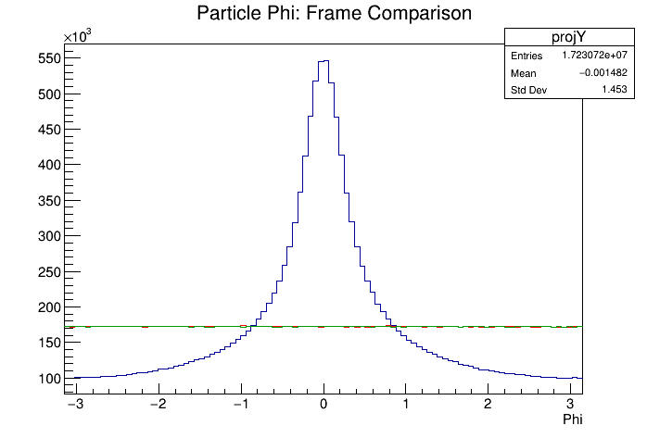
Frame Comparison: Pt, Eta, & Phi
Transformed eta and phi distributions from Pythia sample with beam effects matches exactly the lab frame distributions from default Pythia
Particle Pt distributions match as well
Transformation does what we expect
Lab Frame (Beam Effects)
Transformed (Beam Effects)
Lab Frame (No Beam Effects)

Slide 9
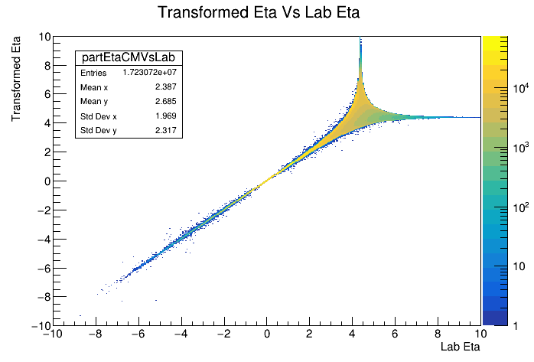
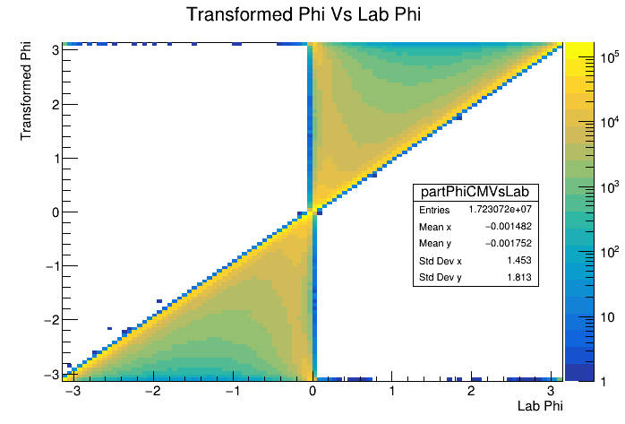
Transformed Vs Original Phi and Eta
Correlation between transformed and lab eta for Pythia sample with beam effects is one-to-one for low eta
Correlation begins to smear out at higher eta with singular behavior near eta = 4.2

Slide 10
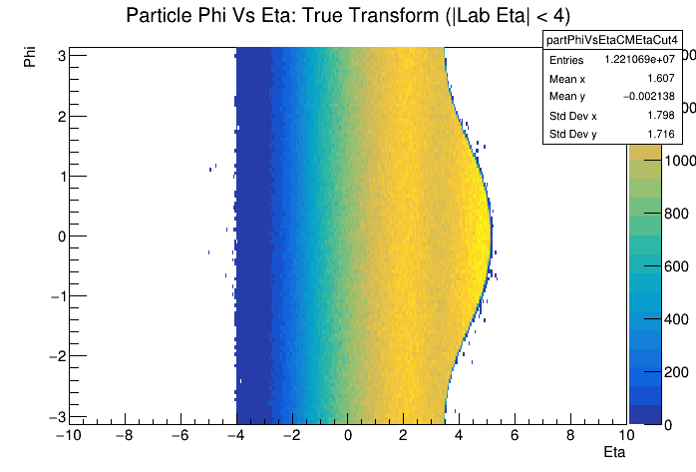
Acceptance Effects: Lab Eta < 4
We have seen that the transformed eta/phi distributions match the default Pythia values very well when considering all particles
How does limiting acceptance due to finite detector acceptance effect transformed distribution
See the ‘bulge’ from crossing angle, but particle distribution is still flat in phi within this region

Slide 11
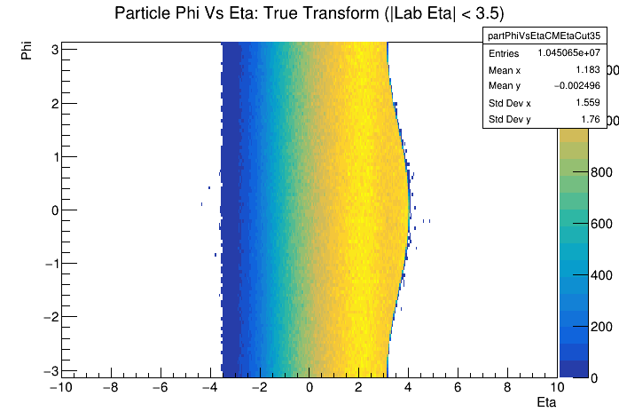
Acceptance Effects: Lab Eta < 3.5
If we look at acceptance of eta between +/- 3.5 in the lab frame (nominal tracking range), ‘bulge’ decreases, but eta range also decreases (no surprise)

Slide 12
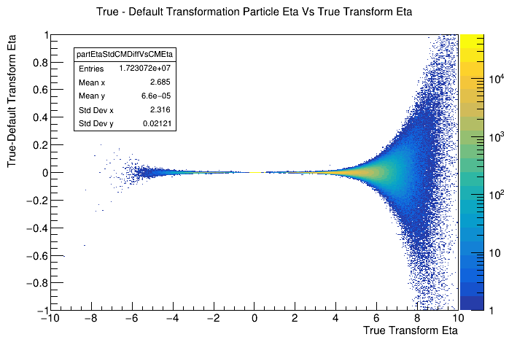
Beam Smearing Effects
All plots above used transformation constructed assuming perfect knowledge of incoming beams
Divergence, beam energy spread, etc introduce momentum deviations which cannot be measured event by event
Compare true transformation (assuming perfect knowledge) with default transformation (assume nominal beam energies and crossing angle)
Deviations are small at mid-rapidity but grow sizable as you move forward

Slide 13
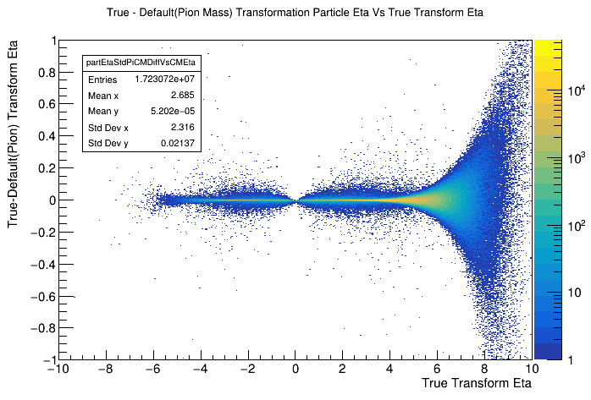
Beam Smearing Without PID
Lorentz transformation depends on momentum and energy of the particle being transformed
How is the transformation affected if we don’t know the energy of the track
Assume all tracks are pions and all neutrals are massless
Look at deviation between true transformation and transformation assuming nominal crossing angle and beam energy as well as the pion mass and massless neutrals assumptions
TODO: Look at detector smearing

