Slide 1
Hot-Spot Position

Slide 2
Question was raised at a previous meeting: Why does the eta position of the ‘hot-spot’ change with beam energy. It should be defined by the pseudorapidity of the outgoing hadron direction (4.38 for 25 mRad)
For 18x275, hot-spot sits at roughly this eta, but moves to lower eta for 5x41
Possible insight gained as I was looking at boosting/rotating to a frame with no crossing angle – the relationship between the boosted/rotated and lab frame eta depends solely on crossing angle and is the same regardless of beam energy – distribution of particles change within the characteristic shape depending on beam energy
Singular point, where one value of lab frame eta can be transformed into a wide range of Boosted/rotated sits at exactly the eta corresponding to the crossing angle
Slides 3-6 show boost / rotation scheme
Slides 7-10 show the lab frame phi vs eta plot for final state particles and different beam energy combinations as well as the plot of transformed eta vs lab frame eta
Position of hot-spot may have more to do with how relativistic the beam is – as energy increases, it seems the hot-spot asymptotically approaches beam pseudorapidity

Slide 3
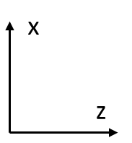
Boost
(6.896/293.29,0.022/293.29,257.15/293.29)
(0.003,-0.001,-18.026,18.026)
(6.892,0.023,275.176,275.264)
Initial Configuration in the Lab Frame

Slide 4
(-1.402,-0.006,-70.420,70.434)
(1.402,0.006,70.420,70.440)
Initial Configuration in the Lab Frame
Boost by sum of beam 4-momenta to get to CM Frame

Slide 5
(0.0,-0.006,-70.434,70.434)
(0.0,0.006,70.434,70.440)
Initial Configuration in the Lab Frame
Boost by sum of beam 4-momenta to get to CM Frame
Rotate about y-axis to eliminate x-component of momentum

Slide 6
Boost
(0.0,0.0,-257.15/293.29)
(0.0,0.0,-18.048,18.048)
(0.0,0.0,274.890,274.891)
Initial Configuration in the Lab Frame
Boost by sum of beam 4-momenta to get to CM Frame
Rotate about y-axis to eliminate x-component of momentum
Rotate about x-axis to eliminate y-component of momentum (not shown)
Boost back along z to (nearly) restore original beam energies

Slide 7
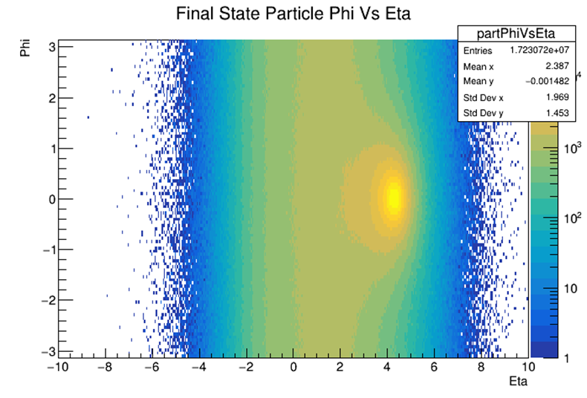
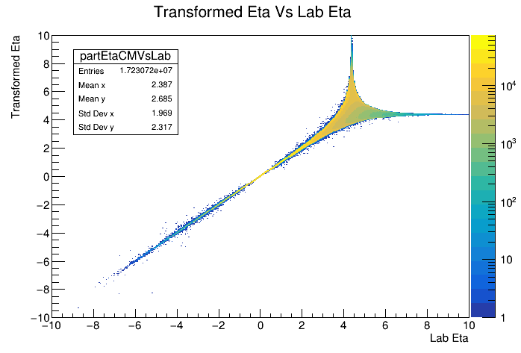
18x275 25mRad Crossing Angle
Red: Eta = 4.382 (25 mRad)

Slide 8
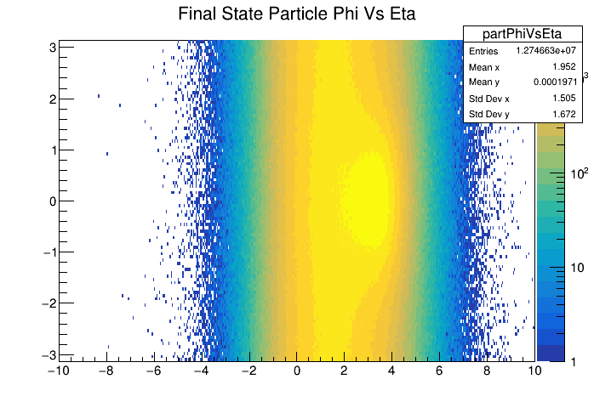
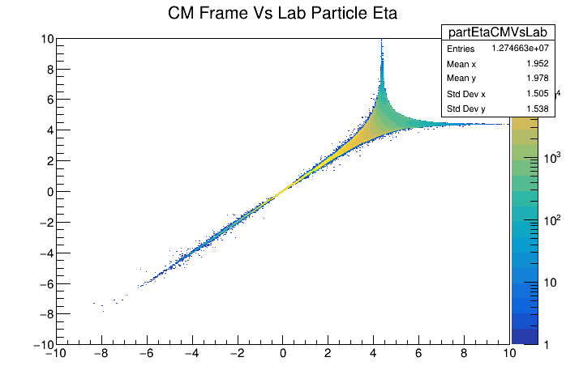
5x41 25mRad Crossing Angle
Red: Eta = 4.382 (25 mRad)

Slide 9
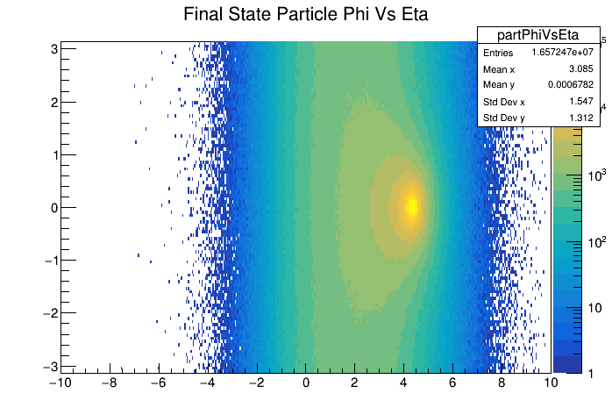
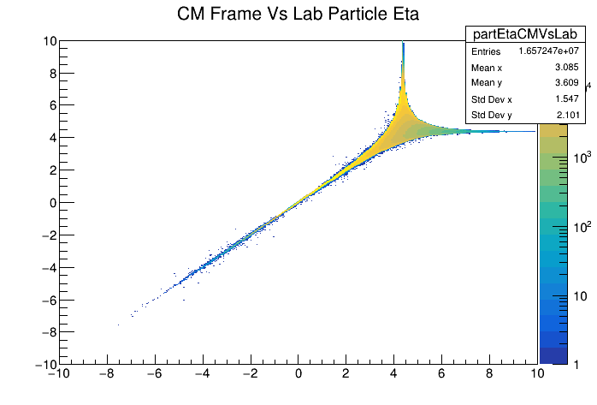
5x500 25mRad Crossing Angle
Red: Eta = 4.382 (25 mRad)

Slide 10
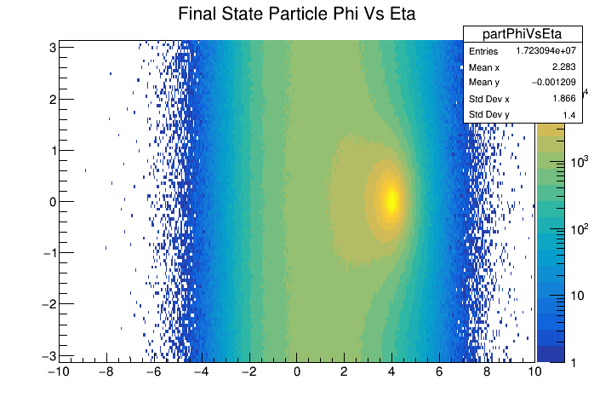
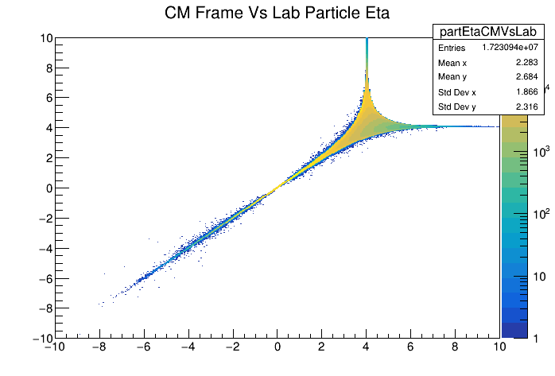
18x275 35mRad Crossing Angle
Red: Eta = 4.382 (25 mRad)
Black: Eta = 4.045 (35 mRad)

