Slide 1
Neutron Detection Studies with a Beam Pipe
Alex Jentsch
March 8th , 2021

Slide 2
Basic Setup
All runs use a neutron gun with E ~ 110 GeV
Using 0.0 < theta < 3.8 mrad
~100k neutrons
Comparisons with different beam pipe material.
All with 2mm thickness and 34cm diameter where neutrons exit toward ZDC.
Goal is to understand how many neutrons are lost in the beam pipe material for each option.

Slide 3
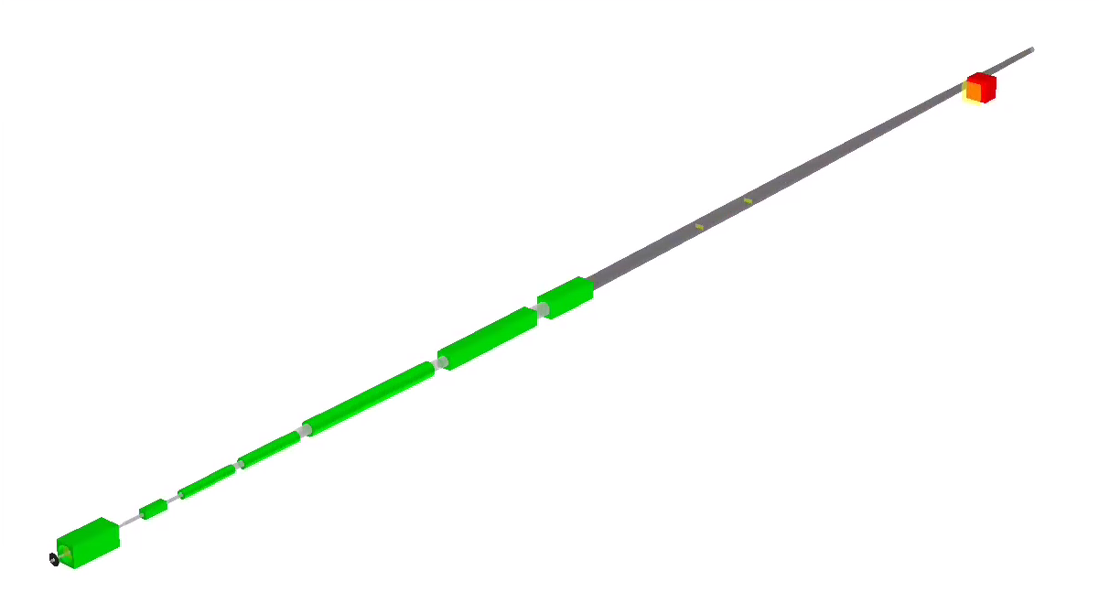
Neutrons incident on pipe with angle ~ 20mrad on average.
This means the neutrons travel through ~10cm of material for a 2mm thick pipe.

Slide 4
Neutron Sample
momentum, p [GeV/c]
transverse momentum, pT [GeV/c]
Polar Angle, 𝛳 [mrad]
Azimuthal Angle, 𝜙 [rad]

Slide 5
Stainless Steel

Slide 6
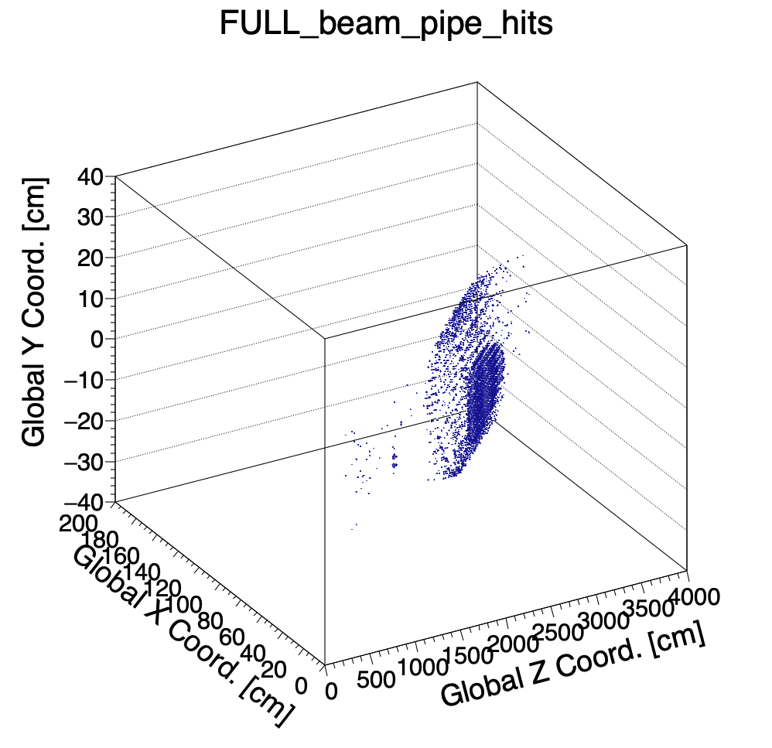
Neutrons with Stainless Steel
B1apf exit

Slide 7
Beryllium

Slide 8
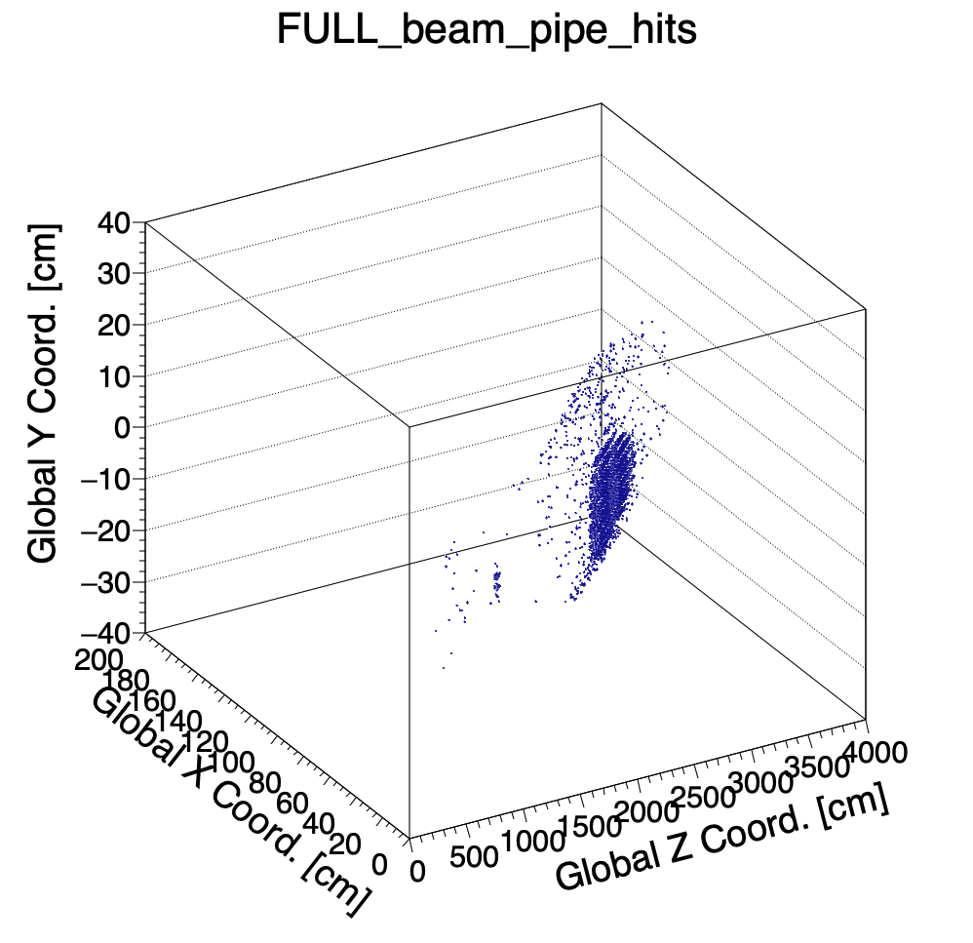
Neutrons with Beryllium pipe
B1apf exit

Slide 9
Aluminum

Slide 10
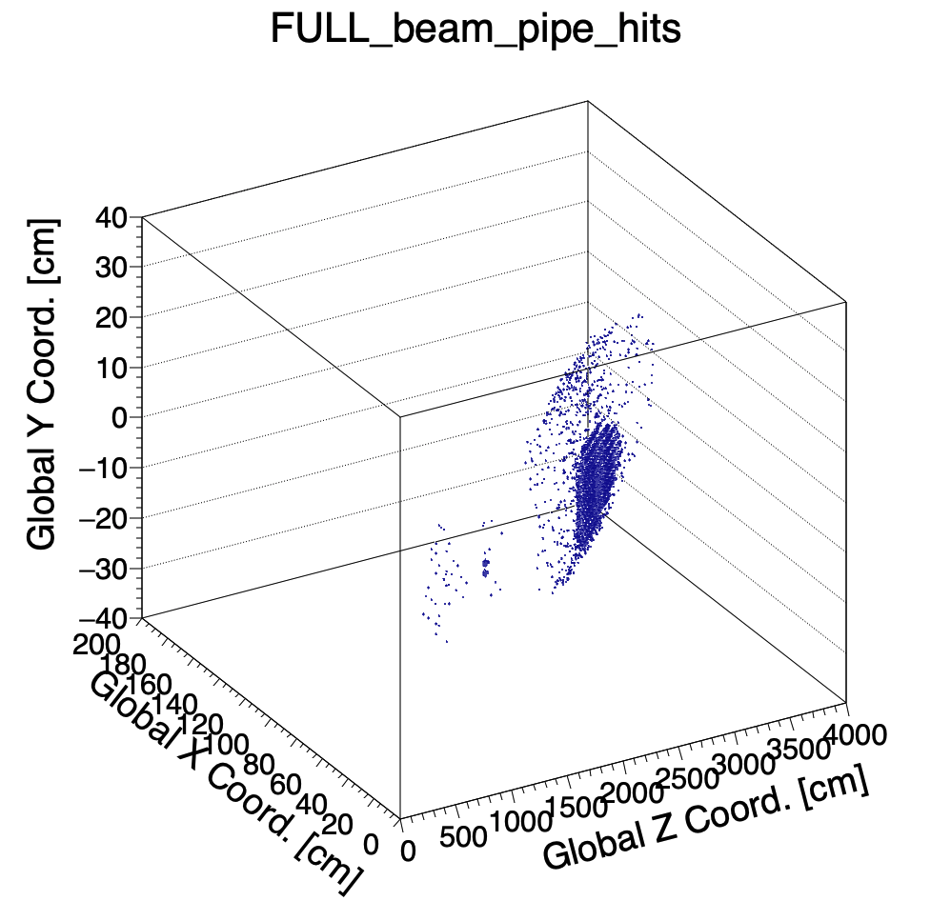
Neutrons with Aluminum pipe
B1apf exit

Slide 11
Summary
Beam pipe will have a major impact on neutron detection.
The ZDC is quite far from the exit of the neutron cone, so tagging the shower is not easy.
Aluminum seems the best option for a window.
Need to simulate a few different thickness options – what’s a reasonable limit?
Needs to be rather large (covering ~ 10m in z).
Photons have been studied as well, but study will be repeated with updated pipe parameters.
With an aluminum pipe at the current location, rotation, and thickness, ~40% of the photons between 50 and 150 MeV make it through the pipe unscathed.
Next up: study impact on protons on the other side of the beam pipe going toward the off-momentum detectors.
Additionally, in discussion with the IR and machine folks to potentially include a window at a greater angle of incidence to reduce the effective material length traversed by the neutrons and photons.
Updates coming soon.

