Slide 1
Expression of Interest for Software
Common Projects
Software Tools for Simulations and Reconstruction
Monte Carlo Event Generators
Detector Simulations
Reconstruction
Middleware and Preservation
Workflows
Data and Analysis Preservation
Interaction with the Software Tools
Explore User-Centered Design
Discoverable Software
Data Model
Future Technologies
Artificial Intelligence
Heterogeneous computing
New languages and tools
Collaborative software
29 institutions
https://indico.bnl.gov/event/8552/contributions/43221/

Slide 2
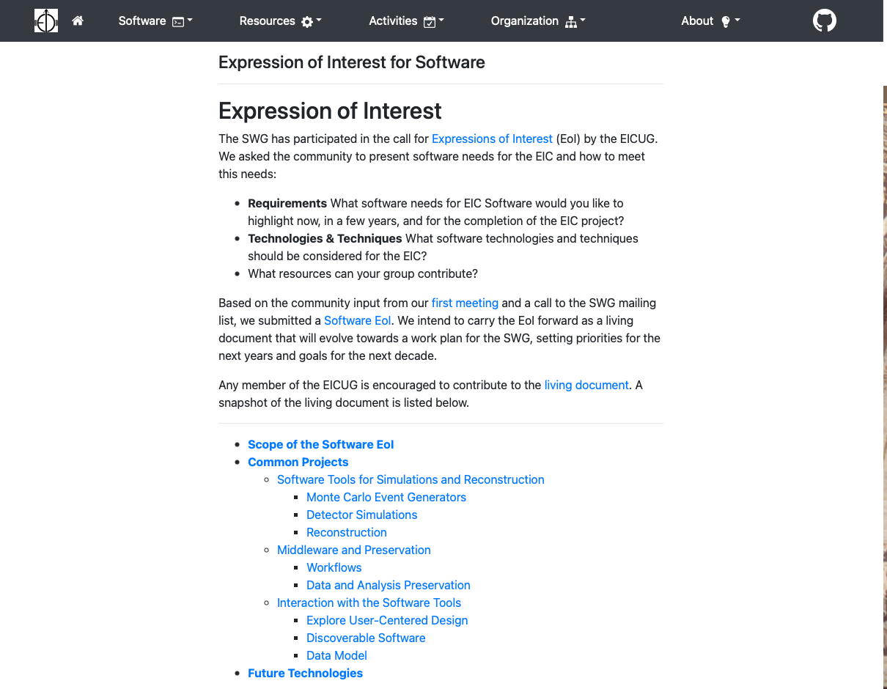
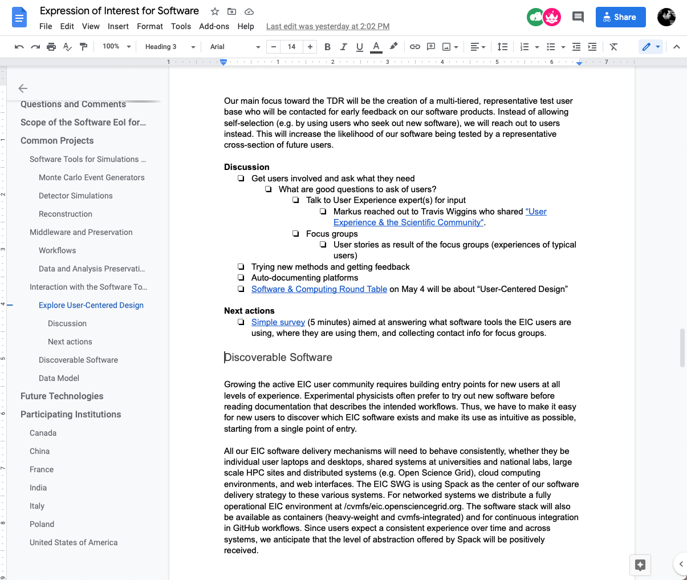
Evolving the EoI towards a Work Plan for the SWG
https://eic.github.io/activities/eoi.html

Slide 3
Update on Common Projects
Software Tools for Simulations and Reconstruction
Monte Carlo Event Generators
02/24 Kolja reported on maintaining Pythia6 for the EIC.
03/10 Prabhakar Palni (Goa University) will report on MC-data comparisons for the EIC
Detector Simulations
Reconstruction
02/24 Joe Osborn updated us on ACTS for the EIC.
Middleware and Preservation
Workflows
Data and Analysis Preservation
02/24, 03/10 Kolja, Markus, Maxim, Sylvester, and Wouter will give update on prototype.
Interaction with the Software Tools
Explore User-Centered Design
03/03 Kolja, Markus, Rebecca, Sylvester, Wouter will report on “Status of Software Survey.”
Discoverable Software
Spack (Wouter)
Data Model
Common output format (Dmitry), data model for streaming readout (Jan)
Validation
MCEGs
Fast simulations eic-smear
Full simulations ESCalate, Fun4All

Slide 4
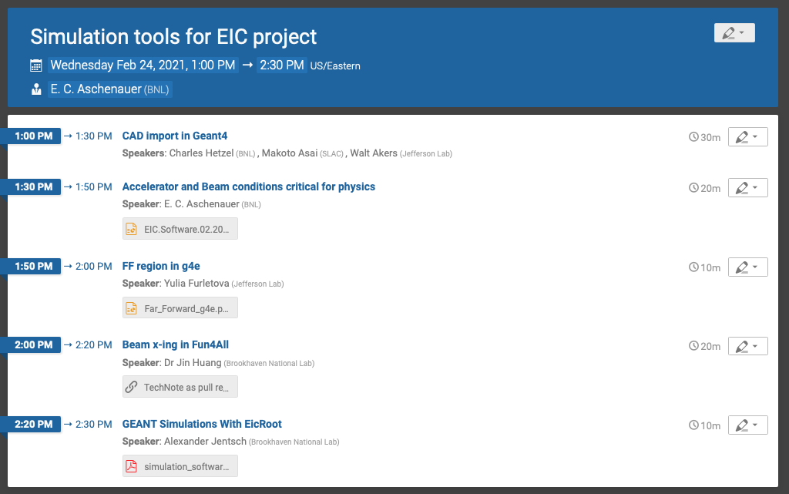
Simulation Tools for EIC Project
https://indico.bnl.gov/event/10941/
https://indico.bnl.gov/event/10941/
Technical note in preparation

