Slide 1
Jefferson Lab MAGNET GROUP
EIC-Experimental Equipment
(BABAR/sPHENIX JLab Engineering Risk Assessment)
v2.00 - October 10th 2020 – updated risk tables
Ruben Fair
Team Members:
Renuka Rajput-Ghoshal – Lead Engineer
Probir Ghoshal
Eric Sun
Dan Young

Slide 2
Outline of talk
Background
Proposal for the use of this magnet
Magnet Construction
Assessment Approach
SLAC Risk Analysis (2004, 2006)
BNL Low Current Test (2016)
BNL High Current Test (2018)
JLab Risk Assessment (2020)
JLab Recommendations

Slide 3
Proposal to use the BABAR/sPHENIX solenoid as a detector solenoid for the EIC project
There is a proposal to re-use the existing 1.5 T BABAR magnet as a detector solenoid for the EIC project.
The magnet for the BABAR experiment at PEP-II at SLAC, CA was manufactured by Ansaldo, Italy in 1997 and was commissioned in 1998
It was then transferred to BNL, NY in 2015 for use in the sPHENIX experiment where it still resides today.
Magnet History
November 1997- Factory Acceptance test at Ansaldo, Itlay
March 1998- Final Commissioning at SLAC
April 2008-BaBAR run ends
February 2015-Magnet arrived at BNL
March 2016- 100 A test
February 2018- tested to 4830 A
No further plans to energize the magnet till 2022 or 2023
It should be noted that by the time the EIC project starts, this magnet will be more than 30 years old and will be required to perform for a further 20-25 years during the expected lifetime of the EIC project

Slide 4
Assessment of magnet
The assessment of this magnet to determine its suitability as a detector magnet for the EIC project currently consists of two key activities:
Assessment of ability to satisfy physics requirements
Status: Physics assessment is in progress – see Renuka Rajput Ghoshal’s presentation for more details
Engineering assessment to satisfy performance and reliability requirements
Status: Preliminary engineering risk assessment complete and is presented here

Slide 5
Magnet Construction
The conductor is composed of a superconducting 16-strand Rutherford type cable embedded in a pure aluminum matrix through a co-extrusion process.
The double layer coil is internally wound on a 35 mm thick 5083 aluminum support mandrel.
11 parallel cooling pipes welded to the outside diameter of the support mandrel form part of the thermo-syphon system. The system has also been used in a forced flow mode supplied by a large helium dewar.
The thermal shield is cooled by the return helium flow from the magnet.
Electrical insulation consists of dry wrap fiberglass cloth and epoxy vacuum impregnation.
In order to have a field homogeneity of +/- 3% in the large volume specified by the BaBar experiment, the current density in the winding is graded: lower in the central region and higher at the ends.
The gradation is obtained by using conductor of two different thickness: 8.4 mm for the central region and 5 mm for the ends.
The magnet is protected by a set of hardware and software interlocks that will either ramp the current in the magnet down or open a breaker which quickly discharges the current into an external dump resistor.
There are 6 axial and 16 radial Inconel 718 tie rods supporting the cold mass.

Slide 7
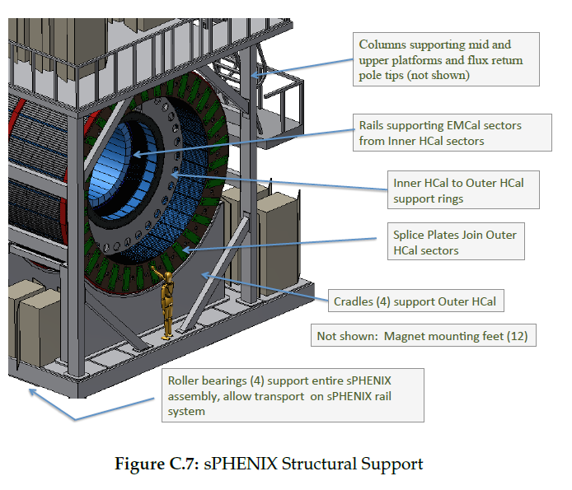
Sizing Scale

Slide 8
Sizing Scale

Slide 9
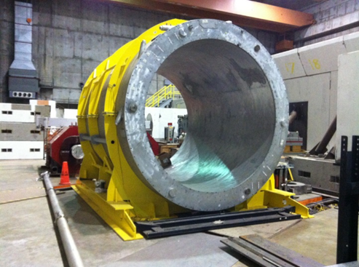
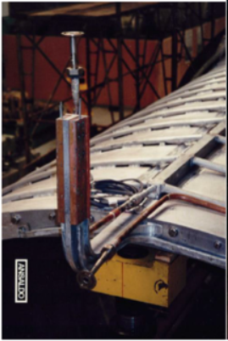
Magnet Construction
Magnet in its cryostat (vacuum jacket)
Lead exit at end of coil

Slide 10
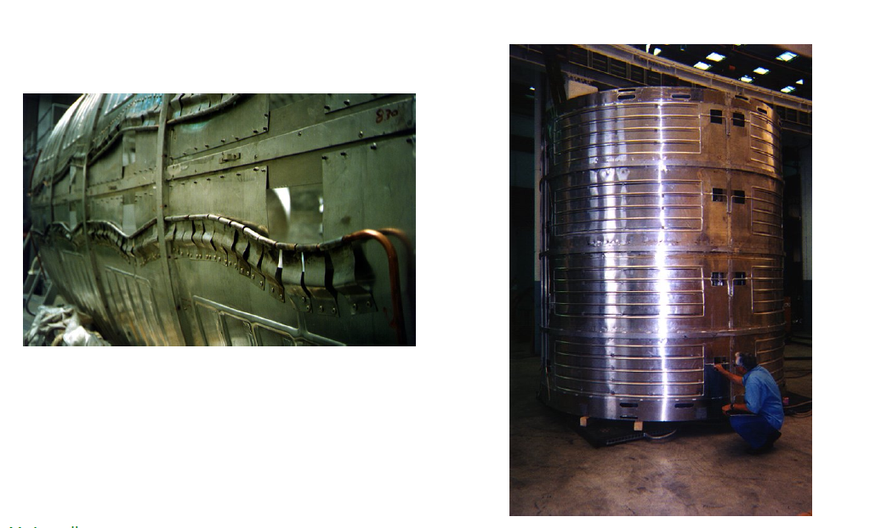
Thermal shield
Inner thermal shield
Outer thermal shield

Slide 11
Thermal Shield Assembly

Slide 12
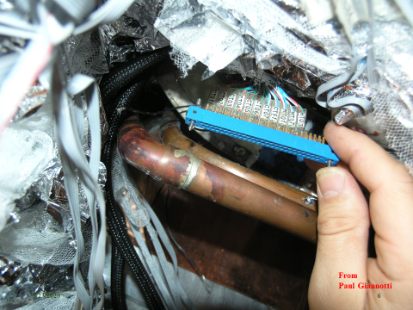
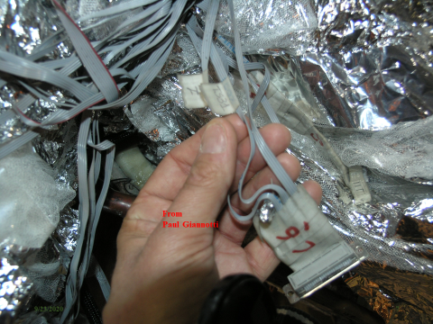
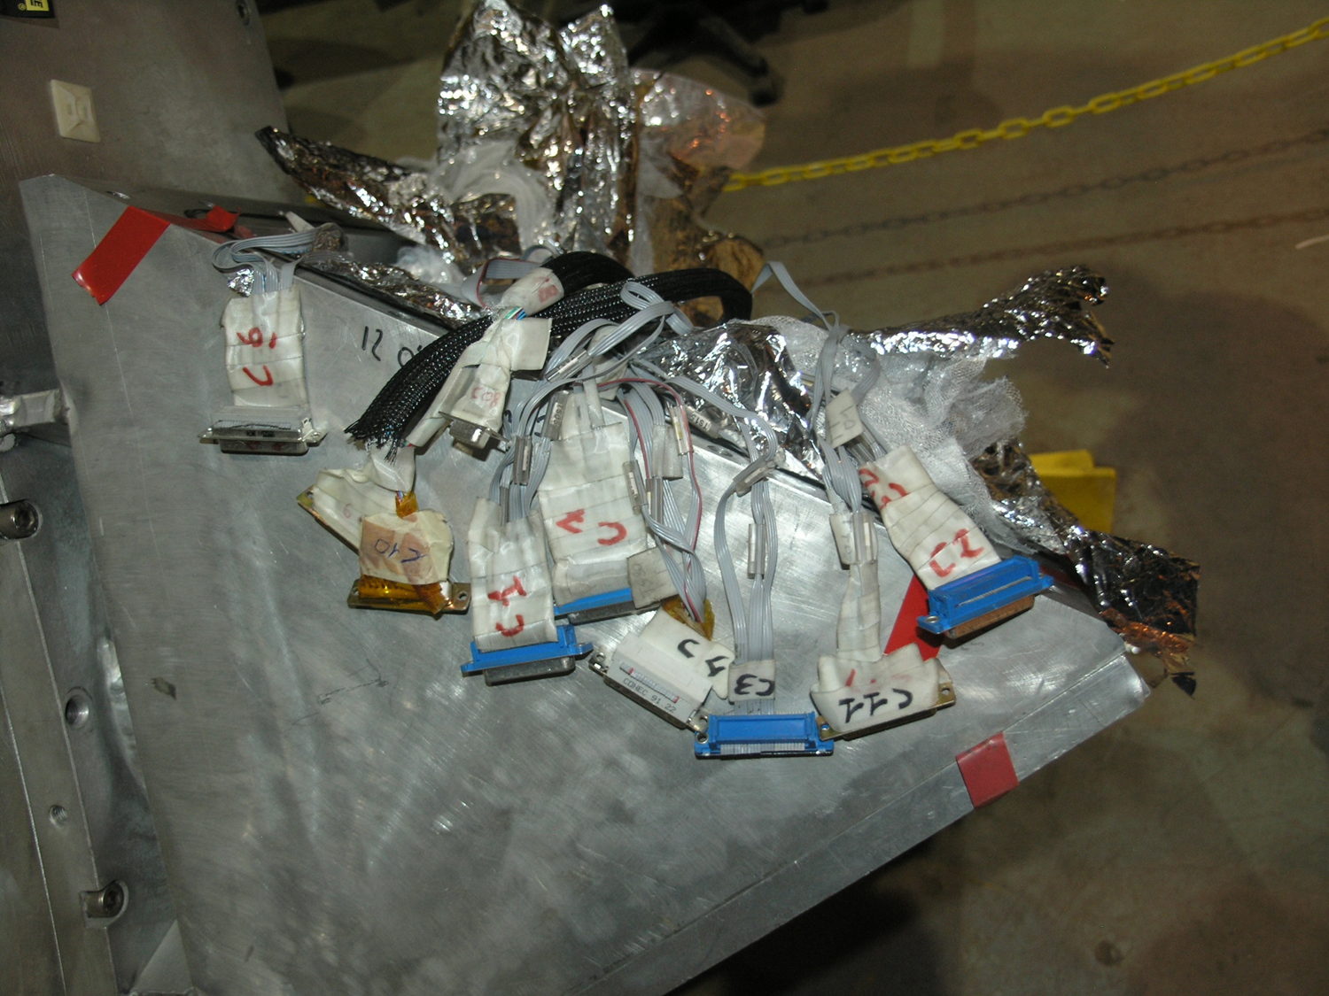
Instrumentation wiring

Slide 13
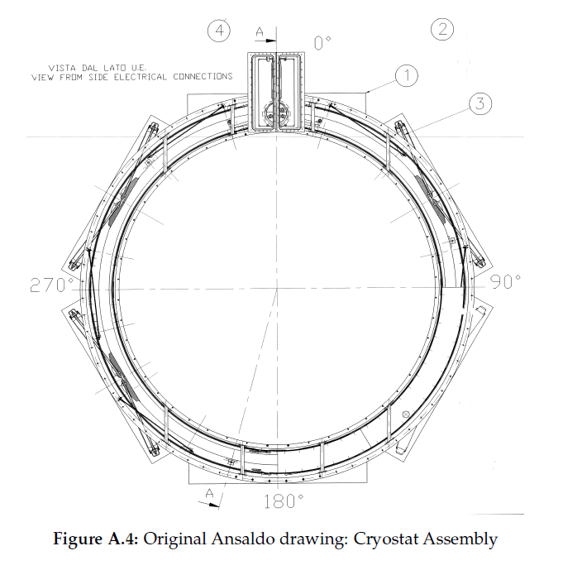
End view – internal support rods

Slide 14
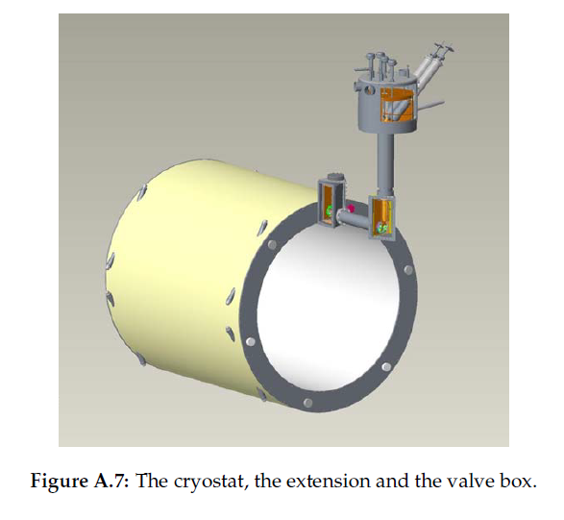
Valve Box

Slide 15
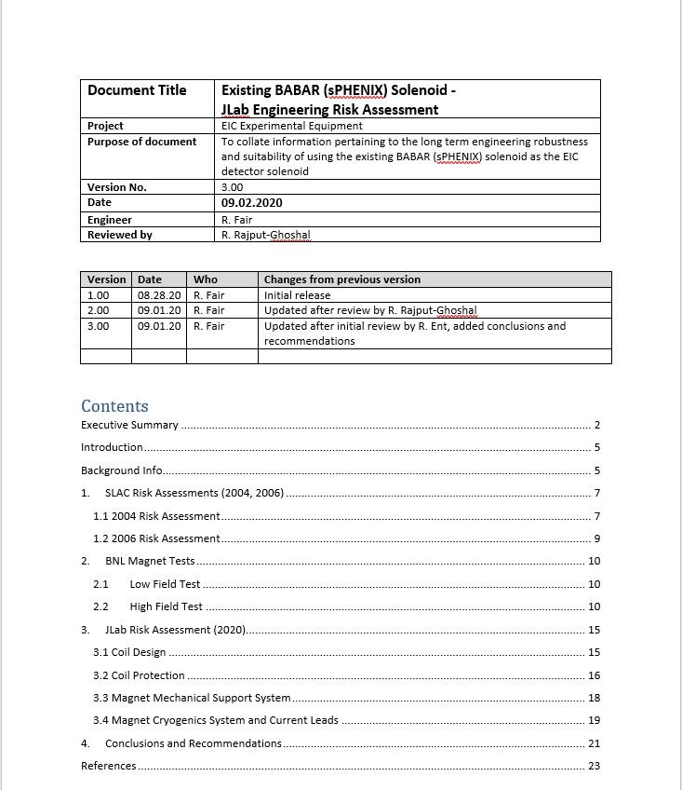
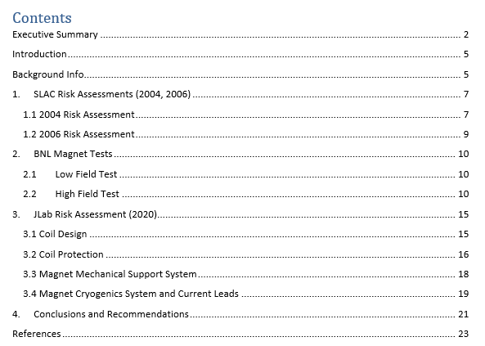
Approach used to conduct the engineering risk assessment

Slide 16
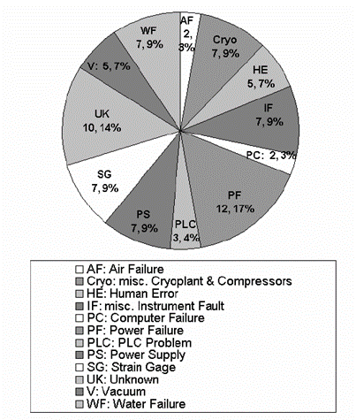
sPHENIX Magnet-SLAC Risk Analysis (2004, 2006)
The magnet started operation in May 1999. Two formal risk assessments were carried out at SLAC in 2004 and 2006 following 5 to 7 years of operation.
From May 1999 – 2004, there have been 63 unplanned interruptions to magnet operations. None of these can be shown to be the result of a spontaneous quench in the coil. In nearly all cases, the interruptions can be traced to failures in utilities or supporting systems or to human error. Three notable categories-
Unknown: 10%
Miscellaneous instrument faults : 8%
Strain gauges: 8 %
After mitigations were implemented – namely installing cooling and vacuum backup systems, changing the control programming and removing unneeded interlocks – the total number of interruptions after 2004 has been significantly reduced.
Magnet availability between 2000 – 2004: approx. 98%

Slide 17
sPHENIX Magnet- BNL Low Current Test (100 A)
The low field test of the sPHENIX Solenoid was completed successfully and accomplished the following important tasks and results.
1. The magnet was cooled down to 4.5 K and warmed back to room temperature without problems and the experience in the cool down and warmup will be useful for the future high field test cool down.
2. The magnet was shown to be electrically stable with no anomalies during ramping and shutdowns.
3. The energy extraction system switching process was verified.
4. The magnet maintained mechanical stability throughout cool down and warmup.
5. Important parameters for quench detection and operation were determined.
6. Magnetic field was verified up to the level of 100 A.
7. Strain gauges were read but more work needs to be done to understand the results before the high field test. (Note: Five strain gauges were not working and one showed an unusually high reading was ignored).

Slide 18
sPHENIX Magnet- BNL High Current Test (4830 A)
The high field test was carried out after installation of a return flux steel box enclosing the superconducting magnet. The magnet achieved field – the following issues were noted:
Several voltage taps (used for quench protection) failed before the test commenced
New temperature sensors were fitted prior to the test but failed to read accurately
Another voltage tap failed intermittently and caused a fast dump of the magnet
The control system crashed causing a fast dump of the magnet
Quench occurred at about 3000 A
Quench occurred at about 4410 A (possibly due to the high ramp rate of 2.5 A/s)
Achieved 4830 A after reducing ramp rates
Magnet only stayed at full field for 36 minutes due to the lack of availability of Lhe
Multiple hardware issues (mostly external to the magnet) were noted and will be addressed prior to the sPHENIX experimental runs.
However, there were a few leaks, most of which were accessed and repaired. But there is still one small cold leak which is currently being managed by pumping
There is also evidence that both Ansaldo and SLAC had previous issues with leaks

Slide 19
JLab Engineering Risk Assessment - 2020

Slide 20
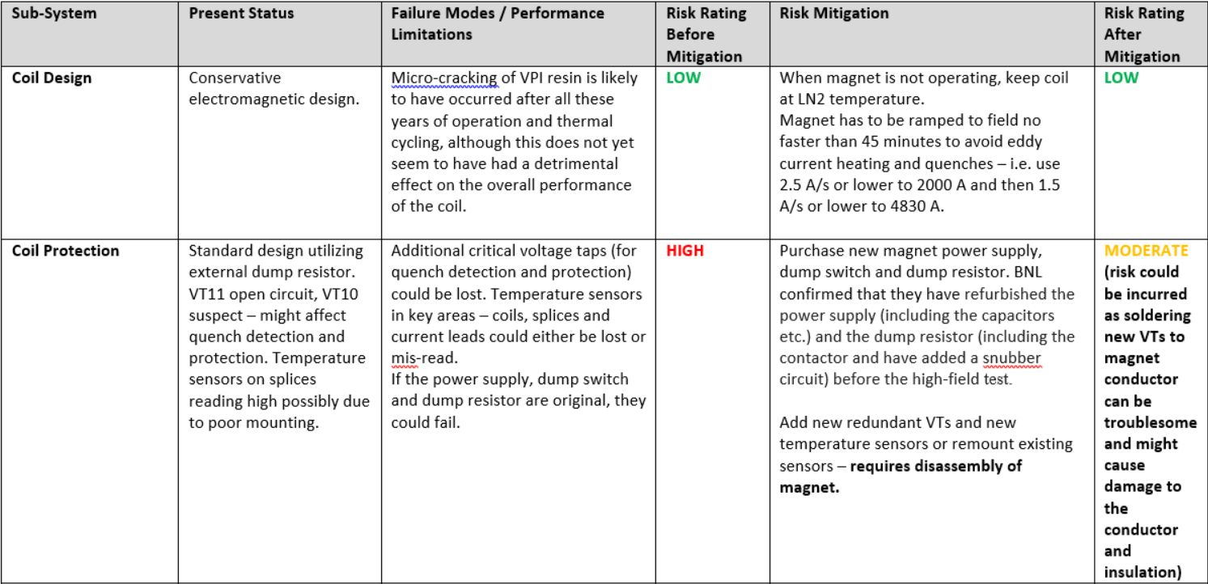

Slide 21
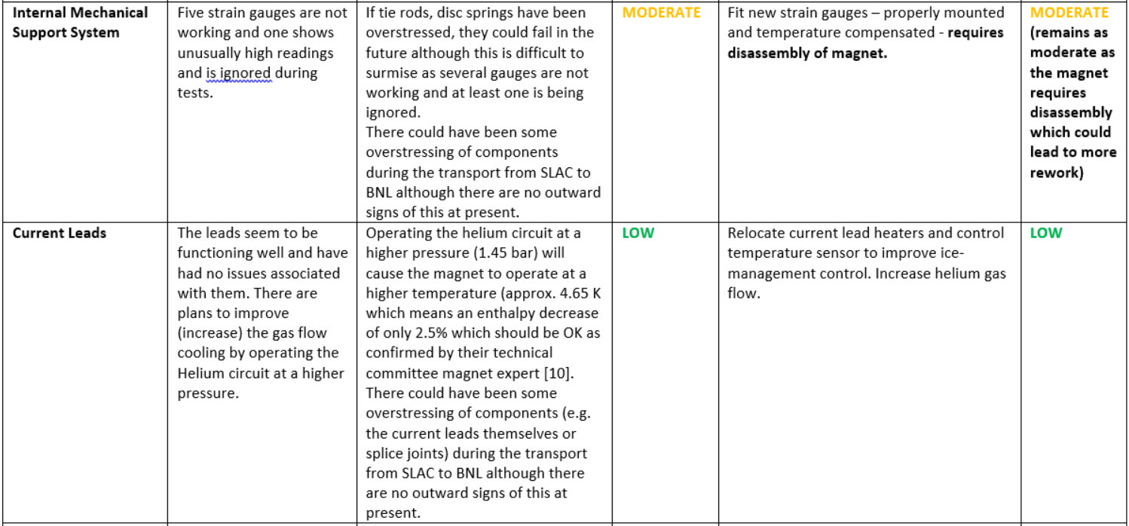

Slide 22
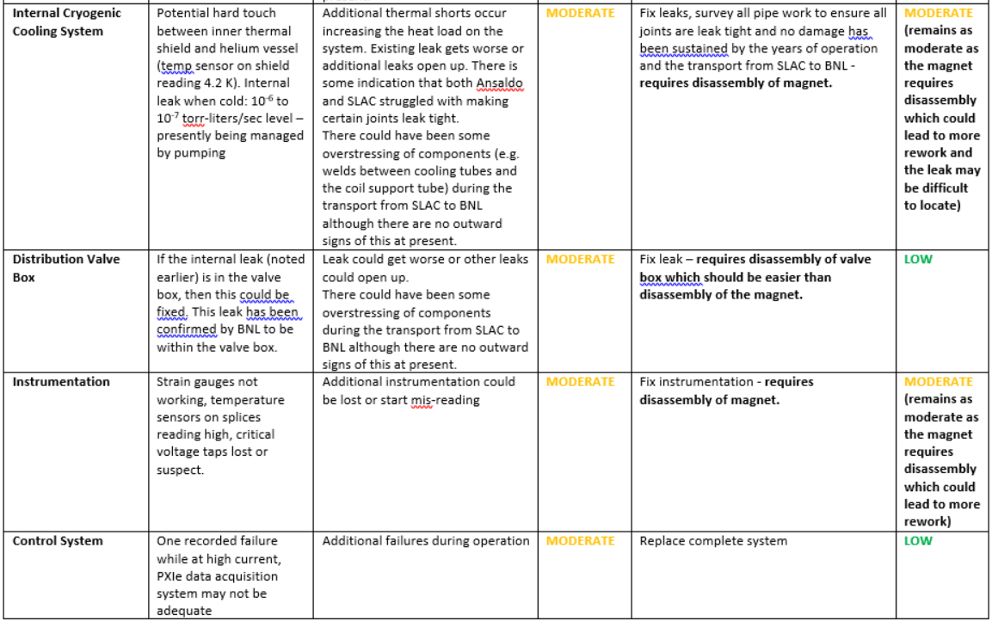

Slide 23
sPHENIX Magnet- Summary
To provide a sufficiently high level of confidence in the reliability of this magnet (from an engineering point of view) and to meet the physics requirements:
The magnet should be refurbished to mitigate the risks identified.
If the valve box is to be re-used, it should also be disassembled to inspect cooling pipework and to repair any leaks. (Note: the one small leak remaining has been established to be within the valve box and should therefore be accessible)
The field will need to be shaped to achieve the required projectivity for RICH operation (see Renuka Rajput-Ghoshal’s presentation)

Slide 24
BACKUP

Slide 25
sPHENIX Magnet- JLab Risk Analysis-Recommendations
To provide a sufficiently high level of confidence in the reliability of this magnet (from an engineering point of view), the magnet should be refurbished as suggested below.
1. The magnet should be disassembled sufficiently:
To allow the existing multi-layer insulation (MLI) to be removed and replaced with new MLI.
To allow inspection of the superconductor coil block – resin and insulation system.
To allow inspection and if necessary, repair of insulation and support of any internal bus bars.
To allow all cooling pipe work and welds to the coil support tube to be inspected and all leaks repaired.
To allow inspection of the thermal shield and cooling pipework ad welds.
To allow inspection of all vacuum seals and welds.
To allow inspection of all accessible conductor splices in particular the ones between the coil and the current leads.
To allow inspection and if necessary, replacement of insulating components – e.g. G10 collars, plates, etc.
To allow inspection and if necessary, replacement of the magnet current leads.
To allow broken voltage taps to be repaired and additional redundant taps installed.
To allow temperature sensors which are presently possibly malfunctioning to be either repaired or replaced.
To allow additional or redundant temperature sensors to be installed
To allow malfunctioning strain gauges to be either repaired or replaced.
To allow additional or redundant strain gauges to be installed.
To allow a full inspection and if necessary, replacement of the tie rods and disc springs for the internal mechanical support system.
2. If the valve box is to be re-used, it should also be disassembled to inspect cooling pipework and to repair any leaks. (Note: the one small leak remaining has been established to be within the valve box and should therefore be accessible)

Slide 26
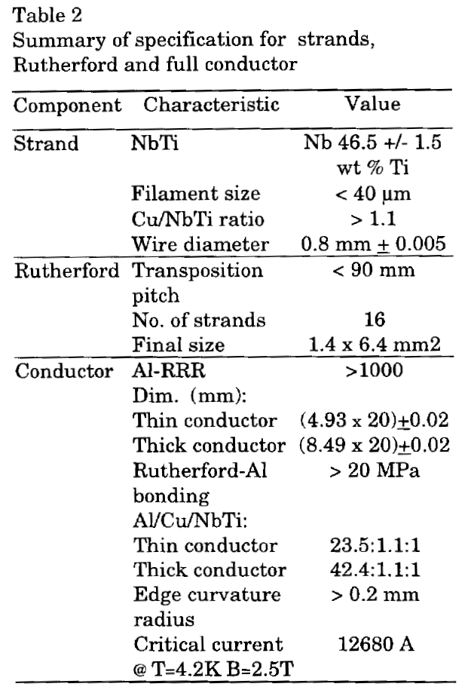
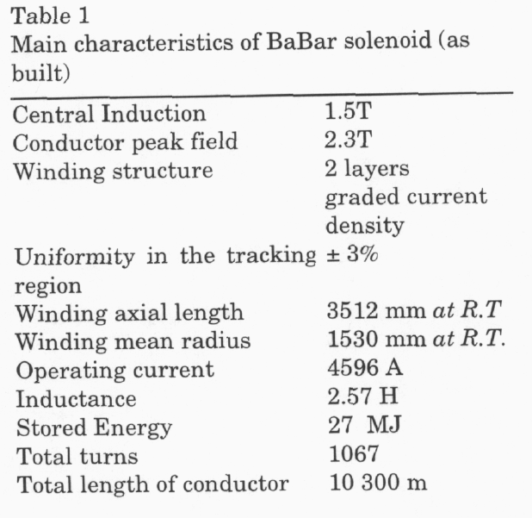
APPENDIX A: SOLENOID DATA

Slide 28
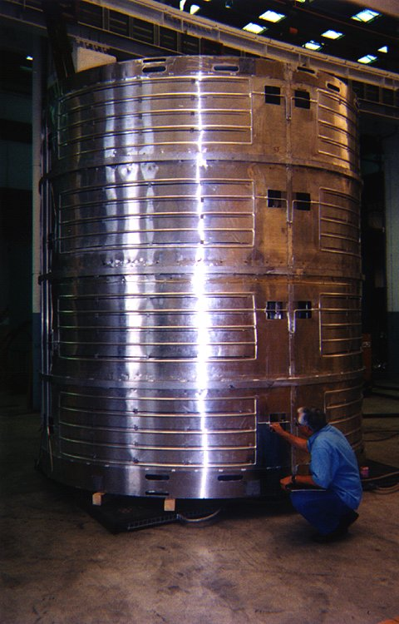
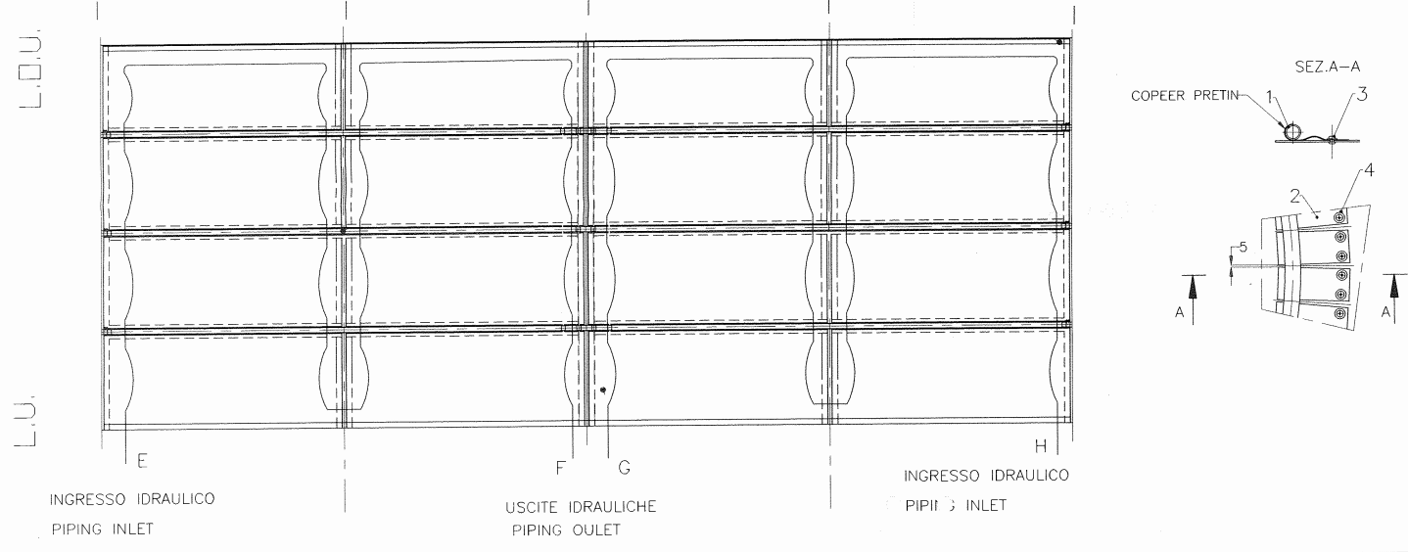
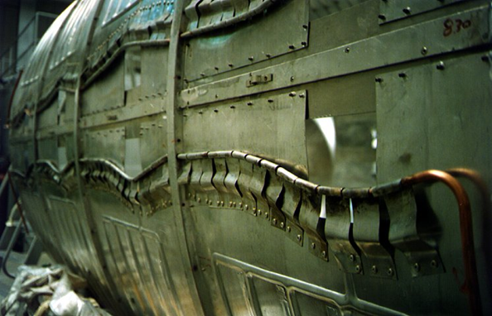
Thermal shield
Inner and Outer shield. Forms an annular enclosure around solenoid
Material: Aluminum
Cooled by using 4.5K vapor from return flow from the separator
OUTER SHIELD
Shield panels: Cooling circuits 5 parallel headered together:
INNER SHIELD
Cooling line: strapped to shield surface

Slide 29
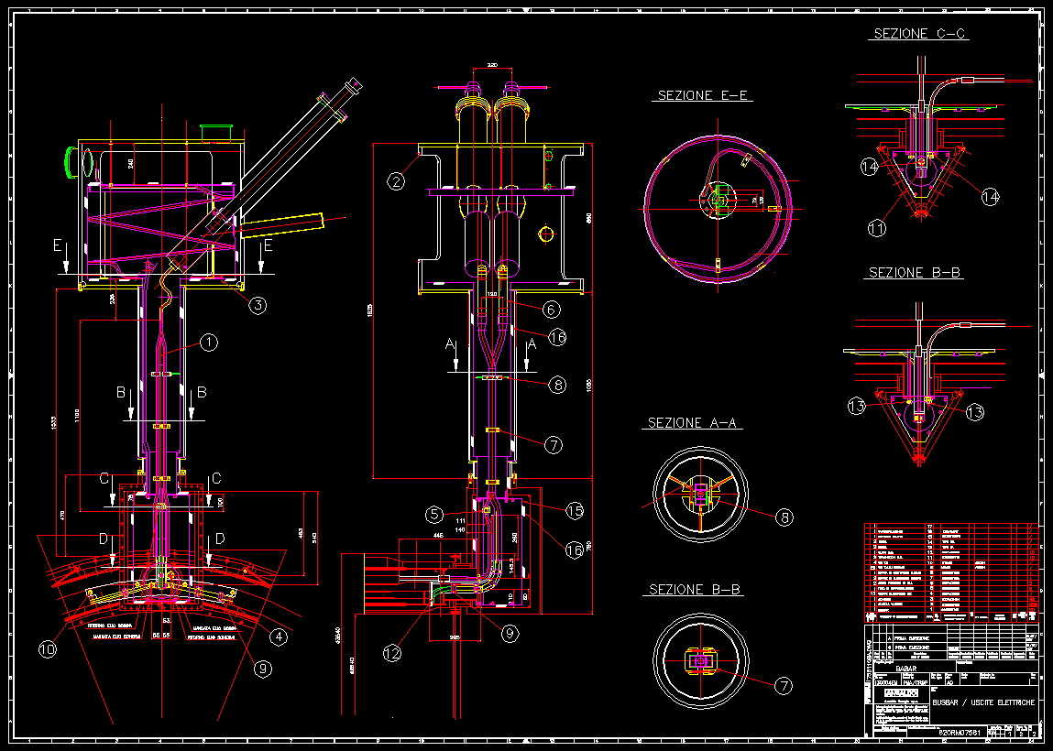
Solenoid Valve & Current Lead box
2x 5000 A Copper Leads
inside “lead pots”
Cryo valves
Cryo lines
Superconducting bus
Splice joints
Thermal shield

Slide 30
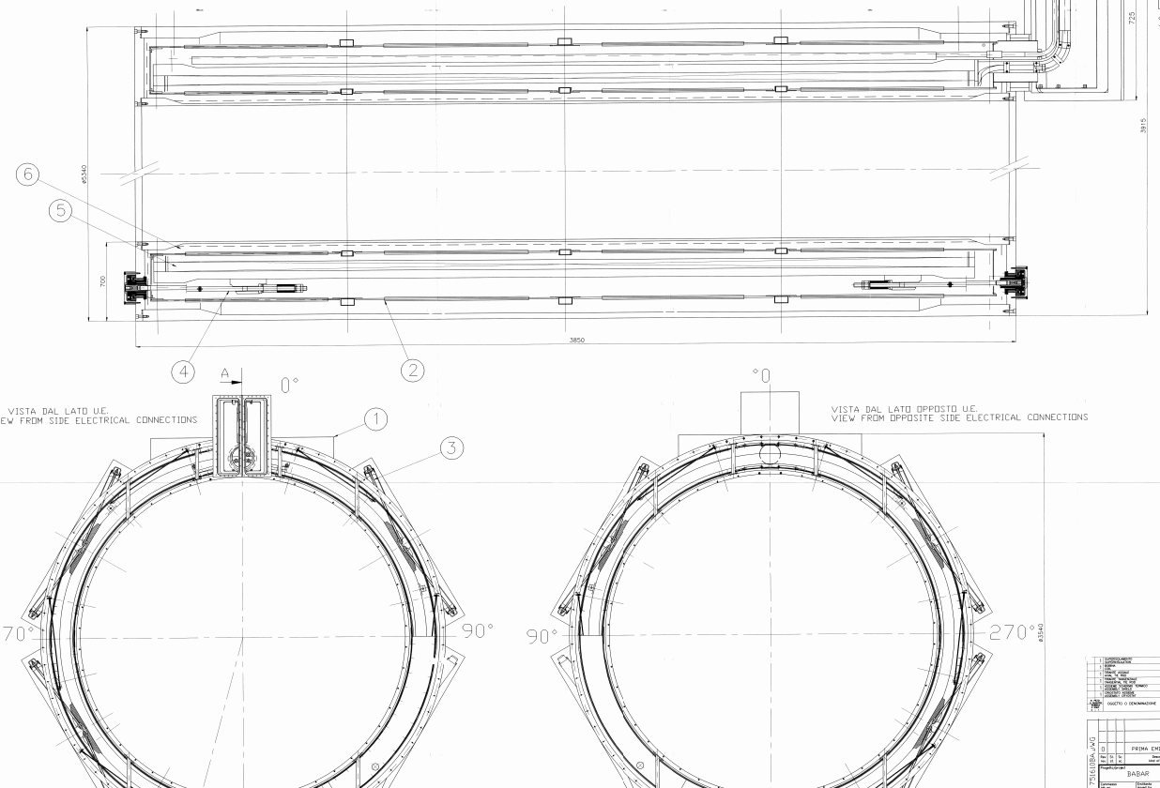
Mandrel Supports

Slide 31
Power supply: Voltage Tap Locations

Slide 32
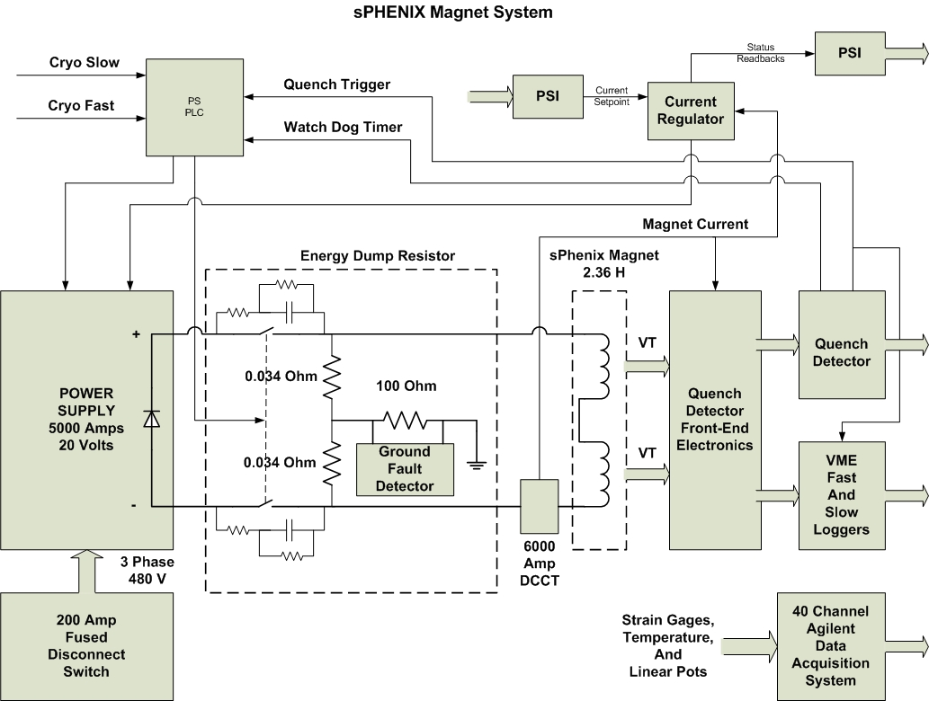
Power Supply: Quench Detector Block Diagram
Slow discharge: >45 min
Fast Discharge: 37 sec, causes quench back

Slide 33
sPHENIX Magnet- JLab Risk Analysis
Coil Design
Coil Protection
Magnet Mechanical Support System
Magnet Cryogenics System and Current Leads
Coil Design:
The coil design is conservative.
The magnet has had several thermal cycles however, to date, there is no evidence of this – i.e. no degrading quench behaviour which is a good sign.
It is clear that eddy-current heating will occur if the magnet is ramped too quickly and that the magnet will quench as has happened a couple of times already during testing at BNL. Ramp rates determined as safe by BNL are: 0 to 2000 A at 2.5 A/s and then 1.5 A/s to 4830 A.
There is also a question of whether the current leads have been over-stressed during the transport from SLAC to BNL – either the leads themselves or splices to the leads. However, there is no outward evidence of any deterioration of the leads at present.

Slide 34
sPHENIX Magnet- JLab Risk Analysis
Coil Protection- The coil is protected with the usual method of an external resistor in parallel with the coil, which extracts approximately 75 % of the stored magnetic energy.
The coil protection system is considered to be standard and works well and reliably as long as the breaker and resistor is serviced regularly. As the resistor and breaker are located externally to the coil itself, these items can be replaced easily if necessary.
Recommendation: Purchase new magnet power supply, breaker and resistor
The coil temperature rise is safe. The hot spot temperature could be twice as high as the average coil temperature rise but would still be considered safe by the usual design criteria of 150 K maximum temperature.
Recommendation: None
At least one critical voltage tap has been lost and another ne considered suspect. They have therefore been eliminated from the quench detection and protection system. There is a high likelihood that additional voltage taps could be lost or could malfunction in the future.
Recommendations: Fit additional voltage taps and check all the others. This requires disassembly of the magnet, and unfortunately this could introduce another risk to the magnet, that of causing damage to the conductor or insulation during the soldering and fitting of new voltage taps. So this remedial action should be carefully planned before execution.

Slide 35
sPHENIX Magnet- JLab Risk Analysis
Magnet Mechanical Support System- There are 6 axial and 16 radial Inconel 718 tie rods supporting the cold mass.
The coil is placed inside a non-symmetric flux return yoke. This gives rise to axial offset forces. In order to have an offset force in one direction only (no inversion during the ramp up), the coil was positioned with ~30 mm axial displacement in the forward direction.
The offset force is not equally shared by the three tie rods. The average strain in the three tie rods is 500 µm corresponding to 0.3 mm displacement.
The net axial force is the difference of two large compressive forces of approximately 380 MT on the forward and backward ends of the coil. It is very sensitive to the axial location of the coil within the barrel.
It is unlikely that the tie rods have been stressed beyond their elastic limit. However, the condition of the tie rods and spring washers remains as an unknown and therefore could pose some risk of damage for future operation.
Several strain gauges (5) have been lost and at least one indicates a high reading and is subsequently ignored during magnet operation.
Recommendation: Fit new strain gauges. This will require disassembly of the magnet.
There is also a question of whether any of these mechanical components have been over-stressed during the transport from SLAC to BNL. However, there is no outward evidence of any deterioration of the internal mechanical support system at present.

Slide 36
sPHENIX Magnet- JLab Risk Analysis
Magnet Cryogenics System and Current Leads-
There is a potential hard touch between the inner thermal shield and helium vessel (observed by the temperature sensor on the inner shield reading 4.2 K).
There also appears to be an internal leak when cold: 10⁻⁶ to 10⁻⁷ torr-liters/sec level – which is presently being managed by pumping during operation of the magnet. It is not clear whether this leak is within the magnet internal cryogenic system or within the valve box.
There is some evidence (observed by BNL engineers who worked on other leaks on the magnet cryogenic system) that both Ansaldo and SLAC have struggled to repair leaks on cooling pipework in the past.
There was a suggestion from an earlier review that the current lead flow may not have sufficient flow due to the return pressure. The proposed solution was to operate the solenoid bath at higher pressure, which means higher bath temperature.
The existing internal leak (although small at present) and the potential for additional leaks is a concern.
There is also a question of whether any of the internal cryogenic have been over-stressed during the transport from SLAC to BNL – e.g. welds between the cooling tubes and the coil support tube. However, there is no outward evidence of any deterioration of the internal cryogenic cooling system at present.

