Slide 1
Forward Side, B0 - Cryostat Layout
17.5 m
Q0EF
Q1EF
Near IP End
Incoming Electron Beam
Outgoing Hadron Beam
B0PF
B0APF
Q1APF
Q1BPF
Q2PF
B1PF
B1APF
Please note:
Extremely busy region.
B0 total length 1.2 m.
Access only possible from IP side, and no access from the hadron downstream side as that region is integrated with the cold mass.
Remember final electron quad Q0eF integrated in the BO magnet
Beams share magnet aperture:
Hadrons: 1.3T field Electrons: 14T/m gradient

Slide 2
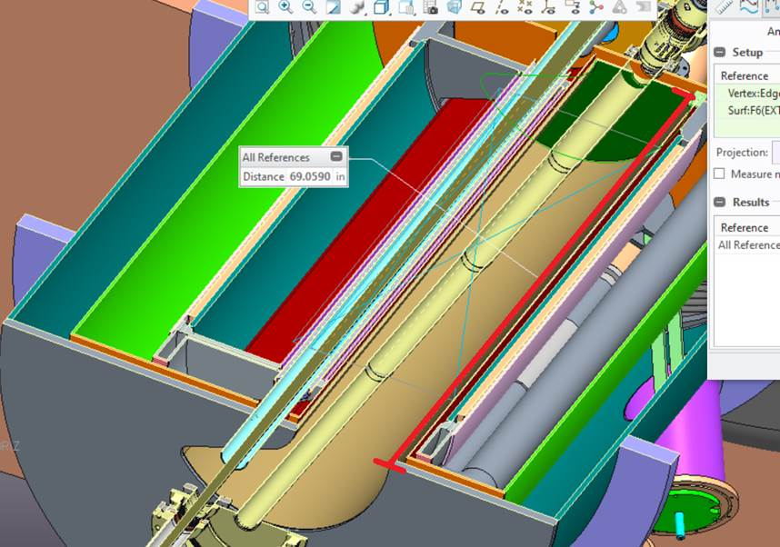
Forward Spectrometer (B0pF)
Top view for B0
The acceptance along z changes due to the increasing proton beam pipe and the crossing angle as the B0 is aligned with the electron beam.
The B0 constitutes one of the most challenging EIC magnets: it needs to provide both field for the proton/ion beam and no field for the electron beam, in limited space.
End of warm bore region
IP-side
YR studies pointed to the need for accurate t measurement in the B0, with 4 Silicon planes separated by 30 cm each, indented by 10 cm from the surface of the B0
this would occupy 1 m of the 120 cm.
a passive absorber as pre-shower allows identification of γ’s
if one wants to integrate more than a pre-shower to measure the energy of the γ’s with higher resolution it will significantly impact the space for the tracking detectors and such their performance.

