Slide 1
Expression of Interest for Software
Common Projects
Software Tools for Simulations and Reconstruction
  Monte Carlo Event Generators
  Detector Simulations
  Reconstruction
Middleware and Preservation
  Workflows
  Data and Analysis Preservation
Interaction with the Software Tools
  Explore User-Centered Design
  Discoverable Software
  Data Model
Future Technologies
Artificial Intelligence
Heterogeneous computing
New languages and tools
Collaborative software
29 institutions
https://indico.bnl.gov/event/8552/contributions/43221/

Slide 2
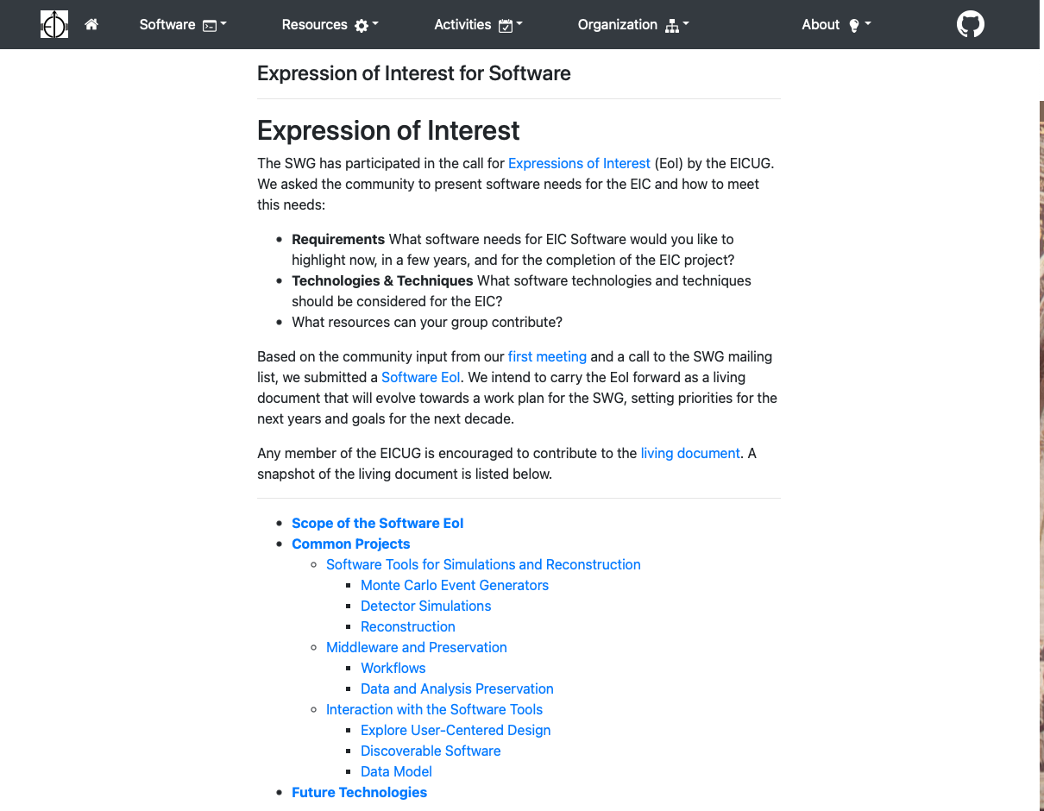
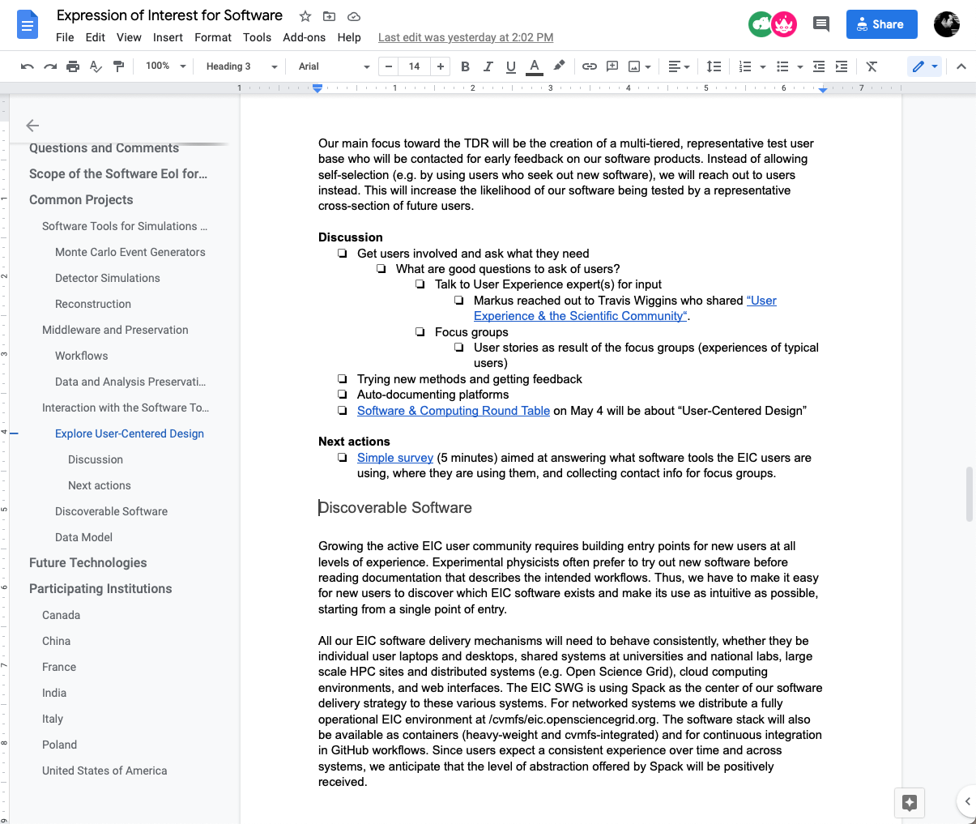
Evolving the EoI towards a Work Plan for the SWG
https://eic.github.io/activities/eoi.html

Slide 3
Update on Common Projects
Software Tools for Simulations and Reconstruction
  Monte Carlo Event Generators
    02/24 Kolja reported on maintaining Pythia6 for the EIC.
    03/10 Prabi reported on MC-data comparisons for the EIC and Barak discussed random number seeding
  Detector Simulations
  Reconstruction
    02/24 Joe Osborn updated us on ACTS for the EIC.
Middleware and Preservation
    Workflows
    Data and Analysis Preservation
    02/24, later Kolja, Markus, Maxim, Sylvester, and Wouter will give update on prototype.
Interaction with the Software Tools
  Explore User-Centered Design
    03/03 Kolja, Markus, Rebecca, Sylvester, Wouter presented report on “Status of Software Survey.”
  Discoverable Software
    Spack (Wouter)
  Data Model
    Common output format (Dmitry), data model for streaming readout (Jan)
Validation
  MCEGs
  Fast simulations eic-smear
  Full simulations ESCalate, Fun4All

