Slide 1
PMG Agenda Items
MIE and I&F Status
COVID impact
High priority issues
Production rate for EMCal sectors (#produced/time) compared to expectations.
Table that shows the float of MIE components to the due date for installation
Status of PEMP notables
Procurements that will need attention or any issue to be raised at the POB
CPI & SPI reports for the I&F upgrade
Near critical path activities (activities that have less than ~20 days float to the critical path for MIE and I&F). The near-critical path report can be set up in P6 and run automatically every month. (Attached file to Indico meeting)

Slide 2
sPHENIX Calendar
FDR LL1 Trigger Electronics Mar 1
FDR/PRR INTT Staves Mar 2
ESRC Review of Carriage/Cradle/OHCal/Solenoid installation (Dry Run/Review) Mar 15
1008 I&F Review practice Mar 30
1008 I&F Status Review Apr 7-8
ESRC Safety systems/electrical power distribution(Dry Run/Review) Apr 12/19
ESRC Magnet(Dry Run/Review) May 3/17
ESRC TPC(Dry Run/Review) Jun 7/21
ESRC Calorimeters(Dry Run/Review) Jul 12/26
ESRC IHCal/EMCal/TPC/MVTX/INTT Installation(Dry Run/Review) Sep 13/27
ESRC MBD and beam pipe(Dry Run/Review) Oct 4/18
ESRC MVTX/INTT(Dry Run/Review) Nov 1/15
MIE Early completion Jan 30,2022
I&F Early completion Oct 2022

Slide 3
sPHENIX/1008 I&F Technical Status
100% of long lead (CD-3A) procurements received: 100% of SiPMs, 100% of tungsten powder, 100% of scintillator tiles, 100% of scintillating fibers.
Test assembly of 3 OHCal sectors completed in building 912.
1st OHCal sectors prepped and ready to install on carriage as soon as tracks are reinforced and carriage is assembled
28/32 OHCal sectors (88%) complete, tested and calibrated. Final four OHCal sectors being assembled over the next 3-4 weeks.
All OHCAL joining plates (dog bones), pins and pucks at BNL.
EMCal blocks for 1st 24/64 sectors complete at UIUC. All but final 20% of blocks at some stage of completion EMCal Sectors 1-15 assembled at BNL. Testing and calibration ongoing. Assembly of sectors 16-19 underway. High eta blocks from Fudan Univ continue to arrive at BNL on schedule to meet early completion.
TPC Inner field cage complete and tested. Outer field cage fab underway at SBU.
GEM Modules for TPC under fab at WSU, Vanderbilt, Temple, Weizmann.
30+ TPC Fee preproduction boards at BNL for testing. TPC Fee slice test (26 board system test) will be performed at BNL within the next 4 weeks.
All production Calorimeter Electronics (except cables) exist or under contract for production.
1008 Track reinforcement contract is awarded.
Work in 1008 Assembly Hall started March 2. To be completed by May 3.
Work in the 1008 IR starts after the beginning of the 2021 shutdown in mid-July and ends Nov 1.

Slide 4
sPHENIX/1008 I&F Status- continued
Magnet flux return Pole tip/end cap awarded to vendor.
sPHENIX Beam Pipe at vendor for modification.
LN2 piping, XY Carriage tables, Carriage Hydraulics in production.
Carriage Platform, Large Support Rings orders at PPM
Engineering design work continues at a fast pace
Meetings held with CERN group that will be performing the magnet mapping in 2022.
Holding remote reviews for major orders
Continue monthly status, EV, PCR for MIE/1008 I&F
11 months of float from PD-4 to sPHENIX MIE early completion. We have lost 3 months of schedule contingency since the pandemic began, 2.5 months Mar-Jul 2020 and in December 2020. We lost one week in the early completion in February 2021.
3.5 months of float from RHIC Run 2023 start and I&F early completion. The Early Completion date has been unchanged throughout the pandemic.
COVID mitigation plans are working but not perfectly. Vendor delays due to COVID have affected the SPI of the MIE (0.80) and the I&F (0.88). The MIE CPI =1.02. I&F CPI=1.06. Both very good.

Slide 5
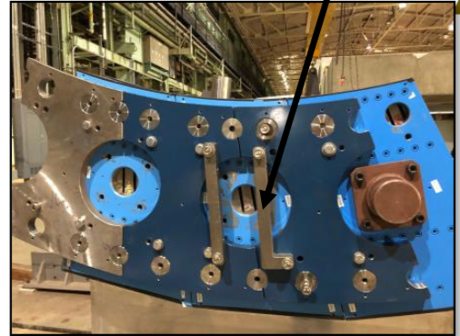
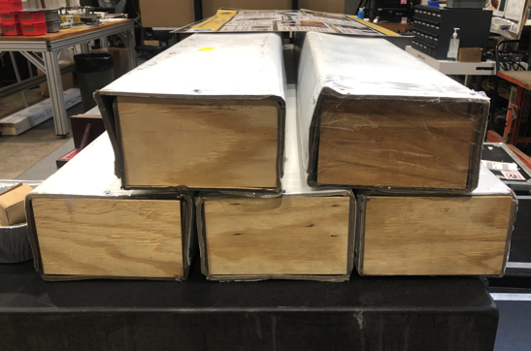
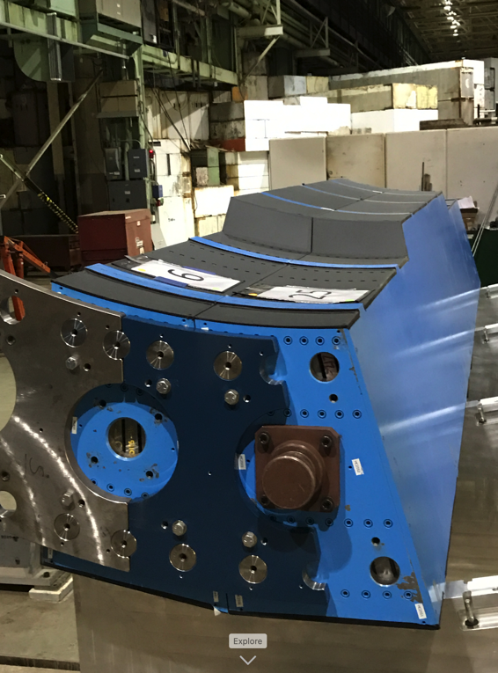
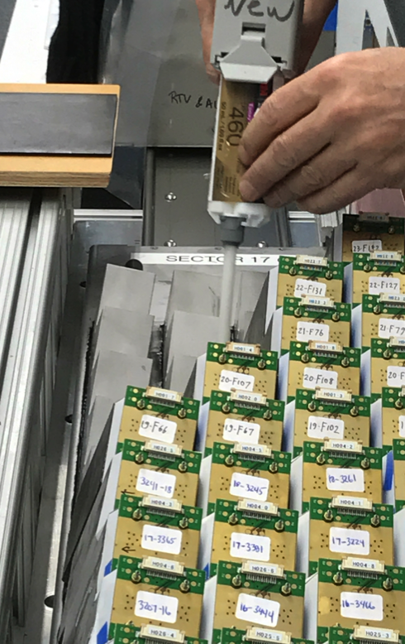
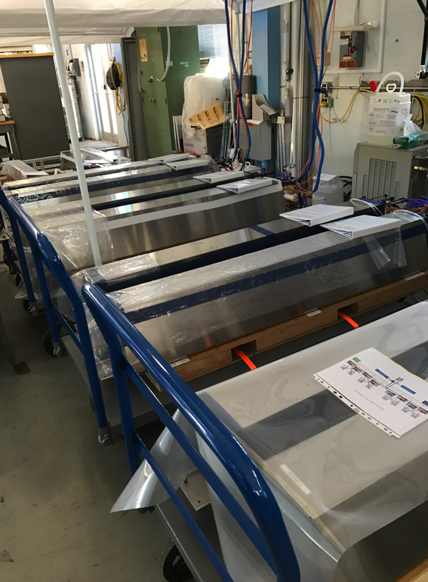
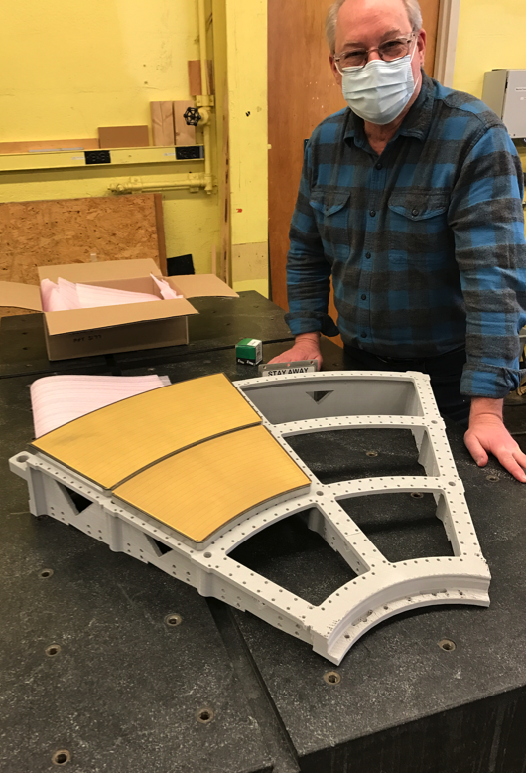
sPHENIX in Photos
Final Scintillating Fiber Delivery
3 OHCal Sector Assembly Test
1st OHCal Ready to Install
Epoxying EMCal Sector 17
EMCal Completed Sectors
TPC R2,R3 Modules Prepped for Slice Test

Slide 6
Operations During the Pandemic
BNL in minsafe mode from the end of March to mid-June 2020. No I&F work done on site.
1008 I&F restarted work at BNL-Phase-1B restart with 5 FTEs for sPHENIX/I&F on June 18
FTE threshold increased to 30 FTEs in late Sept with the total including visitors. We have ~80% of our workforce approved to be on site. However managers, engineers and designers that can work remotely continue to do so.
FTE threshold has been increased to 35 FTEs as of Feb 2021.
COVID mitigation plans continue to be implemented.
We have assigned a Task Coordinator to optimized the personnel on site and tasks performed each day.
We’re in daily communication with BNL safety personnel to make sure that all continues to go smoothly.

Slide 7
High Priority Issues
We need to keep the EMCal and OHCal on schedule.
Prep for installation of the HCal sectors on the carriage in the late spring 2021.
Complete track reinforcement in the 1008 Assembly Hall.
Complete TPC Fee slice test and order the TPC Fee production boards.
Complete remaining engineering design tasks and order components
We must finish the designs and move our attention to assembly, installation and testing.
Can’t allow the final design tasks to get delayed.
Schedule and hold remaining reviews
Place Remaining procurements

Slide 8
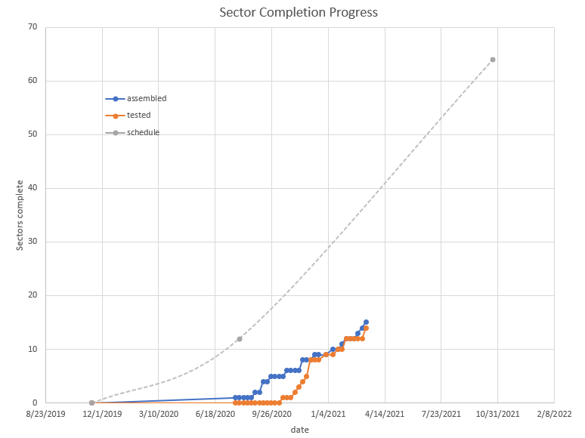
EMCal Sector Production Rate
Sectors Complete
10/22/2021 (BL)
Red line shows producing the 52 EMCal production sectors, sectors 13-64, over the 1-year period
From 2/1/21 to 2/4/22
as in P6 progress file

Slide 9
OuterHCal and EMCal Installation
 | Fabrication Complete | Installation Date | Delta (wk)
OHCal Sector 1 & Splice Plates | Week 8, 2021 | Week 23, 2021 | 14
OHCal Sector 13 | Week 5, 2021 | Week 34, 2021 | 29
SC Magnet Coil | 2018 (testing at BNL) | Week 37, 2021 | >100
OHCal Sector 14 | Week 5, 2021 | Week 41, 2021 | 36
OHCal Sector 32 | Week 17, 2021 | Week 46, 2021 | 29
EMCal Sector 1 | Week 14, 2020 | Week 1, 2022 | 91
EMCal Sector 32 | Week 25, 2021 | Week 5, 2022 | 32
EMCal Sector 59 | Week 52, 2021 | Week 10, 2022 | 10
EMCal Sector 64 | Week 5, 2022 | Week 11, 2022 | 6

Slide 10
TPC and Electronics Installation
 | Fabrication Complete | Installation Date | Delta (wk)
TPC | Week 3, 2022 | Week 26, 2022 | 23
OHCal Cabling | Week 43, 2021 | Week 48, 2021 | 5
EMCal Cabling | Week 43, 2021 | Week 5, 2022 | 14
Digitizers | Week 43, 2021 | Week 14, 2022 | 23
Trigger & Timing Systems | Week 4, 2022 | Week 14, 2022 | 10
Beampipe | Week 32, 2021 | Week 32, 2022 | 52
TPC, EMCal and OHCal on-detector electronics are installed as part of detector fabrication

Slide 11
sPHENIX 2 PEMP Notables in 2021
NP: Complete infrastructure and facility upgrades in Building 1008 to enable the planned start of installation of the sPHENIX calorimeters. (Objective 2.3)
Requires completion of 1008 Assembly Hall track reinforcement by the end of May 2021.
Track reinforcement work started Mar 1 and is scheduled to complete by 1st week of May.
BHSO/SC: Effectively plan, execute, and successfully deliver SC projects equal to or less than $50 million that have been delegated to the Laboratory Director by SC under DOE O 413.3B [Super Pioneering High Energy Nuclear Interaction (sPHENIX)]. Clearly demonstrate successful accomplishment of key milestones in FY 2021 (adjusted for schedule impacts created by the COVID-19 pandemic) in accordance with SC guidance. (Objective 7.1)
EMCal Preproduction Blocks complete 1-Dec -2020 ✔ Completed ahead of schedule
1st OHCal Sector ready to install 15-Apr-2021 ✔ Completed ahead of schedule
EMCal Scintillating Fiber Acquisition complete 31-May-2021 ✔ Completed ahead of schedule
EMCal Sector Assembly 50% Complete 15- Aug-2021
We are on track to complete both PEMP notables in 2021, though COVID impacts are possible.

Slide 12
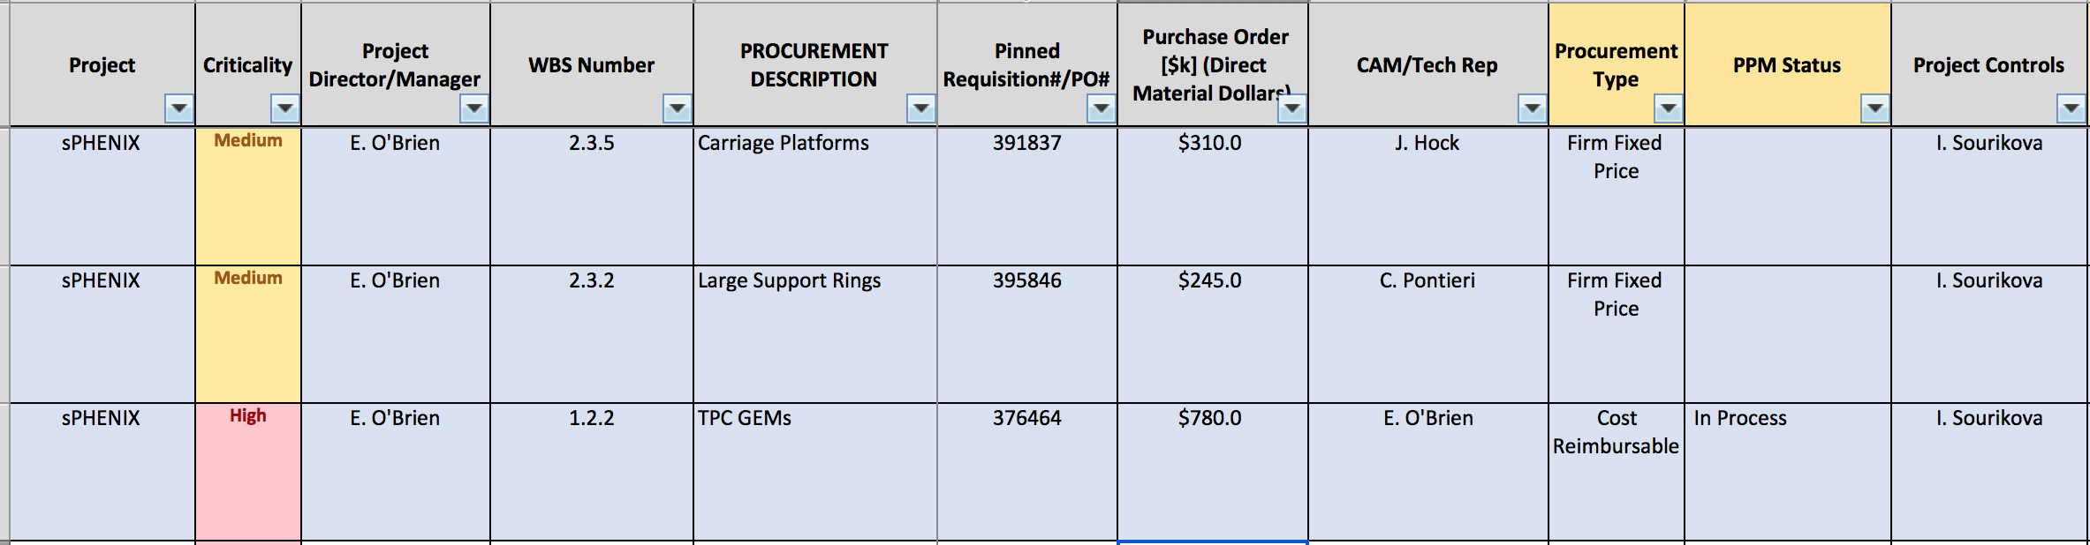
Critical Procurements
In addition there will be a >$1M calorimeter cable order placed within the next 4-6 weeks

Slide 13
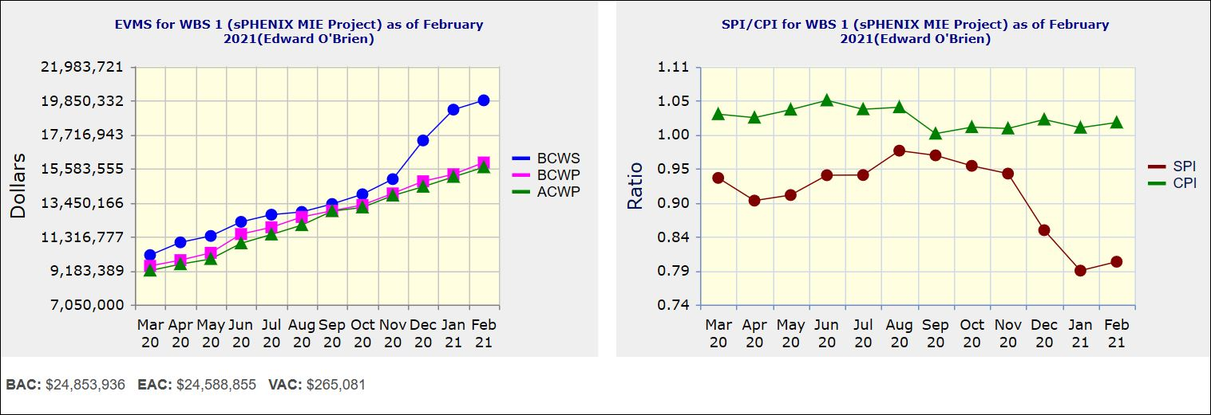
Performance Indices – sPHENIX MIE
Cumulative SPI | Cumulative CPI
0.80 | 1.02
Cumulative BCWS (Scheduled) | $19,852,872
Cumulative BCWP (Performed) | $15,954,504
Cumulative ACWP (Actual) | $15,658,993
DOE SPI or CPI Value Thresholds
0.90 to 1.15
0.85 to 0.89 or 1.16 to 1.25
<0.85 or >1.25

Slide 14
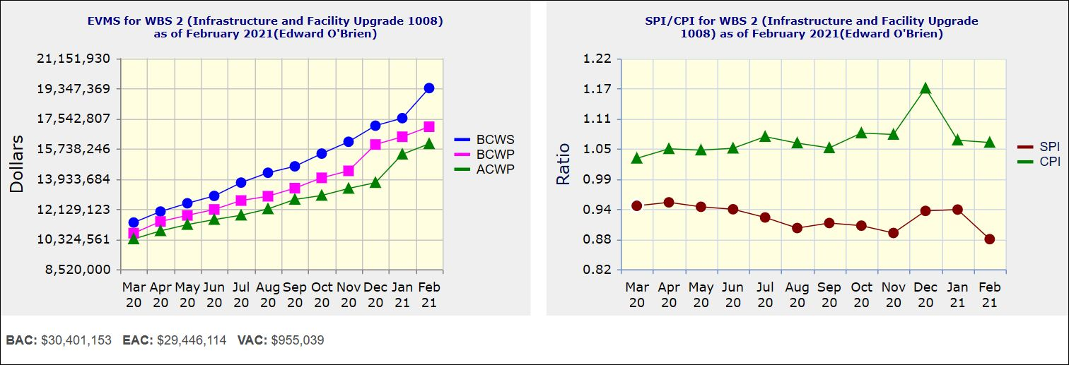
Performance Indices – 1008 Infra and Facility Upgrade
Cumulative SPI | Cumulative CPI
0.88 | 1.06
Cumulative BCWS (Scheduled) | $19,356,581
Cumulative BCWP (Performed) | $17,046,368
Cumulative ACWP (Actual) | $16,025,736
DOE SPI or CPI Value Thresholds
0.90 to 1.15
0.85 to 0.89 or 1.16 to 1.25
<0.85 or >1.25

Slide 15
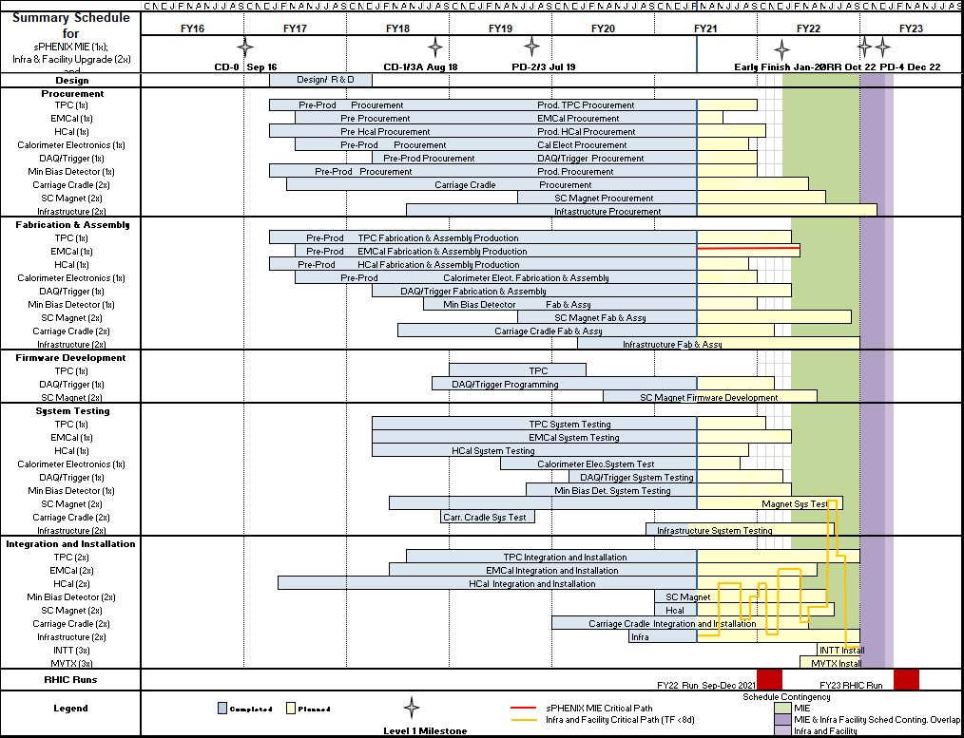
Summary Schedule – sPHENIX MIE and 1008 Infra and Facility Upgrade

Slide 16
Summary
All long lead procurements at CD-3A have arrived.
First OHCal Sector is ready for installation.
Early completion dates remain unchanged for the 1008 I&F and slipped one week for the MIE in February.
Construction is proceeding on sPHENIX final detector components at a wide variety of sites.
Continued great progress in sPHENIX factories. 88% OHCal sectors and 40% EMCal blocks complete. TPC, electronic, DAQ/Trigger all making good progress.
Good technical progress continues to be made on all MIE subsystems.
Approximately 80% of the sPHENIX staff is authorized to work on site at BNL. sPHENIX authorized to have 35 FTEs (including visitors) working on site. All sPHENIX institutions with major project roles in sPHENIX have reopened under low density work conditions. We typically have 25-30 people working at BNL on any one day
sPHENIX Visitors to BNL approved to be on site for Mission Critical work (SBU, Baruch, Rutgers, ISU, Lehigh, U Colorado.. . )
We have a large team of engineers and designers working remotely, and effectively on the design of the sPHENIX MIE.
We have seen a recent slow down in vendor deliveries due to the pandemic. But the vendor performance seems to be back on track in March.
COVID mitigation is a challenge but is working at BNL and other sPHENIX institutions

Slide 17
Back Up

Slide 18
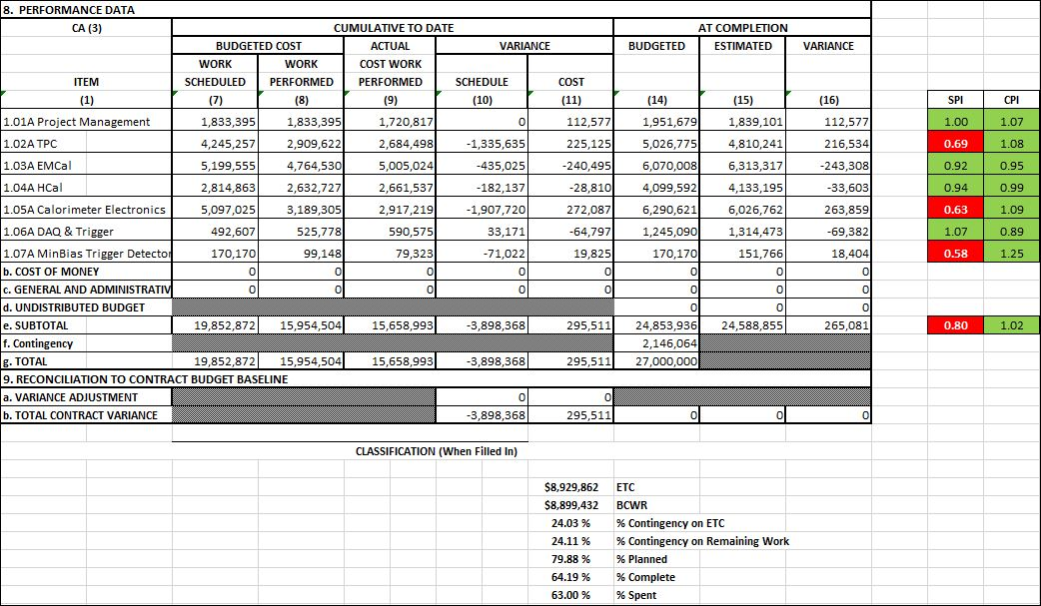
Cost Performance Report (CPR) – sPHENIX MIE
DOE SPI or CPI Value Thresholds
0.90 to 1.15
0.85 to 0.89 or 1.16 to 1.25
<0.85 or >1.25
*Highlights in table above takes variance $ into consideration, not just Indices

Slide 19
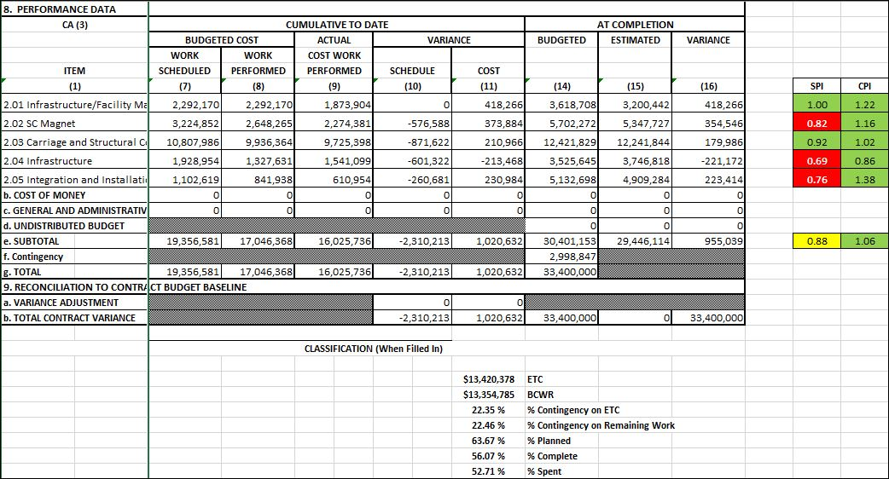
Cost Performance Report (CPR) – 1008 Infra and Facility Upgrade
DOE SPI or CPI Value Thresholds
0.90 to 1.15
0.85 to 0.89 or 1.16 to 1.25
<0.85 or >1.25
*Highlights in table above takes variance $ into consideration, not just Indices

Slide 20
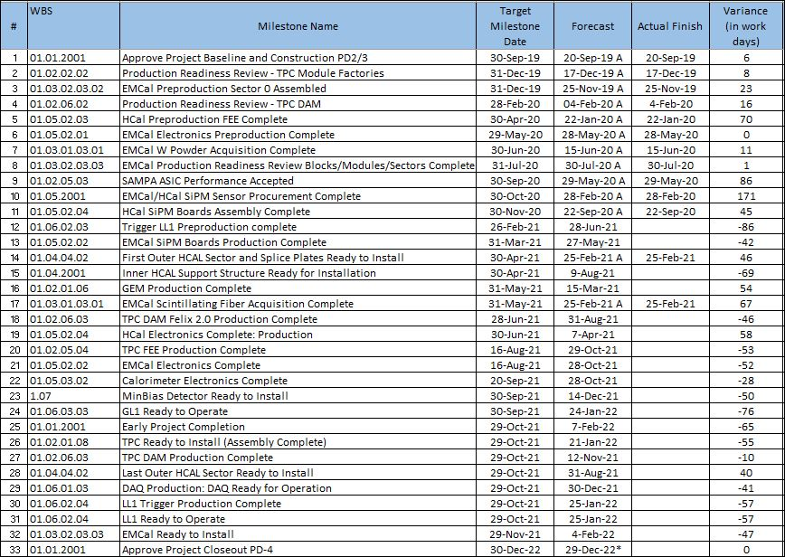
Milestones Status – sPHENIX MIE

Slide 21
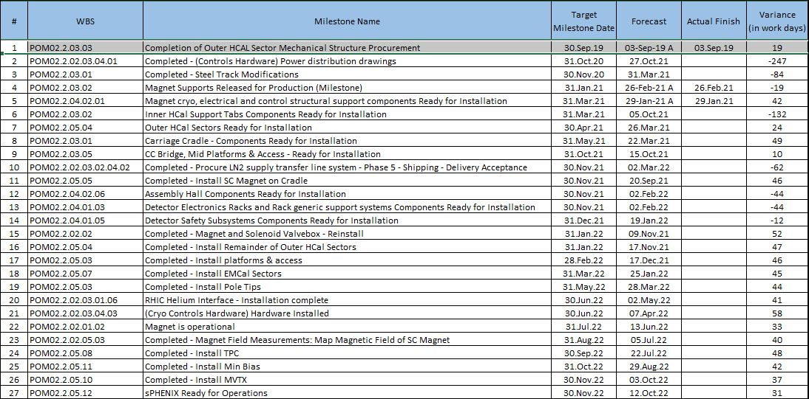
Milestones Status – 1008 Infra and Facility Upgrade

Slide 22
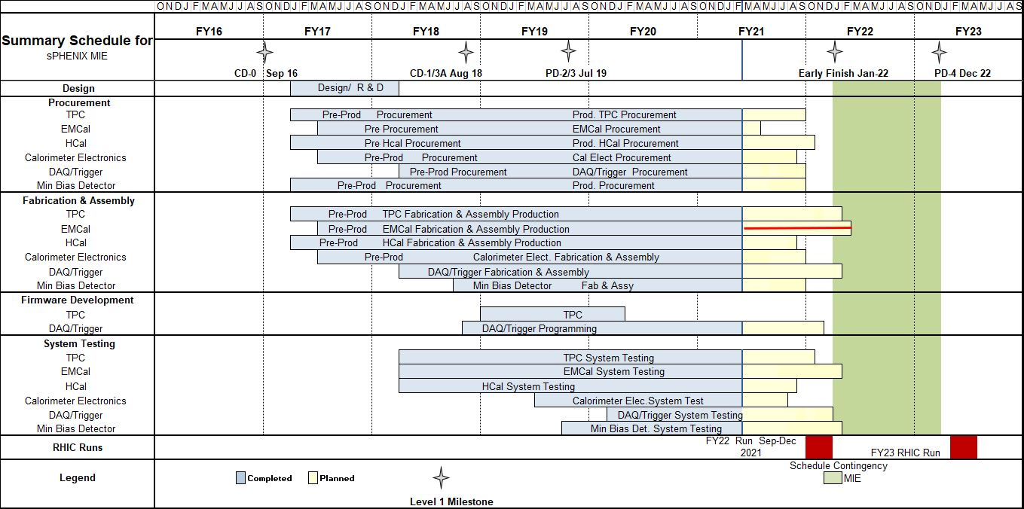
Summary Schedule – sPHENIX MIE

Slide 23
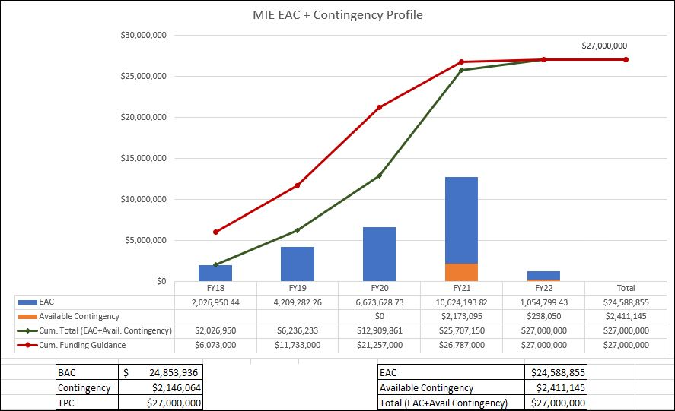
EAC and Contingency Profile – sPHENIX MIE

Slide 24
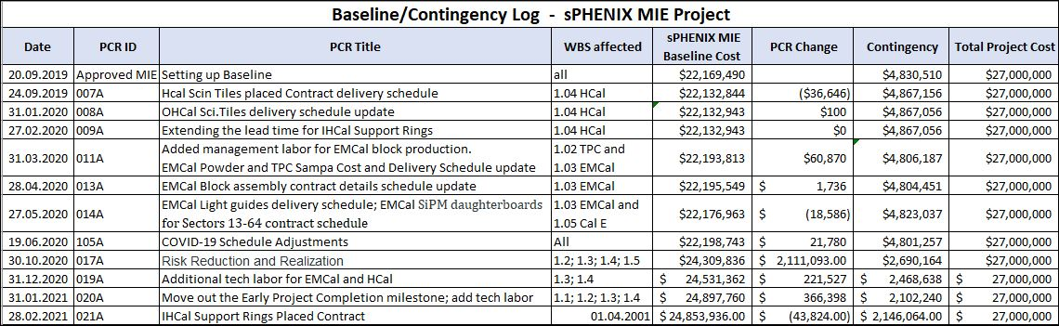
Baseline/Contingency Log - MIE

Slide 25
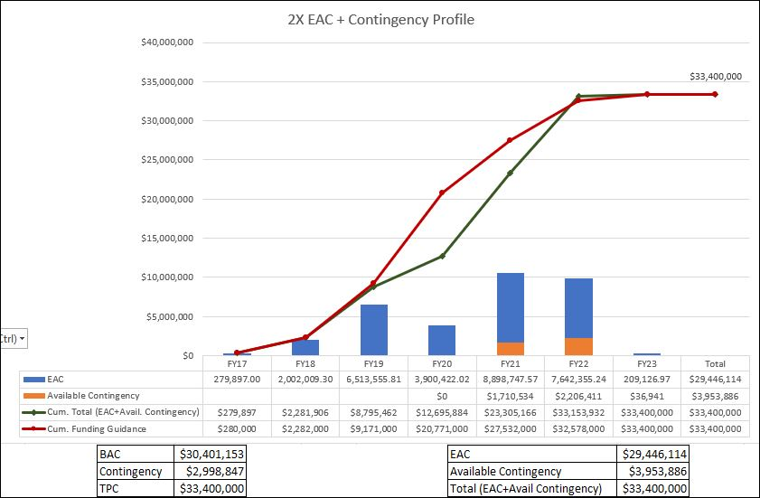
EAC and Contingency Profile – 1008 Infra and Facility Upgrade

Slide 26
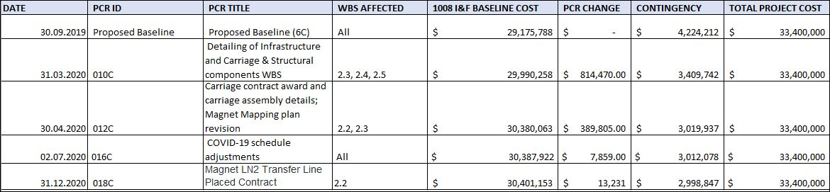
Baseline/Contingency Log - 1008 Infra and Facility Upgrade

Slide 27
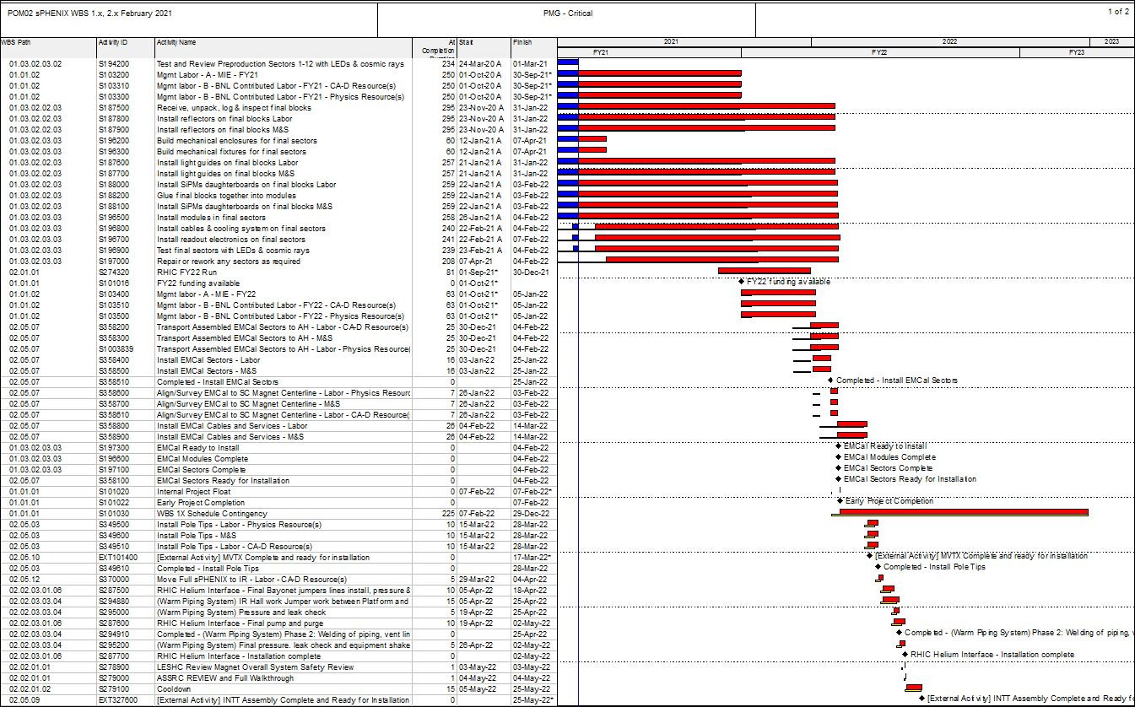
Critical Path (1x, 2x and 3x Combined)

Slide 28
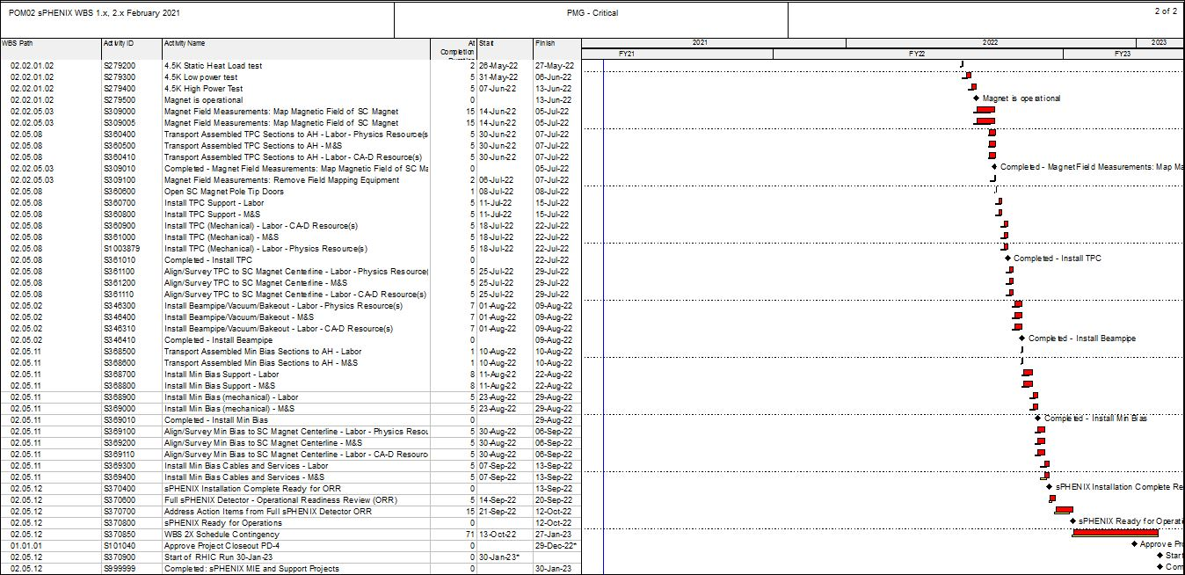
Critical Path (1x, 2x and 3x Combined)

Slide 29
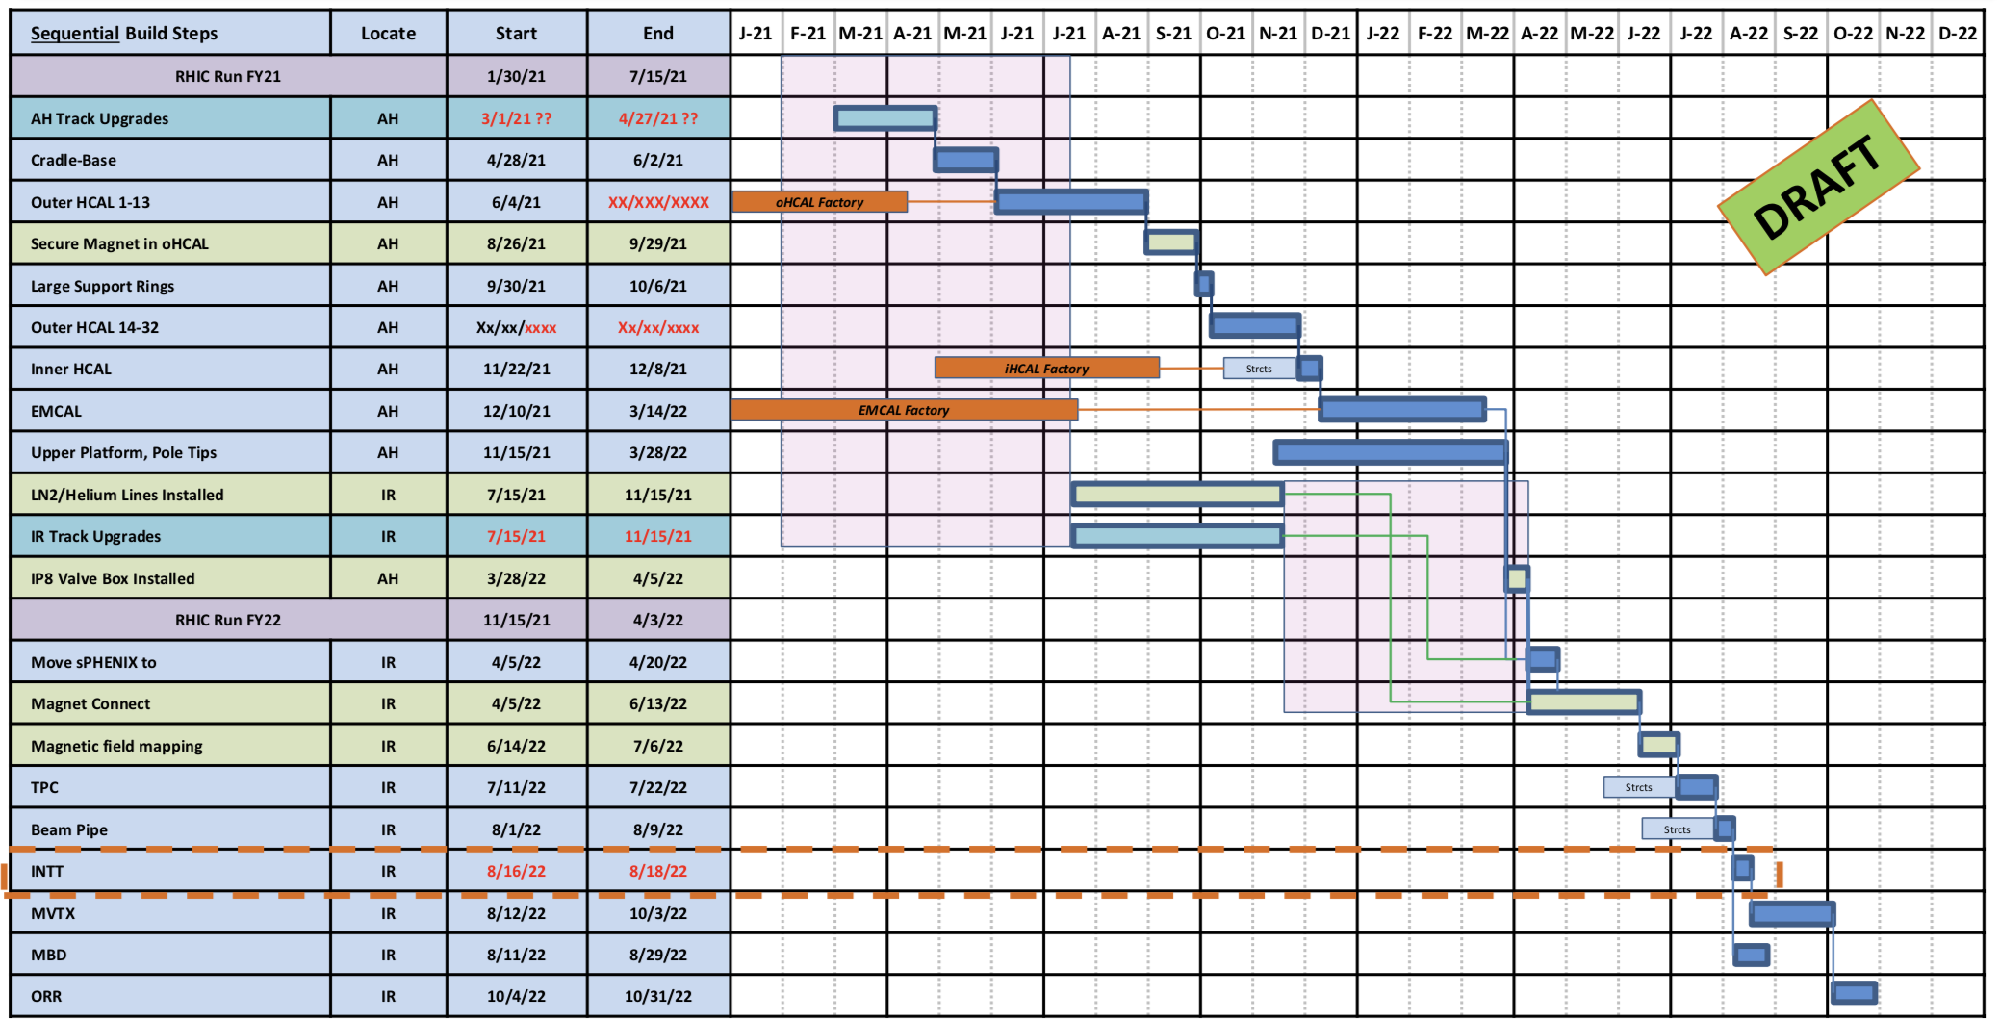
I&F Installation Schedule

