Slide 1
Plans for a Ring-Imaging Cherenkov Detector at the Electron-Ion Collider
TK Hemmick for the
EIC Tracking Consortium

Slide 2
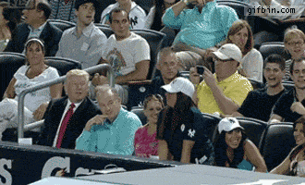
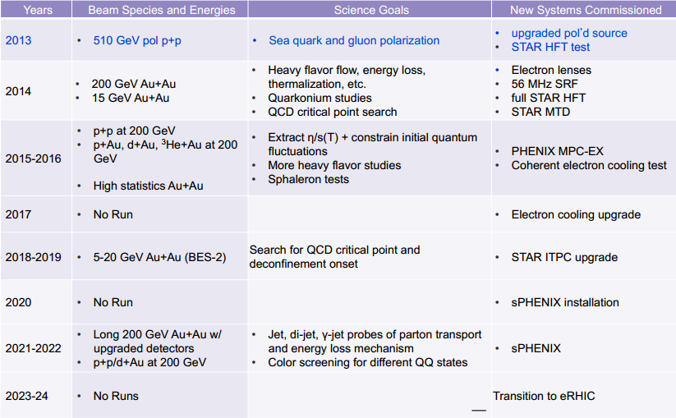
NSAC Rumors lead us to believe:
You
On this timeline (??)
Not You
Will answer questions
Using these Devices
  What is the spatial mapping of quark and gluon fields in the nucleon AND nucleus.
  Is the missing spin to be found via quark orbital momentum?
  Are new phases of matter (Color-Glass Condensate) accessible at low x in nuclei?
  eRHIC or MEIC
  EM Calorimeters
  Hadronic Calorimeters
  Tracking (subject of workshop)
  PID (subject of this talk)
機會 (opportunity)

Slide 3
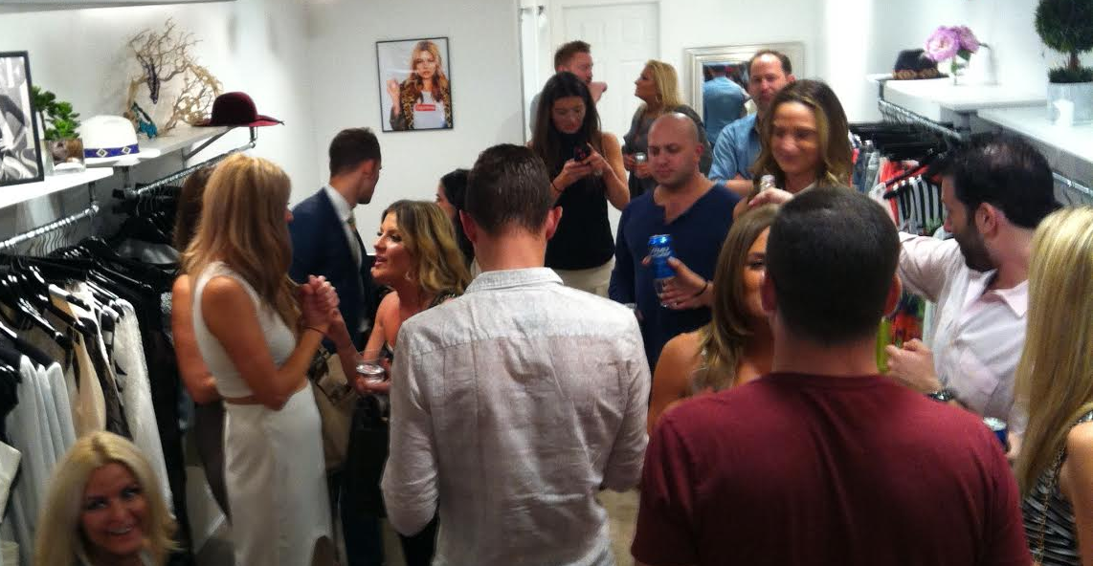
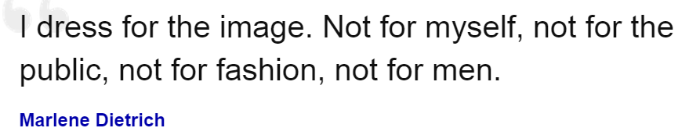
Special Thanks for Images in this Talk:
Celebrating the opening of DFTI (Dress for the Image) Boutique
Images enhanced by the Philadelphia community.
DFTI: Chestnut Street, Downtown Philadelphia…

Slide 4
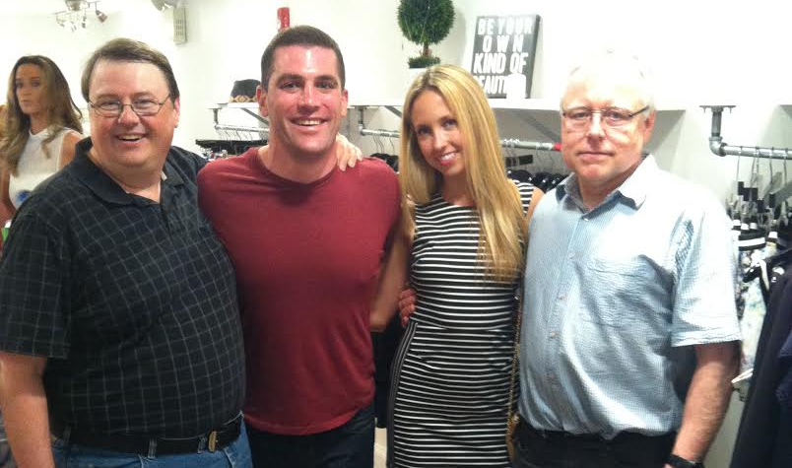
The challenge in proton-electron scattering:
electron
Proton
up
up
down
electron
Jet of Hadronic Debris
Scattering from a high-x quark yields energetic hadronic debris in the “proton” direction.
PID Challenging!

Slide 5
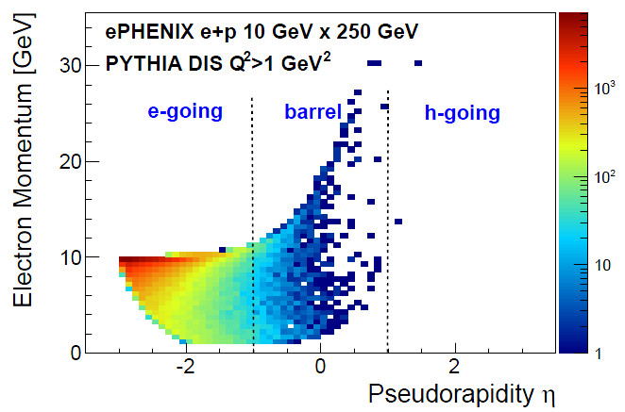
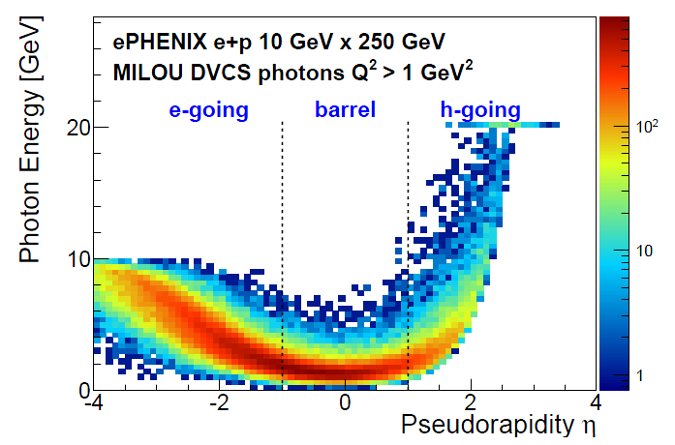
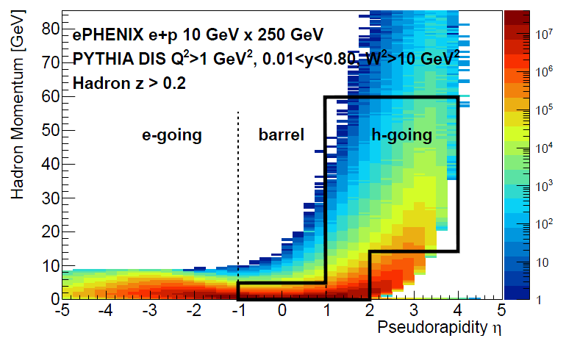
Ejectile Spectra:
ep (eA) HIGHLY asymmetric.
Moderate momenta for ALL species mid- and negative-η.
BAM! Very large lab momenta at positive-η.
Fwd Hadron ID challenging.
50-60 GeV/c Lab Momentum!

Slide 6
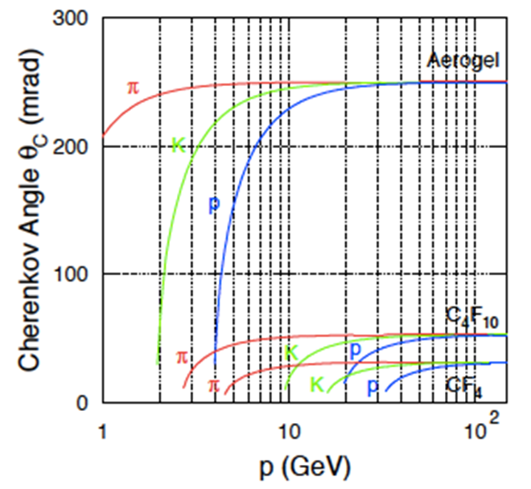
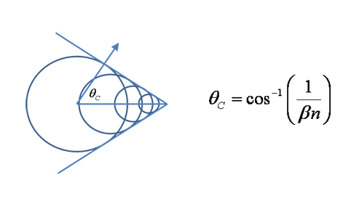
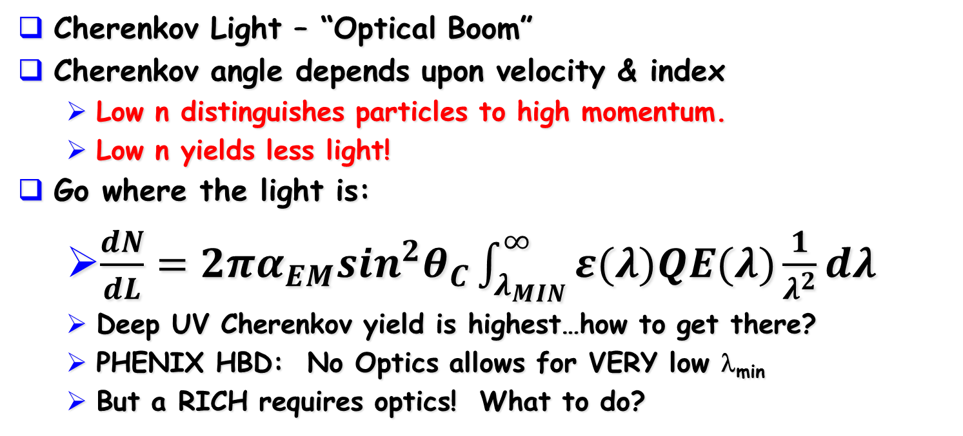
Imaging Cherenkov Light
Cherenkov Angle determines β
Cherenkov Light – “Optical Boom”
Cherenkov angle depends upon velocity & index
  Low n distinguishes particles to high momentum.
  Low n yields less light!
Go where the light is:
  $\frac{dN}{dL}=2πα_{EM}\sin^{2}θ_{C}\int_{λ_{MIN}}^{∞}{ε(λ)QE(λ)\frac{1}{λ^{2}}dλ}$
  Deep UV Cherenkov yield is highest…how to get there?
  PHENIX HBD: No Optics allows for VERY low λ_{min}
  But a RICH requires optics! What to do?

Slide 7
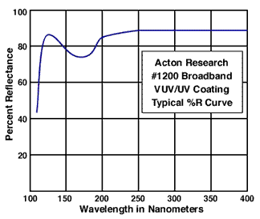
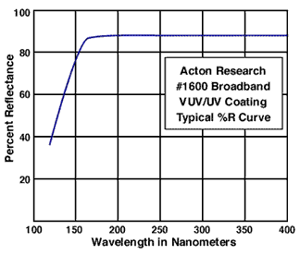
Commercial (small) mirror Reflectivities
Bare aluminum mirrors no good (AlO…high cutoff).
Better has MgF₂ overcoat (right hand).
  Exists and has been made to large scale.
  Not good enough.
Thin Film Interference!
  Tuned for peak at 120 nm.
  Retrieves (most of) the lost light.
Thin Film
Interference

Slide 8

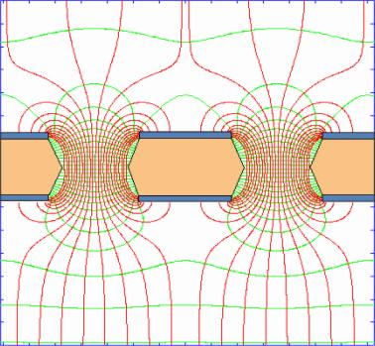
Gas Electron Multiplier for PHOTONs!
150μ
The original idea by F.Sauli (mid 90s) US Patent 6,011,265
Traditionally CHARGED PARTICLE detectors (not photons)
80μ
Two copper layers separated by insulating film with regular pitch of holes.
HV creates very strong field such that the avalanche develops inside the holes
Just add the photocathode
By the way: no photon feedback onto photocathode
CAVEAT: PHENIX HBD too low gain
(4000) to see single photons!

Slide 9
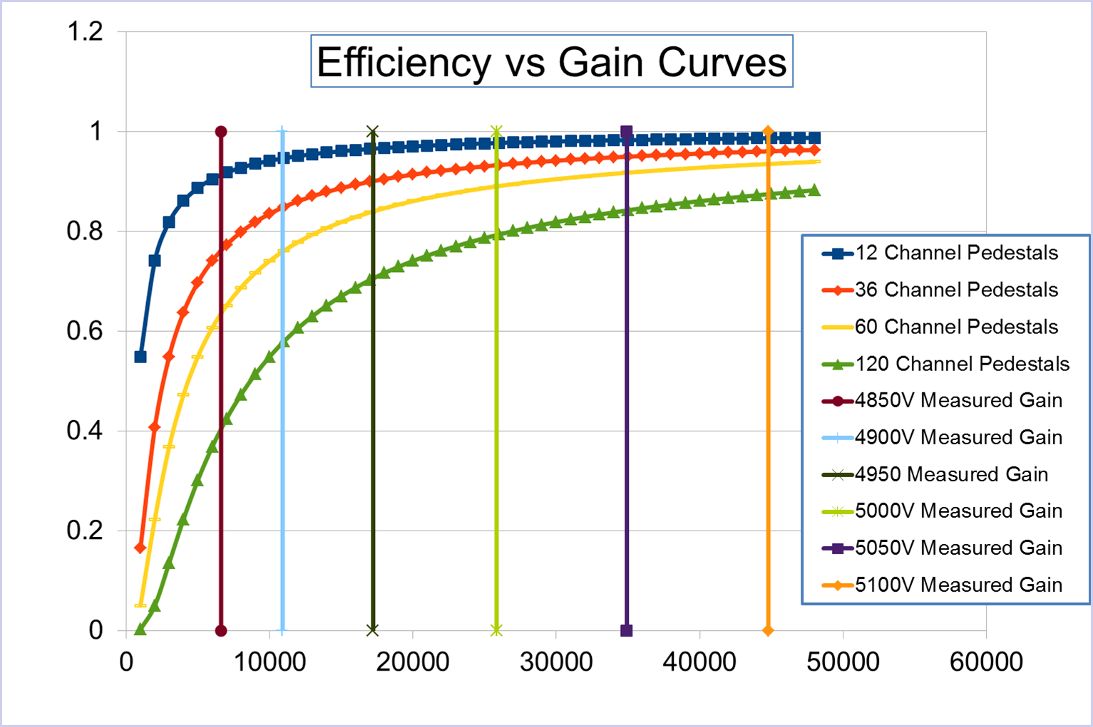
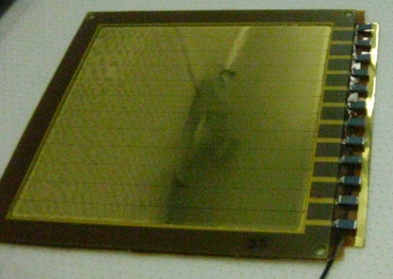
Where do you get more gain?
Harder than you think…
10000 gain (staged)
  N=1 → Poisson(10000)
  N=10→ >Poisson(100)
Gain in a gas (N→inf.)
  Pulse height spectrum of single electron avalanche is EXPONENTIAL!
5 GEMs in a stack.
Highly segmented GEMs
  10x10 cm²
  Low R-divider chain.
  Capacitive spark sensor.
  Never Sparked once.

Slide 10







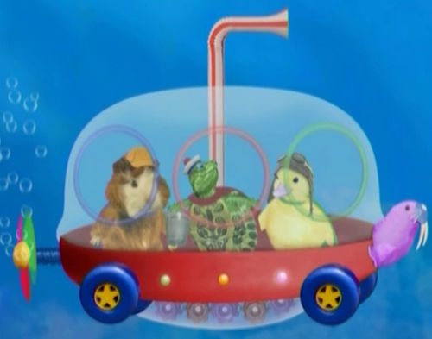
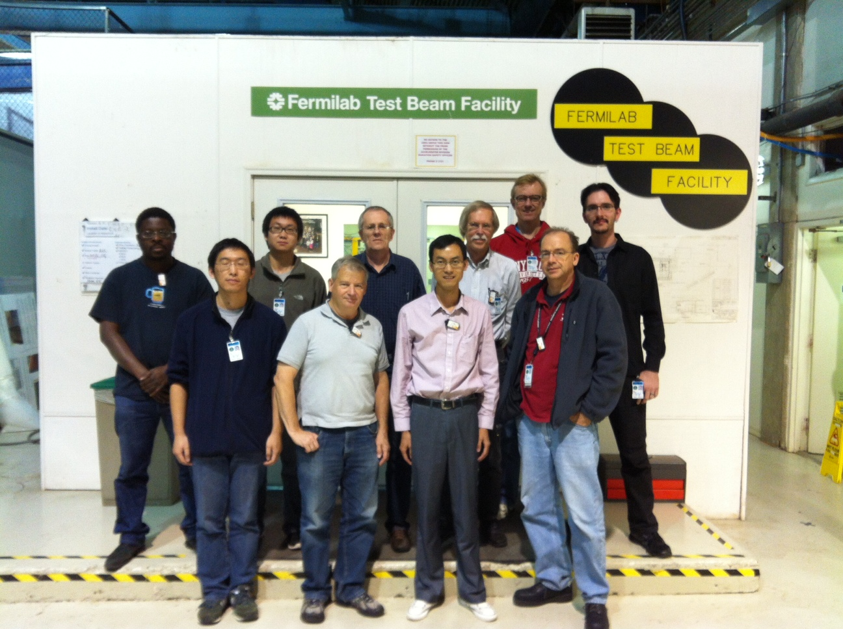
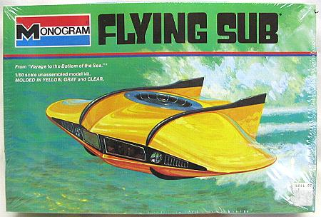
Beam Studies (FLYSUB Consortium)
TK Hemmick
Shift Crew 1
Shift Crew 2

Slide 11
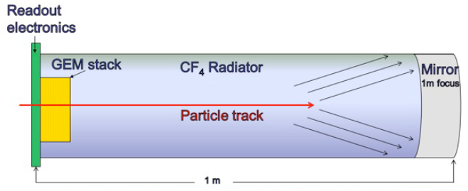
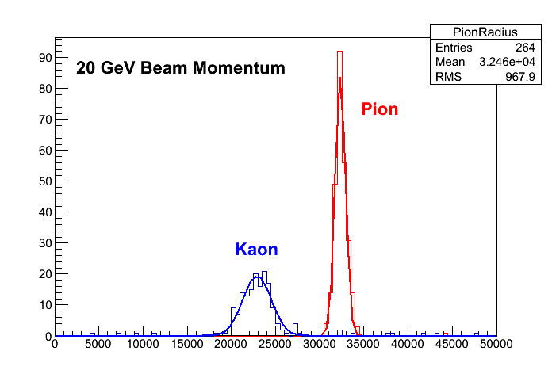
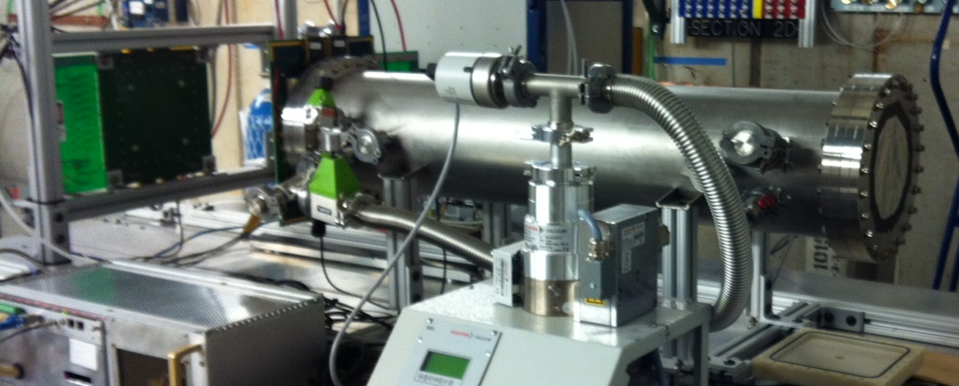
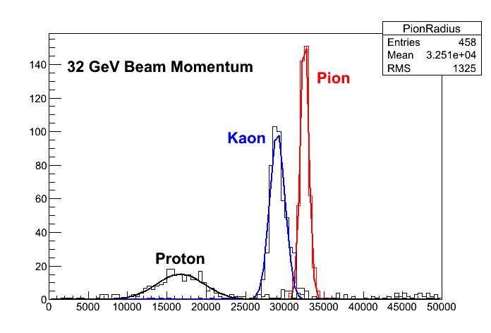
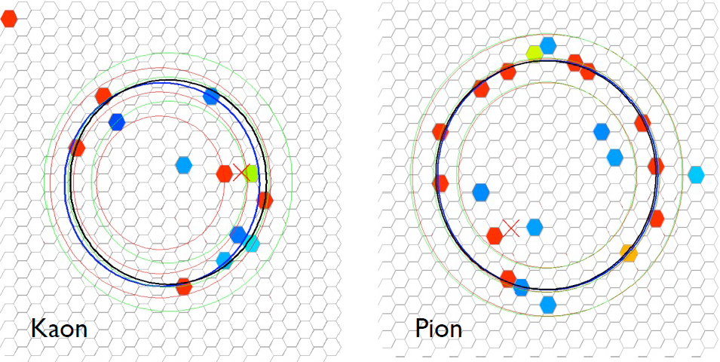
Ring Imaging Cherenkov Detector Prototype
32 GeV Beam Momentum

Slide 12
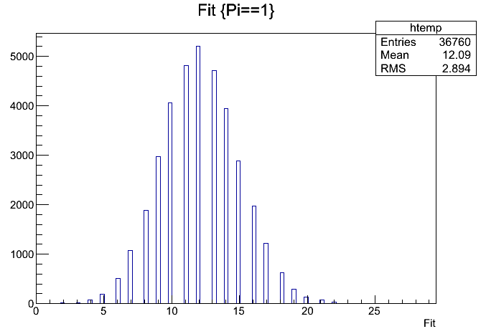
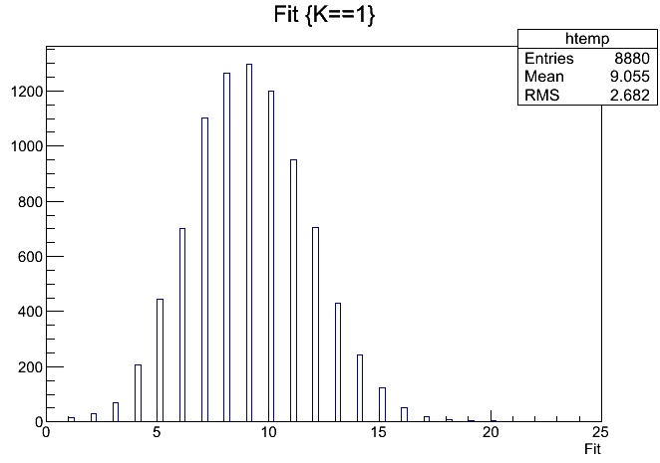
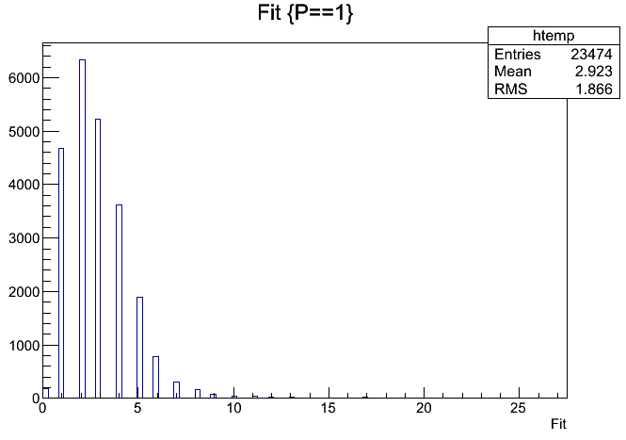
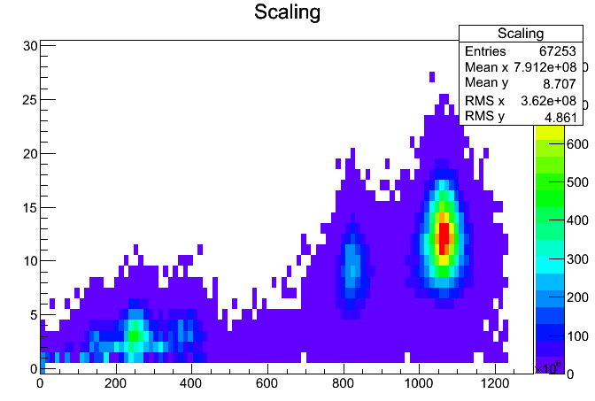
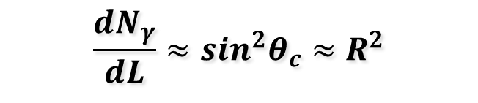
Number of Pads Included in the Fit:
32 GeV
32 GeV
Pion
Kaon
# pads
# pads
32 GeV
32 GeV
# pads
Proton
# pads
R²
$$\frac{{dN}_{γ}}{dL}≈sin^{2}θ_{c}≈R^{2}$$

Slide 13
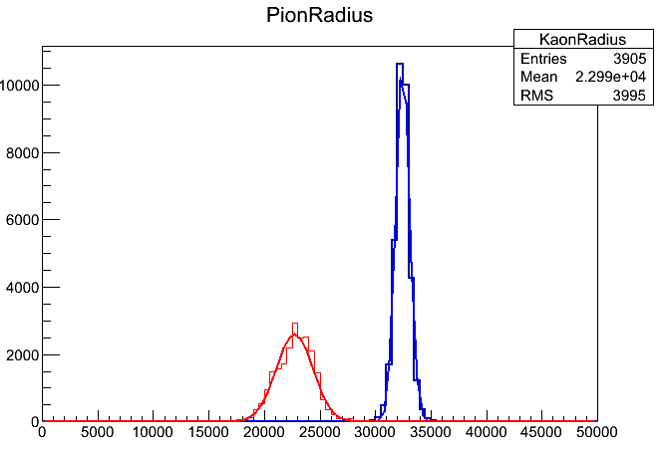
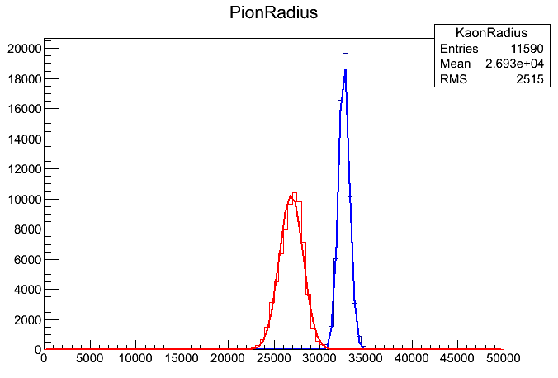
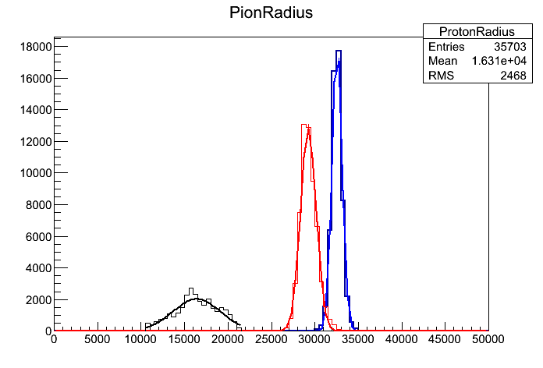
Complete Set of Radii Results:
20 GeV
25 GeV
Kaon
Pion
Pion
Kaon
Reasonable results at all measured energies.
NOTE: 32 GeV is the highest available energy for Kaons at FTBF.
32 GeV
Kaon
Pion
Proton

Slide 14
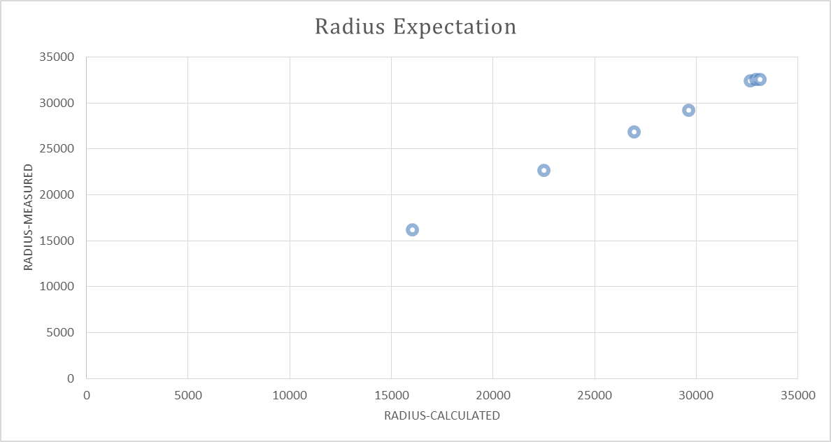
Scaling of the Radius With Expectation
All data is used with equal weights.
Index of Refraction is free parameter.
Fitted result: n = 1.000558 (as expected!).

Slide 15
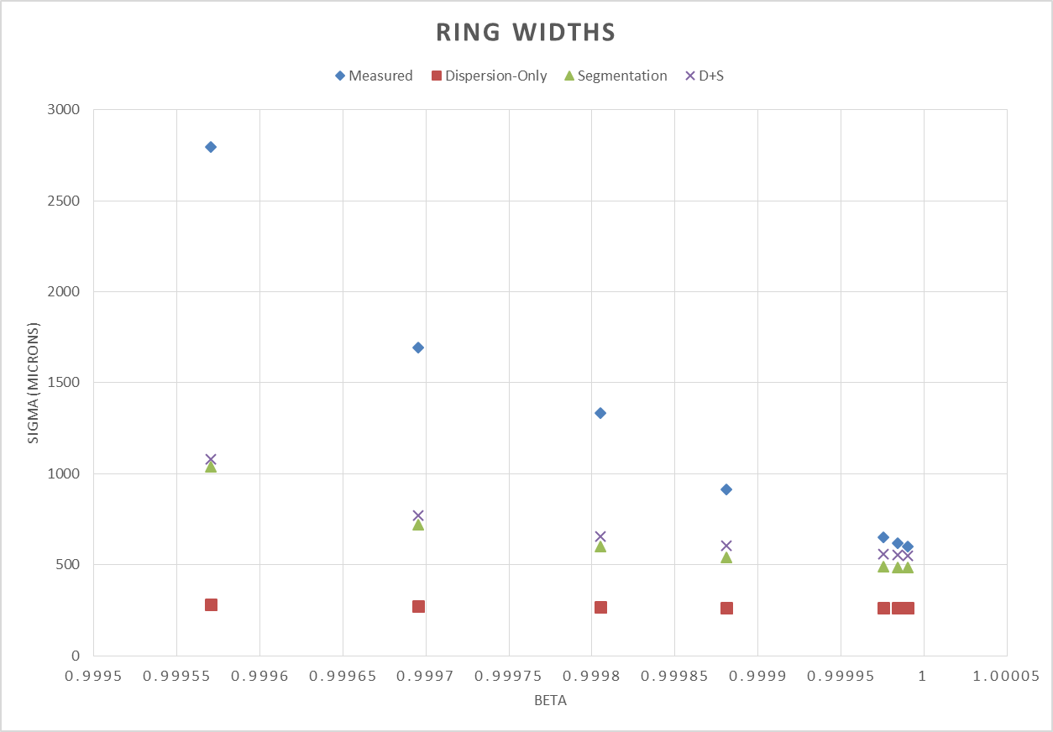
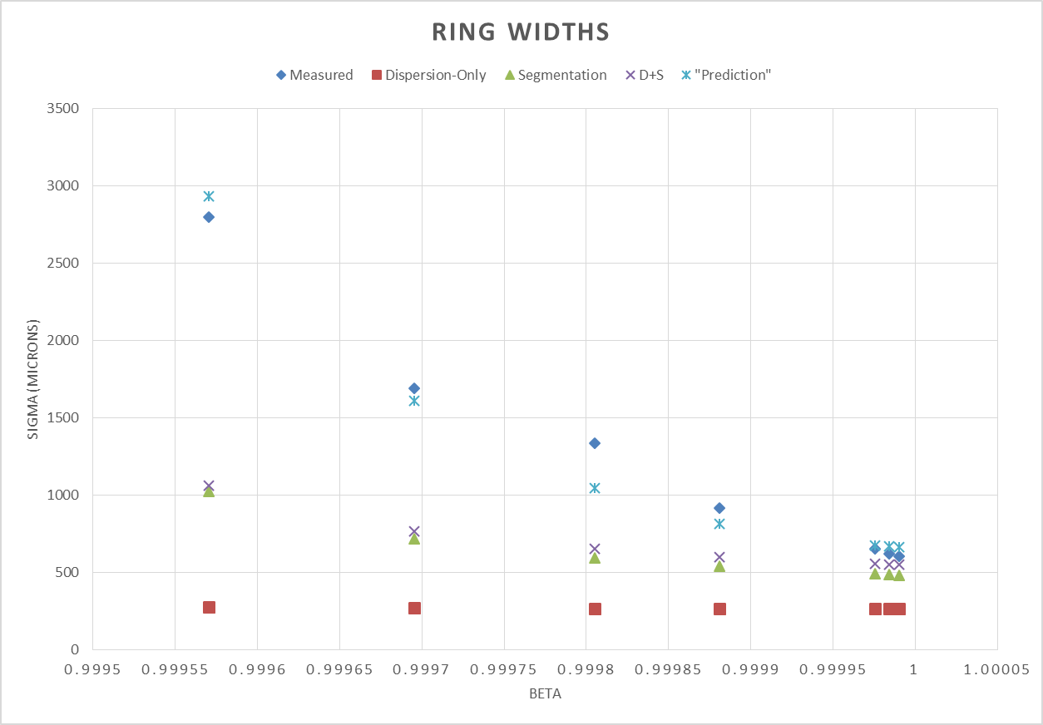
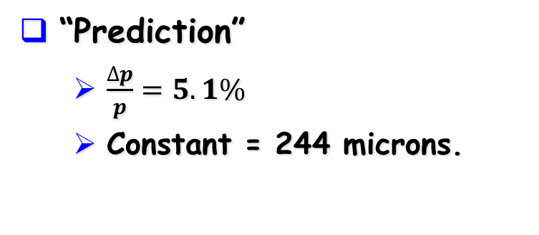
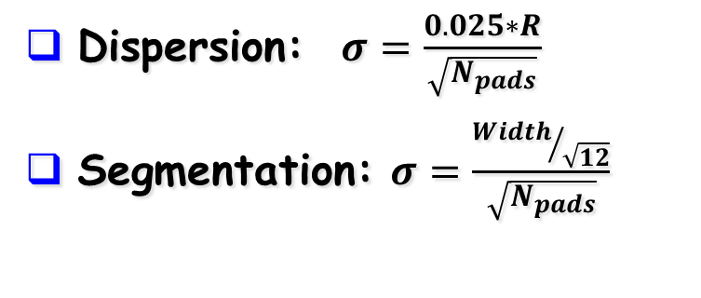
Understanding the widths.
Dispersion: $σ=\frac{0.025∗R}{\sqrt{N_{pads}}}$
Segmentation: $σ=\frac{{Width}/{\sqrt{12}}}{\sqrt{N_{pads}}}$
“Prediction”
  $\frac{∆p}{p}=5.1\%$
  Constant = 244 microns.

Slide 16
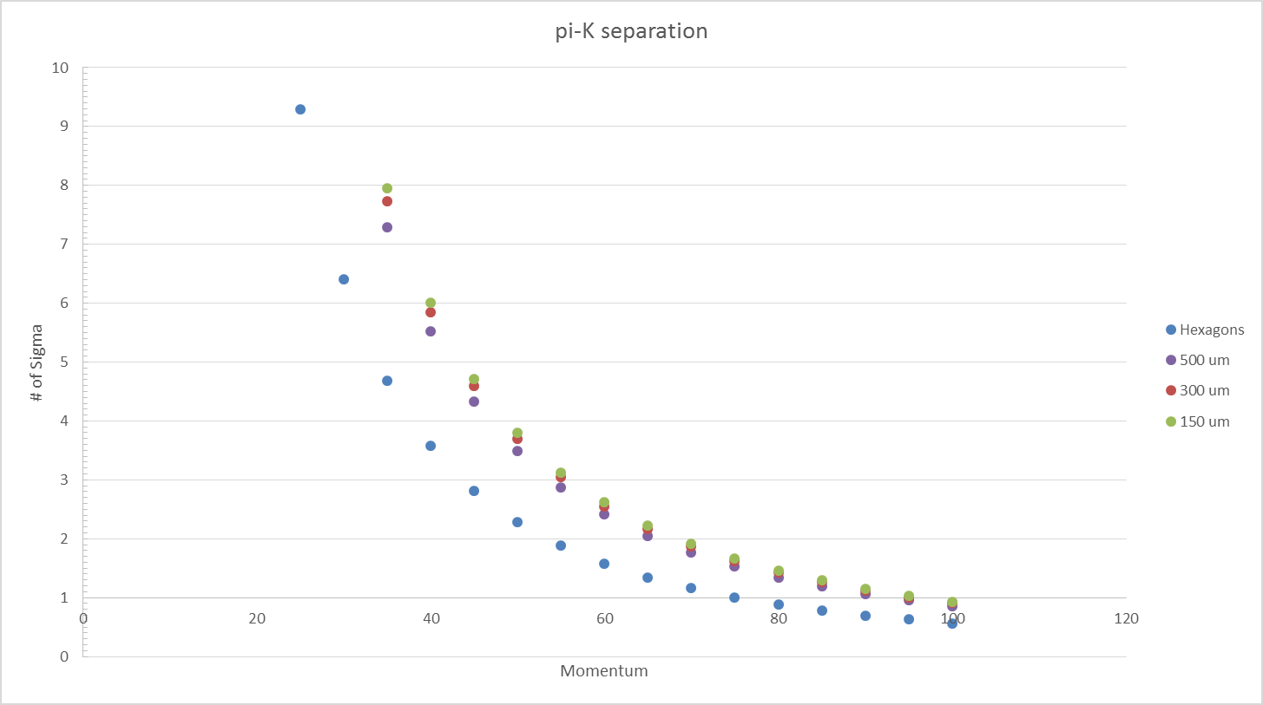
Removing FNAL Beam Spread…
NOTE: Assumptions yield “worst case”
Hexagon pads should NOT be used at EIC (too coarse).
Dispersion becomes limiting factor.
500 micron (sigma) photon position resolution is easy goal.
2.5 sigma separation at 60 GeV.
Practical Limit: Momentum Resolution more than RICH

Slide 17
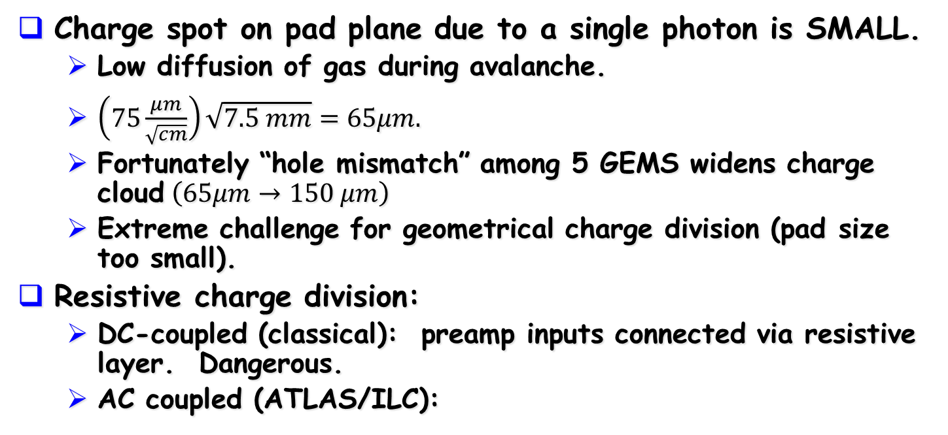
Charge Division Challenges.
Charge spot on pad plane due to a single photon is SMALL.
  Low diffusion of gas during avalanche.
  $\left(75\frac{μm}{\sqrt{cm}}\right)\sqrt{7.5 mm}=65μm.$
  Fortunately “hole mismatch” among 5 GEMS widens charge cloud$\left(65μm→150 μm\right)$
  Extreme challenge for geometrical charge division (pad size too small).
Resistive charge division:
  DC-coupled (classical): preamp inputs connected via resistive layer. Dangerous.
  AC coupled (ATLAS/ILC):
Charge injection
Resistive Layer
pads

Slide 18
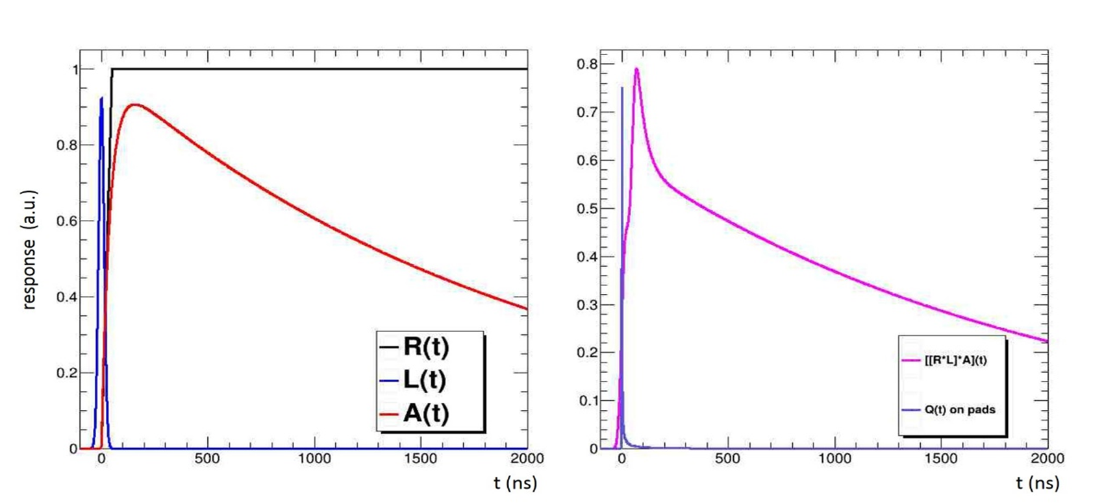
Modeling Dynamic Signal Propagation
Dynamic Charge Dispersion Simulation (ala ILC):
  All components have to be convoluted,
  [[R*L]*A](t)=RLA can be “obtained” analytically
  [RLA*Q](t) has to be solved numerically (working on).
Recent News:
  THREE(!!) students work under the direction of Klaus Dehmelt solving Telegraph Equation.
  Initial results show “challenging” narrow sweet spot for signal propagation.

Slide 19

So…it works…you gonna build this for EIC?
Maybe.
Initial project has proved to be a 100% successful implementation of the conceptual design.
It *WILL* be a viable choice for EIC, but will not be a unique solution to forward PID issues:
  ID’s the highest momentum hadrons (good!).
  ID’s *ONLY* the highest momentum hadrons (not so good).
TKH Personal opinion:
  Today we’ve seen a cavalcade
  of successful R&D efforts/results.
  Choices are coming since we
  would not use all these techniques.
  The Electron-Ion Collider is “getting real.”
We must build COMMUNITY

Slide 20
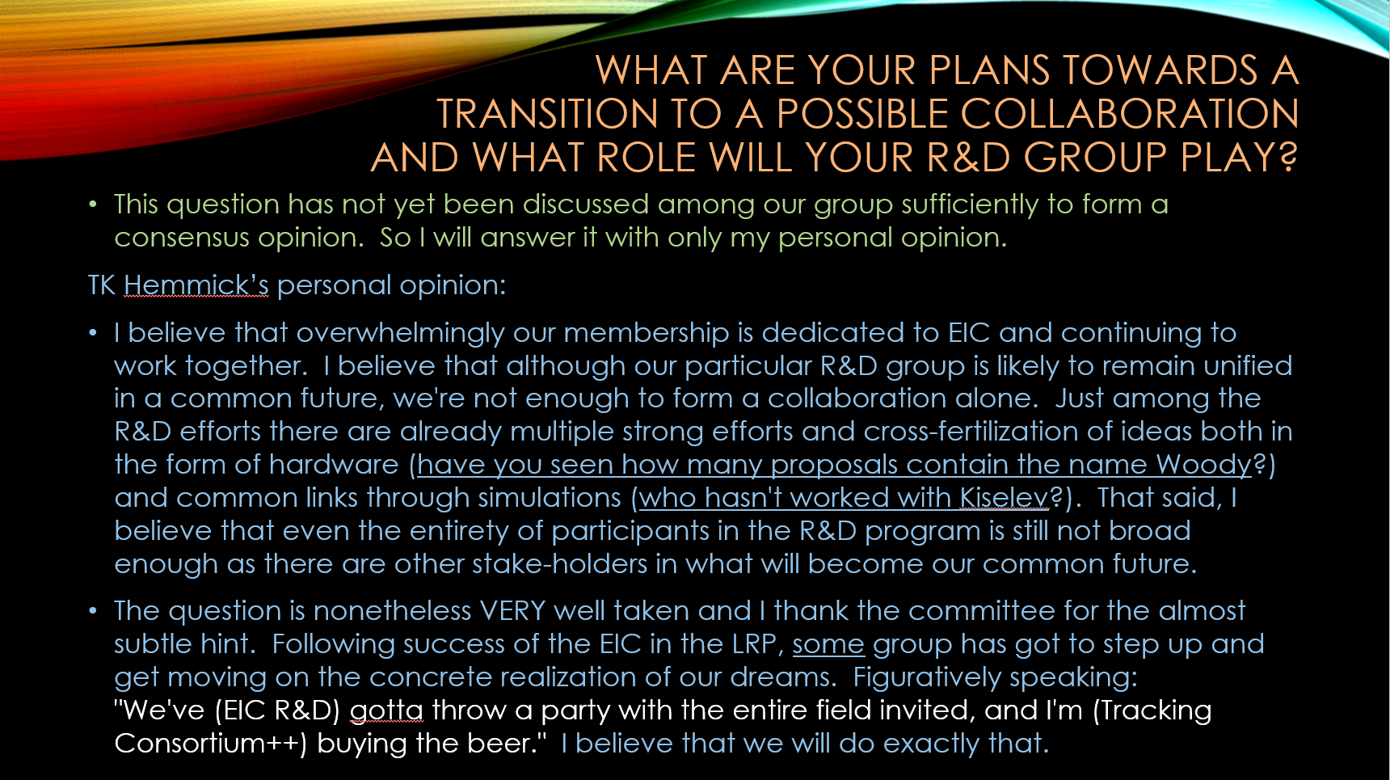
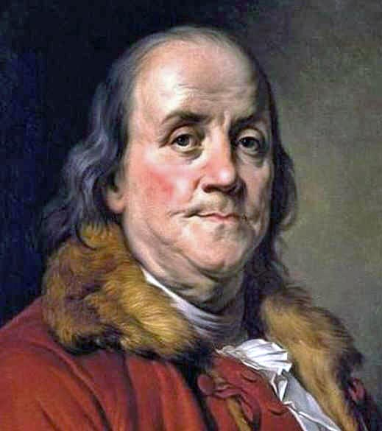
R&D Committee Questions:
Today = Party Planning
We must all hang together or most assuredly we will all hang separately.
Benjamin Franklin, Philadelphia Pennsylvania

