Slide 1
Understanding Systematics in the SRS: Timing, Saturation, and Calibration
EIC Tracking Workshop, Temple university
May 9, 2015
Michael Phipps, BNL

Slide 2
Background for our SRS Studies
SRS used for our Mini-drift detector test beam data
Mini-drift detector features:
Extended drift gap (16.5 mm) to allow vector reconstruction of track
Chevron-style readout pads to segment charge and minimize channel cost
SRS not optimal for detectors with large charge/channel, since originally designed for silicon detectors at CMS
To understand the performance of our mini-drift detector we have to be able to ascribe systematics to the readout system and calibrate it for optimal use within our dynamic range

Slide 3
SRS Architecture: A Quick Look
Preamp
Shaper
Analog Pipeline
Multiplexer Gain (MUX Gain)
Multiplexer
APV25
Preamp/shaper Gain: 100 mV/mip
(25,000 electrons)
Dynamic Range: ~5-6 mip
Shaping Time Constant: 50 ns
Ring Buffer of 192 cells
Analog gain: 100 m$A/mip$
128:1
System Clock
ADC
FPGA
FEC
LHC clock: 40 MHz (25 ns)
10 bit at 40 MHz

Slide 4
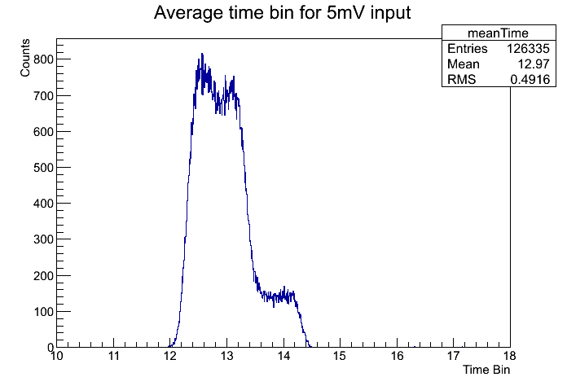
${25}/{\sqrt{12}} ns$ Timing Uncertainty
D(t)
Trigger window: trigger equally anywhere within this window
Measured Uncertainty with External Pulser
$$\frac{−δt}{2}$$
$$\frac{δt}{2}$$
t
25 ns time bins
$$σ_{Total}=\sqrt{σ_{1}^{2}+ σ_{2}^{2}}$$
$$σ_{1}= {25}/{\sqrt{12}}$$
$$σ_{2}= ?$$
$$σ_{t}^{2}= {\int{{\left(t−\left\langle t\right\rangle \right)}^{2} D\left(t\right) dt}}/{\int{D\left(t\right) dt}}$$
At least 7.2 ns of “unfoldable” uncertainty
$$\left\langle t\right\rangle =0 → σ_{t}= \frac{δt}{\sqrt{12}} =7.2 ns$$

Slide 5
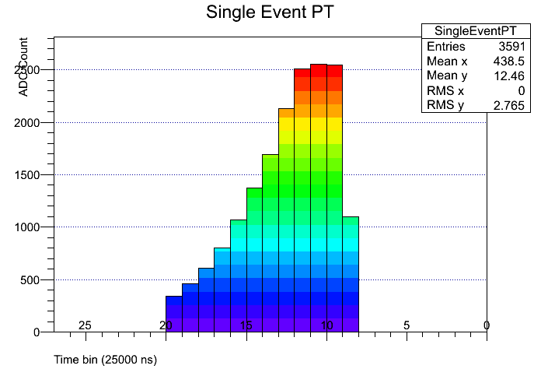
Hybrid Saturation
SRS designed for silicon MIPs of 25k electrons
Shaper has narrow dynamic range with saturation around 175k electrons
Serious problem for wide readout strips (chevrons) or large drift detectors.
Time bin centroid measurements can help minimize by using many unsaturated samples
Clipping

Slide 6
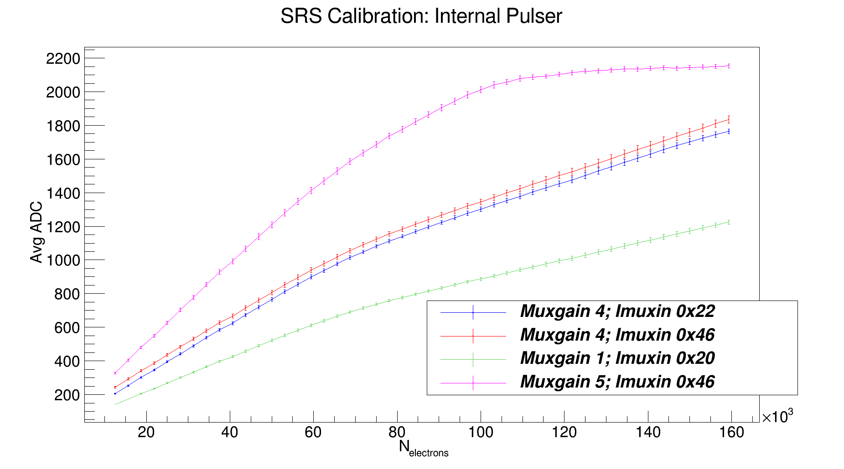
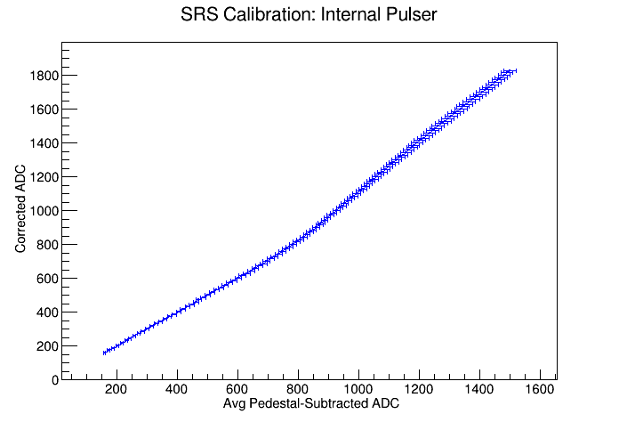
Nonlinear Response
Nonlinearity as function of MUXGAIN and IMUXIN
MUX1 correction curve
FEC saturation
Average Response Across All Channels Across all Input Values -> measures response nonlinearity
Convert from electrons to corrected ADC
Conclusions:
Each MUXGAIN needs its own calibration curve
IMUXIN is just an additive constant -> nonlinearity is in the hybrid and independent of location in FEC range
Correction applied AFTER pedestal subtraction
Nonlinearity around 70k electrons

Slide 7
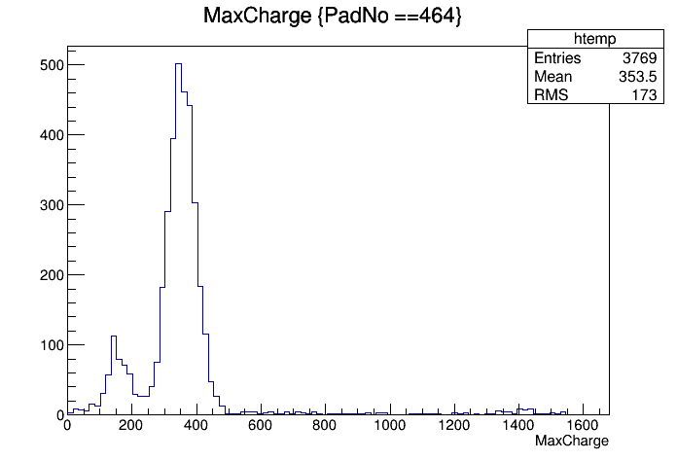
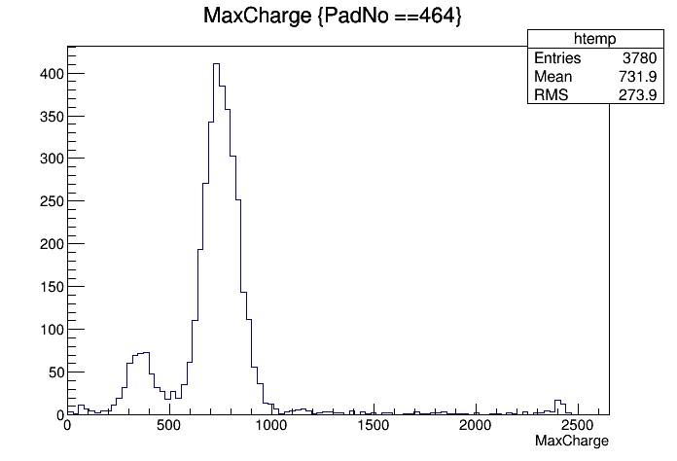
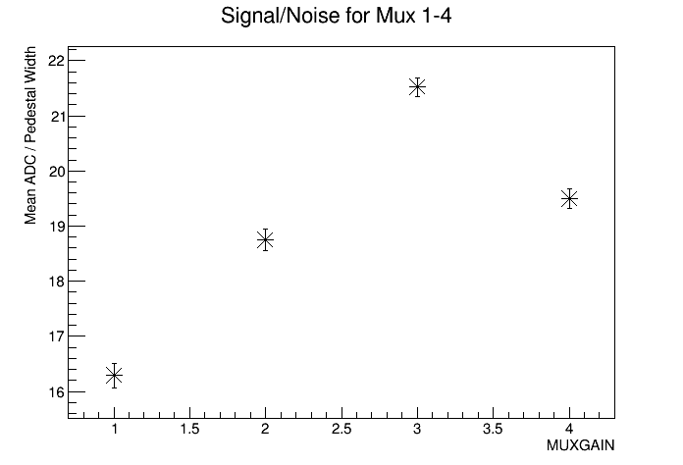
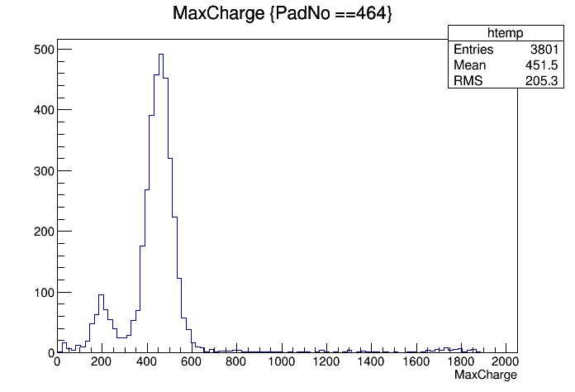
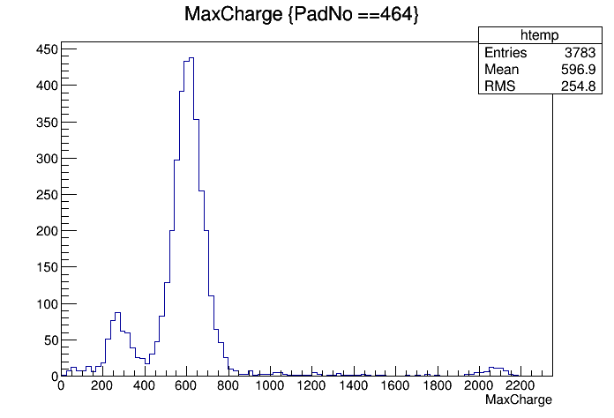
SRS Calibration: Signal/Noise
Fe55 Spectrum: Peripheral pad from highly collimated xray gun
Mux 1
Mux 3
Mux 2
Mux 4
** For better signal to noise, use Muxgain 3 (which is really Muxgain 4)

Slide 8
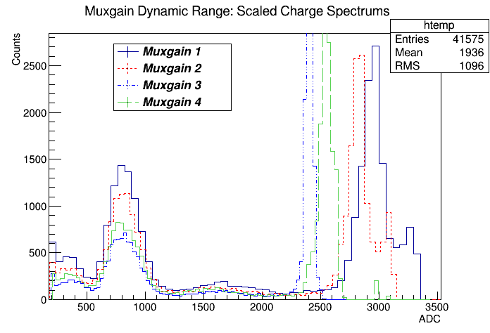
SRS Calibration: Dynamic Range
Fe55 spectrum across all pads for scaled Muxgains
Primary Fe55 peak in center of cluster
- Falls at edge of saturation, so convenient measure of dynamic range
Peripheral primary peak
- Scale the spectrum for each Muxgain from the mean of this peak
** For better dynamic range, use Muxgain 1
- IMUXIN of 0x01 is safest location for pedestal

Slide 9
SUMMARY
At least 7.2 ns timing uncertainty in SRS
Saturation in the hybrid ~175k electrons
Significant nonlinearity beyond 70k electrons
Gain of multiplexer can be optimized to either improve signal/noise or dynamic range

Slide 10
Backups

Slide 11
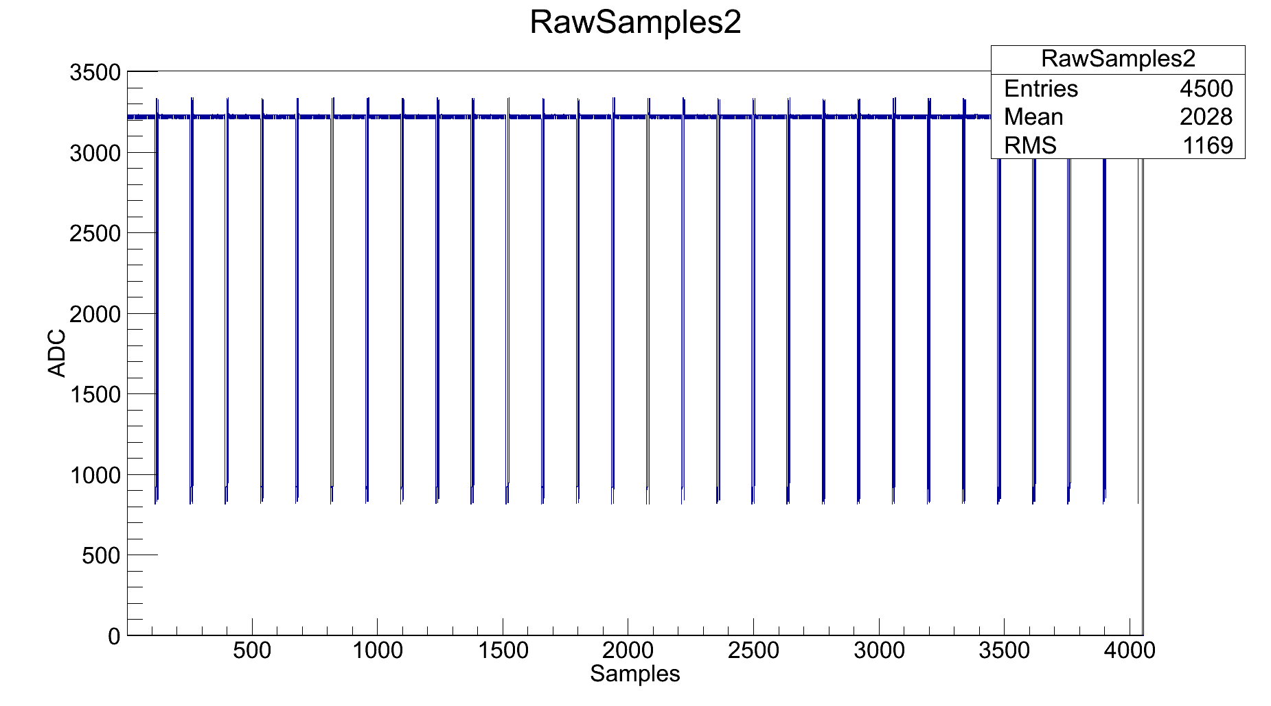
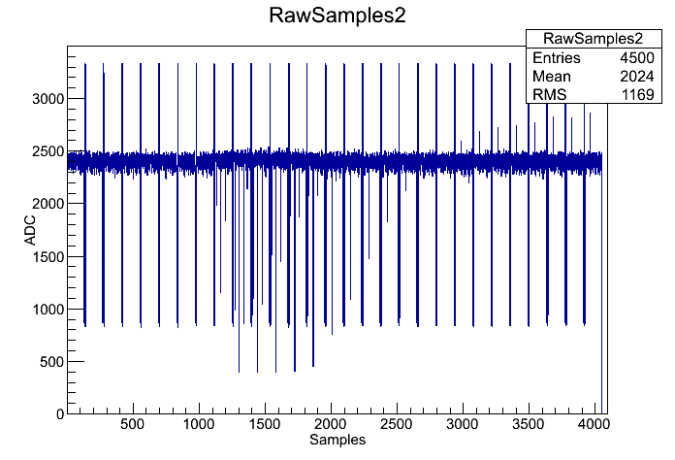
FEC Saturation
Dynamic range between ~400 - 3200 ADC
Since largest MUX5 signal is ~2700 ADC, MUX5 should be avoided with GEMs
MUX3 and MUX4 pedestals have to be carefully aligned within the FECs dynamic range (modify the IMUXIN of the preamp)
Pedestal above threshold
Upper limit:
3200 ADC
Lower limit:
400 ADC
FEC Saturation

Slide 12
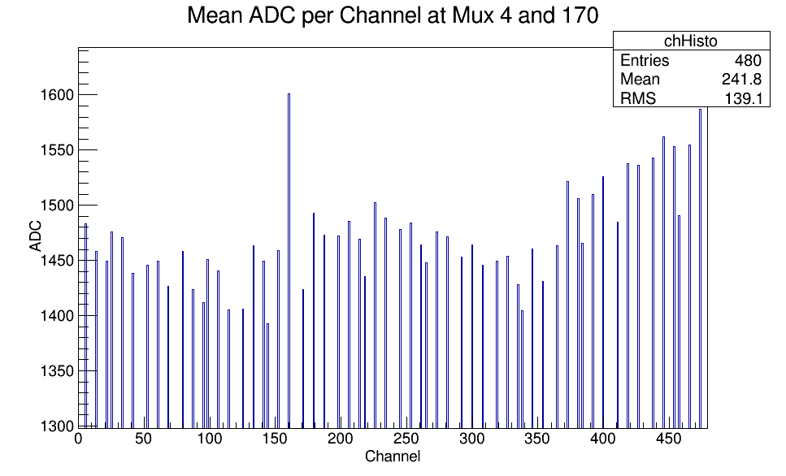
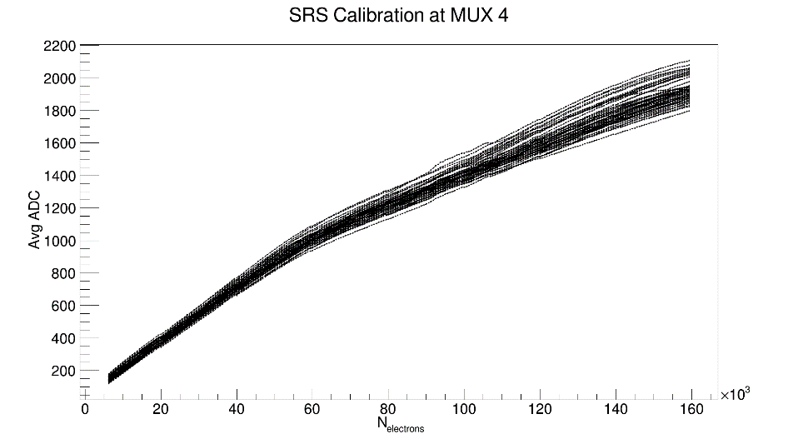
Channel-to-channel calibration
Channel dependent non-linearity curves
Signal response per channel
Internal Pulser
Mux 2
APV Internal Pulser
Internal Pulser
Mux 4

Slide 13
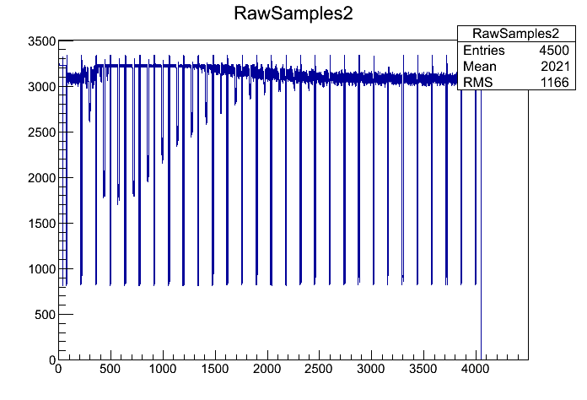
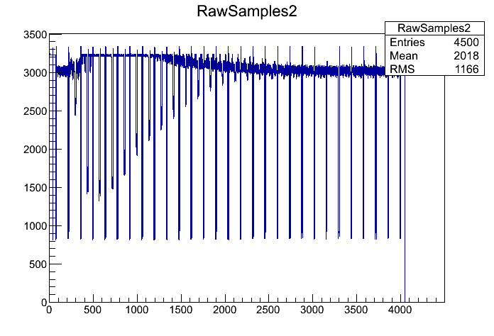
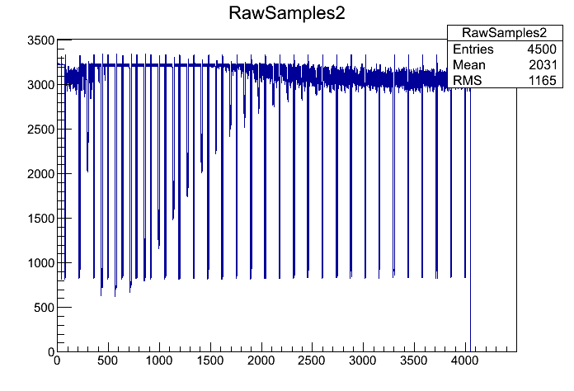
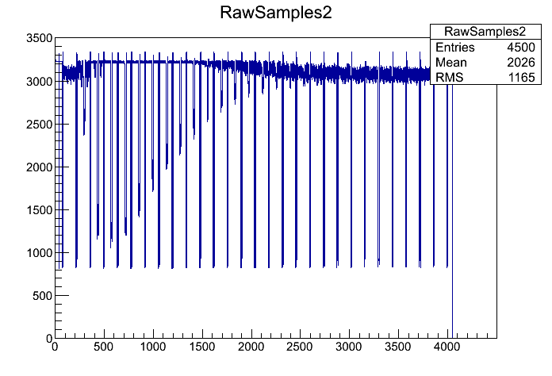
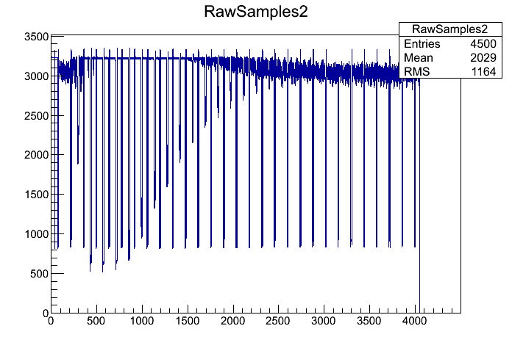
MUXGAIN: *Resistors for Mux3 and 4 appear to be switched in all APVs (ie Mux 4 is nominal Mux)
MUXGAIN 1
MUXGAIN 2
MUXGAIN 3
MUXGAIN 4
MUXGAIN 5
MUX GAIN | Approximate Hybrid Range (Pedestal-subtracted ADC) | Multiplexer Gain (mA/mip)
1 | 1250 | 0.6
2 | 1700 | 0.8
3 | 2500 | 1.2
4 | 2100 (~11 bit) | 1.0
5 | 2900 | 1.4

