Slide 1


Requirements on EIC detector tracking system
Alexander Kiselev
EIC Tracking R&D Workshop at Temple University
May,9 2015

Slide 2
Topics to be covered (or just touched)
Acceptance
Resolutions
Material budget
Present configuration
Future R&D wish list

Slide 3
Acceptance: electrons
{PYTHIA events at different electron energy}
Increasing lepton beam energy: scattered lepton is boosted to negative η
Q² > 1.0 GeV²: rapidity coverage -4 < η < 1 is sufficient

Slide 4
Acceptance: hadrons
{same set of PYTHIA events; Q²>1 GeV², 0.01<y<0.95, z>0.1 cuts applied}
Increasing lepton beam energy boosts hadrons more to negative pseudorapidity
Increasing hadron beam energy influences max. hadron energy at fixed pseudorapidity
(and π±, K±, p± look
the same)
range -3<η<3 covers entire p_{t} & z region important for physics

Slide 5
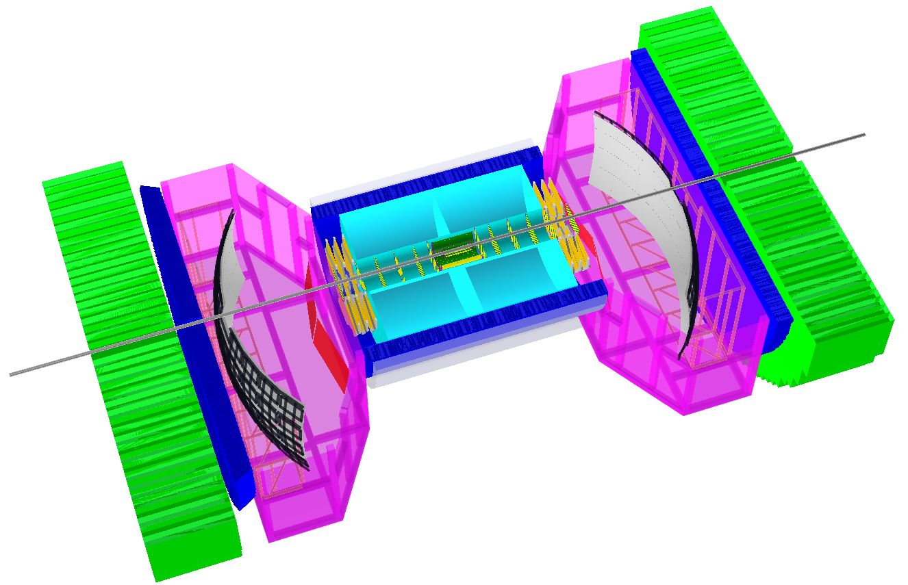
Configuration: whole detector
-4<η<4: Tracking & e/m Calorimetry (hermetic coverage; symmetric layout)
hadronic calorimeters
e/m calorimeters
RICH detectors
9.0m
electrons
hadrons
silicon trackers
TPC
GEM trackers
3T solenoid coils

Slide 6
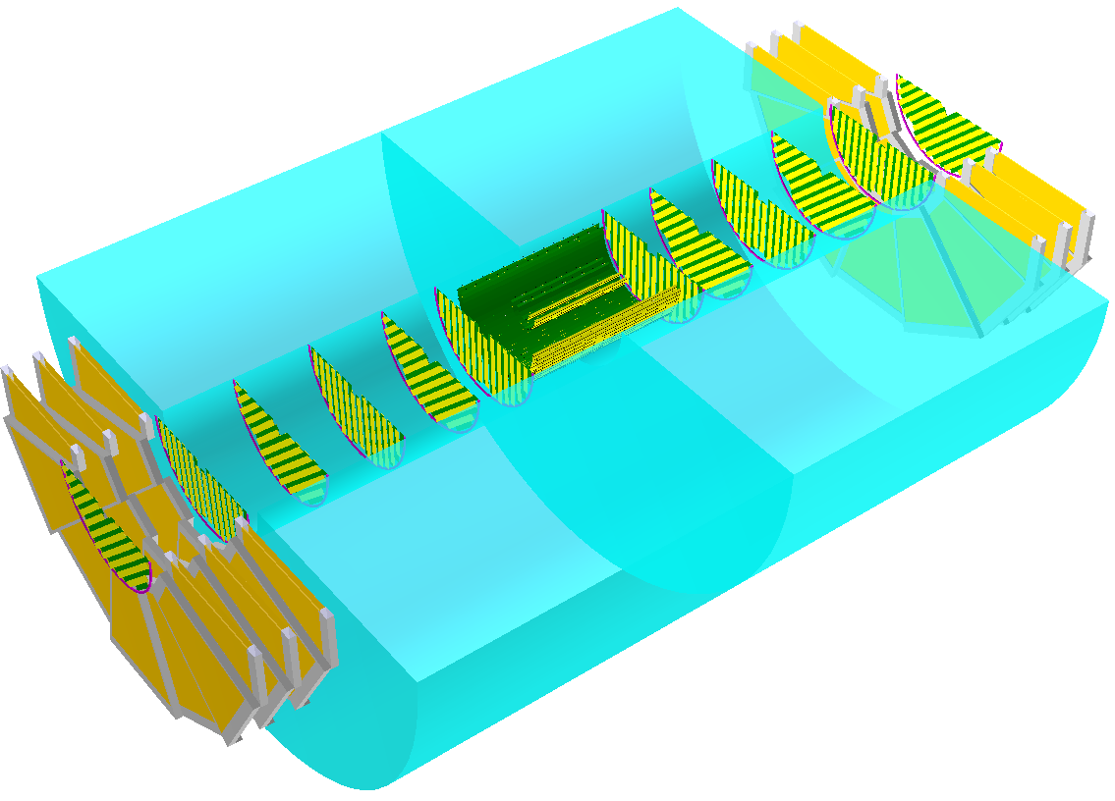
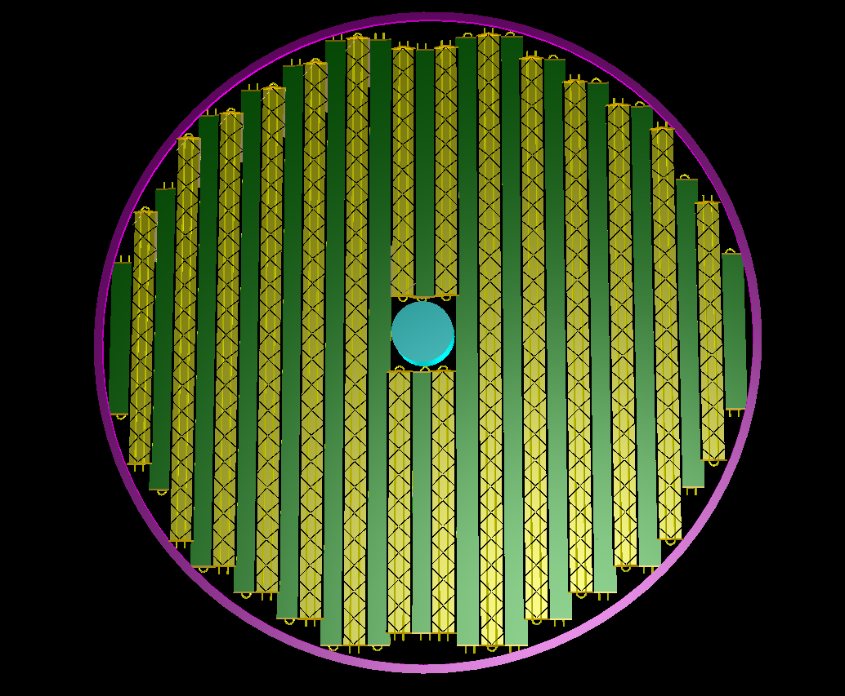
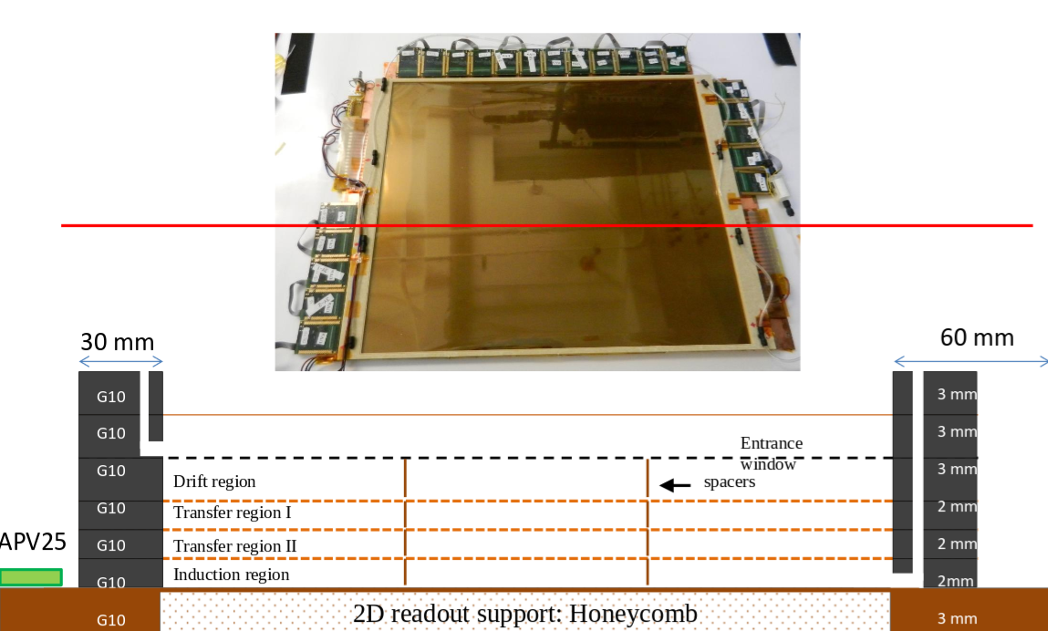
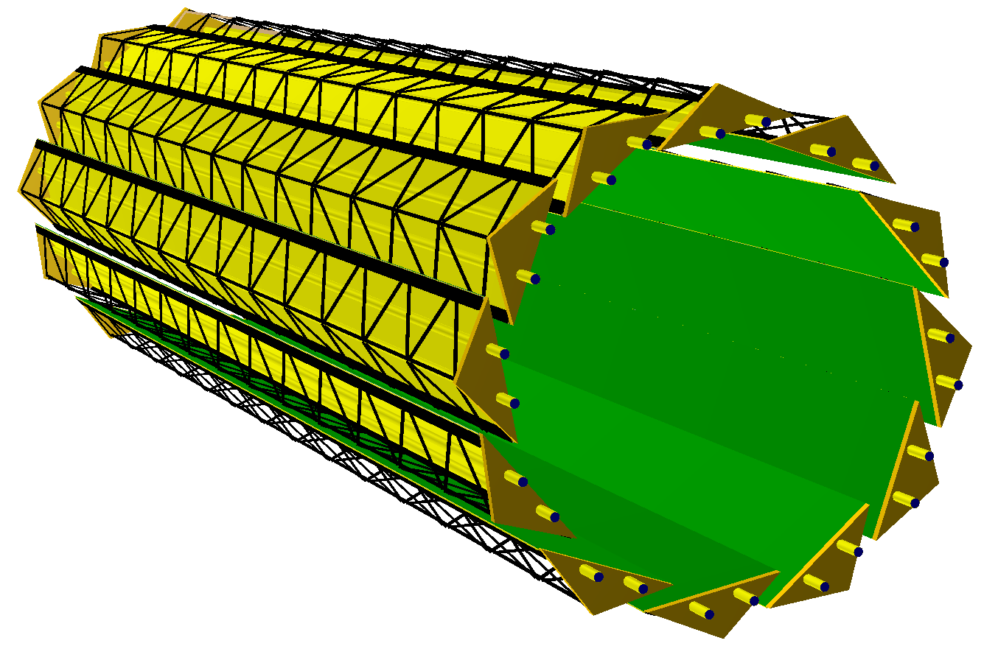
Configuration: tracker
1.6m
SBS
2.0m
ALICE
silicon trackers
TPC
GEM trackers
3T solenoid coils

Slide 7
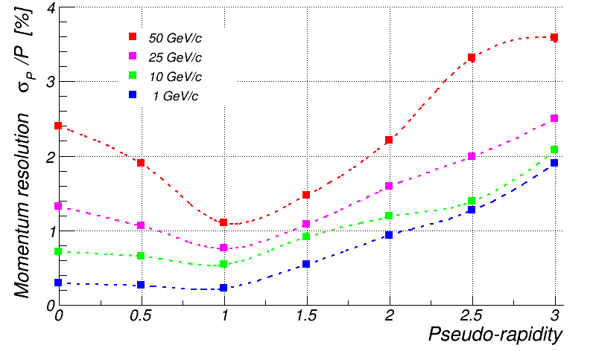
“Raw” momentum resolution
{Box generator at fixed momentum and pseudorapidity}
π⁺
Resolution of a few percent up to (at least) |η|~3

Slide 8
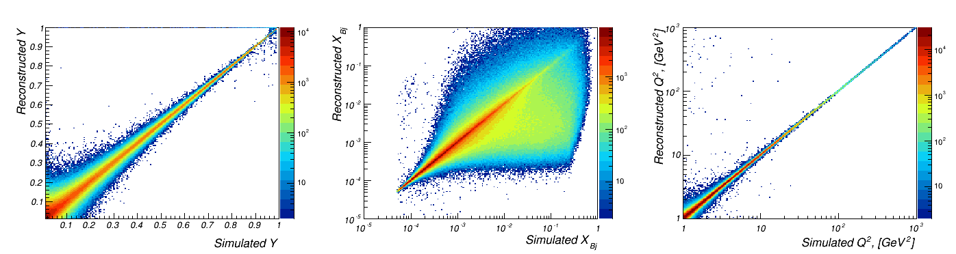
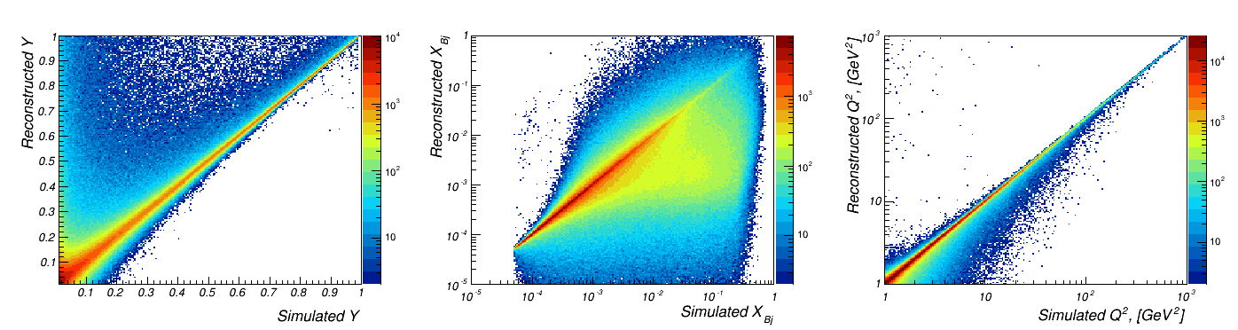
Smearing in kinematic variables
{PYTHIA 20x250 GeV, NO bremsstrahlung} -> {GEANT} -> {Kalman filter track fit}
same procedure; simulation WITH bremsstrahlung
-> looks good despite poor resolution at low Y and long bremsstrahlung tails

Slide 9
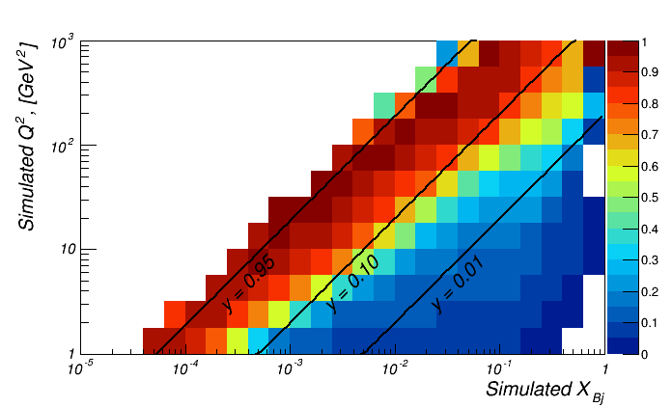
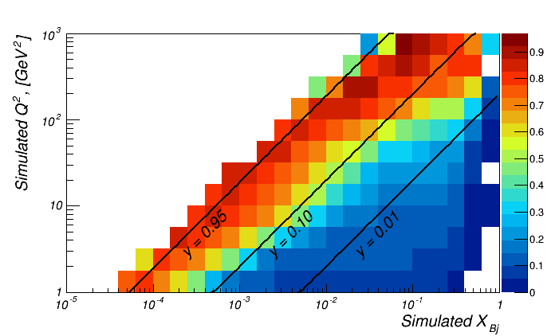
“Purity” in (x,Q²) kinematic bins
Describes migration between kinematic bins
Important to keep it close to 1.0 for successful unfolding
bremsstrahlung OFF
bremsstrahlung ON
Bremsstrahlung matters even for “almost transparent” detector
“Straightforward” tracking can hardly help at Y<0.1

Slide 10
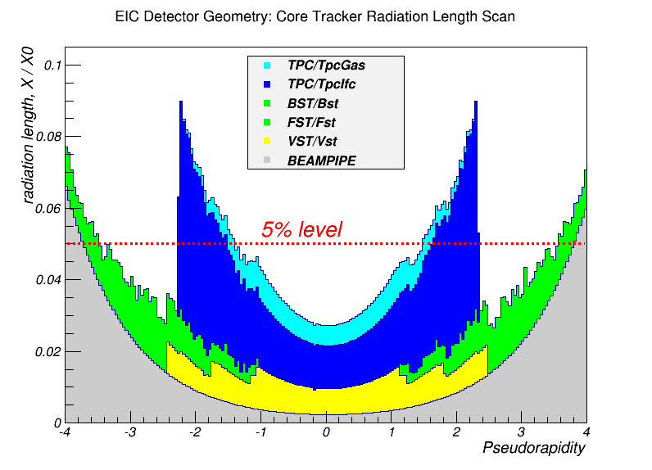
Material budget
“Core” part only (no TPC outer field cage & endcaps; no GEMs)
Compare:
sPHENIX: ~10%
CMS : ~50%
On the ~5% X/X₀ level pretty much in the whole acceptance

Slide 11
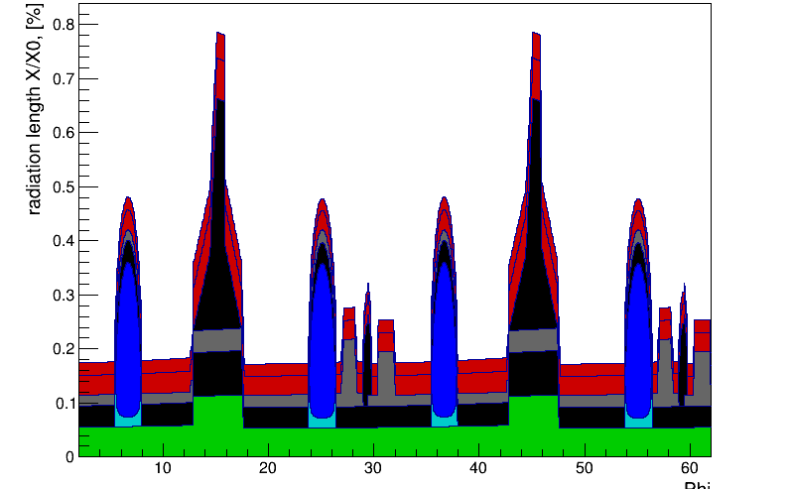
MAPS: present configuration
Modeled according to ALICE ITS stave design
Inner barrel radiation length scan
~0.3% X₀ in acceptance per layer
digitization: discrete 20x20 μm² pixels
vertex tracker:
4 layers at [24..160] mm radius
[-1 .. 1] nominal pseudorapidity coverage
forward/backward trackers:
6 disks at [250 .. 1240] mm from the IP; R_{max} ~195mm

Slide 12
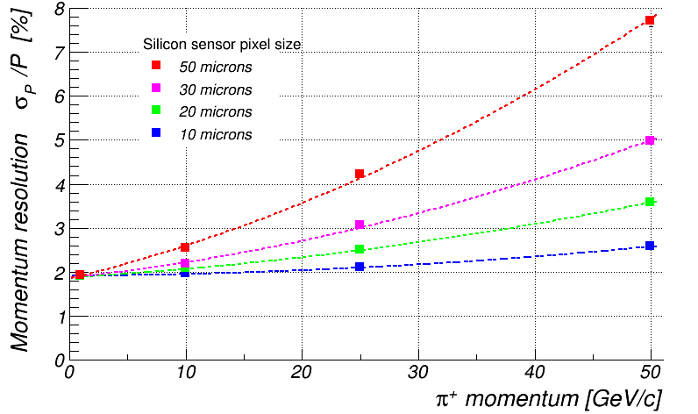
MAPS: possible R&D topics
Reduce further material budget
Minimize dead area material
Optimize cooling system
Develop forward disk setup
Minimize integration time
pixel size effect
π⁺; η=3
Basically need to adapt ALICE design to the EIC environment

Slide 13
TPC: present configuration
~2m long; gas volume radius [200..800] mm
1.2% X₀ IFC, 4.0% X₀ OFC; 15.0% X₀ end-caps
digitization: idealized, assume 5 mm long GEM pads (so up to 120 space points per track)
assume (very) modest single point resolution (>400 μm at the IP)

Slide 14
TPC: possible R&D topics
Attain ILD design single point resolution level
Establish operation in rather inhomogeneous magnetic field
Reduce inner field cage and endplate material budget
Minimize ion back flow
Establish acceptable dE/dx performance with GEM readout
Attain higher drift velocities (?)
RICH-mode operation (?)
Need a high resolution medium size TPC

Slide 15
GEMs: present configuration
3 segmented disks behind the TPC end-caps
SBS design
digitization: 50 μm resolution in X&Y; gaussian smearing

Slide 16
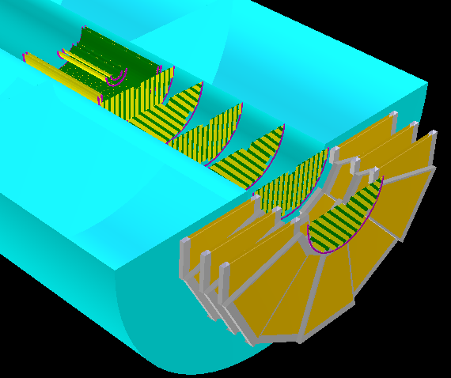
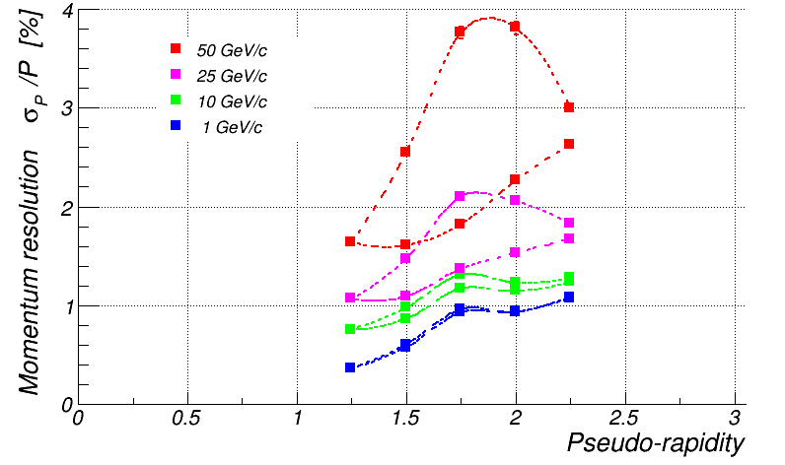
GEMs: possible R&D topics
Establish high resolution at large track slopes
Deliver reliable “vector” measurement
Improve shaper timing
Minimize material budget (?)
With-GEM vs no-GEM momentum resolution
Develop large-scale GEMs
Be able to cover close-to-beam-line area
Need high resolution medium size GEMs
NB: 50 micron spatial resolution assumed!

Slide 17
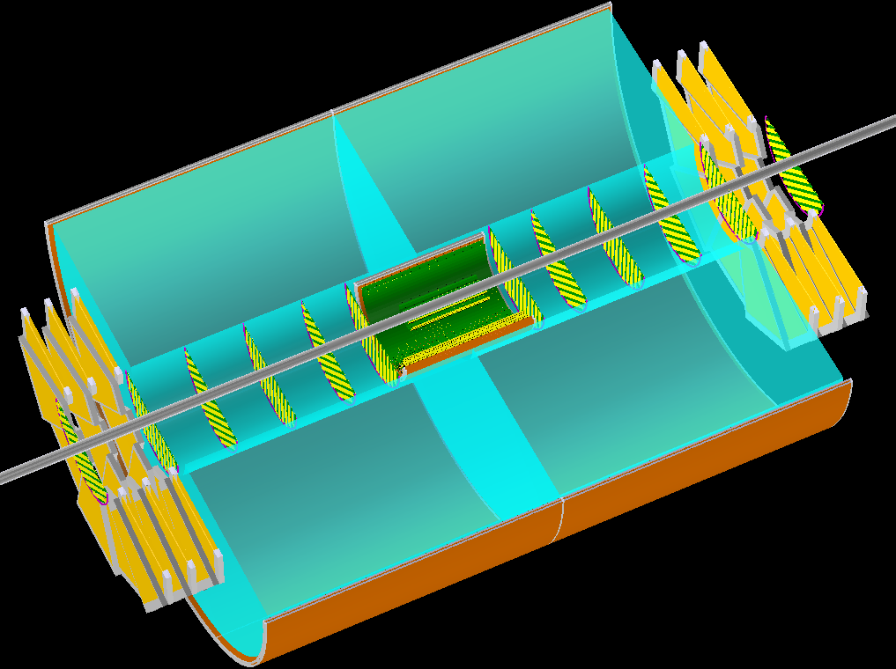
MicroMegas option
Establish <100 micron spatial resolution in a 3T field
Deliver reliable “vector” measurement
Develop large scale samples
Minimize material budget
May want to have a fast device providing “vector” track seeds between MAPS and the TPC
EIC R&D
(Temple, Saclay)

Slide 18
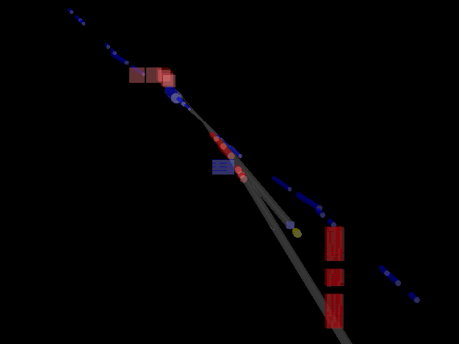
Auxiliary acceptance detectors
photon transport line with Al exit window
Roman Pots
+18 m
electrons
+4.5 m
0 m
-4.5 m
dipole magnet for pair spectrometer
-15 m
low Q² tagger
Legend:
beam pipe
hadron magnet apertures
electron magnet apertures
-31 m
emcals for lumi monitor
-33m
-45 m

Slide 19
Other considerations
Vertex resolution: with MAPS we get it better than 10 microns
Radiation hardness: not a problem?
Readout speed and FE -> main DAQ throughput: acceptable?

Slide 20
Backup

Slide 21
PID requirements
Lepton-PID:
h^{+/-}, γ suppression: 1:1 η <4 to 10⁴:1 η >-1
Hadron-PID:
π/K ratio 3-4 K/p ~ 1 independent of η and (√s)
η <-3: 1 GeV< p < 10 GeV
-3<η <-1: 0.1 GeV < p < 4 GeV
-1<η < 1: 0.1 GeV< p < 4 GeV
1<η < 3: 0.1 GeV< p < 30 GeV
3<η : 1 GeV< p < 100 GeV
impact on PID technology

Slide 22
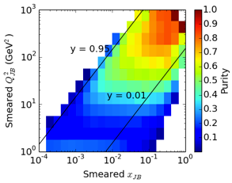
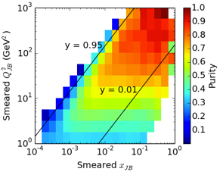
Resolution in Kinematics variables & PID
electron method
hadron method:
DA method:
high important to
unfold measured quantities to Born level
Electron PID: E/p
Hadron PID: RICH
momentum resolution is critical for
RICH performance
(no photon
detector resolution
accounted here)

Slide 23
SIDIS: Pion Kinematics
Cuts: Q²>1 GeV², 0.01<y<0.95, z>0.1
Increasing lepton beam energy boosts hadrons
more to negative rapidity
Increasing hadron beam energy influences max. hadron energy at fixed η (and π±, K±, p± look the same)
-3<η<3 covers entire p_{t} & z region important for physics

Slide 24
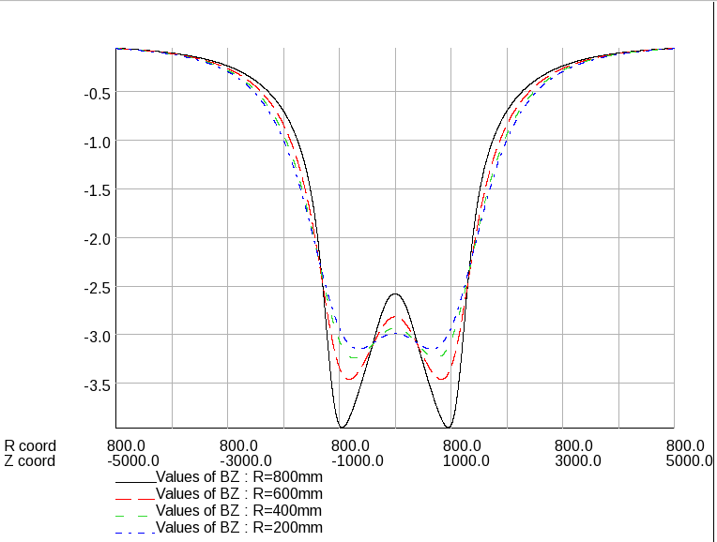
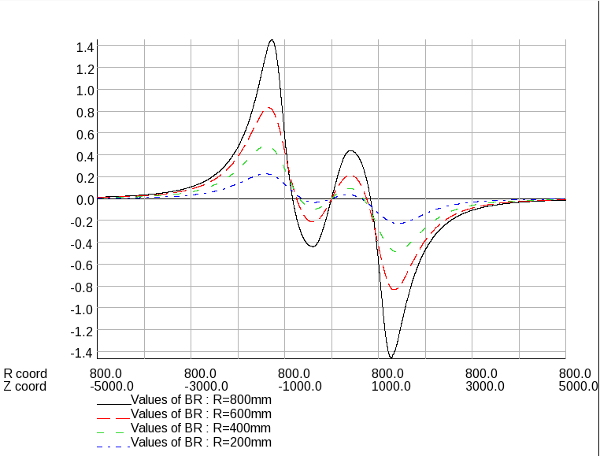
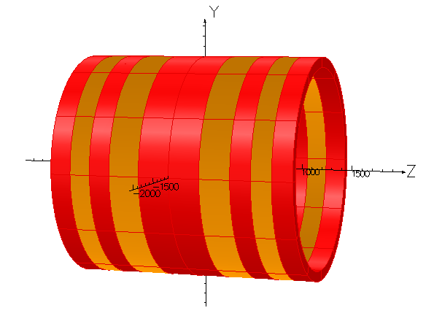
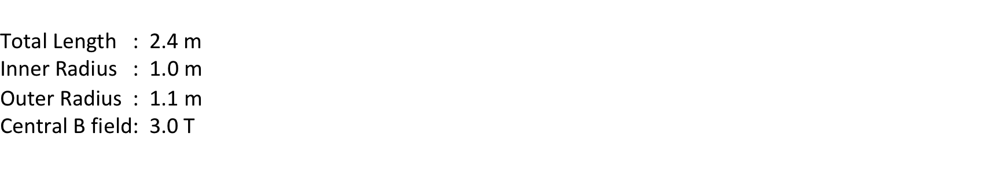
EIC solenoid modeling
main requirements:
Yield large enough bending for charged tracks at large η
Keep field inside TPC volume as homogeneous as possible
Keep magnetic field inside RICH volume(s) small
-> use OPERA-3D/2D
software
Presently used design: MRS-B1

