Slide 1
GEM R&D at Florida Tech
Aiwu Zhang
2015-05-09
EIC Tracking R&D workshop @ Temple Univ.

Slide 2
The FIT HEPA group - People
Faculty: Dr. Marcus Hohlmann
Post-doc: Dr. Aiwu Zhang (dedicated to EIC)
Students: Vallary Bhopatkar (PhD);
Elizabeth Starling (graduate);
Ankit Mohapatra (graduating);
and several undergraduates.
-> more information: http://research.fit.edu/hep_labA/index.htm

Slide 3
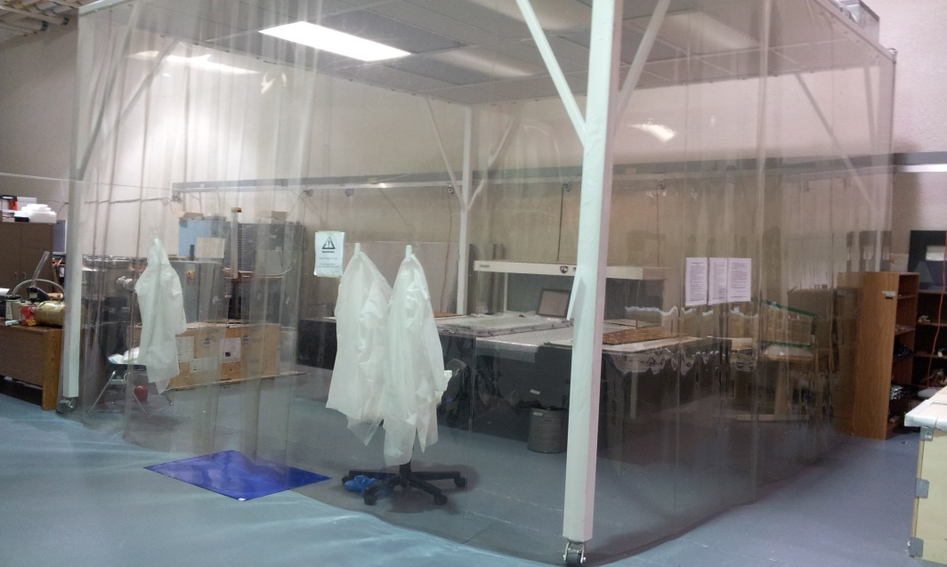
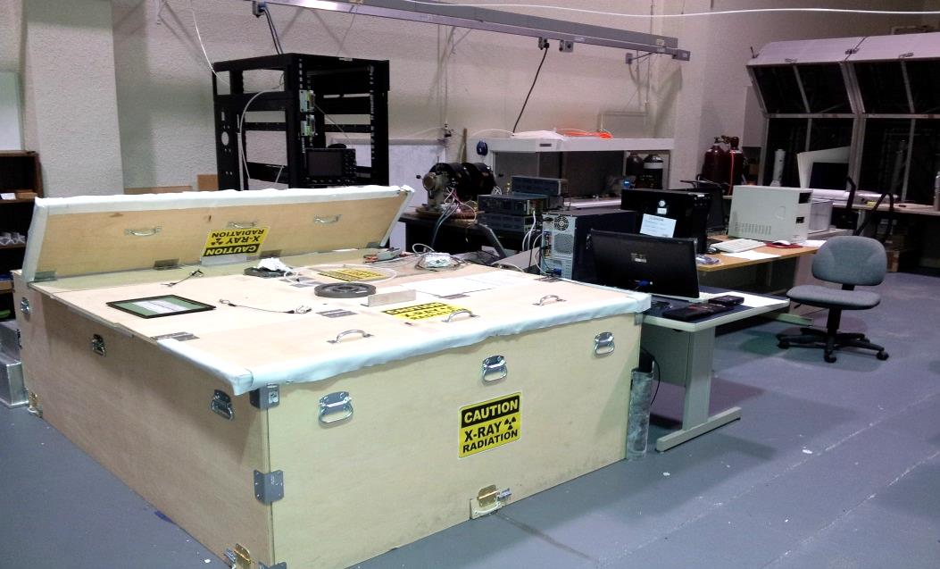
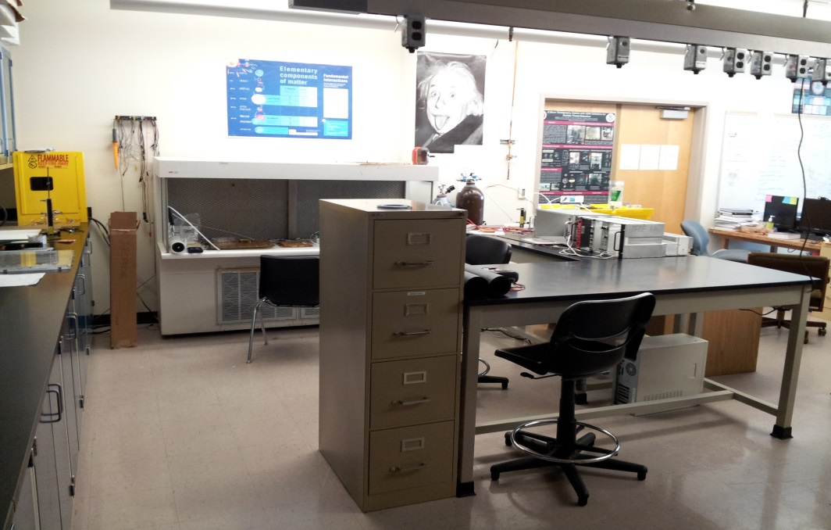
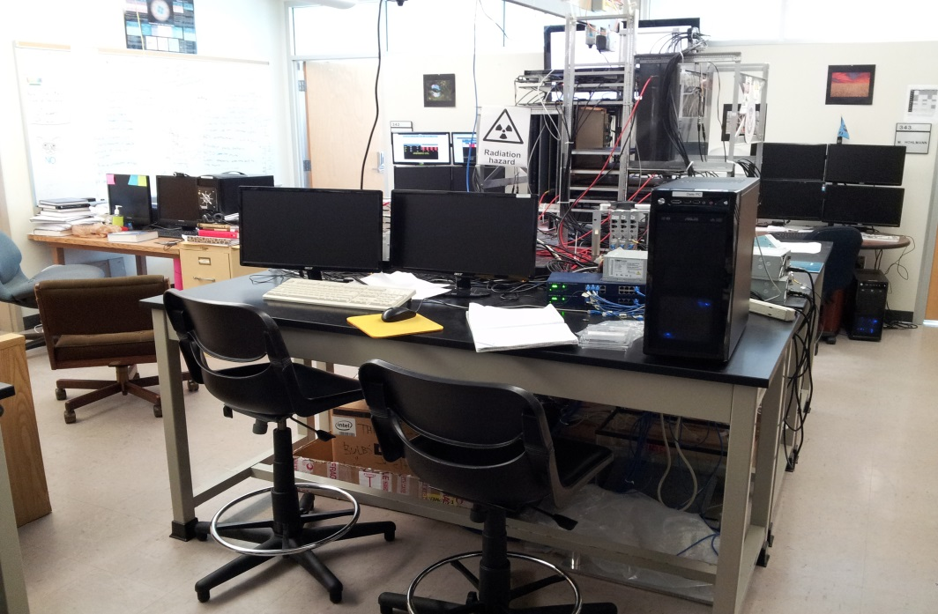
The FIT HEPA group – Lab.
①
②
A work area w/ a large lead shielding box for X-ray radiation
A class 1000 cleanroom
③
④
Flow hood
A work area for assembling small GEM detectors.
A Muon Tomography Station (MTS) with GEMs snapping cosmic muons

Slide 4
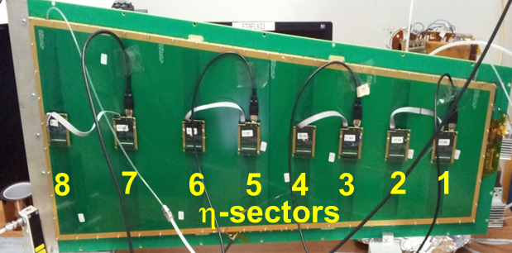
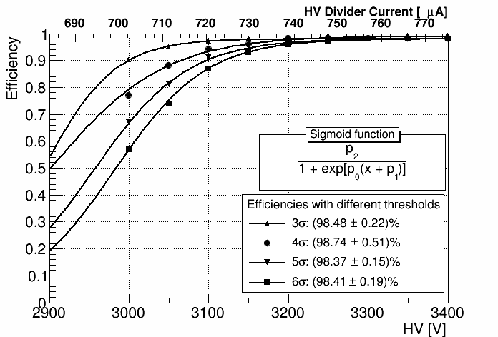
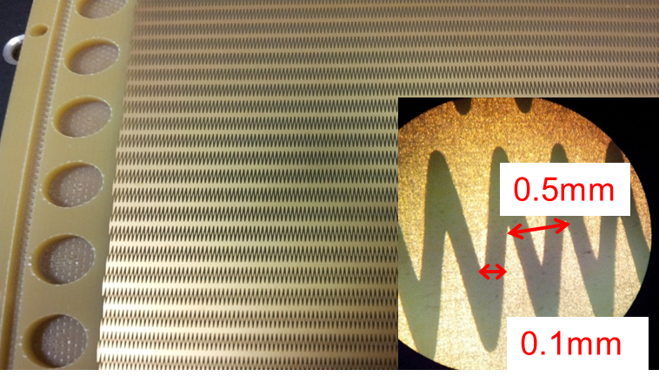
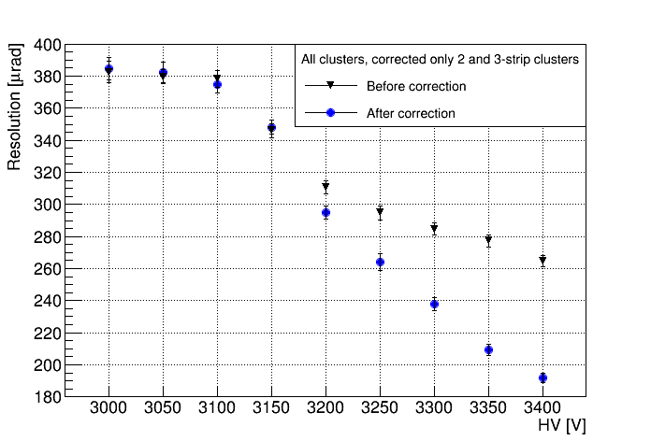
Test of a large-area GEM with zigzag r/o
~24
cm
~1 m
Efficiency
Trapezoidal opening angle 10°
Angular resolution
Strip pitch 1.37 mrad
We have successfully tested a 1-m long prototype read out with radial zigzag strips at FTBF. Final results: detection efficiency is >98%; angular resolution ~190 μrad (~14% strip pitch).

Slide 5
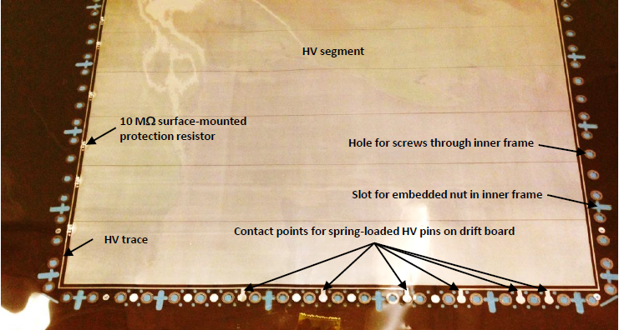
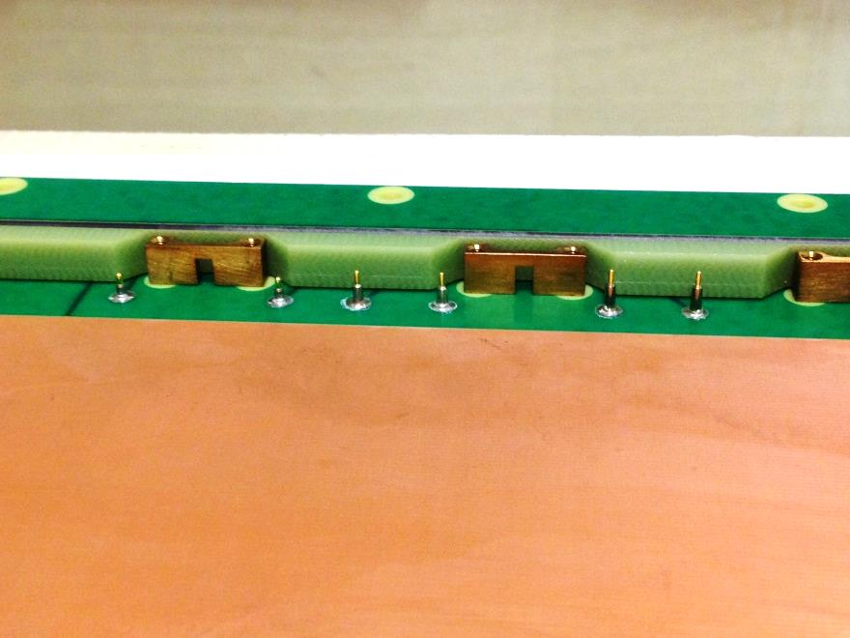
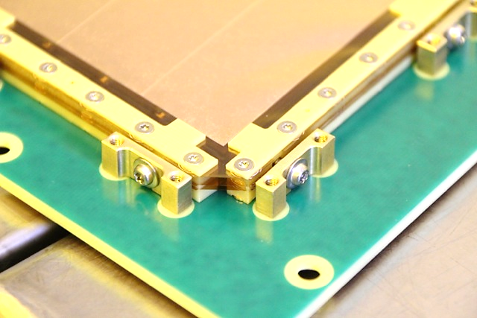
Design approach by FIT
- mechanical stretching (as pioneered by CMS)
O-ring
Brass pull-out
Outer gas frame
Spring-loaded HV pins on drift board
Drift cathode
The embedded nuts
Stretching from the side of frames

Slide 6
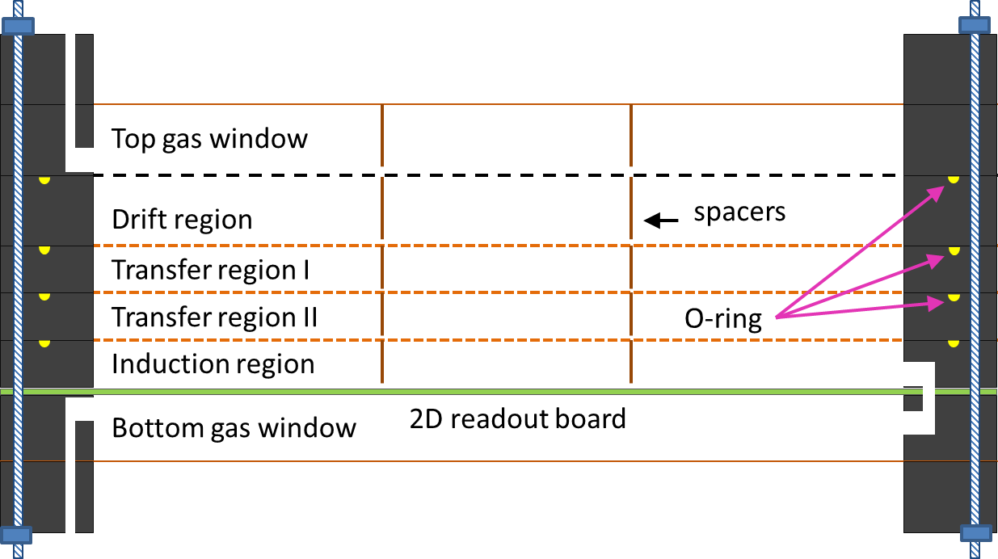
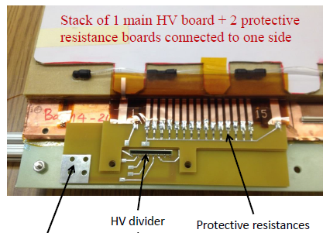
Design approach by U.Va and TU
Use glue (TU) / screws (U.Va) to assemble a triple-GEM detector
Retain access to each HV sector when the detector is closed;
HV traces go directly from foil sectors to outside (frame) region
Protective resistors can be soldered after detector is closed, so they will not be considered in the common foil design.
Glue foils to frames;
Frames then can be screwed (chamber
can be reopened) or glued (can’t reopen).
To power supply connector
HV connection outside a detector (U.Va example)

Slide 7
Designing a EIC-FT targeted GEM prototype
-- Foil Dimensions--
610 mm
A common foil design will minimize mask production costs for manufacturing foils.
In order to go as close as possible to the beam pipe as possible, the distance from the copper edge at the small end to the beam center is set to 80 mm.
Raw apical material width is limited to 610 mm; 25 mm on each side are reserved for framing during production.
Chamber frames with a width of 15 mm are expected. final active length is ~904 mm, the widths at small end and wide end are ~43 and ~529 mm, respectively.
Total active area is 2584 cm², which will be divided into 24 HV sectors with ~107 cm² each to reduce energy of discharges.
~529
904
mm
~43
25 mm
30.1° opening angle
(not to scale)

Slide 8
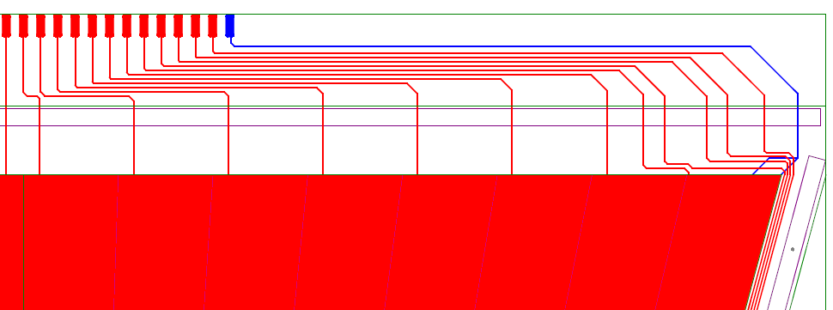
A design suitable for TU
HV pads outside
HV sectors on top surface of a foil
Need some holes for alignment

Slide 9
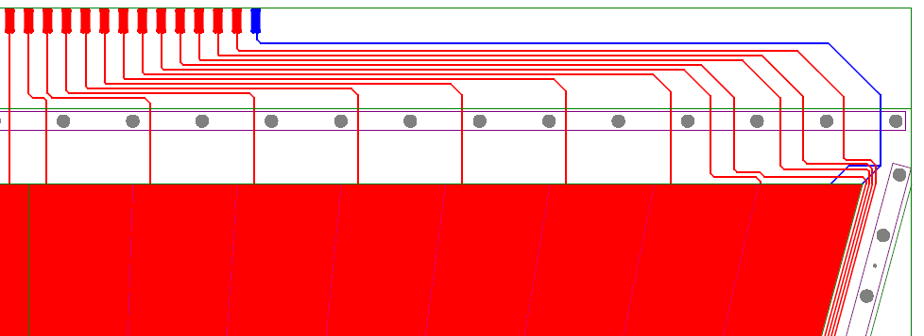
A design suitable for U. Va
Add holes for assembling

Slide 10
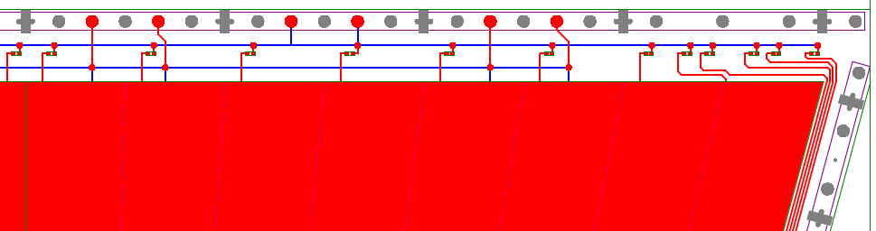
A design suitable for FIT
No HV pads outside, instead, HV pads are in between assembly holes
Need some cross shaped holes
for stretching
Protective resistors
thin inner frames

Slide 11
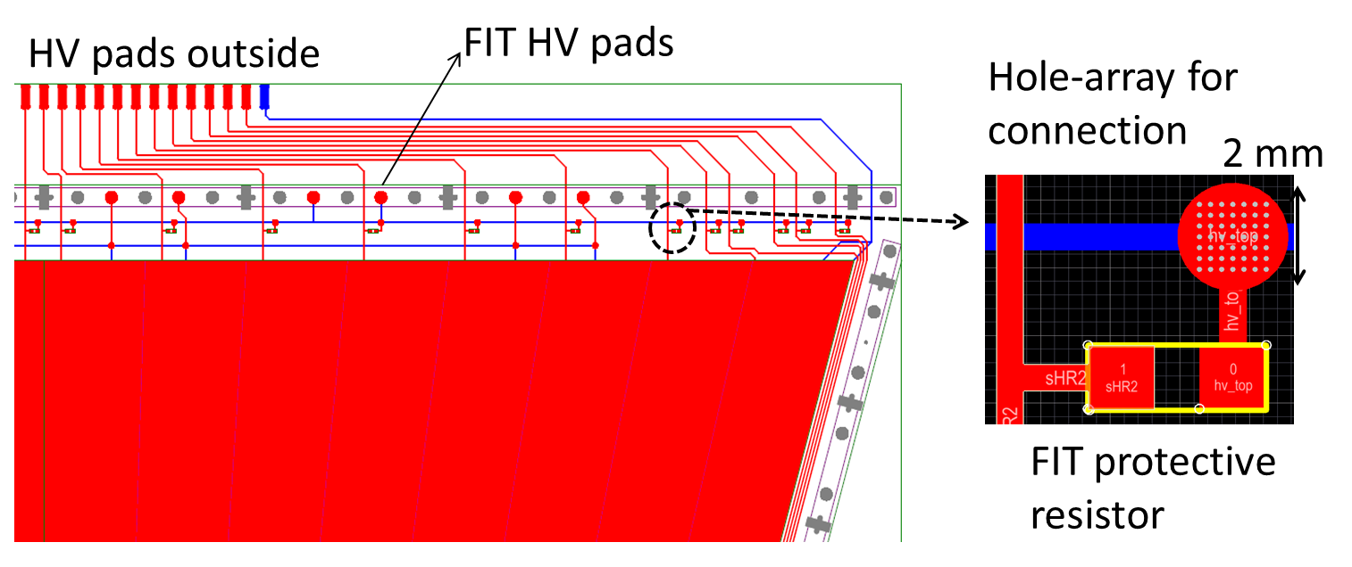
The common 3-in-1 design
& HV connection solution for FIT
on both surfaces
56 mm
A common design for the three groups
HV connection solution for FIT: put array of small holes in a pad, and use conductive glue (H20E from EPOTEK) to establish connection between front and back of foil. Original solution was to use (metalized) vias, but per TechEtch vias can’t be produced easily on the thin foil.

Slide 12
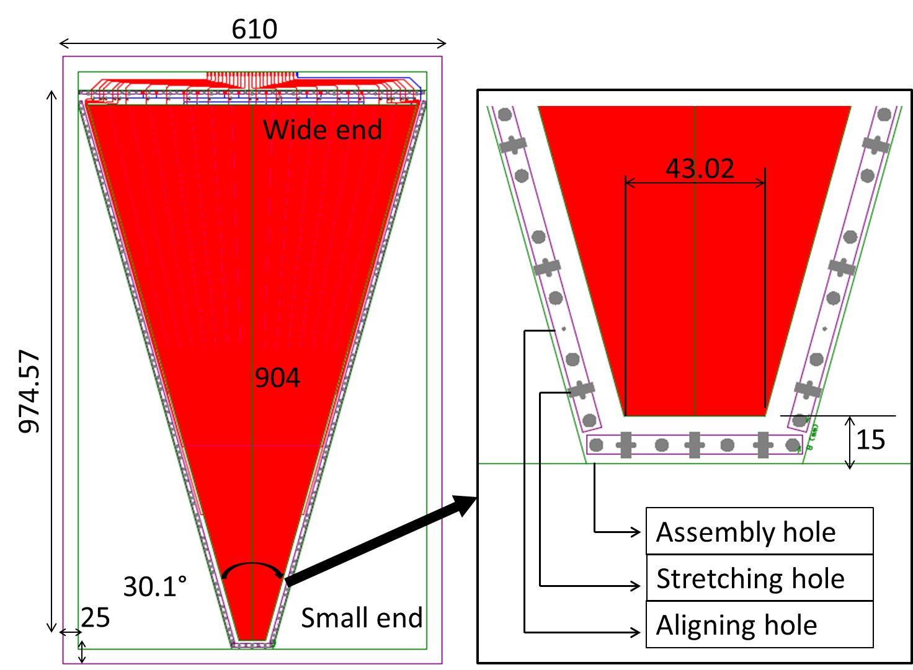
A big-picture view of the foil design
& a closer view of the small end
Units:
mm

Slide 13
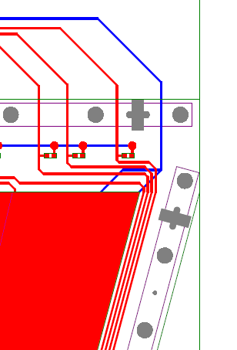
Discussions on the foil design
-- Frames --
Several smaller inner frames with 6 mm width are good for FIT design; this way we can reduce the material budget.
U.Va and TU can use wider frames up to 15mm (a single frame for each GEM layer).
6 mm
It’s possible to reduce some dead area by pushing frames/holes a little closer to the sides if needed.
1 mm pitch / 0.5 mm space
between the 4 HV traces
~3 mm

Slide 14
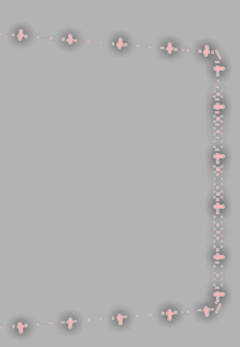
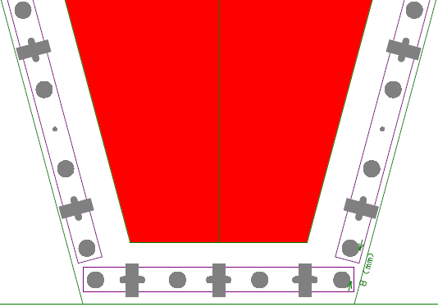
Discussions on the foil design
-- Arrangement of holes --
The FIT cross holes need to be in between two assembly holes. The first assembly hole is pushed a little downward, to place the first cross hole closer to the corner.
For comparison: CMS GEM
foil design
10 mm
8 mm

Slide 15
Discussions on the foil design
-- Other issues --
GEM holes themselves are not implemented in this foil design. Tech-Etch will take care of them.
The FIT group will need Tech-Etch or another company to mount protective resistors (in a cleanroom environment) and the conductive glue before foils are being sent out.
The FIT plans to assemble triple-GEM detector(s) with 3/1/2/1 gas gaps (based on experience from CMS).
We are going to design and test a new r/o board. Our current thinking is to mix regular straight strips at small radius (high angular resol.) with optimized zigzag strips at larger radius (cost-effective). It will be useful if the FIT readout board fits also the U. Va/ TU detecto, so we can test it with 3/2/2/2 gaps.

Slide 16
A rough time schedule for the R&D
May 2015, finalize the common GEM foil design
June 2015, prepare semi-annual progress report in which we’ll also ask for funding for this project in FY2016 (with U. Va/TU)
Dec. 2015, place order to Tech-Etch if we get funded; and hopefully by then all the components (include readout board) for assembling a prototype are designed
Spring 2016, expect to get foils from Tech-Etch and components from various companies, so that a real detector can be assembled
Summer/Fall 2016, a beam test?

Slide 17
Summary
Hope to finish the common GEM foil design soon, then we can move to design of other components.
Minimization of material budget will be considered.
Zigzag strips are cost effective for large-area GEMs. We have room to optimize their structure to achieve the EIC-FT required resolution.
As an idea of reading out a detector, we’ll investigate combining straight strips and zigzag strips, so that
(1) close to beam we have very good resolution and not too many channels since the area is small;
(2) with zigzag strips at higher radius we save channels, electronics cost while resolution also will be reasonable.
Radial zigzag strips
Radial straight strips

Slide 18
Thanks!
Wish the workshop
much success!

