Slide 1
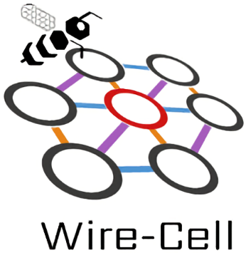

Augmented Signal Processing in Liquid Argon Time Projection Chambers
with a Deep Neural Network
Software Effort to Improve LArTPC Reconstruction
JINST 16 (2021) 01, P01036
Haiwang Yu (BNL)
CPAD Instrumentation Frontier Workshop 2021
18-22 March 2021
Notes:
Good afternoon, I am Haiwang from BNL.
The title of this talk is ...
It is software effort trying to

Slide 2
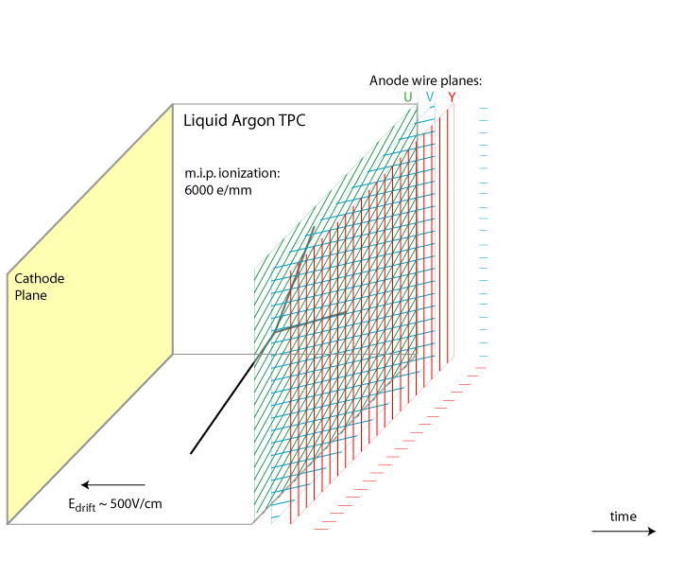


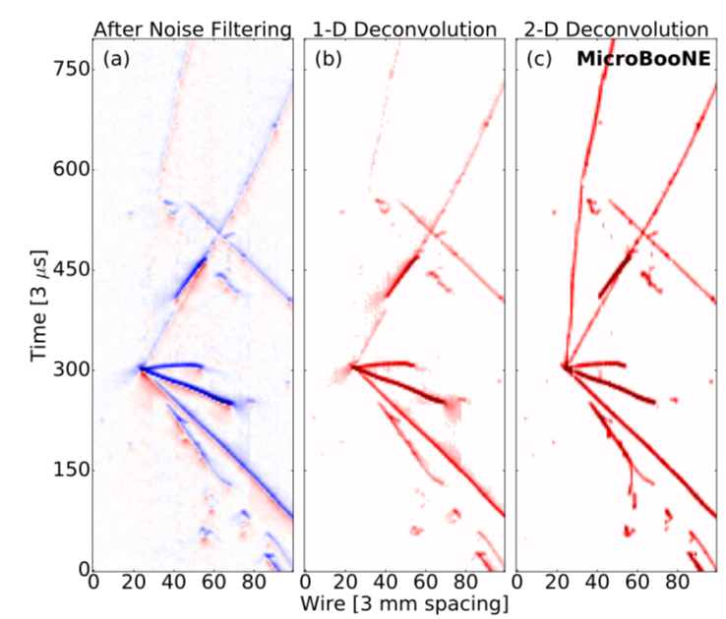
Signal Processing (SP) of Liquid Argon TPC (LArTPC)
Signal formation in a 3 plane LArTPC “Single-Phase” wire-readout, from Bo Yu (BNL), https://lar.bnl.gov/wire-cell/
LArTPC is the central detector in many next-gen neutrino experiments, e.g. DUNE, SBN etc.
Calorimetry and rich topology information
LArTPC wire-readout measures induced charge ⊗ response
Signal Processing (SP) of LArTPC resolves charge from the original measurement:
JINST 13 P07006 (2018)
Current state of the art SP algorithm based on 2D deconvolution:
JINST 13 P07006 (2018)
Notes:
LArTPC is the next ...
Due to heat and cost concerns it is most common to use wire-readout in large scale
This animation illustrated how signal is formed for a 3 plane wire-readout of a LArTPC.
electrons drift towards to the anode wire planes and induce current on the wires according to some detector/field response following this equation.
So a very upstream step of LArTPC reconstruction is to resolve the original charge distribution from the measurement.
The current Current state of the art SP algorithm based on 2D deconvolution is introduced in this paper.
2D here includes both time and space or long-range induction effect.

Slide 3
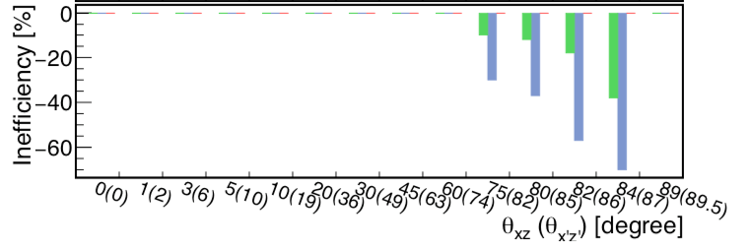
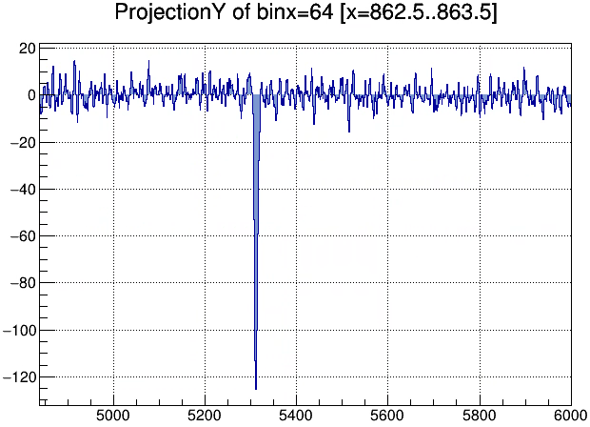
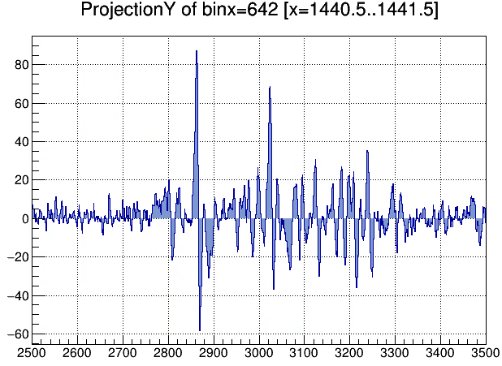
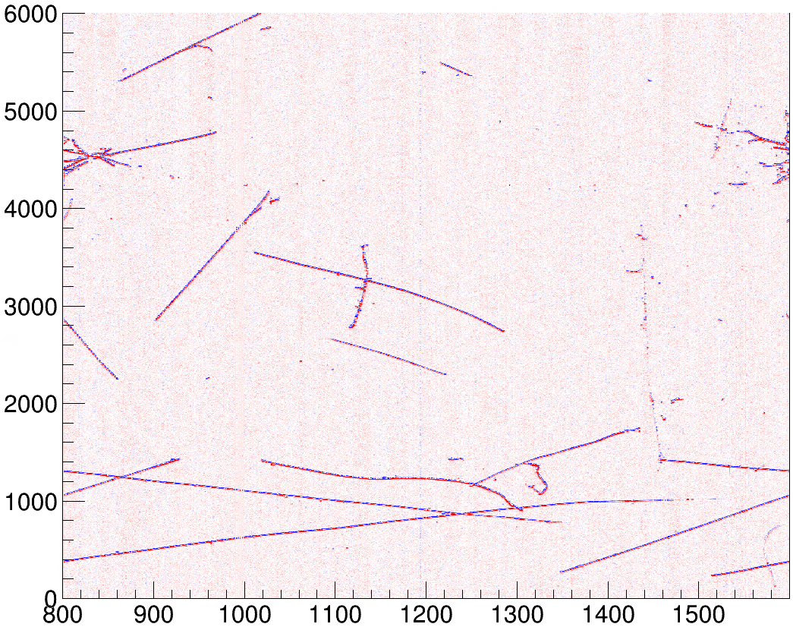
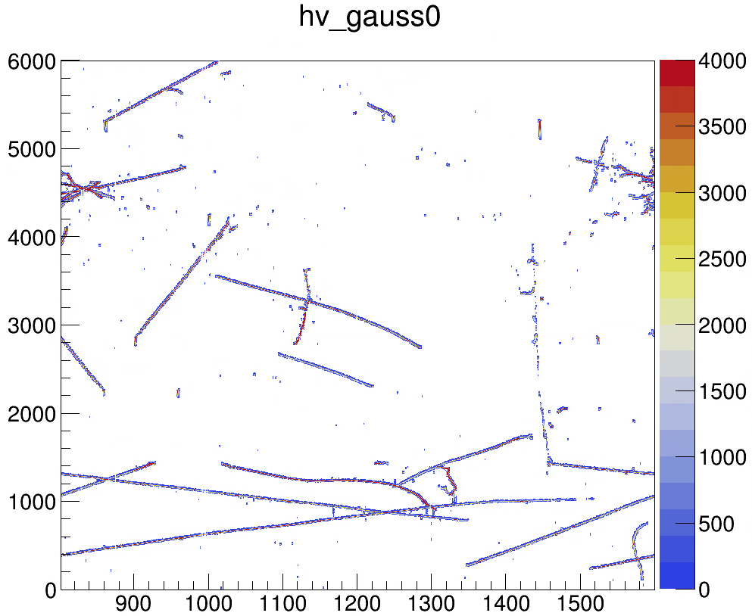
Remaining Challenges in Current Signal Processing (SP)
“Prolonged Track” – weak signal
“Tear Drop” - distorted waveform
Noisy dots - noise
JINST 13 P07006 (2018)
weak
unipolar
Raw
After SP
tick
SP
tick
channel
channel
Notes:
However, there still some remaining challenges in the LArTPC SP. I listed 3 here:
1,
2,
3,
The first one is most concerning as with gaps like this, the topology information would be degradated.

Slide 4
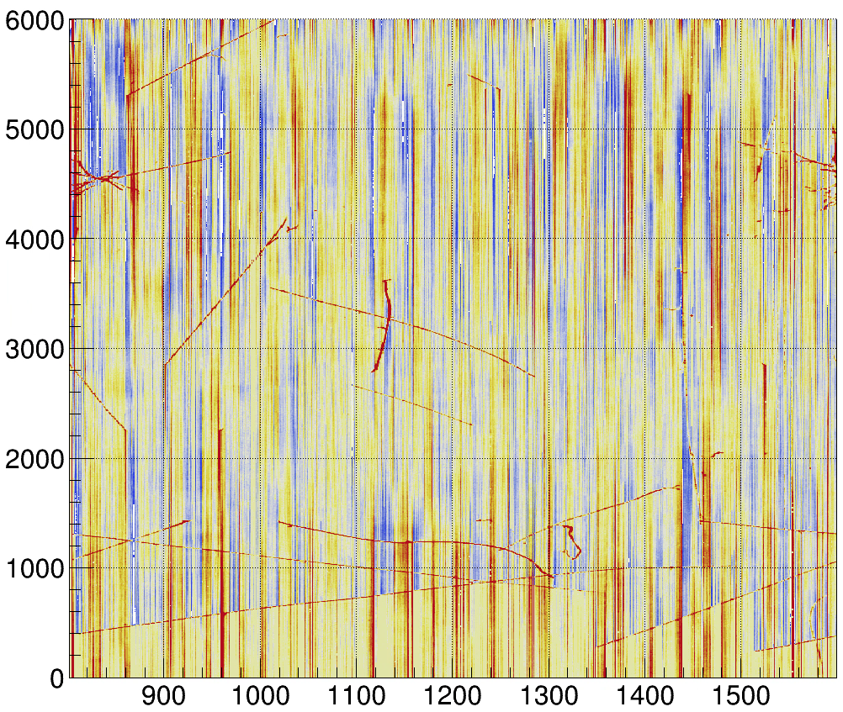
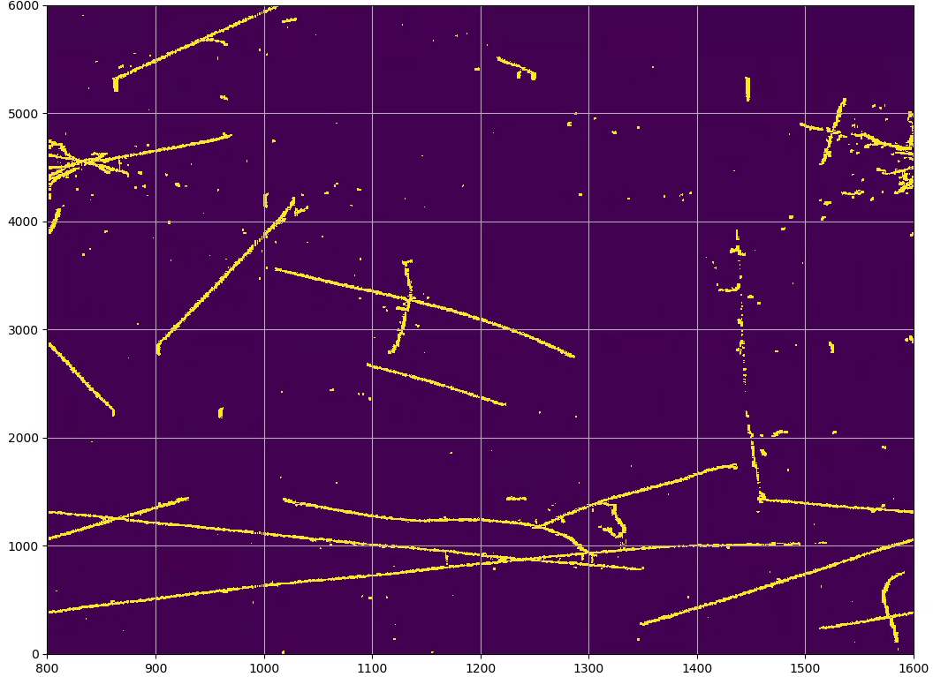
Need to improve “ROI” (Region of Interest) finding
Decon for charge
Waveform ⟶ charge, dense
ROI:
Hit finding, sparsify
SP result:
Sparse, charge
Decon. Waveform
Noise Filtering
+ 2D decon.
Decon. w/ Tight LF
SP Result
Waveform data
ROI Finding
ROI
Decon. w/ Loose LF
Information from Other Planes:
Utilizing plane redundency linked by geometry information
Machine Learning:
Quickly cover more phase space; Utilizing more complicated correlations
Notes:
In this talk we try to further improve the SP with software effort based on the current hardware setup.
The SP essentially does two things: ...
which corresponds to the two major steps, Deconvolution and ROI finding
In this study, we focus on improving the ROI finding by
1, utilizing more information, specifically ...
2, substitute the current

Slide 5
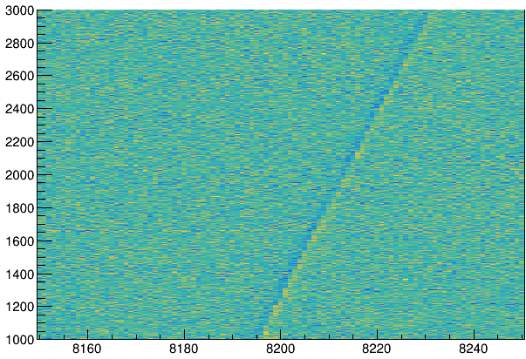
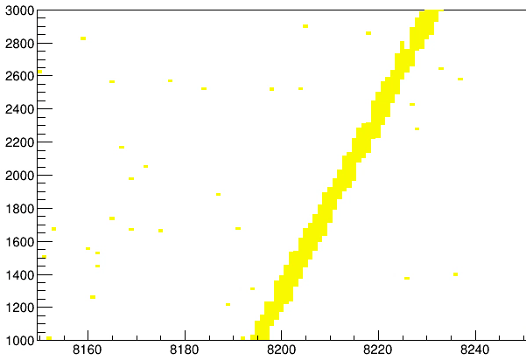
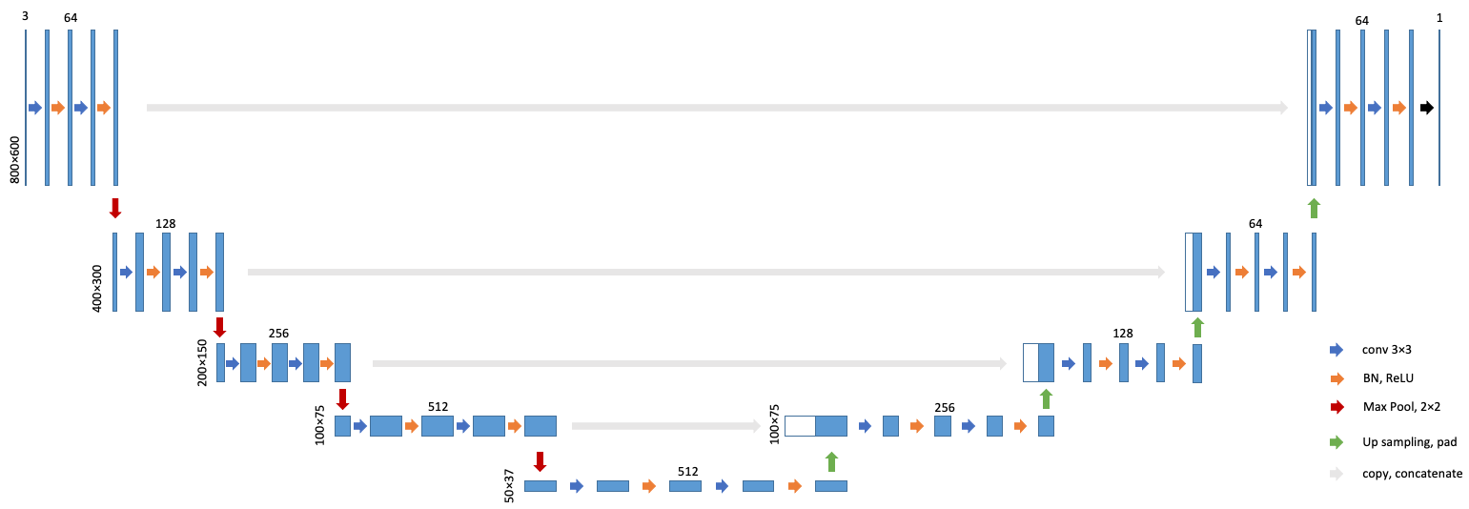
ROI finding as semantic segmentation
Raw waveform vs channels
Tagged ROI
2D semantic segmentation – UNet
arXiv:1505.04597
UNet: auto encoder-decoder + skip connections
Output is sparsely connected components
Input and output are similar at leading order
Forked a Pytorch implementation: https://github.com/HaiwangYu/Pytorch-UNet
tick
tick
channel
channel
...
intermediate images
w/ domain knowledge
Notes:
For the ROI finding alg:
We treat this as 2D semantic segmentation.
And used the UNet which showed good performance in segmentation in other domains.
The U-Net contains a auto-encoder-decoder + skip connections.
However, we do not want to feed the raw ...
But engineer the input first with our domain knowledge on the LArTPC

Slide 6
Muti-Plane Information – Geometry
1, make time slices
time
U
V
W
Using other plane information projected to the target plane: utilizing plane redundancy
Inspired by Wire-Cell ‘3D Imaging’.
arxiv:1803.04850
Key algorithm “Fast projection” realized using “RayGrid” tools: https://github.com/WireCell/wire-cell-docs/blob/master/presentations/updates/20190321/latexmk-out/img.pdf
channel
channel
channel
MP2
MP3
2, Matching active wires (with initial ROI) from multiple planes
U
V
active wire in the time-slice :
ref. plane, target plane
3, On target plane, tag 3-Plane matched ROIs (MP3) or 2-Plane matched ROIs (MP2)
in-active wire in the time-slice
W
Notes:
The idea is quite simple: when the info on one plane is not enough, we use other plane info to help.
This is possible when we have redundant planes, meaning 3 or more.
And we can use geometry information to link them together.
Specifically are 3 steps:
1,
2,
3,
This idea is inspired by the Wire-Cell ‘3D Imaging’.

Slide 7
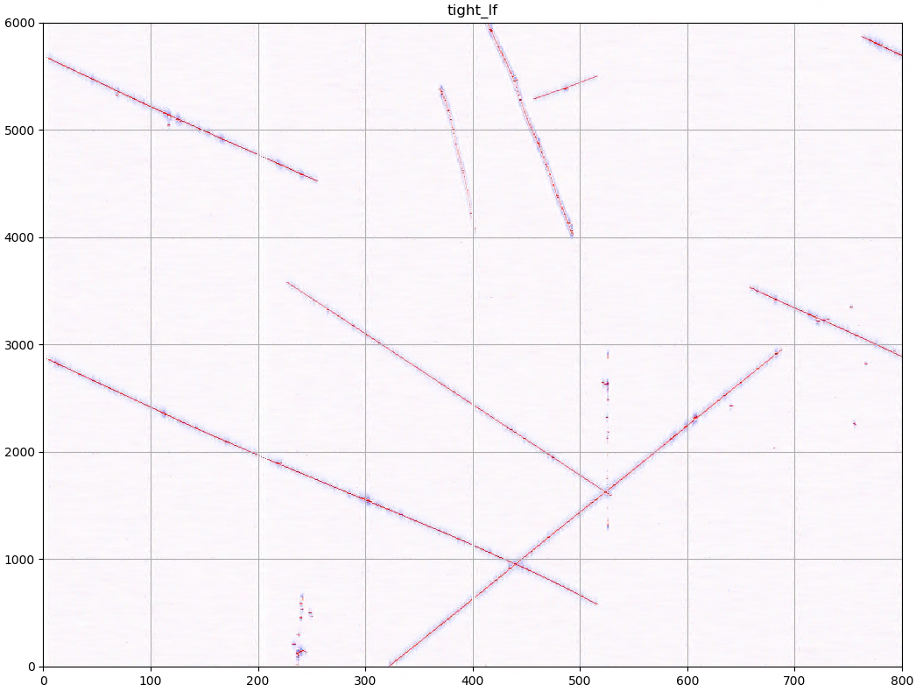
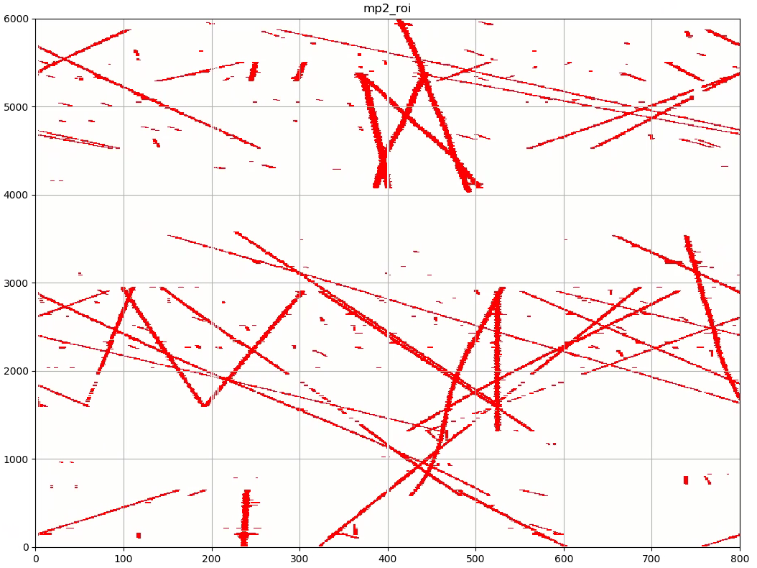
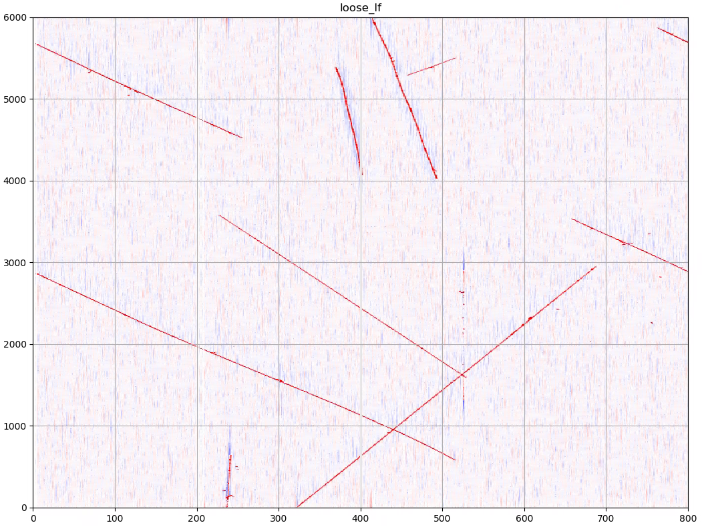
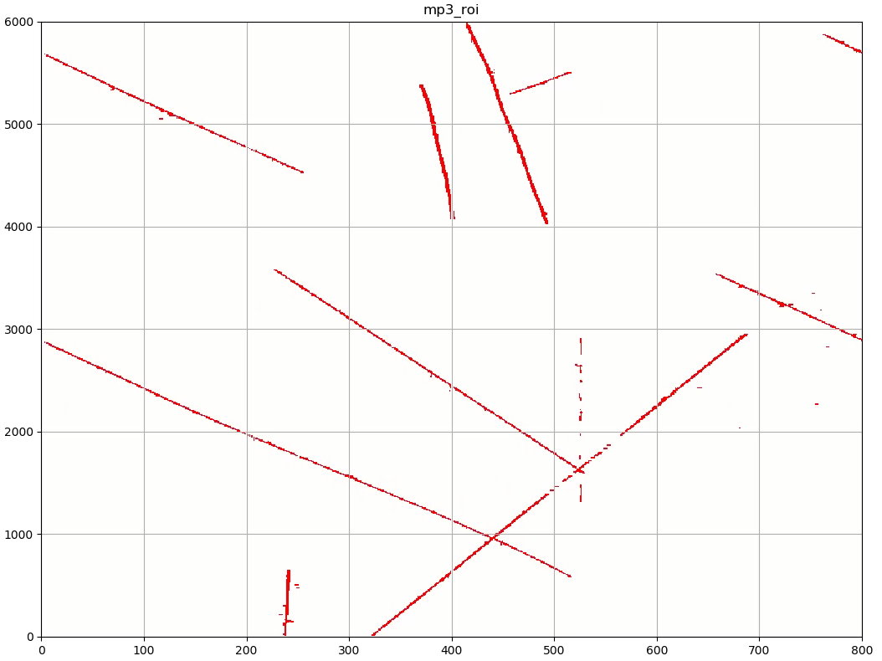
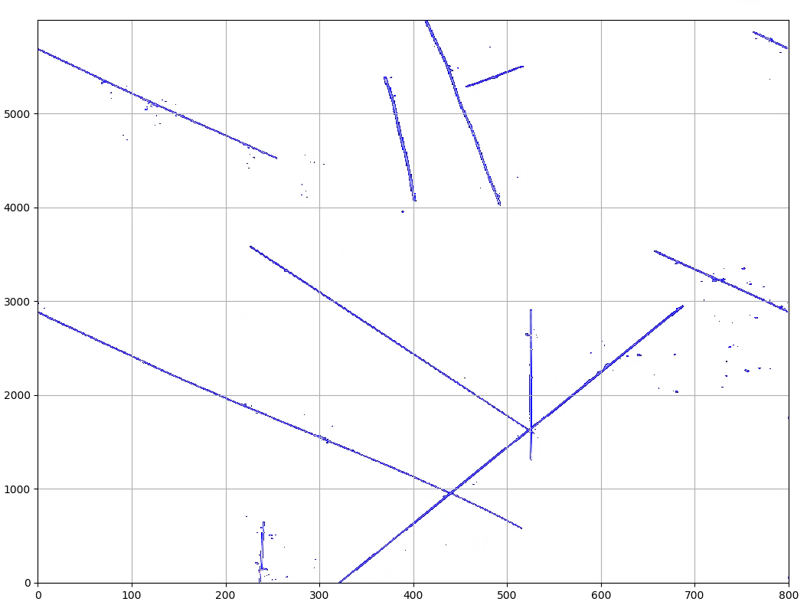
Input and label for DNN - ProtoDUNE Single-Phase simulation
Input candidates
tight/loose: deconvolution with tight/loose low frequency filter
label was made by rasterization of charge depos – 2D gaussian response
tight
MP2
Label
loose
MP3
Notes:
Here are one example showing ...

Slide 8
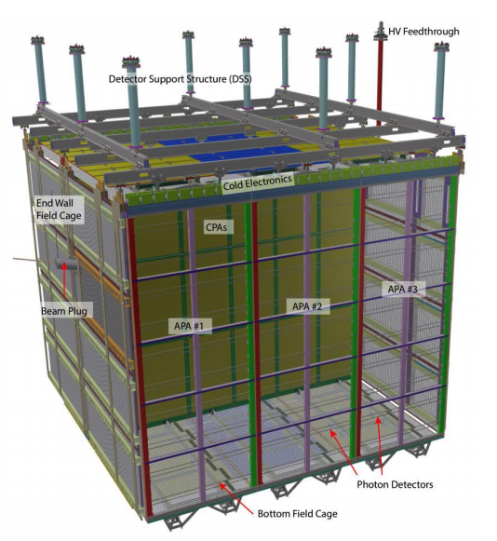
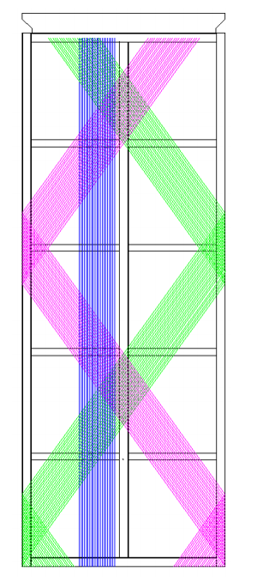
ProtoDUNE Single-Phase
Sketch of a ProtoDUNE-SP APA
from arxiv:1706.07081
ProtoDUNE Single-Phase (the NP04 experiment at CERN) is designed as a test bed and full-scale prototype for the elements of the first far detector module of DUNE (next-generation, long-baseline neutrino oscillation experiment).
major components of the ProtoDUNE-SP TPC
from arxiv:1706.07081
Notes:
Speaking of ProtoDUNE, it is a full scale ...
This plot shows the major ...
And this plot shows the wire geometry

Slide 9
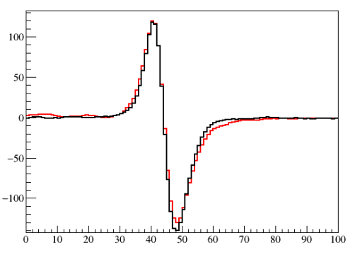
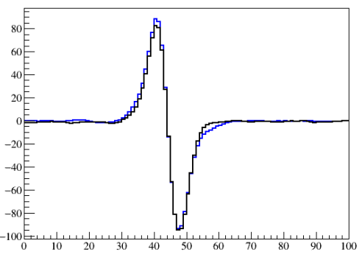
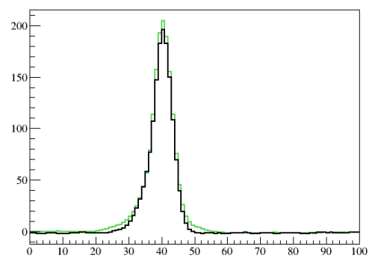
Signal Simulation Validation
2D convolution based simulation for LArTPC
JINST 13 P07006 (2018)
Software stack:
LArSoft for the generator and Geant4 simulation
Wire-Cell Toolkit for the detector response
Average waveform: data vs. MC
MC (black)
MC (black)
MC (black)
U plane
MC scaling: 1.6
Tick: [570, 970]
Ch: [8050, 8200]
V plane
MC scaling: 1.6
Tick: [570, 970]
Ch: [8950, 9200]
W plane
MC scaling: 1.6
Tick: [570, 970]
Ch: [9500, 9750]
Notes:
A critical factor for a ML algorithms to really work in physics analysis is to have a good simulation that represent data features correctly.
We used 2D convolution based simulation for LArTPC which is available in the LArSoft + Wire-Cell software stack.
These plots show good consistency between simulation and data.
This is really important if we want to use our algorithms on real data.

Slide 10
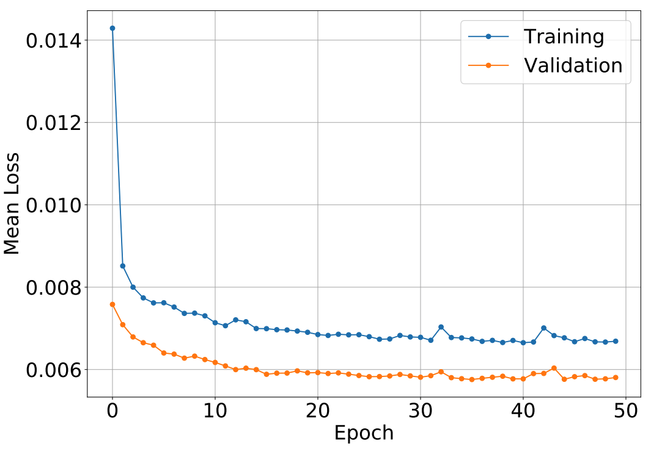
Training
Efficient network – 500 samples already provide good performance – 6 min/epoch
Platform: I9-9900K, 32 GB memory, Nvidia GTX 2080 Ti 11GB, Samsung 970 500GB NVMe SSD
Sample: 500 APA Planes using cosmic generator (450 training, 50 validation)
Loss: cross entropy
Optimizer: Stochastic Gradient Descent with momentum
Notes:
In my opinion, one important factor to consider for a practical ML algorithms is its efficiency.
In principle, if we have infinite amount of data and computing resource, a FC network with enough nodes and layers could do any thing.
But it is unpractical.
In this study, our network design + input engineering is pretty efficient.
With only 500 samples in the training, we already got pretty good performance, which we will show later.
And this leads to a low training time of 6 min/epoch.

Slide 11
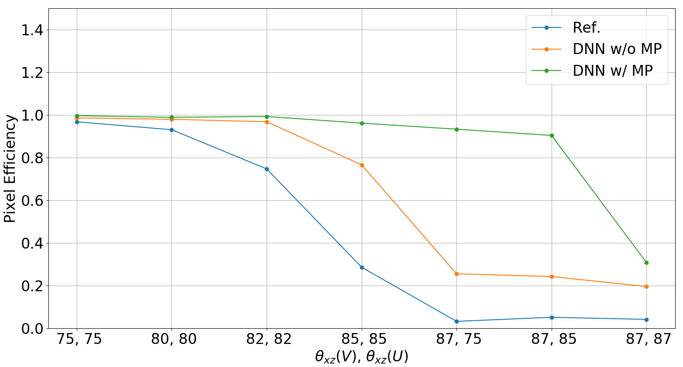
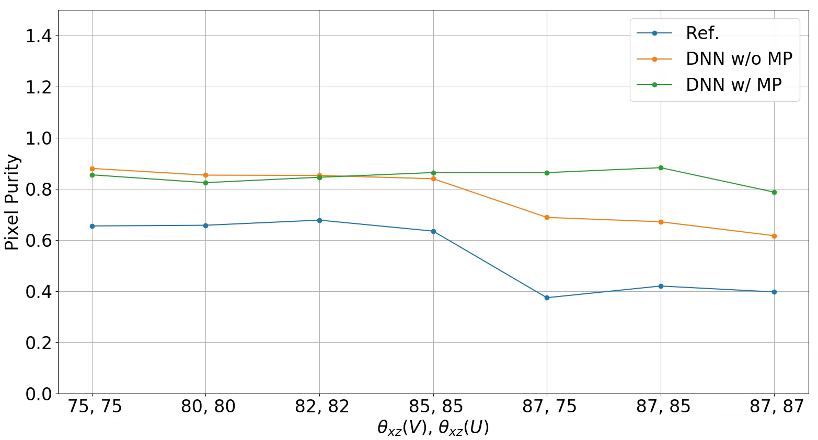
Evaluation with simulation
ROI finding on V plane
DNN ROI finding has higher efficiency and purity than the reference ROI finding especially at large angles.
More effective on tracks have asymmetric angles induction planes
DNN w/o MP information performs slightly better than Ref. but much worse than DNN w/ MP information
pixel based evaluation:
eff = (0 + 3 + 0)/(0+3+4) = 3/7
purity = (0 + 3 + 0)/(0+4+1) = 3/5
a
b
c
pixel labeled as ROI from truth
pixel labeled as ROI from reco.
Notes:
The trained model was first evaluated with simulations of tracks at large angles:
These plots show the eff. and purity for 3 ROI finding algorithms:

Slide 12
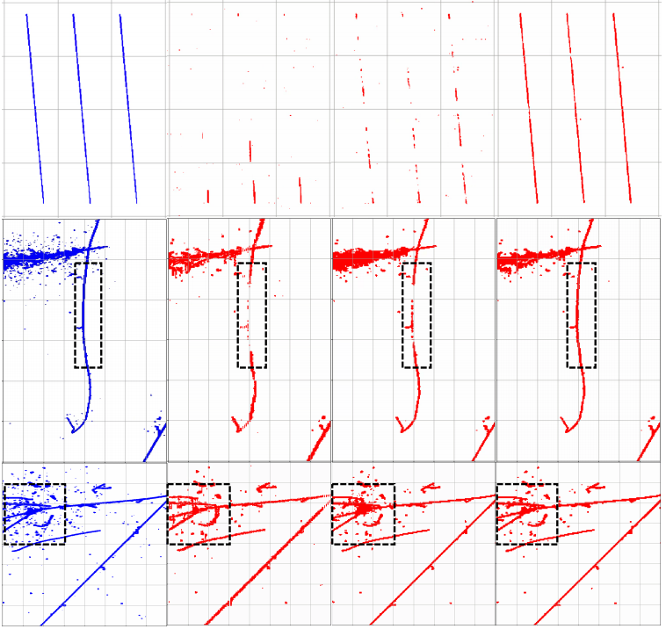
Example ROI finding event displays on simulated data
DNN-ROI
no Geometry
DNN-ROI
with Geometry
Truth
Ref.
straight-line prolonged tracks
cosmic track with a section featuring a large projection angle
an interaction vertex of a charged pion with many activities

Slide 13
Reference SP
ProtoDUNE DATA
run: 5145
subRun: 1
event: 26918
V plane
Notes:
We also tested the DNN ROI finding with pDUNE data
And I circled out some interesting cases

Slide 14
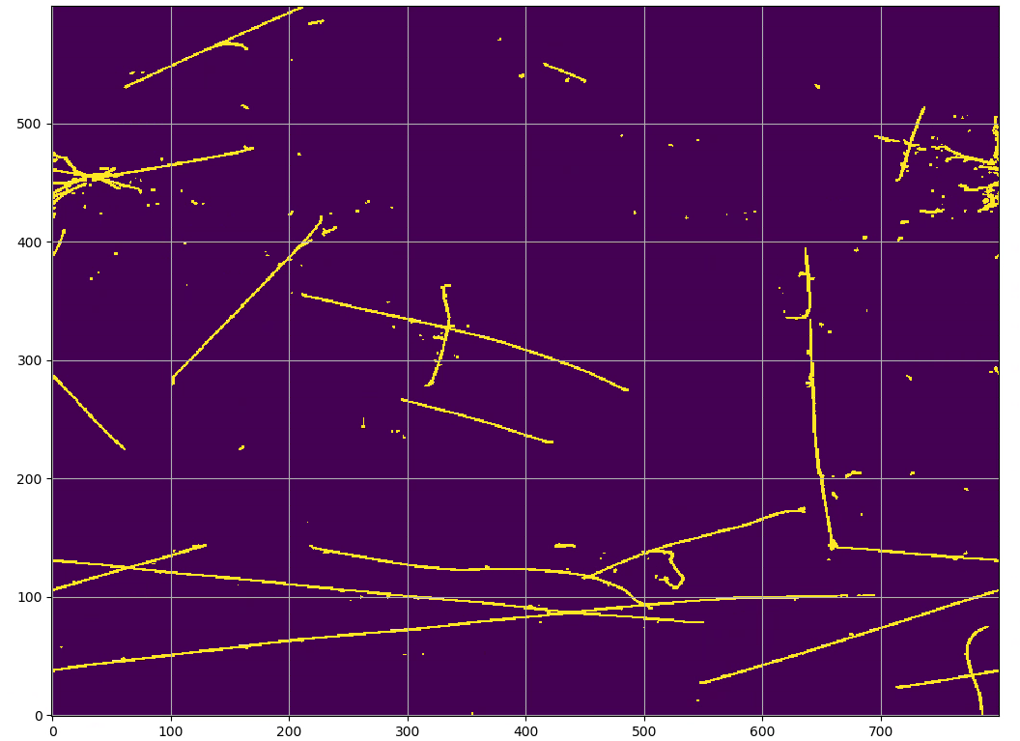
DNN-SP
ProtoDUNE DATA
run: 5145
subRun: 1
event: 26918
V plane

Slide 15
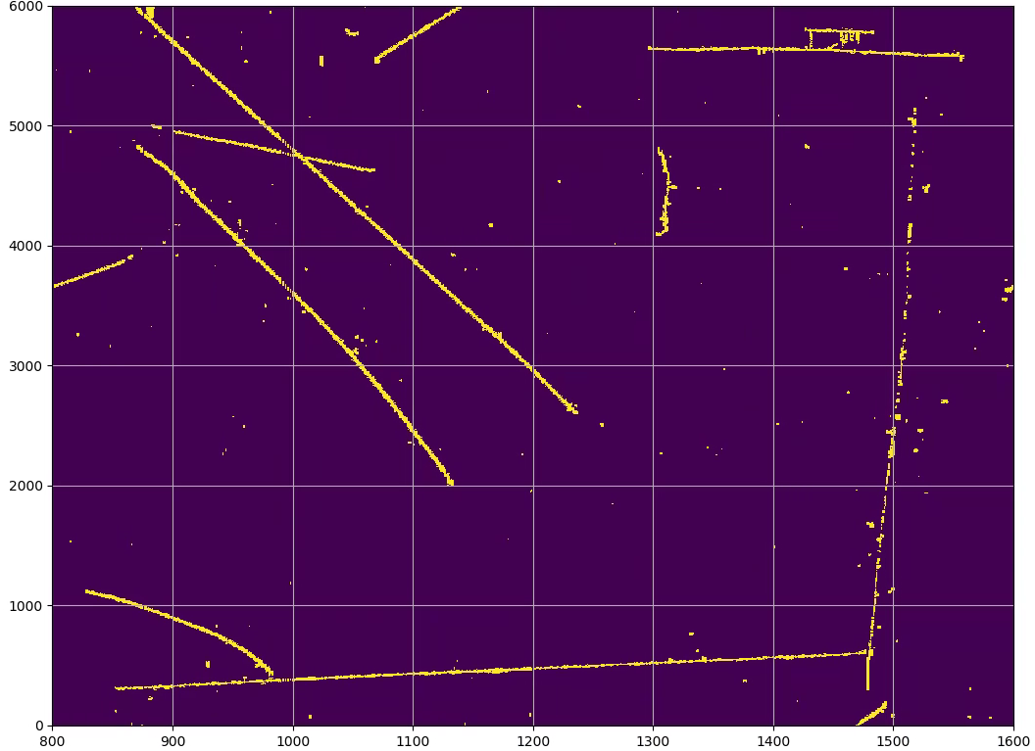
Reference SP
ProtoDUNE-SP Data
run: 5145
subRun: 1
event: 26945
V plane
ProtoDUNE: how and why
L. Manenti: X02.00001
and other ProtoDUNE Talks

Slide 16
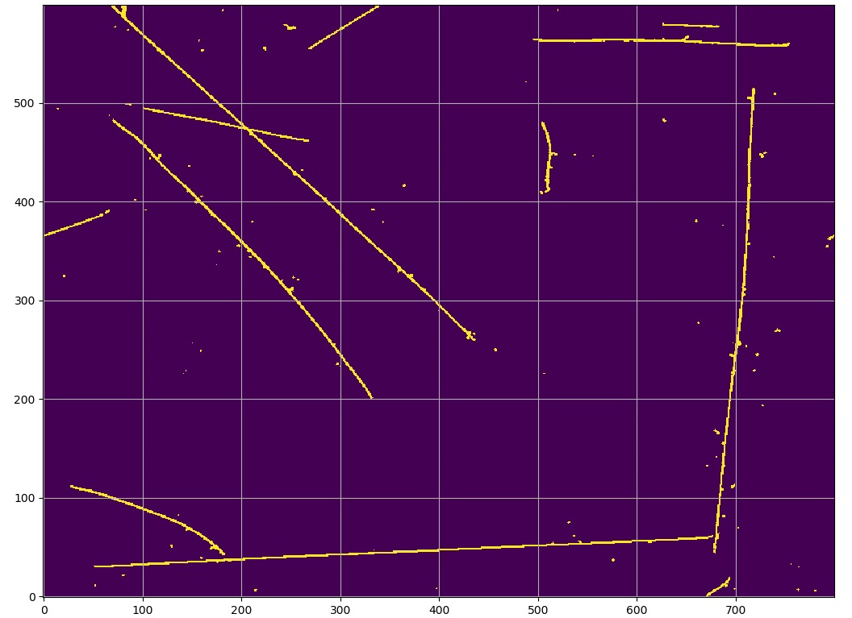
DNN-SP
ProtoDUNE-SP Data
run: 5145
subRun: 1
event: 26945
V plane
Notes:
Also less noisier than the reference method

Slide 17
Deep-Learning in Wire-Cell Toolkit
Training workflow
Established initial machinery for Deep-Learning in Wire-Cell Toolkit
https://github.com/WireCell/wire-cell-toolkit
Data preparing in LarSoft/Wire-Cell
Training with python
Production with C++
LarSoft Simulation
Energy Depos
WireCell Response
Add Noise
Production workflow
Raw waveform
Raw waveform
WireCell
Truth Tagging
WireCell
preprocessing for DNN
WireCell
preprocessing for DNN
DNN Input
in memory
DNN Input
hdf5
Truth Tags
hdf5
DNN ROI Finding
GPU/CPU
Model Training/Testing with Python API
TorchScrip Model in File
ROI
Notes:
This DNN ROI finding is implemented in wct.
We also established the machineries for data preparing/training and production with the wct.

Slide 18
Summary
DNN ROI finding algorithm provides a software improvement on LArTPC reconstruction
based on the the hardware feature - redundant wire plane
combines domain knowledge with machine learning
significant improvement on both simulation and ProtoDUNE-SP data
Ref. JINST 16 (2021) 01, P01036 for more.
Wire-Cell: https://lar.bnl.gov/wire-cell/

Slide 19
Backup

Slide 20
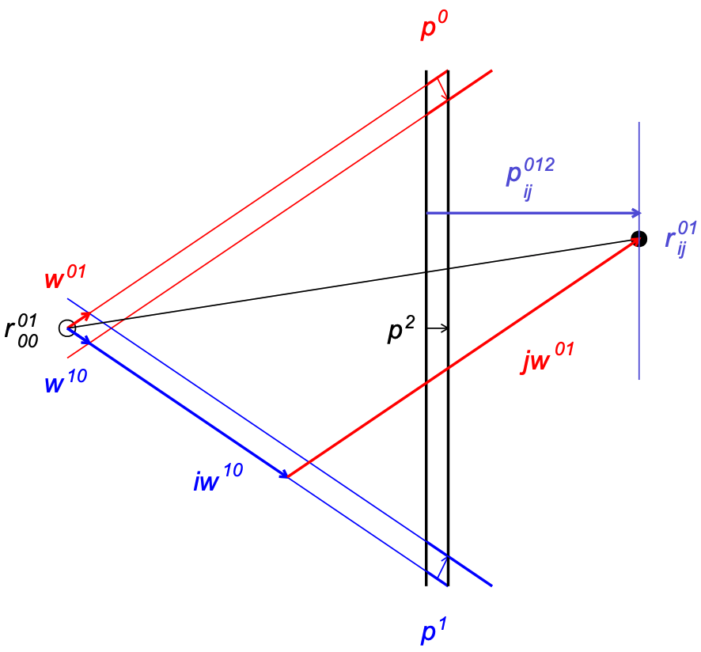


RayGrid fast projection
Non-orthogonal coordinate system
Projection on the “n” plane

Slide 21
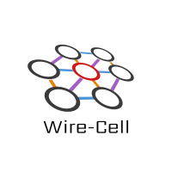
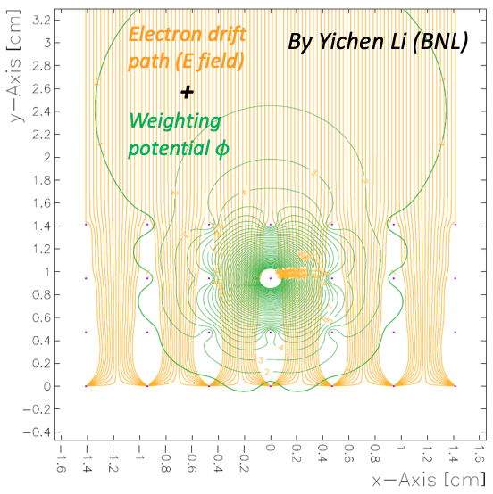
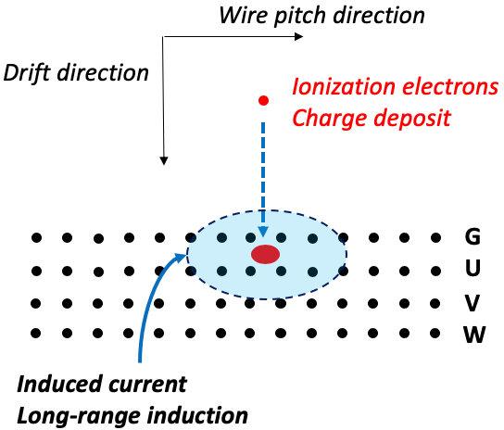
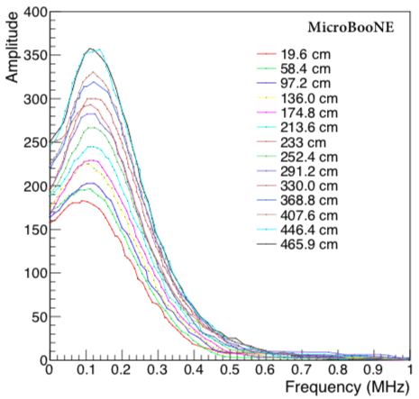
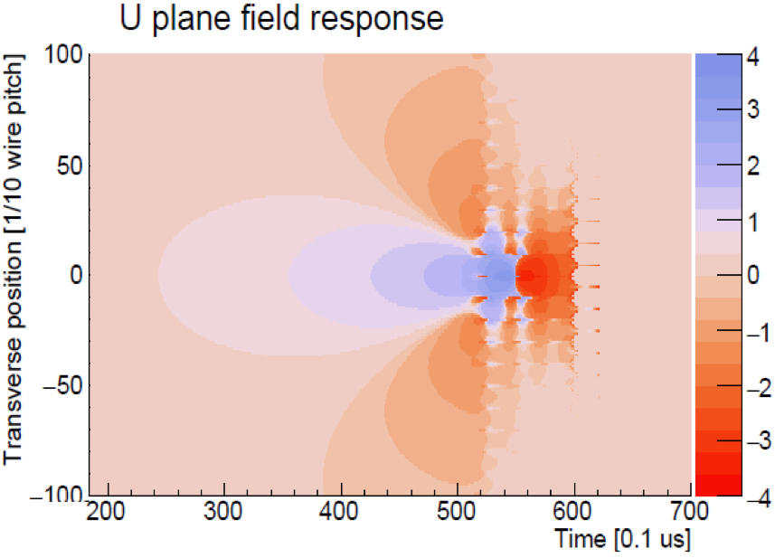

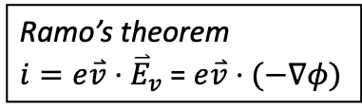
WireCell Detector Response Simulation
Response matrix:
Field response from Garfield simulation
Electronic response
2D convolution – realized by FFT and IFFT
Add inherent electronics noise
M. Diwan. Basic mathematics of random noise part ½
Refer: JINST 13 P07006 (2018)
Ramo’s theorem
$i=e\overset{⃑}{v}⋅{\overset{⃑}{E}}_{v}$ = $e\overset{⃑}{v}⋅(−∇φ)$
2D Conv.
Inherent electronic noise spectrum for different lengths of wires, JINST 13 P07006 (2018)
Garfield, a drift-chamber simulation program User’s Guide, Veenhof, R. (1993)
Hanyu Wei’ talk, DUNE collab. meeting May 2019
Hanyu Wei’ talk, DUNE collab. meeting May 2019

Slide 22
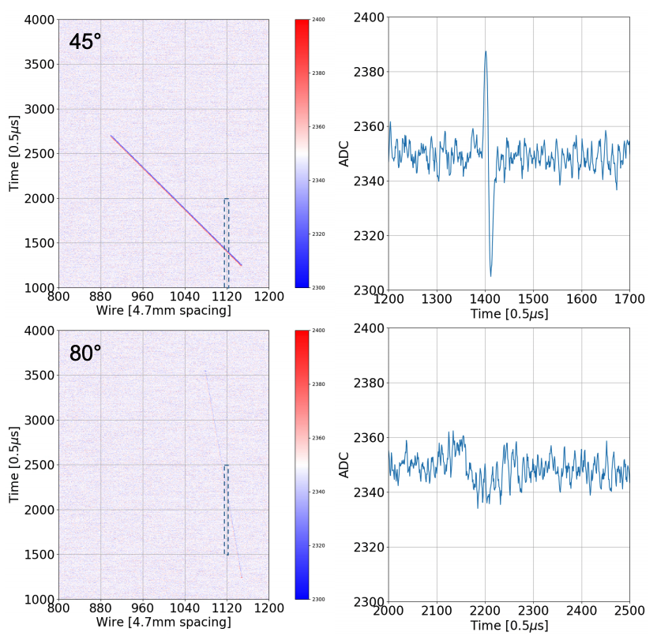
Signal vs. track angle
projection of a minimum ionizing particle (MIP) track on one induction plane

Slide 23
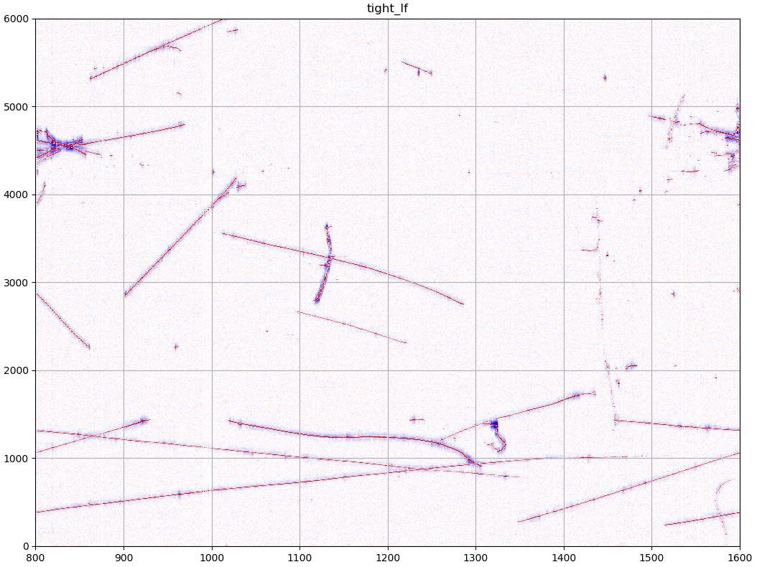
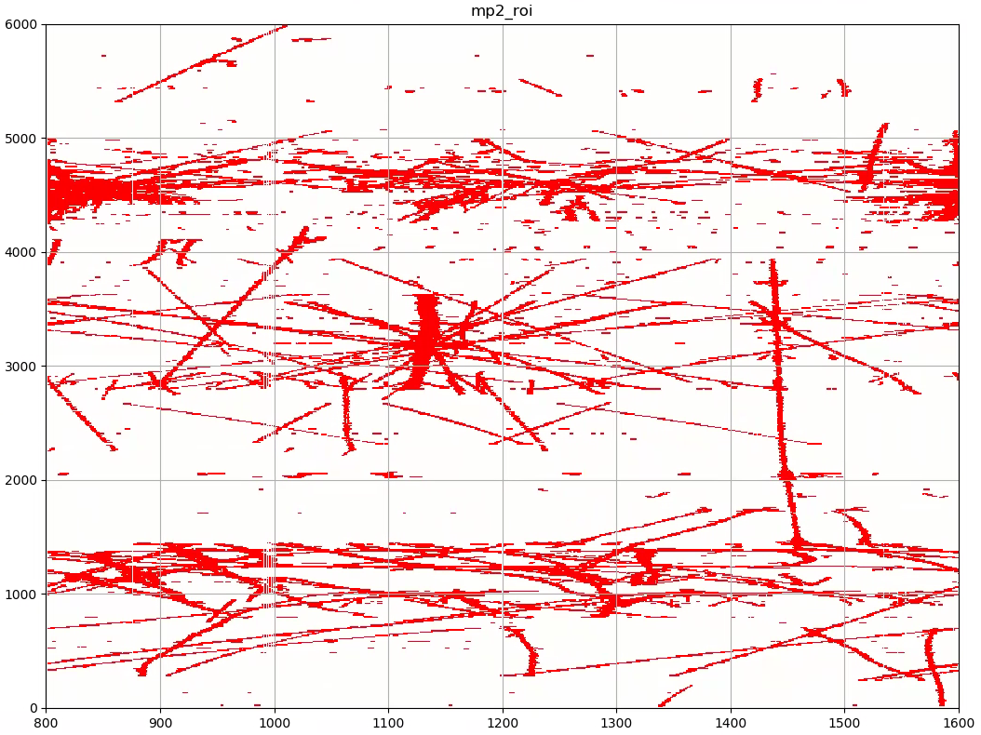
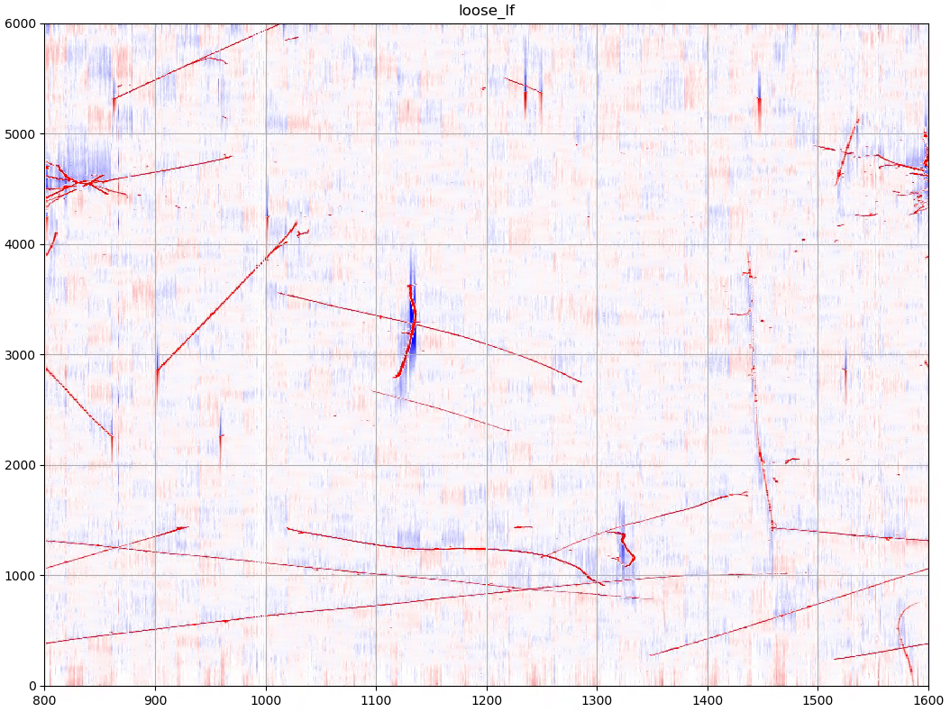
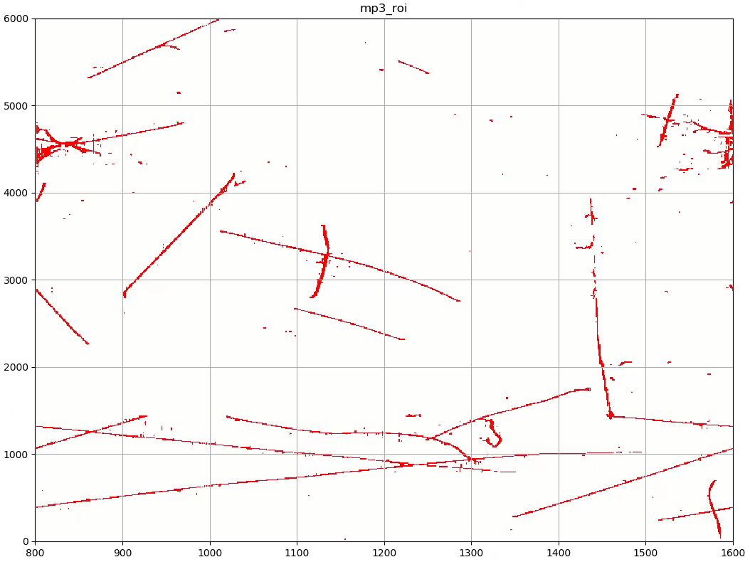
Input Candidates for DNN - ProtoDUNE data
MP2
tight_lf
MP3
loose_lf
Notes:
Here is one example inputs from pDUNE data

Slide 24
Training
 | Unit Time | Total Time
Generator | 2 sec/event | 0.3 hour/500events
G4 | 23 sec/event | 3.2 hour/500events
detector response, truth tagging and waveform preprocessing | 68 sec/APA | 9.4 hour/500 APA
Network training | 6 min/epoch (1 epoch: 1 iteration of 500 APA sample) | 5 hour/50epoch
Sum |  | 17.9 hour

Slide 25
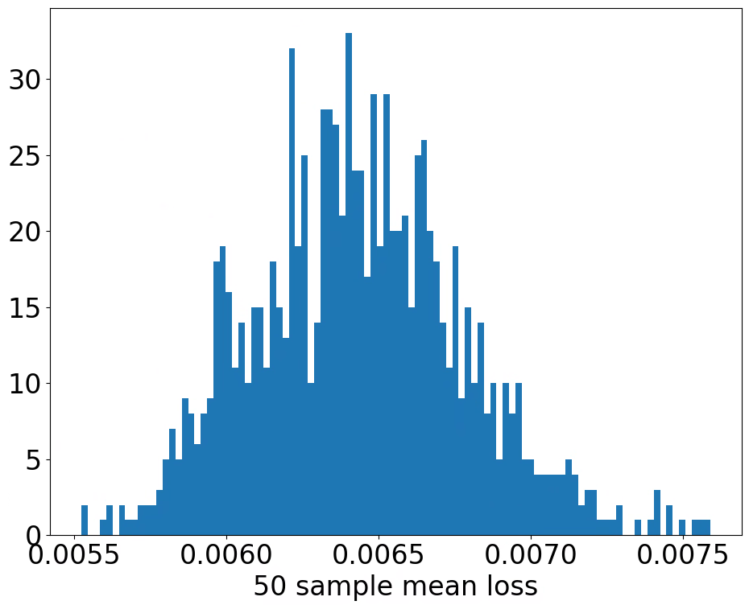
Mean loss of image samples are also expected to vary
We validated this hypothesis using a bootstrapping method. 1000 test samples (each sample contains 50 images) were random chosen from a test data set. Mean loss value was calculated for each sample and the distribution is shown below. We can see that the sample mean loss has a Gaussian like distribution that varies from 0.0055 to 0.0075.

Slide 26
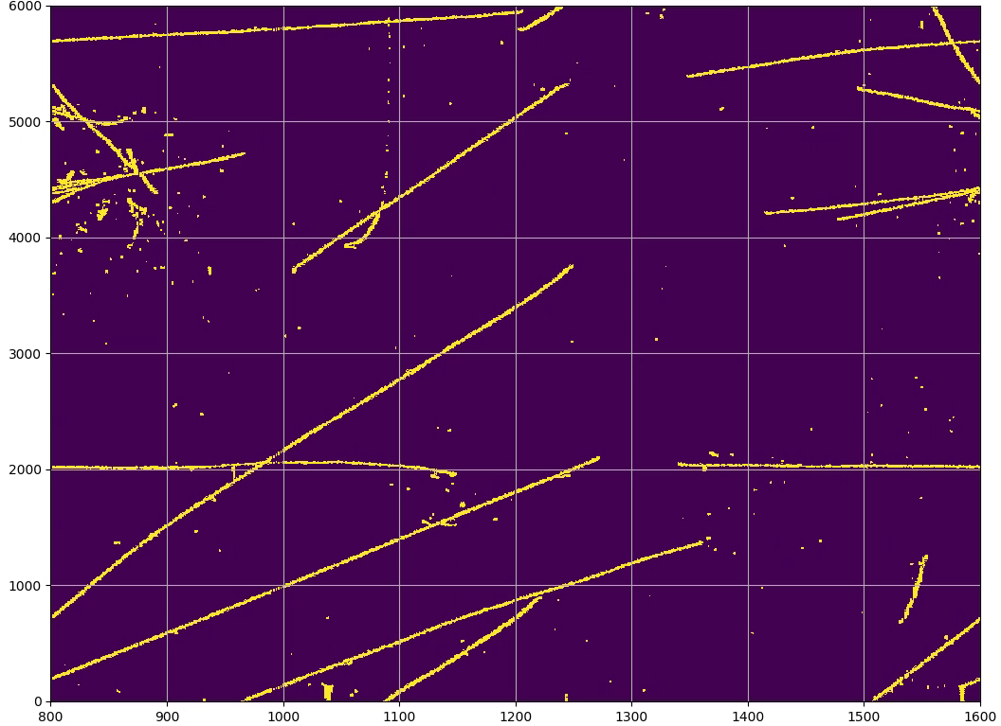
Reference SP
ProtoDUNE Data
run: 5145
subRun: 1
event: 26925
V plane

Slide 27
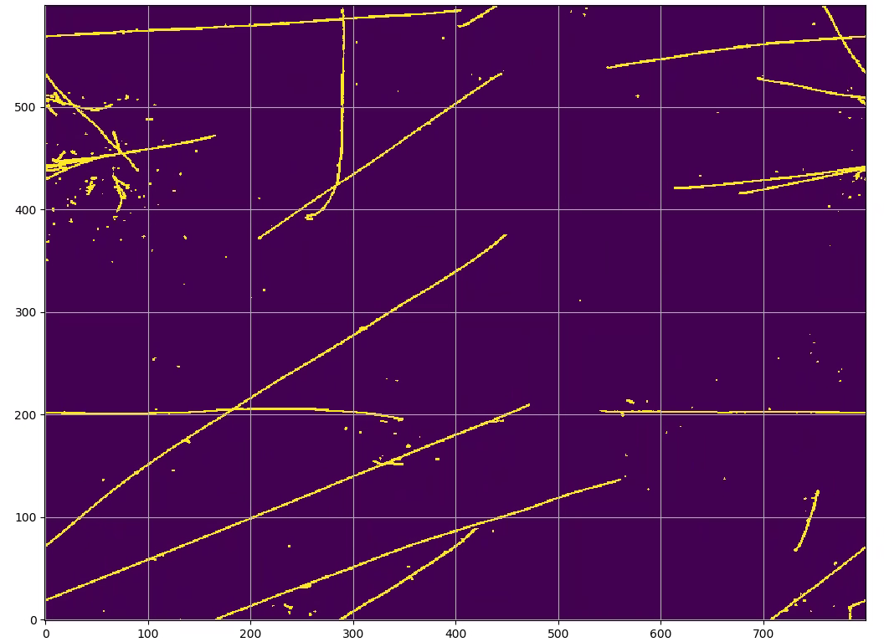
DNN-SP
ProtoDUNE Data
run: 5145
subRun: 1
event: 26925
V plane

