Slide 1
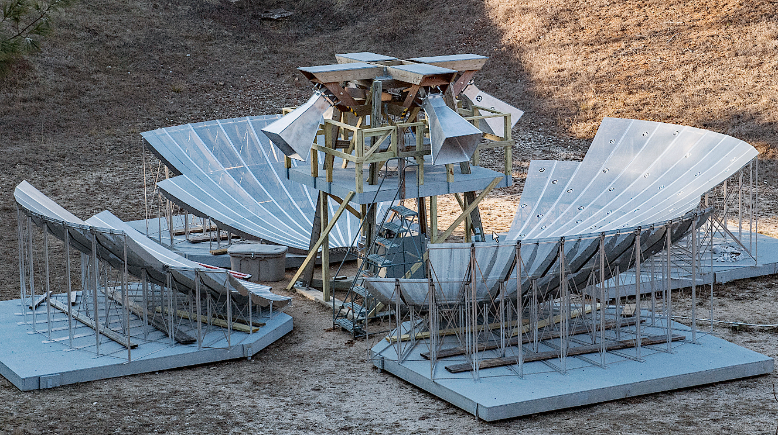

BMX Interferometer: Calibration Studies for a 21cm Intensity Mapping Experiment
P. O’Connor, Anze Slosar, Justine Haupt, Ben Saliwanchik, Paul Stankus, Tom Throwe (BNL)
Laura New burgh, Maile Harris, Emily Kuhn, Annie Polish, Will Tyndall (Yale)
Gregory Troiani ((UMKC)
O'Connor, et al.. (2020, December). The Baryon Mapping eXperiment: a 21cm intensity mapping pathfinder. In SPIE Ground-based and Airborne Telescopes VIII (Vol. 11445, p. 114457C).
arXiv:2011.08695

Slide 2
Studying Dark Energy using 21cm intensity mapping
Study of Dark Energy and Inflation today relies on observations of:
CMB temperature and polarization fluctuations;
Distance-redshift of distant supernovae;
Large-scale structure of matter in the universe, via galaxy spectroscopic surveys, weak gravitational lensing, etc.
The 21cm radio emission of neutral hydrogen is an alternate tracer of large scale structure of the Universe:
Hydrogen line provides accurate, unambiguous redshift measure
Low-resolution telescope can be used to detect aggregate emission all the hydrogen within a voxel (Intensity Mapping, IM)
Emission is detectable through Earth’s atmosphere to redshift z > 10
Uses precisely calibrated radio interferometers to achieve survey speed is potentially faster and cheaper (per source-equivalent) than an optical survey
Observe source redshifts in the range 0 ≤ z ≤ 6 inaccessible to CMB and optical surveys
Telescope = antenna array designed for wide instantaneous field of view, modest angular resolution, and large collecting area
Takes advantage of rapid commercial development of digital RF and high-performance computing technology.

Slide 3
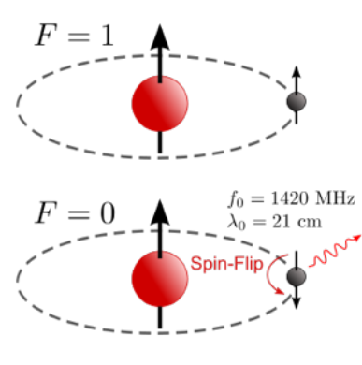
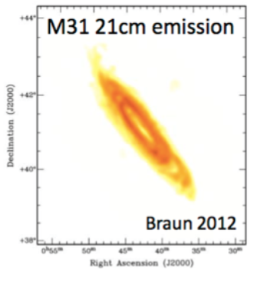
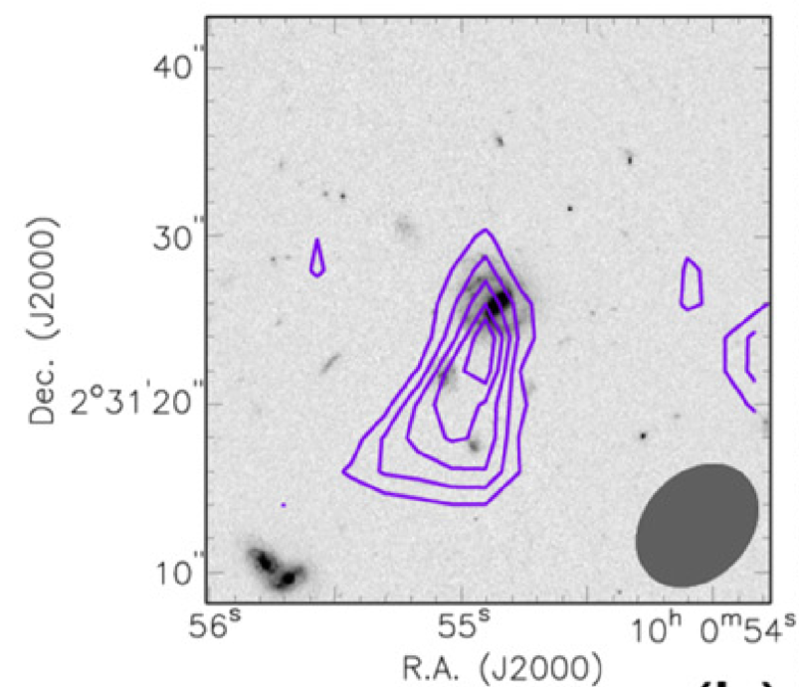
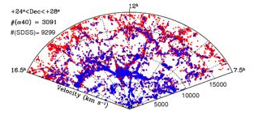
Origin and ubiquity of 21cm emission
Spin-flip transition of neutral hydrogen
Nearby galaxy M31 imaged in 21cm
21cm and optical surveys detect similar structure to z ~ 0.07
Highest redshift detection (z = 0.376)
Fernandez
2016
Haynes et al. 2011
Red: SDSS optical
Blue: ALFALFA 21cm
Grey: optical
Purple: 21cm
Spectral line at 21cm rest-frame wavelength is sharp and isolated
→ Once detected, provides precise redshift

Slide 4
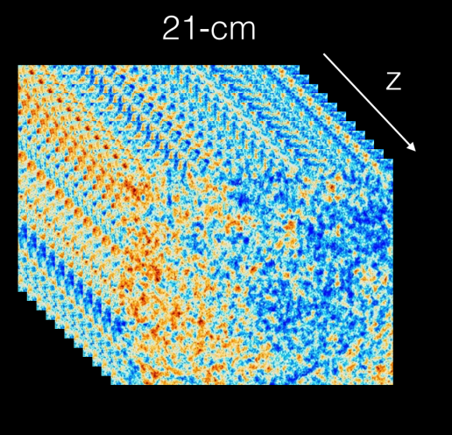
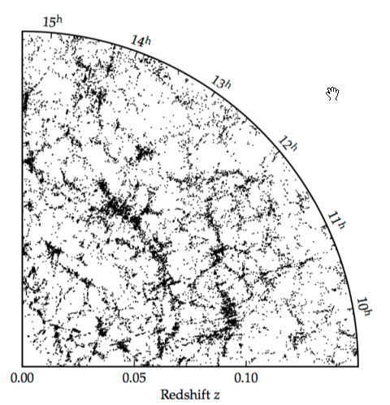
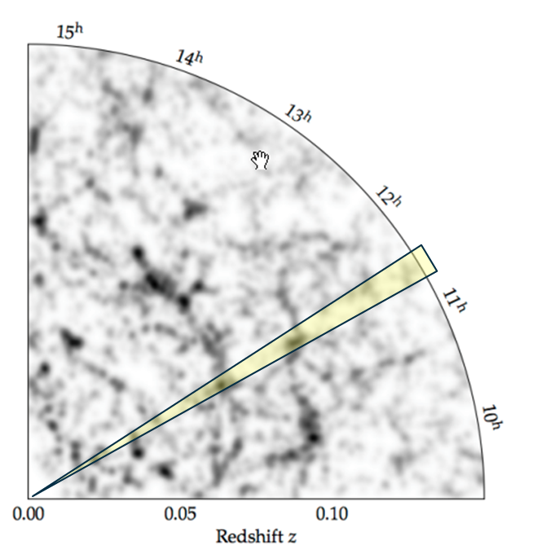
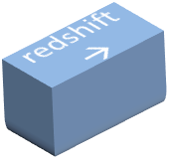
Intensity Mapping technique
Traditional galaxy survey:
individual sources observed, one at a time with spectrograph
Intensity mapping survey:
integrated emission observed as a function of frequency (redshift)
choose Δθ, Δf to be sensitive to scales of interest to cosmology
Build up tomographic reconstruction of density field across large volume of space
pointing direction
Δθ~ 0.2°
Δf ~ 1MHz
redshift
(line-of-sight distance)
redshift
(line-of-sight distance)
Scale of interest for cosmology
Several 1st-generation IM dark energy experiments online, under construction, and proposed: CHIME (Canada), HIRAX (S. Africa), BINGO (Brazil), TIANLAI (China)
US participation minimal at this time

Slide 5
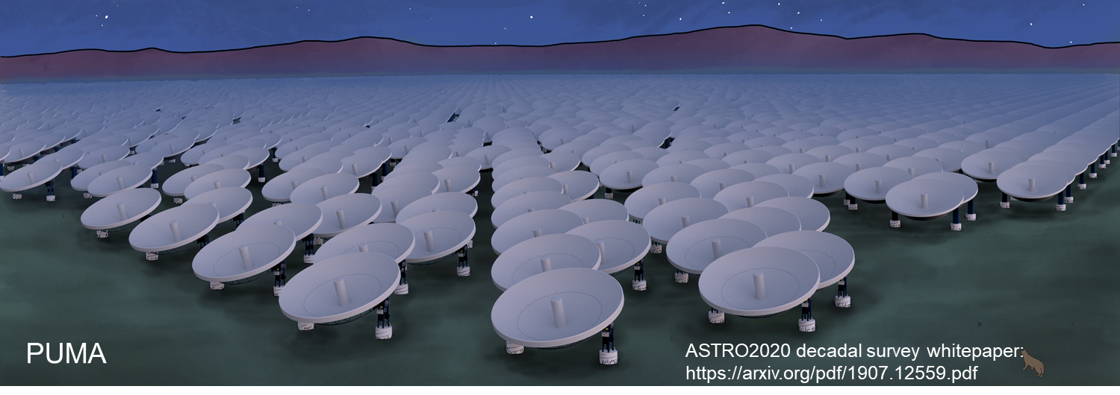

A concrete example: Packed Ultrawideband Mapping Array (PUMA)
A next-generation cosmic survey using intensity mapping of the 21-cm emission from neutral hydrogen
Proposal submitted to the ASTRO2020 Decadal Survey and Snowmass LOI call
Interferometric array of 32,000 (5,000) six-meter dishes closely packed
Redshift range 0.3 < z < 6 corresponding to 1100 < ν < 200 MHz
Primary science goals:
Probing physics of dark energy in the pre-acceleration era
Searching for signatures of inflation
Probing the transient radio sky (fast radio bursts and pulsars)

Slide 6
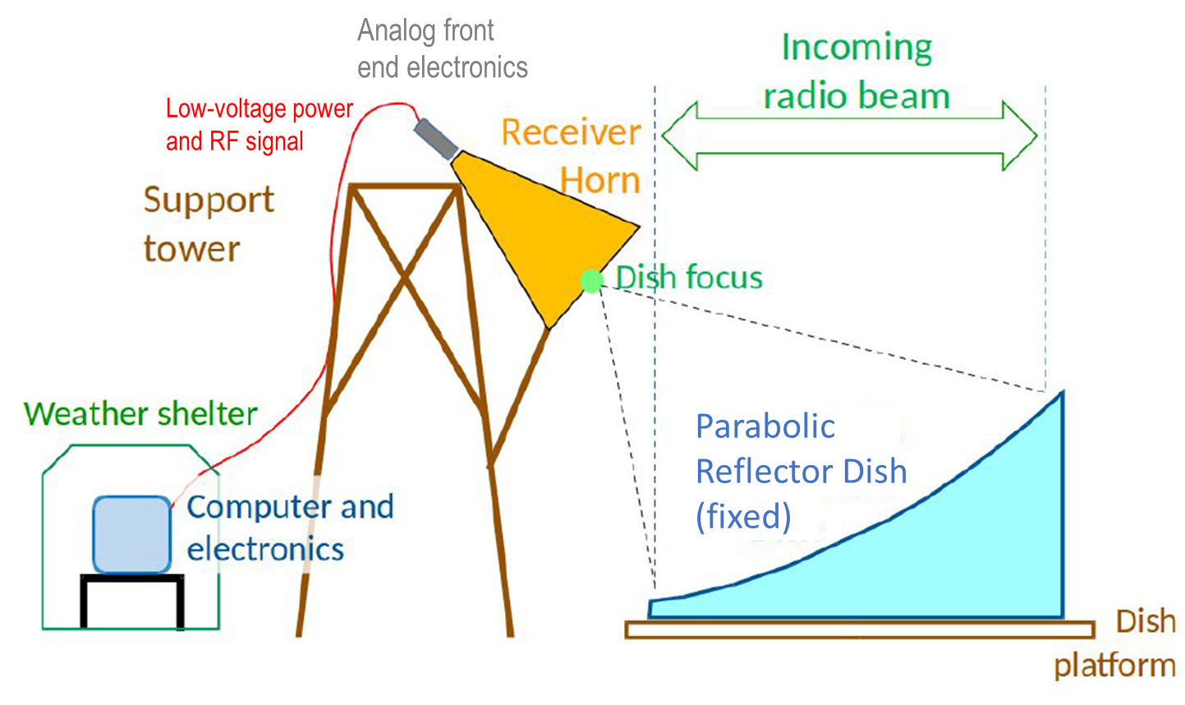
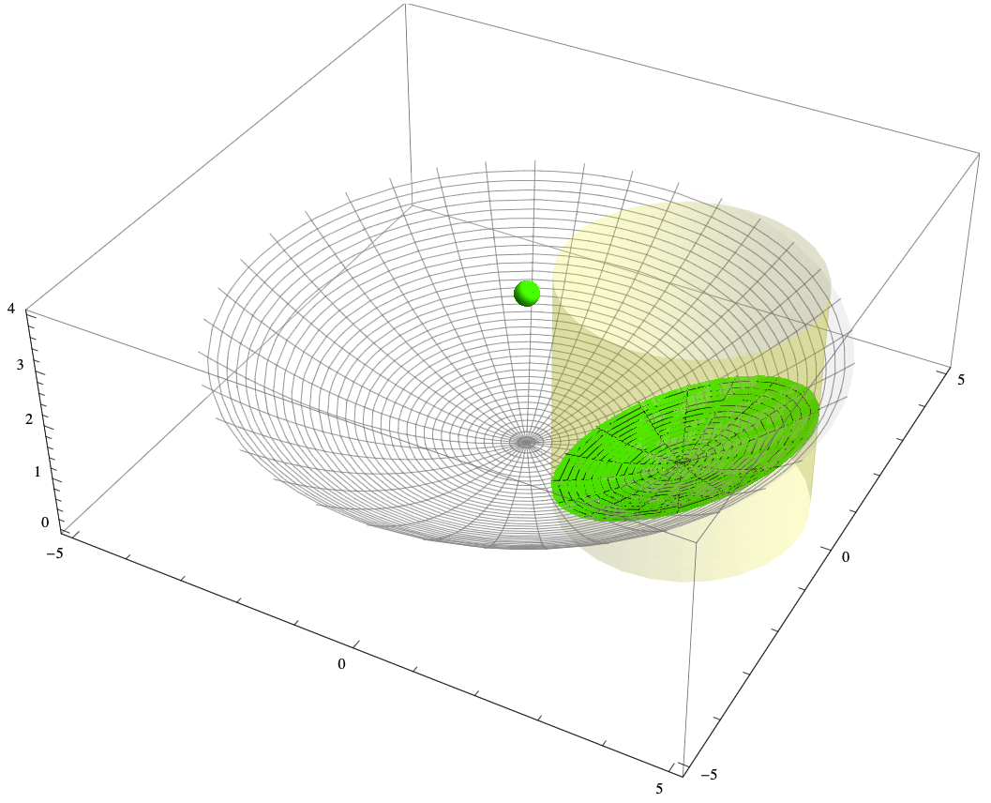
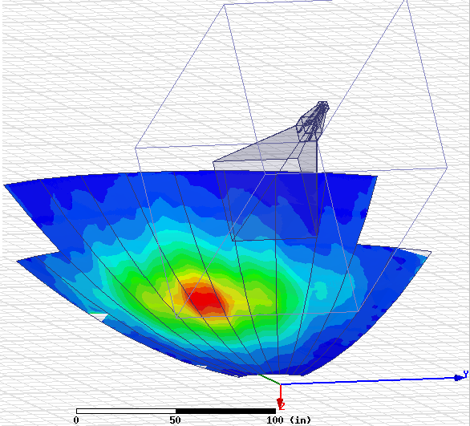
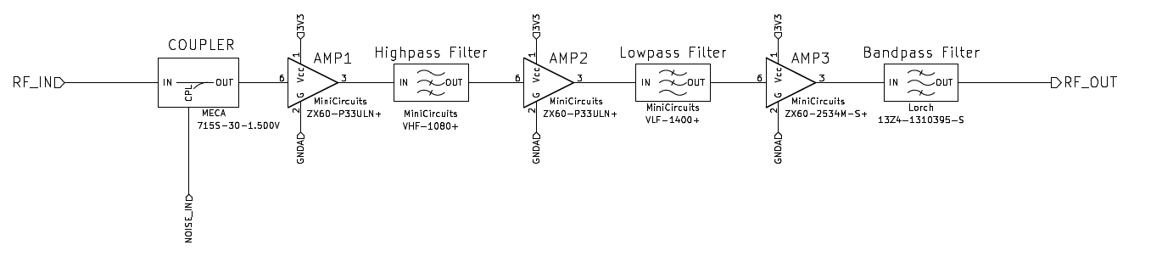

BMX instrument
Off-axis configuration of single dish + receiver
Parent paraboloid
EM Sim of illumination pattern on dish
(fixed)
Front end electronics
Calibrated noise diode

Slide 7

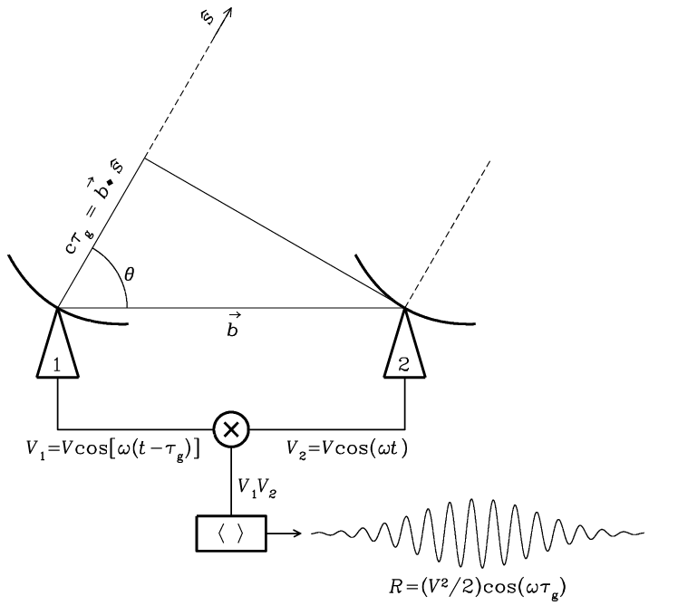
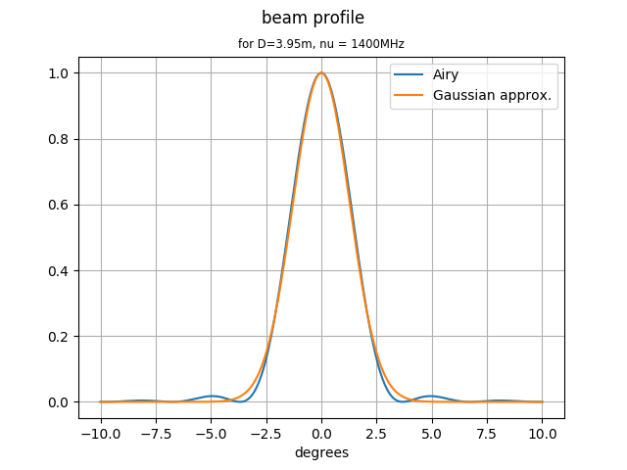
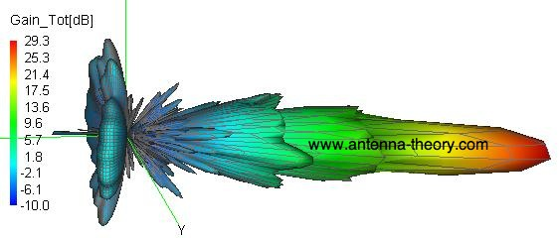


Instrument design: radio interferometer
One baseline (N_{dish} = 2)
Phase of the interference fringes encodes angle to source (θ ):
$$R={B(θ)⋅e}^{−iφ}$$
λ
$φ=\frac{2π\left(\vec{b}∙\vec{s}\right)}{λ}$ =$\frac{2π|b|cos⁡θ}{λ}$
D
b
B(θ) = angular response of dish primary beam
Airy disc and Gaussian approximation
EM sim (not BMX)
NRAO
Interference fringes based on path length difference between 2 stations
Angular resolution λ/|b|
Angular field of view λ/D “primary beam”
Collecting area πD²N_{dish}/4

Slide 8
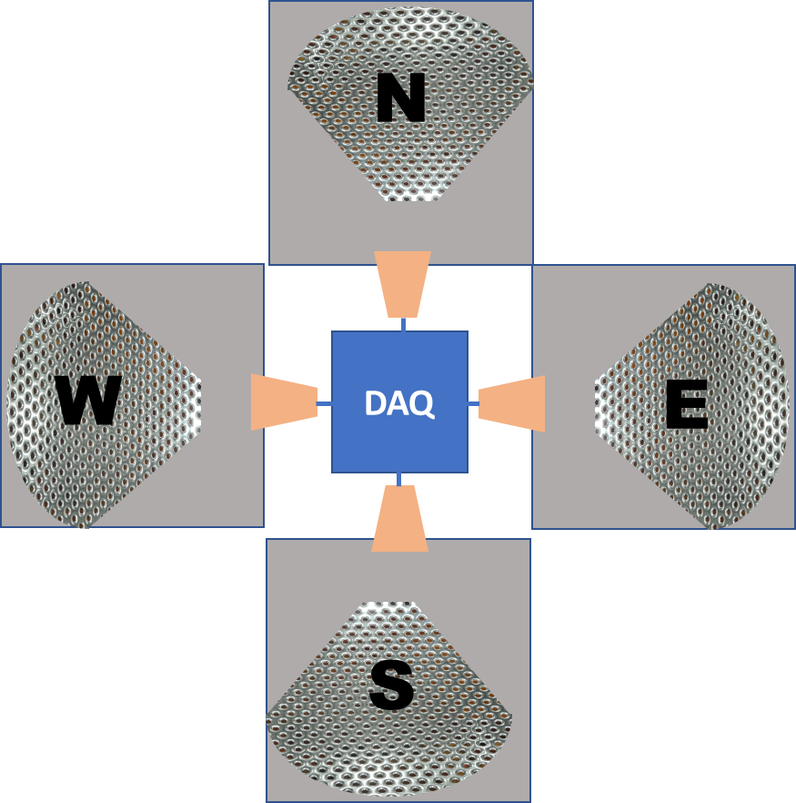
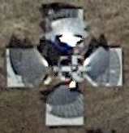
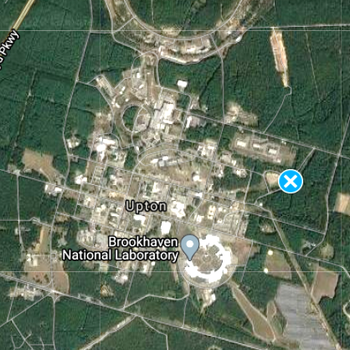
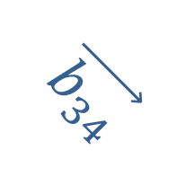
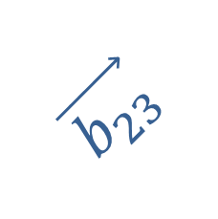
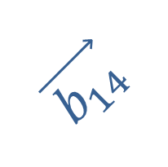
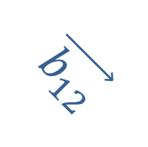


Array baselines
$$\vec{b_{14}}$$
$$\vec{b_{12}}$$
$$\vec{b_{24}}$$
$$\vec{b_{13}}$$
$$\vec{b_{34}}$$
$$\vec{b_{23}}$$

Slide 9
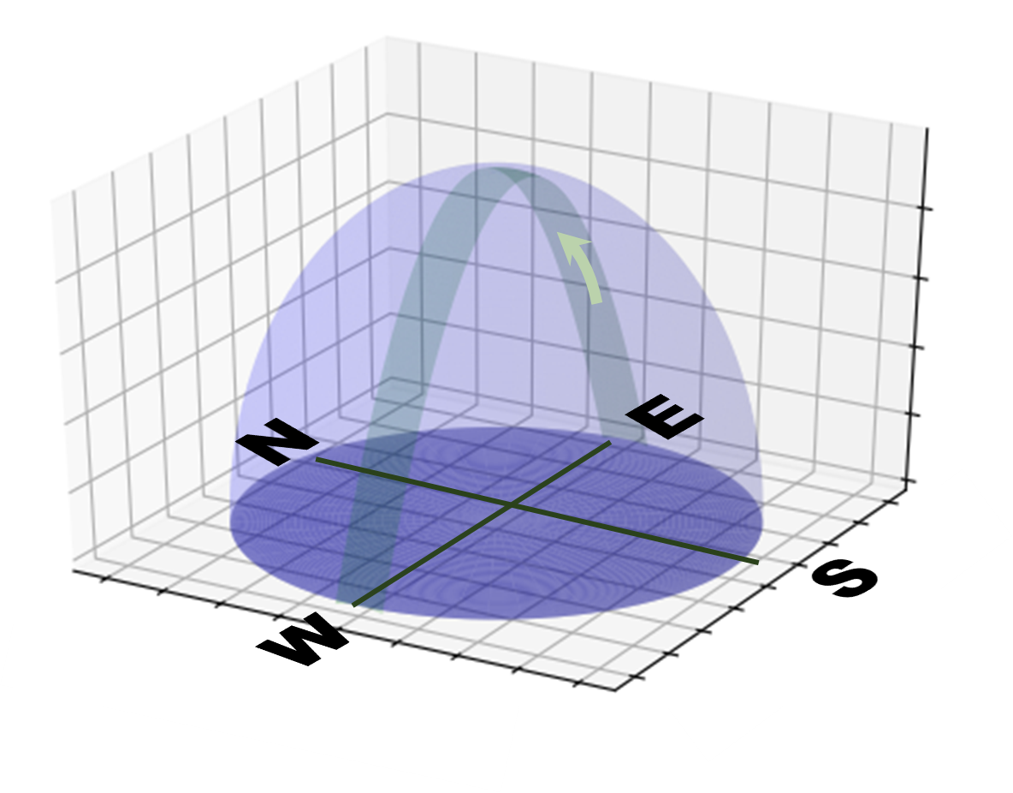
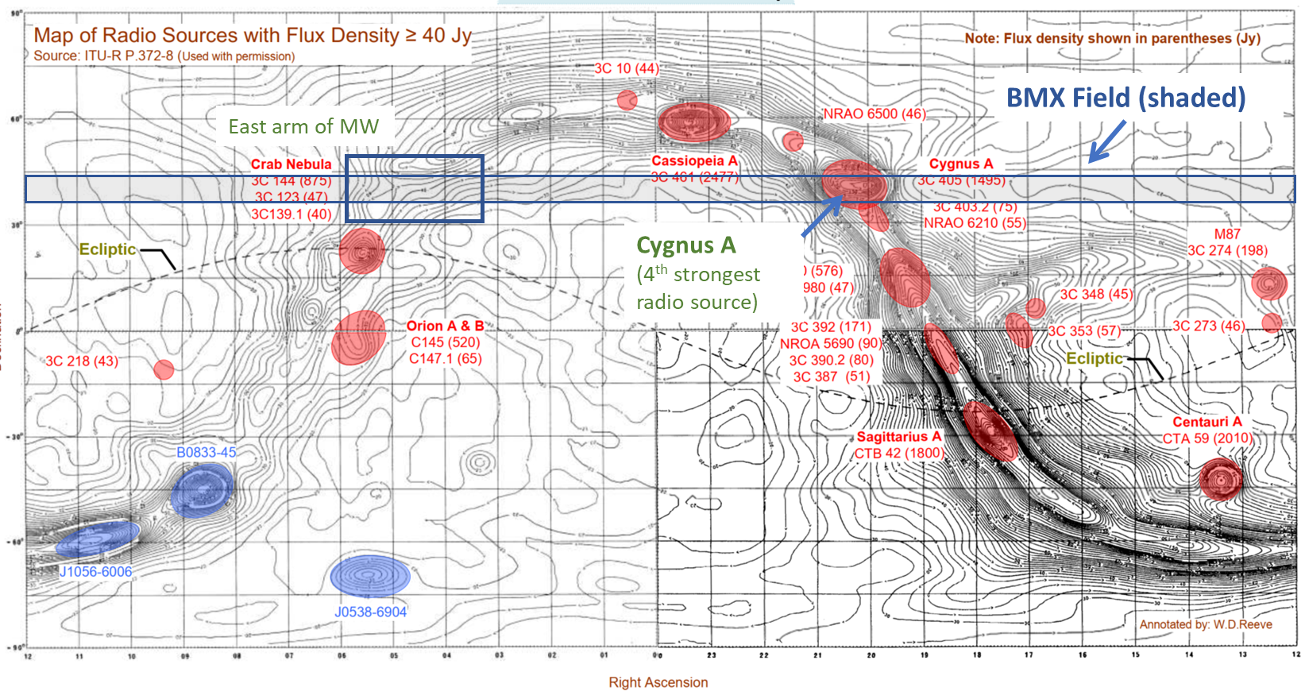
BMX field of view on sky

Slide 10
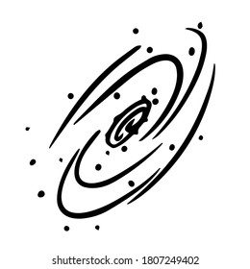

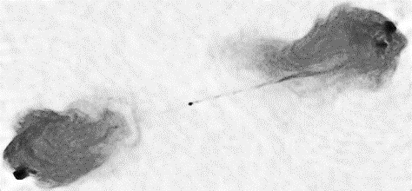
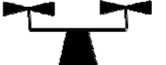
Calibrators
 | DIODE | UAV | GNSS | MW | CygA
For: | gain(ν) | beam(ν) | beam | beam, frequency | beam, array layout
Range | 0 | 170 m | 2e7 m | 5e20 m | 6e24 m
Heading angle | - | Any | ~NE, ~SW | W | W
Angular rate | - | 1 – 1.1 ◦/s | 0.006 - 0.01 ◦/s | 0.0032 ◦/s (sidereal) | 0.0032 ◦/s (sidereal)
Passes/day | - | up to 10 | 20 – 30 | 1 | 1
Power | 3K | 200,000K adj. | 20,000K max. | 1 -- 40K | 5 K @ 1.42GHz
Polarization | No | Yes | No | No | No

Slide 11
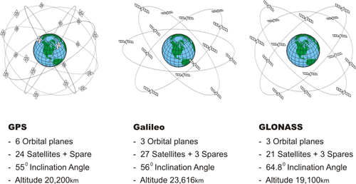
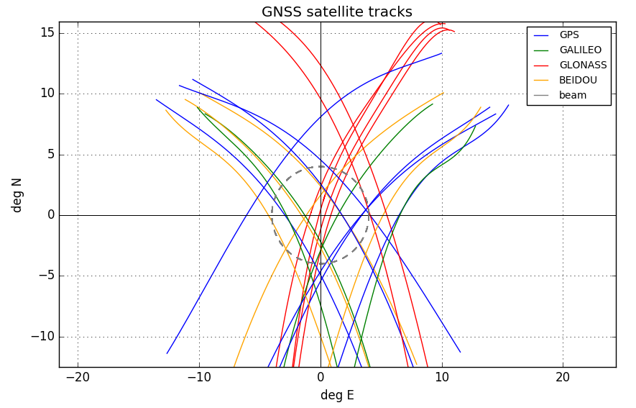
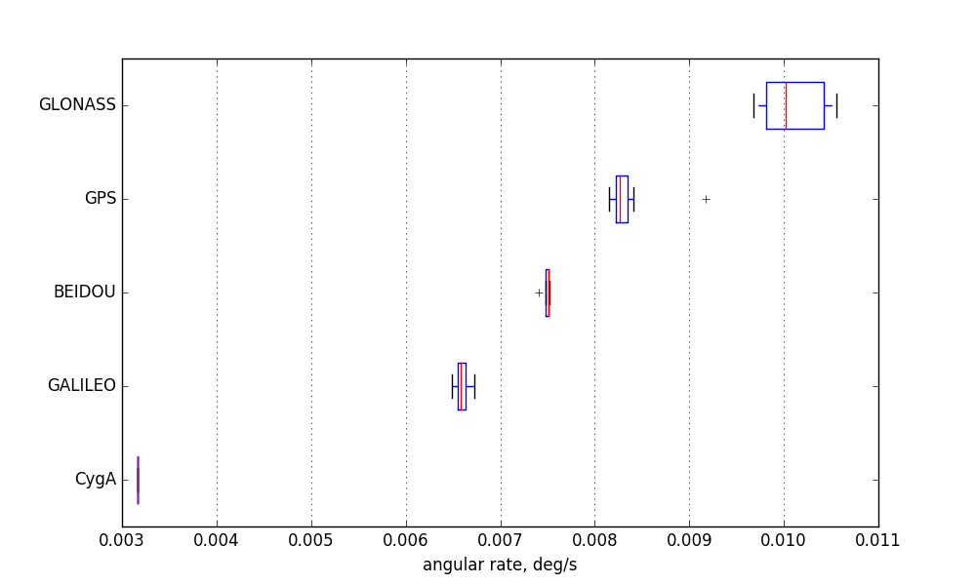
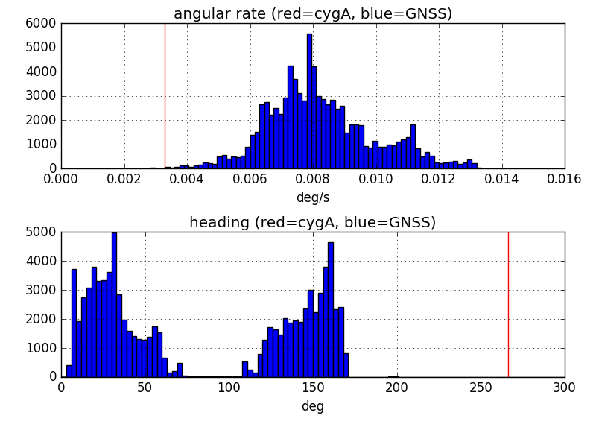
GNSS satellites: constellations, passes over BMX

Slide 12
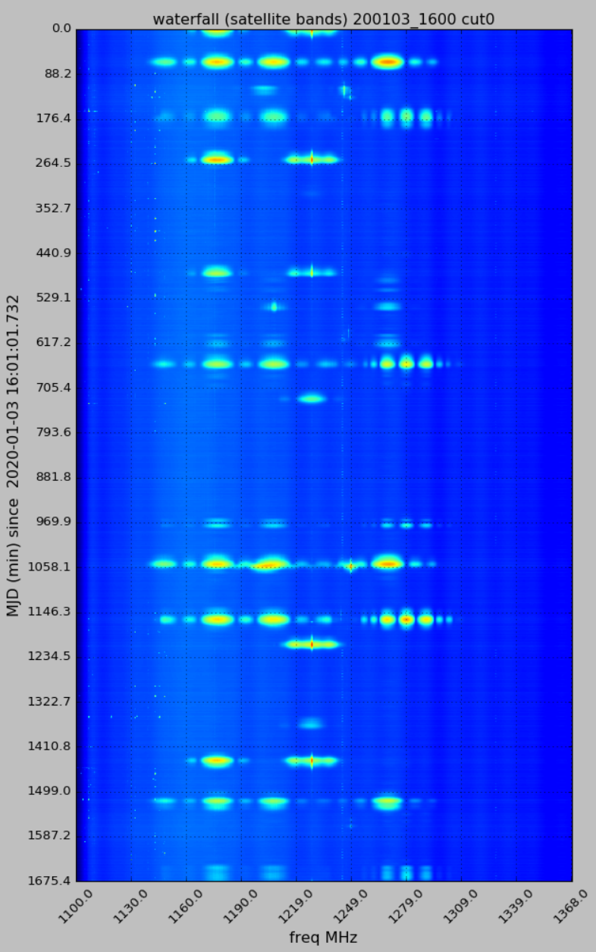
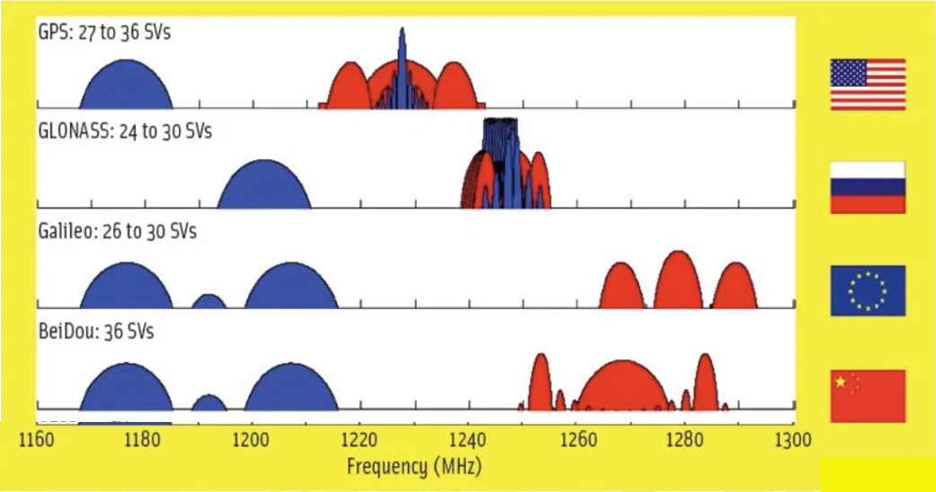
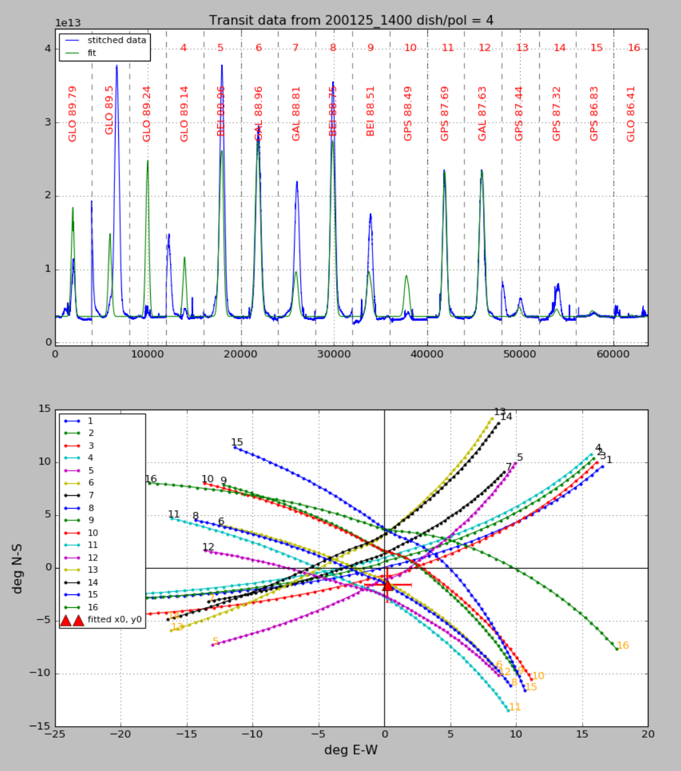
GNSS passes over BMX on 1/3/2020 (13 satellites observed in 4 constellations)
Assigned transmit bands
BEI
GAL
GPS
GPS
GPS
GAL
Predicted tracks from ephemeris
GAL
BEI
GAL
GPS
GPS
BEI
GAL

Slide 13
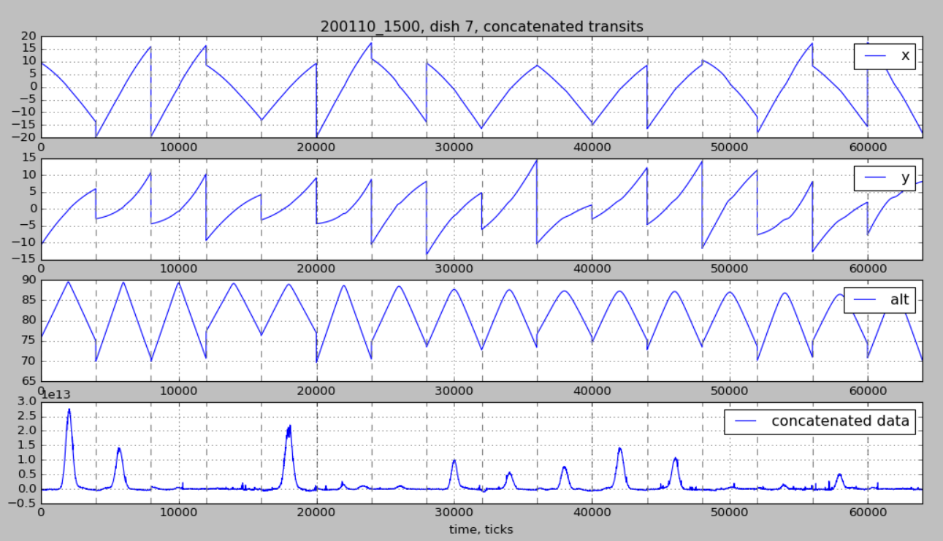
Fitting beam parameters to multiple GNSS signals
Method
Concatenated input data set (16 satellites on 1/10/2020)
Integrate measured single-dish power over GNSS band from 1100 to 1378 MHz.
Remove DC offsets
Define 1-hour time windows centered around transits of up to 16 GNSS satellites (one day at a time).
Assemble “stitched” data:
Data set is predicted [θ_{x}(t), θ_{y}(t)], signal(t).
Jointly fit 2D Gaussian beam model having parameters amplitude, beam pointing center and width (θ_{x0}, θ_{y0,} σ_{x}, σ_{y}).
Joint fit

Slide 14
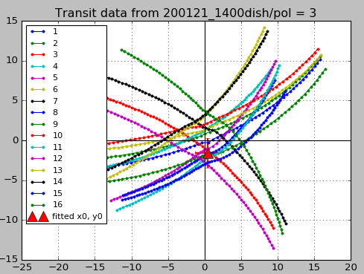
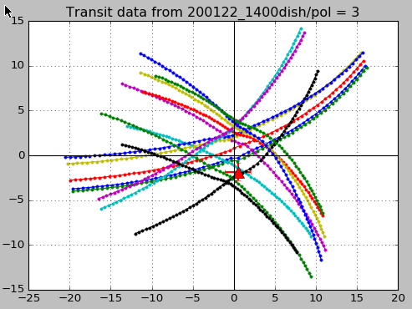
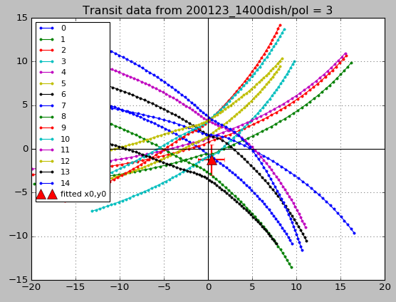
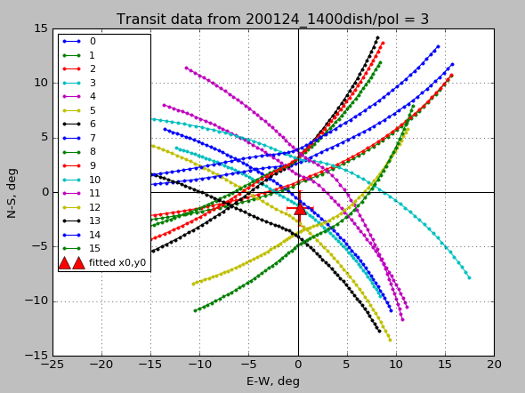
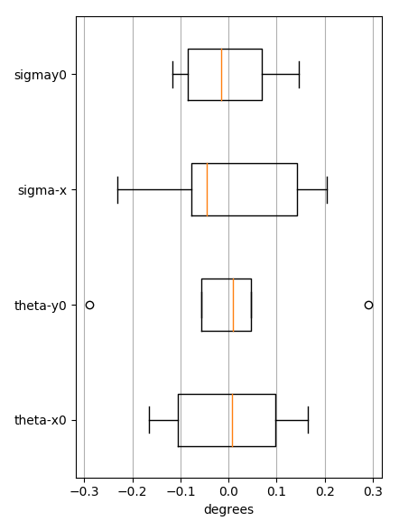
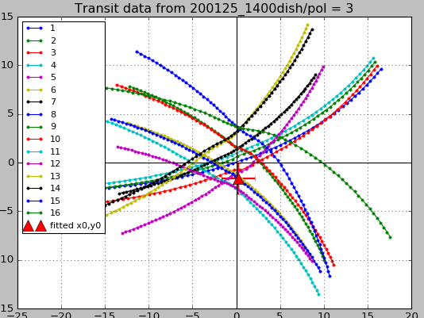
Fitted beam parameters over 21-25 Jan. 2020. Data for W dish, Y polarization
beam parameter | mean | st. dev.
θ_{x0} | 0.3639 | 0.1229
θ_{y0} | -1.5392 | 0.1863
σ_{x} | 1.5953 | 0.1568
σ_{y} | 1.7222 | 0.1030
 | deg | deg
pointing direction
beam width
statistics (mean subtracted)
σ_{y}
σ_{x}
θ_{y0}
θ_{x0}
degrees (mean=0)

Slide 15
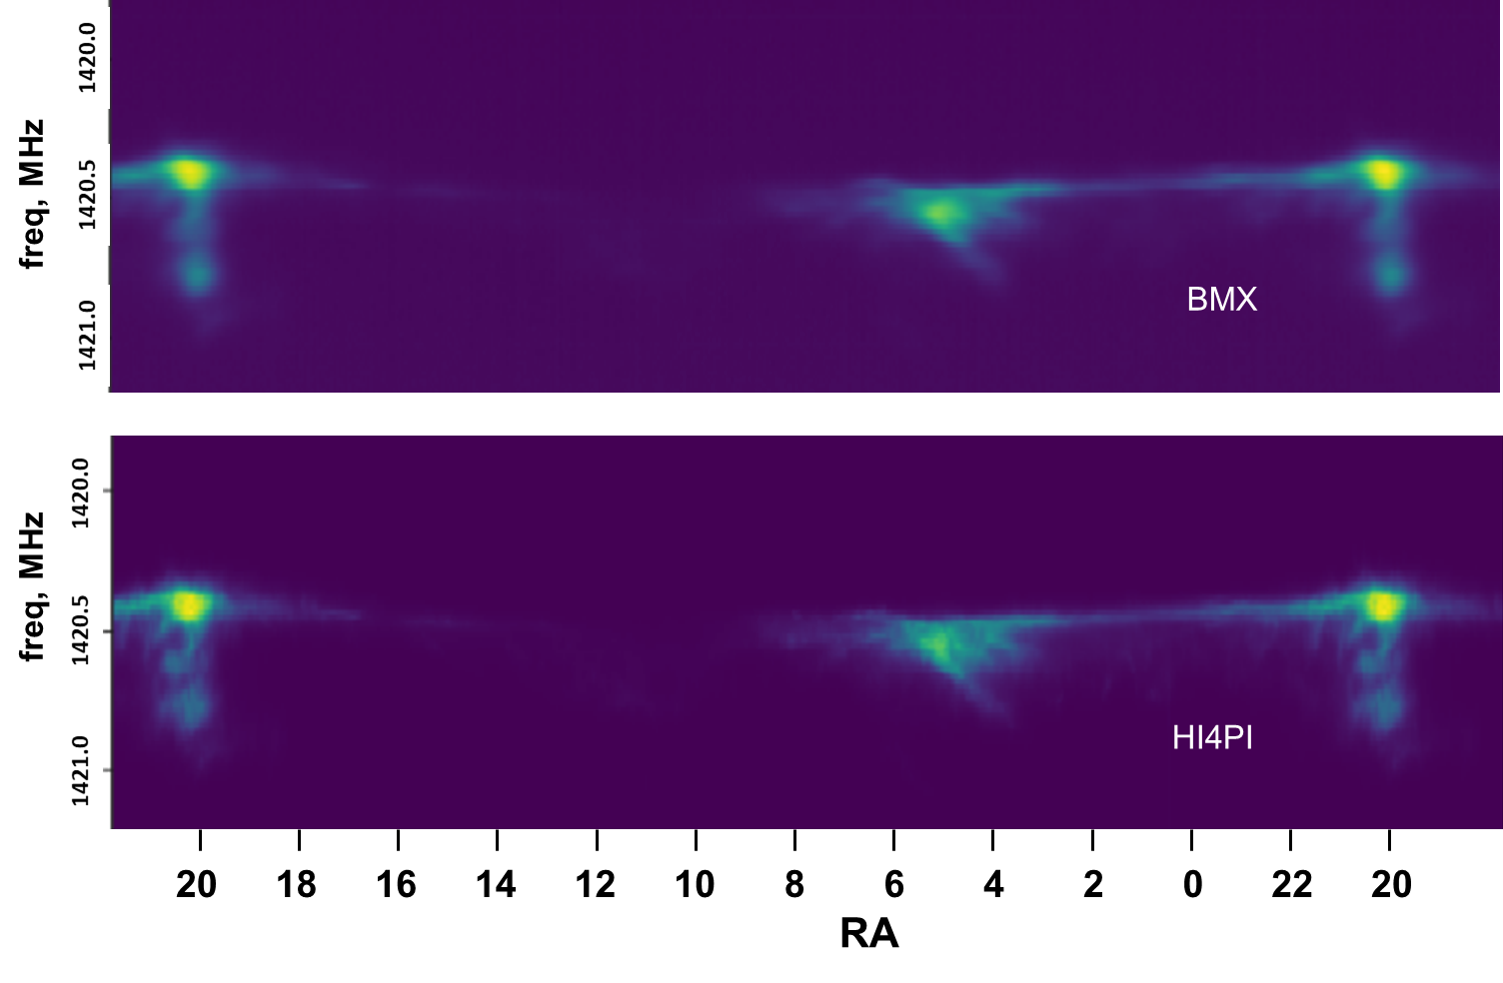
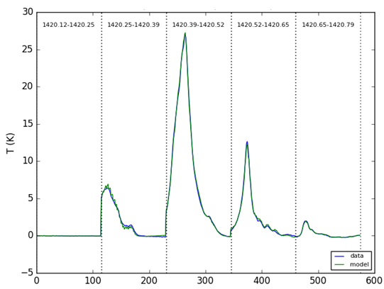
21cm clouds in Milky Way
Milky Way map in RA and frequency for the BMX strip. Top map is BMX data, bottom is rebinned data from the HI4PI survey¹. Note, both maps start at 18h RA (left). After 24 hours, the BMX map extends to 22h the following day while the HI4PI map simply wraps around. Obs. Start: 21:45 UTC 20 October 2020.
Detail of galactic HI structure. Each of the five sub-panels shows BMX spectrometer data in adjacent 130kHz frequency bins during the MW transit of 1 Dec 2017. The x-axis in each sub-panel covers the same ∼ 100 degrees of RA. After transforming frequencies to a Local Standard of Rest (LSR) which takes into account motions of the Earth and Sun, data is fit to a Gaussian beam model (shape, pointing, frequency offset) with the HI signal predicted by the HI4PI map.
1420.12 – 1420.25
1420.25 – 1420.39
1420.39 – 1420.52
1420.52– 1420.65
1420.65– 1420.79
Analysis by C. Sheehy
¹Bekhti et al. A&A 2016

Slide 16
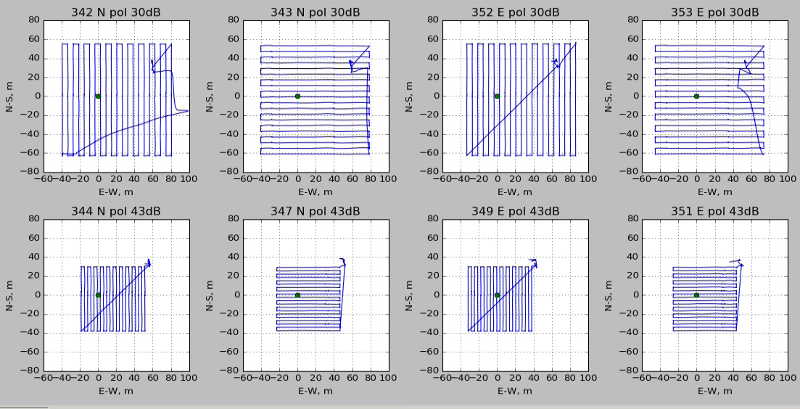
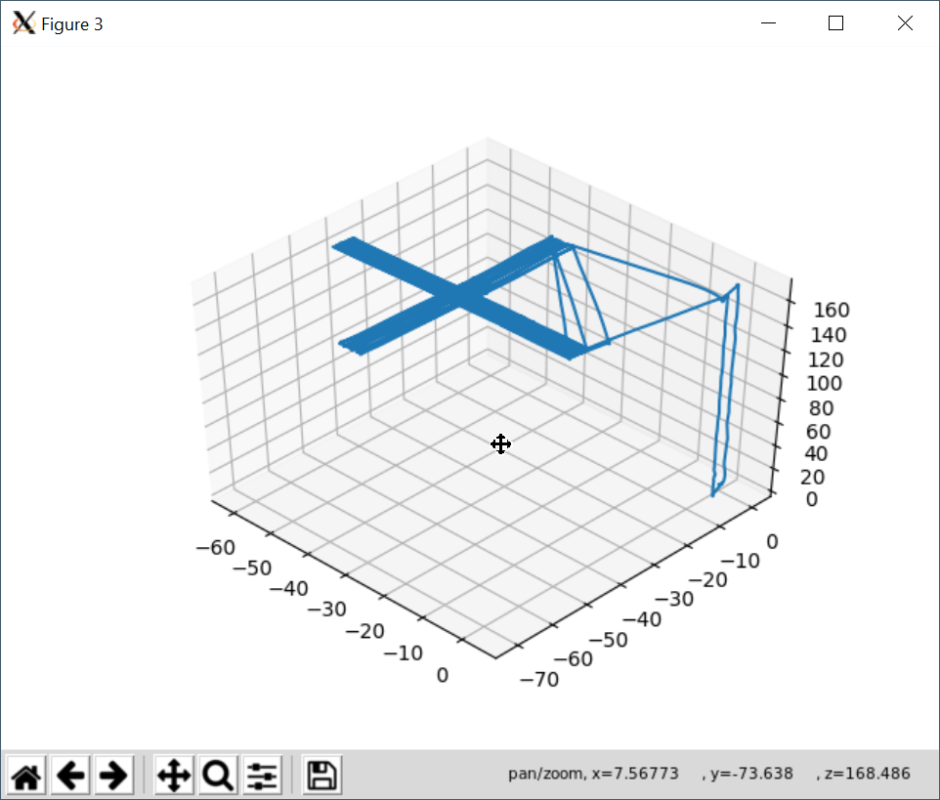
UAV calibrations
Vehicle: commercial DJI hexacopter. Flight time ~25 minutes per battery change.
Transmitter: switched, broadband noise source + biconic antenna (polarized). Variable attenuator to set power level.
Position determination: differential GPS, ~1cm accuracy.
Timebase: GPS
Flight plan: ascend to far field (~170m), fly raster pattern over telescope. Drone “yaw” orientation sets polarization direction either aligned with or perpendicular to direction of travel. While flying legs of the raster, typical speed 2 - 4m/s.
Thanks to Yale team of L. Newburgh for use of DJI
Flight patterns
Repeat rasters in N-S, E-W heading, each polarization, each power level
Higher transmit power and larger extent used to probe sidebands

Slide 17
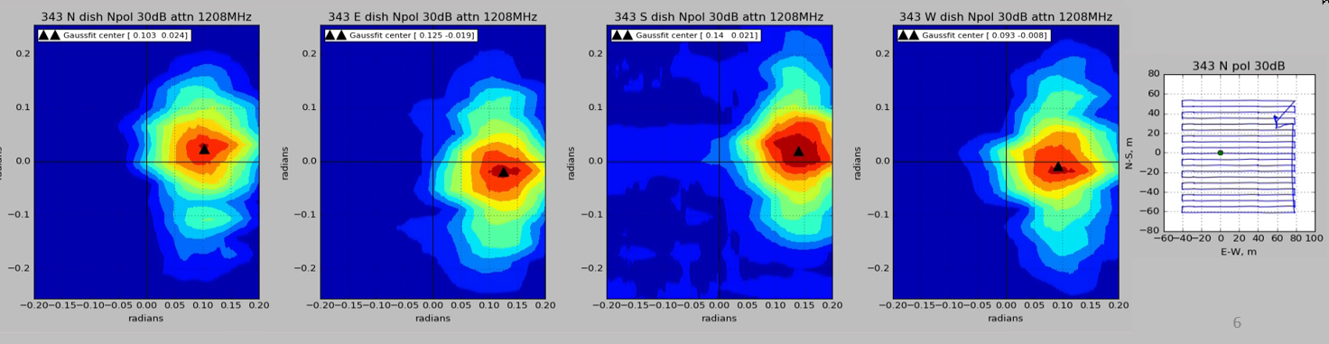
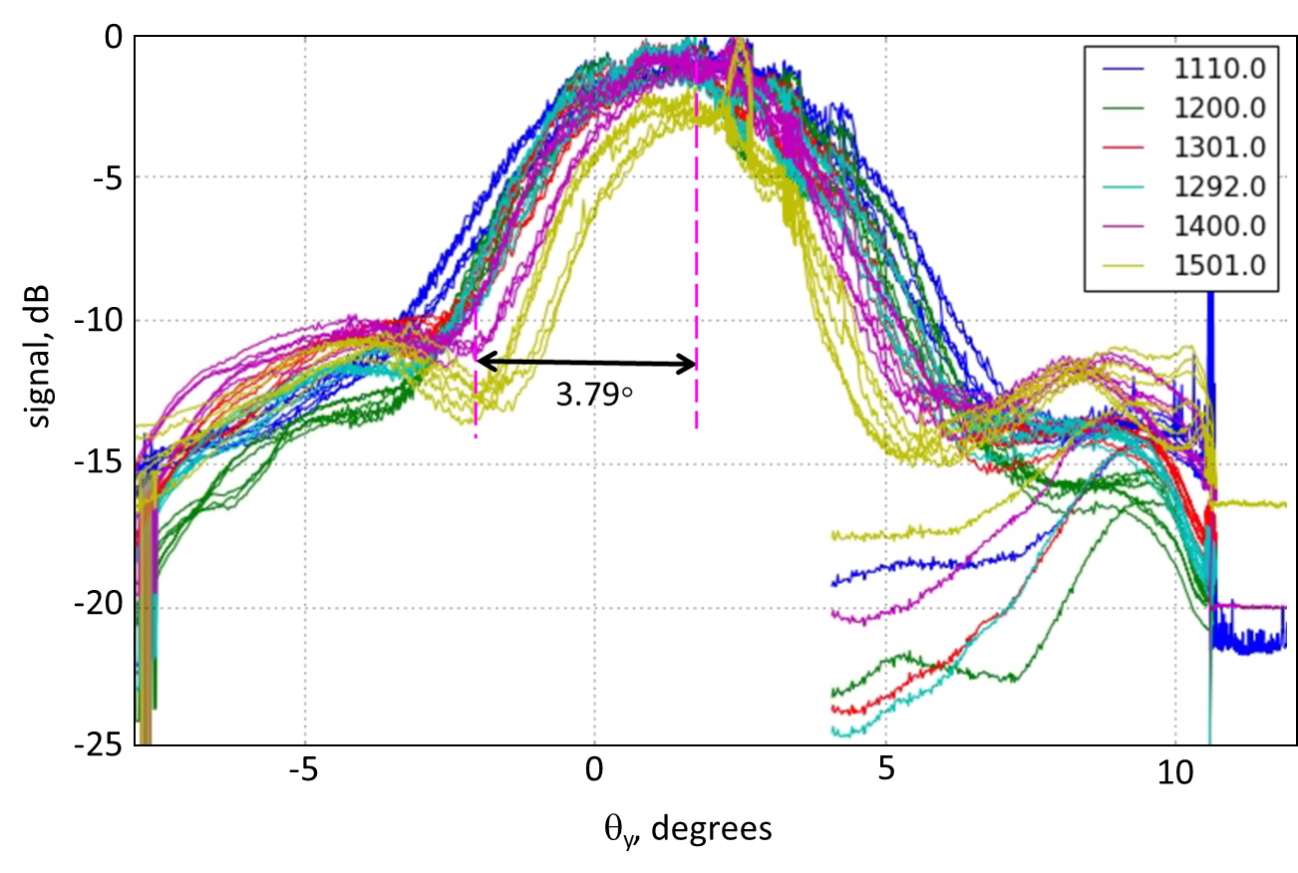
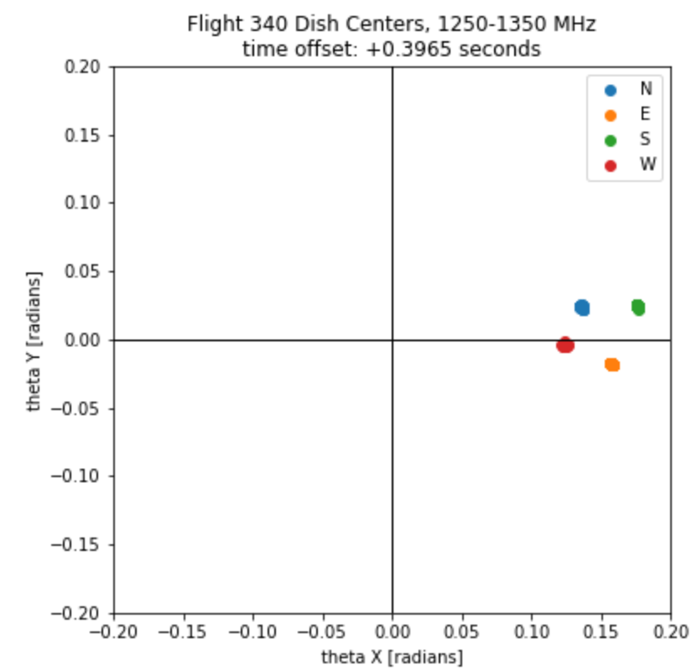

UAV calibrations
Angular response of the 4 dishes
Beam centers vs. frequency
Beam width vs. frequency
Analysis by G. Troiani

Slide 18


Cygnus A transit interference fringes
BMX DAQ records cross-correlations of each pair of dishes (baselines) across the full frequency band
Fringes with SNR ~200 are seen during transit of pointlike CygA source
For every baseline and polarization, fit observed fringes to 1-D model having parameters: amplitude, pointing offset from zenith, width of (composite) beam in Gaussian approximation, projected baseline length in E-W direction, and time delay between signal transmission paths. Position of CygA in horizon coordinates known to high precision.
Repeat fit for several frequency bins, avoiding regions likely to be contaminated by nearby GNSS passes.
Altitude of CygA
GNSS interference
E-W baseline b24
Fringes at 1105MHz
Data (blue), fit (red), envelope (green)
Fitted parameters

Slide 19








Fringes from transit of 17 April 2019
$${\vec{b}}_{12}$$
$${\vec{b}}_{13}$$
$${\vec{b}}_{14}$$
$${\vec{b}}_{23}$$
$${\vec{b}}_{24}$$
$${\vec{b}}_{34}$$
polarization Y
polarization X
polarization Y
polarization X

Slide 20


Interferometer results
Left: Pointing offsets from CygA visibility fitting. Upper: X-polarizations. Lower: Y-polarizations. Colors: (blue, orange, green, red, magenta, brown) = (N-E, N-S, N-W, E-S, E-W, S-W) dish pairs. Statistics for 81 days of observations in early 2020. Right: fitted baselines.

Slide 21
SUMMARY
21cm intensity mapping is a new, cost-efficient observational technique that is complementary to optical and CMB surveys.
It opens the largely unexplored redshift range 2.5 < z < 6 where beyond-ΛCDM physics can be studied - dynamic DE, modified GR, inflationary relic signatures.
Leverages industry advances (wireless, AI) and requires no specialized detector environments (cryo, radiation).
Research needs center on DAQ architectures (with 2030-era electronics), and on calibration methods, including sub-picosecond phase synchronization.
BMX can serve as an early pathfinder to a future large project such as PUMA
well-matched to HEP expertise and is synergistic with many emerging trends in EF and IF electronics.

Slide 22
Future plans
BMX “tune up”:
Improve self-RFI environment at BMX site
Align beams (adjust dish and horn positions)
EM Sims of beam shape
Improve joint fitting of multiple calibrators (drone, GNSS, CygA)
Replace digitizer + channelizer with RFSoC-based platform
GPS message decoding to improve accuracy of array layout
Acquire stable data for ~months
detect cosmic 21cm signal at 0 < z < 0.3 in cross-correlation with galaxy survey

Slide 23
BACKUP MATERIAL

Slide 24



Current/Upcoming OHEP-sponsored cosmic surveys
Dark Energy Survey (DES)
Dark Energy Spectroscopic Instrument (DESI)
Large Synoptic Survey Telescope (LSST)
?
Galaxy Imaging, broadband filters
504 Mpix CCD Focal Plane
Operations 2014 - 2019
Galaxy Spectra
5000 Fiber Focal Plane
Operations 2019- 2024
Galaxy Imaging, broadband filters
3.2 Gpix CCD Focal Plane
Operations 2023 - 2033
Power of a cosmic survey to measure cosmological parameters is limited by
redshift range and accuracy
sensitivity (number of sources)
scale
Improved statistics has to come from increasing survey speed and/or increasing sensitivity to fainter/redder sources, while preserving redshift accuracyr.

Slide 25




Obstacles to scaling optical surveys
Detector technology for IR
Atmospheric transparency in IR
Telescope cost scaling
z = 0
z = 3.5
Airglow
Let’s consider another wavelength range…

Slide 26


Key technological challenges
Since the cosmological 21cm signal is ~10⁴ weaker than astrophysical foregrounds, the major challenge for this method is foreground mitigation.
Interferometers couple bright foregrounds into spatial and frequency modes, making straightforward subtraction difficult.
The key to achieving clean foreground separation is calibrations:
Antenna element primary beam angular response vs. frequency
Gain and phase response of the signal chain vs. frequency
Accurate sky maps of (polarized) galactic and extraglactic sources
Precision timing distribution to ensure coherent recording of GHz signals arriving at thousands of stations separated by km
Power-efficient, real-time processing of network data streams approaching 1Pb/sec
Robust and mass-producible methods of dish and receiver manufacture

Slide 27

Instrument design: radio interferometer
One baseline (N_{dish} = 2)
Large b, small λ
Large D, small N
λ
D
50 μarcsec
EHT
b
NRAO
Interference fringes based on path length difference between 2 stations
Collecting area πD²N_{dish}/4
Angular resolution λ/b
Angular field of view λ/D

Slide 28

Instrument design: radio interferometer
One baseline (N_{dish} = 2)
Large b, small λ
Large D, small N
λ
D
50 μarcsec
EHT
b
Small b, large λ
Small D, large N
NRAO
Interference fringes based on path length difference between 2 stations
Collecting area πD²N_{dish}/4
Angular resolution λ/b
Angular field of view λ/D
CHIME

Slide 29




21cm intensity mapping experiments (0.8 < z < 2.6)
CHIME (Canada)
HIRAX (S. Africa)
TIANLAI (China)
PAON-4 (France)

Slide 30


Slide 31




PUMA Science
Expansion history
Growth of structure
ΛCDM
Mod. GR
Fast Radio Bursts (FRBs)
Primordial nonGaussianity
PUMA
arxiv:1810.09572
arxiv:1907.12559

Slide 32


Galaxy statistics and redshift range vs. optical galaxy surveys
Length of bar = redshift range
Area of bar = effective galaxy number
Speed of LSST, accuracy of DESI

Slide 33


Instrument design: radio interferometer (large-N)
Many baselines (N_{dish} = 5000/32000)
PUMA 32K
PUMA 5K
Every pair of stations provides a baseline
N_{baselines} = $Ndish(Ndish−1)/2$

Slide 34

Instrument design: radio interferometer (large-N)
Many baselines (N_{dish} = 5000/32000)
PUMA 32K
PUMA 5K
Every pair of stations provides a baseline
N_{baselines} = $Ndish(Ndish−1)/2$
Each baseline probes a corresponding spatial frequency

Slide 35


Instrument design: radio interferometer (polychromatic)
One baseline (N_{dish} = 2)
X
⟨ ⟩
AMP
ADC
FFT
λ₁
λ₂
X
⟨ ⟩
b
X
⟨ ⟩
AMP
ADC
FFT
X
⟨ ⟩
“F-engine”
NRAO
“X-engine”
Interference fringes based on path length difference between 2 stations
Collecting area πD²N_{dish}/4
Angular resolution λ/b
Angular field of view λ/D

Slide 36







Full array network
SWITCH
CORRELATOR
Artifact removal
Component selection
Mapmaking
25-50 Gbps
relative phase drift < 150fs
jitter < 600fs
PHASE/FREQ TRANSFER (active)
MASTER TIMING

Slide 37



Switch and X-engine details
Re-organize inputs, group by frequency channels
Send to X-engine
Perform all auto- and cross-correlations (realtime)
Average redundant baselines
Integrate results
freq. channels
D1
D2
D3
dishes
D4
D5
…
DN
To X-engine

Slide 38




Calibration challenges
Since the cosmological 21cm signal is ~10⁴ weaker than astrophysical foregrounds, the major challenge for this method is foreground mitigation.
Interferometers couple bright foregrounds into spatial and frequency modes, making straightforward subtraction difficult.
The key to achieving clean foreground separation is calibrations:
Antenna element primary beam angular response vs. frequency
Gain and phase response of the signal chain vs. frequency
Accurate sky maps of (polarized) galactic and extraglactic sources
Additional techniques are needed to cope with man-made RFI.
Antenna beam pattern (sim.)
Cygnus A E-W transit Fringe Fit
frequency →
W. Tyndall 2019

Slide 39



Front End Electronics Development
BMX RF analog chain
BMX RF analog chain
Measured noise temperature
400kHz channelized data from RFSoC digitizers operating at 3.1GS/s
Xilinx ZCU111 RFSoC FPGA digitizer/channelizer
400kHz channelized data from RFSoC digitizers operating at 3.1GS/s
Xilinx ZCU111 RFSoC FPGA digitizer/channelizer
Real-time FFT in firmware (unwindowed)
Real-time FFT in firmware (unwindowed)
Software FFT with Blackman window
Software FFT with Blackman window
39

Slide 40




Antenna directional response characterization
Beam calibration using UAV and/or satellite
Global navigation satellites
Drones!
fixed-wing (BMX)
quadcopter (Yale/OVRO)
~20 GNSS satellites transit within 10 degrees of BMX zenith each day (4 constellations)
L. Newburgh

Slide 41





Low-cost dish construction methods
BMX dish
Notional PUMA dish
Composite dish construction
2.5m
6m
15m
CHORD
HIRAX
SKA

Slide 42


By the numbers…
DATA
DOLLARS
 | PUMA-5K | PUMA-32K
Raw data rate | 240 | 1500 | Tbit/s
Real-time computation | 15 | 100 | PFLOP
Output data rate | 13 | 82 | GB/s
Data volume | 0.9 | 5.7 | PB/day
Power * | .23 | 1.5 | MW
*no ASIC
DEVELOPMENT TIMELINE

Slide 43

Summary
21cm intensity mapping is a new, cost-efficient observational technique that is complementary to optical and CMB surveys.
It opens the largely unexplored redshift range 2.5 < z < 6 where beyond-ΛCDM physics can be studied - dynamic DE, modified GR, inflationary relic signatures.
Leverages industry advances (wireless, AI) and requires no specialized detector environments (cryo, radiation).
Detector elements require exquisite control of spatial and frequency characteristics.
Research needs center on DAQ architectures (with 2030-era electronics), and on calibration methods.
The PUMA project is well-matched to HEP expertise and is synergistic with many emerging trends in EF and IF DAQ.
Opportunities exist for multi-agency and international partnering.
2005 cellphone
puma.bnl.gov

Slide 44
Thank you
puma.bnl.gov

