Slide 1
Introduction to CORE Workshop
”Kick-Off” Workshop for “COmpact detectoR for Eic” (CORE)
29-30 March 2021
Hosted by SBU Center for Frontiers in Nuclear Science
CHARLES E. HYDE*
Old Dominion University
*Support from
DOE DE-FG02-96ER40960
SBU-CFNS
BNL Generic Detector R&D
SURA/CNF

Slide 2
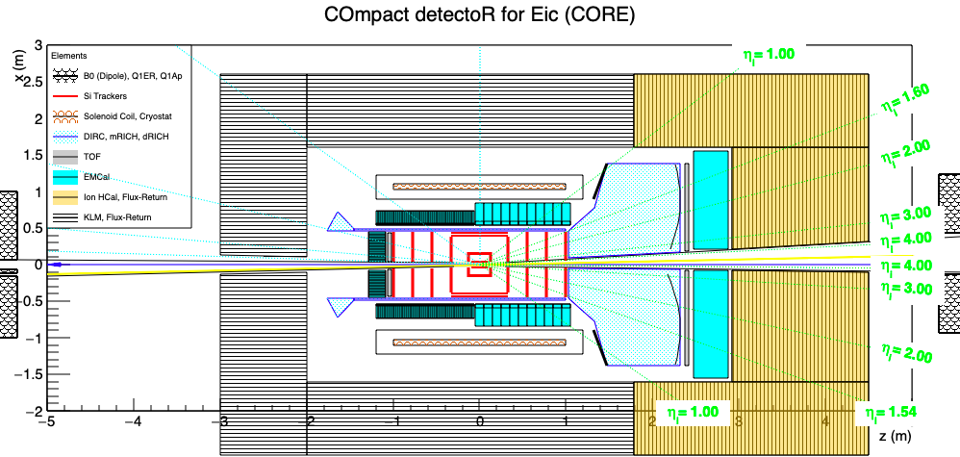
ORGANIZING Principles of CORE
All Si Tracker
Compact Solenoid
2𝜋 PbWO₄ EMCal
hpDIRC in Barrel
dual-RICH in Ion EndCap

Slide 3
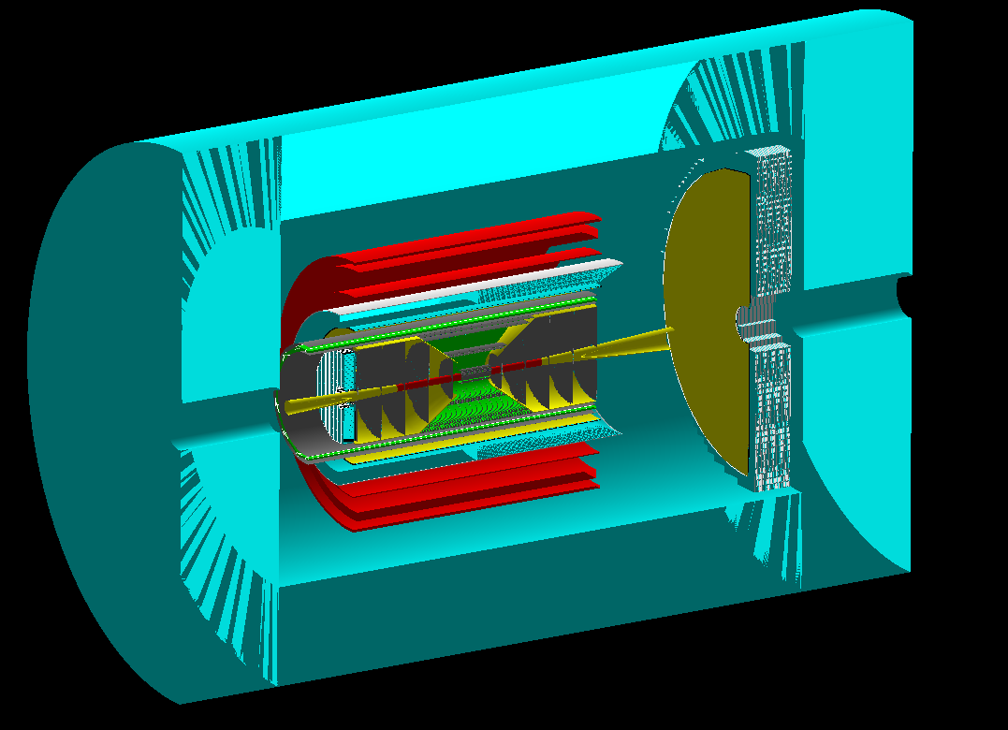
Additional Aspects of CORE
CORE in Fun4All (B. Smookler)
Ample space in forward Barrel and ion-Endcapfor EMCAL
Compact size
HCal & Muon detection as required by physics
Complete Roll-In, Roll-Out?
Move quads closer for higher luminosity?
Option for high field Solenoid

Slide 4
“Mid-Life” Upgrade Options (after first 5-10 years of operation)
DIRC
Photosensor timing beyond 100 ps rms could increase the momentum reach of the DIRC, even at day 1
Advances in low-noise SiPMs could enable DIRC operation in very high magnetic fields.
New Cherenkov metamaterials:
Compact PID with (n-1) = (4→20)•10^{–4}
V.Ginis PRL 113 (2014) 167402
Smaller pixel size Si Tracker upgrade

Slide 5
EIC Call for Collaboration Proposals for Detectors (https://www.bnl.gov/eic/CFC.php)
Detector 1 is within the scope of the EIC project and should be based on the … Yellow Report (YR) and THE Conceptual Design Report (CDR)…. It is currently planned to be located at Interaction Point 6 (IP6) on the Relativistic Heavy-Ion Collider.
Detector 2 could be a complementary detector… would reside at a different Interaction Point from Detector 1. … is currently not within the EIC project scope. Routes to make Detector 2 and a second interaction region possible are being explored.
The Proposals should include two parts:
A description of the science addressed and performance estimated through simulation … the R&D needs, risks, and, if applicable, adoption of emerging new technologies.
A collaboration roster and structure, timescale and cost (including potential sources of funding sources and assumptions), and potential upgrade paths.

Slide 6
Building a Collaboration
All are welcome
Today is just a “Coming-out-Party”
We will soon ask for people to officially declare interest
Participation in CORE does not exclude participation in any other detector proposal
One major decision we need to make soon:
Is this a Detector-1 Proposal (Included in Project Budget)?
Is this a Detector-2 Proposal (Not included in Project Budget)?

Slide 7
Possible Collaboration Structure
Contact Person(s)
Proposal Editorial Board
Budget/ Personnel
Board
Membership
Detector Design Coordinator
Simulations Coordinator
Institutional Board
Subsystem | Coordinator
Tracker
DIRC
PbWO4
dRICH
Forward HCAL
…
Process | Lead
Exclusive
JETS
SIDIS
Tagging
Nomination Committee
Charter Committee

Slide 8
CORE Collaboration Timeline
JULY 2021
Technical Performance eval.
Draft of SUB-SYSTEM Text
INITIAL COSTING
AUGUST 2021
FULL SIMULATIONS
Collaboration structure def’n
SEPTEMBER 2021
Finalize COSTING
Define TDR Roles / REsponsibilities
Rough Draft of Full Proposal
OCtober-November 2021
Finalize Proposal
April 2021
Initial Membership, Charter
CoordinatorS
May 2021
CHARTER Ratification
Elections (as per CHARTER)
Sub-System Top-Level Decisions
Simulation strategy/ Framework
JUNE 2021
Final Design Decisions
Initial Simulations

