Slide 1
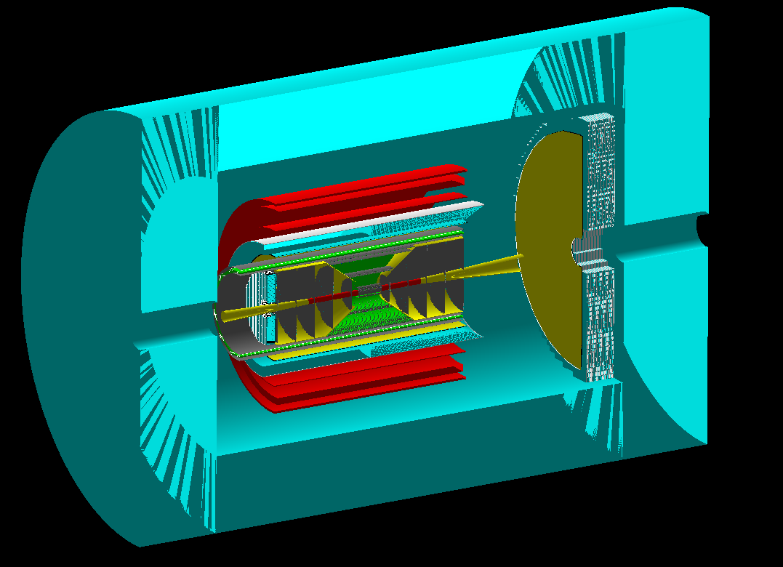
CORE: a COmpact detectoR for the EIC
Pawel Nadel-Turonski
Stony Brook University
CFNS CORE workshop, March 29-30, 2021

Slide 2
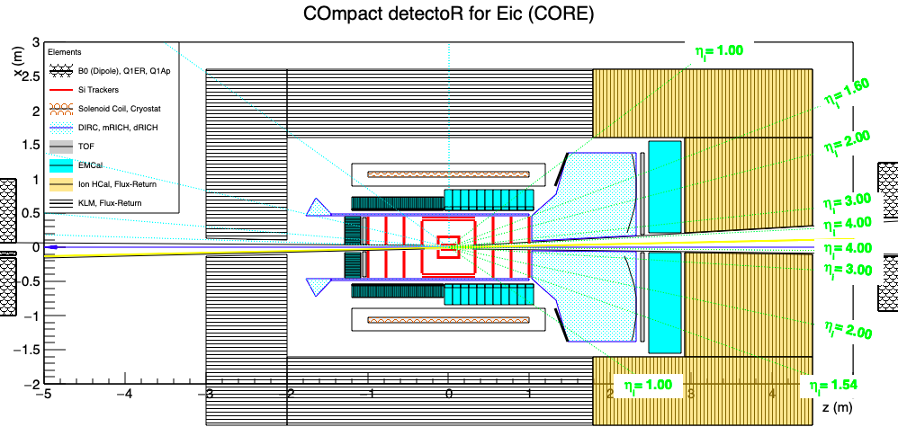
a COmpact detectoR for the Eic (CORE)
CORE in Geant (fun4all)
B. Schmookler
A (nearly) hermetic general-purpose detector that fulfills the EIC physics requirements
A small size, in particular of the inner systems, is cost-effective and allows:
An overall reduction in cost without performance loss
Improved performance in critical areas without large additional cost
Risk is minimized by utilizing subsystems from the Generic EIC R&D program
Balance can be different in a Detector 1 or 2 proposal

Slide 3
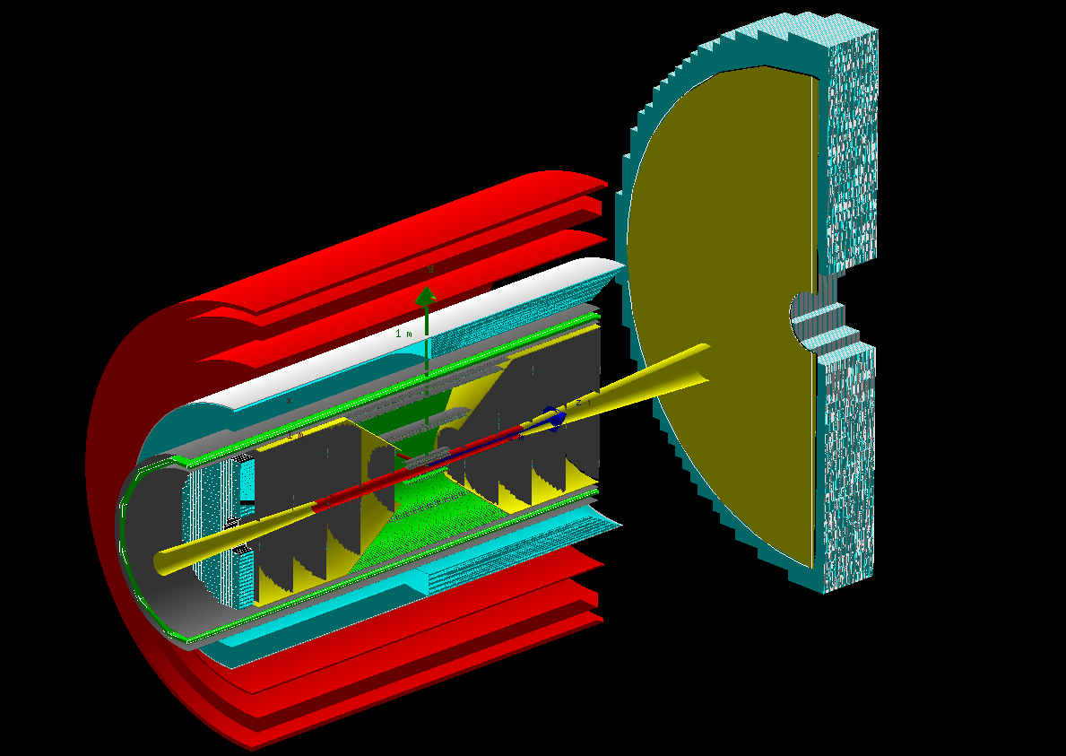
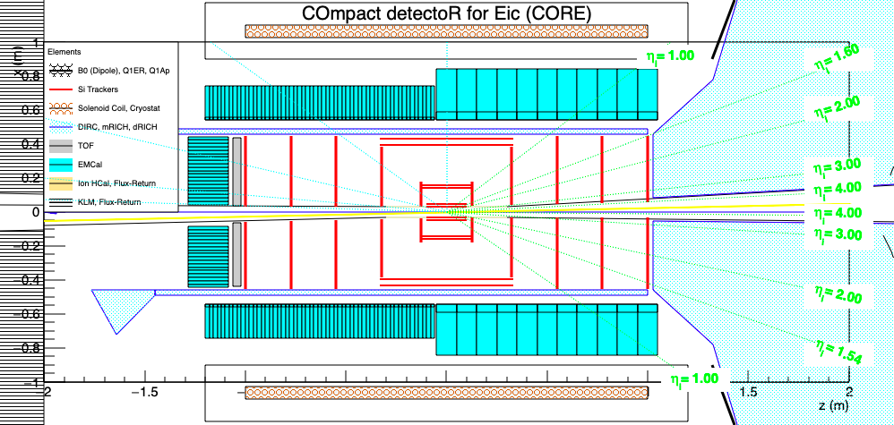
The core of CORE
inner CORE in Geant (fun4all)
dRICH photosensors
B. Schmookler
Small solenoid (2.5 m long, 0.9 m inner radius)
could be new, but compatible with ZEUS
Small central all-Si tracker (eRD25)
Radially compact, high-performance barrel DIRC Cherenkov (eRD14)
Dual-radiator RICH with outward-reflecting mirrors in the hadron endcap (eRD14)
Extended PWO₄ EMcal coverage (up to 2π, η < 0) on the electron side (eRD1)

Slide 4
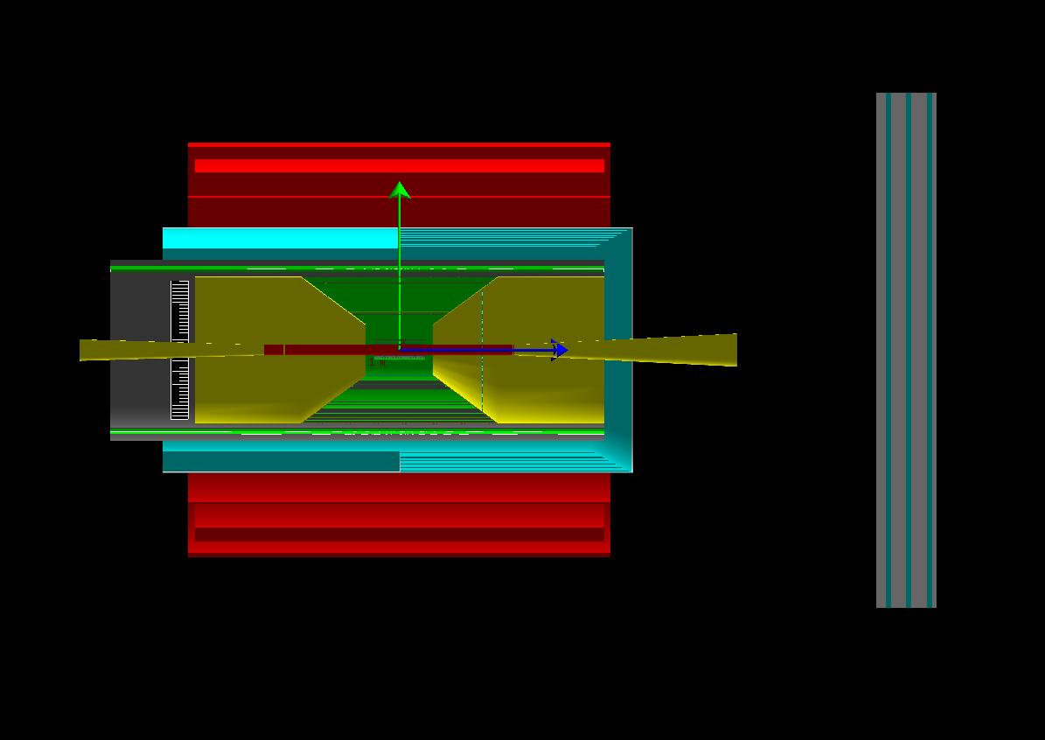
Solenoid options
The CORE solenoid is 2.5 m long with a 0.9 m inner radius
CORE is compatible with any field in the 2-4 T range
4 T is affordable due to the small volume of CORE
Can be operated at 2 T (better acceptance, hID)
2 T is the current low-cost, low-risk baseline option
Ultimately the choice of field will be a collaboration decision
B. Schmookler
cost (2020 M$) = 1.8 x 0.458 x (stored energy)^{0.7}
M. A. Green and S. J. St. Lorant, Adv. Cryo. Eng. 39
The CORE and ZEUS solenoids have similar dimensions, and the latter could be used for CORE.
However, the low cost of a new 2 T solenoid limits the benefits of re-use.
solenoid | field (T) | volume (m³) | 2020 cost (M$) | with 50% contingency
EIC-IP6 | 3 | 29 | 21 | 32
CORE | 4 | 6.4 | 11 | 16
CORE | 3 | 6.4 | 7 | 11
CORE | 2 | 6.4 | 4 | 6

Slide 5
Central Si-tracker
--> talk by E. Sichtermann
A silicon tracker is compact, has a high resolution, and offers opportunities for future upgrades.
The tracker developed by eRD25 would utilize ALICE ITS3 technology and is designed for the angular resolution requirements of the DIRC, making it a good choice for CORE
B. Schmookler
GEM layer (eRD6)
 | ITS2/ALPIDE | ITS3
technology | 180 nm | 65 nm
pixel-size | 27 x 29 μm | 10 x 10 μm
thickness | 50 μm | 20-40 μm
Note: modern microprocessors use 7 nm technology. The (unfair) comparison shows an opportunity for future improvements.
eRD25 tracker

Slide 6
CORE in the context of the Yellow Report
CORE systems are all designed to provide a cost or performance advantage, or be complementary to the YR reference detector
YR table 10.6 requirement matrix
A small DIRC, for instance, provides the same performance as a large one, but is cheaper.
The small size makes CORE particularly suited for improving performance in two key areas: (e-side) electron ID and (h-side) hadronic calorimetry
highlighted in the YR “matrix”
CORE also seeks complementarity with the reference detector by improving muon identification, which would be useful for, e.g., charmonium production and GPD studies using timelike processes.

Slide 7
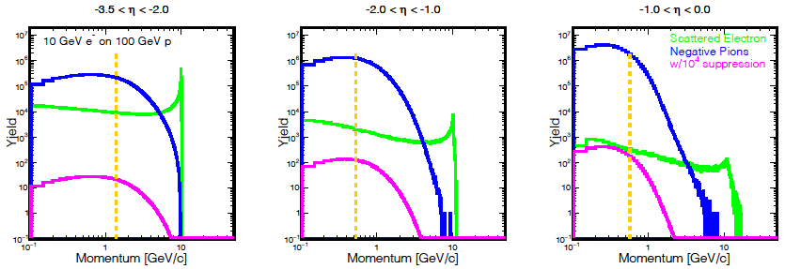
e/𝜋 identification in the electron hemisphere
η = -ln(tan(θ/2))
B. Schmookler
Q² > 1 &
y < 0.95
to the right of orange line
For the EIC, a clean identification of the scattered electron is essential.
The YR requirement matrix lists a pion suppression of up to 1:10⁻⁴ for the e-endcap and barrel.
Since the relative pion background rises at larger (less negative) η, the barrel region poses the greatest challenge and requires the best electron ID.
However, in the reference detector the best EMcal (PWO₄) only covers the inner endcap (η < -2).

Slide 8
CORE solution for e/𝜋 identification in the electron hemisphere
B. Schmookler
Q² > 1 &
y < 0.95
to the right of orange line
CORE addresses the eID issue by extending the PWO₄ EMcal coverage up to η < 0.
Additional e/π suppression (at least 1:10 up to 1.2 GeV) is also provided by the DIRC
The result is a barrel eID configuration that can provide good pion suppression with a high electron efficiency (potentially enabling measurement of A_{PV}).
A better energy resolution also improves photon detection in the electron hemisphere.

Slide 9
4𝜋 EMcal
The PANDA PWO₄ EMcal covers the endcap and barrel (outside of a DIRC)
up to 2π (η < 0) PWO₄ coverage
--> talk by C. Munoz Camacho
The small size of CORE makes it affordable to extend the PWO₄ coverage up to 2π.
The PWO₄ area will be half or less of that planned for PANDA, which is similar in size to CORE
An additional small-angle EMcal can be placed behind the main detector endcap
η > 0 coverage (several options – including pre-showers for γ/π⁰)
--> talk by C. Woody
The η > 0 barrel EMcal should be relatively compact and projective
The endcap EMcal needs to be affordable and work well with a high-resolution Hcal

Slide 10
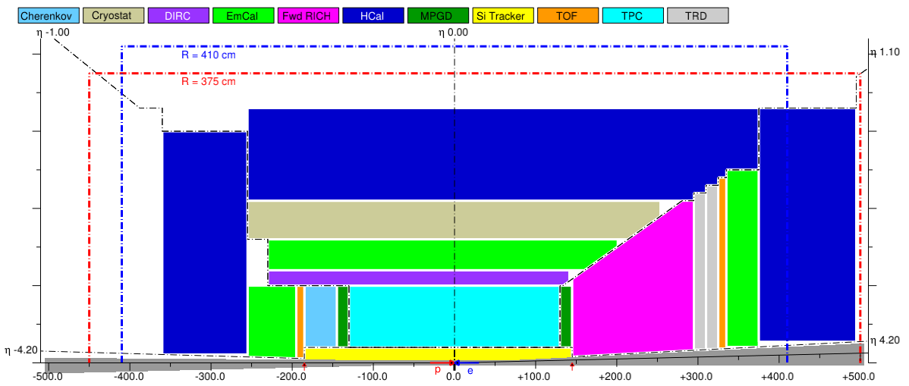
CORE 2π PWO₄ EMcal superimposed on the YR reference detector
The CORE barrel EMcal is shown in red/white
The much larger barrel EMcal for the reference is shown in green.

Slide 11
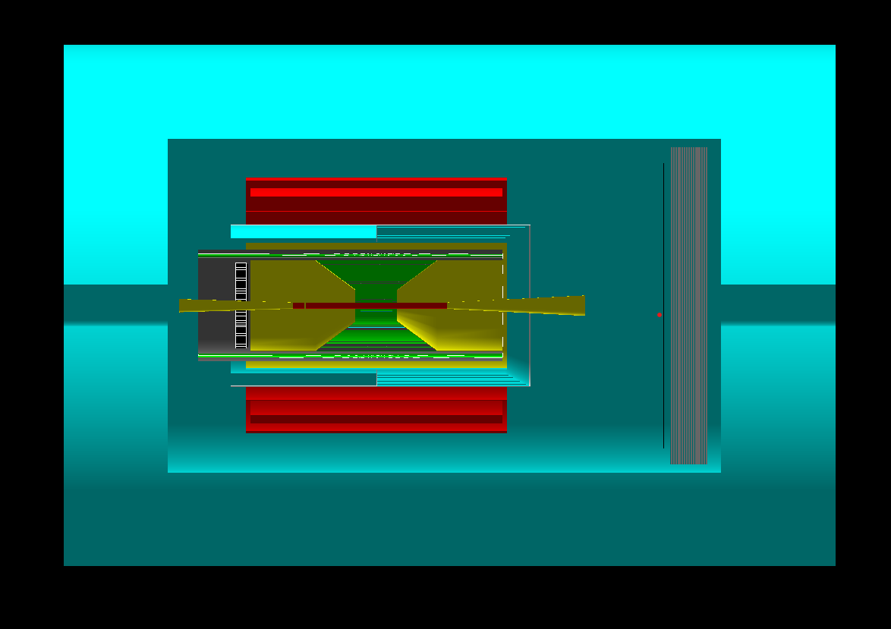
YR table 10.6 requirement matrix
Hadronic calorimetry
--> talk by O. Tsai
The inner part of CORE is independent of the Hcal configuration.
.
But the smaller size of CORE makes a high-resolution Hcal in the hadron endcap (η > 2) a particularly interesting option.
This would have a significant impact on measurements of jets where the energies are highest and tracking is least efficient
In the barrel and electron endcap, jet energies are lower and jets are best reconstructed from individual tracks (tracking, PID, EMcal).
Here, the Hcal is mainly used for individual low-momentum neutral hadrons (mostly K_{L}). Resolution has a more limited impact.

Slide 12
Muon ID
The Belle II K_{L}-μ (KLM) system
At the EIC, mid-rapidity muons have relatively low momenta, and it is important to minimize multiple scattering (placing a muon detector behind an Hcal is not feasible).
Since jets are best reconstructed from individual tracks, one approach is to trade energy resolution for better muon and neutral hadron (K_{L}) ID, and lower cost (cf. Belle II KLM)
--> talk by W. Jacobs
One can also try to enhance the muon ID capability of a more conventional barrel Hcal, or improve the energy resolution of a KLM-inspired system
--> talk by O. Tsai

Slide 13
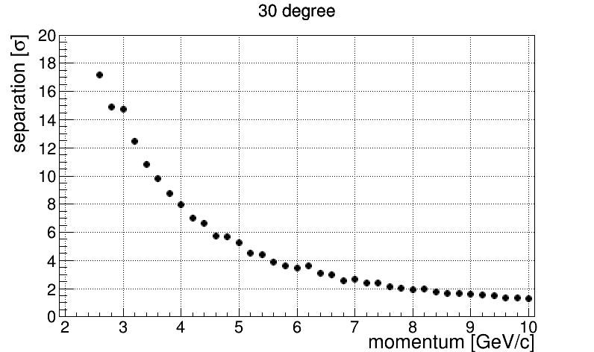
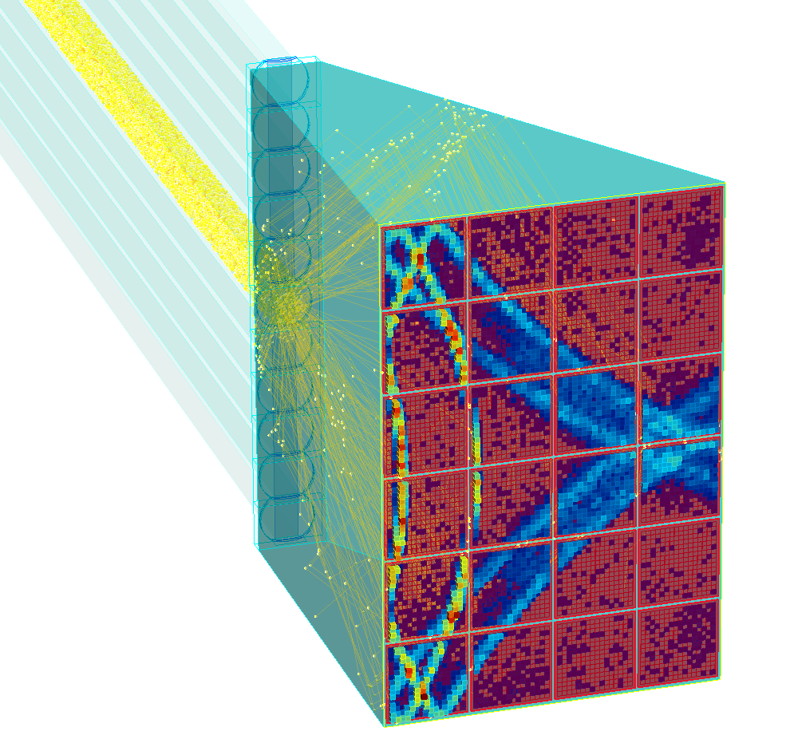
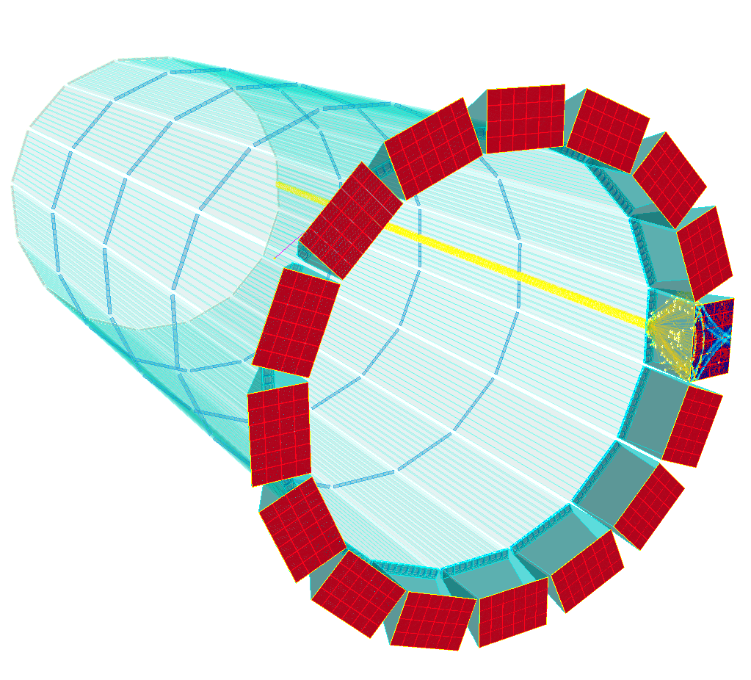
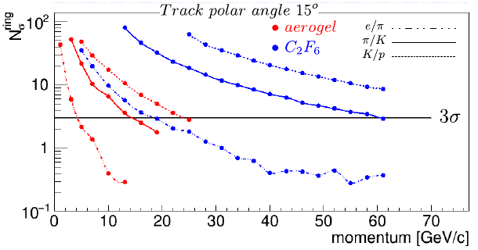
Hadron Identification in the barrel (hpDIRC) and hadron endcap (dRICH)
--> talk by G. Kalicy
The hpDIRC has a π/K separation of >4σ up to 6 GeV (and 2σ at 8 GeV).
The minimum momentum for π/K ID in threshold mode is 0.2 GeV
Using aerogel and gas radiators with a single set of photosensors the dRICH provides continuous π/K separation of >3σ up to 60 GeV and an excellent e/π separation (no TRD needed).
e/π: 10σ at 10 GeV
--> talk by E. Cisbani, M. Contalbrigo

Slide 14
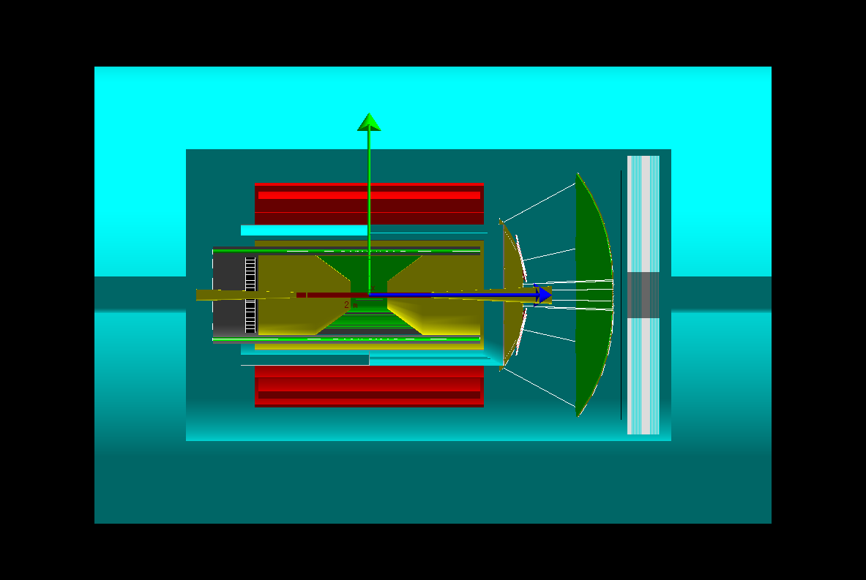
TOF in the hadron endcap
CORE with a dual-radiator RICH (eRD14)
CORE with a gas-only RICH (eRD6) and LGAD-based TOF behind it
The dual-radiator RICH (dRICH) is a cost-effective solution with continuous coverage over a wide momentum range, but a simple TOF system could provide PID for the lowest momenta below the aerogel thresholds.
However, pending the implementation of the dRICH in fun4all, Geant simulations can start using a gas-only RICH in combination with high-resolution LGAD TOF, which is already implemented

Slide 15
Hadron Identification in the electron endcap
--> talk by G. Giacomini
While high-resolution TOF is not competitive with Cherenkov detectors in the central barrel (small radius), it could be a good solution for the electron endcap.
t₀ can be obtained using an electron scattered into the endcap and/or a separate ”start” layer integrated with the Si-tracker.
A Si timing “start” layer (eRD29) could be added in-between disks
The TOF installation is modest and resolution could improve through future upgrades.
High-resolution TOF using LGADs or LAPPDs (which work up to 2 T)
Alternatively, CORE could also support an aerogel RICH (e.g., the mRICH) by extending the endcap by 30 cm, for which there is plenty of space - although this would also extend the length of the PWO₄ EMcal.
Complementarity?

Slide 16
Future upgrades – a few examples
Rapidly evolving technologies create natural upgrade paths
Photosensors, Si-timing, S-tracking, optical meta materials, etc.
Advances in photosensor timing beyond 100 ps rms can in the shorter term increase the momentum reach of the DIRC; SiPMs could provide tolerance to very high magnetic fields.
The next generation of Si-trackers could improve position (momentum) resolution, readout speed, and further reduce mass.
At the time of an EIC mid-life upgrade, optical metamaterials might be available for use as Cherenkov radiator, greatly improving momentum reach for compact PID systems.
Pioneering studies at SBU as part of eRD6

Slide 17
Thank you!

Slide 18
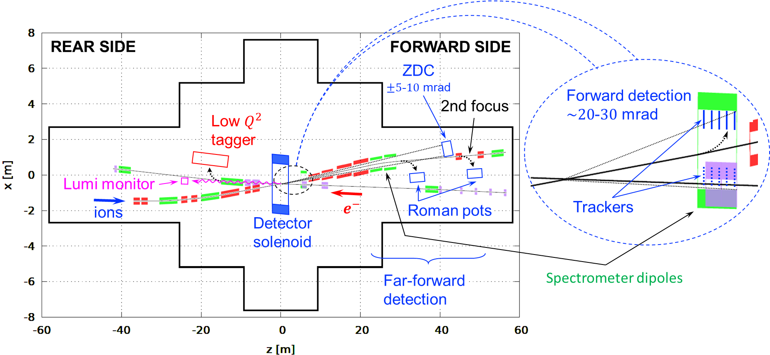
IR integration
Despite its compact size, CORE has a lot of room available for supports and services
In its nominal configuration, CORE fits into a -3 m to +4.5 m IR space.

Slide 19
YR requirement matrix
YR table 10.6

Slide 20
YR detector subsystem matrix
YR table 11.50

