Slide 1
EIC Project & Two Detector Scenario
Jim Yeck, EIC Project Director
CORE Workshop
March 30, 2021

Slide 2

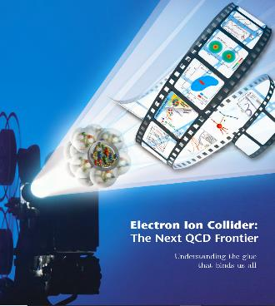
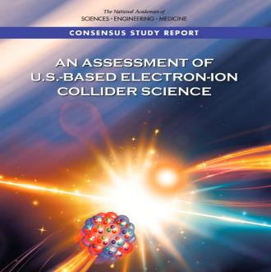
Project Requirements
Project Design Goals
High Luminosity: L= 10³³ – 10³⁴cm⁻²sec⁻¹, 10 – 100 fb⁻¹/year
Highly Polarized Beams: ~70%
Large Center of Mass Energy Range: E_{cm} = 20 – 140 GeV
Large Ion Species Range: protons – Uranium
Large Detector Acceptance and
Good Background Conditions
Accommodate a Second Interaction Region (IR)
Conceptual design scope and expected performance meets or exceed NSAC Long Range Plan (2015) and the EIC White Paper requirements endorsed by NAS (2018)

Slide 3
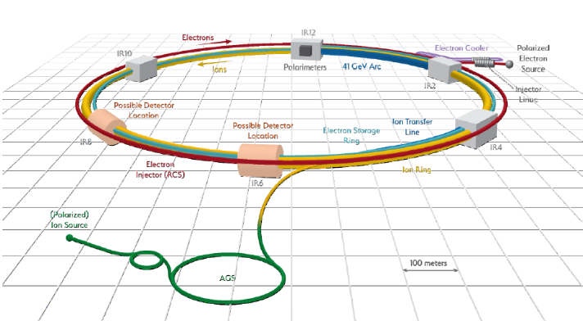
EIC Machine Parameters
Double Ring Design Based on Existing RHIC Facilities
Hadron Storage Ring: 40 - 275 GeV |  | Electron Storage Ring: 2.5 - 18 GeV
RHIC Yellow Ring and Injector Complex |  | Many Bunches, Large Beam Current - 2.5 A
Many Bunches, 1160 @ 1A Beam Current |  | 9 MW Synchrotron Radiation
Bright Beam Emittance ε_{xp}= 9 nm |  | Superconducting RF Cavities , 10MW Power
Flat Beam, Requires Strong Cooling
High Luminosity Interaction Region(s) |  | Electron Rapid Cycling Synchrotron
25 mrad Crossing Angle with Crab Cavities |  | Spin Transparent Due to High Periodicity

Slide 4
EIC Recent History
Event | Date
DOE Mission Need Statement Approved | January 22, 2019
DOE Independent Cost Review | July 2019
DOE Electron Ion Collider Site Assessment | October 2019
Critical Decision – 0 (CD-0) Approved | December 19, 2019
DOE Site Selection Announced | January 9, 2020
BNL TJNAF Partnership Agreement | May 7, 2020
DOE Office of Science Status Review | September 9-11, 2020
Independent EIC Conceptual Design Review | November 16-18, 2020
DOE Office of Science CD-1 Review | January 26-29, 2021
DOE Independent Cost Review | January - February 2021
CD-1 Approval Target Date | April/May 2021

Slide 5
Project Organization
BNL/TJNAF Partnership
  BNL and TJNAF partnering agreement signed in May 2020.
  Executive Management Team established that integrates BNL and TJNAF into project leadership roles.
  EIC Council, chaired by BNL Director, established in June 2020. TJNAF Director is a founding member. Major international partners will also join the Council.
Established standing advisory committees with international membership
  Machine Advisory Committee: 08/26/20, TBD
  Project Advisory Committee: 08/27/20, 12/01/20, 04/29/21
  Detector Advisory Committee: 09/28-29/20, 12/18/20, 03/24-26/21

Slide 6
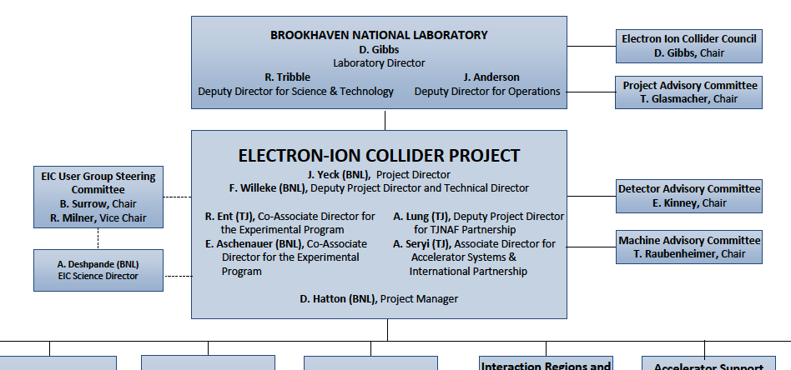
Project Organization

Slide 8
EIC Partnership Plans
Bi-lateral meetings with potential partners are underway to discuss opportunities in the accelerator and experimental areas.
Accelerator Partnership Activities (~5-10% In-kind)
  In-kind contributions to accelerator design and hardware expected
  Workshop hosted by UK Cockcroft Institute in October 2020 Promoting Collaboration on the Electron-Ion Collider
Detector Partnership Activities (Project Detector ~30% In-kind)
  Expressions of Interest submitted in November 2020
  Call for proposals for detectors issued in March 2021
Regular meetings among the international funding agencies organized by DOE Office of Nuclear Physics.
New York State is a partner in the EIC infrastructure ($100M).

Slide 9
Experimental Program Preparation
Yellow Report and EIC Conceptual Design Report are both available and include the reference detector concept.
BNL and TJNAF Jointly Leading Process to Select Project Detector | BNL and TJNAF Jointly Leading Process to Select Project Detector
2020 | Call for Expressions of Interest (EOI) | May 2020
 | EOI Responses Submitted | November 2020
 | Assessment of EOI Responses | On-going
2021 | Call for Collaboration Proposals for Detectors | March 2021
 | BNL/TJNAF Proposal Evaluation Committee | Spring 2021
 | Collaboration Proposals for Detectors Submitted | December 2021
✔️ | Decision on Project Detector | March 2022

Slide 10
CD-1 Reviews
CD-1 Preparation Reviews
  Independent Design Review – November 2020 ✔️
  Director’s Review – December 2020 ✔️
DOE CD-1 Reviews
  DOE Office of Science, Office of Project Assessment
  CD-1 Readiness Review – January 26-29, 2021 ✔️
  DOE Office of Project Management Independent Cost Review – Jan/Feb 2021 ✔️
DOE reviews recommend proceeding with CD-1!

Slide 11
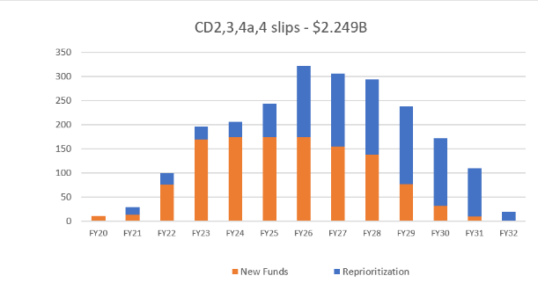
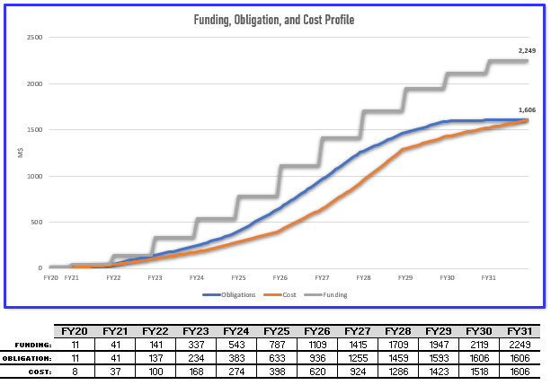
CD-1 Plan Revised – Ref. Profile v2
DOE TPC $2,249M
Proposed DOE PMB $1,606M
Contingency $643M (40%)
Revised Milestones
  CD-2 January 2023
  CD-3 March 2024
  CD-4a Early Finish Jul 2030
  CD-4a Jul 2031
  CD-4 EF Jul 2031 (no change)
  CD-4 Jul 2033 (24-month schedule contingency)
Notes
  Funding profile consistent with financial obligation plans
  Revised timeline for Critical Decisions
  Reasonable schedule and cost contingencies

Slide 12
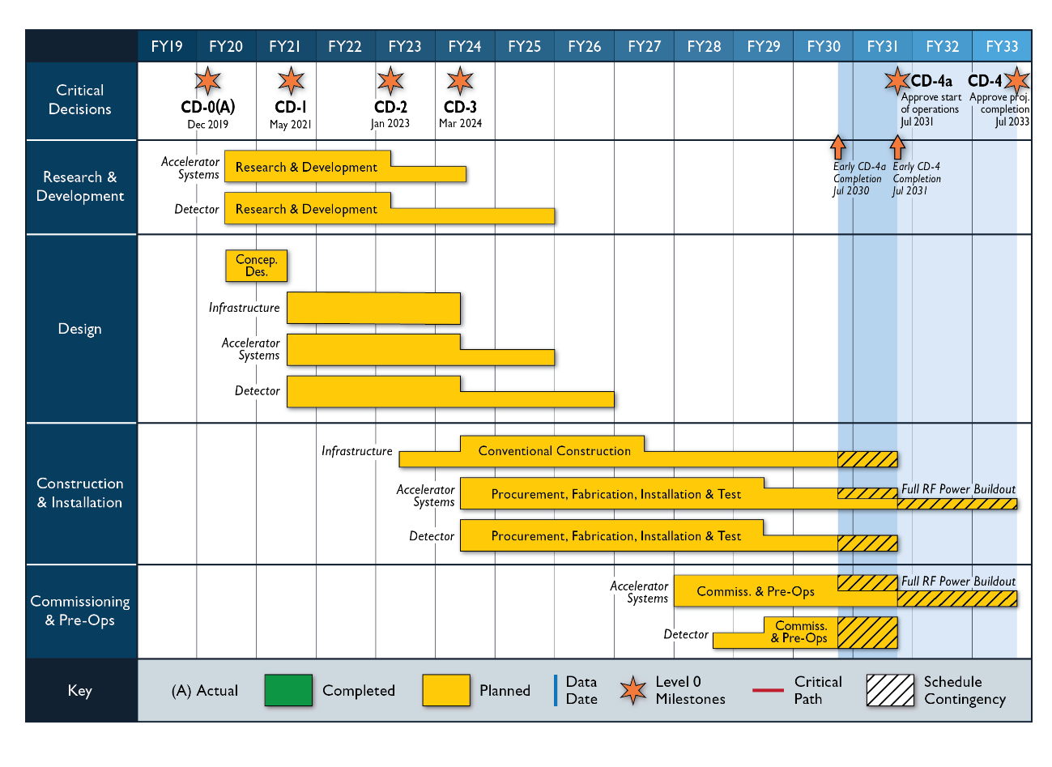

Slide 13
Key Milestones
DOE Critical Decision (CD) | CD-1 Review (2020) | Change (Months) | Proposed (03/21)
CD-1, Alternative Analysis | April 2021 | +1 | May 2021
CD-2, Performance Baseline | October 2022 | +3 | January 2023
CD-3, Construction Start | July 2023 | +8 | March 2024
 |  | Construction Start to Early Ops = 6 ¼ Years | Construction Start to Early Start of Ops = 6 ¼ Years
Early Start of Operations (CD-4a) | July 2029 | +12 | July 2030
Late Start of Operations (CD-4a) | January 2031 | +6 | July 2031
CD-4 Early Project Completion | July 2031 | = | July 2031
 |  | Schedule Contingency = 2 Years | 2 Years Schedule Float
CD-4 Late Project Completion | January 2033 | +6 | July 2033
Revised funding profile including actual FY2021 ($30M vs $43M)
DOE Total Project Cost with 40% contingency
Additional year of schedule contingency on project completion

Slide 14
Post CD-1 Timeline
Accelerator Technical Reviews | Spring/Summer 2021
Call for Detector Proposals | March 2021
Start Preliminary Design | April 2021
Detector Proposals Submitted | December 2021
Selection of Project Detector | March 2022
Start Earned Value Tracking | Summer 2022
Clarify In-kind Deliverables - Agreements | Summer/Fall 2022
Goal for CD-2 Approval | January 2023
Goal for CD-3 Approval | March 2024

Slide 15
Two Detector (Two IR) Scenario
EIC with two interaction regions and detectors
  Ensures a robust EIC physics program and enhances the science reach.
Detector concepts needed now
  Informs strategies towards achieving two detectors and IRs
  Influences project decisions
  EIC project schedule is an important planning constraint
Major effort needed to secure resources (~$500M)
  Possibly a DOE Major Item of Equipment (MIE) project
  Significant international engagement will be required

Slide 16
EIC Challenges and Opportunities
Affordability – EIC is very large project for DOE Office of Nuclear Physics (NP) and Office of Science (SC)
  Requires reprioritization of RHIC funding and new funding
  Significant ramp up of project funding required to maintain schedule
  Most cost-effective project follows a technically driven schedule
Partner Engagement – Expectations and Implementation
  International engagement is highly desirable and expected
  In-kind contributions to the accelerator and detector are being pursued
  Partners must engage now given the technically driven schedule
  Collaboration proposals should include in-kind contribution plans

Slide 17
Summary
Excellent progress in 2020 - congratulations on the Yellow Report and Conceptual Design Report!
Ready for CD-1, DOE approval expected in May 2021.
CD-2 preparations underway and approval milestone in less than two years, January 2023.
DOE and the EIC project promoting international collaboration and partnership in the EIC and exploring possibilities for in-kind contributions.
Response to the Call for Collaboration Proposals for Detectors at the EIC is critical to CD-2 and project success.

Slide 19
Electron-Ion Collider Overview & Machine-Detector Interface Considerations
EIC Calorimeter Workshop
March 15 2021
F. Willeke, BNL
EIC Technical Director
EIC Deputy Director

Slide 20
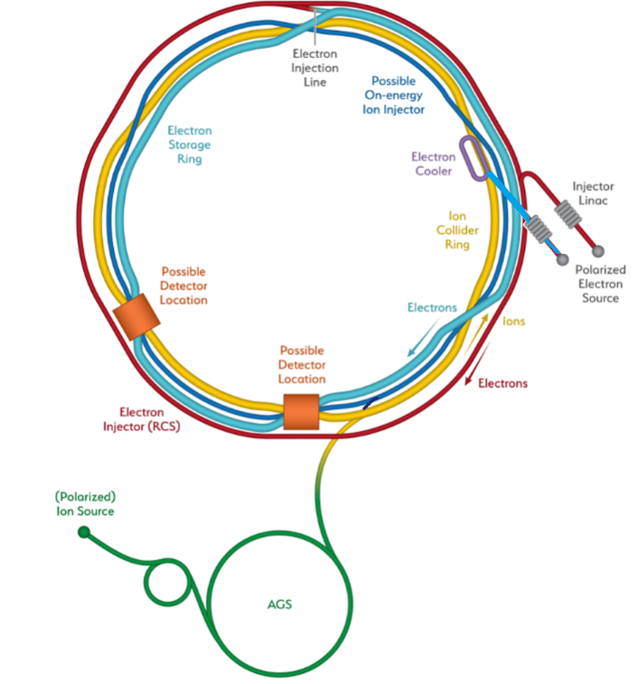
Overview
Requirements
EIC Accelerator Design
IR overview
IR magnets
IR set up for low E_{cm}
2 IR’s
IR 8
Summary

Slide 21



Requirements
EIC Design Goals
High Luminosity: L=(0.1-1)∙10³⁴cm⁻²sec⁻¹, (need 10 -100 fb⁻¹)
Collisions of highly polarized e and p ( and light ion) beams with flexible spin patterns of bunch structure: 70%
Large range of center of mass energies: E_{cm} = (20-140) GeV
Large range of Ion Species: protons – Uranium
Possibility to accommodate a 2nd detector and IR
Large detector acceptance
Good background conditions (hadron particle loss and synchrotron radiation in the IR)
These goals match or exceed the requirements of the Long-Range Plan for Nuclear Science and the EIC White Paper, endorsed by the National Academy of Science
EIC Design meets or exceeds goals and requirements

Slide 22
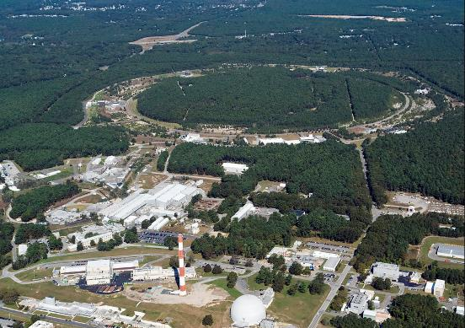

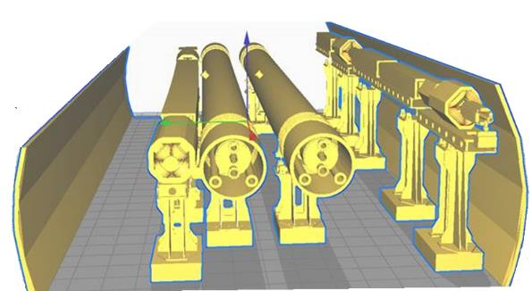
EIC Collider Concept
RHIC
Design based on existing RHIC,
RHIC is well maintained, operating at its peak
Hadron storage ring 40-275 GeV (existing)
  RHIC Yellow Ring
  many bunches, 1160 @ 1A beam current
  bright beam emittance ε_{xp}= 9 nm, flat beam
  need strong cooling
Electron storage ring (2.5–18 GeV, new)
  many bunches,
  large beam current (2.5 A) ➔10 MW S.R. power
  s.c. RF cavities
  Energy independent radiation damping
Electron rapid cycling synchrotron (new)
  1-2 Hz
  Spin transparent due to high periodicity
High luminosity interaction region(s) (new)
  L = 10³⁴cm⁻²s⁻¹
  Superconducting magnets
  25 mrad Crossing angle with crab cavities
  Spin Rotators (longitudinal spin)
  Forward hadron instrumentation
EIC
RCS
ESR RHIC

Slide 23
High Luminosity Concept
Highest luminosity in the center of mass energy (E_{cm}) range of the EIC requires strong hadron cooling
Strong hadron cooling for hadron energies up to 275 GeV is very challenging and requires new techniques and demanding technologies
➔ Maximize Luminosity while keeping hadron cooling requirements modest
Implies:
  Maximize total e, p currents: 2.5 A e @10 MW RF; 1A p (3 x RHIC)
  Chose maximum bunch population compatible with collective effect N_{e} = 1.7 x 10¹¹ e
  Number of bunches minimized N_{b} = 1160
  Luminosity maximized with maximum (p) beam emittance ε_{px}= 9.5 nm,1.5 nm
  Minimum strong hadron cooling requirement τ_{cool} = 2-3 h
  25 mrad Crossing Angle
Modestly strong focusing, Small β*_{y} = 5 cm
  Manageable dynamic aperture issues (+/- 15 σ_{x}, 10 σ_{e})

Slide 24
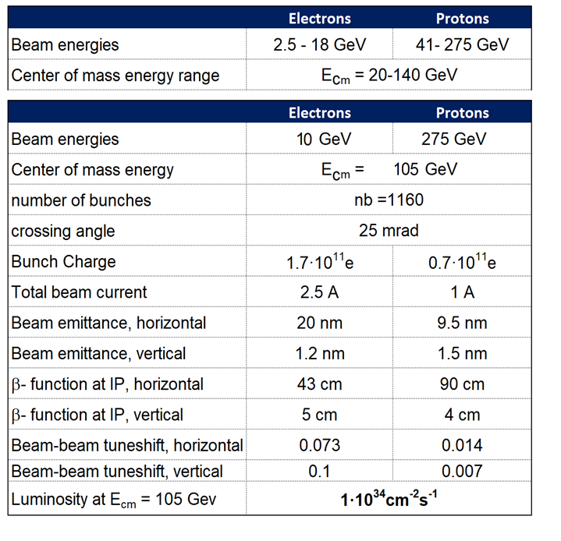
EIC CDR Parameters for E_{cm} and Luminosity

Slide 25
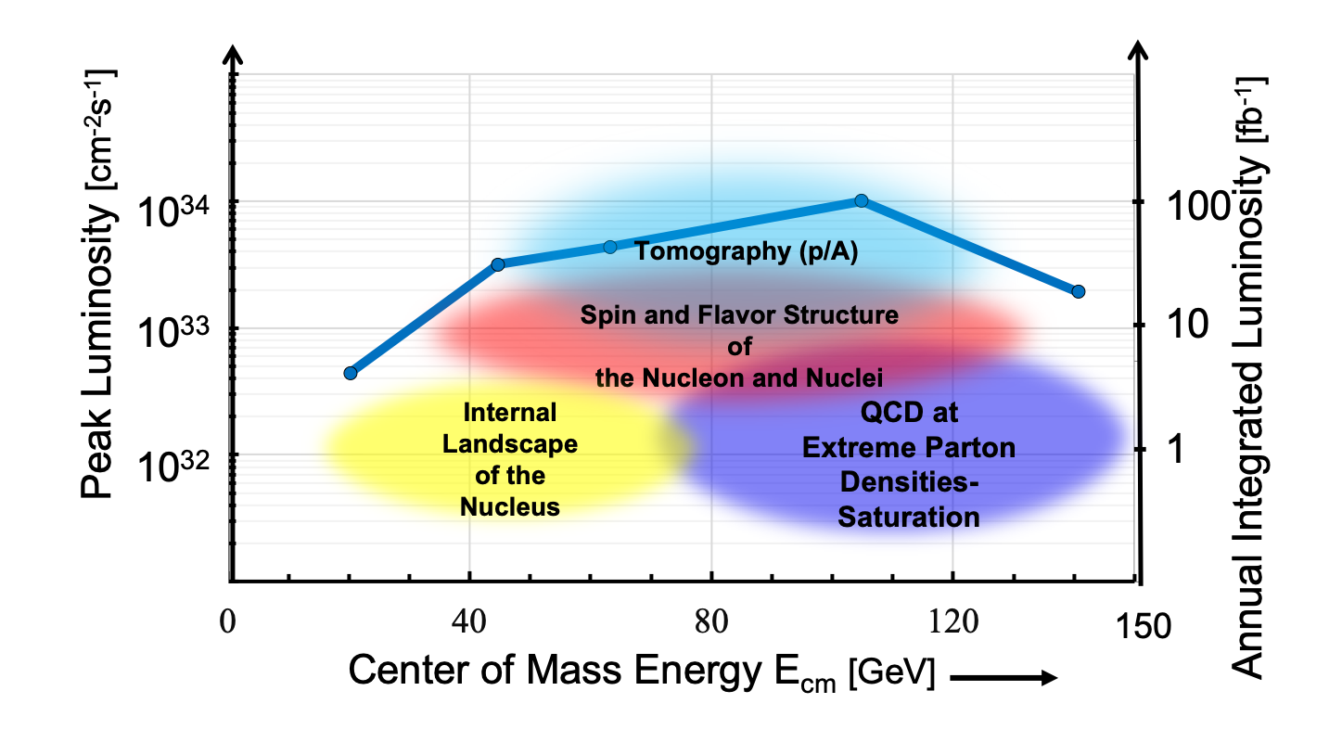
Luminosity versus E_{CM} center of mass energy

Slide 26
Interaction Region & Machine Detector Interface
Most constraint part of the collider. Multiple requirements, most are conflicting:
Space requirement for detectors L=-4.5/+5m (note: luminosity~1/L)
detector radius limited to 3.4m by building , need to bypass detector with RCS
Forward hadron apertures determined by forward neutron and scattered ion beams +/- 4mr neutrons, proton p_{t} =(1.3-0.2) GeV/c, accommodate Roman pots in vacuum system, beam orbit geometry which provides free path for neutrons from IP to ZDC
Provide space for luminosity measurements and local polarization measurements
High luminosity, small β* high chromaticity generated in final focus
Total chromaticity is limited as its necessary compensation caused dynamic aperture limitation
Meets beam optical constrains to be able to compensate chromaticity
Novel s.c. magnet technology required for implementation
Synchrotron radiation emitted from final quadrupoles does not hit detector beam pipe.
Optimized vacuum geometry minimizes impedance and beam heating
Crossing angle 25 mrad required to accommodate large number of bunches
Accommodate crab-cavities to compensate detrimental crossing effects: crab crossing
Accommodate spin rotators and keep IR beam optics spin transparent
Fits inside the existing straight section (at least for IR 6) and matches adjacent hadron and electron arcs
Compensate detector solenoid field without anti-solenoid for spin, crabbing, beam dynamics

Slide 27
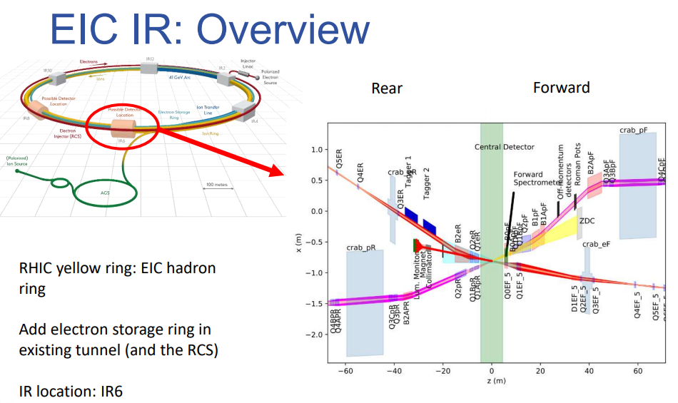
Interaction Region (WBS 6.06)
Beams collide at the collision point in the center of the Interaction Region
IR Design is constraint by numerous requirements:
provides sufficient space for detector and detection of forward scattered particles
defines the collision orbits with a crossing angle of 25 mrad,
establishes focusing of the beam at the IP but avoiding extensive local chromaticity generation,
employs complex superconducting magnets with novel but-prototyped magnet technology
contains a low impedance vacuum system
generates manageable synchrotron radiation
accommodates crab cavities for hadrons and electrons with correct beam optics
accommodates spin rotators
fits inside the existing straight sections
accomplishes matching beam orbits and optics to the adjacent arc minimizing special dipole and quadrupole magnets
provides a spin matched electron and proton transport
provides optimum betatron phase advances to allow for compensation of 2nd order chromaticity
provides favorable condition for luminosity measurements and auxiliary detectors

Slide 28
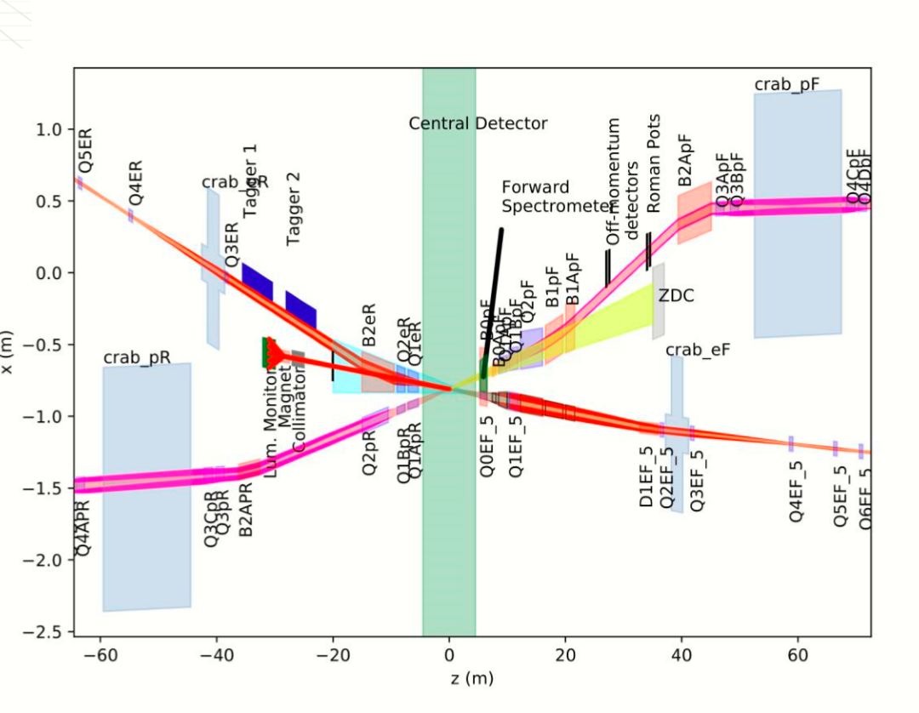
Interaction Region Layout
IR Top view (with stretched vertical scale)
28

Slide 29
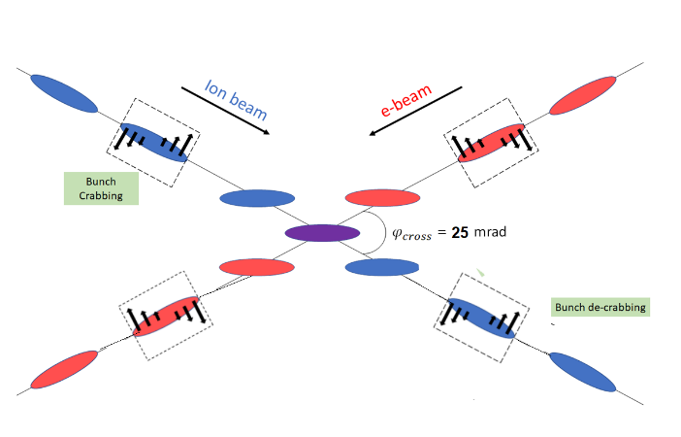
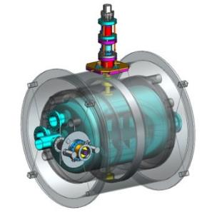
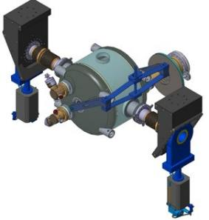
EIC High Luminosity with a Crossing Angle
Modest crossing angle of 25 mrad
- avoid parasitic collisions due to short bunch spacing,
- for machine elements, to improve detection
- reduce detector background,
Note: IP moves radially by 75 microns (long: 3 cm) during collisions of 100 ps
However, crossing angle causes
- Low luminosity
- Beam dynamics issues
avoided by Crab Crossing
Consequently:
Effective head-on collision restored
beam dynamic issues resolved (mostly)
Several transverse RF resonator (crab-cavity) prototypes built
- tested with proton beam in the CERN-SPS

Slide 30
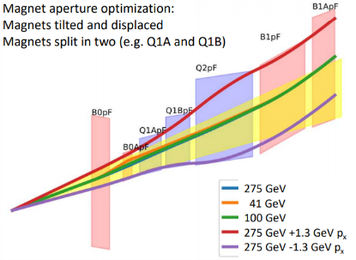
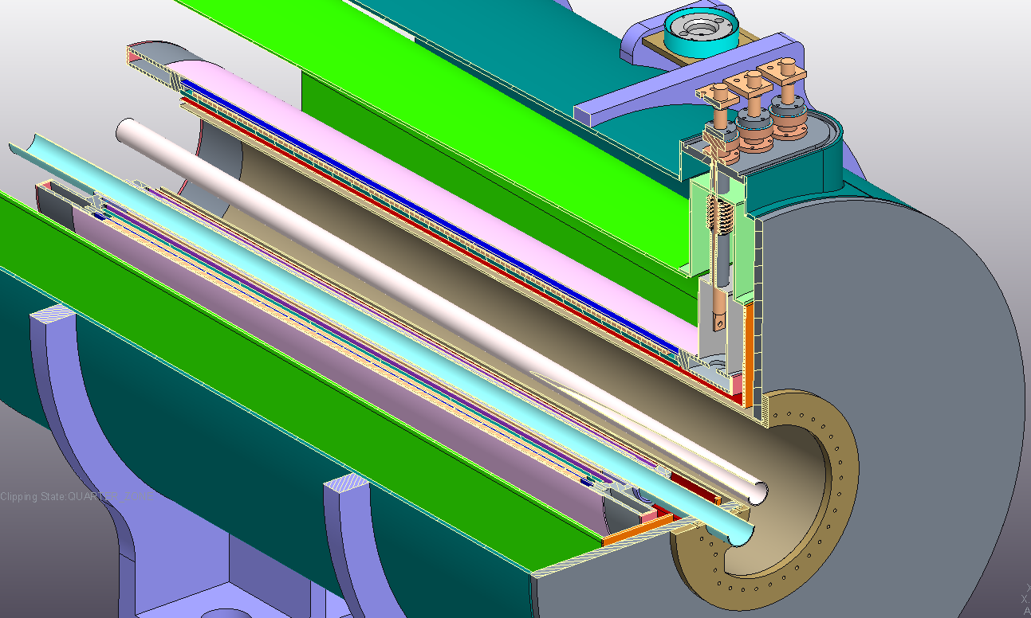
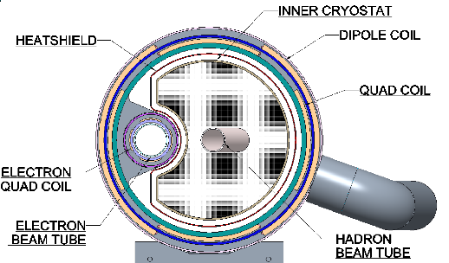
Magnet Technology
B0 spectrometer magnet

Slide 31
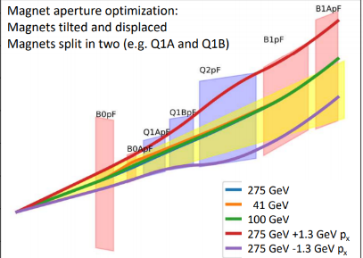
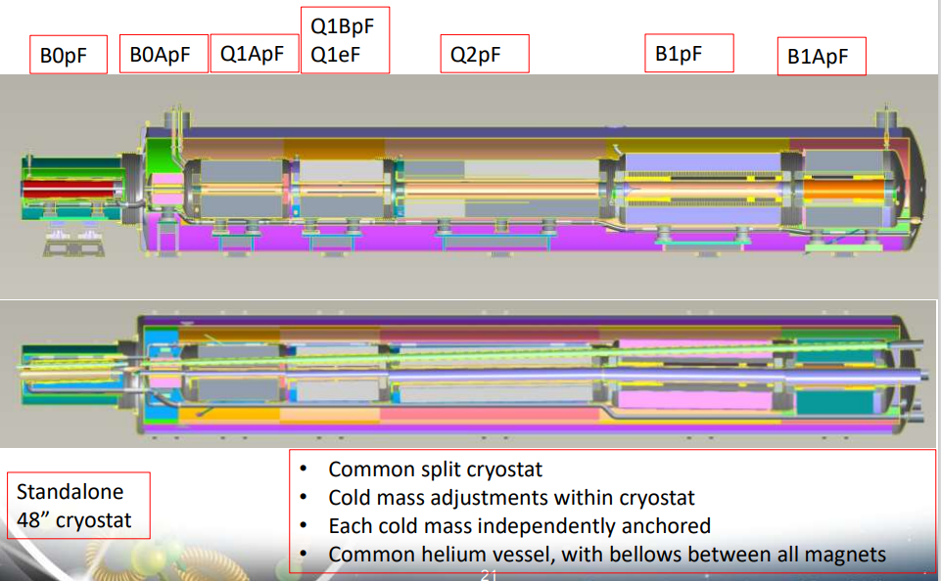
Magnet Technology

Slide 32
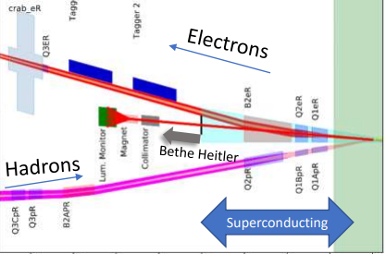
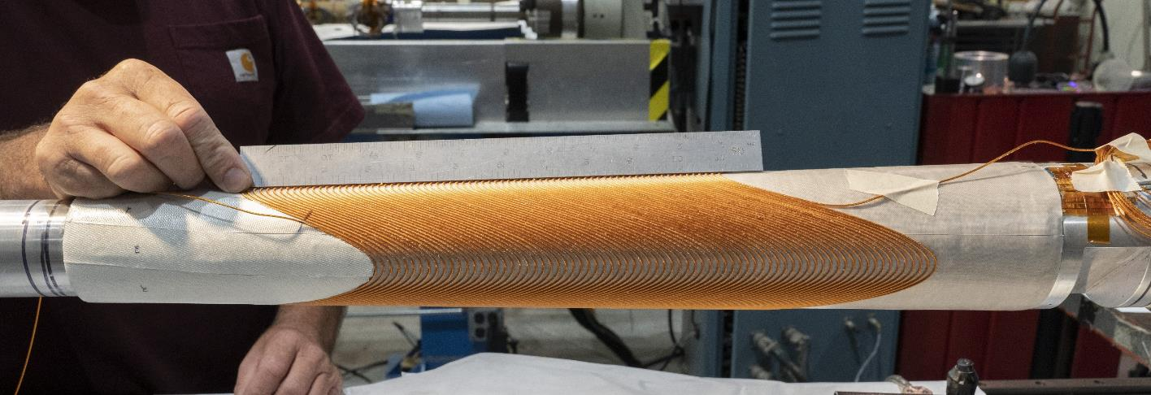
Magnet Technology
Successful prototype of a direct wind double helix quadrupole magnet with tapered aperture
during the winding process.
This technology will be used for Q1eR

Slide 33
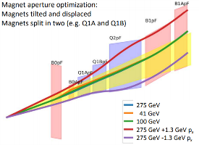
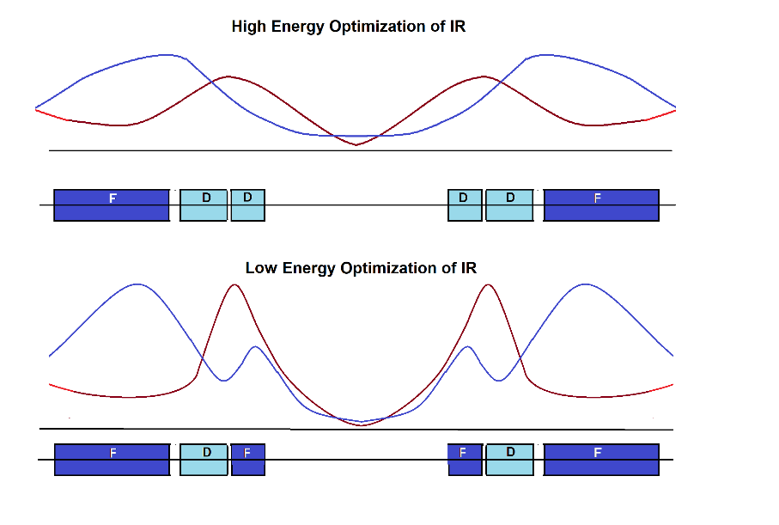
How to get more luminosity at lower E_{cm}?
schematics
Doublet focusing
For hadrons, final focus lens (vertical) is split into two magnets (tapering the aperture that way).
Doublet focusing for E_{cm} ~100-140 GeV.
For low hadron beam energy
(E_{cm} =60 GeV) can rewire into triplet focusing, reduce β* ➔ Increase L by factor of 2
Triplet focusing

Slide 34
Luminosity at lower E_{CM}
Luminosity E_{cm} ~ 40 – 60 GeV could be increased by factor of almost 2 (work in progress! )

Slide 35
Operation with two Detectors
Only one detector and one IR is in the EIC budget. The project is working on accommodating a second IR and detector. Required funding of ~500M$ is unclear at this point
The bunches cannot collide in two IRs with maximum intensity.
Simultaneous collisions of all bunches in 2 Irs most likely requires to reduce the intensities by up to a factor of 2:
L ➔ 2 x L/4
Instead, we arrange for half of the bunches collide in one IR the other half in the second IR (luminosity sharing)
L ➔ 2 x L/2
So far, we don’t have (yet) a satisfactory solution for operation with 2 IRs, too much chromaticity, to much deterioration of polarization!
What works: Run collisions in one IR at a time and alter Irs
L ➔ 2 x L/2
Nota bene: Two IRs as compared to one will most likely not increase the sum of the (integrated) luminosity

Slide 36

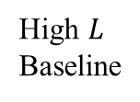



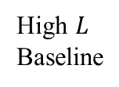



Luminosity Sharing
Conservative assumption: luminosity is shared between two detectors, different bunch pairs collider at different IPs
Luminosity in the medium rage can pushed at the expense of acceptance
Annual Integrated Luminosity [fb⁻¹]
Peak Luminosity [cm⁻²s⁻¹]
10³⁴
10³³
10³²
High $L$
Baseline
Combined $L$ of both IRs
High $L$
Baseline
Fair-share $L$ per IR
$$7.9$$
$$10⋅{10}^{33}$$
$$6.1$$
100
10
1
Tomography (p/A)
$$1.54$$
Spin and Flavor Structure of
the Nucleon and Nuclei
$$0.44$$
Internal
Landscape of the Nucleus
QCD at Extreme Parton Densities-
Saturation
150
Center of Mass Energy E_{cm} [GeV]

Slide 37
IR 8
The first interaction region of EIC is at IR 6
Present RHIC offers IR8 as a possible second IR and detector location.
IR 8 has significantly less space than IR6.
A much larger crossing angle (35 mrad seems possible) in IR 8 compared with the present 25 mrad crossing angle in the first IR is most likely not possible without a major effort in civil construction.
The tunnel end in IR 6 is 6.9 m wide over a length of 284 m. In IR8 it is only 6.4 m wide over a length of 117 m. Further out it is only 5.27 m wide.
A detector bypass for the RCS limits the detector radius to 3.4 m
At present, we are planning the hadron and electron pathlengths in IR 8 similarly to the ones in IR6. This will constrain the differential pass length for electrons and hadrons in a later full IR8 layout, as any pathlength difference between hadron and electrons might not be able to be compensated any more by already existing accelerator arcs.
IR8 centerline needs to be moved at least 85 cm from present midline of the tunnel (outwards)
Work in progress to lay out reference design for IR with larger crossing angle and stronger emphasis on forward detection

Slide 38
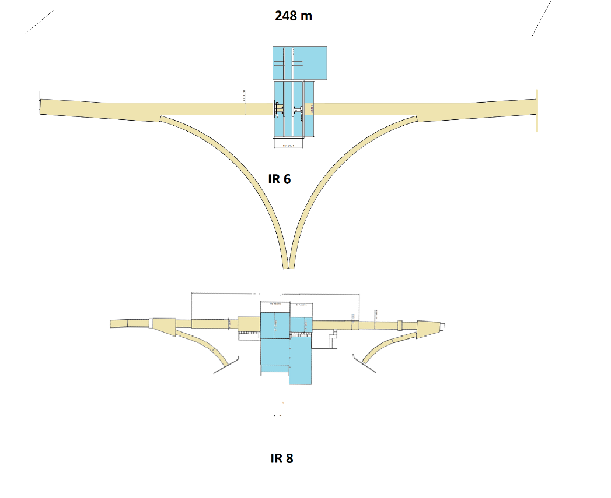
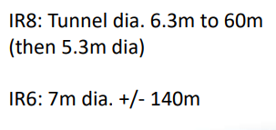
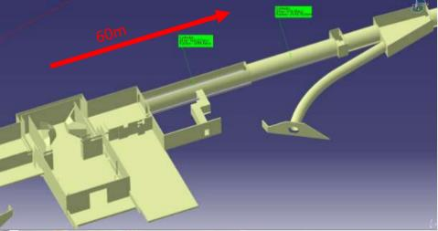
IR6 vs IR 8 geometry

Slide 39
Summary
The EIC has challenging performance goals
The EIC conceptual design supports these goals
The design effort is well organized, and challenges are under control
The EIC conceptual design has achieved CD1 maturity
The interaction region has progressed well
SC Magnet design has matured as well as vacuum systems and other important hardware systems
A possibility of increasing the luminosity for lower center of mass energies <100 GeV is being pursued and looks possible
Operation with 2 IRs being worked out and challenges are being addressed

Slide 40
Backup

Slide 41
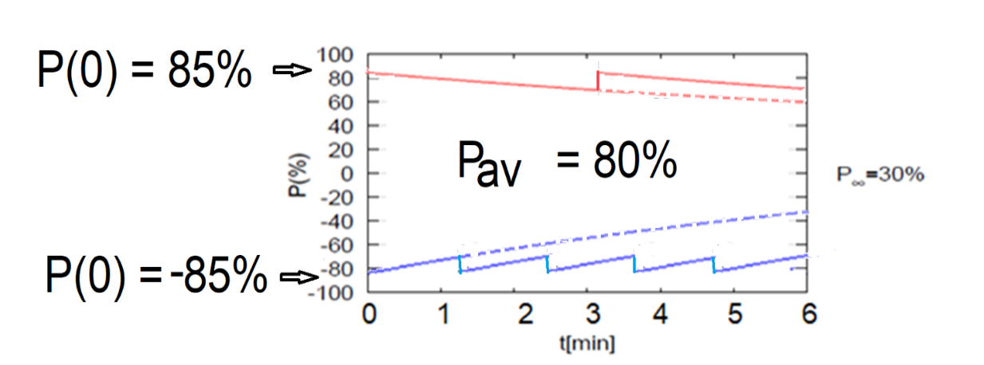
80% average polarization at electron storage ring by frequent on-energy injection of highly polarized (85%) electron bunches
Equilibrium polarization in ESR is too slow and only ~50%
Frequent injection of bunches with high initial polarization of 85%
Initial polarization decays towards P∞ < ~30-60%
At 18 GeV (worst case) every bunch is refreshed in 2.2 min with RCS cycling rate of 2Hz.
B P
B P
Refilled every 1.2 minutes
Refilled every 3.2 minutes
Re-injection
P_{av}=80%
P∞= 30%
(conservative)
P_{av}=80%
Re-injections

Slide 42
EIC CDR Parameters for E_{cm} and Luminosity

Slide 43
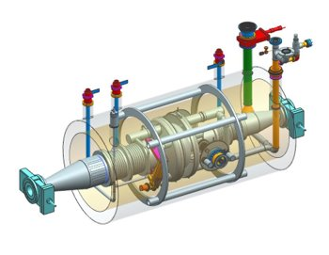
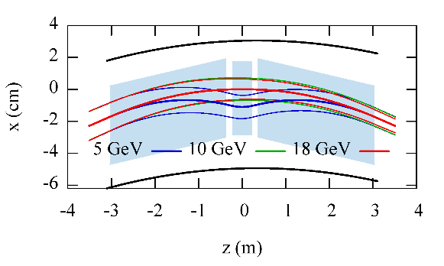
Electron Storage Ring (WBS 6.04)
FODO-cell design, normal conducting magnets
Superconducting RF 591MHz 1-cell
14 MW installed RF power (solid state)
Vacuum system extruded OFE Copper
NSLS-II type Bellows
Radiation damping maintained <10 GeV
Control radiation damping and emittance super-bends (all dipoles split in 3 with center bend can be reversed)
High spin polarization by frequent injection of 85% polarized bunches, fast kickers (10ns)
Courtesy R. Rimmer

Slide 44
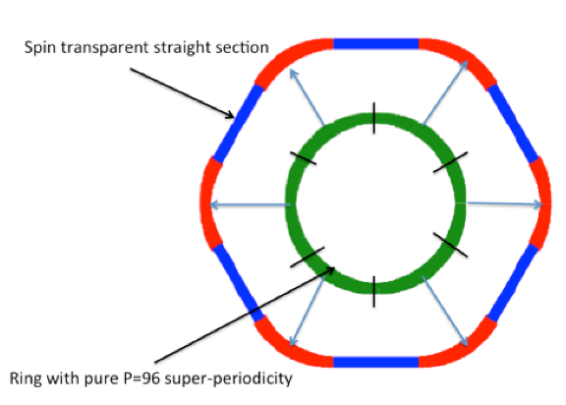
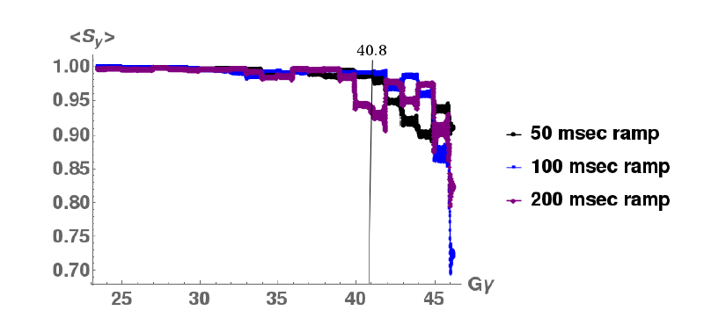
Electron Injector (WBS 6.03)
Electron Injector consists of:
  polarized electron source (existing, being commissioned, SLAC/JLAB design)
  400 MeV s-band injector LINAC (new)
  spin transparent Rapid Cycling Synchrotron (RCS) (new)
RCS spin transparency achieved by high quasi symmetry due to periodic arcs with unit transformation straight section: all systematic depolarizing resonances suppressed, and imperfection resonances weakened

Slide 45
Hadron Storage Ring (WBS 6.05)
RHIC Yellow Ring is the Hadron Storage Ring of the EIC
Existing hadron injectors incl. polarized p and ion sources support EIC beam parameters
Large energy range 41GeV -275 GeV
Use Blue Ring sector IR2 to IR12 as a bypass for low energy running (41GeV), sector IR6-IR4 as injection channel
Increase beam current by factor of 3 to 1A (1160 bunches)
Insert a Cu- and aC-coated liner into cold beam pipe to limit thermal loads and suppress e-cloud
Insert 4 more Siberian snakes (2➔ 6) to improve polarization performance for protons and He-3
To obtain/maintain flat beam emittance, short bunches(6 cm), introduce strong hadron cooling in longitudinal and horizontal plane by coherent electron cooling with plasma enhanced microbunching amplification

Slide 46
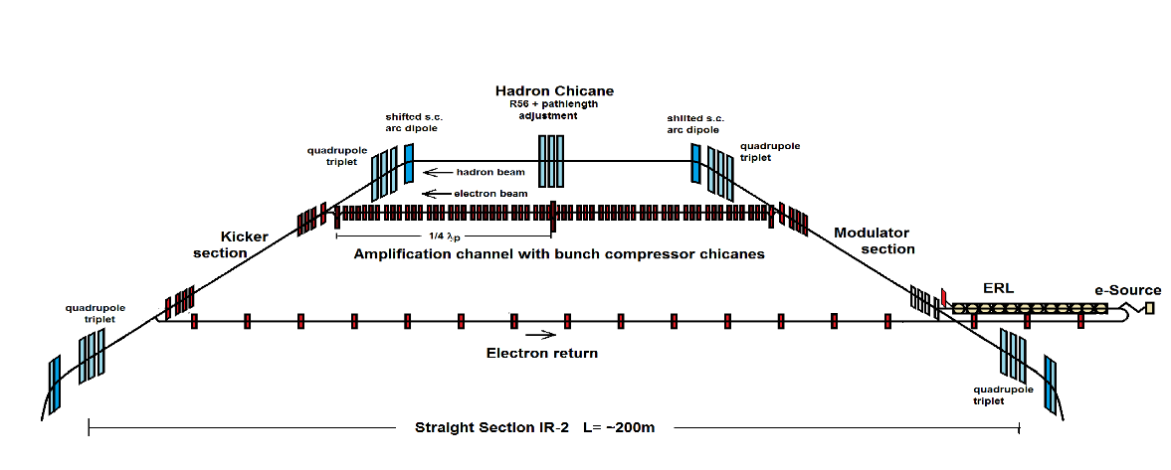
EIC Strong Hadron Cooling (WBS 6.05.08)
Coherent Electron Cooling with μ-bunching amplification
Design Cooling Rate R_{cool}= 1-2 h⁻¹
Electron beam current I_{e}=100 mA (1nC/bunch), electron emittance ε_{xyN}= 2.5/0.5μm
Scope
400 keV DC gun
149 MeV, 120 mA ERL, e-beam dump
Transfer lines to connect to hadron orbit and to return electrons to ERL
Amplification sections with strong quadrupole triplet focusing and bunching chicanes
Hadron chicane using existing s.c. magnets
2 K He sub-cooler, RF and power infrastructure, e-beam diagnostics
Shared tunnel with e-injector LINAC

