Slide 1
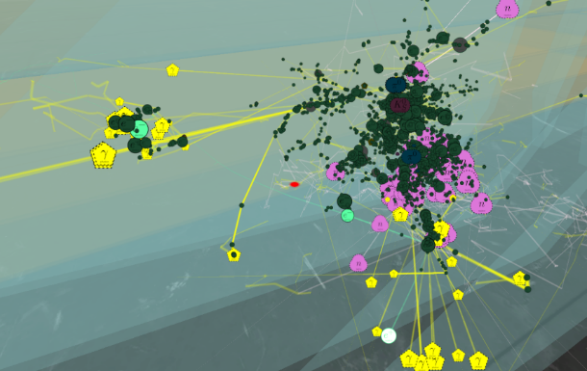


Belle II K_Long-Muon (KLM) Detector
CORE KLM
Brief Report on Design and Performance of a K_{L} and Muon subDetector at Belle II
,
Ad-Hoc: CORE Workshop
29-30 March, 2021
W. W. Jacobs
CEEM/Indiana University

Slide 2
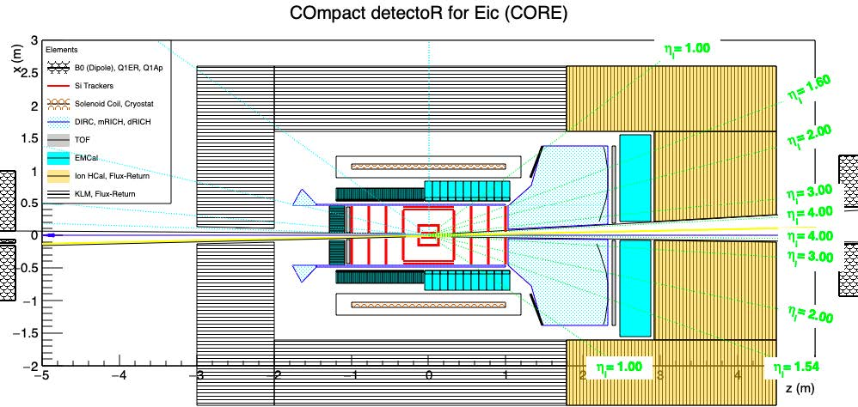
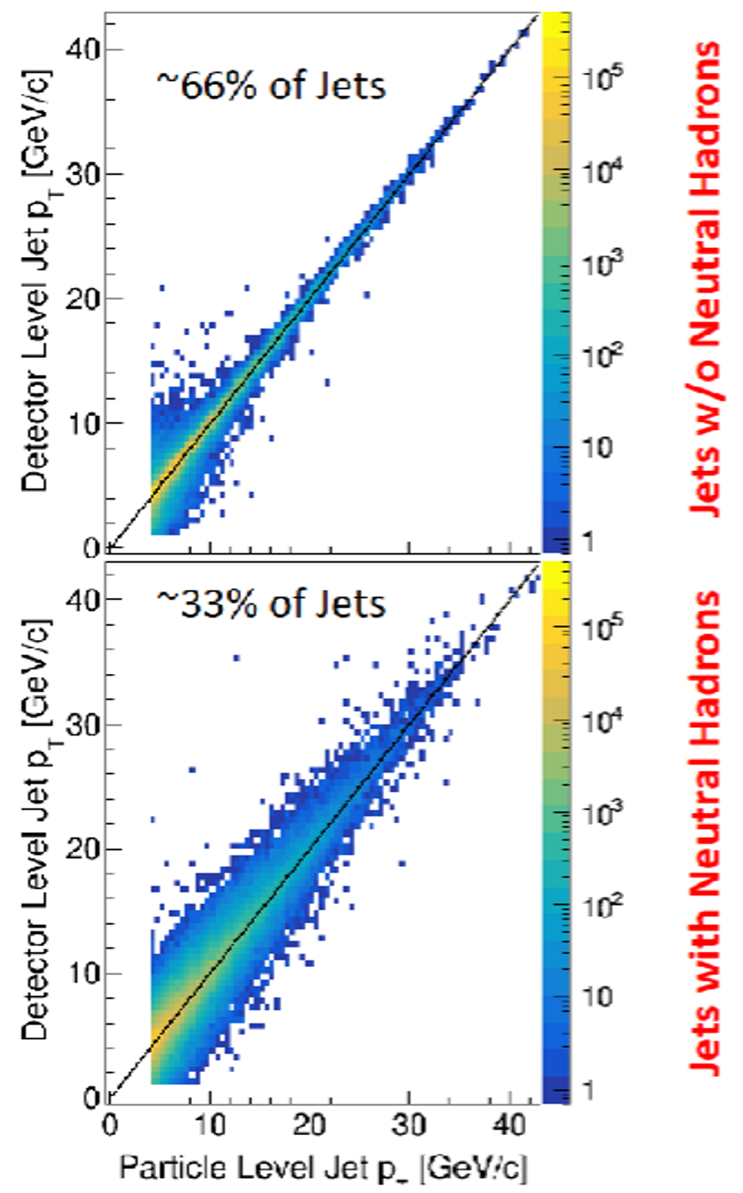
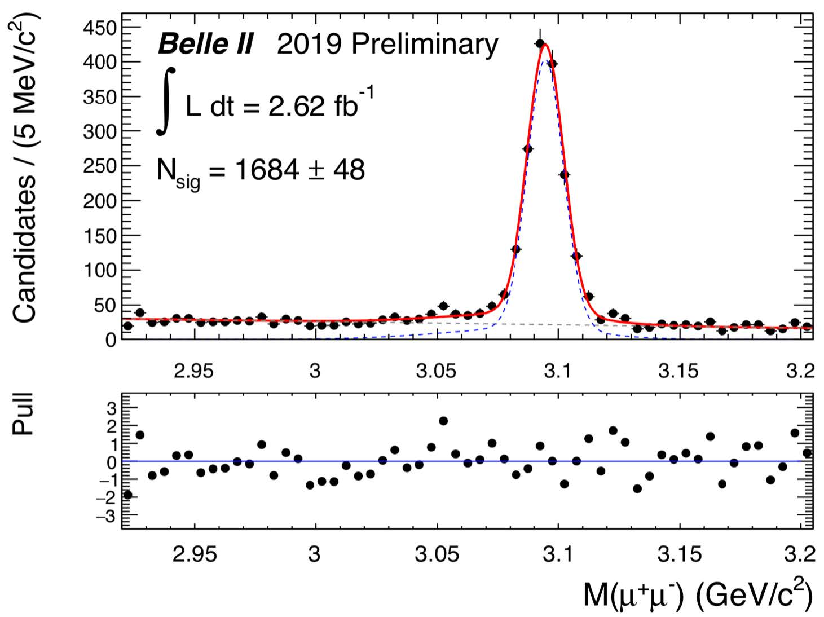
KLM: K_{L} and Muon subDetector at CORE
Identify K_{L} and other neutral particles in jets … correct or veto
.
High efficiency and high purity μ detection and ID:
e.g., for di-lepton production (J/ψ) and time-like Compton scattering processes
Provide additional detector response and coverage for verification or veto.
B.S. Page et al., arXiv.1911.00657 “Jet Physics at a Future EIC“
J/ψ → μ⁺μ reconstruction with early running Belle II data ⁻

Slide 3
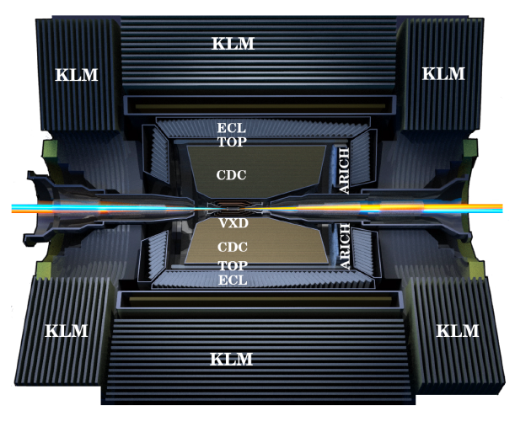
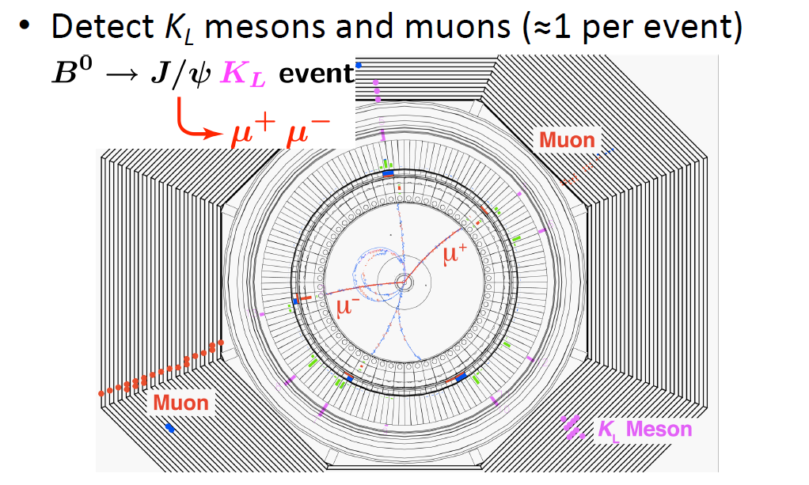
KLM @ Belle II: a Useful Starting Point
Belle II and Prior Design Performance Requirements:
Detect K_{L} mesons and muons
Identify the muons and K_{L} mesons with high efficiency and purity
  for muons above ~ 0.6 GeV momenta
  good angular resolution (~ 2 deg) for the K_{L}‘s
KEK: e⁺e⁻ collider “B-factory” (Υ(4S)=10.58 GeV)
Belle: 1999-2010 w/ integrated luminosity ~ 1ab⁻¹
Belle II: upgraded detector w/ super KEKB machine … expect 50ab⁻¹ integrated luminosity w/ upgrades
First Belle II collisions April 2018 … now in production running
Also as a veto in missing energy modes like: B → τν

Slide 4
Example: upgraded Belle II detector at Super KEKB
Active readout elements interleaved with 1.5 T solenoid magnet return steel
Configuration optimized primarily for μ and K_{L} detection and ID
Relatively inexpensive, technically simple construction, robust operation
It is not a full-fledged/proper EM or Hadron calorimeter
Tracking
ECAL, iTOP, PID
Octagonal Iron yoke structures:
14 layers of ~ 47 mm thick steel plates
~ 40 mm thick air slots => 15 barrel, 14 Forward , 12 Back instrumented
KLM Backward
Endcap
 | Χ₀ (cm) | λ_{I} (cm)
return steel | ~ 37.5 | ~3.9
scintillator | ~ 1.4 | ~0.7
KLM Barrel
KLM Forward Endcap

Slide 5
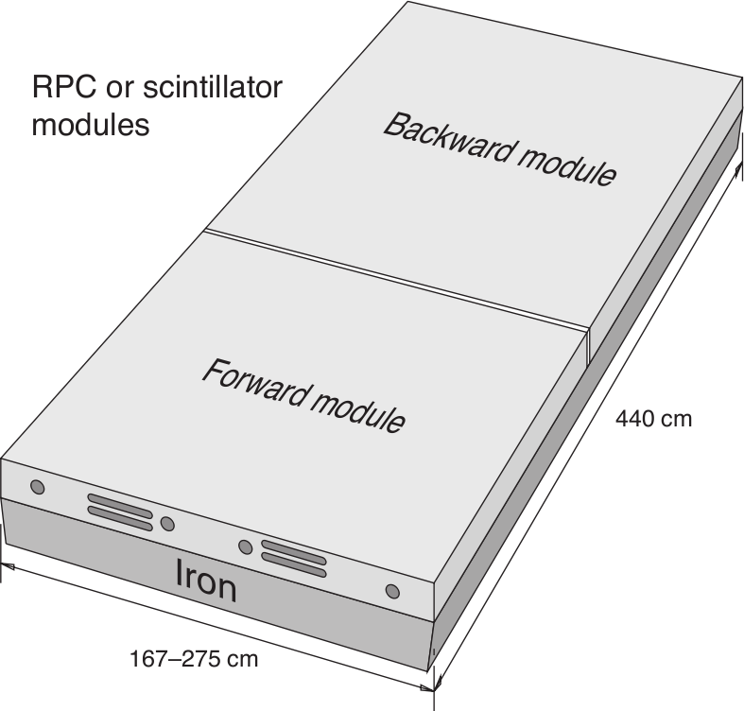
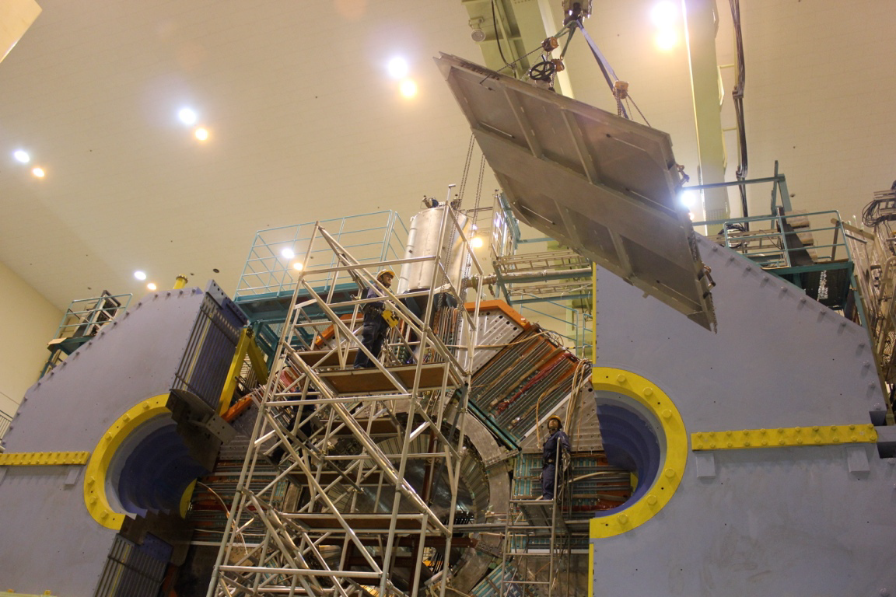
Belle II detector KLM components
Endcap
Barrel
2014
2013

Slide 6
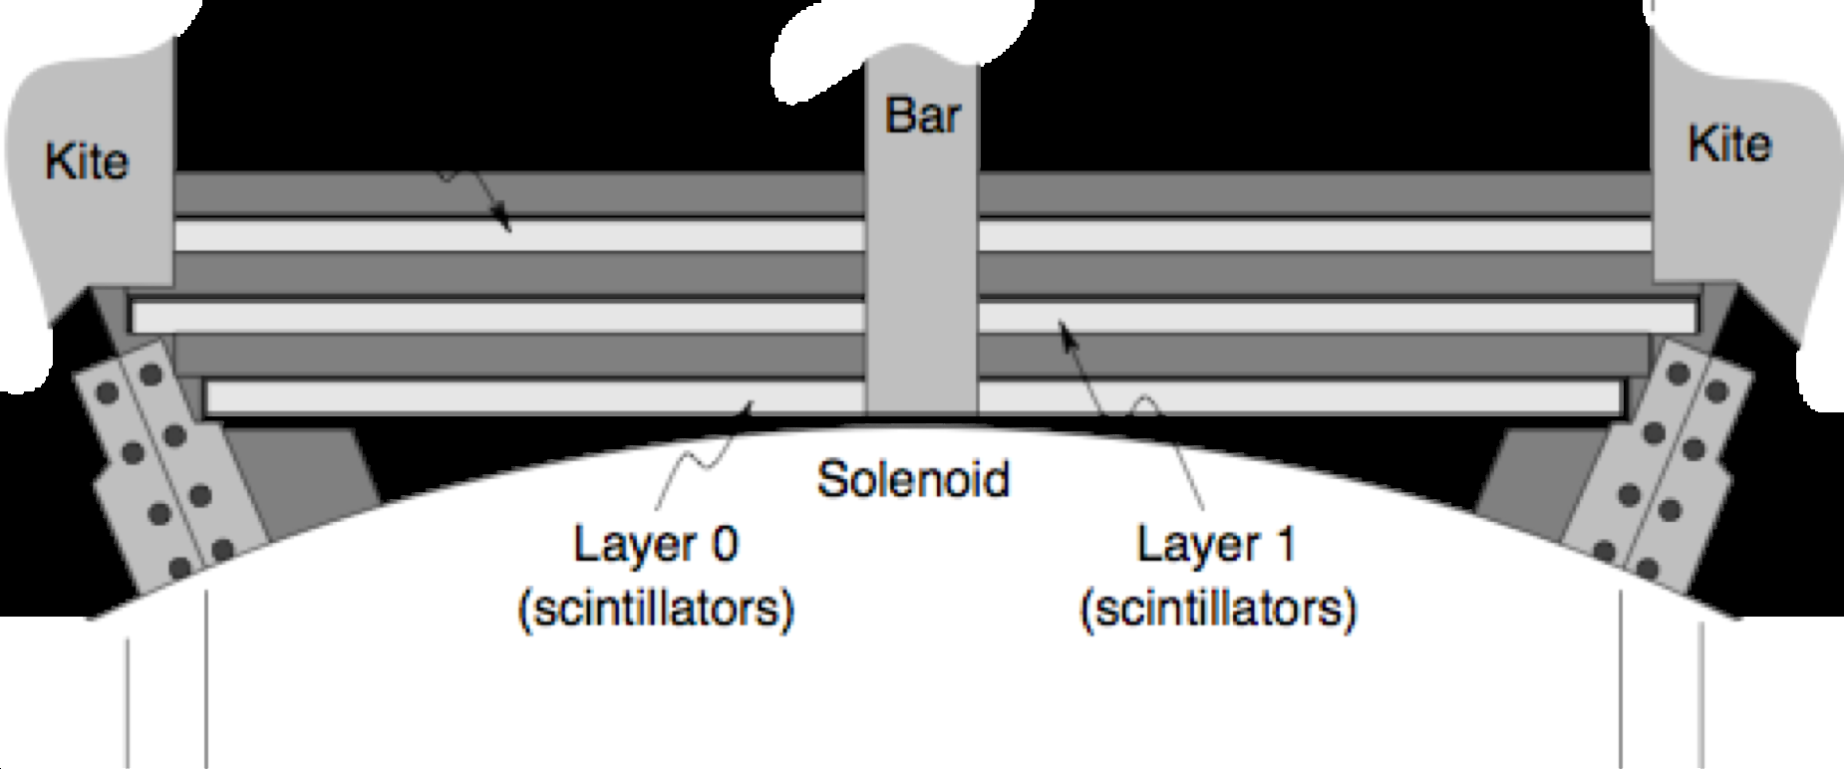
Now: first 2 Barrel layers are scintillator based (replace RPC)
Scintillator strips: ~ 1x2 cm cross section extruded with fiber hole or machined w/ cut
Hamamatsu SiPM attached to fiber (mirrored at far end)
1.5 T field operation
rad-hard (est. >10-year lifetime @ Belle II)
8-pixel threshold => >99% efficiency
~ 1.3 x 1.3 mm2
667 pixels

Slide 7
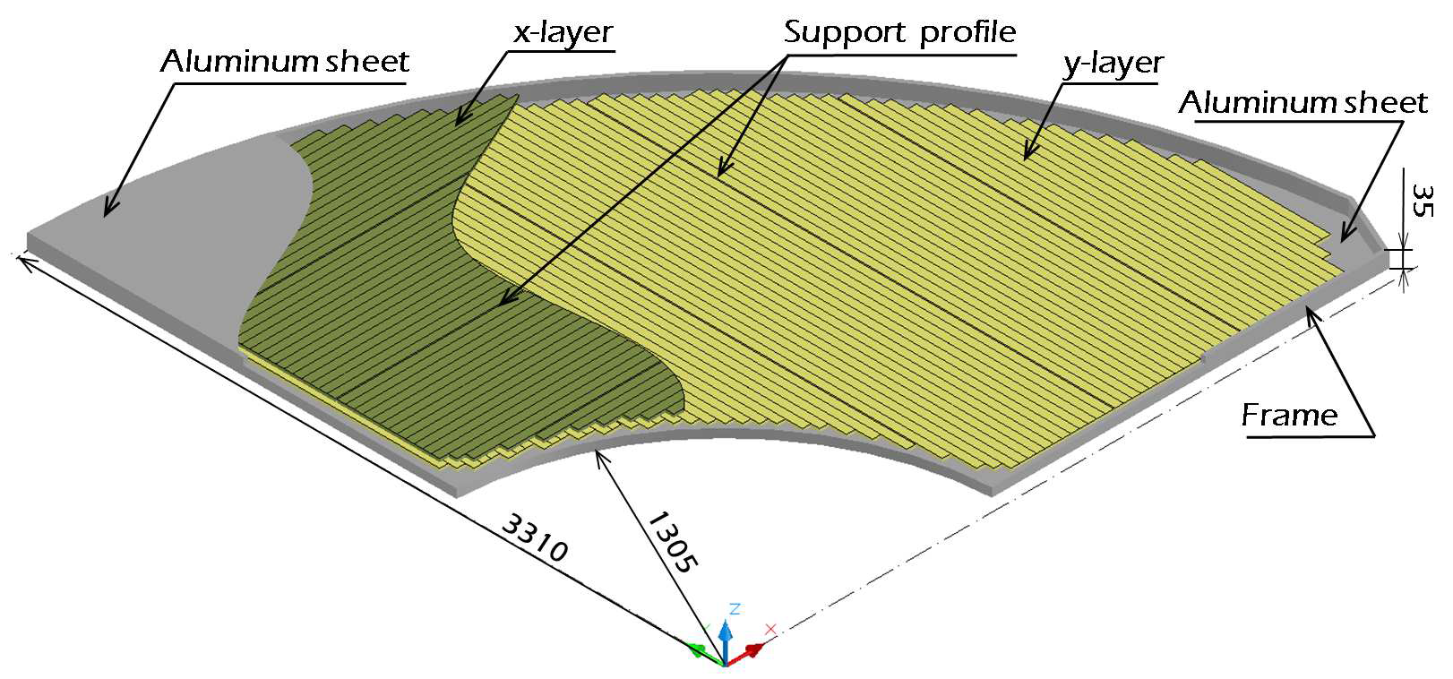
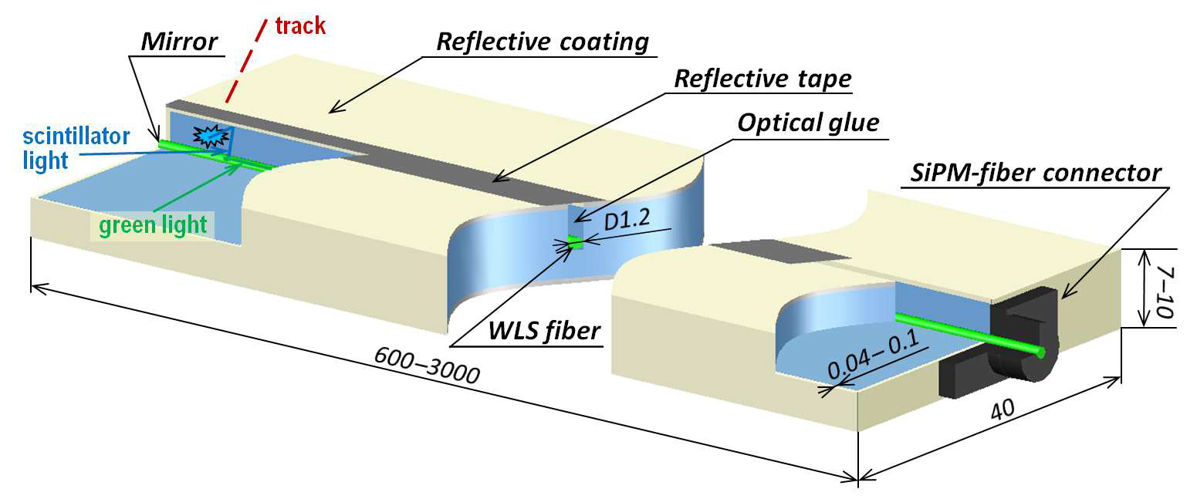
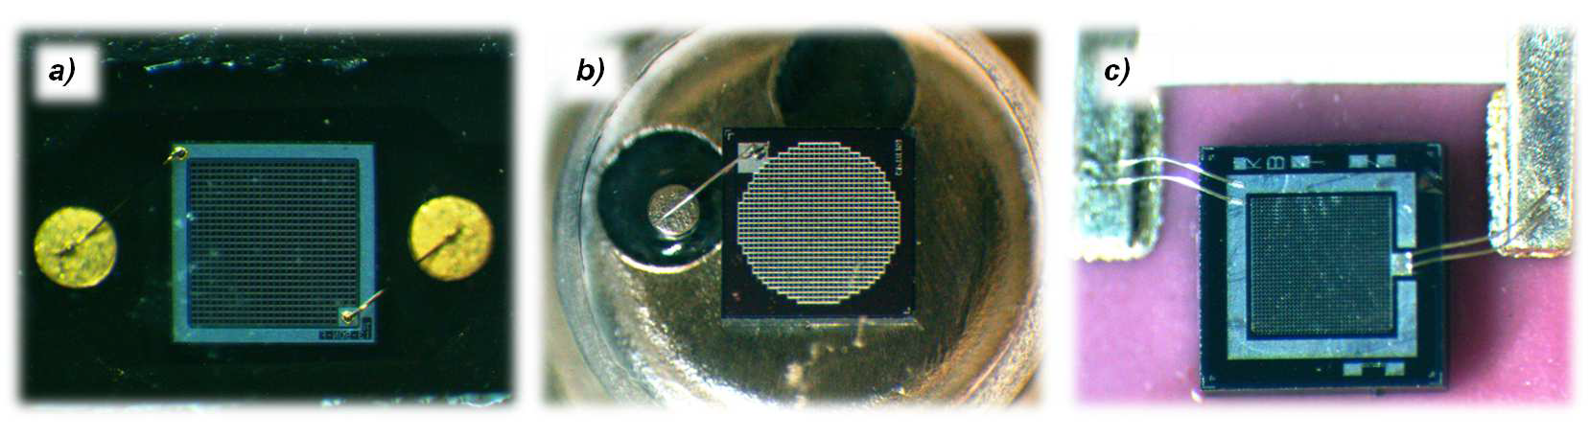
All Endcap layers upgraded to scintillator at start of Belle II
Similarly, scintillator strips ~ 0.7x4 cm² machined w/ cut)
Single strip readout w/ SiPM
FEE readout has pulse shape characterization capabilities … FW implementation (w/ barrel) under development
See: T. Aushev et al. arXiv:1406.3267v3 (2015) for details

Slide 8
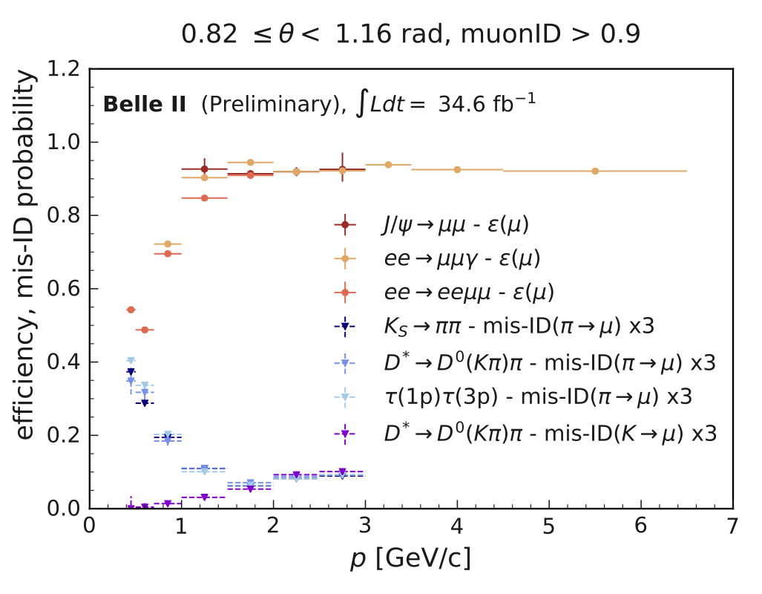
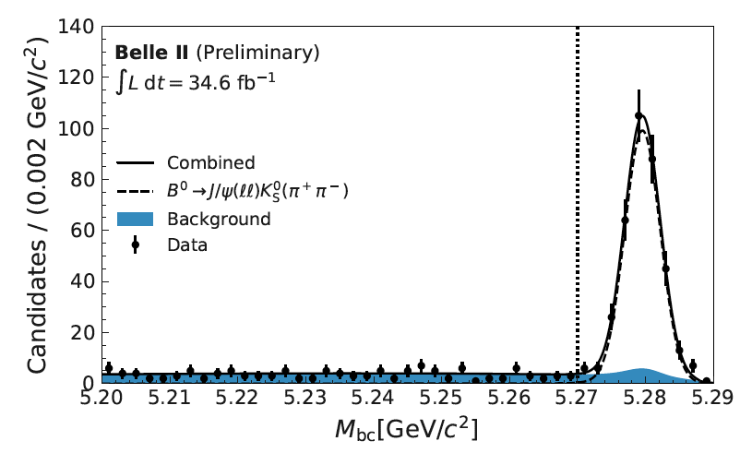
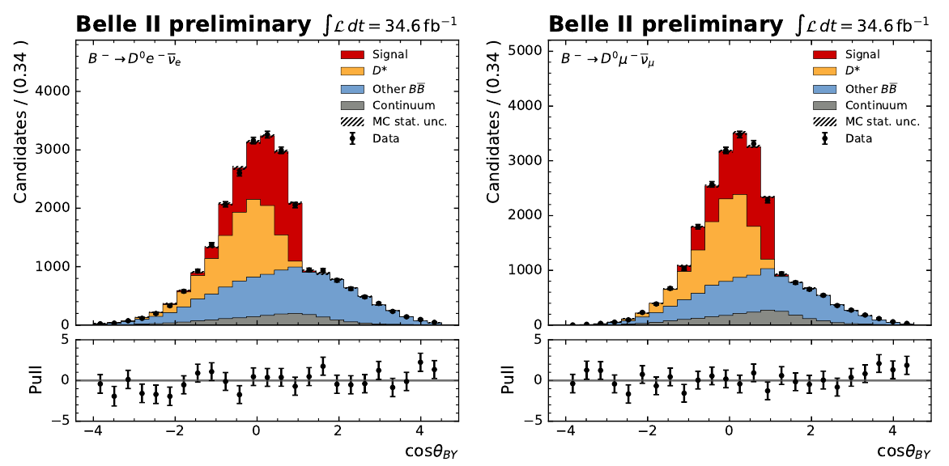
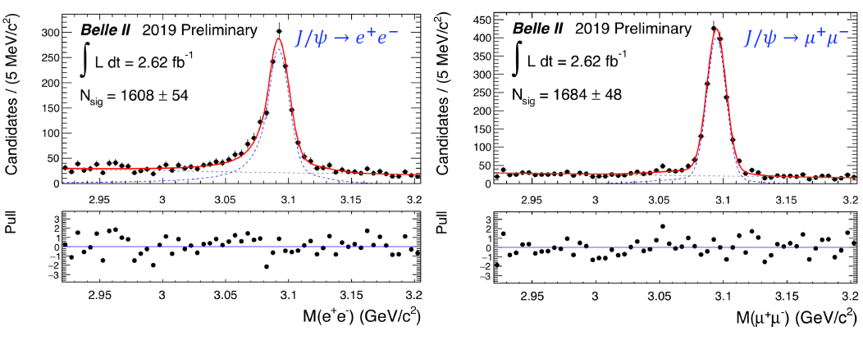
KLM performance (muon ID efficiency, fake rates, physics).
2020 muonID > 0.9 performance (barrel)
B → J/ψ Ks for ICHEP2020 CPV
(low p region under further study)
328+-20
Early running J/ψ → ℓ⁺ℓ⁻ reconstruction
https://arxiv.org/abs/2008.07198
Notes:
Plot on the top shows part of barrel

Slide 9
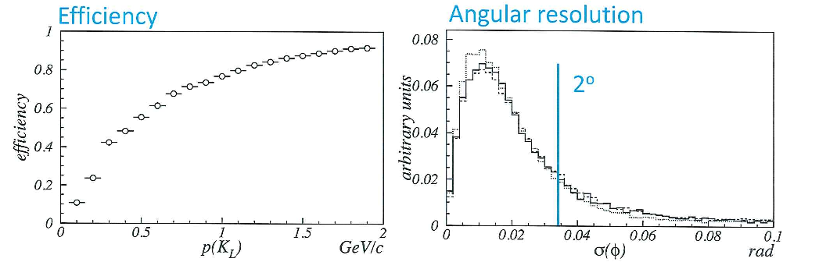
KLM performance: K-long detection and kinematics
Belle II analyses and algo/FW implementation for K-long are in progress; current expectations are based on results from Belle Data:
Efficiency: fraction of reconstructed K-long clusters vs. K-long momentum in kinematically constrained decays
Angular resolution: comparison of K-long cluster centroid w/known K-long direction.
Current efforts include: using BDT to distinguish K_{L} mesons from background; future possible use of FEE based signal shape characterization, etc?
In an upgrade, is a rough K-long momentum determination by TOF possible? (e.g., ~ 100ps gives ~13% resolution for ~ 1.5 GeV/c K_{L} and ~ 2 m flight path)

Slide 10
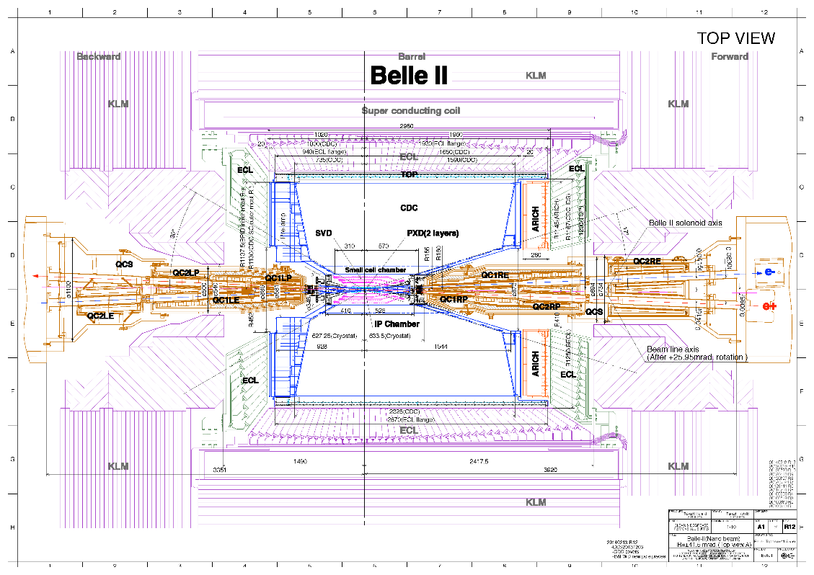
KLM Belle II vs CORE Comparison and Implementation
KLM region indicated in CORE layout is of scale a little smaller than Belle II (barrel + 1 endcap), particularly in radial direction.
Belle II uses original Belle magnet for 1.5 T field and interleaved KLM in the flux return; the design has a robust cryostat, etc. with energetic muon/K_{L} detection at the exterior
Y. Makida et al., AdvCryogEng 43, 221 (1998)
~ 3.4 m
~ 5.9 m
A stronger CORE solenoid would require even more return steel (w/ ~ field free detector “slots”; current depiction looks already thin in depth).
of course many options are open if one takes a flexible design approach.
~ 2.2 m

Slide 11
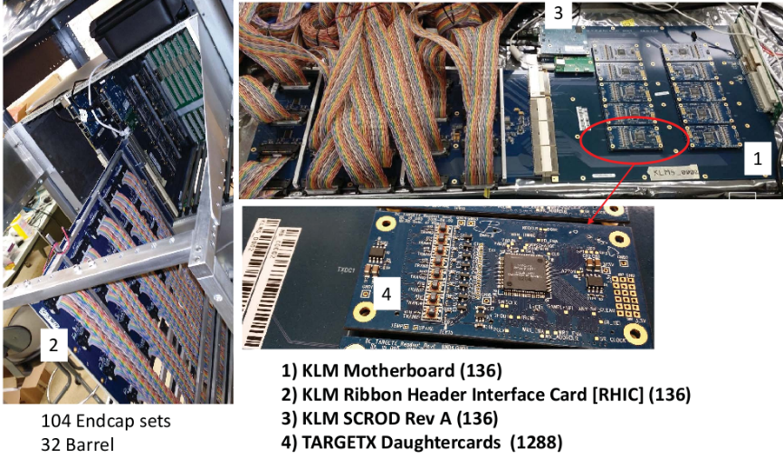

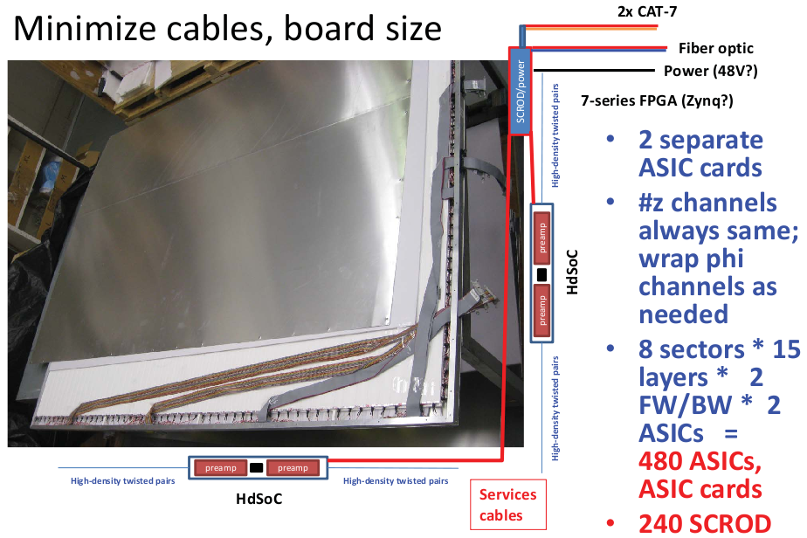
Plans (EOI to Belle II): replace 13 remaining Barrel RPC layers
Fabricate the new scintillator layers
Redesign scintillator readout for all 15 layers
Move digitizing front end electronics into detector panel
Developments: embedded ASIC; compact SCROD; 64-chn readout; several different preamp options
K_{L} time-of-flight possible?
Expected installation ~ 2026
~ 26k channels: initial cost est. ~1.4-1.8M elec., ~4.8M det., w/ some reuse of crates, etc.

Slide 12
Summary, Status and TBD
A KLM subsystem is an important and successful part of the Belle II experiment; it presents a useful baseline/starting point for a CORE application (EIC EOI #26 )
Currently under Belle II development are optimization of muon efficient/fake rates at lower momenta; K-long efficiency and ID improvements in HW and FW.
Can an K-long momentum via TOF be effectively included in an (EOI) anticipated upgrade to all scintillator sensors with improved readout?
Issues and TBD
There are many things not directly touched on in this presentation:
  Magnet strength, flux return design incorporating CORE KLM needs
  Signal vs. background rates, etc. vs. envisioned readout technology
  Particle purity and momentum ranges of interest for CORE physics
  Where is material budget critical, etc.
None seem insurmountable!

Slide 13
BACKUP SLIDES

