Slide 1
LGAD-based TOF
An overview of R&D of Low Gain Avalanche Diodes for high performance TOF
Gabriele Giacomini
Instrumentation Division
Brookhaven National Laboratory
COmpact detectoR for the Eic (CORE) workshop
March 29th-30th 2021

Slide 2
Outline
Low-Gain Avalanche Diode (LGAD) structure,
  as compared to standard silicon sensors
Fabrication at BNL
  In class-100 silicon clean room
Timing properties
Towards 4D detectors
  AC-LGAD, Deep-Junction, Deep-Layer
Status of CMOS read-out
  ALTIROC & others

Slide 3
Collaborations
W. Chen, G. D’Amen, G. Giacomini, E. Rossi, A. Tricoli
(Brookhaven National Laboratory)
S. Ayyoub, R. Islam (Cactus Materials Incorporated)
C. Gee, S. Mazza, H. Sadrozinski, B. Schumm, A. Seiden, Y. Zhao
(Santa Cruz Institute for Particle Physics)
A. Apresyan, K. Di Petrillo, R. Heller, R. Lipton, S. Los, C. Madrid, C. Pena, S. Xie, T. Zimmerman (FNAL)
K. Nakamura, K. Hara, T. Ueda, S. Kita (KEK, U. Of Tsukuba)
3
3

Slide 4
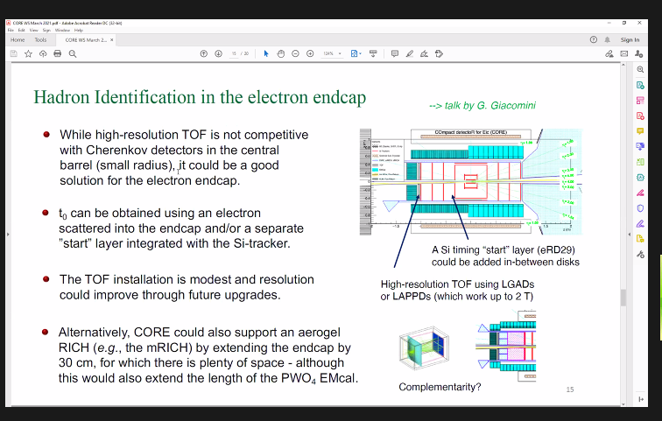
Talk by P. Nadel-Turonski
4

Slide 5
Structure of an LGAD vs std silicon diode
LGADs are Avalanche Diodes specifically tailored for the detection of mips in HEP.
LGADs are 20-50um thick (only active volume!) as compared to hundreds of um of std strip/pixel sensors.
LGADs feature a p+-layer (gain layer) under the n+.
Depletion of the p+ gain layer creates intense Electric Field, high enough for electron impact ionization to occur.
Hole impact ionization ~ 0
→ no BreakDown
→ gain ~ few 10s
Amplification is needed to have a good S/N when reading-out fast.
If the substrate is thin (~ 50 μm) and the gain is ~ 20 → signal is fast (~30 ps)
LGAD
STD silicon pixel
aluminum
aluminum
oxide
oxide
n⁺⁺
n⁺⁺
JTE n
gain layer - p⁺
50 um
Epitaxial layer – p⁻
High resistivity wafer – p⁻
substrate – p⁺⁺
Gain layer edge terminates on JTE (not necessary, though…)
100-300um
Substrate is just for handling, can be thinned down after the fabrication.

Slide 6
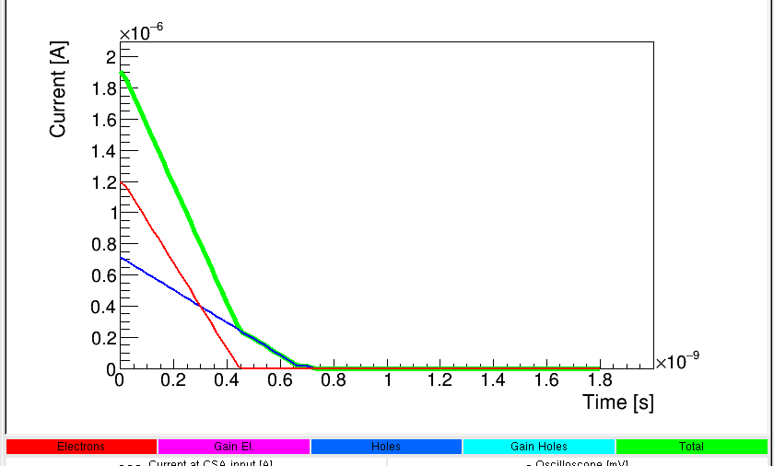
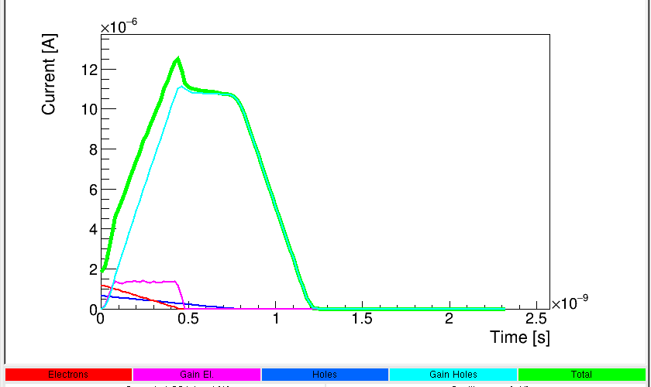
Signal shape in LGAD vs std diode
(V_{bias}= 200V)
50 um thick diode
(Gain = 1)
50 um thick LGAD
(Gain = 20)
Signal dominated by holes drift in the substrate
In an LGAD:
larger amplitude, for a better S/N
longer signal
slower slope
but electronics has a limited bandwidth
http://personalpages.to.infn.it/~cartigli/Weightfield2/
6

Slide 7
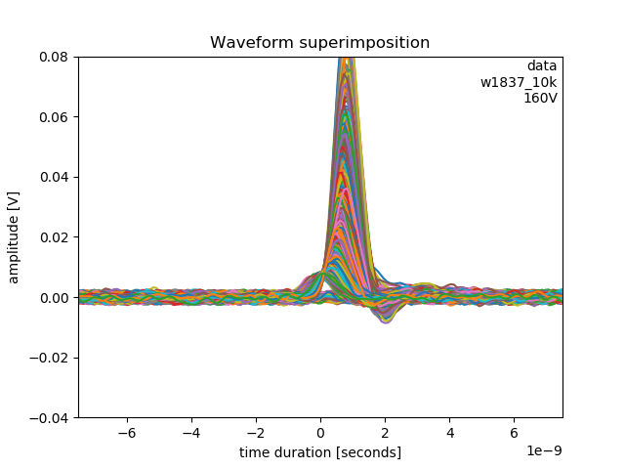
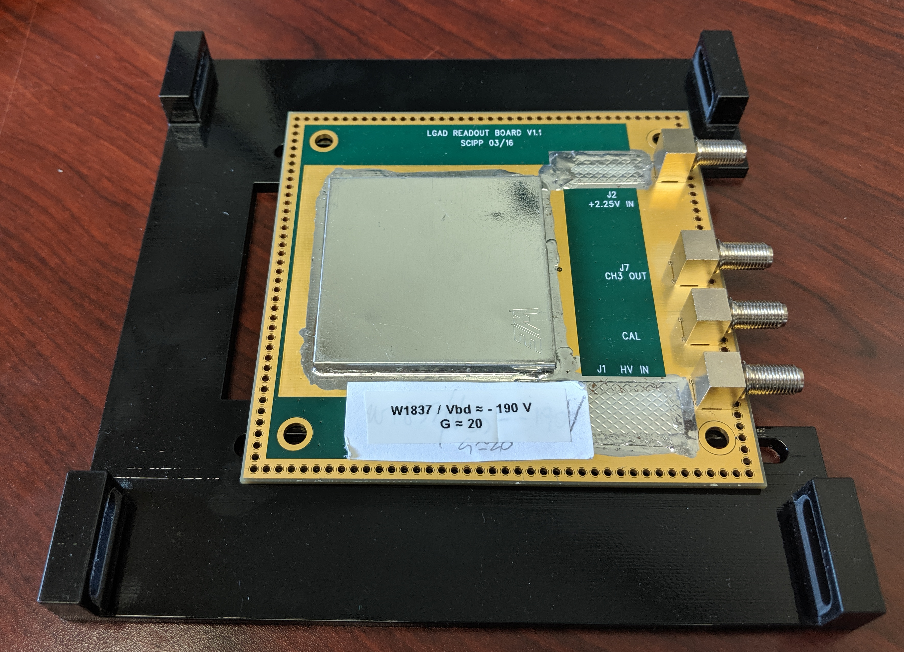
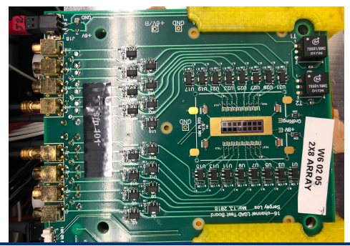
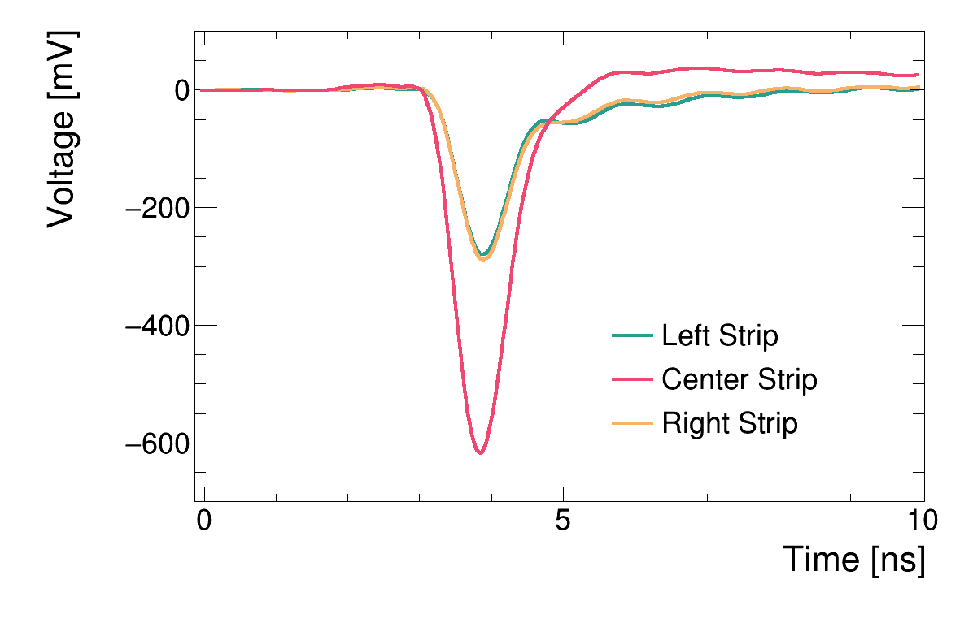
Measurements with Betas
In practice, the bandwidth of the read-out electronics is limited
TA board by SCIPP, Santa Cruz
Betas from ⁹⁰Sr
1Ghz scope
50-μm thick
2.25V
Integral
[Vs] / R_{feedback}
→ charge[C]
calibration
-HV
16-channels TA board by FNAL
Apresyan et al. “Measurements of an AC-LGAD strip sensor with a 120 GeV proton beam”,
2020 JINST 15 P09038

Slide 8
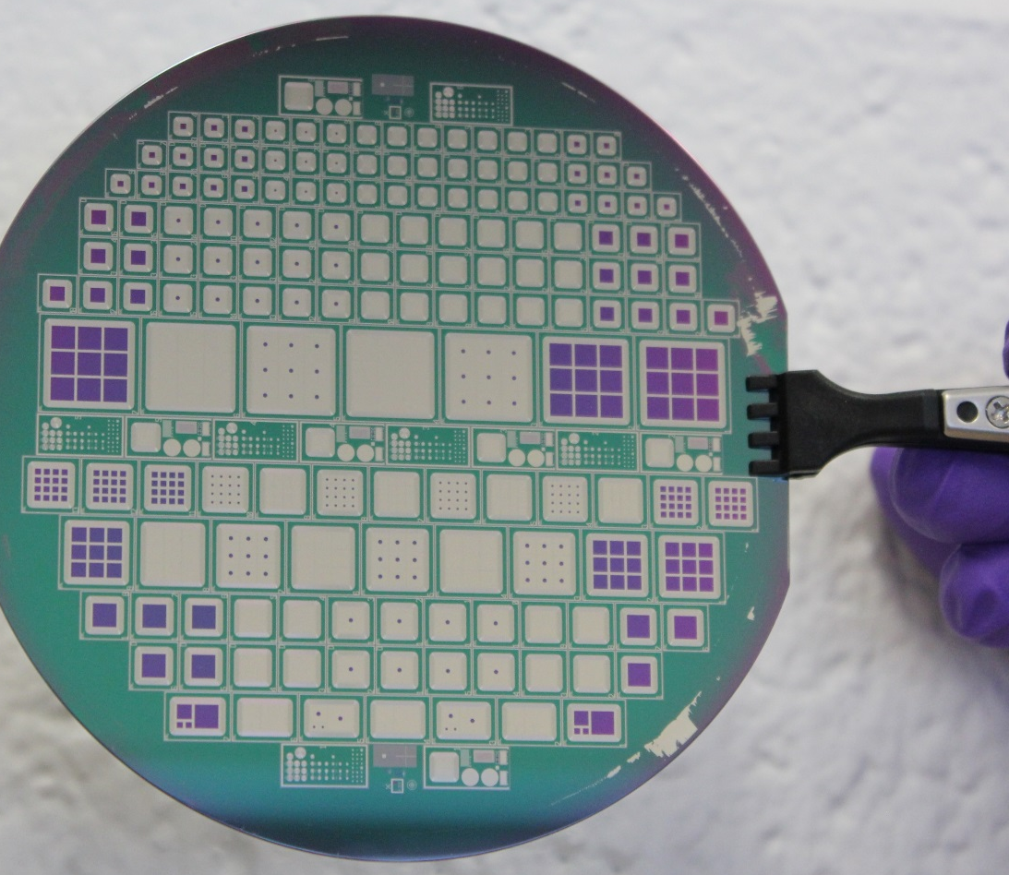
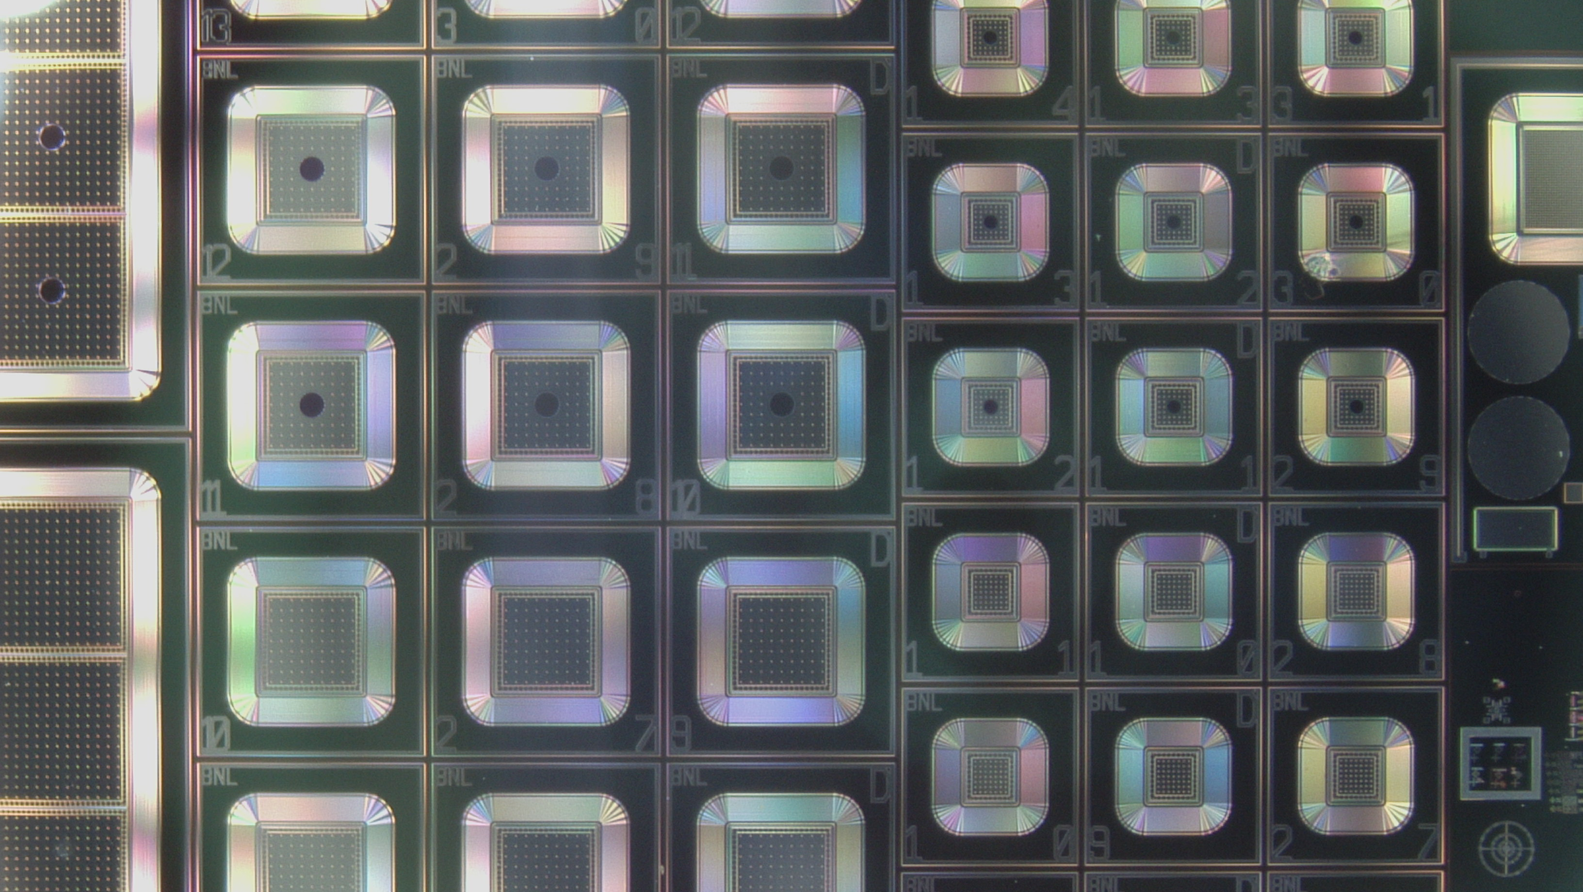
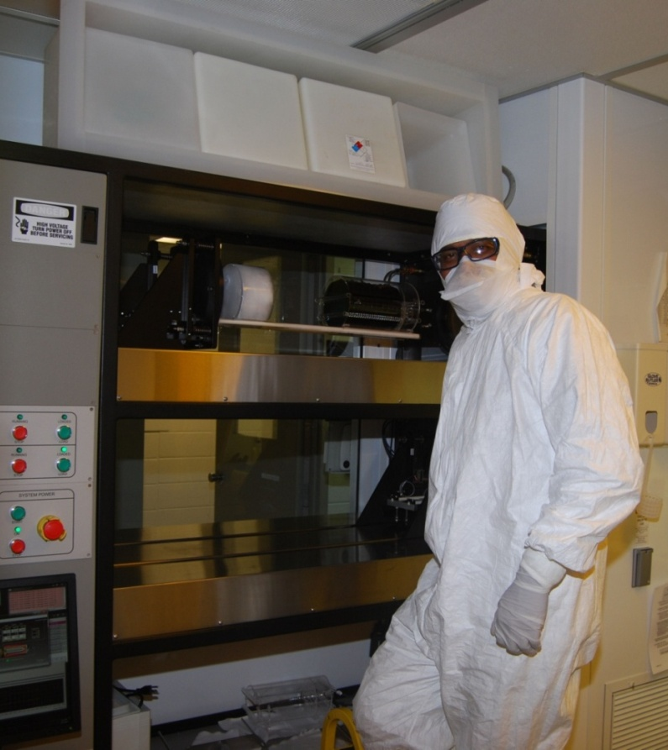
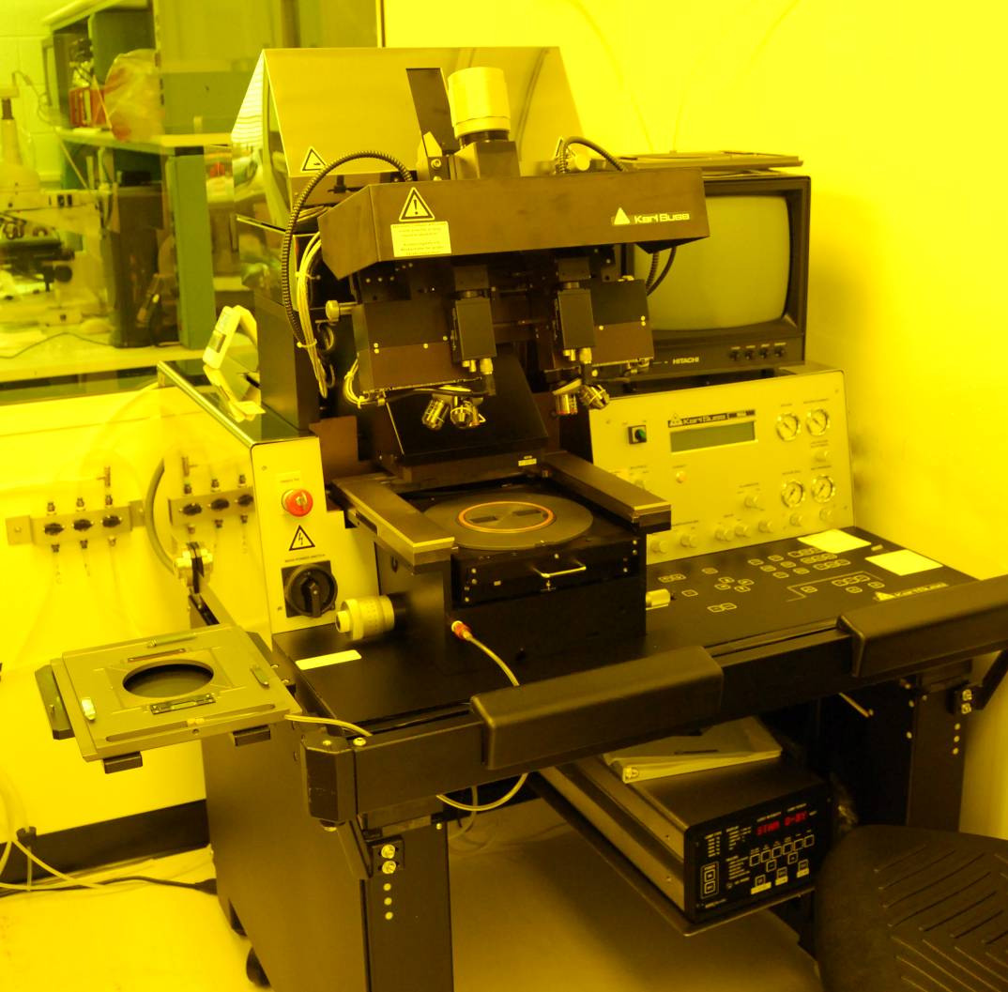
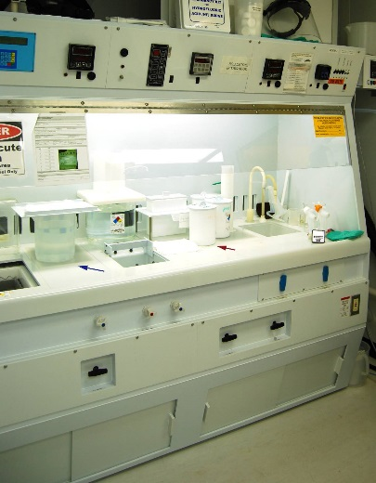
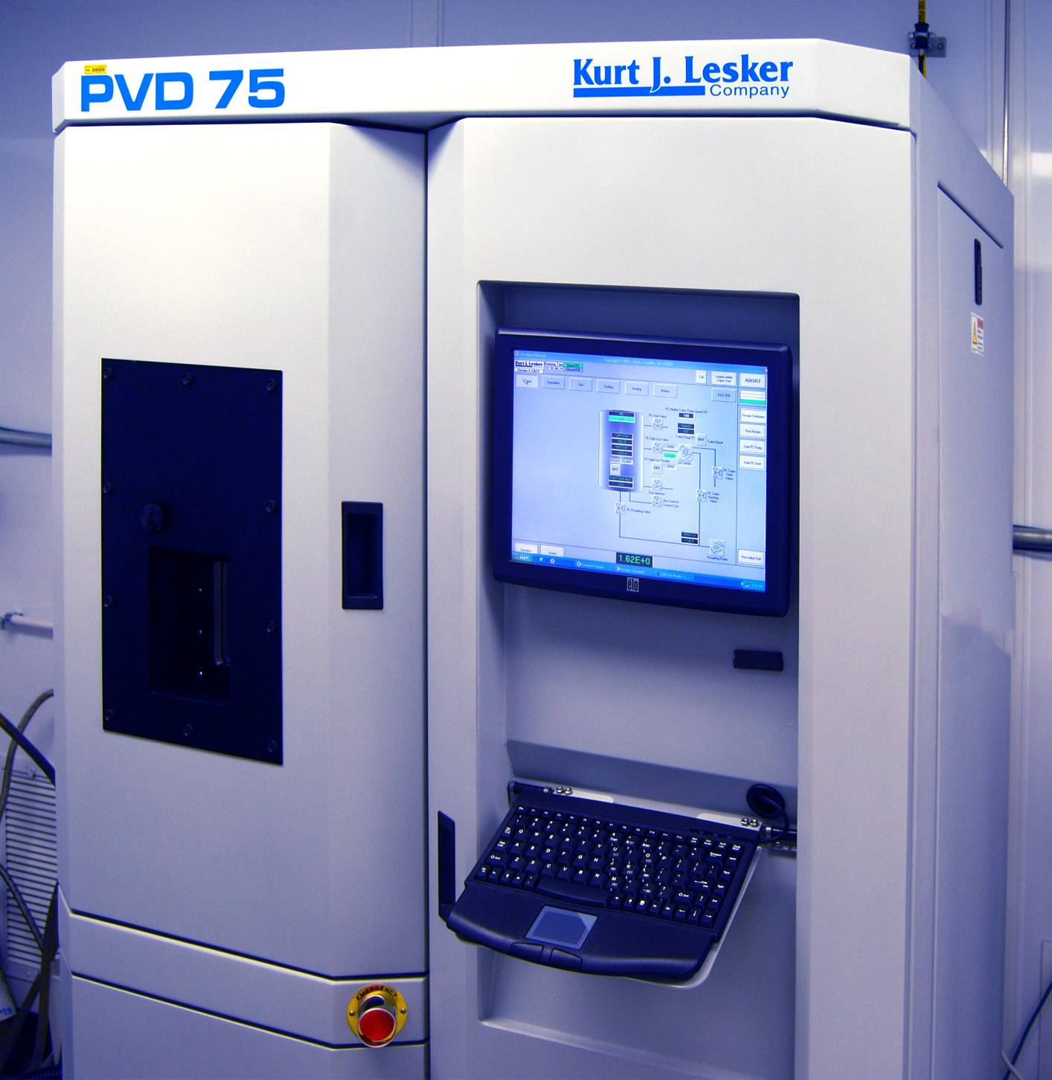
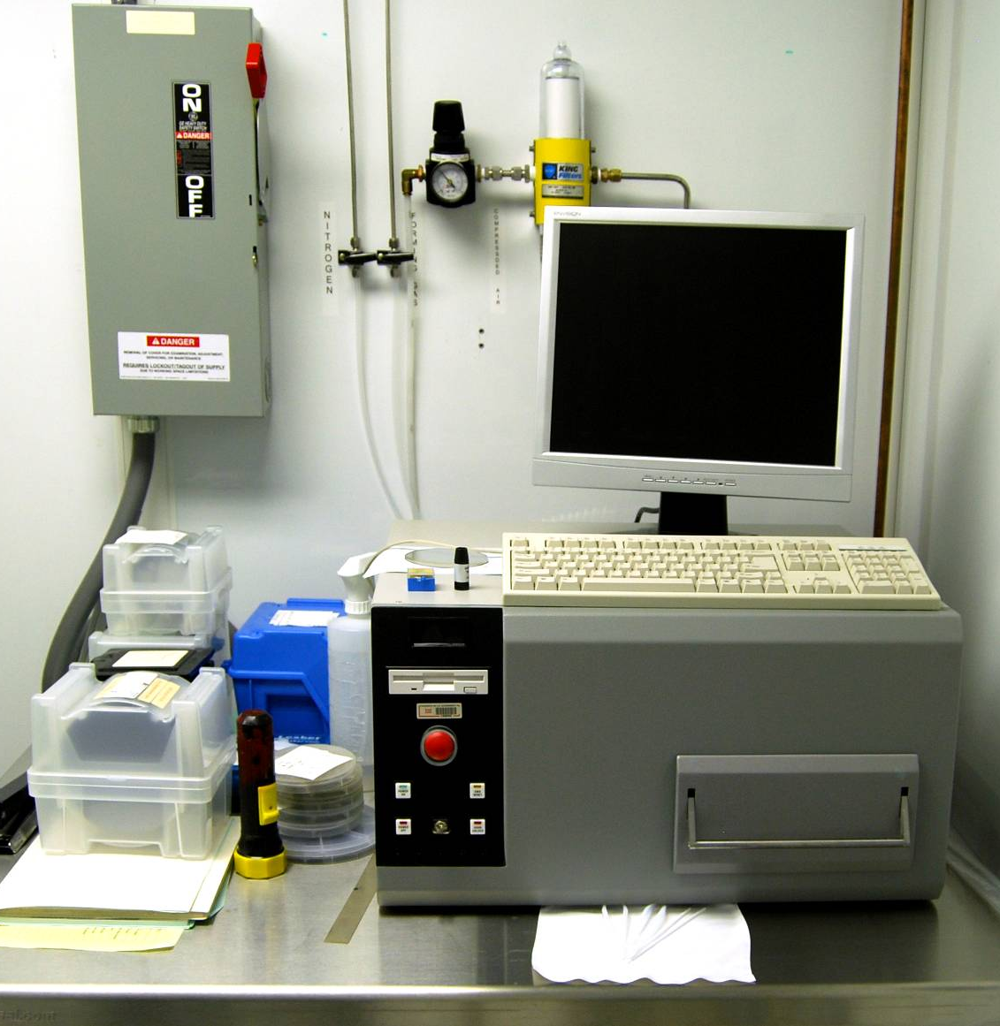
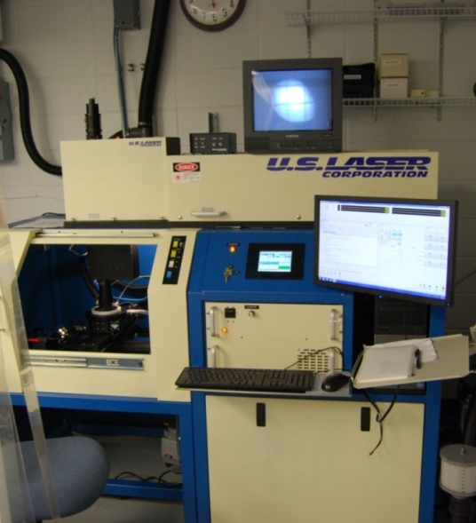
LGAD fabrication at BNL
1mmx1mm
2mmx2mm
All silicon process done in BNL Instrumentation Division Class-100 Clean Room
Furnaces for
dry oxidations
and annealings
Double-sided
mask aligner
Wet bench
(HF, RCA I & II, piranha, polyetch, …)
Sputtering
(Al, Al1%Si, Ti)
RTA for sintering
Laser dicing
CNM (Barcelona, Spain), FBK (Trento, Italy), Hamamatsu (Japan), IHEP-NDL (Beijng, China) are also producing LGADs.

Slide 9
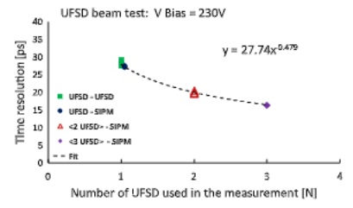
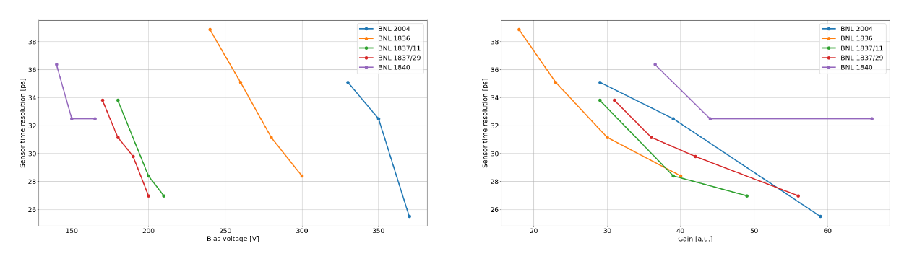
Timing Performance
First test beam using 3 LGADs from CNM (Barcelona), 230V, gain ~ 30,
proved σ_{t} ~ 16ps.
One sensor has σ_{t} ~ 28ps.
Waveforms acquired by a 4GHz, 20Gs/s and analyzed offline.
Cartiglia et al. “Beam test results of a 16 ps timing system based on ultra-fast silicon detectors” NIMA 850 (2017) 83-88
Thin
Gain ~ 20
Velocity saturation of carriers
BNL LGAD time resolution. Below 30ps if
Bias Voltage
gain
10

Slide 10
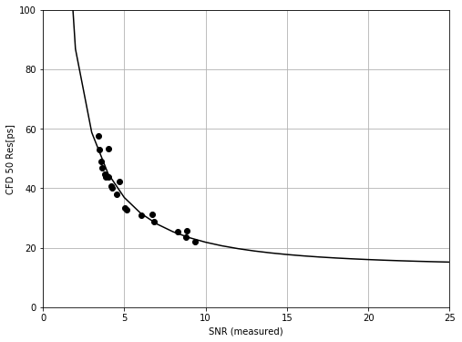
Thinner substrates
By going thinner (than 50um), better timing resolution is possible.
Of the different contributions to σ_{t:}
Jitter: small with high S/N, high gain
time walk: negligible with CFD
ADC: negligible
“Landau” noise: charge is deposited not-uniformly along the track: ultimate noise level but smaller in thinner substrates
20-um thick HPK LGAD.
Rising time < 200ps.
~400ps in a 50um LGAD.
20 micron thick sensor
A. Seiden, “Toward Large Scale 4-D Tracking:
AC – LGADs” CPAD 2021
20 ps per sensor are achievable with a modest S/N in a 20um thick sensor.
11

Slide 11
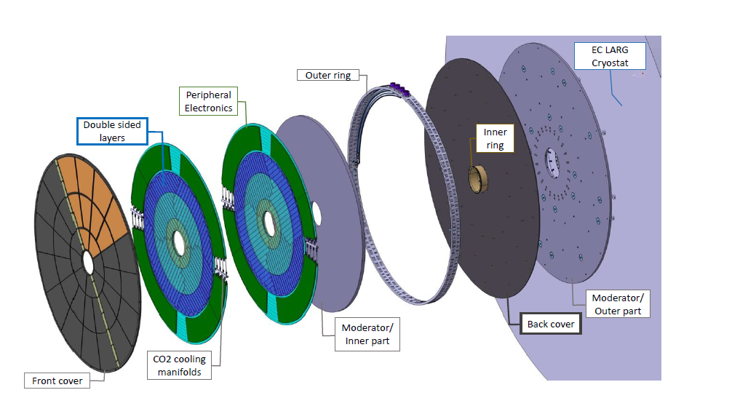
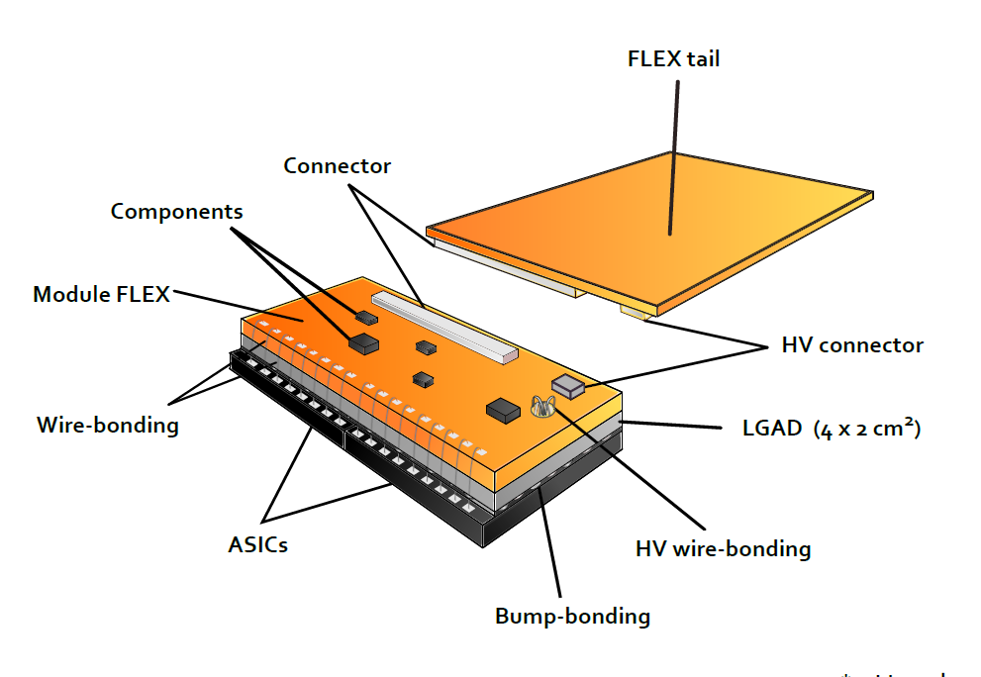
ATLAS HGTD
ATLAS High Granularity Timing Detector in the forward region made of two double sided LGAD layers (made by Hamamatsu).
Read-out by ALTIROC
Provide a track time measurement combining 2 or 3 hits of 30 ps (non irradiated) and 50 ps (after 2.5 10¹⁵ n_{eq}/cm²) for triggered events (L0 or L1)
→ Resolution per hit : < 35 ps for Q > 10 fC (non irradiated)
< 70 ps for Q = 4 fC (smallest MIP charge form sensor)
8043 4x2 cm² modules made of a LGAD sensor flip-chipped to two ASICs
Pixel size 1.3x1.3 mm²
(Cd ~4 pF)
225 channels / ASIC
ASICs signals are wire bonded to a module flex.
Similar detector in CMS: MIP Timing Detector

Slide 12
Limits of LGADs
Lateral dimensions of Gain layer must be much larger than thickness of substrate, for a uniform multiplication.
Dead volume (gain~1) extends within the implanted region of the gain layer:
→ pixels/strips (pitch ~ 100 μm) with gain layer below the implant have a Fill Factor<<100% (Voltage dependent)
→ large pads are preferred (~ 1 mm); e.g., HGTD of ATLAS and MTD of CMS
→ 4D detector not possible!!!
aluminum
oxide
n⁺⁺
Dead Volume
n⁺⁺
Dead Volume
JTE n
gain layer - p⁺
Active Volume
Epitaxial layer – p⁻
substrate – p⁺⁺

Slide 13
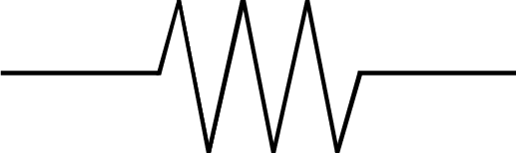
AC-LGAD concept
Two main differences:
one large low-doped high-ρ n⁺ implant running overall the active area, instead of a high-doped low-ρ n⁺⁺
A thin insulator over the n⁺, where fine-pitch electrodes are placed.
100% Fill Factor and fast timing information at a per-pixel level both achieved!!!
  Signal is still generated by drift of multiplied holes into the substrate and AC-coupled through dielectric
  Electrons collect at the resistive n⁺ and then slowly flow to an ohmic contact at the edge.
aluminum
dielectric
AC-pads
oxide
oxide
n⁺⁺
n⁺⁺
n⁺
n⁺⁺
JTE n
gain layer - p⁺
JTE n
gain layer - p⁺
AC- LGAD
Std LGAD
Epitaxial layer – p⁻
Epitaxial layer – p⁻
substrate – p⁺⁺
substrate – p⁺⁺
In a simple lumped model,
signal current i goes
to the readout electronics if
→ Z(R_{n+}) >> Z(C_{AC})
R_{n+}
C_{AC}
n⁺⁺
(GND)
i
C_{bulk}
V_{bias}

Slide 14
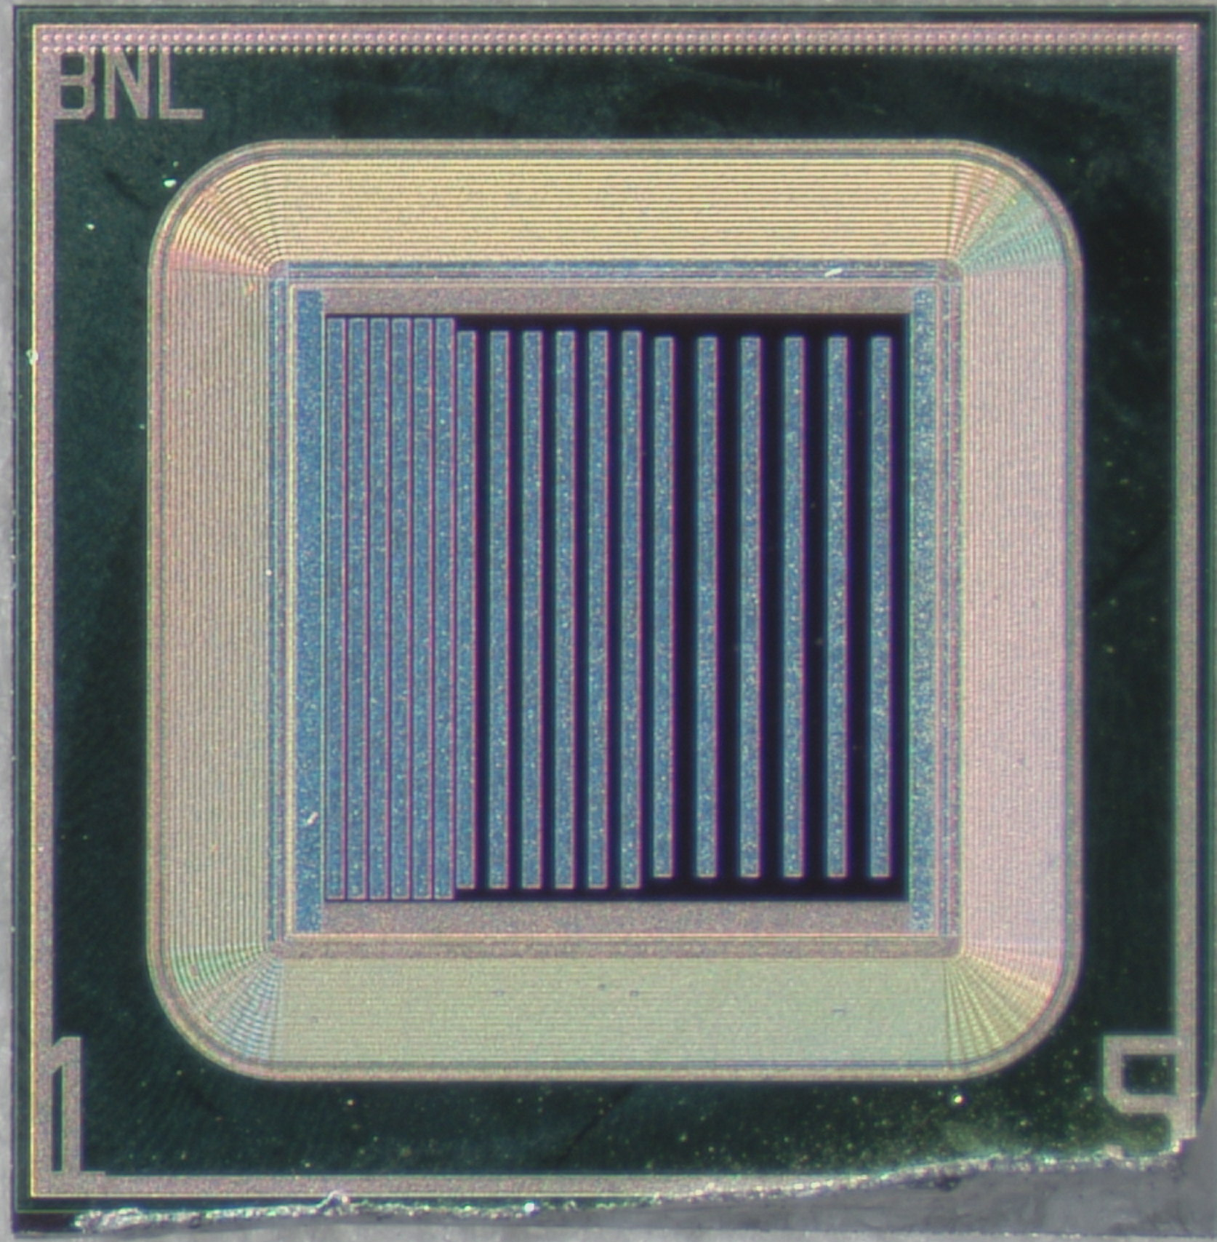
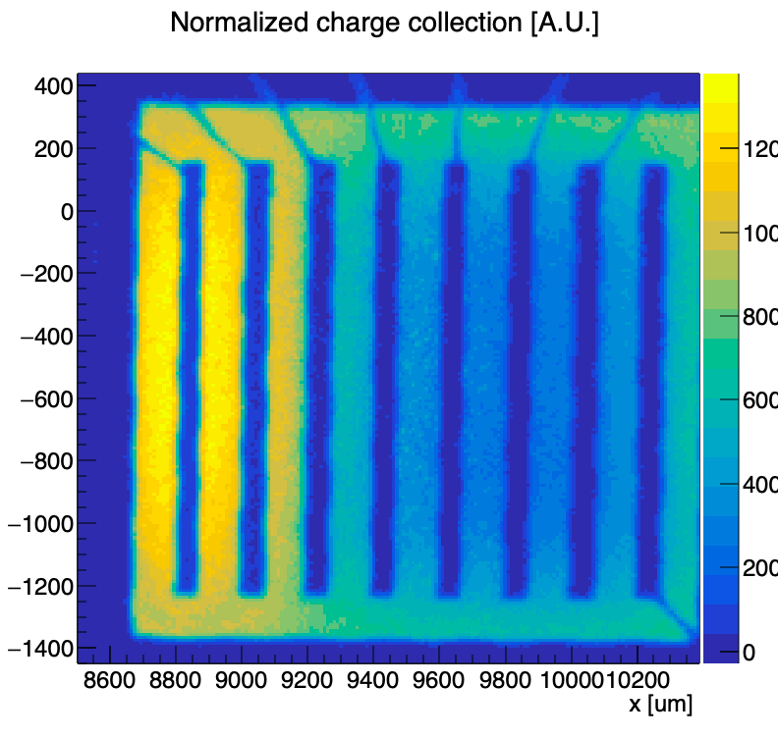
Signal sharing in AC-LGAD
signal is shared among several electrodes.
→ interpolation allows to enhance position/timing resolution.
Since multiple electrodes see a mip, not the best choice in a high event rate environment. EIC is ok.
Pitch/σ_{x} > 10 (https://arxiv.org/abs/2007.09528)
σ_{t} ~ 35 ps.
Strip under measure is seeing signals from far away
BNL AC-LGAD strip sensors, at pitch of 100, 150, 200 um.
In a recent beamtest at FNAL:
σ_{x}<15um
σ_{t} ~ 35ps.
100% fill factor
TCT laser scan (measure of signal amplitude as a function of the laser hit position)
Signal sharing
15

Slide 15
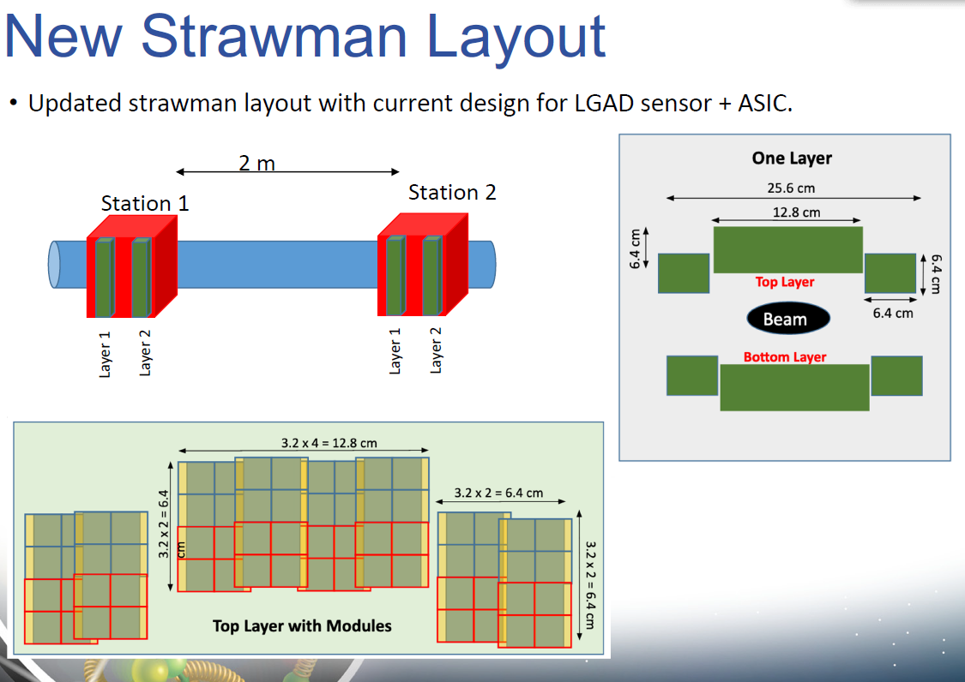
AC-LGADs are the baseline for detectors in EIC Roman Pot
Slide from A. Jentsch
eRD24 Progress Report
EIC R&D Meeting, 3/25/2021
Also, consortium of 14 international institutes with interests in the LGAD technology for EIC detectors.
See Expression of Interest on “Fast timing silicon detectors for EIC detectors”
https://indico.bnl.gov/event/8552/contributions/43183/attachments/31235/49294/EIC.EoI_LGAD_consortium.pdf
Contacts: Alessandro Tricoli (BNL) atricoli@bnl.gov, Wei Li (Rice) wl33@rice.edu
16

Slide 16
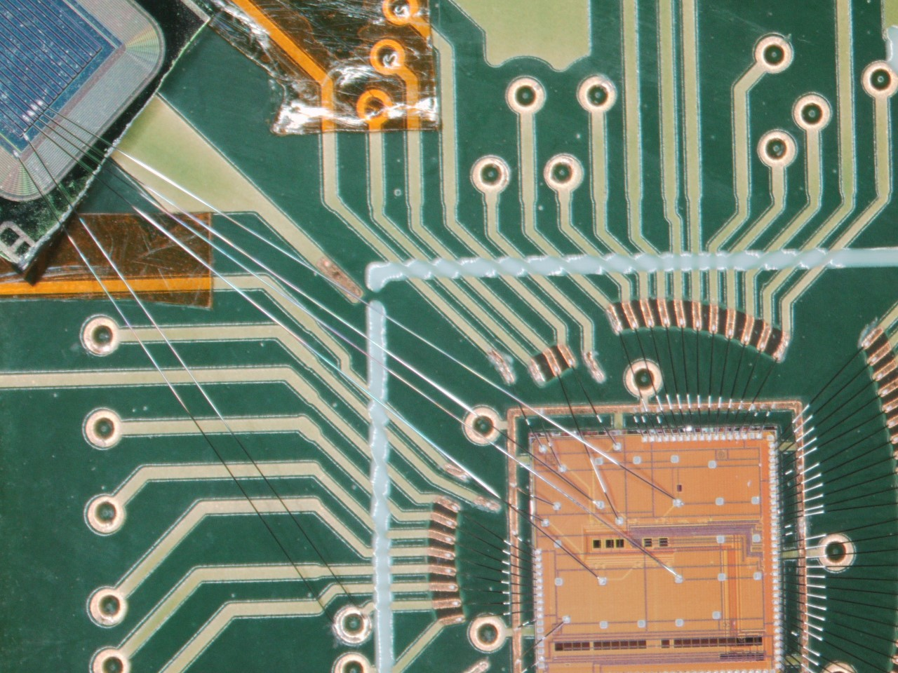
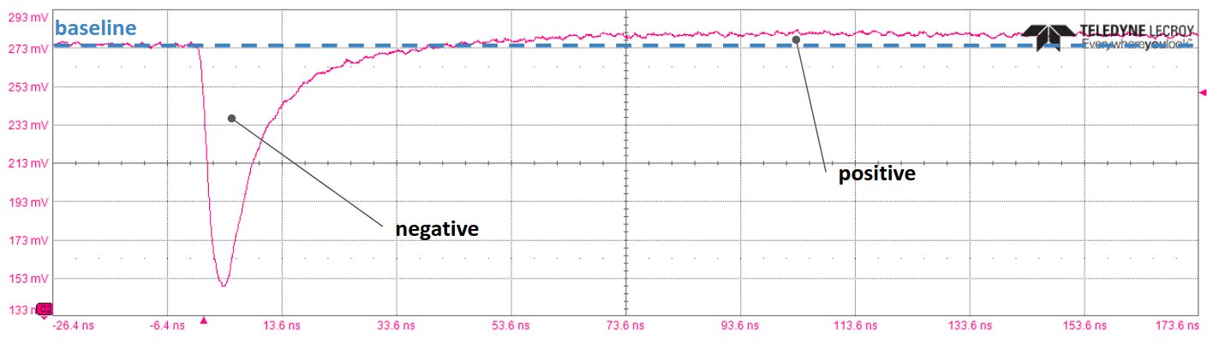
ALTIROC for read-out of AC-LGADs
In ATLAS HGTD, DC-LGADs are read-out by ALTIROC (Omega group, France).
Time jitter smaller than 20 ps for input
charge larger than 5 fC.
Uses 2 TDC: TOT and TOA.
TDC take a lot of space. OK in HGTD where the pixel is 1.3mm x 1.3mm
Can it read-out also AC-coupled LGAD?
Yes! An excellent baseline.
If we use the fact that:
Pitch/σ_{x} > 10, ASIC pixel may be larger than 1.3 mm x 1.3 mm ??
AC-LGAD wire-bonded to ALTIROC0
17

Slide 17
Other fast CMOS read-outs
In a 4D detector, pixel is small.
Issue is to shrink the CMOS pixel size as well, while retaining good timing (TDCs take room !! ) and low-power consumption/cm^{2.}
ALTIROC (HGTD, ATLAS). For EIC Roman Pots, its pixels will be shrunk to 0.5mmx0.5mm (from 1.3mm x 1.3mm).
ETROC (MIP Timing Detector, CMS)
FCFD0 (FNAL) (Apreysan, “4D trackers for future collider experiments”, CPAD 2021)
Timespot (https://web.infn.it/timespot/), although for the read-out of 3D pixel sensors
…
18

Slide 18
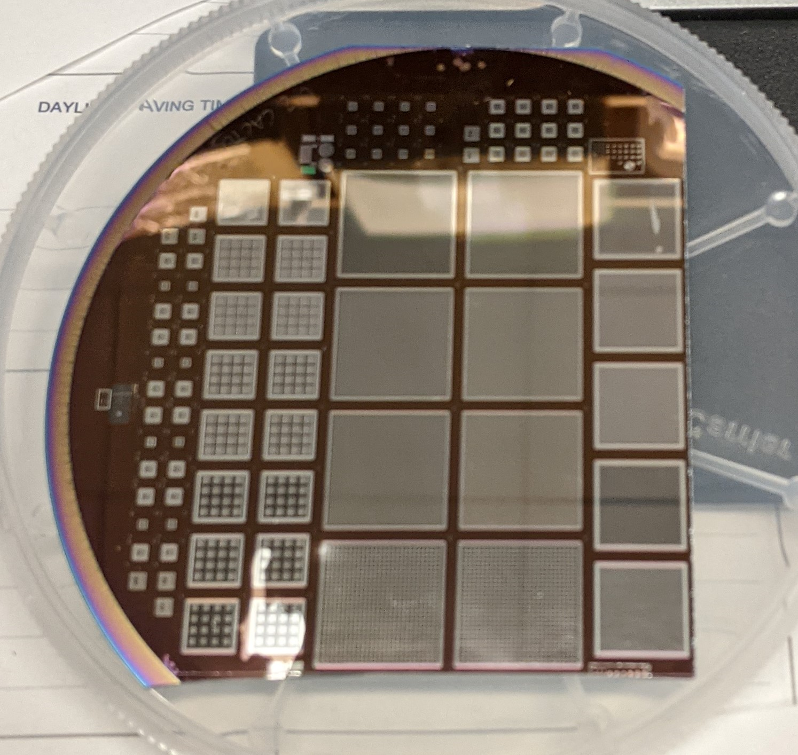
Other efforts toward a 4D detector - 1
Deep-Layer AC-LGAD
AC-pads
2nd epi layer
oxide
n⁺⁺
n⁺
n⁺⁺
gain layer - p⁺
Epitaxial layer – p⁻
substrate – p⁺⁺
Wafer cut to mount some devices on boards
This is an AC-LGAD, with a deep gain layer
Price to pay for this is a complication in the process, as it needs a deposition of a thin epitaxial layer.
The advantage: being the gain layer deep and narrow, there may be advantages in the rad-hardness
This is FNAL idea, fabrication @ BNL of a few wafers
19

Slide 19
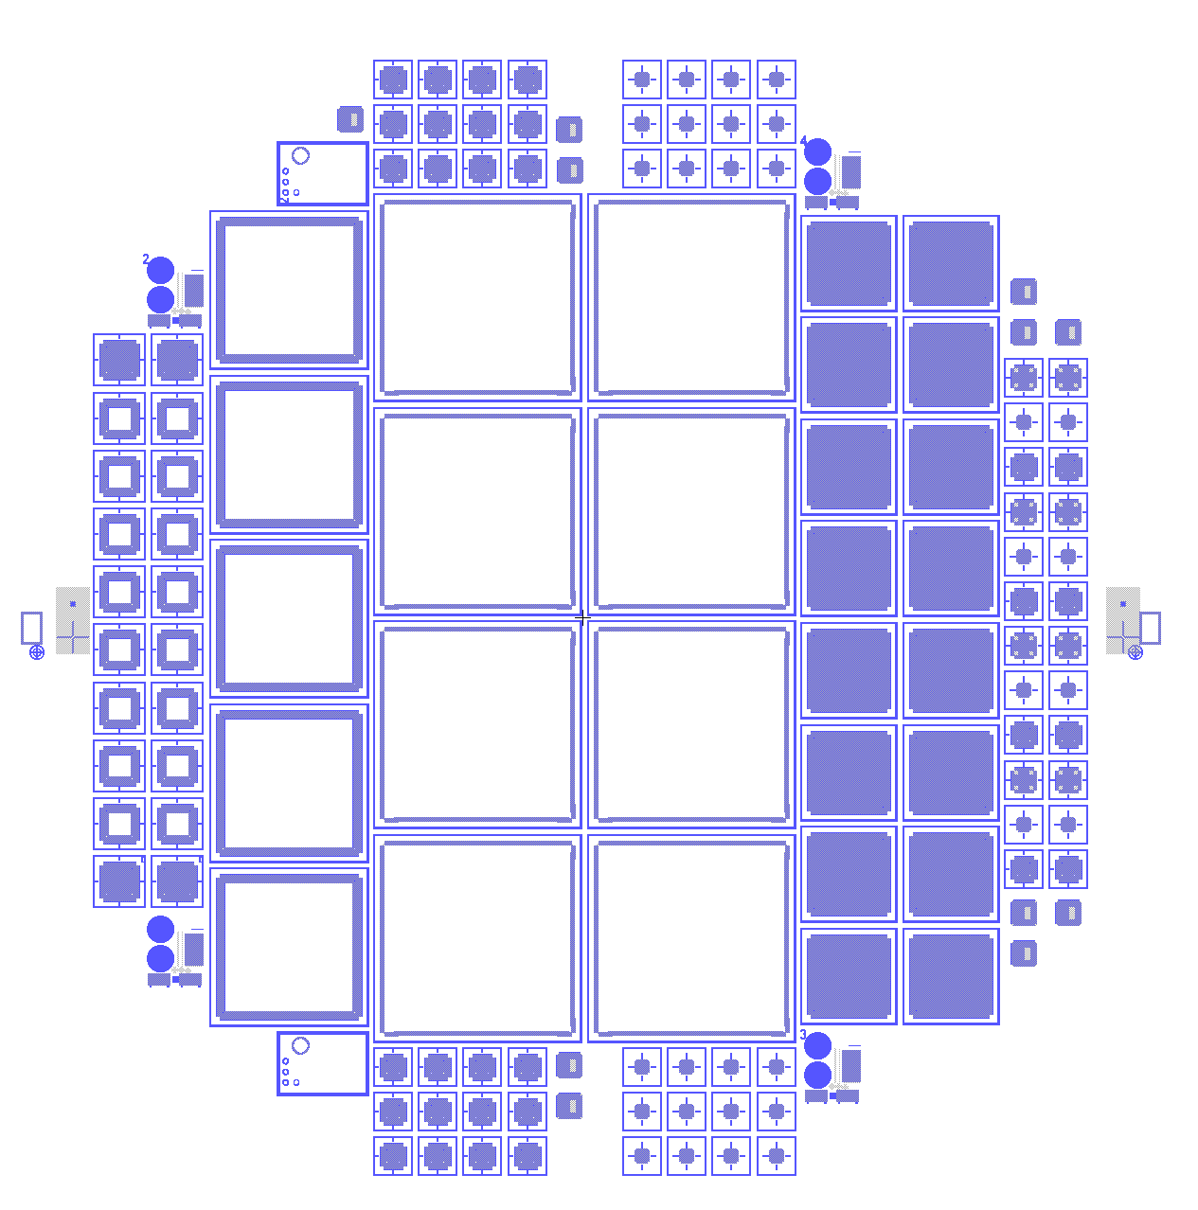
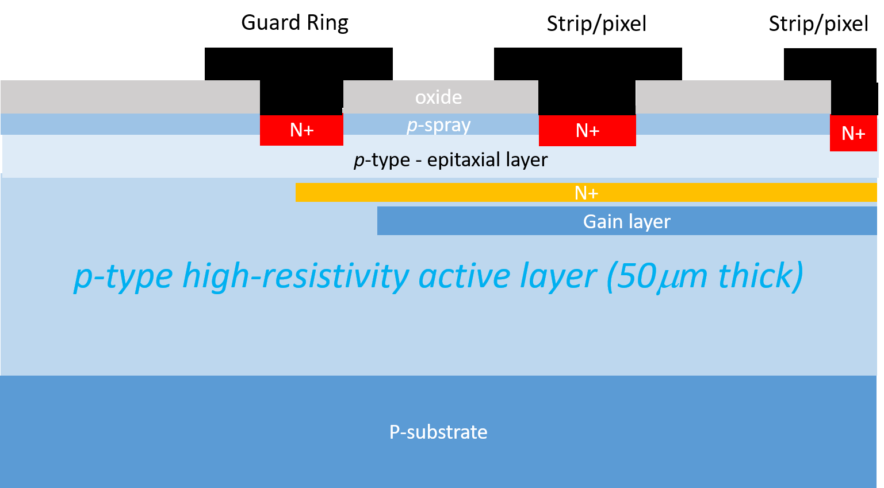
Other efforts toward a 4D detector - 2
Deep-Junction LGAD
Deep junction (n+ and p+ implants) created on conventional wafers used for LGADs, and it is depleted under the applied voltage.
Over the junction, a few μm thick p-type HR epitaxial layer has been grown.
n+ electrodes (strip and pixels) are then implanted and DC-contacted by aluminum.
Mask layout – 4” wafer
4x4 pixel sensors
(pixel pitch = 1.3mm)
ETROC/ALTIROC compatible
1cm x 1cm
Strip sensors
2mm x 2mm
Strip sensors
As of now, only concept, under process at BNL.
Single channel test devices
It is a DC-LGAD, signal induced in the strips/pixels by drift of the multiplied holes in the substrate; spatial resolution as in a conventional silicon strip detector.
20

Slide 20
Summary
LGADs can have a σ_{t} < 30ps, once a few design rules are met
Established technology: a few foundries (BNL, CNM, FBK, HPK) can do them
If we want σ_{x} ~ 100um, LGADs are not good enough and other LGADs families must be used (or developed): AC-LGADs, Deep-Layer, Deep-Junction …work in progress
Intense AC-LGAD testing at test beams, proved σ_{t} ~35ps σ_{x} < 10um (better than sqrt(12) as signal sharing can be used to interpolate)
  Work to do to optimize electrode geometries
CMOS read-out with small pixel pitch is challenging. Work in progress.
For EIC RPs, ATLAS ALTIROC used as baseline. It could be used also for a TOF as well as for a 4D .
Joining effort through the LGAD consortium will benefit all
  ASIC, sensor development, mechanics ...
  sharing of engineering solutions, costs, know-how ...

Slide 21
Back up

Slide 22
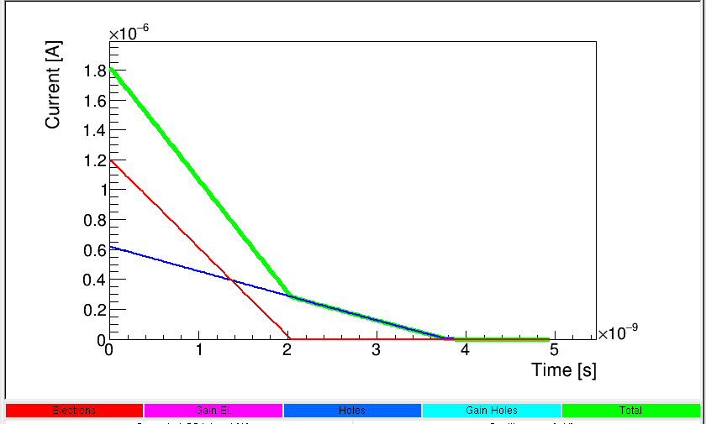
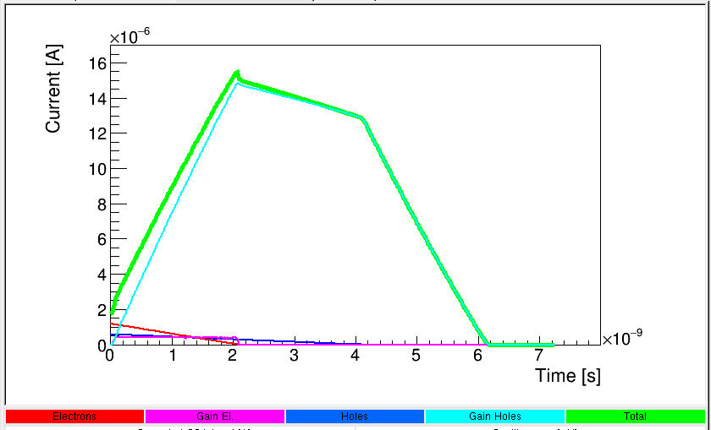
Signal shape in LGAD vs std diode
50 um thick diode
(Gain = 1)
V_{bias} = 200V
200 um thick diode
(Gain = 1)
V_{bias} = 500V
Longer signals
Larger amplitude
200 um thick LGAD
(Gain = 20)
V_{bias} = 500V
50 um thick LGAD
(Gain = 20)
V_{bias} = 200V
slower signals
http://personalpages.to.infn.it/~cartigli/Weightfield2/
6

Slide 23
Limits of LGADs
Lateral dimensions of Gain layer must be much larger than thickness of substrate, for a uniform multiplication.
Dead volume (gain~1) extends within the implanted region of the gain layer:
→ pixels/strips (pitch ~ 100 μm) with gain layer below the implant have an Fill Factor<<100% (Voltage dependent)
→ large pads are preferred (~ 1 mm); e.g., HGTD of ATLAS and MTD of CMS
→ 4D detector not possible!!!
aluminum
oxide
n⁺⁺
Dead Volume
n⁺⁺
Dead Volume
JTE n
gain layer - p⁺
Active Volume
Epitaxial layer – p⁻
substrate – p⁺⁺
n⁺⁺
n⁺⁺
A possible Solution: Closely-spaced electrodes can be put on the opposite of the wafer (i-LGADS, CNM Barcelona),
but wafers must be thick to be processed.
→ not possible to associate fast-time information on a per-pixel level!
JTE n
gain layer - p⁺
Fine-pitch electrodes

Slide 24
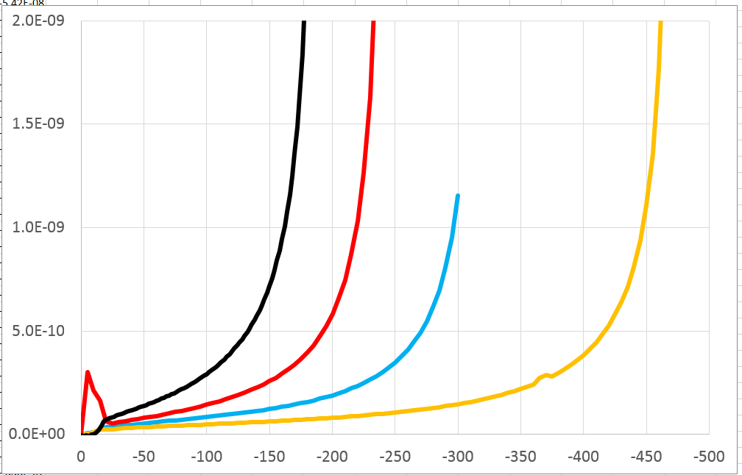
Static Electrical Characterization
C⁻²-V
BNL’s LGADs :
Leakage current as measured on diodes (gain=1) 1x1 mm² is ~ 10pA (1nA/cm²)
Consistent from batch to batch
Clearly current depends on gain layer dose, so does the breakdown voltage
GR can stand higher voltages
Diode
1/Capacitance² (F⁻²)
LGAD
Shift of the full V_{depl}
by the V_{depl, gain}.
Bias Voltage (V)
LGAD 1x1 mm²
Doping profile of gain layer
LGAD Current (A)
3.25e12 cm⁻²
3.15e12 cm⁻²
3e12 cm⁻²
2.75e12 cm⁻²
Bias Voltage (V)
CNM (Barcelona, Spain), FBK (Trento, Italy), Hamamatsu (Japan), IHEP-NDL (Beijng, China) are also producing LGADs.

