Slide 1
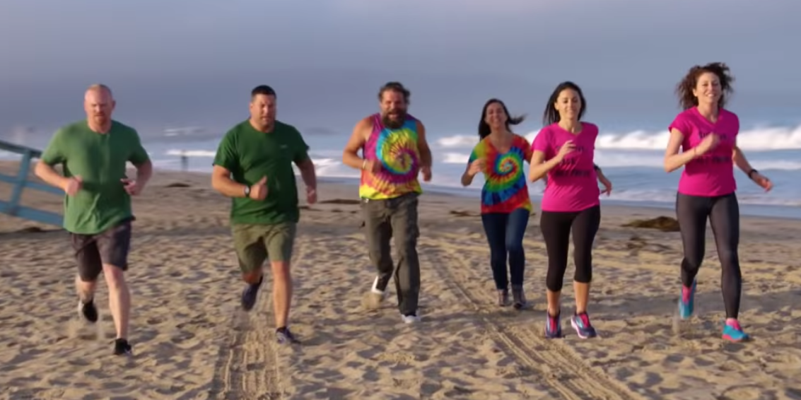
Experiments “from scratch”
“From scratch” originally refers to a line scratched into the direct to start a footrace.
Thomas K Hemmick, Stony Brook University
Many slides shamelessly and deliberately stolen from Glenn Young
The modern definition also includes “making something w/o resources”

Slide 2
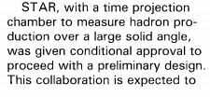
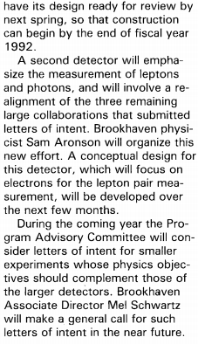
Vision
CORE is to be congratulated on a clear vision
Vision was easier in the early days of RHIC.
Funding eliminated thoughts about any comprehensive detector.
Opinions (baseless → prophetic) on best approach were numerous:
Stat Mech requires statistics; measure with a large aperture.
Non-color probes (photon, di-lepton) are emitted from earliest stages.
The “Mel-fest” was a crystalizing event: narrow & define choices:
Aperture = STAR
Penetrating Probes = RE2 (eventually named PHENIX)
Smaller “niche” proposals:
BRAHMS: forward and far-forward eta.
Phobos: low p_{T}

Slide 3
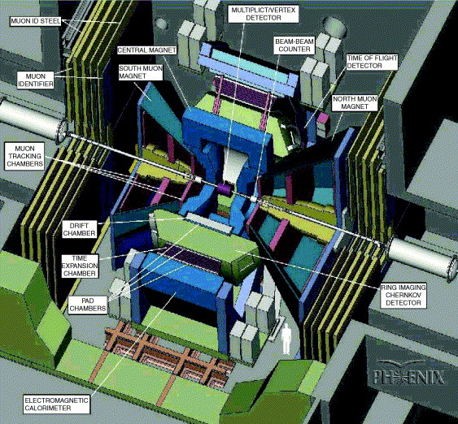
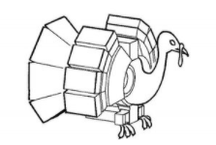
PHENIX Origins
Merger of four groups after “foundational” RHIC PAC of August 1991
Dimuon, OASIS, TALES, SPARC
Each emphasized lepton and photon detection
Differences about phase space covered, degree of PID, EMCal resolution (!)
Dimuon and OASIS had members from BNL Physics
Denoted RE2 for some time
Formation at QM1991 conference (November 1991 Gatlinburg)
Approvals:
Physics 1992
Technical 1993
Cost & Schedule 1994 – just in time for the FY 1995 government shutdown!
About 3200 days from Formation (11/1991) to First Beam Run (8/2000)

Slide 4
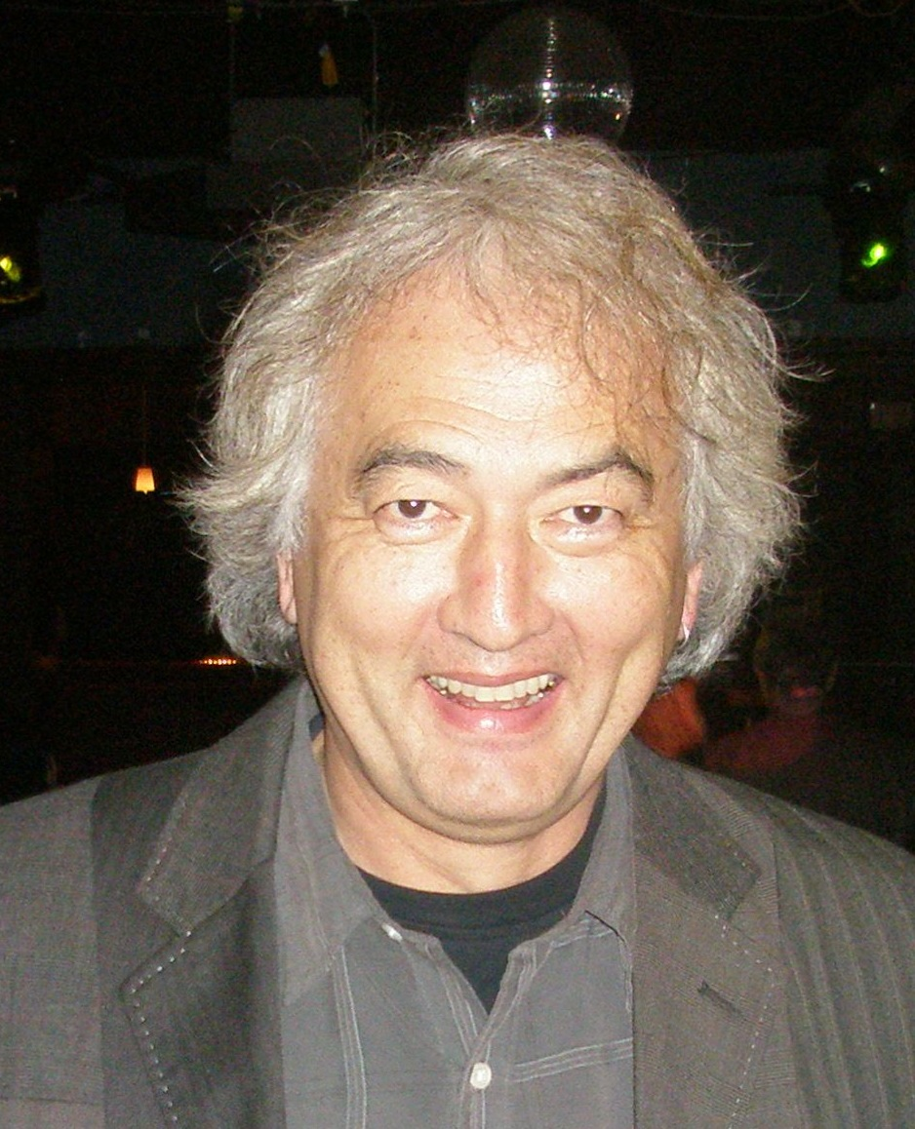
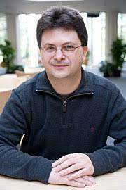
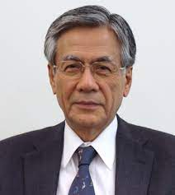
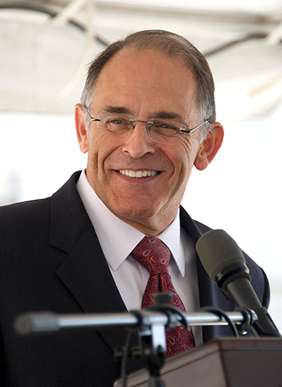
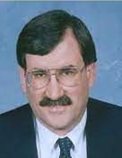
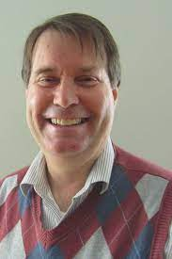
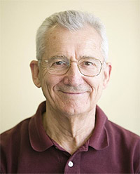
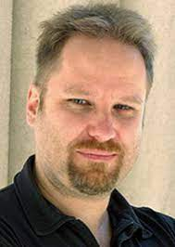
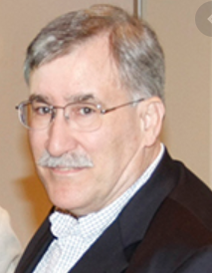
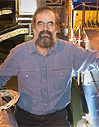
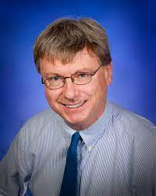
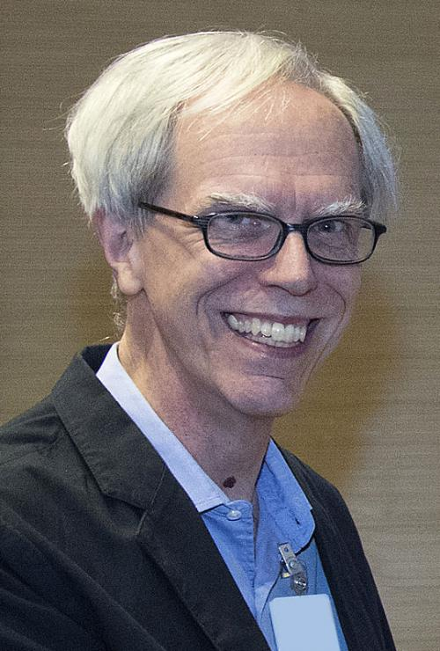
Leaders
Clone Glenn
Set up your DEDICATED Leadership early
Insist they drop commitments to other experiments
Hire a lead engineer
Find/hire someone who speaks EVMS
Find someone who can schedule in Primavera; arrange for their full attention
Find someone to head Simulations; make sure they understand it is a thankless task
TRAIN YOUR L2 MANAGERS IN EVMS
Set a master timeline
It takes 3 years to get to CD-3; by 10 years you want to be looking at collisions
Set up a Speaker’s Bureau early and use it
Advertise your experiment
Gain exposure for younger members
Compel working to deadlines
Harris
Nagamiya
Aronson
Young
Busza
Roland
Young
Morrison
O’Brien
Haggerty
Hansen Videbaek
Google could not find Ole Hansen, so here’s a picture of Fleming Videbaek

Slide 5
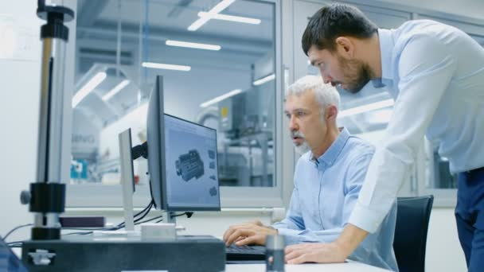
Hire Senior Engineers early on
You need a principal engineer
How will you run reviews? Document designs? Decide a design is final? Decide a design is ready to produce/procure? Handle safety and QA? Recruit engineering and design talent? Assign people? Assign and enforce stay-clear zones?
You need a lead engineer for installation
Deciding if things can be assembled, in what sequence, and over what timescale is a multi-year task, already at the design stage
Create the interface documents
Survey, tooling, fixtures, rigging, telescope sight-lines, crane weights, transports
Installation is an area where most collider detectors, probably dating back to Mark-I, have been overly optimistic (think factors of 2 or π)
You need experienced engineers to guide mechanical and electronics choices
You will need lead mechanical engineers on each subsystem

Slide 6
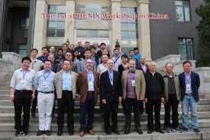
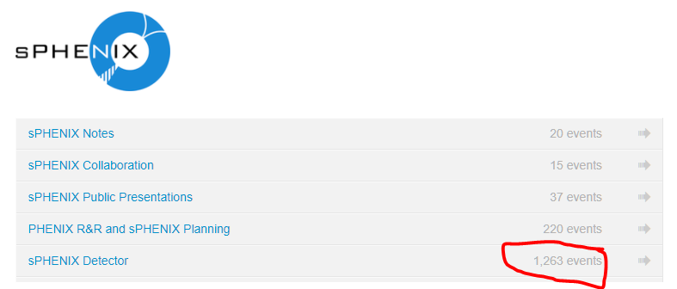
Central Physics Group
Set up a group of 8-10 physicists to act as a central physics group
PHENIX called them the Young Turks
In days of e-mail they corresponded regularly and met monthly
sPHENIX meets “Fortnightly”.
This is in addition to the other regular meetings.
The Bosses gave them a free hand, modulo non-infinite cash supplies
The Bosses insisted assertions be backed up by homework
The Bosses set minimum requirements for physics capability (photons and electrons below 1.5 GeV for PHENIX, triggerable, full event rate matched to accelerator)
Empower them
Expect it to take a year to define things
Sure, you will be reviewed before then
Designs mature from CD-1 to CD-2 to CD-3
A sense of “ownership” for the experiment must be present in the Young Turks.
108 General Mtgs
1263 Detector Mtgs

Slide 7
Define your Detector Lead Persons
This is necessarily fluid until the detector scope starts to settle
It is essential to move quickly at that point
These people need to lead the technical definition
They must guide costing, scheduling, staffing, venue definition
They must have a high tolerance for outside advice yet enough self-confidence to reject wise comments from Tribal Elders
Junior people can do surprisingly well if you empower and trust them
Note that you will all be a decade older when you start data-taking
Form these people into a Detector Council headed by your project director and manager
These people must understand that Baselined Projects are not democracies – they are much closer to top-down organizations once you start to build and have deadlines and budgets and 100 monthly reports over 8 years and reviews and more reviews and ever more reviews
This is separate from Collaboration Council and Institutional Boards
Support, value, and promote people who dedicate their work to the future.
This especially true at universities.
You and your colleagues must appropriately value this work.

Slide 8
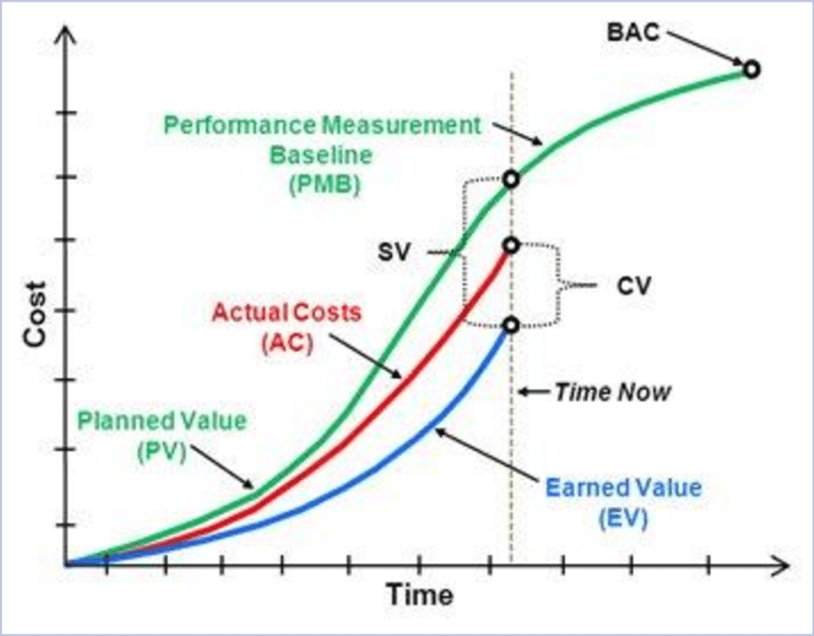
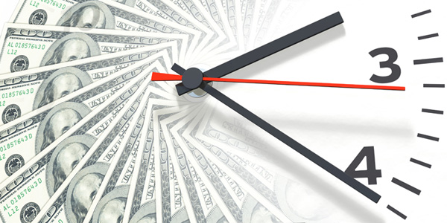
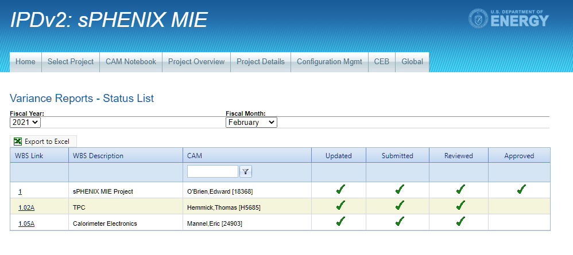
EVMS
EVMS can be your best friend, but only is you take it seriously at the early stage.
Predictive power entirely rests on quality of dependencies.
Designed like a true experimentalist would design
$ℏ=c=1$ (GeV is the only unit) → Time = money (dollars are the only unit!)
If you can photograph it, you earn the value.
Actual Conversation:
TKH: Hey xxx, did you order that recirculatory?
Bossmang: Maybe we should have one more review.
TKH: I have 13 days float.
Bossmang: OK, let’s place that order.

Slide 9
Capture the Scale of the Enterprise
Rubbia’s rule (1983): One physicist can spend $100K/year
Update to 2020: maybe $300K/year?
That implies 1000 person-years effort “just to build the thing”, or 160 full-time physicists assigned to detector construction for 6 years
Double that (at least) for software type activities
Double again for engineering, design and technician work
PHENIX peaked at 650 people (350 physicists) circa 1997-1998 and cost $200M in today’s dollars
and experiments

Slide 10
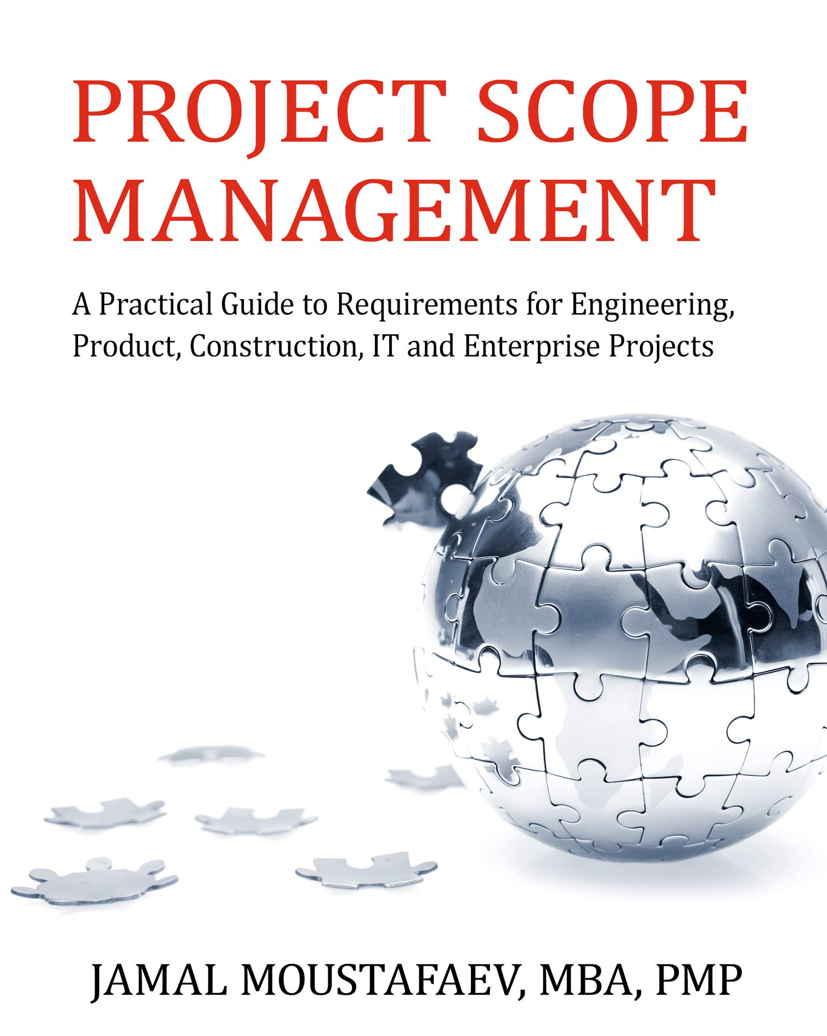
Set the Experiment Scope
Compel yourselves to decide the following within the year
Physics ‘in or out’
angular coverages
PID workhorses (type of Cerenkov? TOF? dE/dx?)
segmentations
channel counts
minimum-acceptable resolutions
event rates and data volumes
Can Jim Yeck afford your data storage needs?
Can DOE afford the computing power to analyze it all?
You cannot cost and schedule and staff what you cannot first define

Slide 11
On or Off the DOE Budget
Non-DOE contributions are encouraged; PHENIX was >50% non-DOE funds
Other USA funding agencies; Other countries; Re-purposed equipment
International contributions may require an MOA or “higher” agreement
START NOW
Future additions are OK, but your baseline detector MUST PERFORM A PHYSICS PROGRAM
Example: RIKEN-funded south muon arm in PHENIX added the spin-physics program

Slide 12
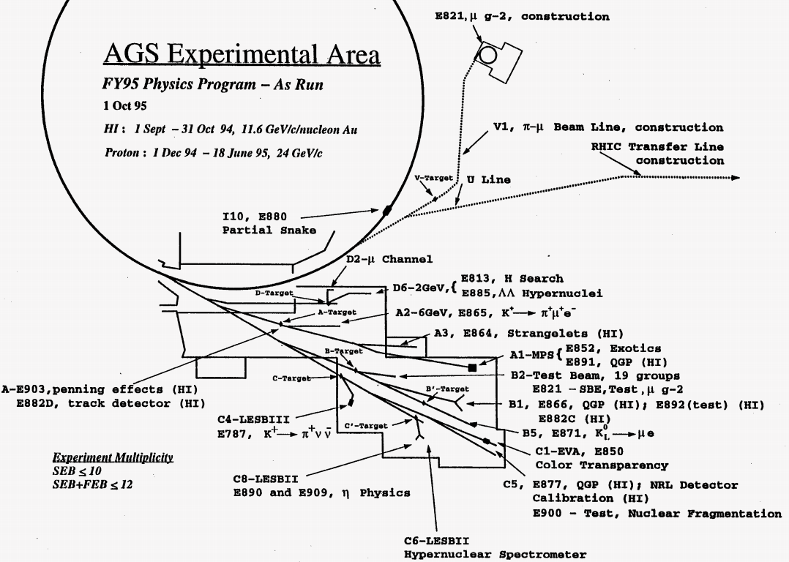
R&D Program
Define where you need R&D
This is NOT conceptual R&D – this is R&D for developing a manufacturable item
Include 1-2 rounds of concept check, then prototype, then pre-production prototype
Determine if you need a test beam and/or one or more cosmic ray test stands
Figure out where these need to be (FNAL or JLab or CERN for test beams?)
More than one Cosmic Ray test stand will be very helpful in 2-3 years
These also drive your DAQ group
Obvious R&D topics
Photosensors
Radiation hardness – detectors and electronics both
PID method for e & γ, for π/p/K
You cannot cost/schedule what you can’t define (think CD-2/3)
NOTE: 4 experiments, 19 groups

Slide 13
Estimating Notes
Figure out how many engineers you will need – double it
Figure out how many designers you will need – triple it
Figure out how many techs you will need – hmm, add 50%
BUT – start figuring out where they will be employed and where they will work
Figure out your factory space needs and start to find/commit the space
Glenn built 4 clean rooms at JLab for 12GeV – that’s $1.5-$2M of ‘stuff’ that you will not be installing into your detector
Learn what Estimate Uncertainty and Risk Uncertainty are
Understand that they measure different things
DOE will expect a full-blown Risk Registry
Acclimate yourself early on to saying “50% Contingency”

Slide 14
Build Some Breathing Room into the Schedule
Scheduling the work aggressively (“ASAP”) is a recipe for disaster
Take careful notes while you build prototypes
It takes months to
Move funds to universities
Advertise contracts, evaluate bids, pick vendors, start actual work
Get time on uncommon machines (big lathes, specialty materials lines)
Await scheduled chip fabrication cycles
Something major will go wrong
PHENIX – Gingrich’s government shutdown FY’95
12 GeV – 2008-2010 Great Recession
sPHENIX – COVID-19

Slide 15
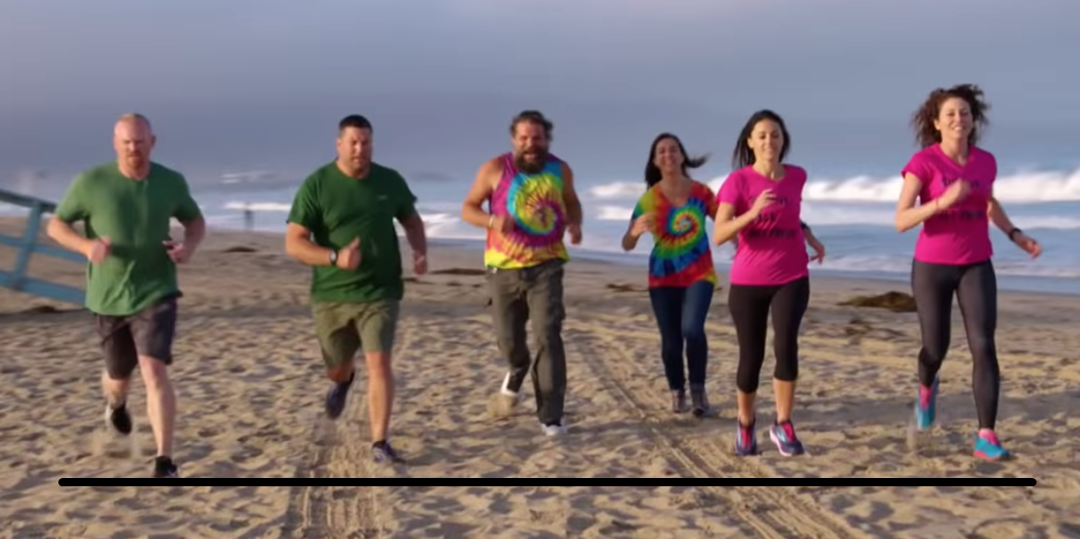
Summary: The race has begun…
CORE seems an exciting program.
Over the next ~year EIC directions will crystalize.
A central group of people will be required to fully commit.
Dedication, community, and ownership are vital.
Expect a “staged” switchover from partial to full commitment:
Leaders become exclusive to EIC experiments soon.
Lead engineers follow shortly thereafter.
The “Young Turks” step up soon afterwards.
Our community must value early commitment to EIC endeavors.

Slide 16
BACKUPS

Slide 17
Decide Your Tracking Technology
PHENIX lost a year in these discussions, guided out of the wilderness by a junior professor who challenged the Elders
Do you really have to have redundant coverage over a particular piece of phase space?
What physics drives your resolution requirements?
If the wonderous device which you just must have has not ever run in a physics experiment, decide how long you can hold the decision open while doing R&D work before you have to pick something known to work
2 years for prototyping of an unproven concept is a very long time in 413-world

Slide 18
Decide the Required Calorimetry Performance
The sPHENIX EMCAL will need refurbishment. The SiPMs will be wearing out. Aim for more areal coverage – improve the position non-uniformity
The barrel HCAL ought to be OK
The forward and backward calorimeters are going to cost a lot of money. Think very hard about what resolution you need and what e/h response you need. State-of-the-art hadron resolution is expensive. What physics program needs better than 100%/√E ?
The electron-tagging calorimeter needs a very good constant term, better than 1%

Slide 19
Review the BaBar magnet
Do this now. Your critics are not silent.
Talk to K. Amm, M. Anerella et al. from the Superconducting Magnet Division at BNL
They know the BaBar magnet, they know the risks, we’ve done a bit of groundwork for you
Maria Chamizo expects to hear from you
Talk to the JLab magnet group (R. Fair) – they recently built for the 12 GeV project some 7 new superconducting magnets in the relevant size-and-stored-energy range and also maintain, did surgery upon, and operate an older and larger superconducting magnet. They’ve written a report on possible issues with the BaBar magnet. They known their stuff. They are credible.

Slide 20
Decide the FEE and DAQ Architecture
Event-builder or not – work out the implications and settle this
Triggered or not – the resulting decisions on whether or not to buffer pending a trigger, in particular whether to buffer on-detector, are central to your architecture
The trend is clearly away from event builders and if possible from triggers
Can you afford the resulting data volume and transport bandwidth?
FADCs cost space, power, optical bandwidth, cooling and cabling
Life is easier at lower power. How slow can you digitize?
Decide if you can use community-available ASICs, if not then COMMIT to making your own
12 GeV and sPHENIX decided for 3 existing ASICs, but in two cases did make straightforward modifications – allocate 2 years minimum to prove this out
PHENIX and STAR opted to roll their own – PHENIX did 14 different ones. That carries risk and needed several design groups totaling over 50 people. An advantage was a compact low-power setup with minimal cabling off the main detector
DO NOT UNDER ANY CIRCUMSTANCES ASSUME THE LARGER PHYSICS COMMUNTIY WILL RIDE TO YOUR RESCUE ON ASICS. BE PREPARED TO RECRUIT AND PAY FOR TALENT.

Slide 21
Building the Host Lab Group
Following are some notes
Pre-history of RHIC
Timeline of the PHENIX experiment at RHIC
Build-up of the group at BNL from 1991-2000, with emphasis on skillsets

Slide 22
RHI Program Early Days
1983 NSAC LRP – a RHI collider of 30x30 GeV/A or higher
1984 DOE Office of Science Rejuvenation Plan (Al Trivelpiece)
Light sources to LBNL & ANL, neutron source to ORNL, RHIC to BNL
1986 startup of fixed target RHI programs
CERN at SPS – WA80/93/98, NA35/49, NA38/50, later NA44, NA45
BNL at AGS – E802/859/866, E814, E864
Continued through mid-1990s
RHIC-inspired workshops 1983 (QM), 1984, 1985, 1987, 1988
1984 and 1987 at LBNL (I think), others at BNL
Collaborations already forming at 1984 fall workshop
Experiment “concept” presentations at 1985 and later; major push 1988
RHIC TAC review held fall 1990 – included costing
RHIC PAC review and “decisions” held August 1991

Slide 23
Sources of People at BNL
BNL AGS and CERN SPS RHI experiments were a key source, a bit for Day-1 BNL people but chiefly for those added over the next decade
Others at BNL had worked at CERN ISR
Others at BNL were part of D0 at FNAL Tevatron
Others had worked on cyclotrons (10 MHz bunched-beam machines)
Others had worked at Linacs (LAMPF; CEBAF had not yet started)
RE2 started with maybe 200 people on the rolls of the 4 earlier collaborations
PHENIX peaked at 650 people during construction (1997-1998)

Slide 24
Day-1 Skillsets, BNL Group
Three with EMCal experience (leadglass, U-scint, LAr/Cu)
One with tracking chamber experience
One senior engineer with SLD/electronics/PM experience
Only one person with experience working with Instrumentation Div
No DAQ/trigger/online computing experience
Modest experience on simulations, reconstruction, and offline analysis

Slide 25
Day-1000 Skillsets, BNL Group
Added two EMCalorimeter people “post SSC”
Added a tracking chamber person (pad type) in wake of major re-org
Picked up three postdocs/junior staff with general calorimeter, neutral meson reconstruction and tracking reconstruction experience
Picked up former atomic physicist with knack for organizing
Picked up lead mechanical engineer and designers (D0 experience)
Picked up senior tech (D0) who could direct designers and techs
Started picking up technicians (went from 0 to 10 over a decade)
Could lead an R&D effort with by then >400 collaborators, over half from outside USA

Slide 26
Day-2000 Skillsets, BNL Group
Added three scientists with DAQ experience from AGS HEP program
Added computer scientist for online controls
Added mid-career electrical and electronics engineers
Added postdoc/junior staff with online computing experience and another with DAQ experience, both from CERN program
Developed links with large group in Instrumentation to handle timing system, TPC readout electronics, and general electronics control
Could host very-early-days operations in 1008 Control room – first chain test of electronics
Could direct design room efforts, 1008 installation, 1008 rack room build

Slide 27
Day-3000 Skillsets, BNL Group
Added postdocs/junior staff for offline computing
Added junior staff for online computing, data reconstruction at RCF, counting house operations, database construction/operation
Co-Headed simulations and analysis data-challenges
Lead all detector chain tests and initial DAQ commissioning
Guided many nervous junior colleagues in bringing their detectors online for the first time
Office staff went from one to two to handle visitor influx
Physics analysis ‘interest areas’ were becoming established
By this time a regular cycle of talks on physics and detector plans/progress was established

Slide 28
Start of RHIC Operations, BNL Group
Peak was perhaps 80 people during 1996-1999 construction push
DOE ONP had been inquiring since 1995 about long-term staffing
Magnitude of staffing needs came into focus after ONP took trip to CDF
Scale of RHIC operating budget discussed at NSAC circa 1995 – frankly a bit of a shock to the “NP” community – first “>$100M/year” operating budget
PHENIX prepared a management plan listing every group’s commitments, staffing levels, long-term expectations – public version rather “thin”, DOE version highly detailed and by name
BNL PHENIX group by 2001 was 23 scientists, 10 techs, 5 engineers
Of the scientists, 12 were postdocs or had hired in earlier as postdocs
Eight senior staff came from what one would call HEP
Two senior staff from RHI NP, one from Atomic (BNL tandems)

