Slide 1
Status Report from the Detector Team
by
Douglas Higinbotham (JLab) and Kenneth Read (ORNL)
ECCE Intuitional Board Meeting 12 April 2021

Slide 2
Charge
Define the configuration of the ECCE detector for the proposal – the central barrel, the forward hadron and backward electron arm, as well as the far-backward and far-forward beamline instrumentation – that enables ECCE to address the full physics program in the National Academy report and the EIC White Paper.
Important that technology choices take into account the interests of the ECCE consortium members.
For the proposal, we envision a baseline configuration with perhaps a few configuration options. It is important to establish the detector configurations that will be required for simulation studies soon.
Because ECCE starts with the fixed 2.8m diameter bore of the BaBar solenoid, a key challenge will be to identify a configuration of the central barrel that can fit tracking, PID and calorimetry (with adequate performance) in this constrained space.

Slide 3
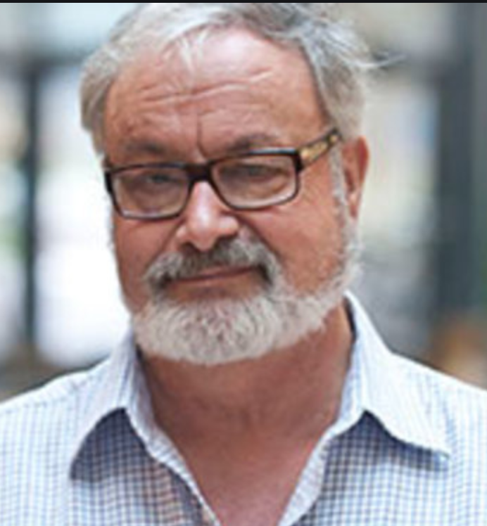
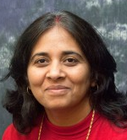
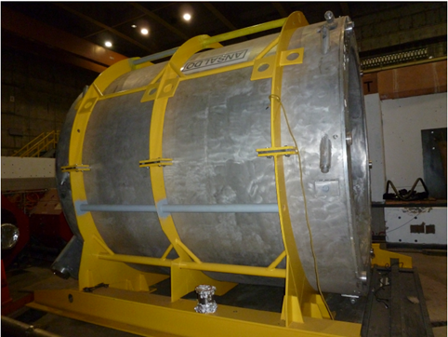
BaBar Magnetic Field convener: Paul Brindza with Renuka Rajput-Ghoshal (JLab)
Unique feature of the ECCE proposal is reuse of the BaBar magnet.
Engineering study has been done. There are items to address before this magnet is used for another 20 years: https://tinyurl.com/h4uesj9z
A challenge will be the acceptance and performance of the forward hadron arm in the 1.5T field and whether or not this can be addressed by shaping the field.

Slide 4
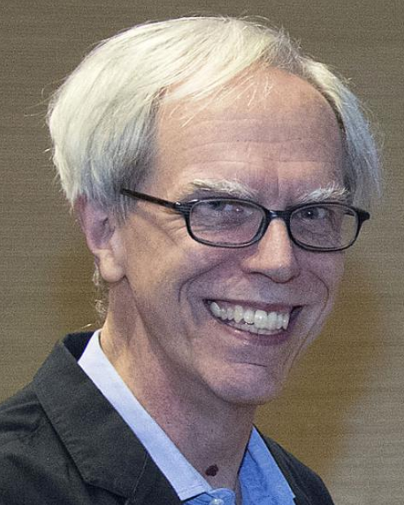
IP8 Equipment Reuse convener: John Haggerty (BNL)
John is already taking care of “the IP8 Equipment Use before the Re-Use” as IP8 gets ready for the sPHENIX experiment.
Oversaw acquisition of the former BaBar magnet from SLAC.
John will interface with other detector groups informing them which equipment / detectors can reused.
Important for cost-effectiveness of ECCE proposal.

Slide 5
Calorimetry co-conveners: Friederike Bock (ORNL) and Yongsun Kim (Sejong U.)
Friederike represents ORNL EIC Consortium of teams.
Yongsun represents Korean EIC Consortium of institutes.
Electromagnetic Calorimetry
Lead Tungstate (PbWO₄)
W powder / ScFi
SciGlass (with backup options such as Pb/Sc Shashlyk)
and more under consideration
Hadronic Calorimetry
Magnet Steel (reuse)
Pb/Sc
Fe/Sc (reference detector material)
and more
JOIN US (for this and other systems)! Links shown on last slide.

Slide 6
Tracking co-conveners invitations outstanding
Silicon Barrel Tracker (central barrel)
Leading choice
Focus can be on details of layout
Endcap Tracking
Candidate technologies:
Micro Pattern Gaseous Detectors (MPGD)
Monolithic Active Pixel Sensors (MAPS)
Details of tracking systems required for full simulations and specs of data acquisition system.

Slide 7
Particle Identification co-convener invitations outstanding
Hadron Particle Identification
Dual RICH (aerogel and gas)
Aerogel
Gas RICH
Modular RICH
DIRC
dE/dx
TOF
And more
Electron / Hadron Separation at Low Momentum
Transition radiation detector
Hadron Blind Detector
Modular RICH
Aerogel
And More
Many combinations possible. AI optimization can be explored (huge phase phase of options though with clear goals).

Slide 8
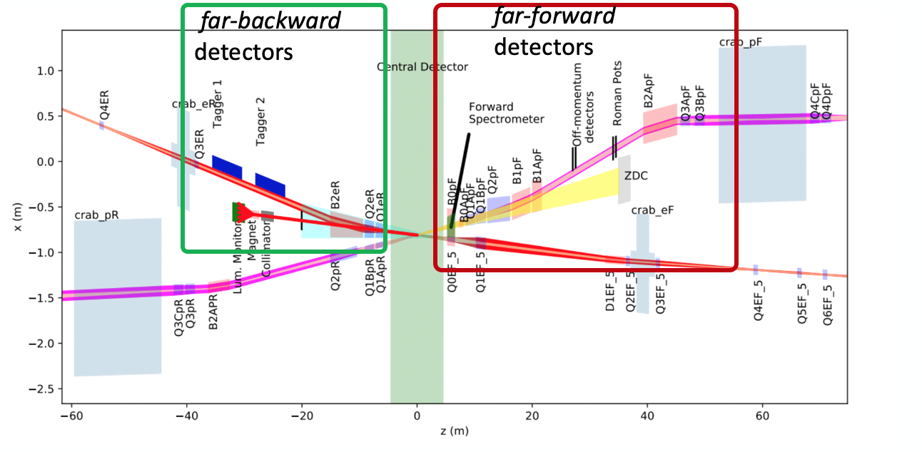
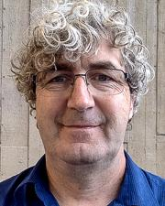
Far Forward/Backward Detectors confirmed co-convener: Michael Murray *
FAR BACKWARD DETECTORS
low-Q2 (electron) tagger
Lumi-detector
FAR FORWARD DETECTORS
Zero Degree Calorimeter – Si/W & PWO (SciGlass)
Roman Pots – Silicon sensors, AC-LGADs (Low Gain Avalanche Detectors)
Off-momentum Detector – Silicon sensors
B0-trackers - Monolithic Active Pixel Sensors (MAPS) & timing layers
We will study both the 25 mrad crossing as proposed for IP6 and the 35 mrad with secondary focus as currently proposed for IP8 with a midterm goal of writing a publication detailing the results.
*ALSO NOTE: Yulia Furletova (JLab) and Alex Jentsch (BNL) will continue their yellow report role interfacing with accelerator division to optimize the far forward/backward regions.
NOTE: Yulia Furletova (JLab) and Alex Jentsch (BNL) will continue their yellow report roll
Interfacing with accelerator division to optimize the far forward/backward regions.

Slide 9
Data Acquisition & Electronics co-conveners being determined
Front End Electronics (depends on detector choices)
Streaming Readout / Conventional Readout / Hybrid
Triggerless / Triggered / Hybrid
Common solutions to reduce cost and improve schedule
Physics requires many different timing combinations:
low Q2 tagger and Roman pots located ( ~60m apart )
forward electron and far forward hadron
All particles in the central detector
and on and on.
Event building (either classic or virtual) needs to be carefully considered. Informed by schemes successfully implemented by other experiments.

Slide 10
Next Steps
Finalize All The Detector Working Group Co-conveners.
Start Regular Meetings with the Detector Working Groups.
Short term goal: Create a feedback Loop with simulation team to ensure full set of detectors can do the physics of the White Paper and National Academy report (a requirement of the call for collaboration detector proposals)
Medium term goal: Attempt iteration with AI optimization for appropriate aspects (noting non-AI approach remains available and cross-checks will be done).
Long term goal: Finalize details of acceptable configuration(s) for the Proposal, including technologies, cost, schedule, and risks.
Please, sign-up for the detector mailing list: https://lists.bnl.gov/mailman/listinfo/ecce-eic-det-l
Multiple Mattermost channels with very active discussion, including Tracking, PID, Calorimeters, ECCE, ...: https://chat.sdcc.bnl.gov/eic/channels/fun4all-ecce

