Slide 1
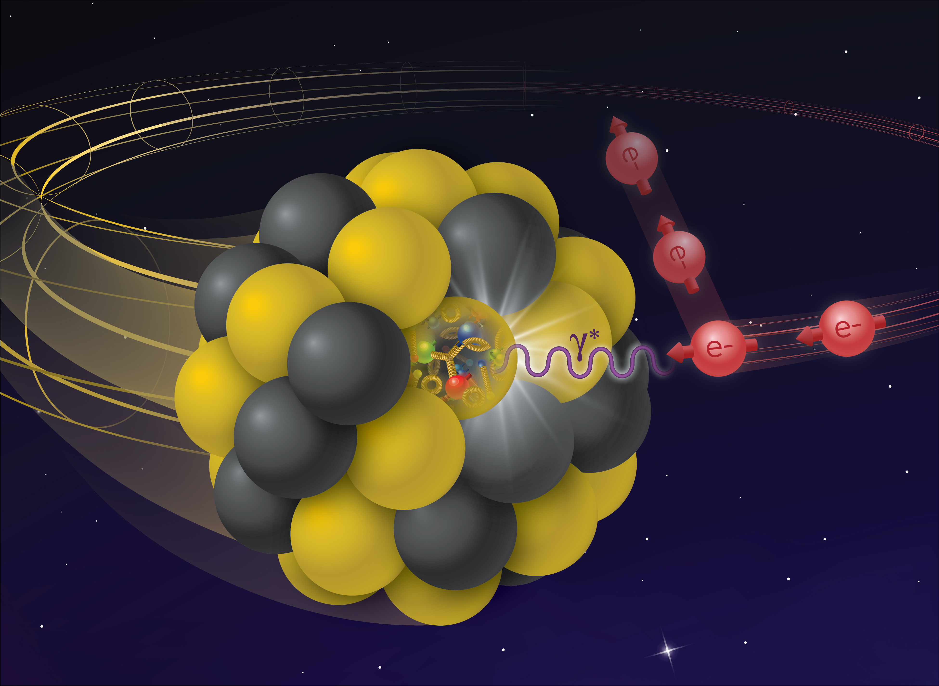
Welcome / Orientation
1st EIC@IP6 Bi-Weekly Meeting
Barbara Jacak
UC Berkeley & LBNL
On behalf of the EIC@IP6 Organizing Committee
Silvia Dalla Torre, Abhay Deshpande, Olga Evdokimov, Yulia Furletova, Barbara Jacak, Alexander Kiselev, Franck Sabatié, and Bernd Surrow
1

Slide 2


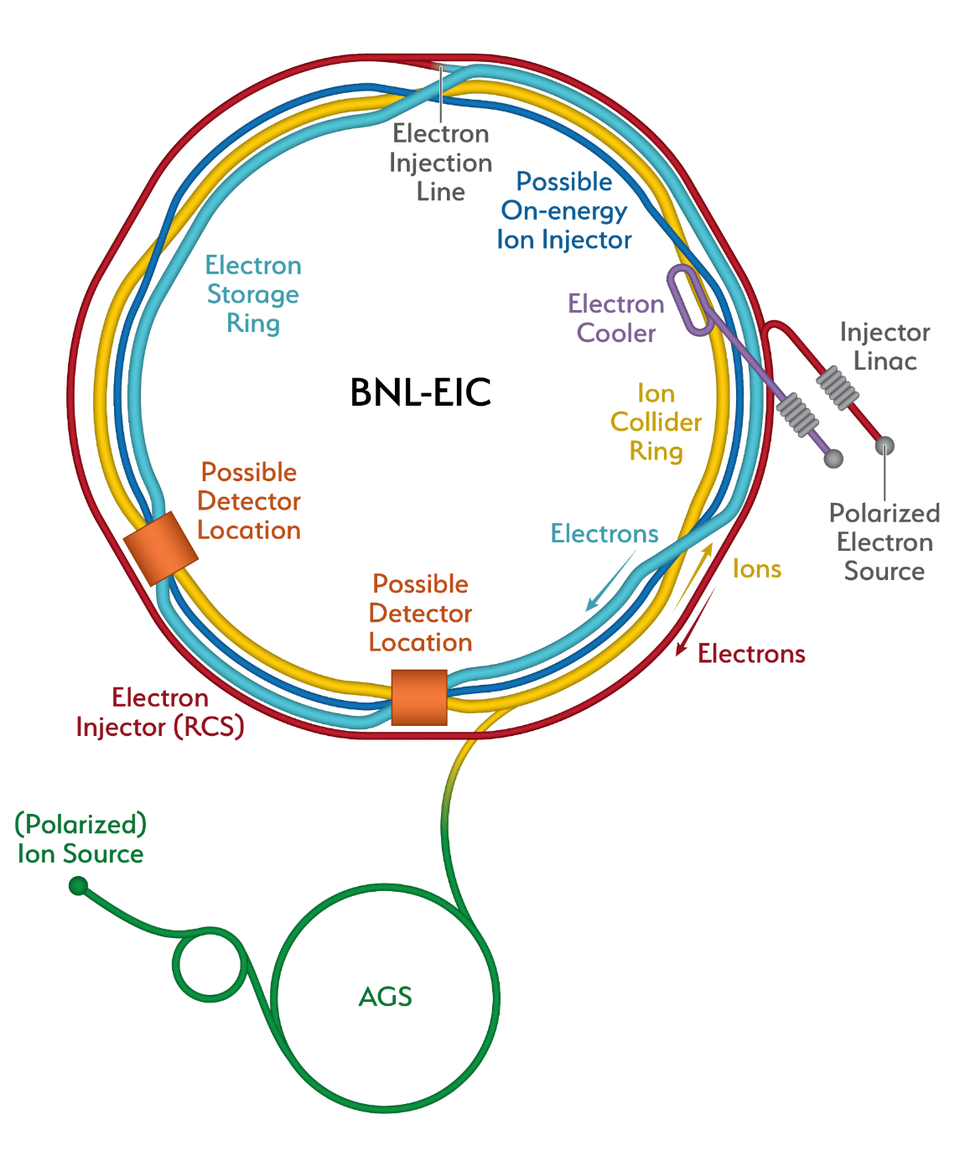
Outline
Introduction / Institutions / WWW-page
Overview of agenda
Collaboration Naming Survey
Mailing lists / Slack channel
IP8
Hall D
IP6
EIC@IP6 Bi-Weekly Meeting
April 1, 2021
Bernd Surrow

Slide 3

Introduction / Institutions / WWW-page
We are delighted to see you!
We start working together towards an EIC experiment at IP6!
Biweekly & monthly meetings at staggered times
Goals:
    1) EICUG community’s strong preference for 2 detectors -> multiple exciting detector initiatives. 2) We invite all interested groups and consortia to come together to propose a
    detector inspired by the YR detector concept with new central magnet up to 3T.
3) Begin forming a new collaboration for IP6
Announcements / News / Updates WWW-page: https://sites.temple.edu/eicatip6/
Hall D
EIC@IP6 Bi-Weekly Meeting
April 1, 2021
Bernd Surrow

Slide 4
Introduction / Institutions / WWW-page
Regular general EIC@IP6 meetings
  Finding an appropriate meeting time window is challenging, covering multiple time zones.
  Bi-weekly meetings: 11:00AM (EDT) - 02:00PM (EDT) for April 1, April 15, and April 29
  Monthly meetings: 08:00 PM (EDT) - 11:00 PM (EDT) for April 8 and May 6
  Note: There is no intention to separate collaborators by region. It is only intended to make it easier for our European and Asian collaborators. We also plan to record all meetings and make them available to all.
  Permanent ZOOM links:
  Thursday, April 1, 2021: US/EU - 11:00AM (EDT) - 02:00PM (EDT) / Bi-weekly
  https://temple.zoom.us/j/98280886660?pwd=Mk9hMlU1TUdITysvYkVLNTRjbUVYQT09
  Password: eic@ip6
  Thursday, April 8, 2021: US/Asia - 08:00PM (EDT) - 11:00PM (EDT) / Monthly
  https://temple.zoom.us/j/96313723031?pwd=UEpuSHVWQ3N3aVpvZllGajMvSVF0Zz09
  Password: eic@ip6
EIC@IP6 Bi-Weekly Meeting
April , 2021
Bernd Surrow

Slide 5
Introduction / Institutions / WWW-page
Institutions
  Multiple institutions have either expressed their explicit interest during the recent kick-off meeting or afterwards to the EIC@IP6 effort.
  A list of institutions has been compiled that have expressed interest in joining the EIC@IP6 effort. Everybody has been contacted to confirm the actual contact for each institution and confirm the EIC@IP6 interest. Additional information has been requested, such as sub-system interest and if an institution is planning to participate in more than one detector proposal / IP. Click here!
  We kindly ask you to provide feedback by Friday, April 9, 11:59PM (EDT).
  Establishing a complete institutional list will be the basis of forming a proto-collaboration Institutional Board (IB), which will vote on various matters of our effort moving forward.
  Regular IB meetings will be arranged in addition to the general bi-weekly EIC@IP6 meetings. Olga will talk about this part in more detail!
  Any comments or questions?
EIC@IP6 Bi-Weekly Meeting
April 8, 2021
Bernd Surrow

Slide 6
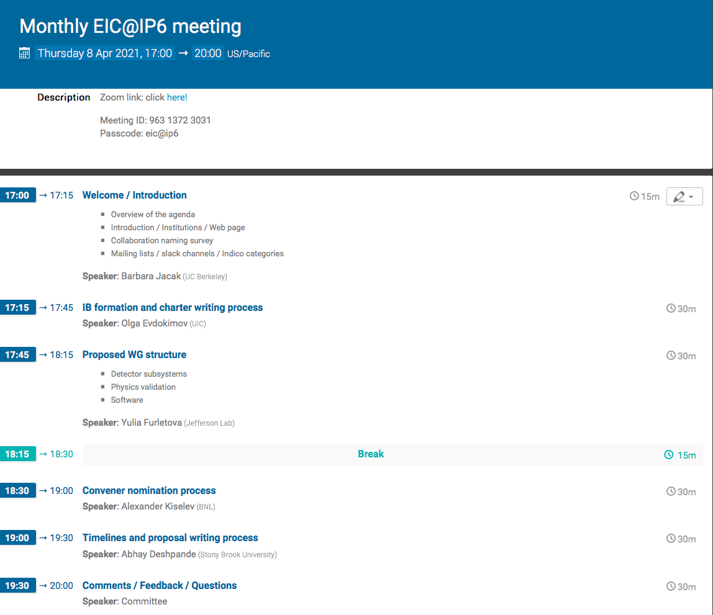
Overview of Agenda
EIC@IP6 Bi-Weekly Meeting
April ,
Bernd Surrow

Slide 7
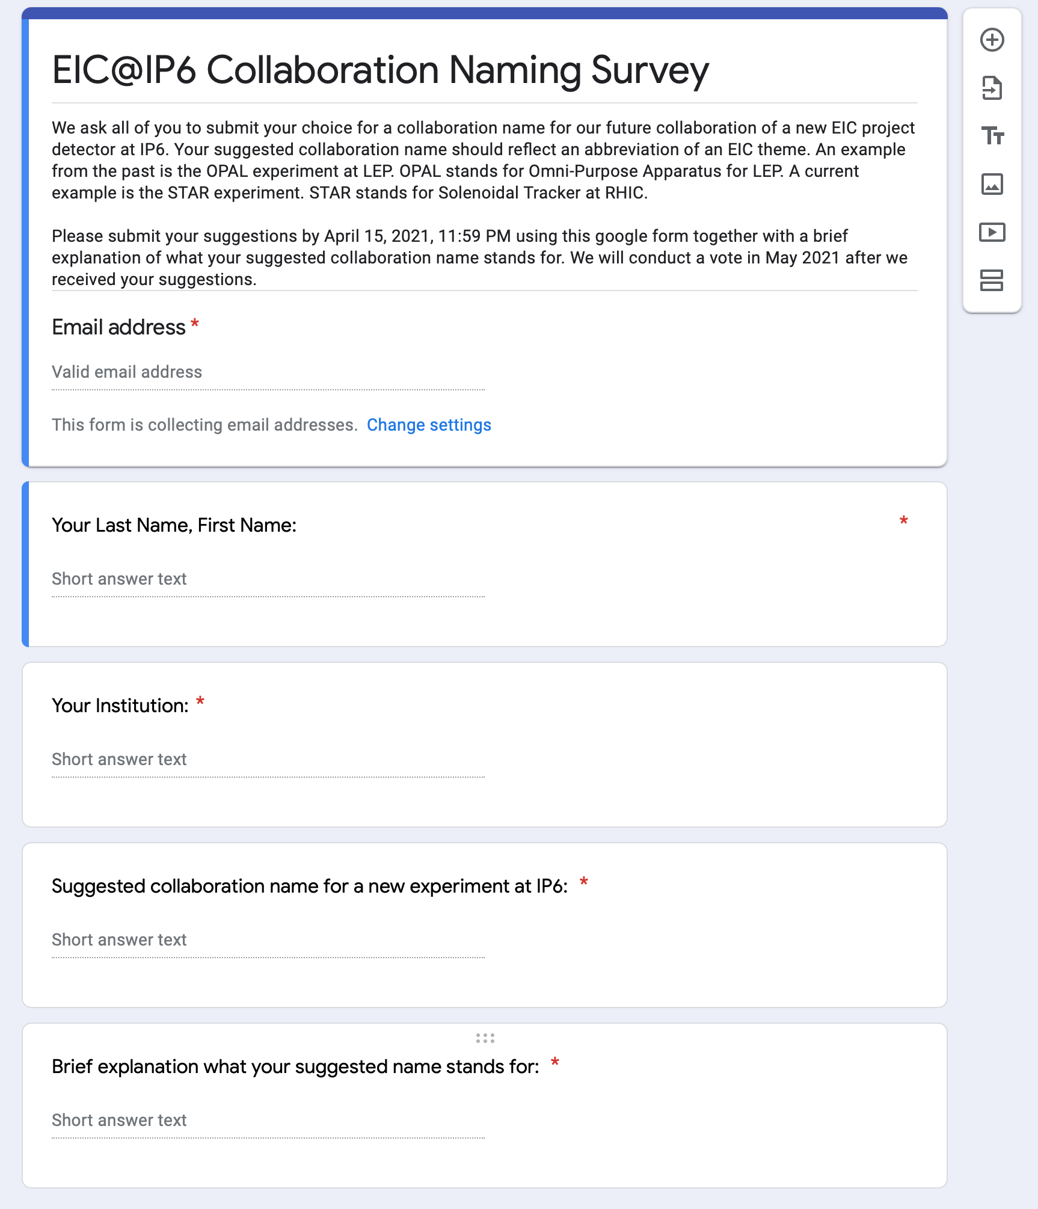
Collaboration Naming Survey
Reminder: https://forms.gle/nZjwdiWUKdtai75XA
EIC@IP6 Bi-Weekly Meeting
April , 2021
Bernd Surrow

Slide 8
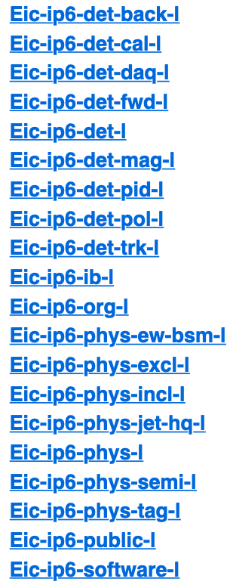
Mailing Lists / Slack Channel
Mailing lists: https://lists.bnl.gov/mailman/listinfo/
  Overview:
Detector Mailing Lists
Physics Mailing Lists
EIC@IP6 Bi-Weekly Meeting
April , 2021
Bernd Surrow

Slide 9
Asking convener nominations for:
Detector groups:
  Luminosity monitor & Q² tagger
  Calorimeter
  DAQ/readout
  Far Forward instrumentation
  Integration/Magnet
  PID
  Polarimetry
  Tracking
Physics Validation groups:
  Diffraction, exclusive, tagging
  Inclusive
  Jet/HQ
  SIDIS
Nomination deadline: Friday April 9, 11:59 EDT

Slide 10
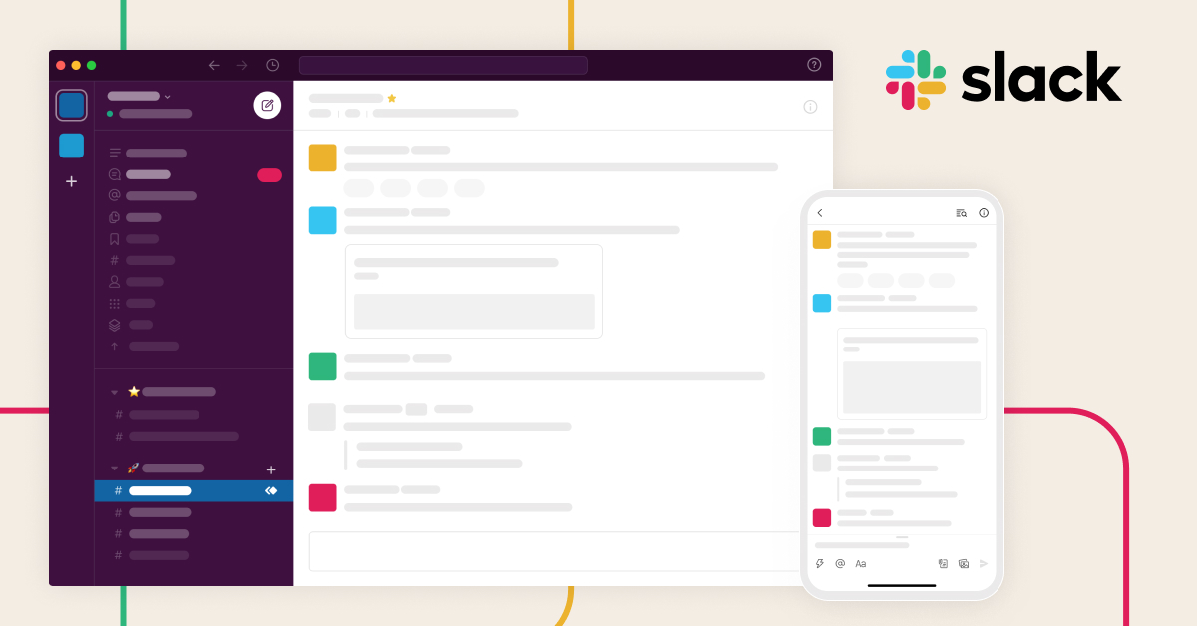
Mailing Lists / Slack Channel
Join EIC@IP6 on Slack:
https://join.slack.com/t/eicip6/shared_invite/zt-nsocbr8y-~lrhqi8We6FjV1CmnmVVTQ
EIC@IP6 Bi-Weekly Meeting
April 8,
Bernd Surrow

Slide 11
Spinning Glue: QCD and Spin
Summary
We thank you for interest and look forward to a very fruitful collaboration for many years to come:
YR study
Open Call for Detector Proposals
Detector proposals
IP8
Collaboration formation
IP6
EIC@IP6 Bi-Weekly Meeting
April,
Bernd Surrow

