Slide 1
Expression of Interest for Software
Common Projects
Software Tools for Simulations and Reconstruction
Monte Carlo Event Generators
Detector Simulations
Reconstruction
Validation
Middleware and Preservation
Workflows
Data and Analysis Preservation
Interaction with the Software Tools
Explore User-Centered Design
Discoverable Software
Data Model
Future Technologies
Artificial Intelligence
Heterogeneous computing
New languages and tools
Collaborative software
29 institutions
https://indico.bnl.gov/event/8552/contributions/43221/

Slide 2
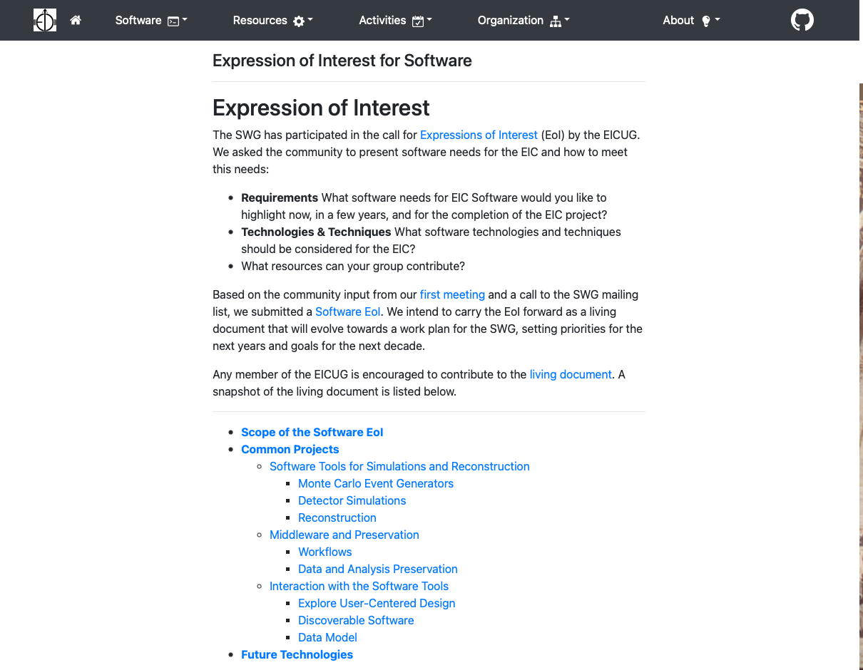
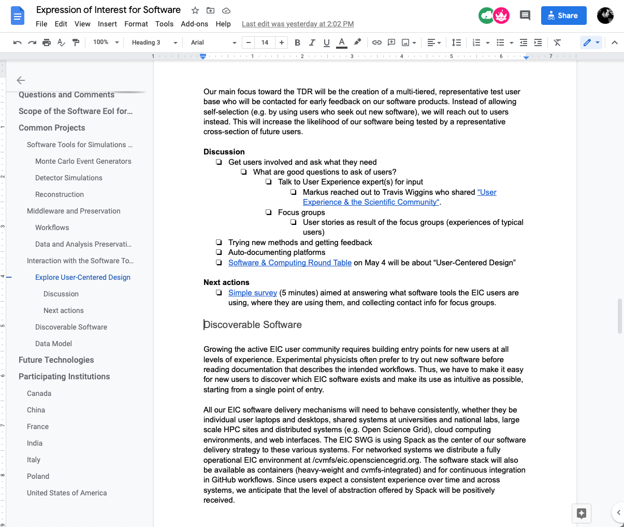
Evolving the EoI towards a Work Plan for the SWG
https://eic.github.io/activities/eoi.html

Slide 3
Update on Common Projects
Will receive more and more input
from proto-collaborations
Software Tools for Simulations and Reconstruction
Monte Carlo Event Generators
02/24 Kolja reported on maintaining Pythia6 for the EIC.
03/10 Prabi reported on MC-data comparisons for the EIC and Barak discussed random number seeding
ToDo Request for suggestions what MCEG to use
Detector Simulations
03/25, 03/31 Project eAST, CAD import started, including status report of existing detector simulations by EIC Generic R&D program
Started Note on "Accelerator and beam conditions critical for EIC simulations"
Reconstruction
02/24 Joe Osborn updated us on ACTS for the EIC.
Validation
MCEGs: see above
Fun4All: going through calorimeter simulations with the initial goal to provide parametrizations for eic-smear.
Starting stages eic-smear, ESCalate
Middleware and Preservation, see also Wouter’s overview
Workflows
Data and Analysis Preservation
02/24 biweekly meetings, next April 12 at 11:0 a.m. (EDT)
Interaction with the Software Tools
Explore User-Centered Design
03/03 Kolja, Markus, Rebecca, Sylvester, Wouter presented report on “Status of Software Survey.”
04/07 Focus-group discussions started
Discoverable Software
04/07 Wouter will report on first meeting, next meeting on April 19 at 11:00 a.m. (EDT)
Data Model
Common output format (Dmitry), data model for streaming readout (Jan)

