Slide 1
Electron-Ion Collider : roman pots readout ASIC analogue front-end proposal
Maxime Morenas – March 2021
PhD student at OMEGA microelectronics group

Slide 2
AC-Coupled LGAD modelisation
From Nicolo Cartiglia

Slide 3
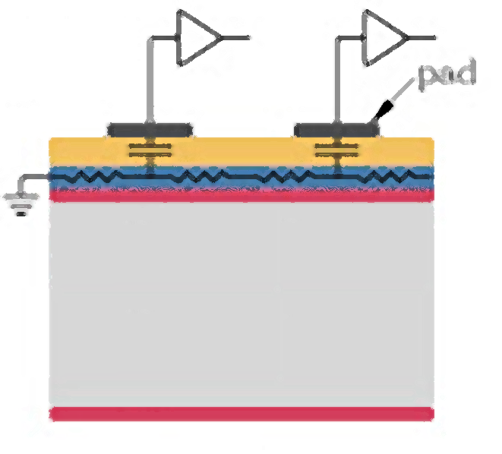
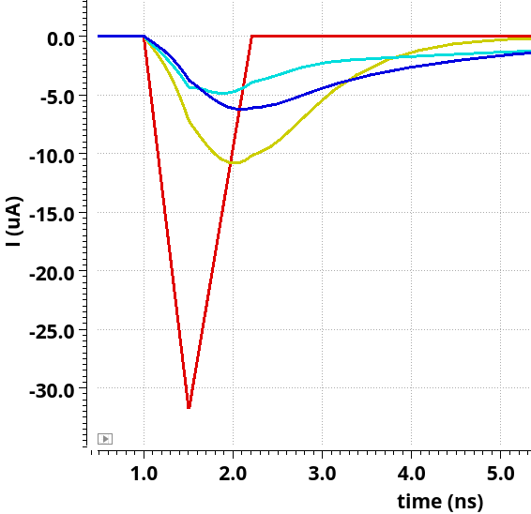
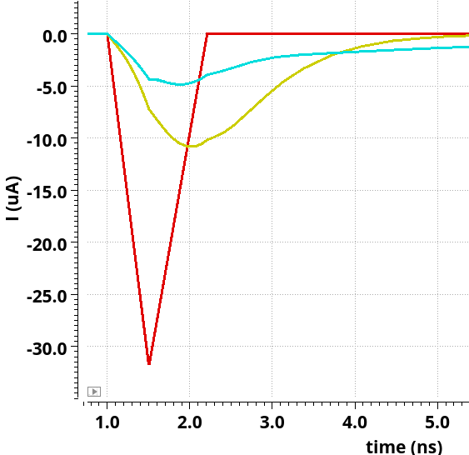
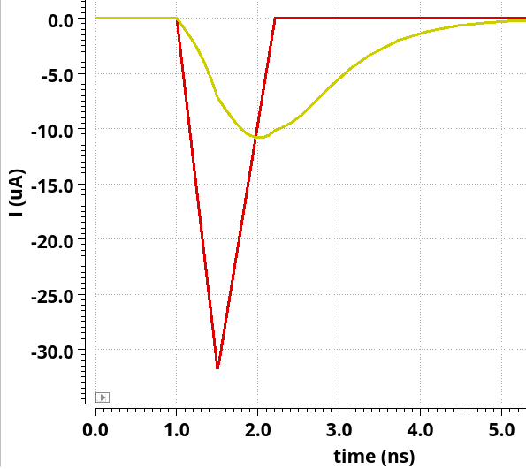
Charge injection modelisation
Case A :
Charge deposited closest to the pad
Fastest and largest signal :
Size the upper limit of the bandwidth and input voltage before saturation
Case B :
Charge deposited furthest from the pads
Slowest and smallest signal :
Size the lower limit of the bandwidth and the minimum charge detected
Received
500 ps
700 ps
Injected (19 fC)
Current spread in time
Current amplitude received divided by a factor 5

Slide 4
Overall architecture
Choice criteria :
Pixel area
Power consumption
Linearity versus input charge
Signal drift time at the output of the preamplifier
Today : only detector+PA+discri simulated

Slide 5
ASIC prototype specifications
ASIC requirements
Pixel size | 500 µm
Number of channels | 1024
Typical charge | 19 fC (120 ke- rms)
Minimum threshold | < 2 fC
Noise | < 0,4 fC
Dynamic range | 100 fC
Channel jitter at 19 fC | < 20 ps
Power per channel | < 3 mW
TDC LSB | 20 ps (TOA)
TDC range | 2,5 ns (TOA)
Hit rate | 15 hits/pixel/second
Clock frequency | 45 MHz
TID and neutron fluence | None

Slide 6
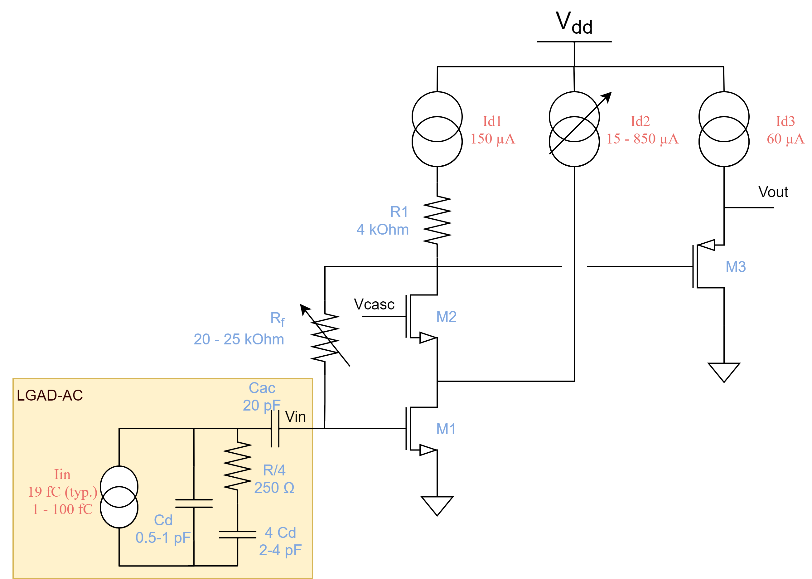
Preamplifier : a voltage preamplifier architecture
Tunable :
Id2 current :
Set the DC output voltage,
thus the dynamic range before saturation
Set the current drawn by the preamplifier and the final jitter
Feedback resistance (R2) :
Set the DC input bias
Set the open-loop gain : $G_{OL}=gm1 ∗R_{X}=19$
Thus set the preamplifier input impedance :
$$R_{in}=\frac{25 k}{G_{OL}} \sim 1,3 kΩ$$

Slide 7
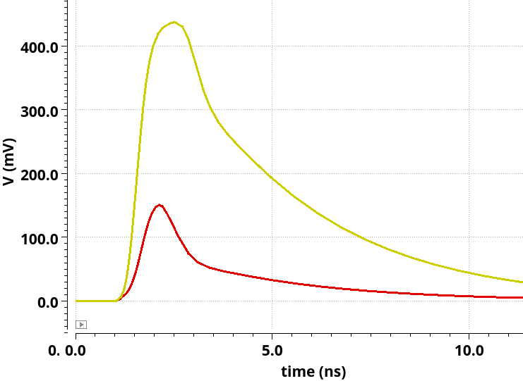
Simulation results : with LGAD signal with neighbours
Preamplifier output
100 fC (max)
Rise time :
~700 ps
Return to baseline in more than 15 ns :
Preferable to integrate the charge with a shaper instead of using long range TDC
19 fC (MIP)

Slide 8
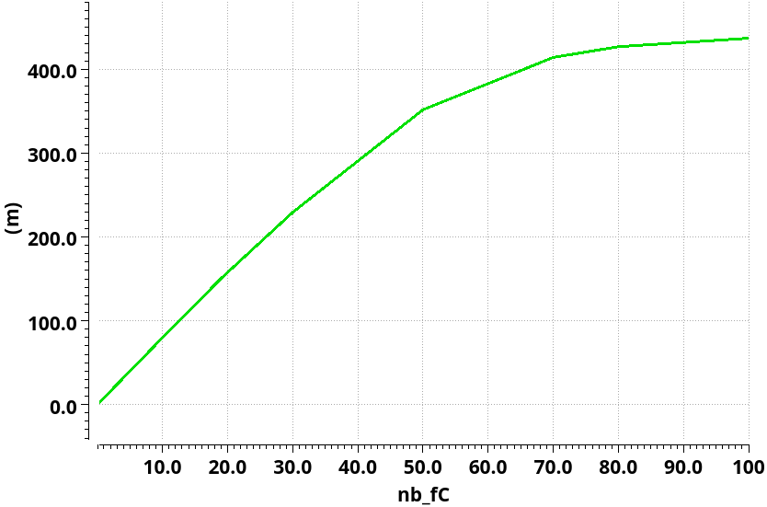
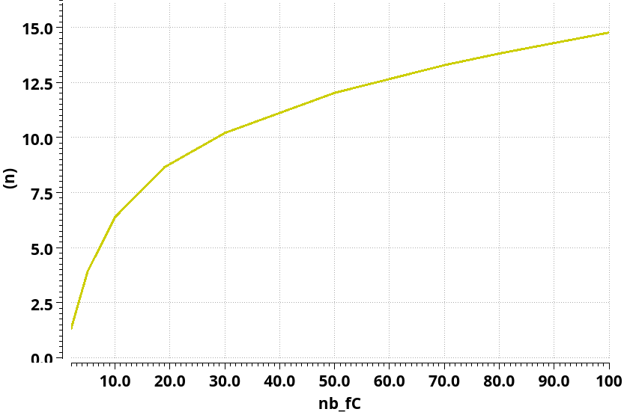
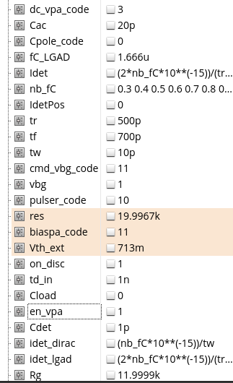
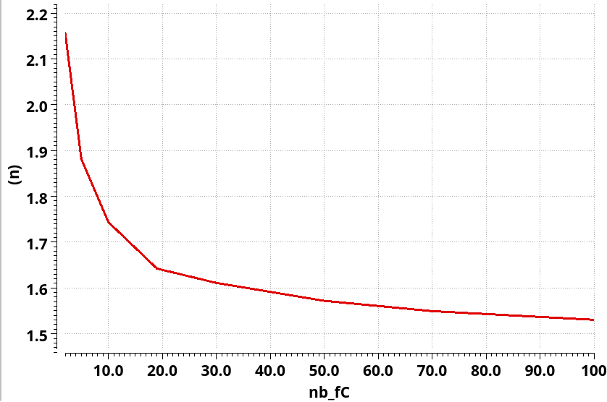
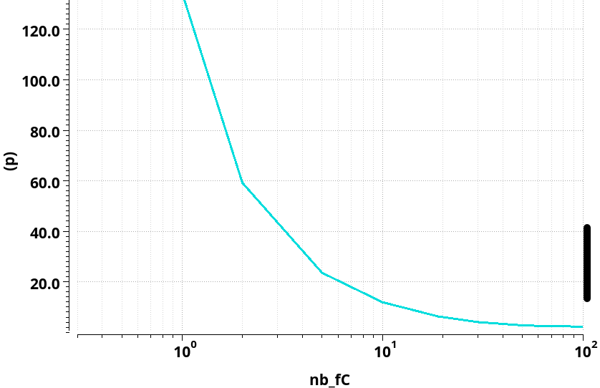
Simulation results : with LGAD signal with neighbours
Preamplifier linearity
160 mV at 19 fC
TOT [ns]
8,6 ns at 19 fC
TOA [ns]
1,6 ns at 19 fC
RMS noise = 1,5 mV
→ Minimum threshold at 2 fC (7,5 mV)
Jitter [ps]
7 ps at 19 fC

Slide 9
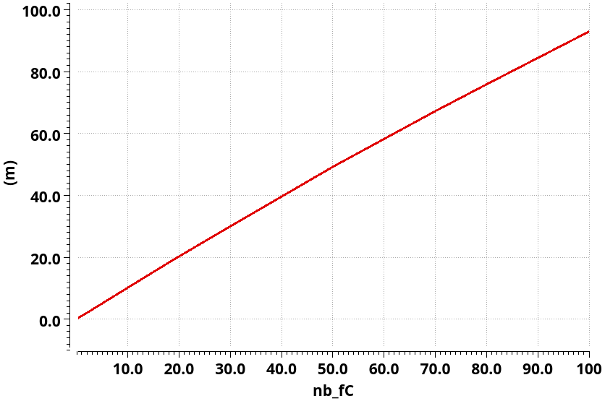
Conclusion
Power consumption and small charge detection are antagonists
Going beyond 2 fC is a challenge !
Long time constant makes shapers preferable
Further design tuning requires updated typical and pessimistic detector characteristics
Integration over 20 ns after TOA
Preamplifier ouput voltage

