Slide 1
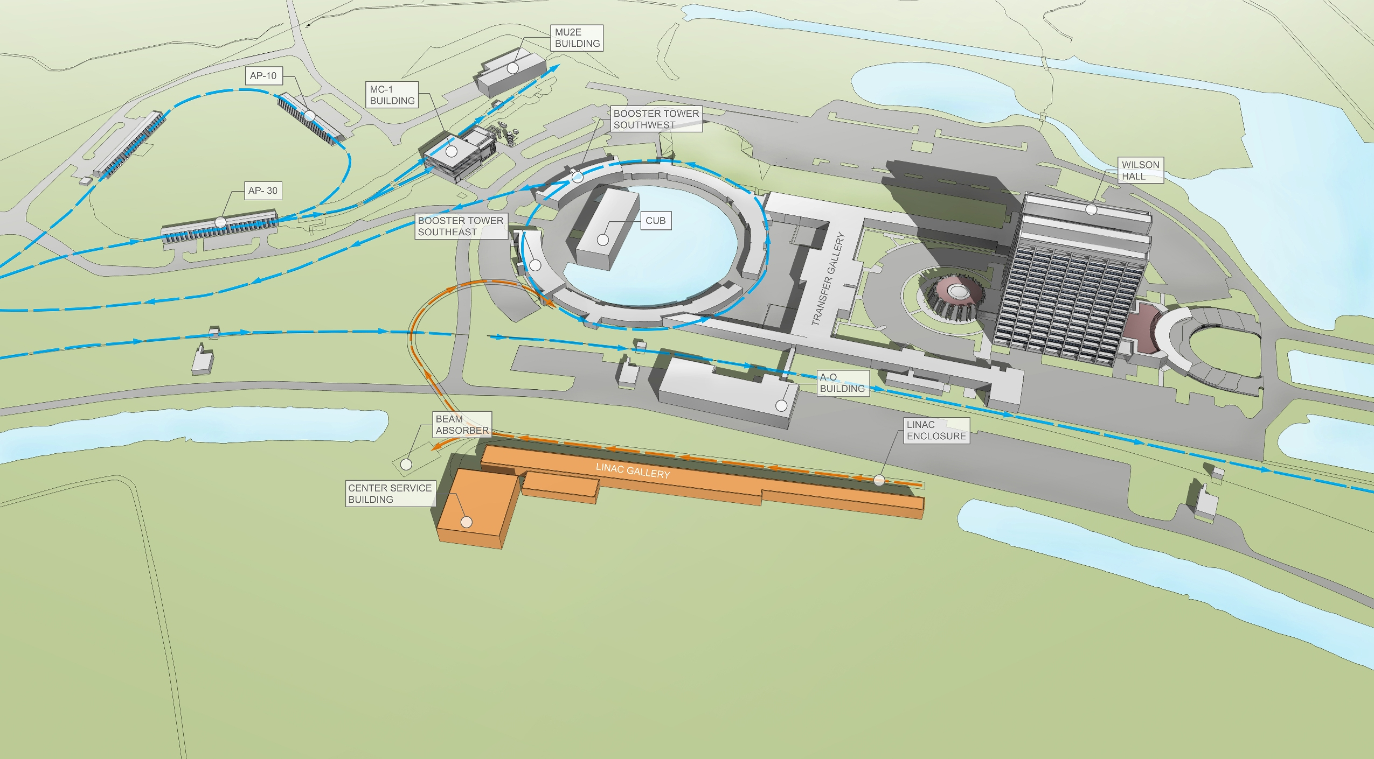
DUNE Technical, Cost and Schedule
U.Bassler, M.Lindgren, D.Nygren, S.Pordes, N.Tsuyoshi
LBNC review
April 19, 2015

Slide 2
Observations (1/3)
DUNE has made excellent strides in forming an international long-baseline neutrino program
There is a great deal of carry-over from LBNE which helps preparation for CD1-R which will also benefit from further integration of work and design studies by LBNO
Presentations for the CD-1R should explicitly address the items called out in the charge letter.
Performance/Physics requirements for the Near Detector need to be defined
Near Detector conceptual design needs to be integrated with performance/physics requirements
Near Detector should benefit from relevant experience from T2K and other experiments (MINOS, MINERVA)

Slide 3
Observations (2/3)
The CERN test is presently on the critical path. The scope of these tests could be redefined to avoid possible schedule problems for the construction start.
Some more attention should be paid to the logistics issues of detector assembly – both for the detector itself and as to how they relate to the excavations in processing.
The arguments for the timing of the construction of the cryostats needs to be stated clearly.
The process for evaluating and choosing among alternative designs for both the near and the far detector needs to be refined.
Further development of the draft interface agreements is needed (ML)

Slide 4
Observations (3/3)
We did not investigate possible single-point failures.
We did discuss long-term electronics reliability.
The possibility of a common fund purchase of liquid argon was discussed
Operations costs for DUNE were not discussed

