Slide 1
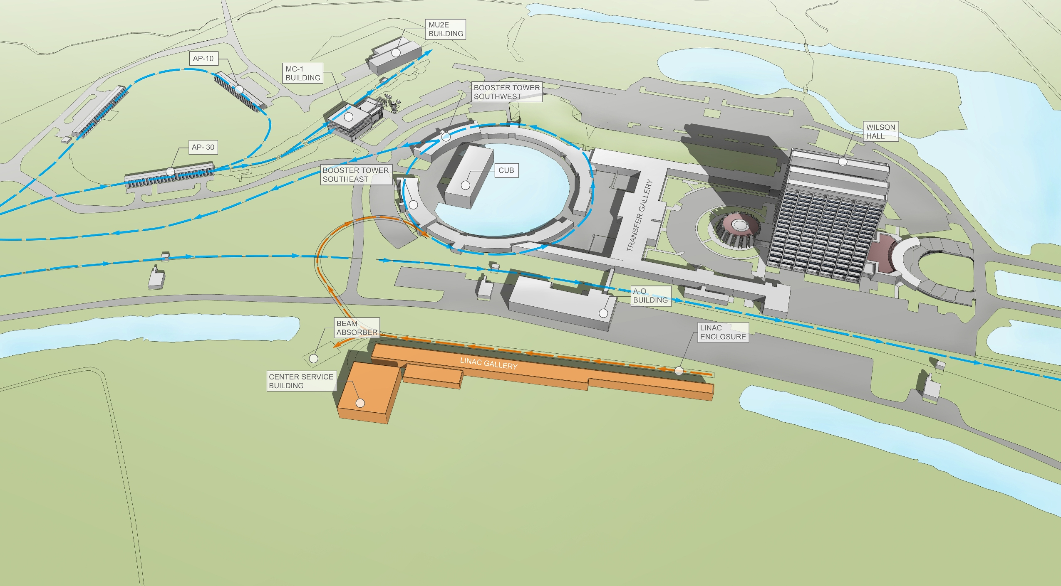
Physics
F. Di Lodovico,P. Huber, N.Mondal, D. Wark
LBNC review
April 19, 2015

Slide 2
Observations
The physics case is well documented and compelling.
Impressive effort in a short time to merge the work of LBNE and LBNO into a single effective collaboration.
Our recommendations are intended to improve an already strong case.
In our opinion all the optimizations should be primarily driven by CP physics.
A physics coordinator or a similar mechanism in the future would help with information transfer and in integrating the physics inputs used in different parts of the experiment.

Slide 3
Recommendations
The systematics table (table 6 in the LoI) claims that DUNE will achieve a factor of 3 improvement on T2K in systematic uncertainties in the modelling of neutrino interactions. The justifications offered for that improvement are not sufficiently well justified and are open to criticism. We recommend that more detailed and better supported reasons be offered for this critical improvement. As a secondary recommendation the collaboration should consider pointing out more explicitly that such ambitious systematic improvements are not necessary for the beginning phases of the experiment (<150 kT·MW·yr). This needs to be fixed for CD-1R.

Slide 4
Recommendations
Near detector design does not appear well integrated in the long baseline physics. After CD1-R, mechanisms need to be put into place to make sure that the physics requirements of the long baseline experiment are of primary importance in the design of the near detector.
DUNE needs to put more effort into software tools, including reconstruction, so that this can be integrated into a full end-to-end physics analysis ready for CD2 for DUNE.
DUNE should form a beyond the SM working group.

