Slide 1
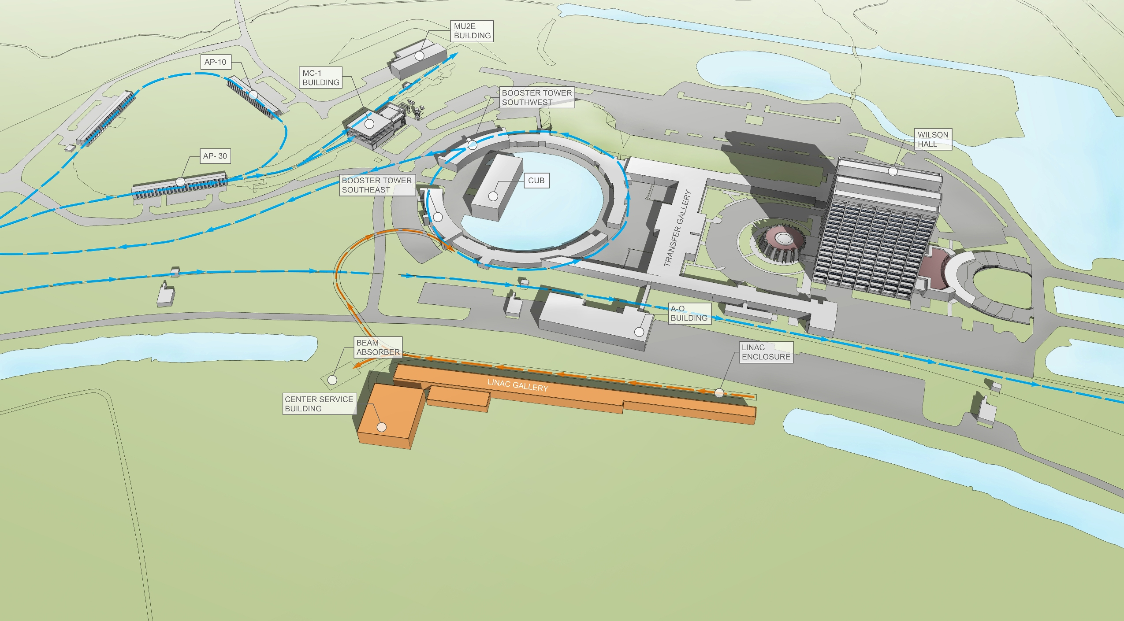
Management
D.MacFarlane, M.Lindgren, K.Robinson, N.Smith, & D.Wark
LBNC review
April 19, 2015

Slide 2
Strategic Issues
Management and governance is a key part of the CD-1R charge

Slide 3
Observations
Many elements of LBNF and DUNE project management have been under discussion and are progressing:
DUNE project (TC, RC), LBNF project (Director, PM), EFIG, RRB, IAC
Concepts for project reporting, performance metrics, resource allocation, and overall optimization have also been under discussion
Examples can be drawn from the LHC & the LHC detectors
Initial organizational concepts for treating the DUNE project as an integrated international project have been developed
A risk workshop was held the week of April 15 to develop common practices and an overall risk registry for DUNE/LBNF

Slide 4
Recommendations
Develop a written proposal for the overall governance and organizational structure of the combined DUNE + LBNF project by May 5
Should address project reporting and oversight, integration and interface management, interactions with the RRB and IAC, role of the EFIG, relationship between DUNE project and the collaboration, role of the DUNE EC, etc
An analysis of how this management structure would respond to various plausible project challenges should be considered, e.g, global optimization, funding or schedule shortfalls, etc

