Slide 1
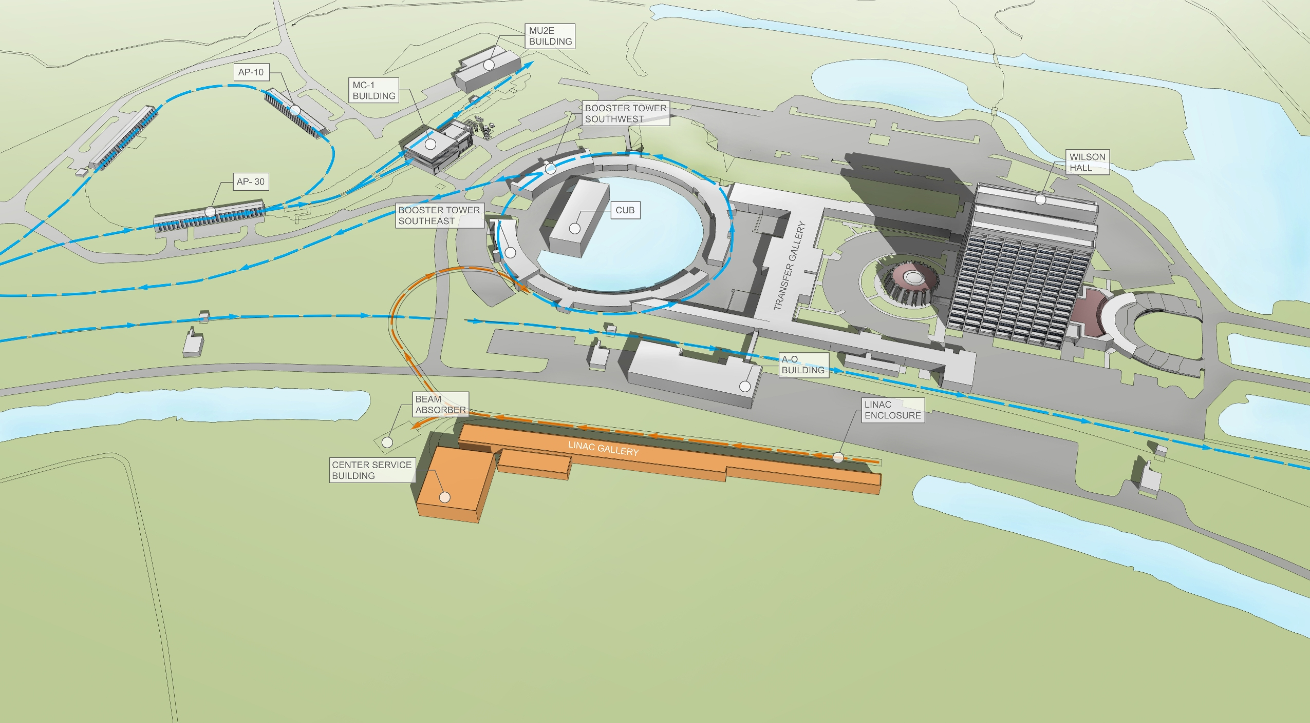
LBNF Technical, Cost and Schedule
Kem Robinson
Nigel Smith
LBNC review
April 19, 2015

Slide 2
Findings
LBNF has a credible path towards CD-1R, with good progress to date against planned milestones
Several design reviews intended prior to Director’s review during mid to late May
Previous CD-1 studies provide a strong basis for development of CD-1R documentation, costs and schedule
Inclusion of Core Costs adds some additional workload
Risk management process evolving, very strong start to collating risks across both projects, using external consultants and workshops.
High impact risks managed, others monitored

Slide 3
Observations
Several high level risks identified in the risk workshop have yet to be assimilated and mitigated in order to be retired
Scope of LBNF evolving with operational responsibility for SURF to be assumed by Fermilab with some aspects incorporated within project
Potential implications to support other SURF operations
Substantial work remains to be completed on the path towards CD-1R
Availability of resources to complete on required timescale is of concern
Construction and deployment sequence not yet finalised, with potential collisions on resources (shaft, drifts) and time (contractors) during excavation and construction underground
Detector design for modules 3/4 may impact required excavation topology
Expansion of near detector cavern strongly supported for potential additional science capability

Slide 4
Observations
It is important to continue to integrate the new international nature of DUNE into planning and presentations

Slide 5
Recommendations
Clarify CERN contributions to LBNF, both resources (engineering) and hardware (cryostats, membranes)
Fermilab/LBNF
Integrate management of risk and ES&H across both DUNE and LBNF
LBNF/DUNE
Review potential additional costs associated with operations of SURF and determine ownership (LBNF or SURF operations)
LBNF/DUNE

