Slide 1
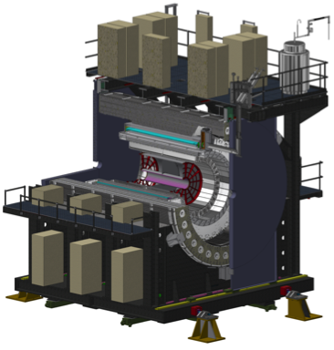
sPHENIX MIE Project Overview
TPC | Project Director | Last CD Achieved | % Complete | CPI | SPI
$27.0M | Edward O’Brien | PD-2/3 | 75.1% BCWP/BAC @ 5/31/2021 | 1.02 | 0.83
Scope
Detector systems produced, tested and ready for installation: Time Projection Chamber w/ electronics, Electromagnetic Calorimeter w/ electronics, Hadronic Calorimeter w/ electronics, DAQ/Trigger, Minimum Bias Detector, Project Management
Not in scope
SC-Magnet, Bldg/Det Infrastructure, Installation and System Commissioning
Schedule
CD-0 received Sept 2016
CD-1/3A received Aug 2018
PD-2/3 received Sept 2019
Early completion end Jan 2022 (10.75 months float to PD-4)
PD-4 Dec 2022
Cost
$27.0M AY TPC 34.6% contingency on an ETC of $6.2M
Costed and Committed= 90.8%

Slide 2
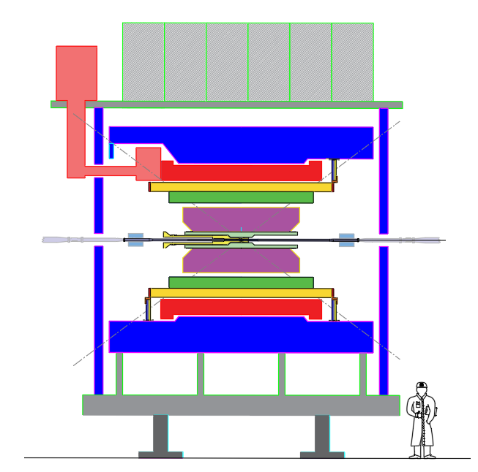
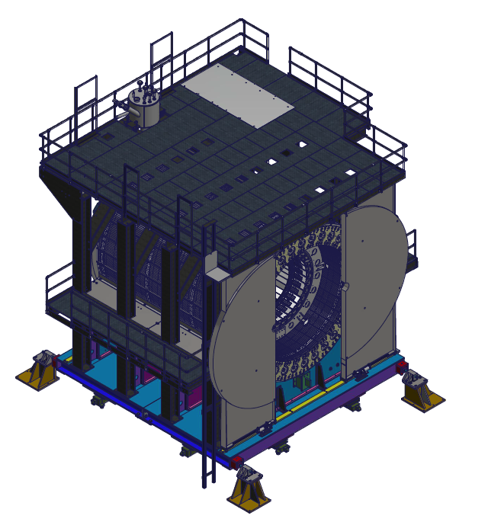
sPHENIX Elevation View and 3-D Model
Cryo valve box and pipes
Upper Platform Racks
Outer HCAL
Magnet
TPC
INTT
Inner HCAL
EMCAL
Floor to top of Upper Platform: 28.3 ft
MVTX
Floor to magnet center : 17.3 ft
Beam Pipe
Large Support Rings
MBDs
AH track upgrades and cradle-base assembly are complete
North
West
Cradle-Carriage
North-South: 25 ft
East-West: 25 ft
North
sPHENIX looking at the north side with pole tip doors open and EMCAL installed. This is the condition when sPHENIX is moved from the 1008 AH to the IR. sPHENIX will weigh ~880 tons when rolled into IR and 900 tons when complete.
This is a simplified 2D model of sPHENIX highlighting the nested detector structures and magnet return steel construction.

Slide 3
Available Resources & External Dependencies
BNL has granted the sPHENIX MIE an Extraordinary Project Rate (Reduced Overhead)
Reuse of >$20M of existing infrastructure and equipment from the PHENIX experiment including use of the Building 1008 (PHENIX) complex
BNL-funded Infrastructure and Facility Upgrade ($33.4M AY) to 1008 complex including bringing cryogenics for the SC-Magnet into the sPHENIX IR, upgrading safety, power, environmental controls, cooling systems, providing steel flux return for the magnet.
BNL contributed labor from RHIC Ops ($25M AY) ( 80% the PHENIX group in Phys Dept in addition to CAD, BNL Instrumentation, NSLSII and Magnet division)
Former BaBar SC-magnet received from SLAC spring 2015. Tested to 105% of full current at BNL.
Collaborator contributed labor (subsystem assembly and testing, QA, calibration, commissioning)
Si strip detector (INTT) primary funding from RIKEN Lab –Japan with additional US and international contributions.
Extended (in eta) EMCal coverage to (-1.1< eta < 1.1) from international sources.
BNL-funded capital project for instrumentation of an Inner HCal ($1.6M)
BNL-funded capital project for an Si pixel detector (MVTX) ($4.8M)

Slide 4
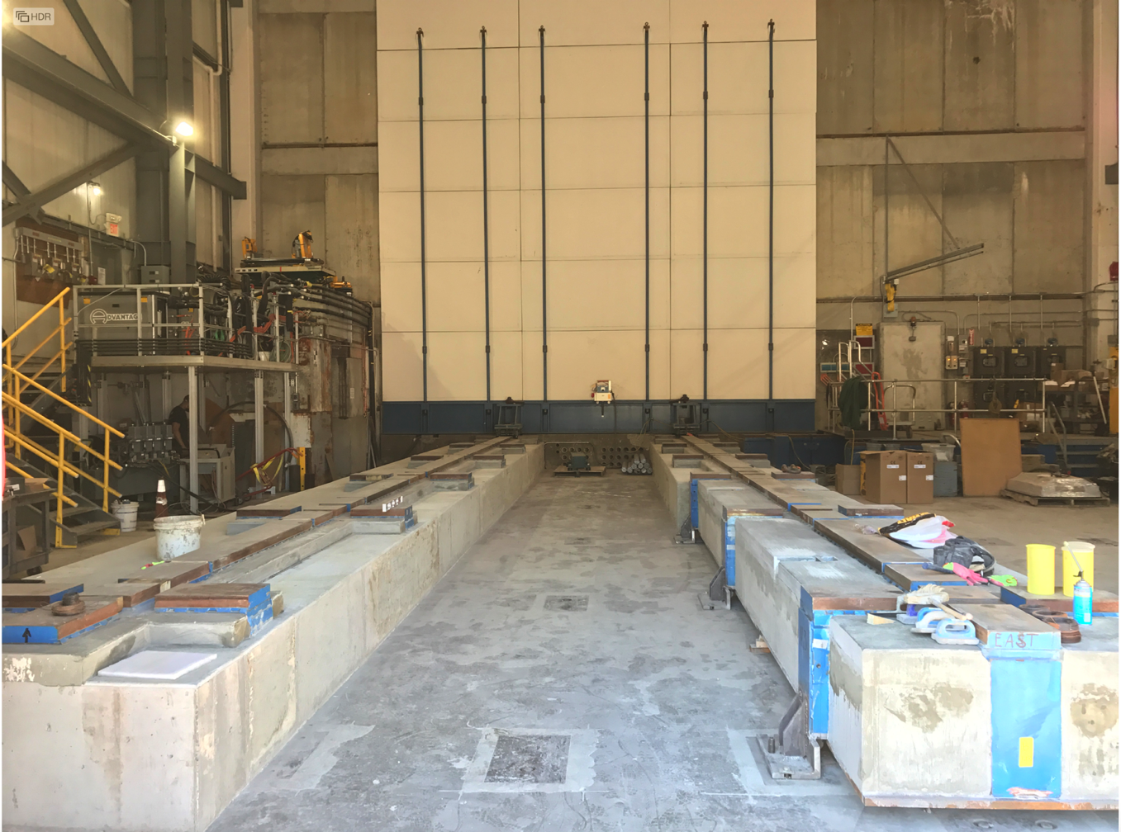
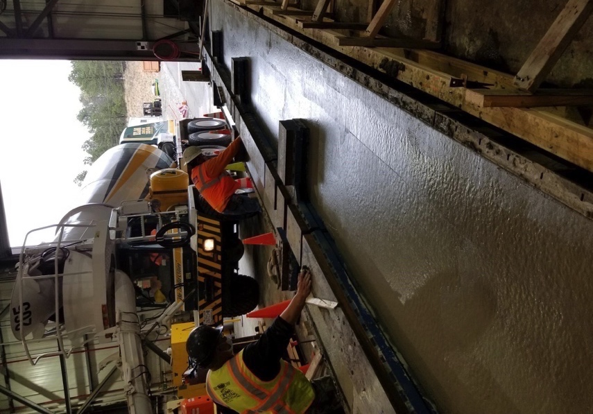
Track Reinforcement in 1008 Assembly Hall 5/14/21
Assembly Hall Tracks Complete
Pouring South track
Drying North Track
Infrastructure

Slide 5
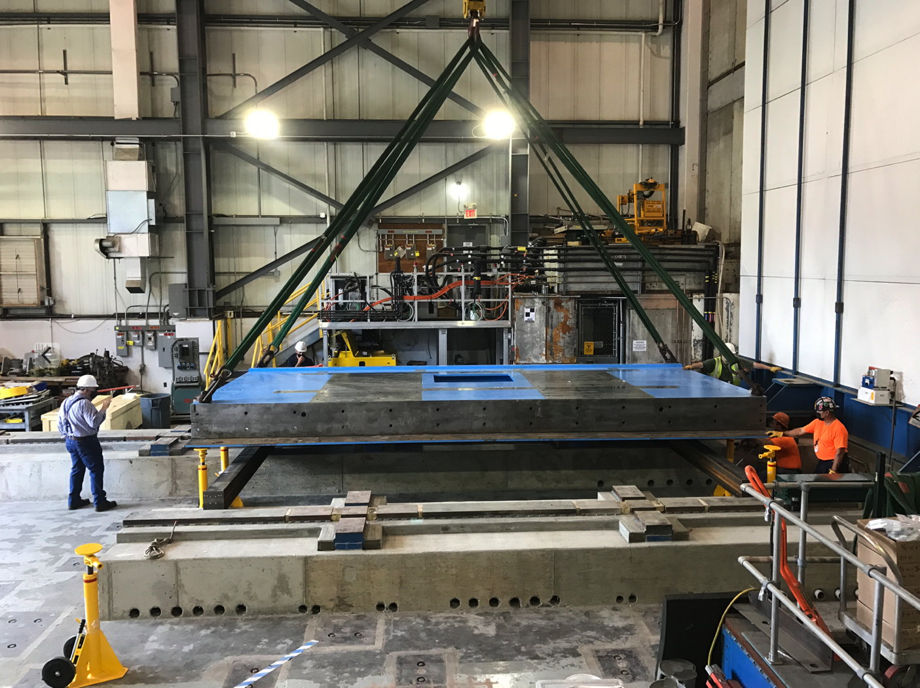
1st sPHENIX Component Installed in sPHENIX Hall, 5/27/21
Carriage & Installation

Slide 6
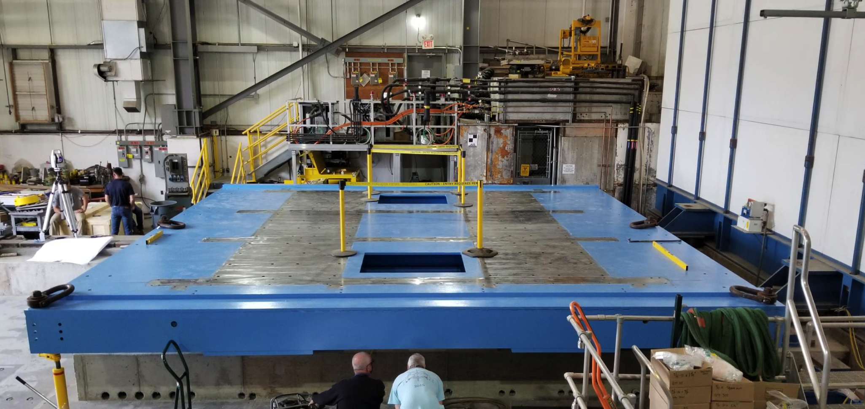
Base Installation Complete 6/1/21
Carriage & Installation

Slide 7
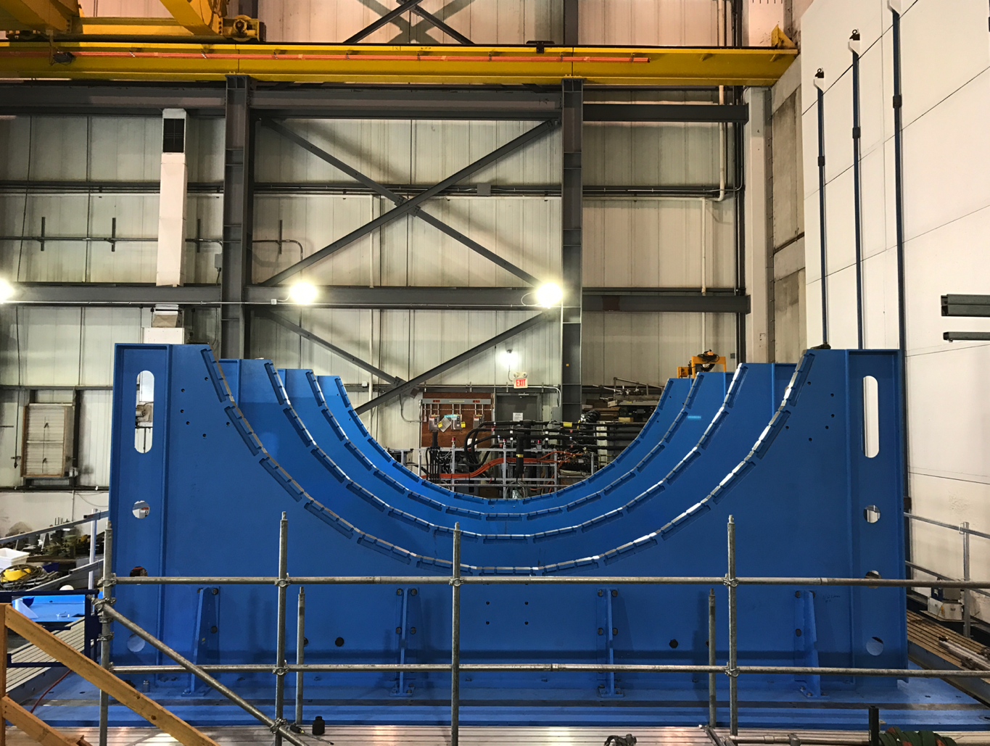
Carriage/Cradle Assembled 6/11/21
Surveyors, engineers and techs are leveling and squaring the carriage/cradle frame prior to installation of first subsystem component, the 1st Outer HCal sector, week of 6/21.
Carriage & Installation

Slide 8
sPHENIX Calendar
SPHENIX Collaboration meeting Jun 17-18
ESRC TPC Review Jun 21
Installation of 1st sPHENIX OHCal sector in RHIC Hall wk of Jun 21
IHCal Installation PRR Jun 22
RHIC PAC Jun 22-23
Annual sPHENIX MIE Review Jul 14-15
ESRC Calorimeters Review Jul 26
ESRC IHCal/EMCal/TPC/MVTX/INTT Installation Review Sep 27
ESRC MBD and beam pipe Review Oct 18
ESRC MVTX/INTT Review Nov 15
sPHENIX MIE Early completion date Jan 31, 2022
sPHENIX Ready for Operations Oct 12, 2022
Start of RHIC 2023 Run Feb 1, 2023

Slide 9
Annual Review Committee July 14-15
Review Committee Chair
*Ken Read, ORNL
Subcommittee 1—Calorimeters and Tracking
* John Parsons, Columbia
Ken Read, ONRL
Subcommittee 2—Data Acquisition, Triggers, and Electronics
*Myron Campbell, U of Michigan
Rainer Bartoldus, SLAC
Vivian O’Dell, Univ of Wisconsin
Subcommittee 3—Environment, Safety and Health
*Bill Rainey
Subcommittee 4— Cost and Schedule
Elmie People-Evans, ANL
Julia Chaffin, LLNL
Subcommittee 5— Project Management
Ron Ray, FNAL
*Patty McBride, FNAL
DOE invitees
James Sowinski
Paul Mantica
Kenneth Hicks
Elizabeth Bartosz
Robert Caradonna
Ivan Graff
Jehanne Gillo

Slide 10
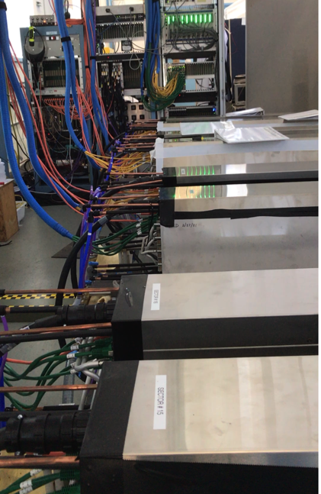
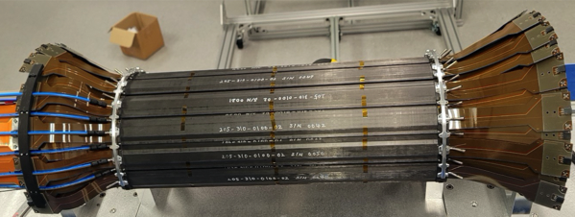
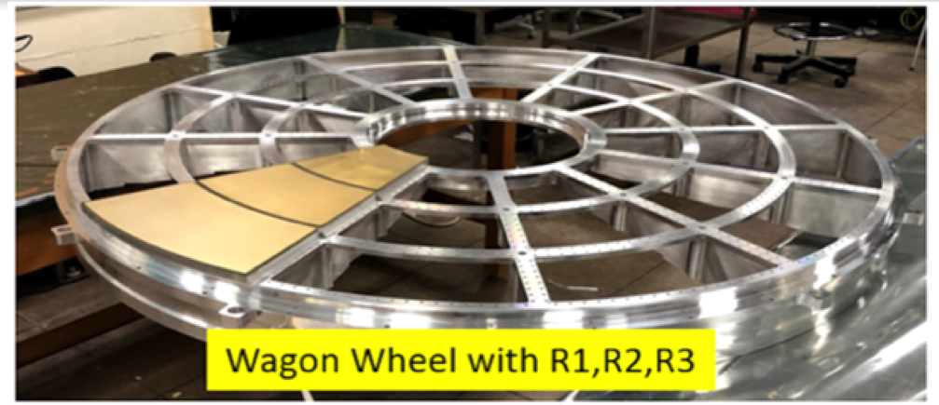
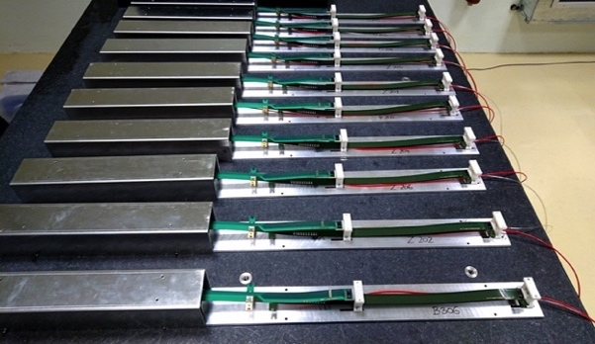
sPHENIX Status
The OHCAL Sectors are complete. Electronic burn in tests continue until sectors ready to install starting in June
EMCal blocks 65% complete at UIUC. Fab on all but final 6% of blocks has started. EMCal Sectors 42% complete at BNL. Testing and calibration ongoing.
TPC Fee board ready for fab. PCB fab started. Testing of SAMPA v5 ASIC complete at Lund. 6300 good chips shipped to and received at BNL (5000 chips required)
GEM Module framing for TPC >60% complete at WSU, WIS, Vanderbilt, Temple
Major computer orders, Buffer boxes, EBDCs, starting to arrive in 1008
TPC Fee slice test continuing at BNL.
All R1, R2, R3 TPC pad planes at SBU
84/84 MVTX “Gold+ Silver ” staves complete at CERN.
> 30% production INTT ladders complete
EMCal sector testing @ BNL
INTT ladders/HDIs @ BNL
MVTX Staves @CERN
TPC Wagon Wheel w/ R1, R2, R3 @ SBU

Slide 11
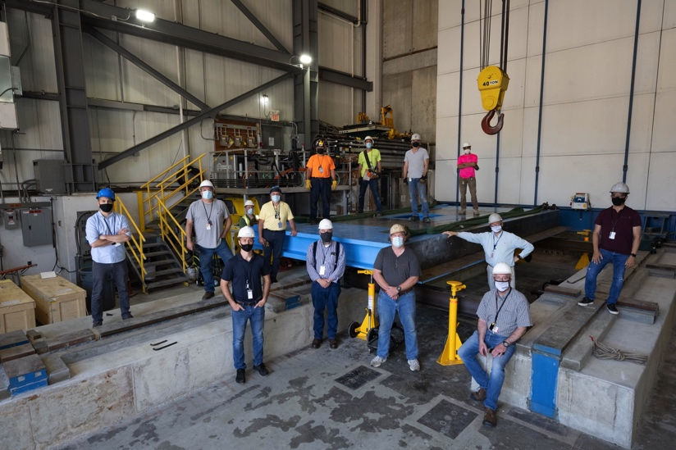
1008 Infrastructure and Facility Upgrade Status
sPHENIX Installation in 1008 has begun
XY Carriage tables, Carriage Hydraulics installed
Magnet flux return Pole tip/end cap in production
sPHENIX Beam Pipe at vendor for modification.
Large Support Rings in production
Platform, EMCal installation fixture awarded
Work on IR track reinforcement starts mid-July
Engineering design work continues at a fast pace
LHe cryo components to be completed by this summer. LN2 piping, in production or at BNL.
Meetings held with CERN group that will be performing the magnet mapping in 2022.
The I&F Early Completion date has been unchanged throughout the pandemic.
3.5 months of float from RHIC Run 2023 start and I&F early completion.
Observing significant cost increases on raw materials.
Carriage base installed in 1008

Slide 12
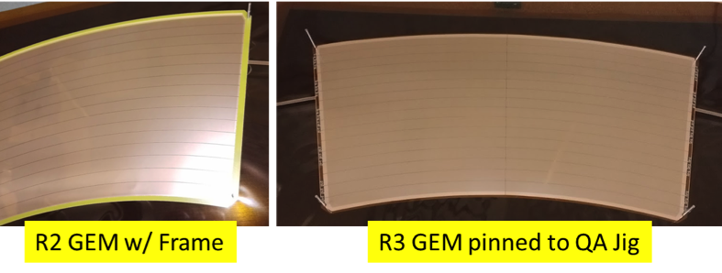
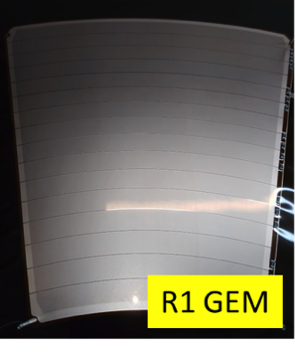
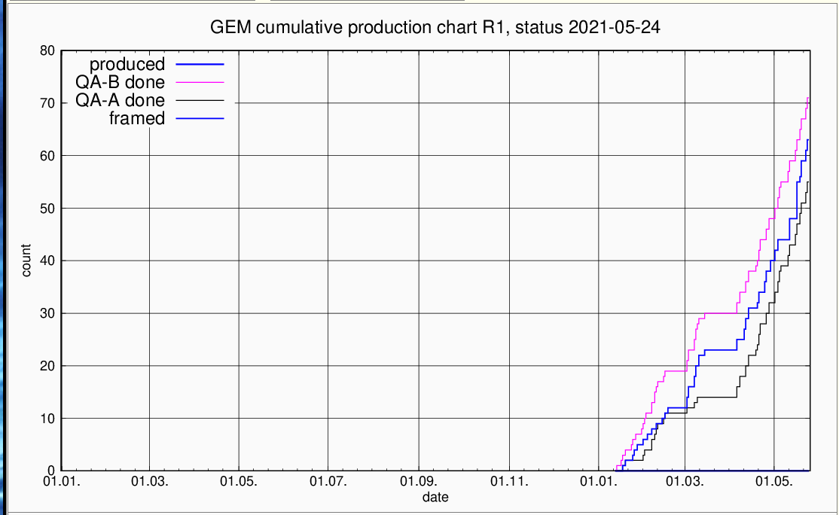
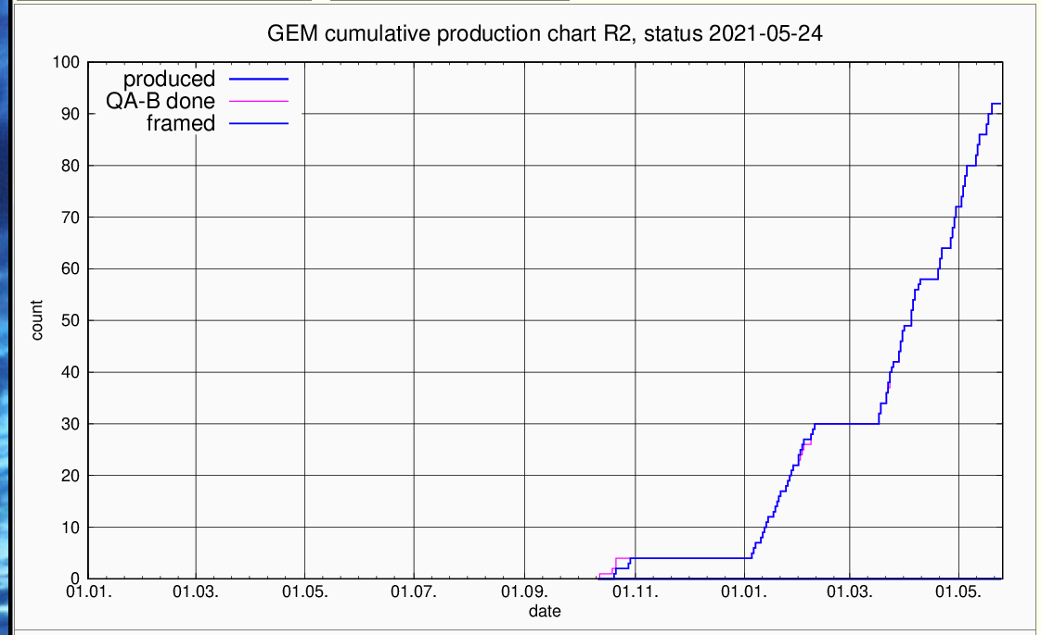
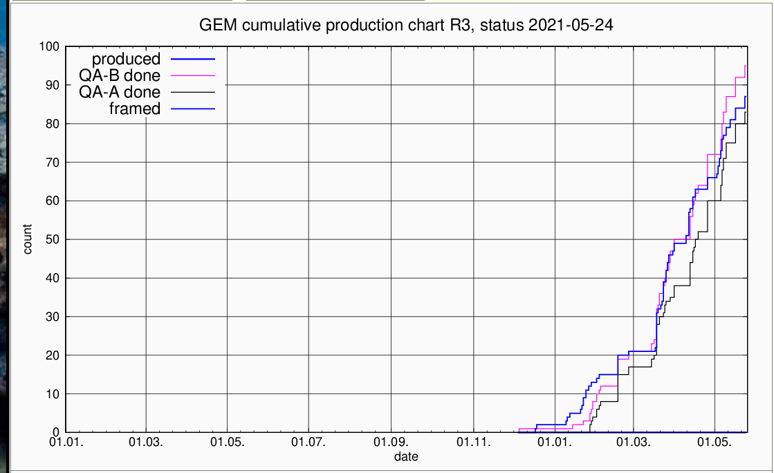
TPC GEM Production Rate and Yield
GEM production going very well. Avg yield > 90%
Framing 100 good GEMs ea type +30% spares
Weizmann
Wayne State
Vanderbilt and Temple

Slide 13
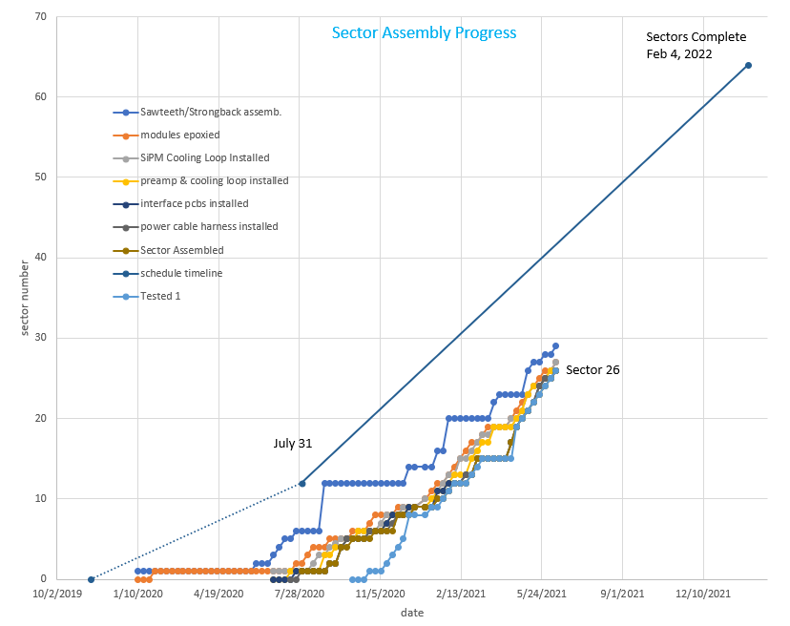
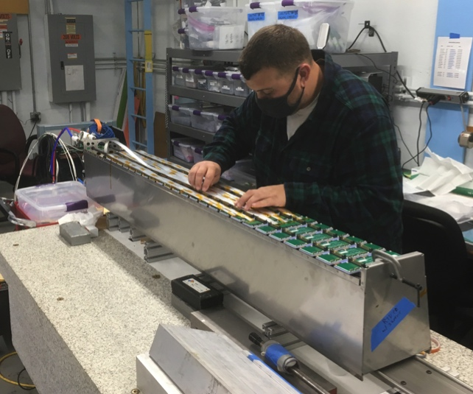
EMCal Progress Tracking – Sector Assembly
Sectors 1-27 complete
Sectors 28-29 being assembled
Sector 30 assembly starts next week
Sector production slope consistent with P6

Slide 14
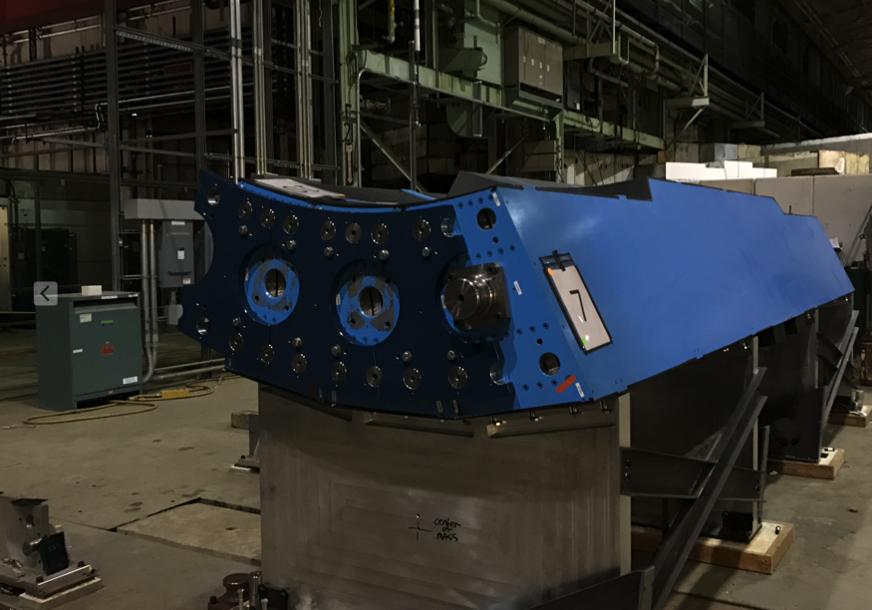
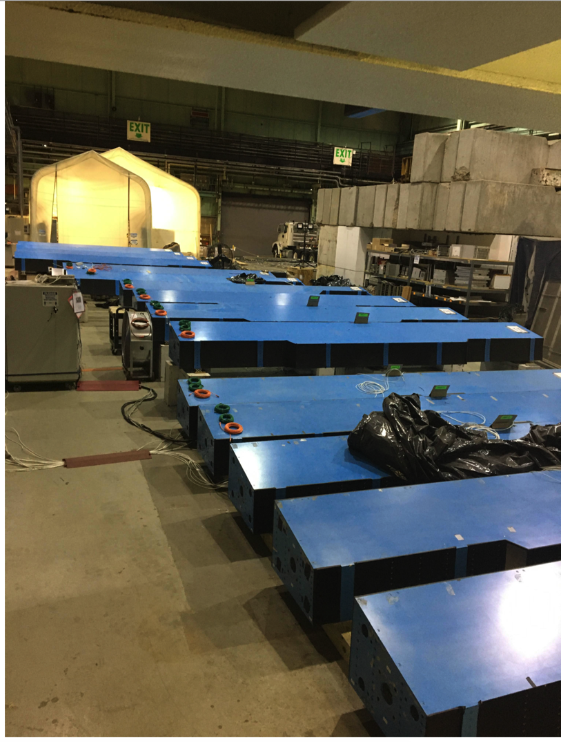
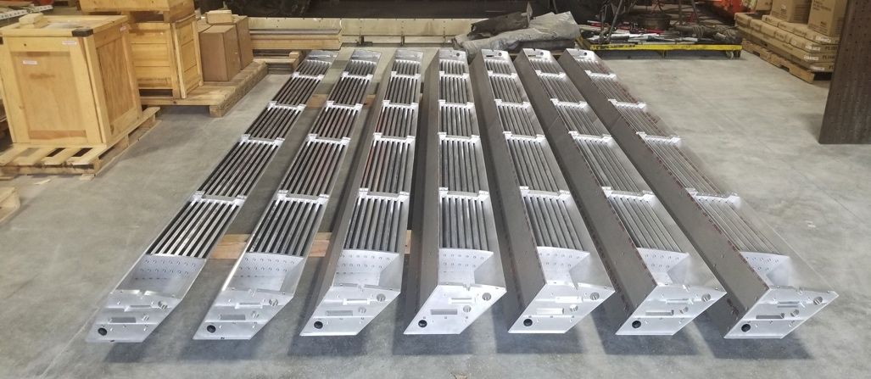
HCal Progress
Practice Assembly of three OHCal sectors
Outer HCal sectors going through final testing/burn-in in B912 @ BNL
Inner HCal sectors at vendor being prepped for shipping to BNL

Slide 15
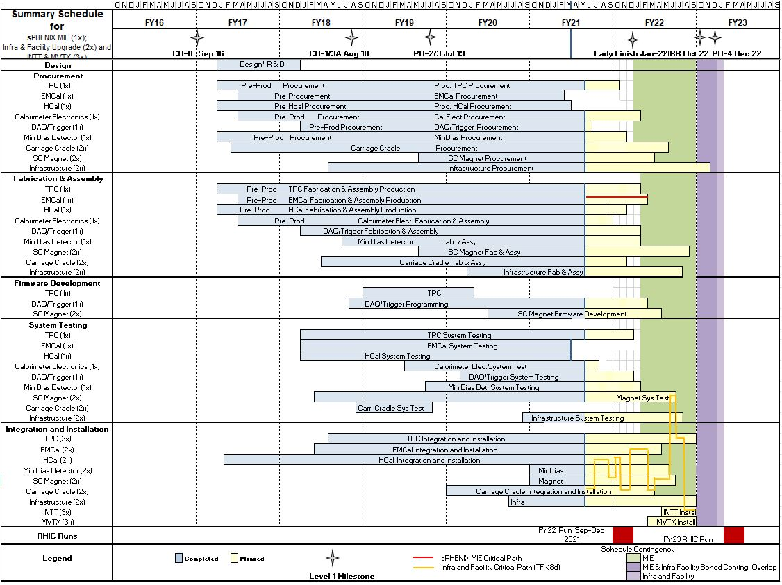
Summary Schedule – sPHENIX MIE and 1008 Infra and Facility Upgrade

Slide 16
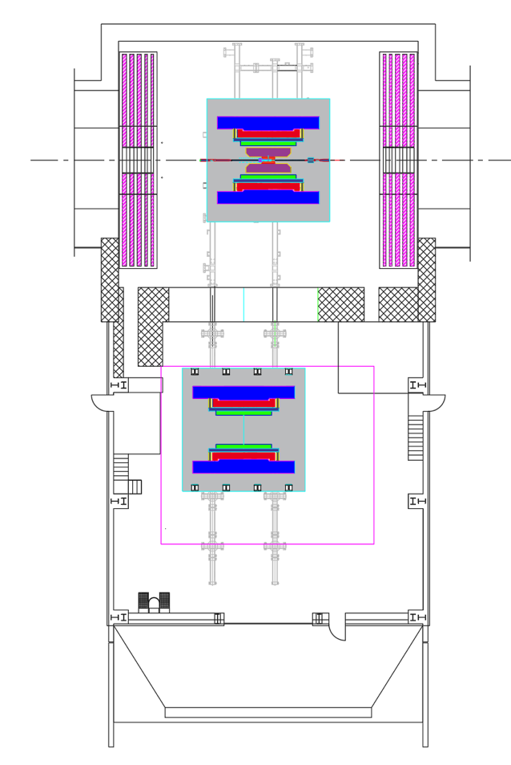
sPHENIX Assembly Sequence
(II) IR Hall Work
April-22’ to Oct-22’
(I) Assembly Hall Work
May-21’ to April-22’
oHCAL work will continue through the end of the 2021 calendar year

Slide 17
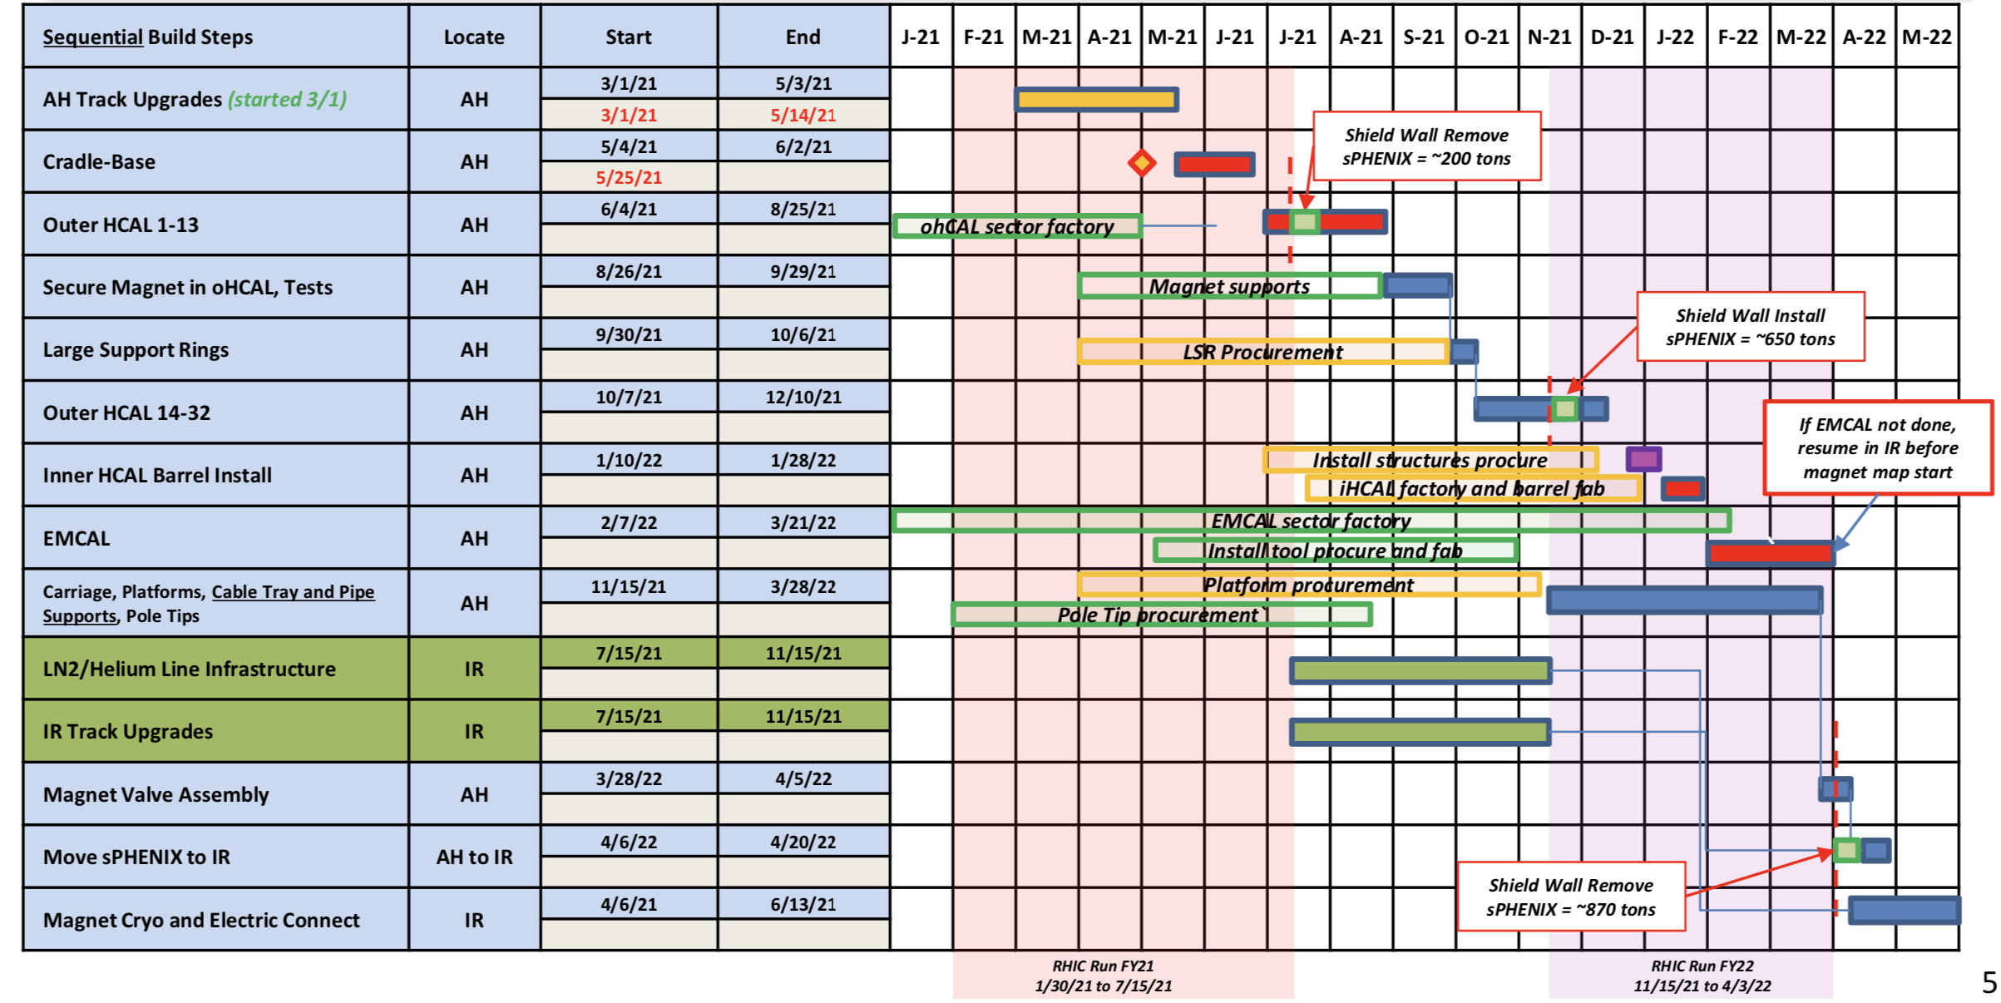
1008 Assembly Hall Installation Schedule

Slide 18
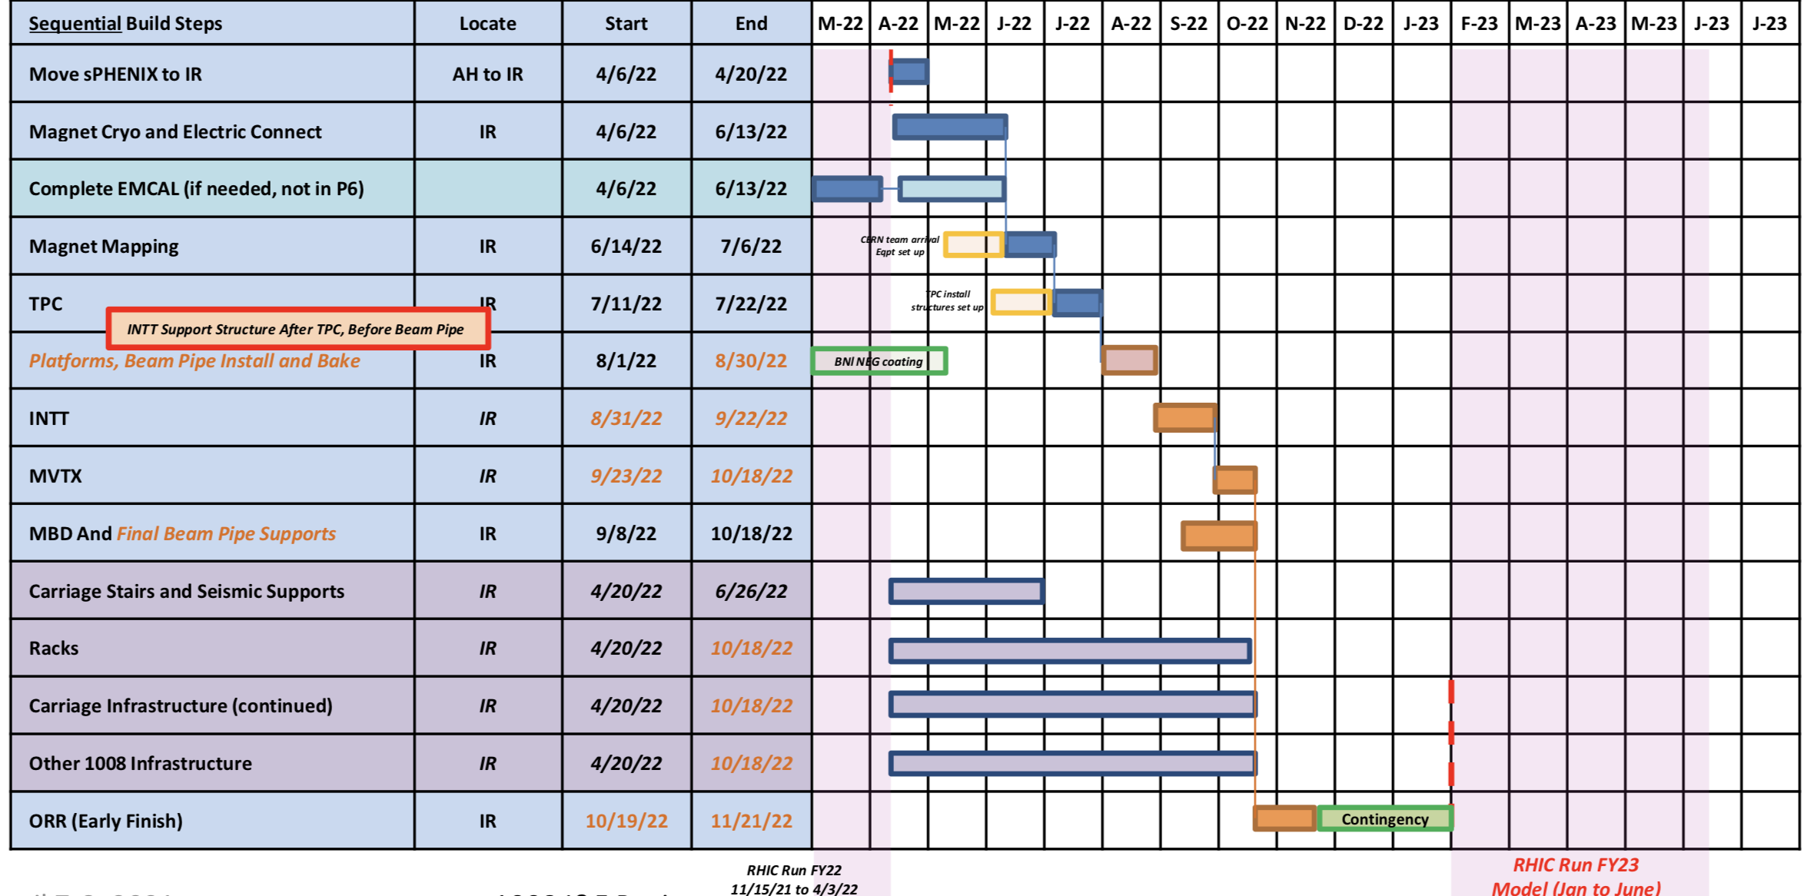
1008 Interaction Region Installation Schedule

Slide 19
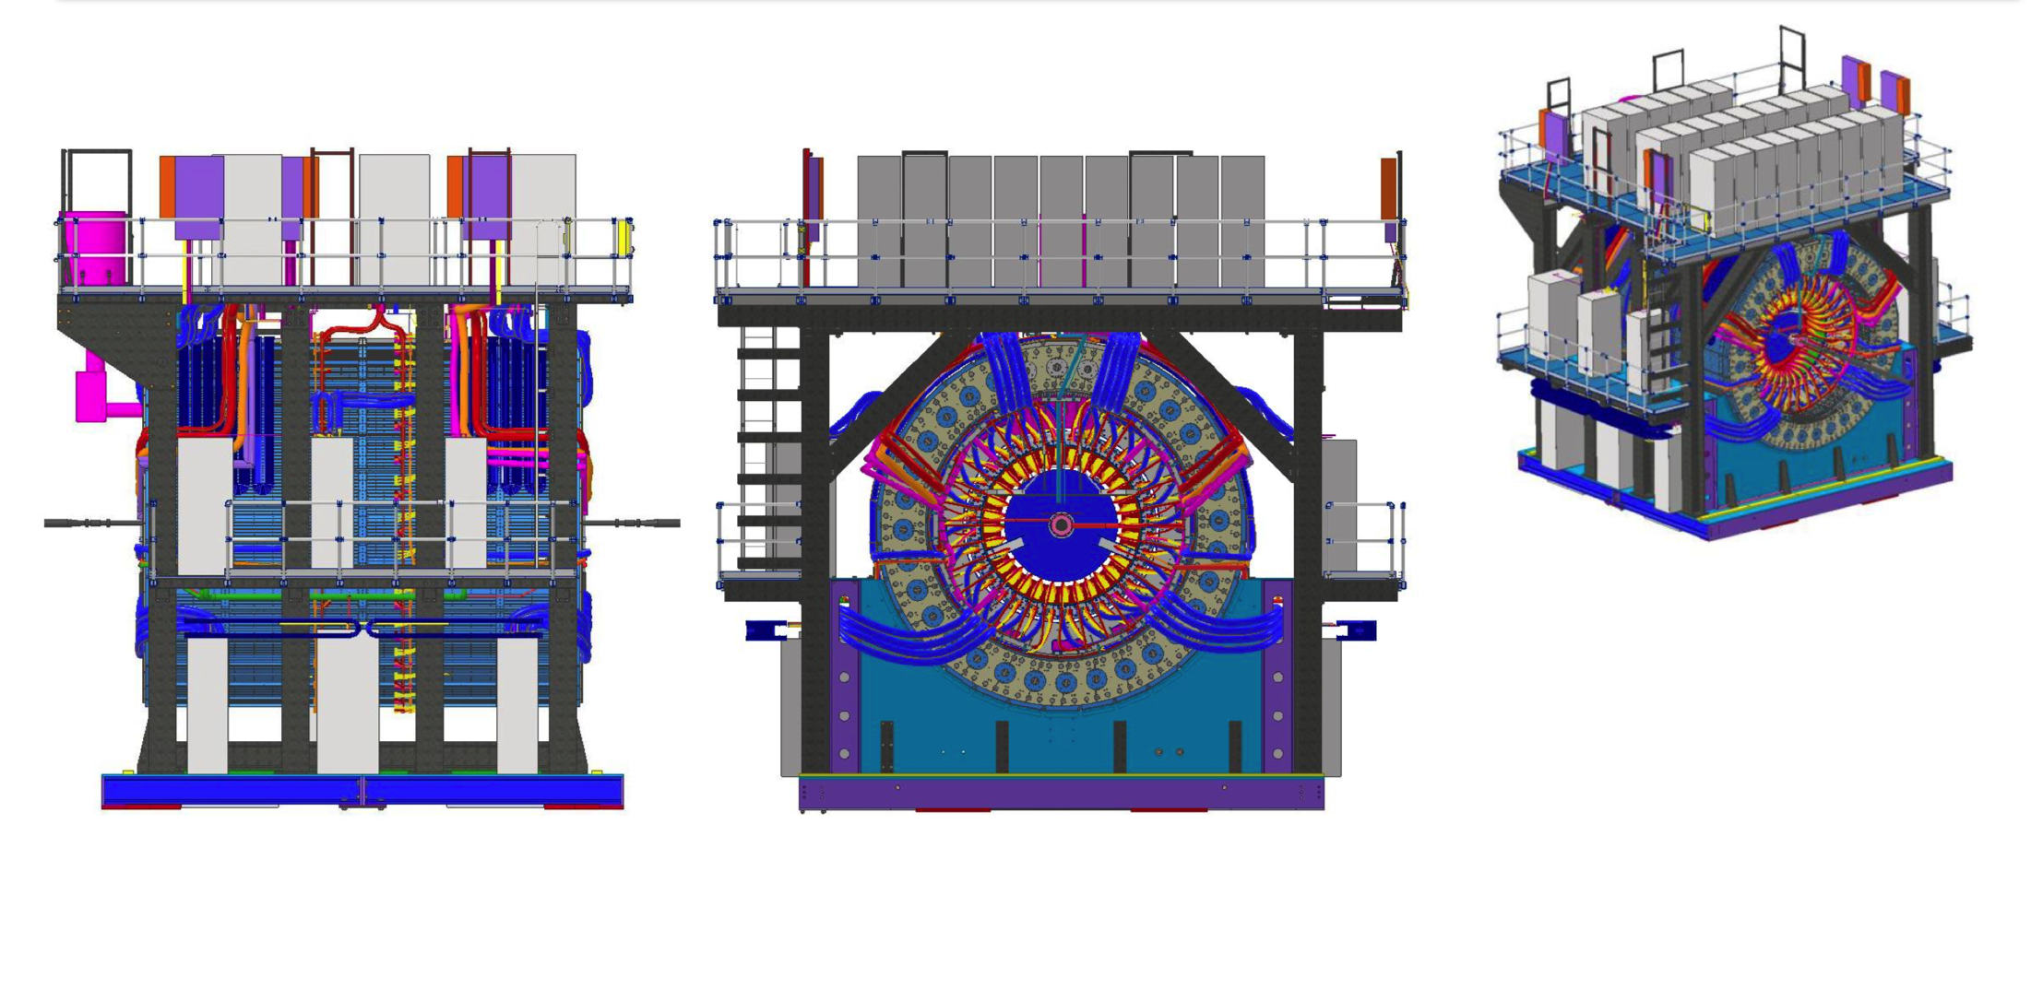
On Carriage Infrastructure

Slide 20
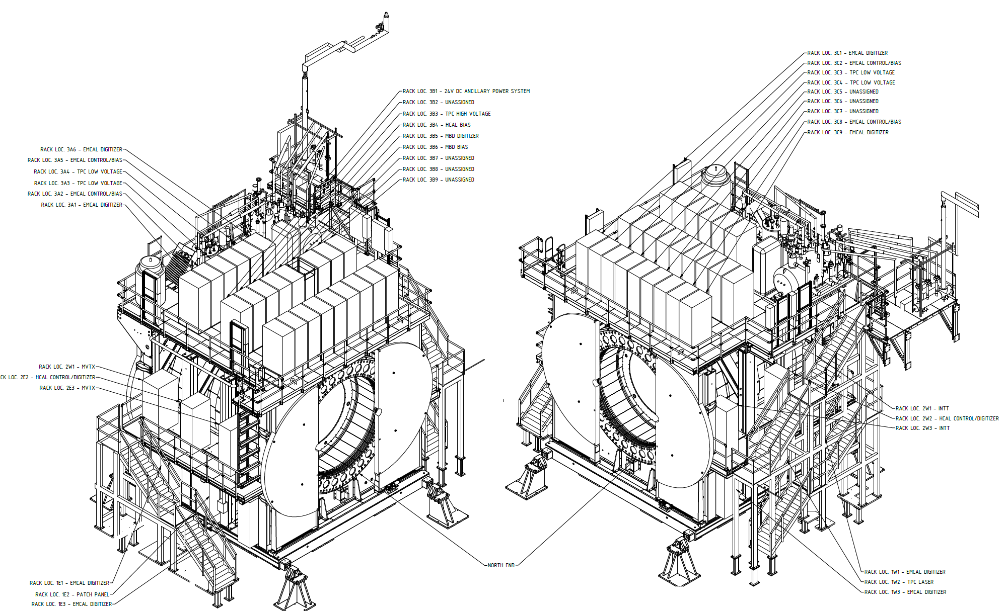
sPHENIX rack assignments

Slide 21
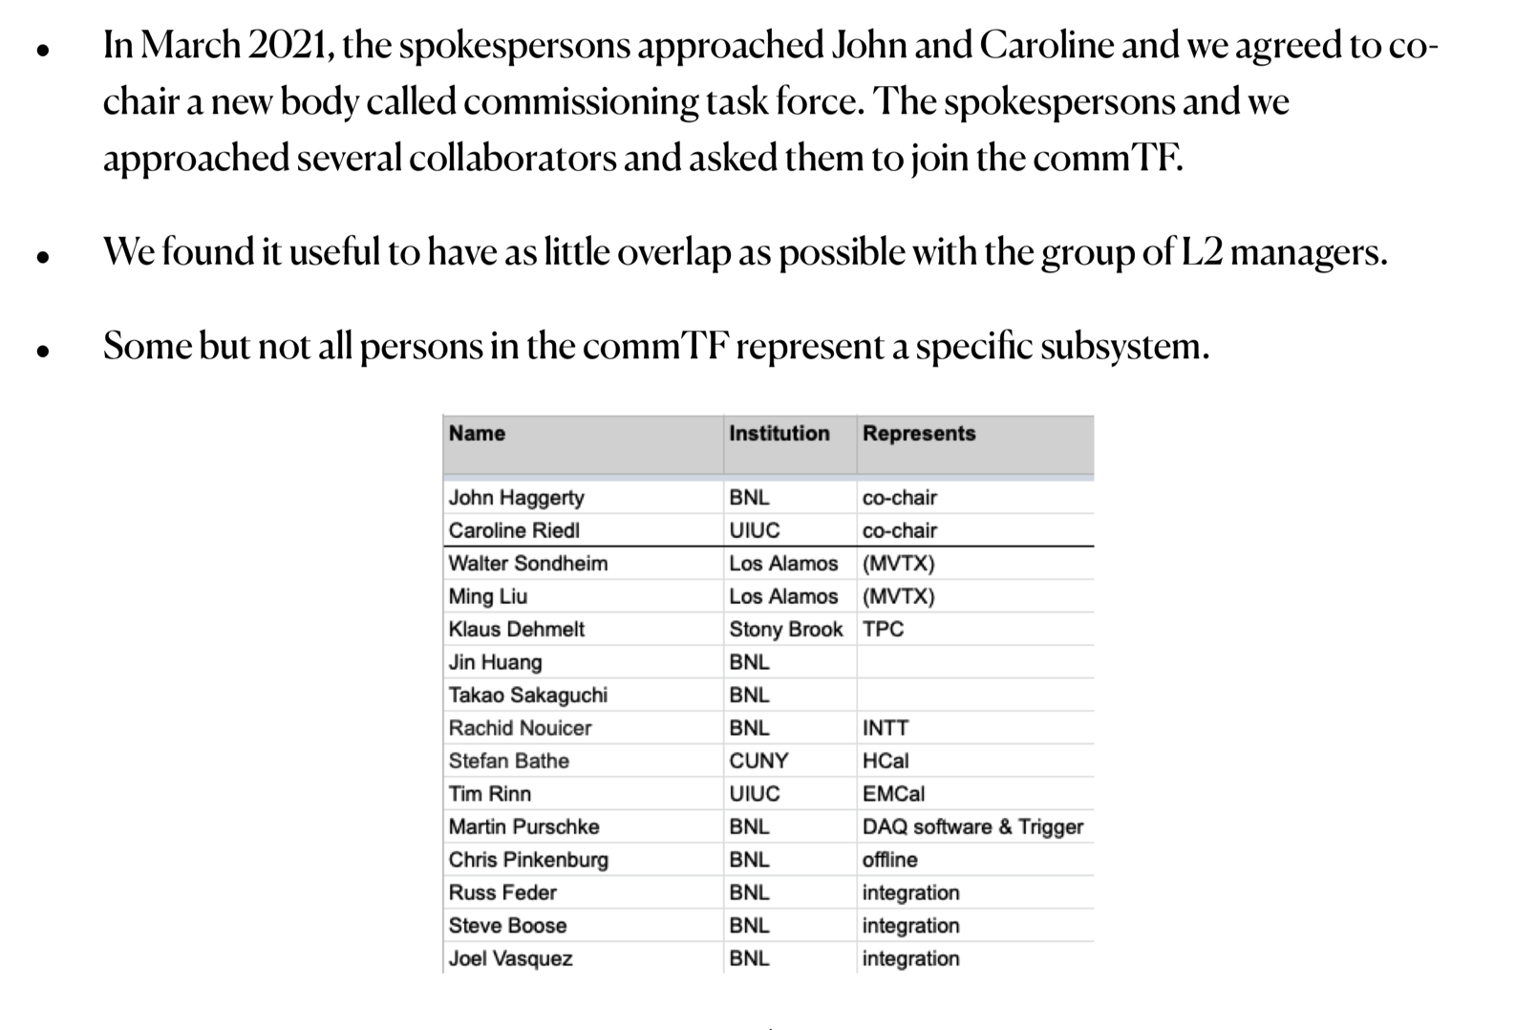
sPHENIX Commissioning Task Force

Slide 22
Goals & Definition of Commissioning Task Force

Slide 23
Commissioning stages and components
Commissioning stages
Commissioning components
Pre-installation commissioning and testing
Installation commissioning
Post-installation commissioning
Magnet commissioning
DAQ and Electronics Commissioning and Installation
Full detector commissioning (essentially DAQ and computing commissioning)
Trigger commissioning
Cosmic ray running
Beam operation
TPC
EMCAL
OHCAL
IHCAL
MBD
Computing
Trigger/Timing
DAQ
Control and Monitoring (AC/LV/HV/safety)
Magnet and cryo
Non-MIE
INTT
MVTX

Slide 24
Pre-installation commissioning and testing
Testing of components prior to installation in detector
May or may not involve connection to complete services (power, cooling, DAQ, trigger), but should as much as feasible
This stage is largely covered by the detector MIE project but requires a clean (and quick!) segue to the next stage
Mostly not in 1008 (except for DAQ/Trigger/Computing/Control/Monitoring)
Collaborators at this stage develop the experience and expertise needed for all subsequent stages

Slide 25
SC-Magnet commissioning
Largely decoupled from other commissioning steps, but many implications and requirements for safe operation
Can happen only in IR
There will be a (hopefully brief) period of time which will impede any other work on the detector
Initially, IR will be locked out when the magnet is ramped
Work on the carriage and detector will be restricted during the actual mapping campaign
Magnet mapping
April-July 2022

Slide 26
DAQ and Electronics Commissioning and Installation
Development of DAQ software, installation of DAQ computing, and integration with FEE should take place in stages of progressively increasing complexity
Unfortunately, full system tests before installation in the detector will not be possible, but we should test as large a chunk as possible
Because of the size and power requirements, this will be in the 1008 Rack Room
The testing may appear to be somewhat front-loaded, but that’s by design, to allow sufficient float to recover from problems which require substantial software development

Slide 27
Detector commissioning/chain/slice tests I
Single FEE tests
1 TPC FEE + 1 FELIX + GL1GTM NIM-to-optical
1 XMIT group + 1 DCM/JSEB + GL1GTM NIM-to-optical
Test multievent buffering as GL1GTM firmware available; random triggers; data integrity
Performance measurements (livetime vs rate)
Develop and implement zero suppression for CAL and TPC
Desirable to have zero suppressed formats early in order to work with data as we plan to take it
Development of data logger (SDL—sPHENIX Data Logger)
100% software development (up to a point)
Performance measurement—requires network switch + high performance Buffer Box
Log data from Single FEE tests via network to data logger
Joint TPC/CAL test
1 TPC FEE + 1 XMIT group + GL1GTM + SDL
Test of trigger synchronization with dissimilar systems
Two FEE tests
2 TPC FEE + 1 FELIX + GL1GTM
2 XMIT group + 1 DCM/JSEB + GL1GTM
Tests of synchronization between FEE
Standalone event recording followed by SDL

Slide 28
Detector commissioning/chain/slice tests II
CAL Slice test
A full rack of digitizers is 16 fibers == 2 DCM’s
Start with a half-rack, take data with all 8 ports of DCM
Measure livetime/rate for random triggers; assess data integrity
Expand to full rack, 2 DCM groups, 2 JEB machines
Connect to SDL
By this time, it should be possible to use sPHENIX grade zero suppression
TPC Slice Test
A full sector of TPC FEE (26)
Test with 1 FELIX to start, then break down into 2
SDL
CAL + TPC Slice Test
Combine the above tests with SDL
At this point, the DAQ could be said to be “working”
Measure performance for random triggers
Milestone Review
Note that this step must be complete by April 2022 in order to support the installation schedule

Slide 29
Major application developments
Servers
EBDC server
FELIX configurator
SEB server
DCM2/JSEB2 configurator
Data Logger (SDL)
Stream configurator
Trigger/Timing server
Trigger configuration
Timing configuration
Calorimeter FEE configurator/monitor
TPC FEE configurator/monitor
INTT configurator (INTT Consortium)
MVTX configurator (MVTX Consortium)
OPC device control/monitoring
Clients
“run control”
GUI’s
“run control”
Others convenient tools (timing, trigger, Cal FEE, TPC FEE,…)
OPC controls and monitoring
Offline
Offline event builder
Assemble complete events from n time slices
Monitoring framework
Monitoring plots for detector electronics health and welfare
Subsystem monitoring

Slide 30
Full detector commissioning
Full detector commissioning (essentially the final stage of DAQ commissioning)
Once a full detector “works” (which may come in stages, for example, 8 sectors of HCAL may be the complete detector at some point), it must be operated in concert with other detectors (the PHENIX equivalent of building up the “Big Partition”)
Problems may require detector systems to return to previous stage for debugging and repair
Pedestal measurement and testing with zero suppression
Testing must demonstrate full speed operation with random trigger
Many safety implications possibly requiring watch shifts to allow power to remain on
Projected to begin about April 2022
If we do the slice tests right, we’ll be able to switch the fibers and take data from the detector
This would be the first full scale test, so there will be some bumps in the road

Slide 31
Beam operation
Plan to start with a few 6 bunch stores, then transition to low intensity 110 bunch stores
Possible startup plan:
6 bunch, zero crossing angle, 5 stores
110 bunch, zero crossing angle, 5 stores
6 bunch, 2 mr crossing angle, 5 stores
110 bunch, 2 mr crossing angle 1 kHz/5 kHz/10 kHz/15 kHz 20 stores
Timing of MBD
MBD-only data-taking
Trigger development with beam
If we start with A+A, calorimeter trigger development could be parasitic
It may be possible to have detectors timed together so that detectors are all “close” in time at turn-on

Slide 32
sPHENIX Issues
Need continued effort from BNL PPM to complete upcoming sPHENIX procurements and contracts. We still have $6M in procurements to place in the next 12 months including the MIE, 1008 I&F upgrade, MVTX.
Need to maintain this level of personnel support from BNL from now until the start of sPHENIX operations. We have ~ 8 FTEs (technicians and engineers) from BNL Instrumentation working on sPHENIX or external dependencies (INTT). We also have 8-10 CAD FTEs (technicians and engineers) from CAD working on sPHENIX. Addition personnel from the Magnet Division also support sPHENIX.
Need to increase employees and visitors on site while working under COVID protocols. Plan to increase number of sPHENIX persons on site from 35 FTEs now to 40 FTEs by mid-July and 45 FTEs by the Sept approved by BNL assuming continued progress on COVID.
BNL Management has indicated this increase is likely even if BNL stays in Limited Operation mode.

Slide 33
Summary
sPHENIX Assembly has started in 1008
Construction is proceeding on sPHENIX final detector components at a wide variety of sites.
Continued great progress in sPHENIX factories: OHCal sectors complete, 65% of EMCal Blocks and 42% EMCal sectors complete. All TPC chips tested. All MVTX staves complete. Electronic, DAQ/Trigger, MBD, INTT, IHCal all making good progress.
Majority of Major 1008 I&F parts are complete or on order.
This includes the barrel and end cap flux return steel, LHe and LN2 components, cryo controls and power, carriage/cradle, the beam pipe modification, XY carriage tables, carriage hydraulics, carriage platform, Large Support Rings, various installation fixtures.
We have a large team of engineers and designers working remotely, and effectively on the design of the sPHENIX MIE.
We have 35 FTEs approved to work on BNL including visiting scientists and students.
We typically have 25-30 people working on BNL site for sPHENIX in an average working day.
Expect the BNL authorized number to increase to 40 FTEs mid-July and 45 FTEs by September.
Early completion dates of MIE and 1008 I&F are holding constant despite COVID impact.

Slide 34
Back Up

Slide 35
Note on magnet operation
sPHENIX taps into RHIC cryogenics system both for LHe and controls.
Roberto Than (RHIC cryo) notes that “there is no starting ahead for sPHENIX”
The magnet does not get to 4K until RHIC is started its cooldown of 4K.
Pre-run Cryo: Scrub Dec 2022
Pre-run Cryo: 45K Wave Jan 2023
Run starts & Cryo-weeks count starts: Feb 2023 and 4.5K wave starts in RHIC
Week 1: RHIC 4.5K Fill and sPHENIX cooldown
There is no "starting ahead for sPHENIX”
If everything goes according to plan, the LN2 system is supposed to keep the magnet at 90K if it stays inside the Detector Hall.
During the 4 weeks of 45K wave for RHIC we have the option to switch to 45K supply and get it colder than 90K.
When we start the RHIC 4.5K fill wave for the BLUE ring, we will have 4.5K helium and can start the solenoid cooldown.

Slide 36
Cosmic ray running
Magnet off
“All” detector components energized
Development/configuration/timing/testing of a CR trigger is possibly time-consuming
Ideas to use variant of jet/Upsilon trigger
It is hard to see how a trigger of this complexity could be implemented before the presently scheduled beam operation

Slide 37
High Priority Issues
Keep 1008 installation activities progressing forward.
We need to keep the EMCal and IHCal assembly on schedule.
Complete TPC Fee slice test, receive and test first article TPC Fee boards
The TPC Fee production assembly house has been awarded.
All SAMPA v5’s have been tested by Lund and shipped to BNL.
Production Fee PCB ordered
Keep all electronics on schedule (TPC, Calorimeter, MBD DAQ/Trigger)
Complete remaining engineering design tasks and order components
We must finish the designs and move our attention to assembly, installation and testing.
Schedule and hold remaining reviews
Place Remaining procurements

Slide 38
OuterHCal and EMCal Installation
 | Fabrication Complete | Installation Date | Delta (wk)
OHCal Sector 1 & Splice Plates | Week 8, 2021 | Week 25, 2021 | 17
OHCal Sector 13 | Week 5, 2021 | Week 36, 2021 | 31
SC Magnet Coil | 2018 (testing at BNL) | Week 39, 2021 | >100
OHCal Sector 14 | Week 5, 2021 | Week 43, 2021 | 38
OHCal Sector 32 | Week 17, 2021 | Week 48, 2021 | 31
EMCal Sector 1 | Week 14, 2020 | Week 1, 2022 | 91
EMCal Sector 32 | Week 26, 2021 | Week 5, 2022 | 31
EMCal Sector 59 | Week 52, 2021 | Week 10, 2022 | 10
EMCal Sector 64 | Week 5, 2022 | Week 11, 2022 | 6

Slide 39
TPC and Electronics Installation
 | Fabrication Complete | Installation Date | Delta (wk)
TPC | Week 4, 2022 | Week 28, 2022 | 24
OHCal Cabling | Week 3, 2022 | Week 5, 2022 | 2
EMCal Cabling | Week 3, 2022 | Week 5, 2022 | 2
Digitizers | Week 44, 2021 | Week 17, 2022 | 25
Trigger & Timing Systems | Week 4, 2022 | Week 17, 2022 | 13
Beampipe | Week 8, 2022 | Week 32, 2022 | 24
TPC, EMCal and OHCal on-detector electronics are installed as part of detector fabrication
Digitizer, Trigger and Timing installed after roll-in during April 2022
EMCal & HCal cabling starts only after Upper Platform in placed and essential cryogenics work is underway

Slide 40
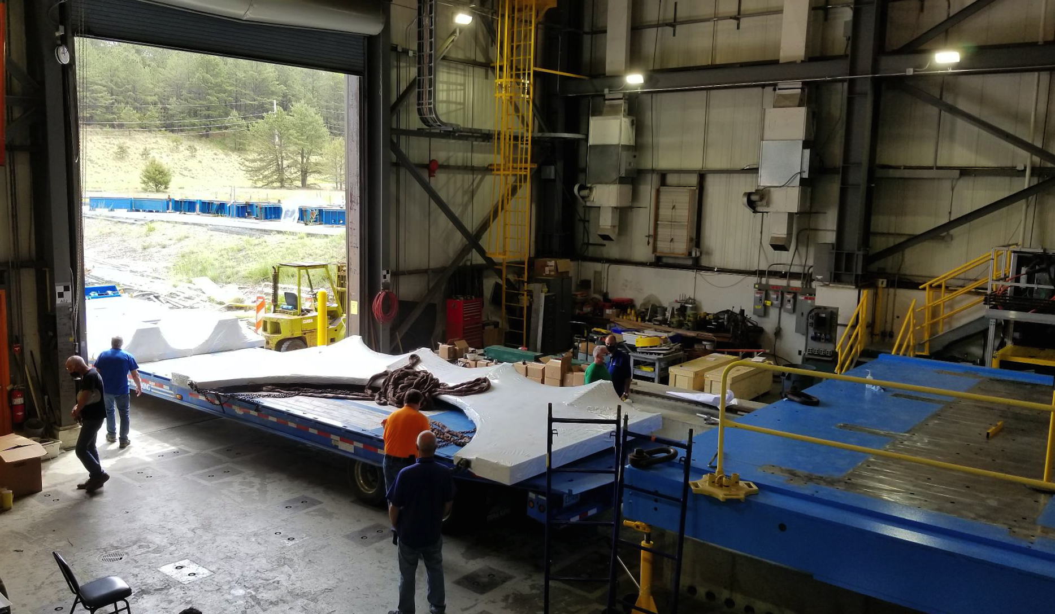
Preparing for Cradle Installation 6/2/21
Carriage & Installation

