Slide 1
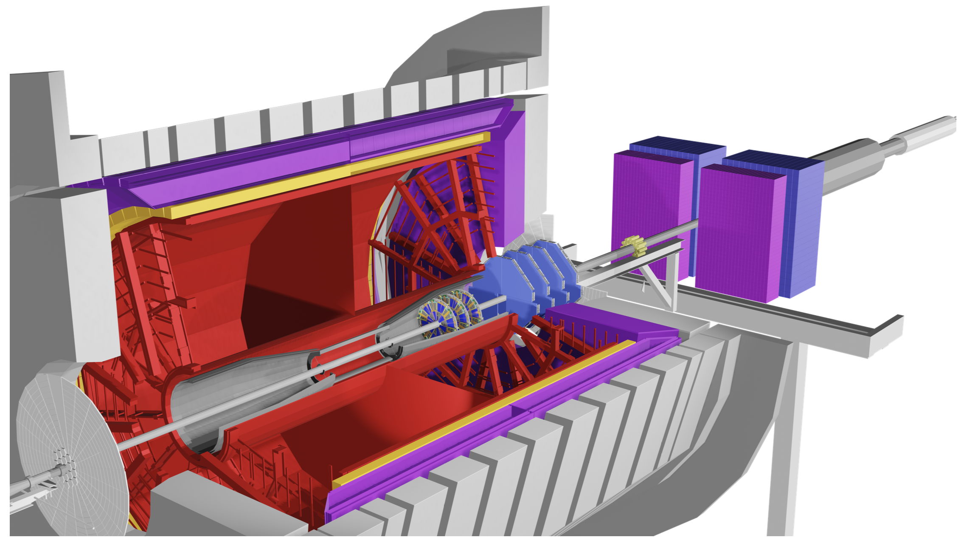

BNL NPP 2021 PAC Meeting
Results from the STAR Cold QCD program and readiness of the Forward upgrades
E.C. Aschenauer

Slide 2
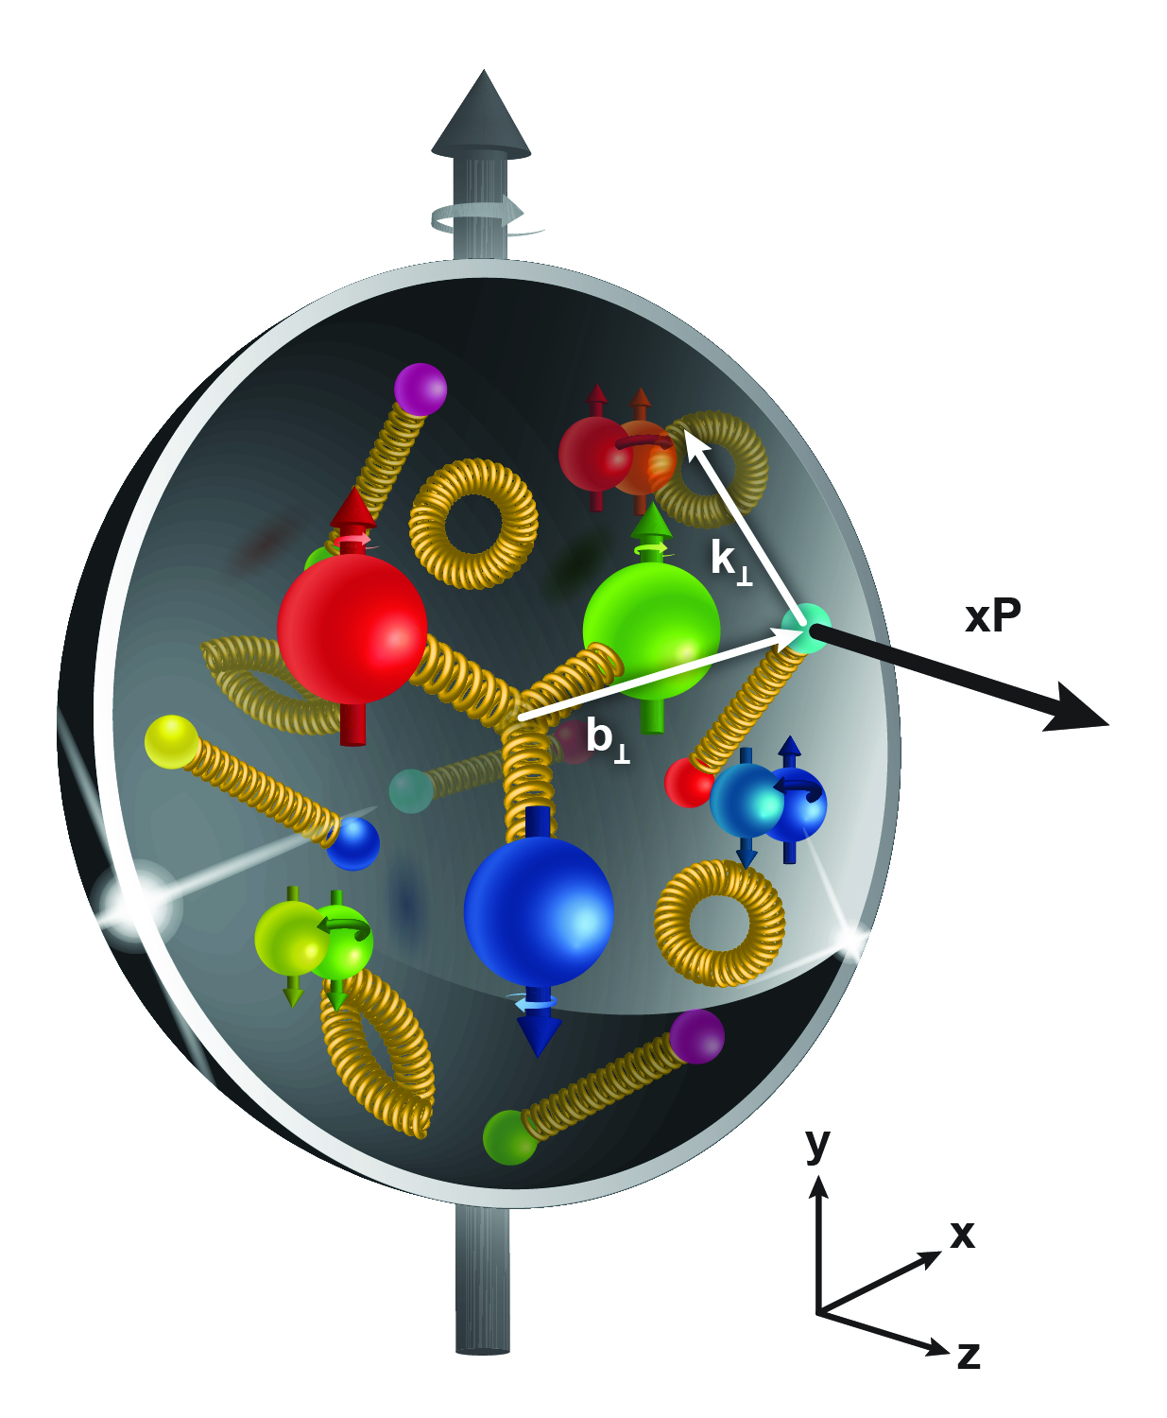



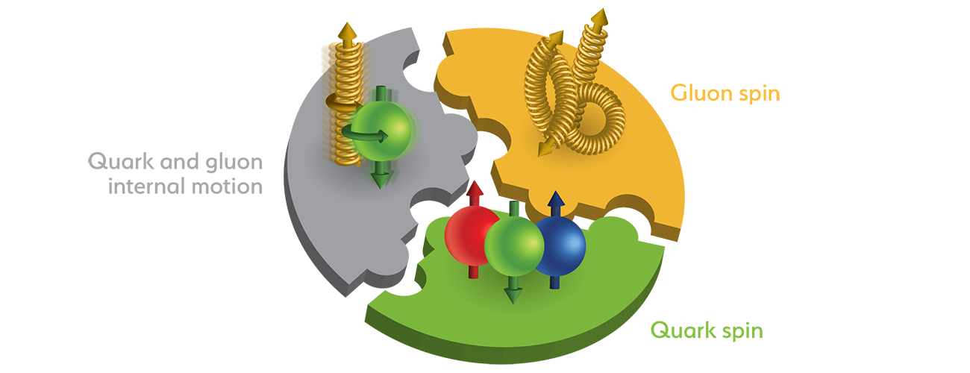
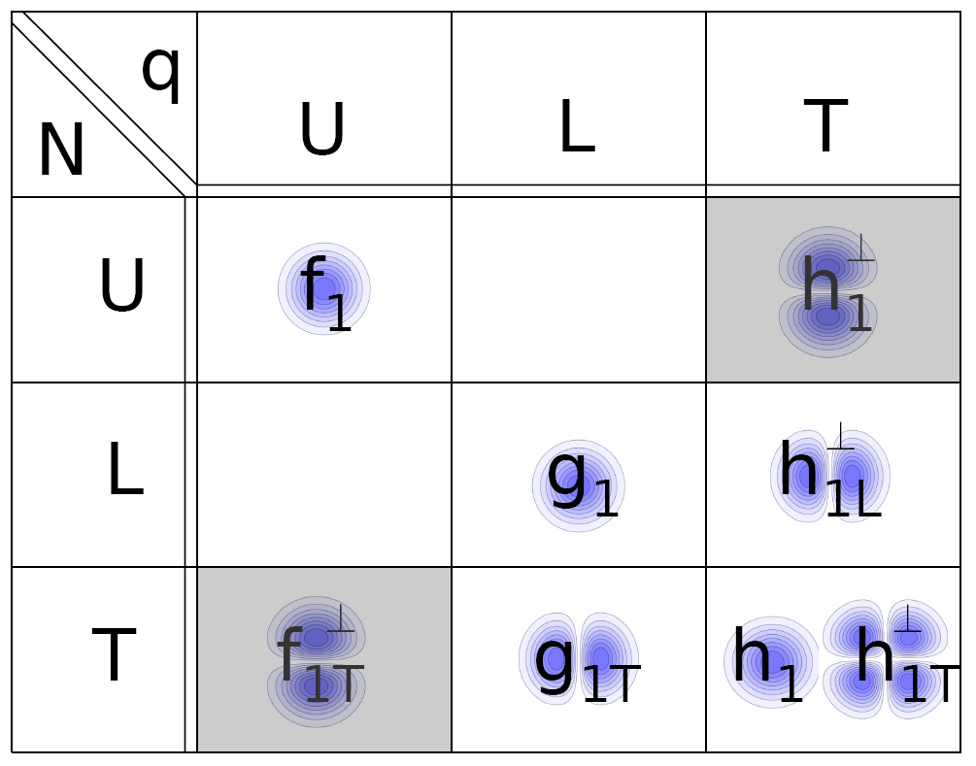
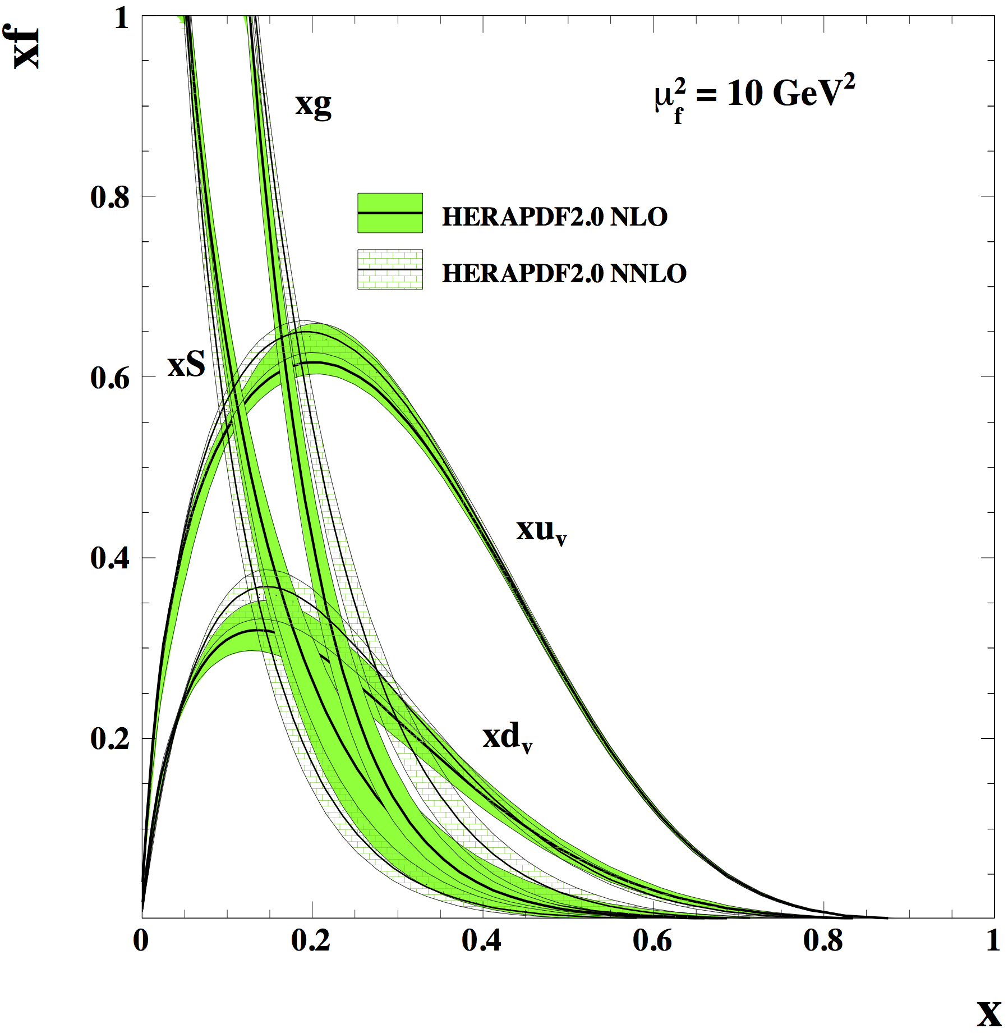
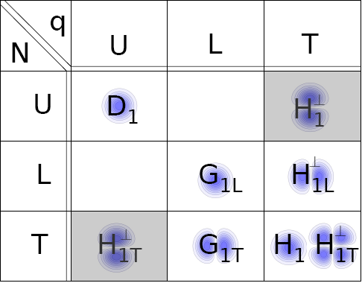
The Pillars of the STAR Cold QCD Program
(n)PDFs
& (n)FF
TMD PDFs
& FF
Helicity PDFs
L_{g,q}
ΔG
Δq
unpolarized
pp, pA
longitudinal
polarized pp
transverse
polarized pp, pA
upcoming 2022 & 2024
data taking finished ≤ 2015
upcoming 2022 & 2024

Slide 3
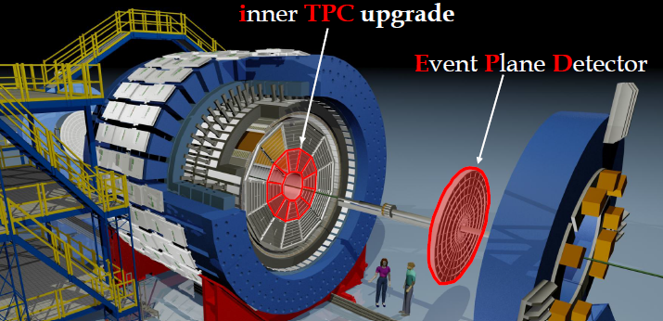
The Uniqueness of STAR
large rapidity coverage -1 < η < 4 → high to low x
  lowest x at forward rapidity at 500 GeV
  highest x at forward rapidity at 200 GeV
PID – dE/dx & ToF → quark flavor separation
large acceptance → enables observables with complicated structures, i.e. di-jets

Slide 4
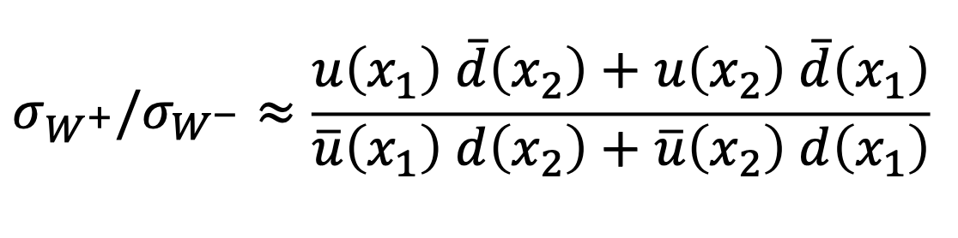
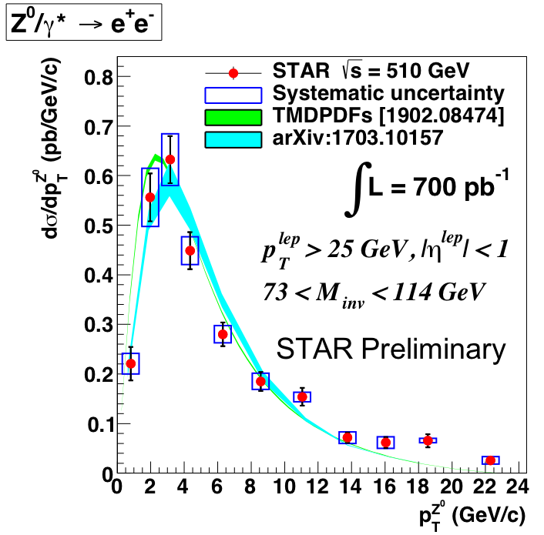
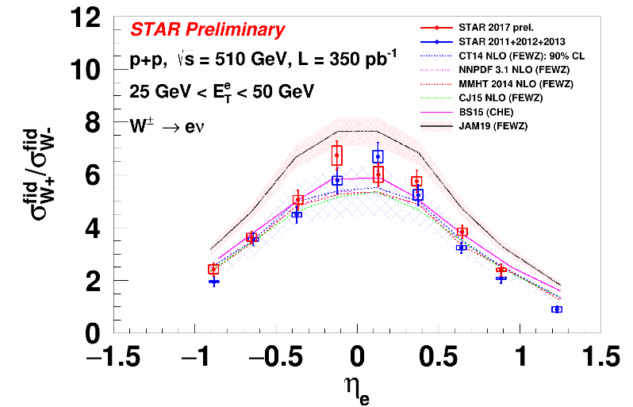
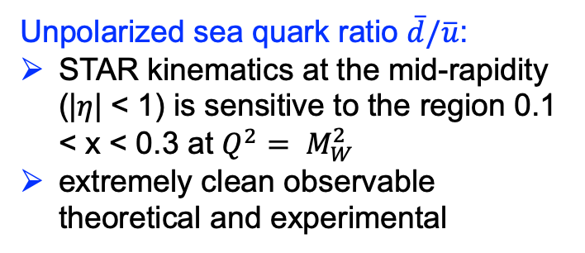
W^{+/-} and Z⁰ Cross section
Unpolarized sea quark ratio $\overline{d}/\overline{u}$:
STAR kinematics at the mid-rapidity (|$η$| < 1) is sensitive to the region 0.1 < x < 0.3 at $Q^{2}= M_{W}^{2}$
extremely clean observable theoretical and experimental
Z0 cross section can constrain unpolarized TMD PDFs
All Data: 2011 - 2017
Run11-13, PRD 103, 012001(2021)

Slide 5

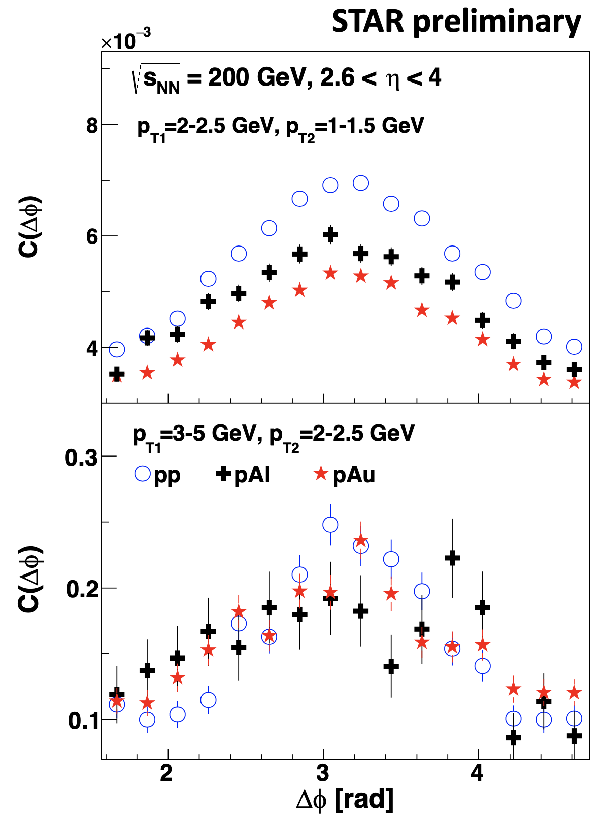
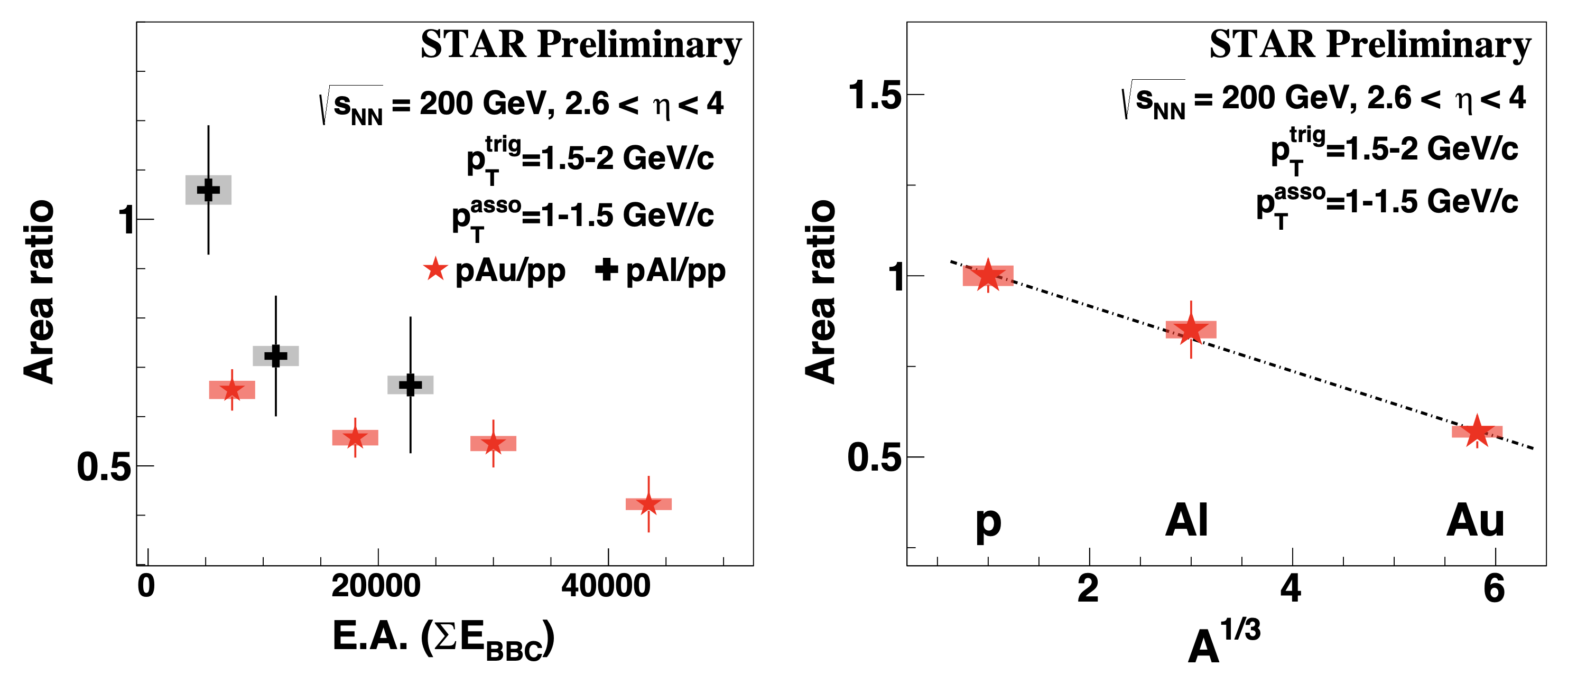
Probing Non-linear Effects in QCD
Forward rapidities at STAR provide an absolutely
unique opportunity to have very high gluon densities
→ proton – Au collisions
combined with an unambiguous observable
counting experiment of Di-jets in pp and pA
Saturation: Disappearance of backward jet in pA
p
p
p
A
A dependence: at low p_{T} more suppression in pAu than pAl in comparison to the pp
x dependence: at high p_{T} range (large x) no suppression in pA

Slide 6
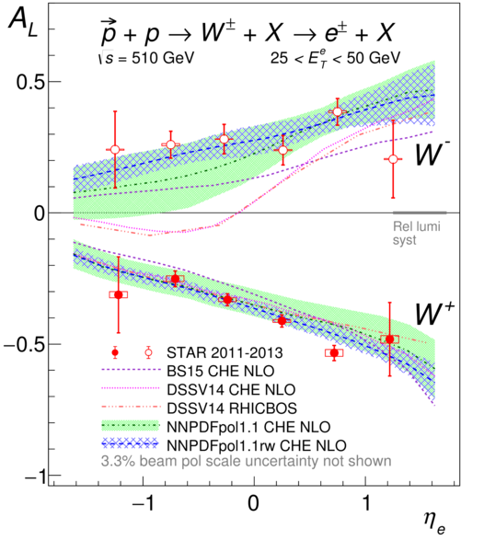
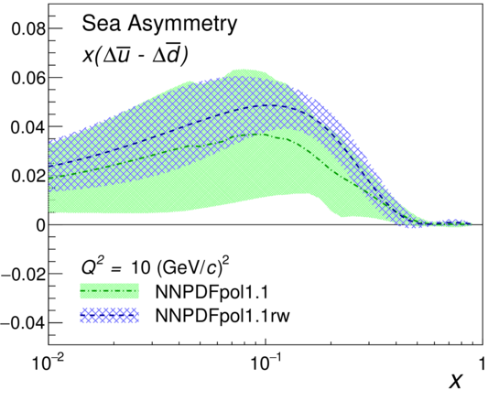
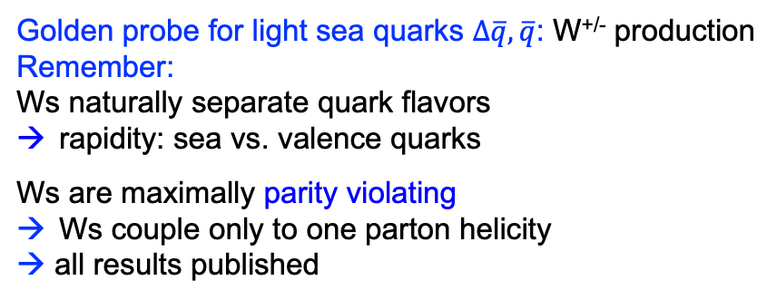
Helicity PDFs: Δq_{s} and ΔG
Golden probe for light sea quarks $∆\overline{q}, \overline{q}$: W^{+/-} production
Remember:
Ws naturally separate quark flavors
rapidity: sea vs. valence quarks
Ws are maximally parity violating
Ws couple only to one parton helicity
→ all results published
Phys. Rev. D 99, 051102(R)
Golden probes for Δg:
Double spin asymmetry A_{LL} for jets, di-jets and π⁰
Remember: to increase x-range covered:
go to higher √s (200 GeV → 500 GeV)
or
go to higher rapidity: -1<η<1 → -1 <η<1.8 (-1 <η<4 with fSTAR)
or both
Di-jets: constrain the shape of the Δg(x,Q2)
→ 4 papers in the last years → all but < 5 papers published

Slide 7
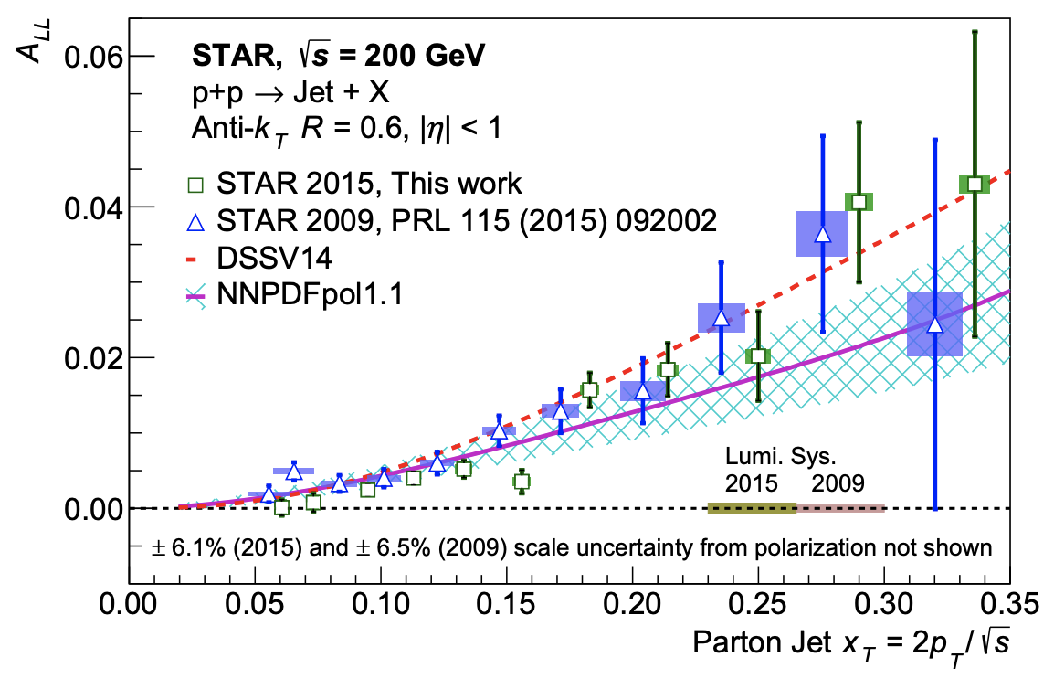
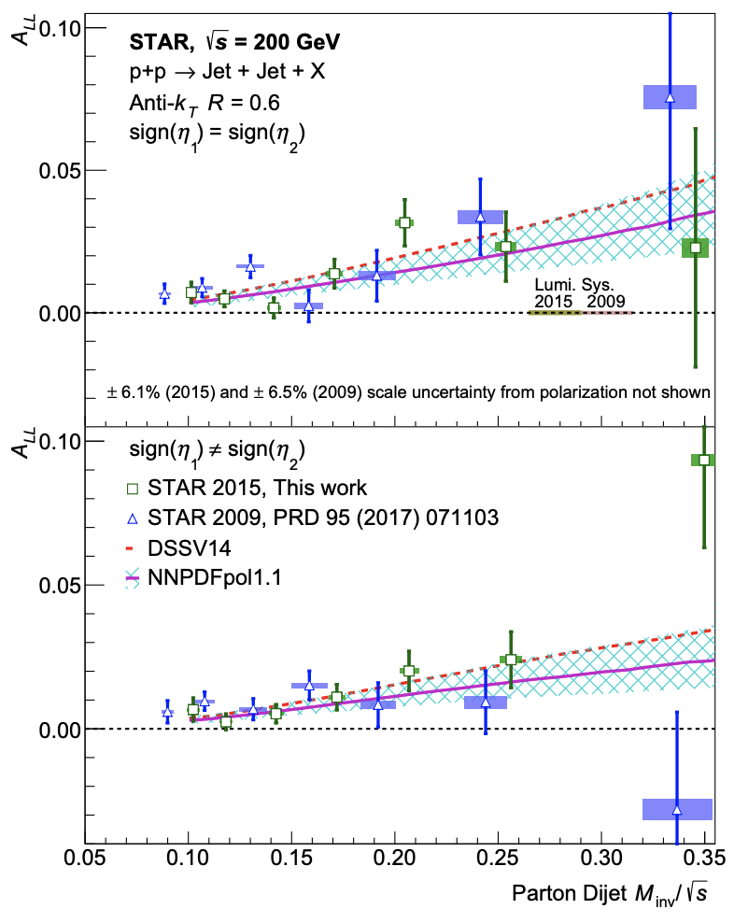
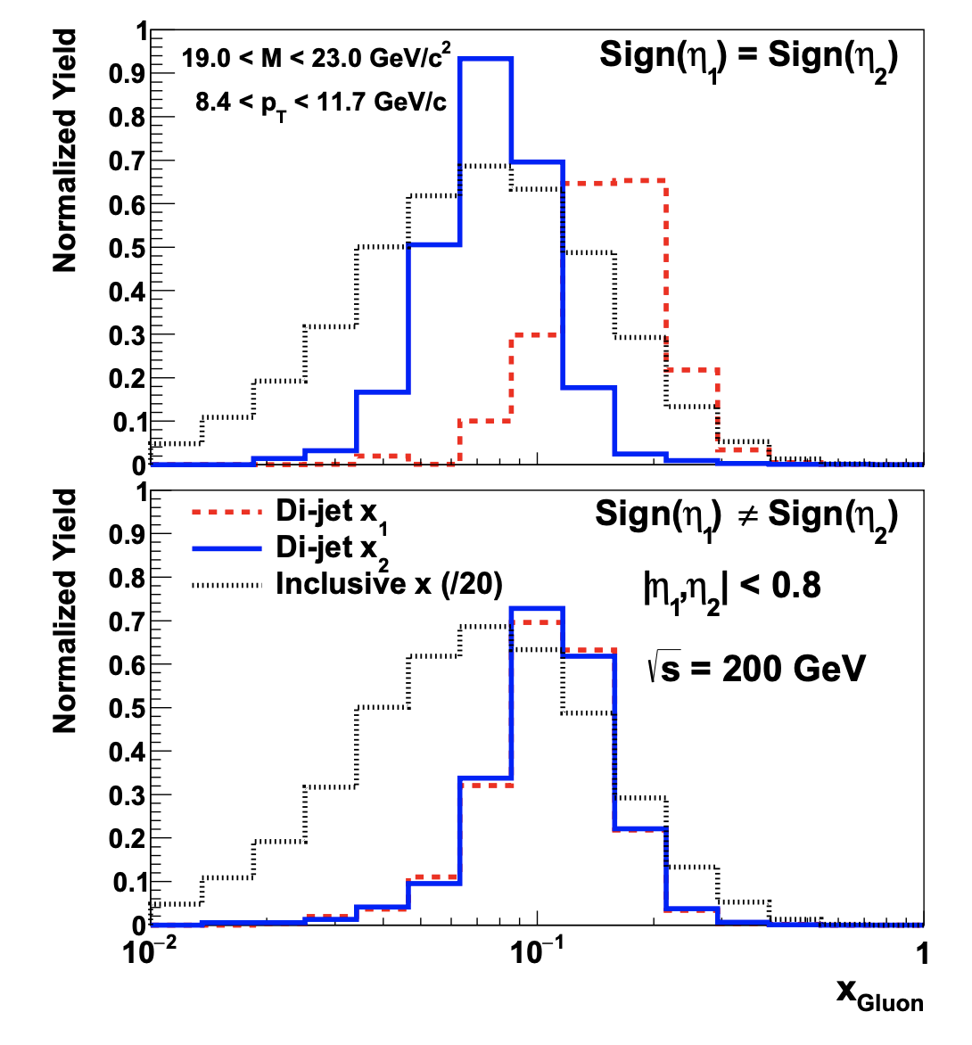
Helicity PDFs: ΔG
STAR, PRD 103 (2021) L091103
Newly published results:
Largest 200 GeV longitudinally polarized pp dataset (2015); improved both statistical and systematic uncertainties
This result will reduce the uncertainty of gluon polarization for x_{T} > 0.05 if included in global fits
STAR, PRD 103 (2021) L091103
Two different η topology bins
Di-jets: Much narrower ranges of initial state partonic momentum fraction tested; different topologies enhance sensitivity of the data to selected x;

Slide 8
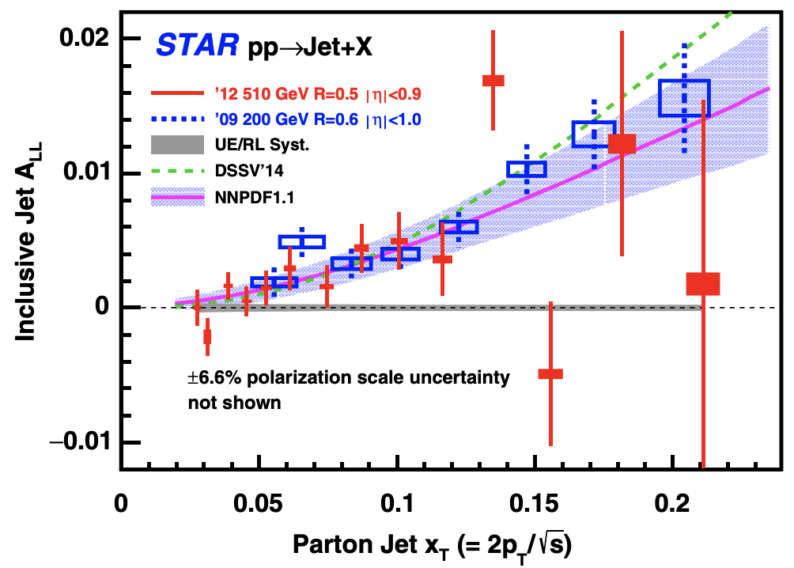
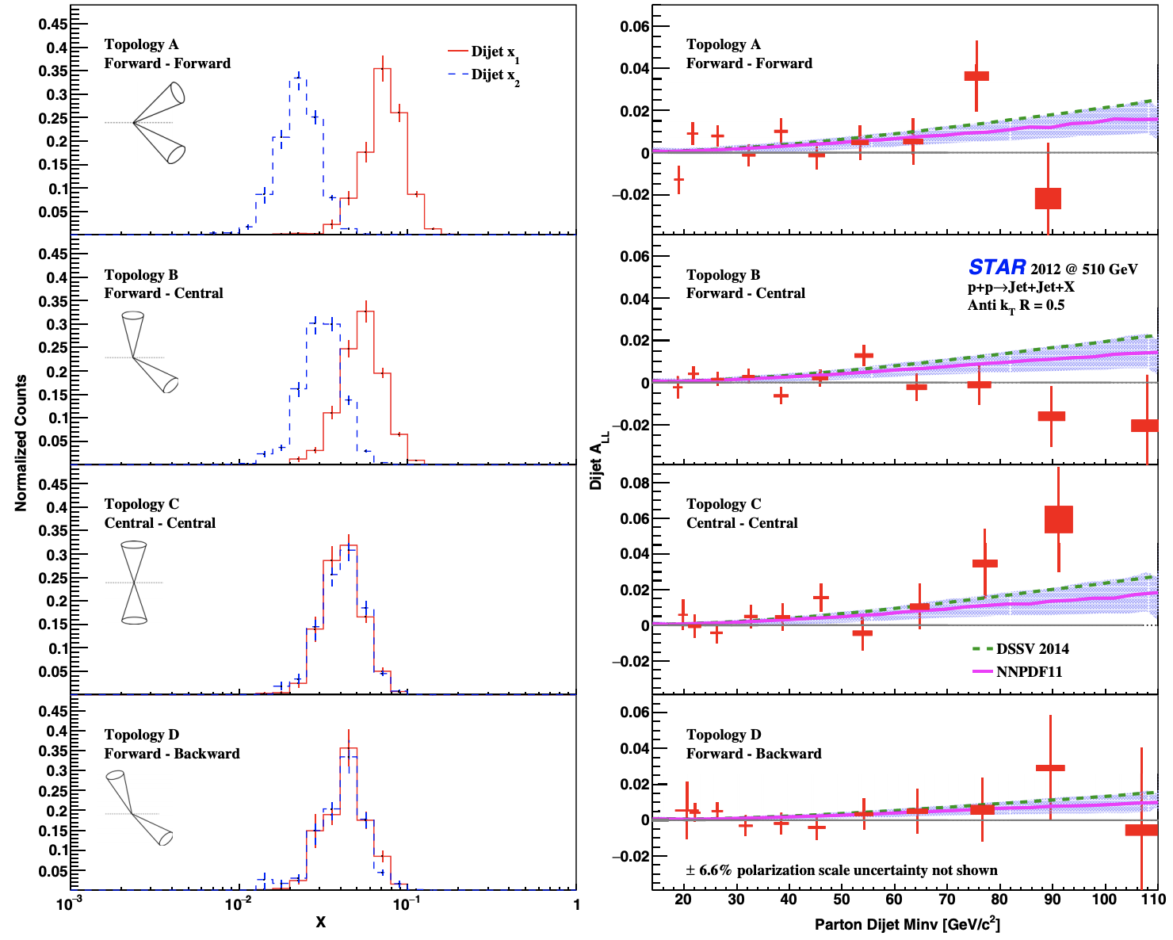
Helicity PDFs: ΔG
STAR, PRD 100 (2019) 052005
Four different η topology bins
Measurement of jet and di-jet A_{LL} at 510 GeV with 2012 data:
Higher √s pushes sensitivity to lower x (down to 0.02)
Consistent results from both energies
Run 2013 A_{LL} publication in preparation
STAR has concluded the collection of longitudinally polarized data

Slide 9
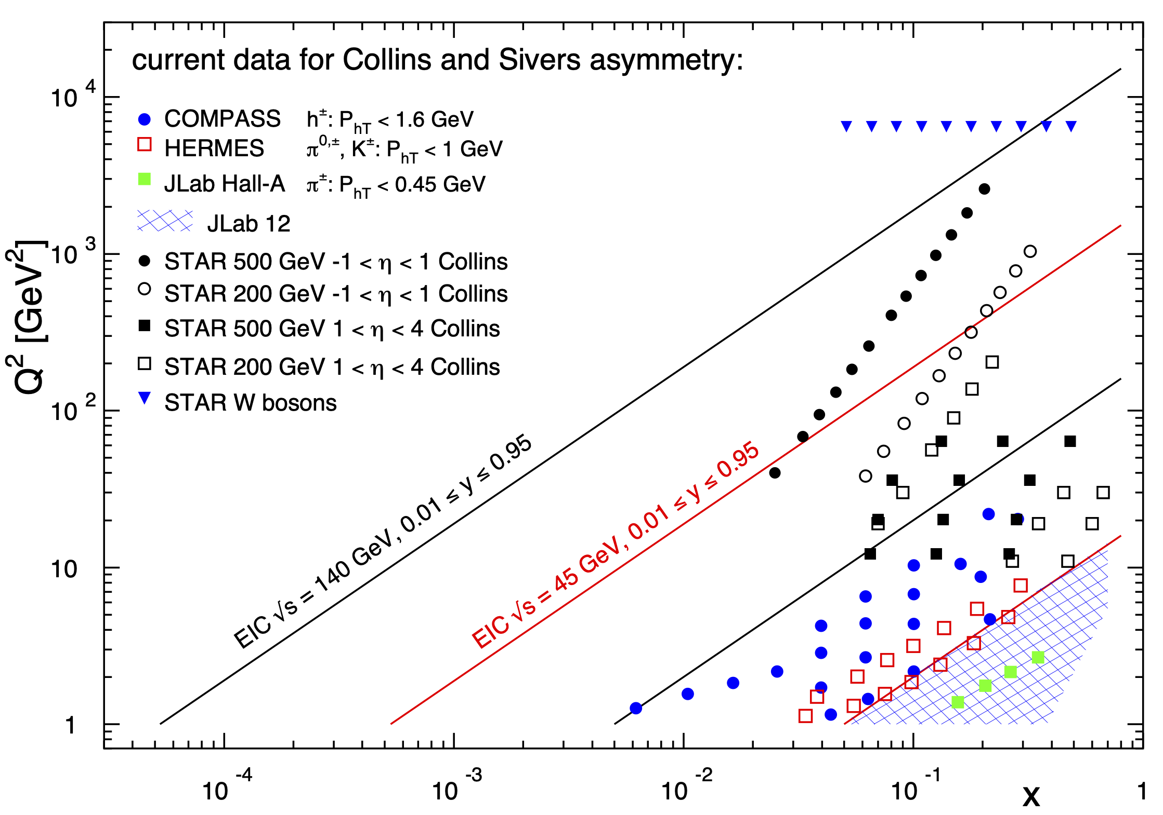
Transverse Momentum Dependent PDFs and FF
Before STAR TMDs came only from fixed target ep data → high x @ low Q²
need to establish concept at high Q² and wide range in x
RHIC unique kinematics: from low to high x at high Q² → TMD evolution
high precision data to test factorization and universality of TMDs
pp ← → DIS@EIC
Sivers effect:
In a transversely polarized proton, the constituent parton has a flavor dependent intrinsic transverse momentum.
Non-universality:
Sivers_{DIS} = -- (Sivers_{DY} or Sivers_{W,Z0})
Collins effect:
Correlation between the polarization of a scattered quark and the momentum of a hadron fragment transverse to the scattered quark direction:

Slide 10
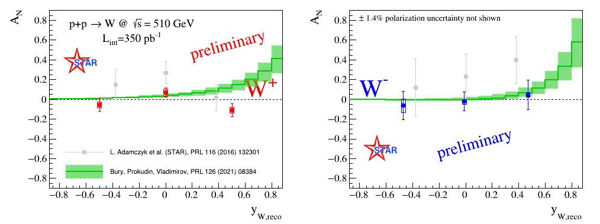
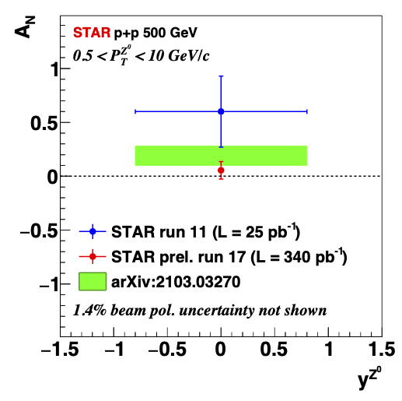
2017: A_{N} for W^{+/-} and Z⁰
Improved uncertainties from run 2017 preliminary results
Bury, Prokudin, and Vladimirov PRL 126, 112002 (2021) – extraction includes SIDIS, DY and 2011 STAR data with N³LO and NNLO accuracy of the TMD evolution assuming sign-change
2x more statistics from run 2022 at 510 GeV with STAR iTPC (expec. ~350 pb ⁻¹)

Slide 11
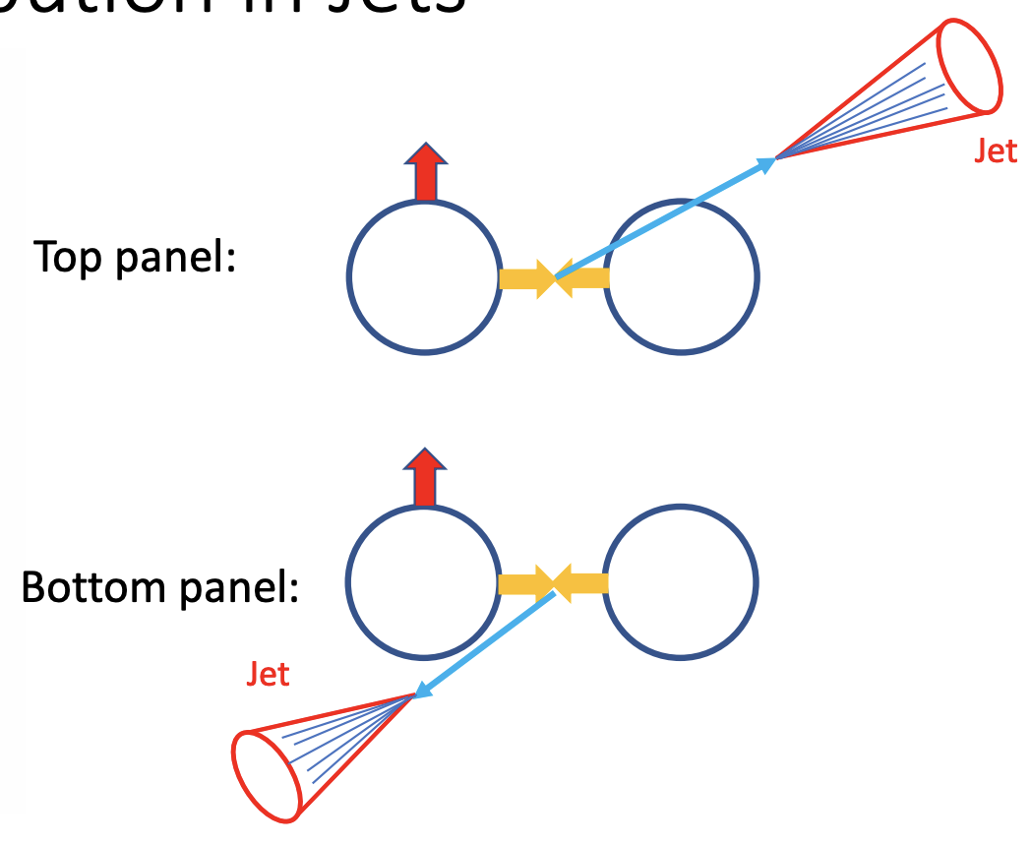
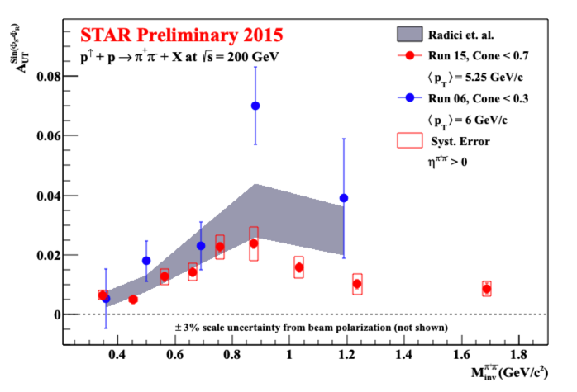


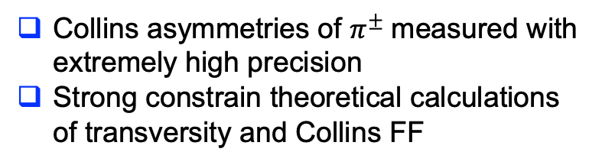
Collins asymmetry for $π^{±}$ in jets
$$x^{F}>0$$
$$x^{F}<0$$
Collins asymmetries of $π^{±}$measured with extremely high precision
Strong constrain theoretical calculations of transversity and Collins FF
STAR, DIS2021 and PRL 115 (2015) 242501
Di-hadron correlation measurements:
“interference FF” (collinear framework)
Correlation of transverse spin of fragmenting quark and momentum cross-product of di-hadron pair
→ strong constrain on IFF and transversity

Slide 12
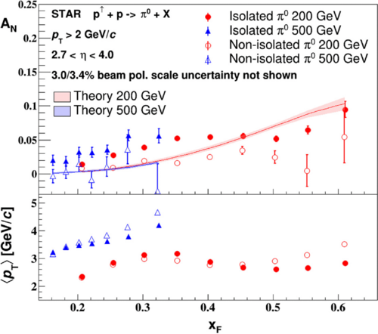
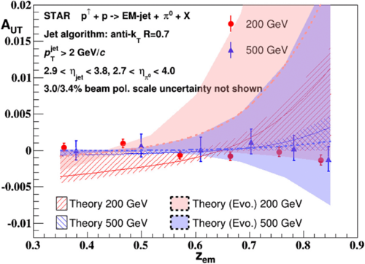
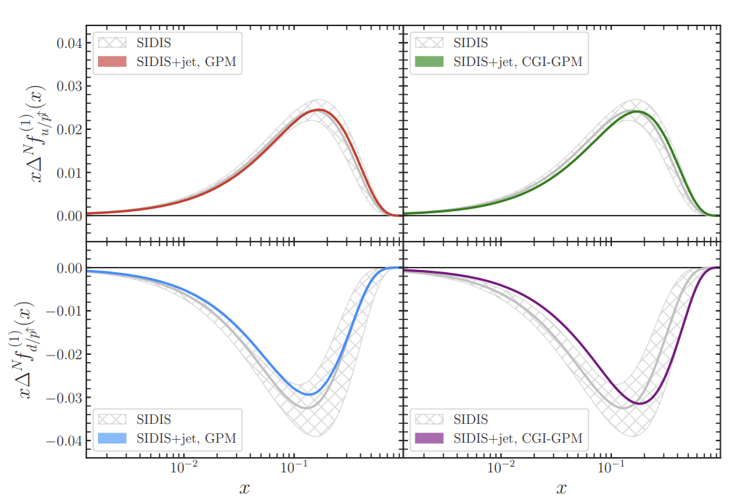
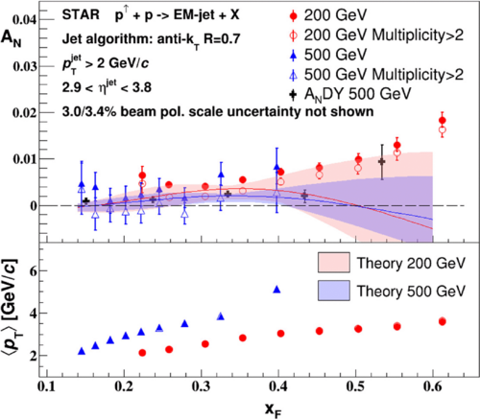
TMDs at forward rapidities 2.7 < η < 4
π⁰ A_{N}
π⁰ in EM jets A_{UT}
incl. EM jets A_{N}
STAR, PRD 103 (2021) 92009
STAR, PRD 103 (2021) 92009
STAR, PRD 103 (2021) 92009
Impact of forward EM jets A_{N} on u and d Sivers function
Weak dependence on the center-of-mass energy
Measured small A_{N} Collins asymmetry for π⁰ within EM jets
  small contribution from Collins to π⁰ AN
A_{N} for non-isolated π⁰ and higher-multiplicity EM jets lower
  additional mechanism needed to explain asymmetries → diffractive subprocesses?
STAR forward upgrade capabilities with jets and charged hadrons
Study forward Sivers, Collins and Diffractive processes:
→ charged-hadron enhanced jets (prediction from Twist-3 formalism), hadron in jet
Collins asymmetry, diffractive processes with rapidity gaps

Slide 13
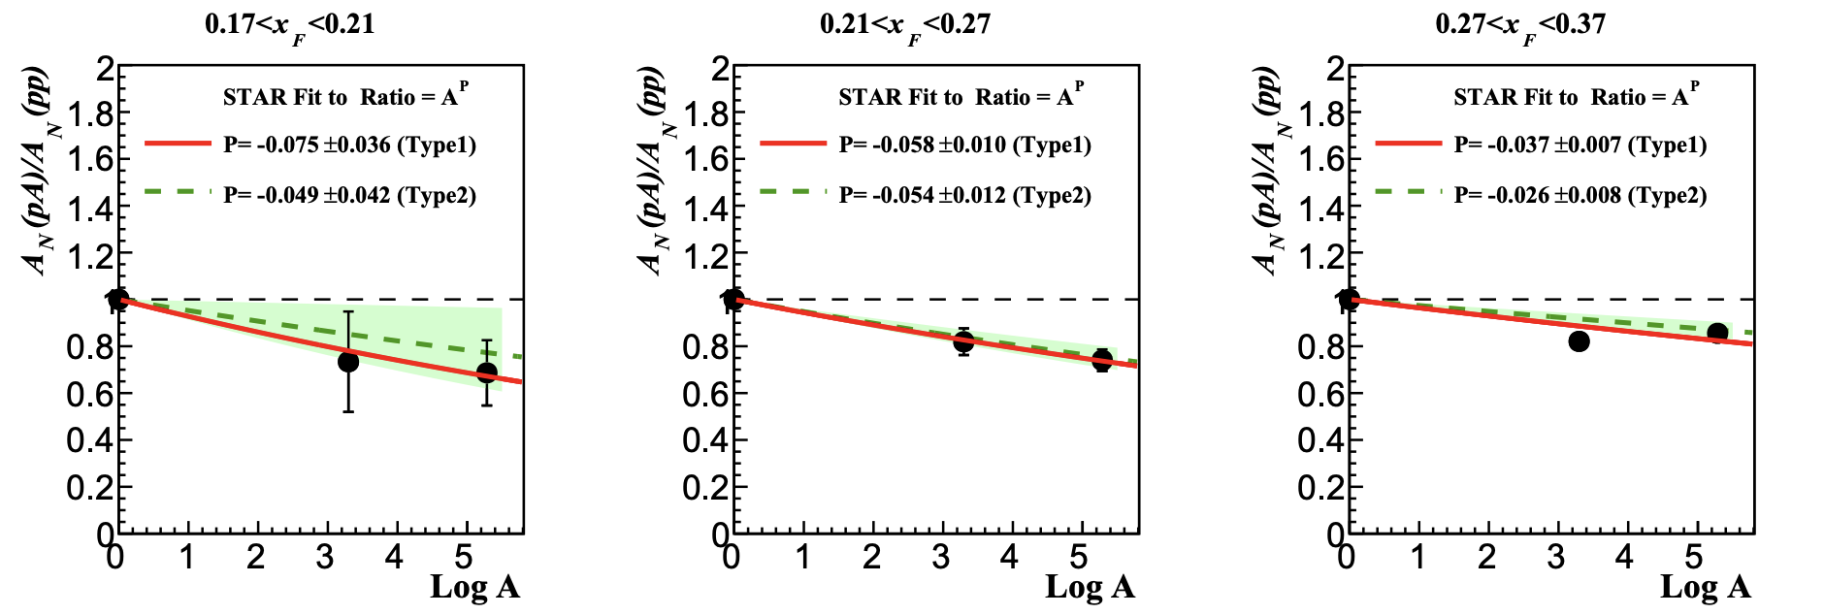
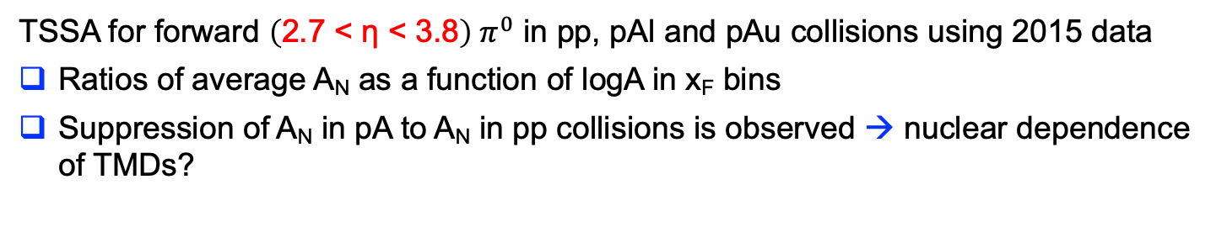
Nuclear Dependence of A_{N}
STAR, PRD103 (2021) 072005
Type1: correlated uncertainties in the ratio; Type2: without correlated uncertainties
TSSA for forward $\left(\text{2.7 < }\text{η}\text{ < 3.8}\right) π^{0}$ in pp, pAl and pAu collisions using 2015 data
Ratios of average A_{N} as a function of logA in x_{F} bins
Suppression of A_{N} in pA to A_{N} in pp collisions is observed → nuclear dependence of TMDs?

Slide 14
The STAR Forward Upgrade
Combines:
Electromagnetic and Hadronic Calorimetry
with SiPM readout & new ADC + trigger modules
with Tracking
Silicon detectors and
small-strip Thin Gap Chambers (sTGC)
Silicon
sTGC
ECal
Observables:
inclusive and di-jets
hadrons in jets
Lambda’s
correlations mid-forward & forward-forward rapidity
Requirements from Physics:
good e/h separation
hadrons, photon, p⁰ identification
HCal
STAR forward upgrade: 2.5 < η < 4
faces blue RHIC beam
rapidity coverage the same as
EIC hadron Arm
Detector | pp and pA | AA
ECal | ~10%/√E | ~20%/√E
HCal | ~50%/√E+10% | ---
Tracking | charge separation photon suppression | 0.2<p_{T}<2 GeV/c with 20-30% 1/p_{T}

Slide 15

High Level Schedule – Slide from PAC-2020
September
14th , 2020
4.5 Month
Shutdown
January
25st , 2021
July
12th, 2021
(9th Aug)
18 weeks
Shutdown
November (Dec.)
15th , 2021
ECal already installed
Installation of:
ECal SiPMS & FEEs
HCal
HCal SiPMS & FEES
All DAQ & Trigger electronics
→ ECal and HCal ready for data taking
Full System check of Silicon
  Cooling system
  DAQ
  one Si prototype module
Si support structure test installation
sTGC gas system installation &
commissioning
24 (28)Weeks
BES-II
Installation of:
Si - tracker
sTGC-tracker & Readout (maybe
partially installed earlier during run)
Work during Run-21:
Commissioning of
Calorimeter system
Full System check of sTGC
with beam
  one sTGC prototype module
  VMM electronics prototype
  Gas system
  DAQ
Till today all work done according to plan

Slide 16
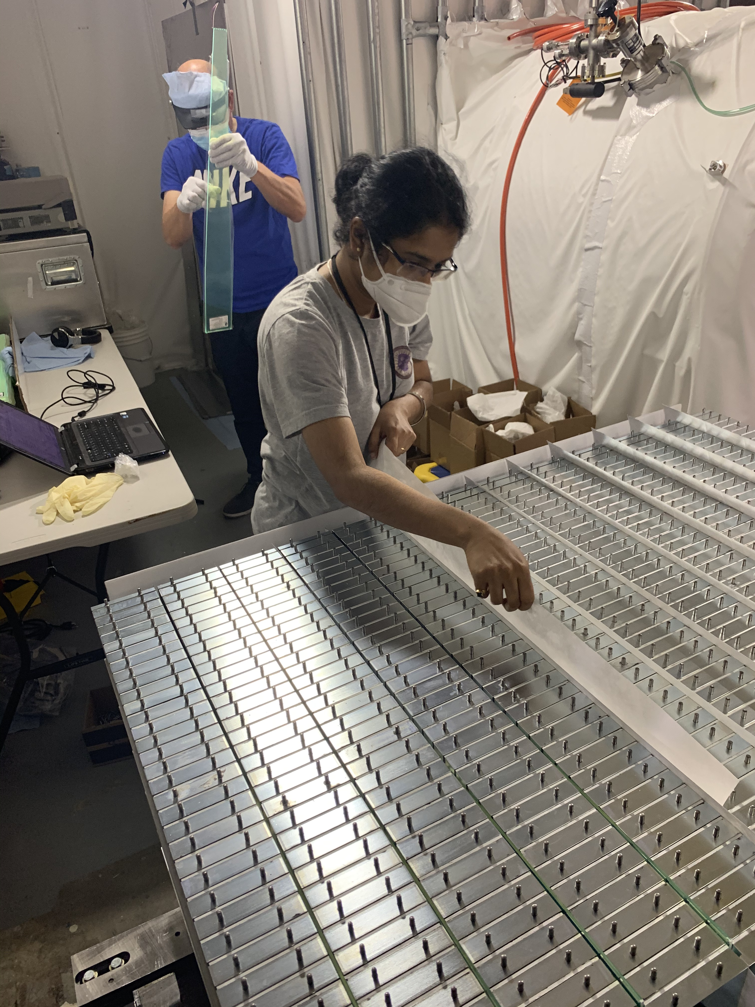
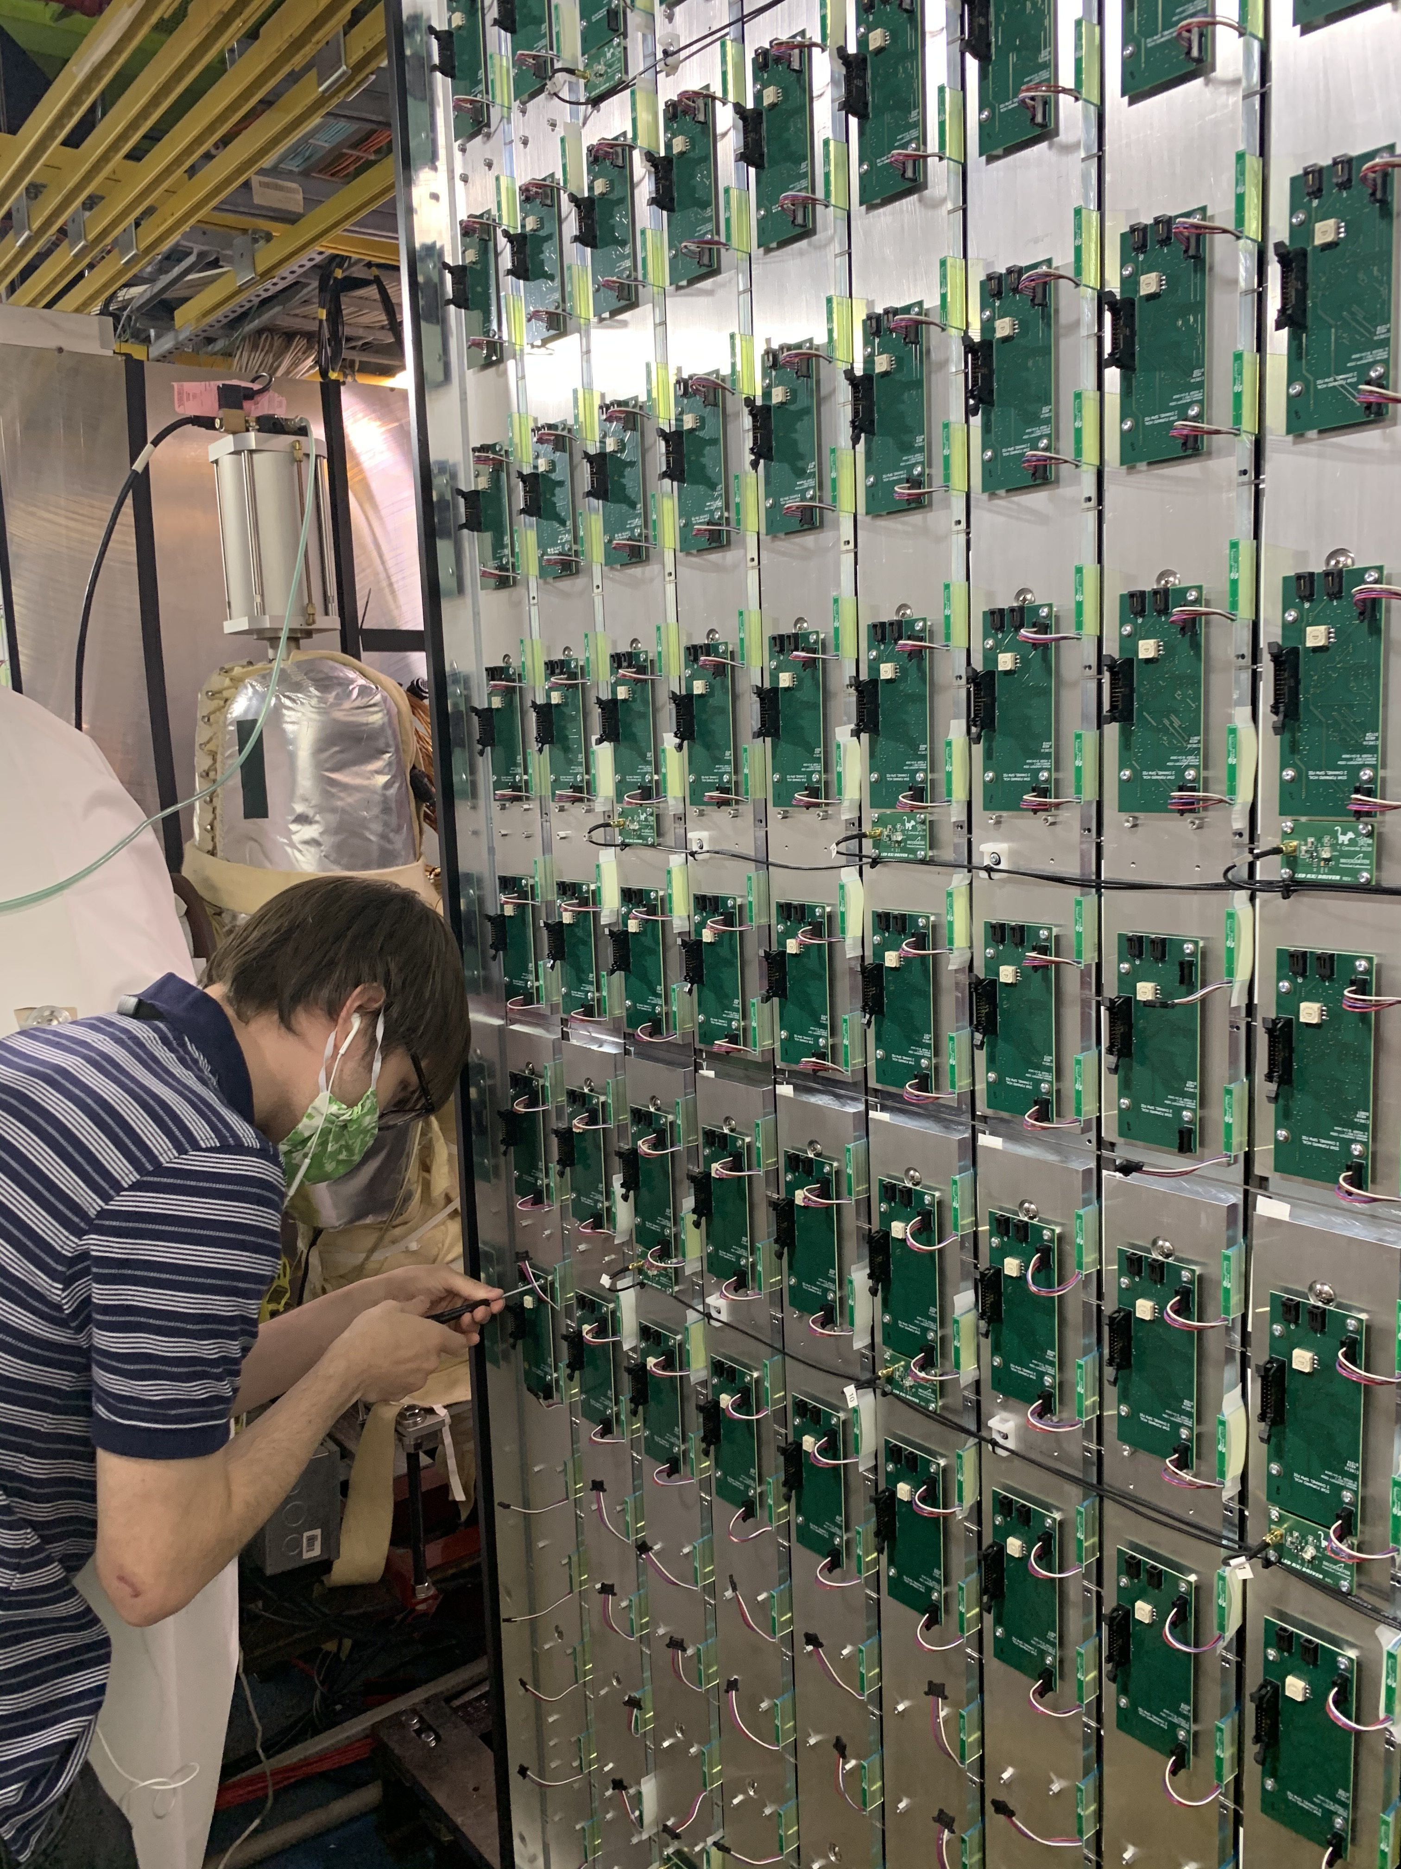
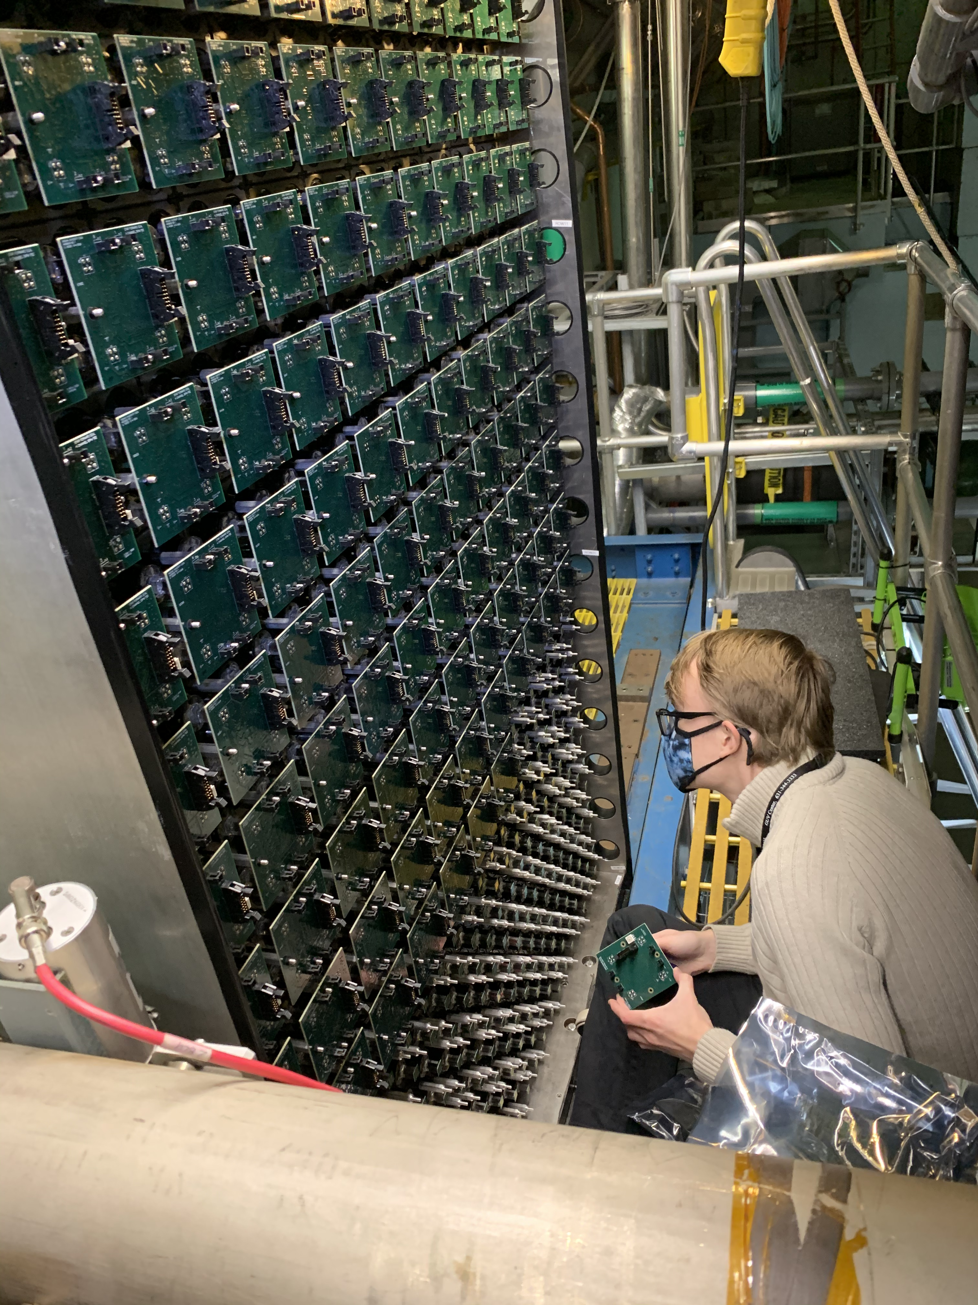
fSTAR: Forward Calorimeter System
Forward Calorimeter System (FCS)
ECal – 1496 channels ~ 8 tons
HCal – 520 channels ~ 30 tons.
SiPM Readout Bias ~ 67V
New digitizers + Trigger FPGA = DEP boards
Members of UC EIC Consortia
Assembling FCS in Autumn 2020 at BNL
Large group of STAR collaborators actively engaged in all aspects of the project: ACU, BNL, UCLA, UCR, Indiana University CEEM, UKU, OSU, Rutgers U., Temple U., Texas A&M U., Valparaiso U.
Could engaged students despite COVID → nobody was infected

Slide 17
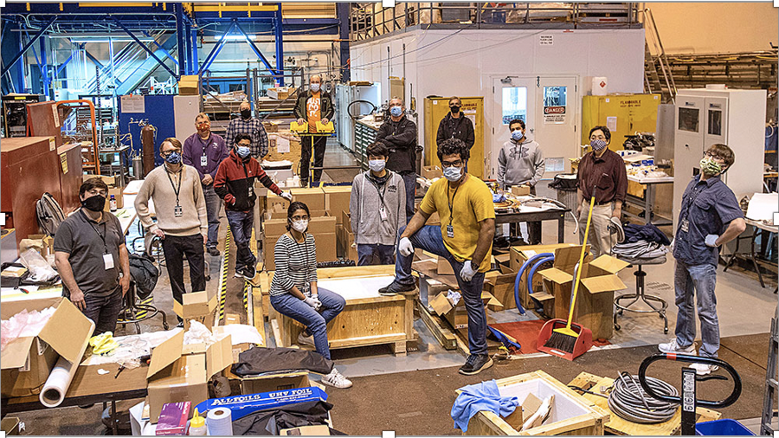
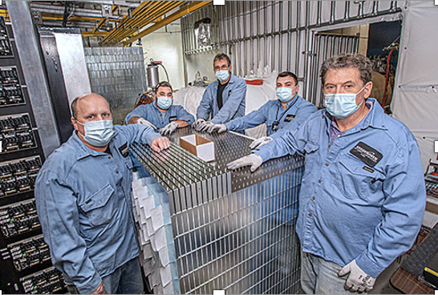
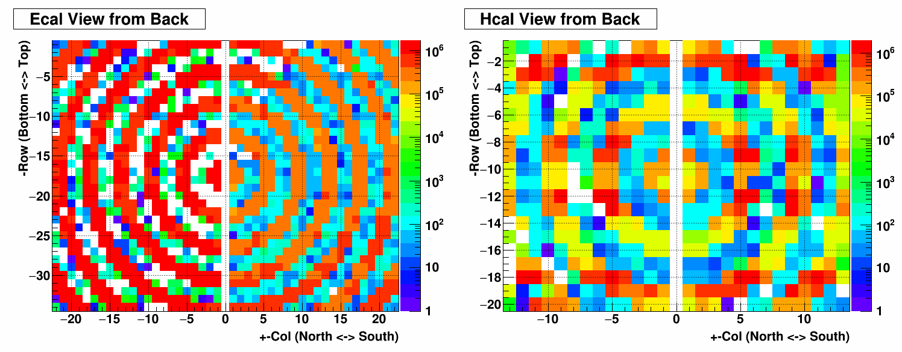
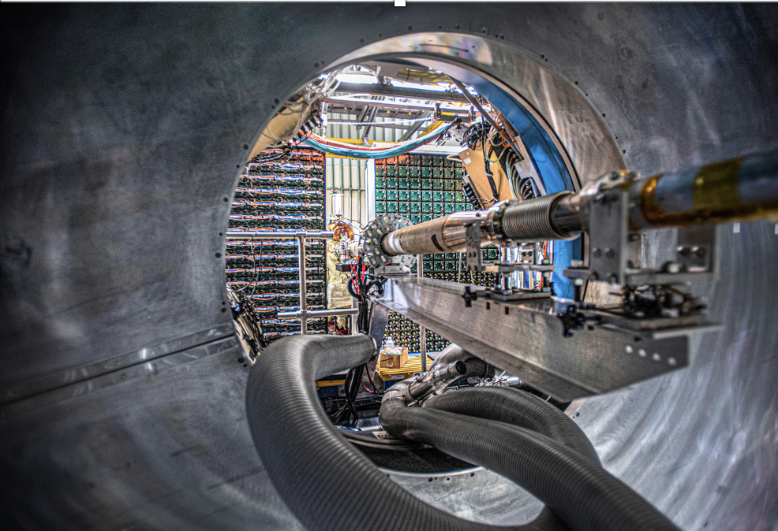
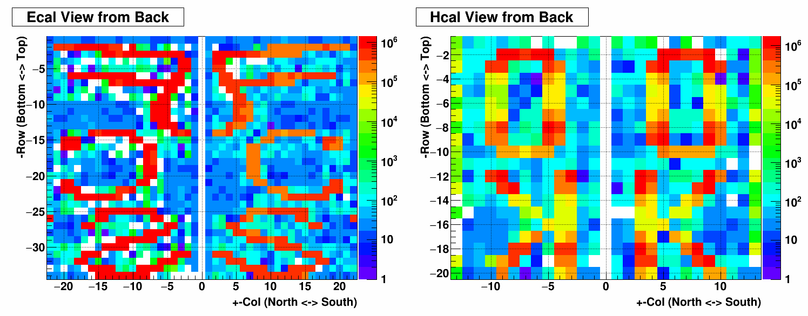
https://www.bnl.gov/newsroom/news.php?a=217681
FCS Construction and Initial Commissioning Completed.
Intensive help from CAD Tech’s
→ Big Thank you

Slide 18
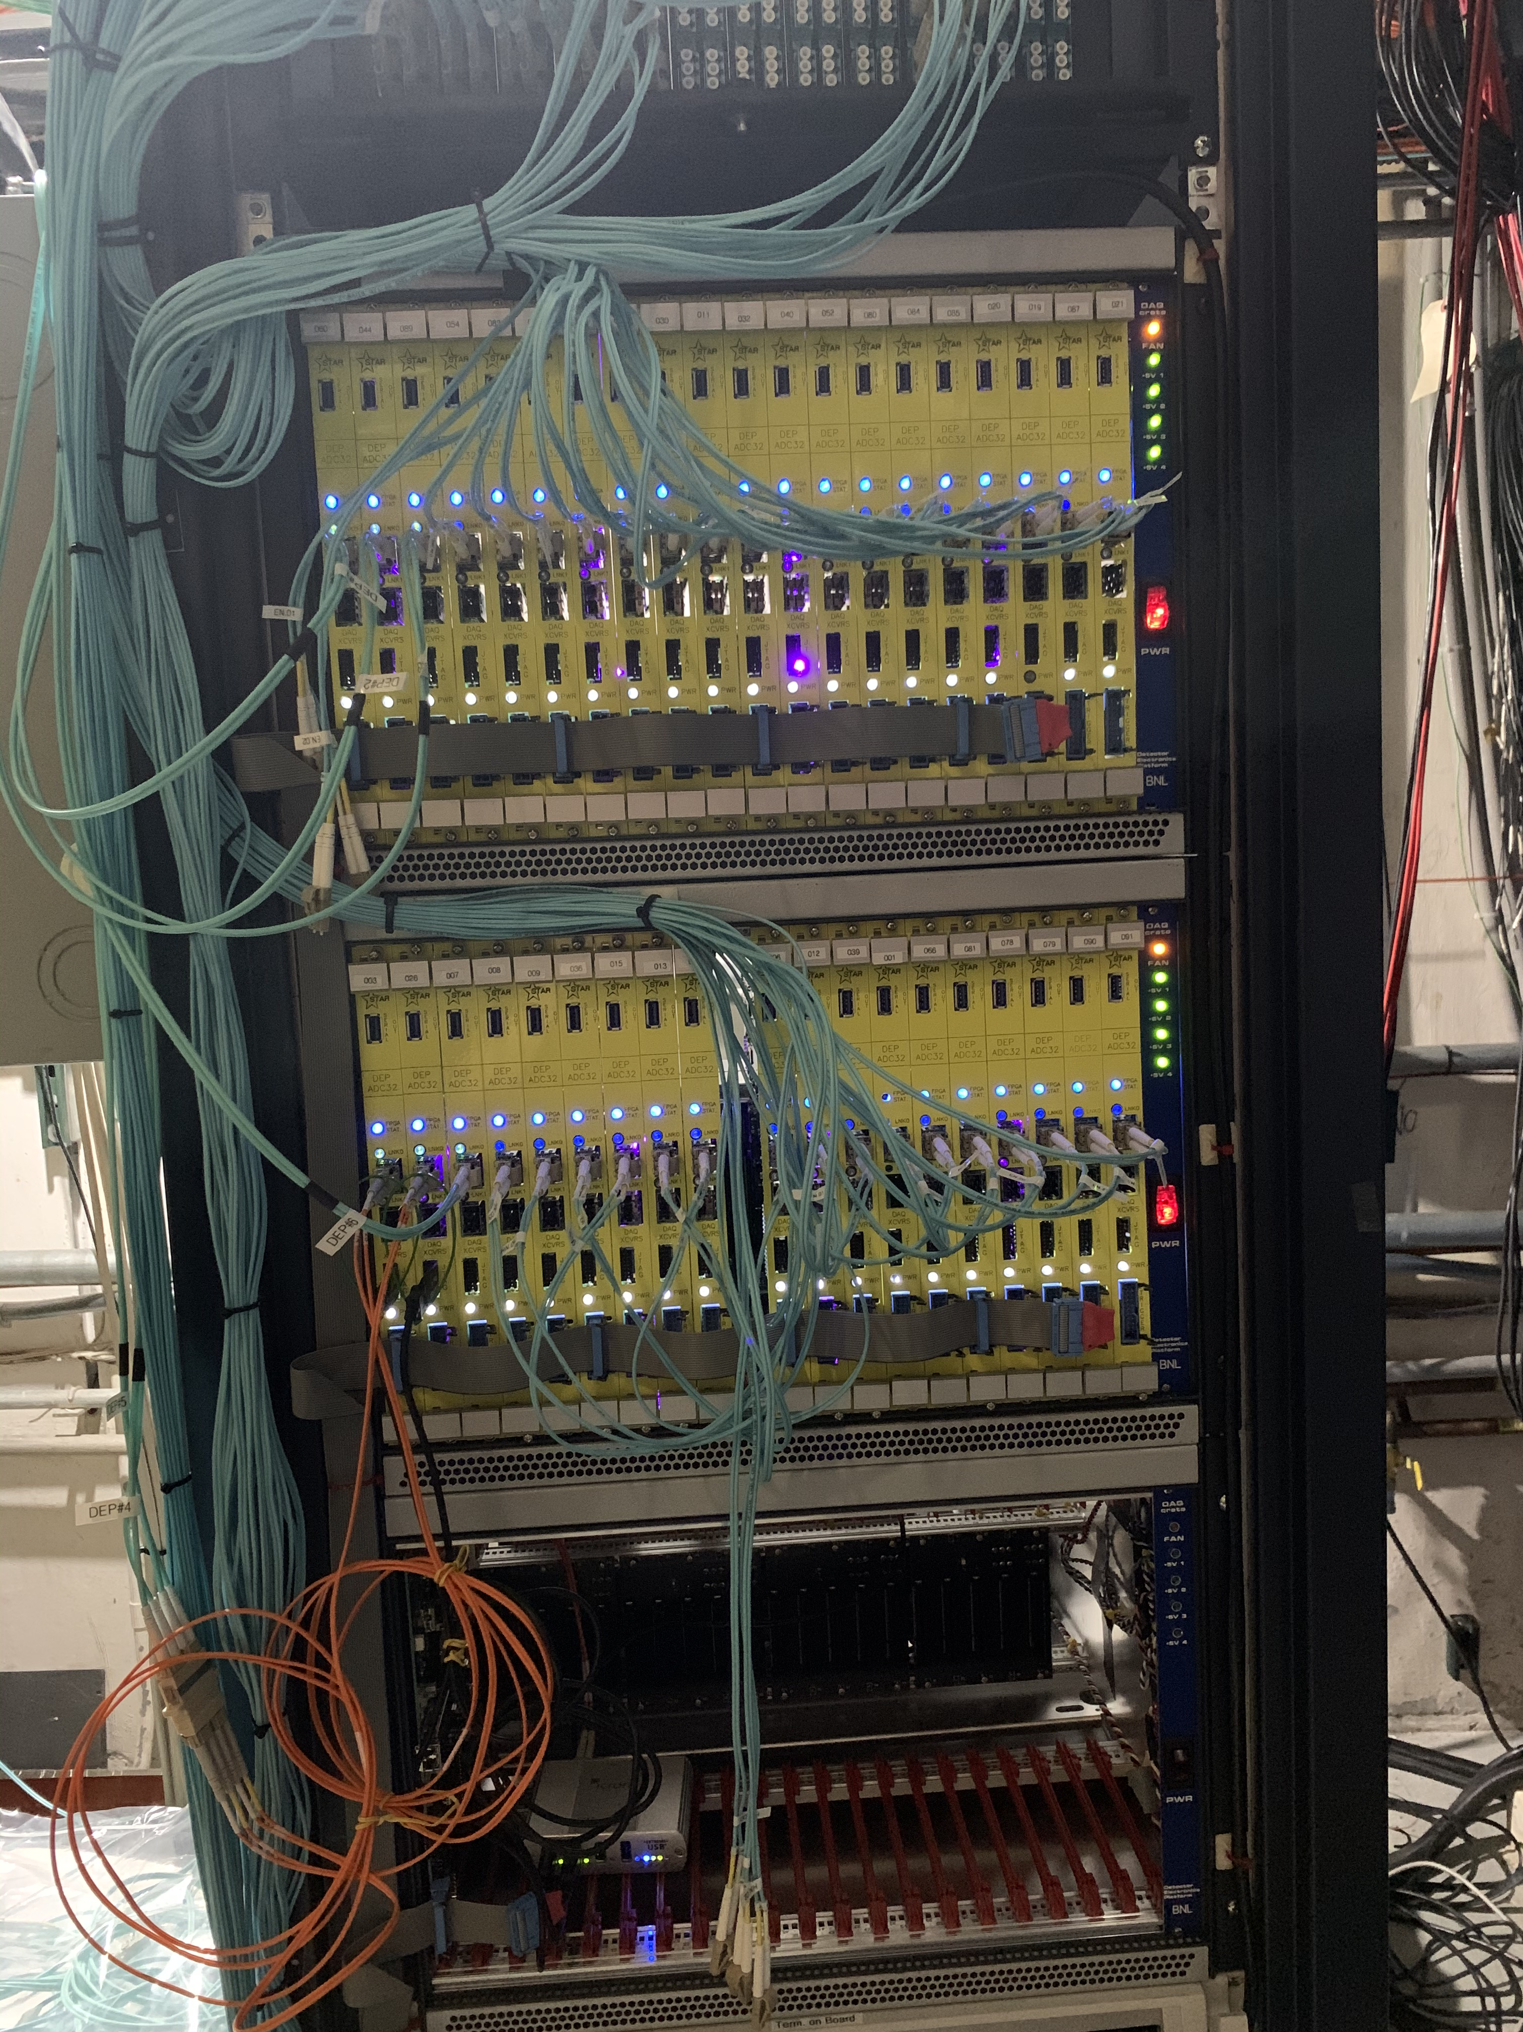
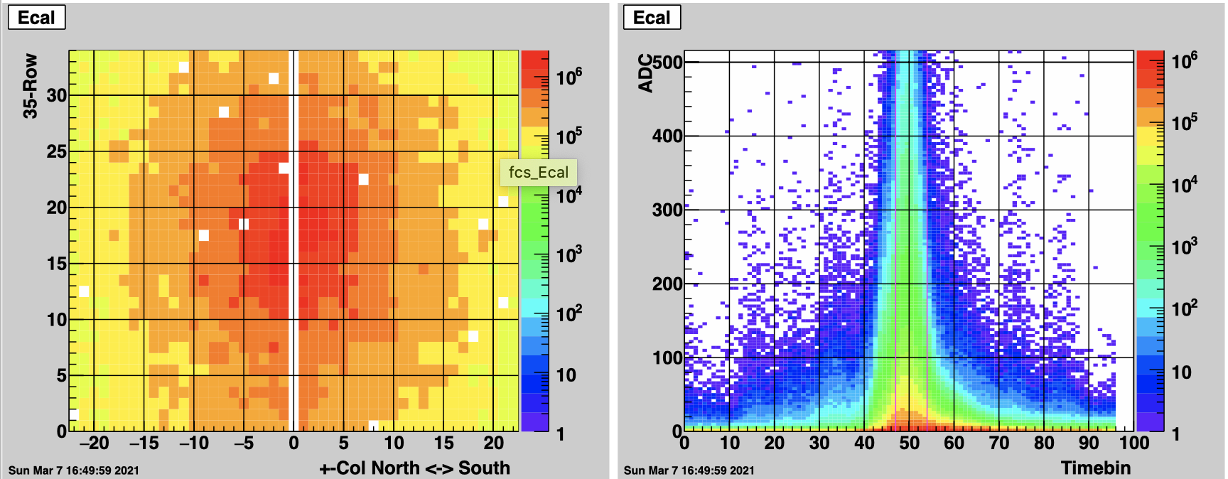
FCS Readout and Commissioning, Run 21
FCS is ready for data taking
On-line machinery in place
Monitoring systems checked
Slow controls integrated in STAR SC system
Off-line and MC machinery in place
Trigger commissioned
Grad students well engaged and analyzing OO data
From jEVP @ STAR physics run (AuAu 7.7GeV)

Slide 19
fSTAR: Silicon Tracker – Status
STAR Collaborators:
UIC, SDU, IU, BNL, NCKU
Detector Module Assembly
  40 fully assembled and tested (36 needed for installation)
  2 sensor currents higher than normal, 1 missing an APV in readout
  Not usable: 4 sensor current issue, 2 readout issue, 1 cooling tube issue
DAQ System
  Status of the crates and readout electronics boards verified in September 2019
  Expect to have 40+ inner signal cables made by end June
Cooling System
  Cooling unit is running with <1% per day leakage
  Significantly increased leakage rate after connecting soft cooling tubes and modules -> Solved by switching to a different kind of soft tube used at PHENIX
Integration
  Support structure assembled in the clean room
  Installation tool checked and adjusted for the measured TPC cone dimensions
  Risk in connecting soft cooling tubes -> risk reduced with the new type of soft tube
Slow Control
  EPICS IOC and GUI for the DAQ system are ready
  EPICS IOC and GUI for cooling system ready
Online and Offline Software
  Online monitoring plots - first version ready this week
  Online zero-suppression and common mode noise subtraction to be implemented
  Offline software under development

Slide 20
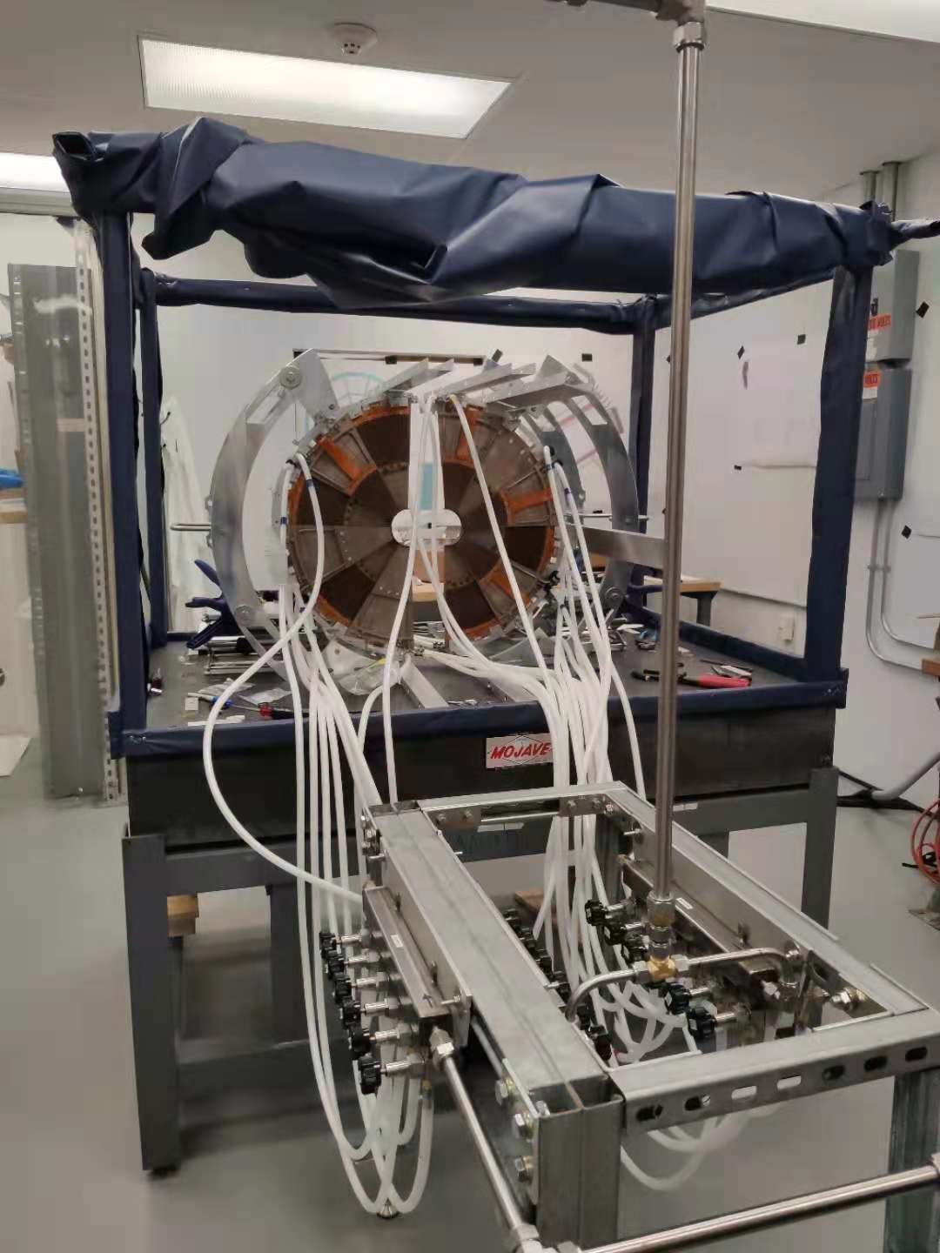
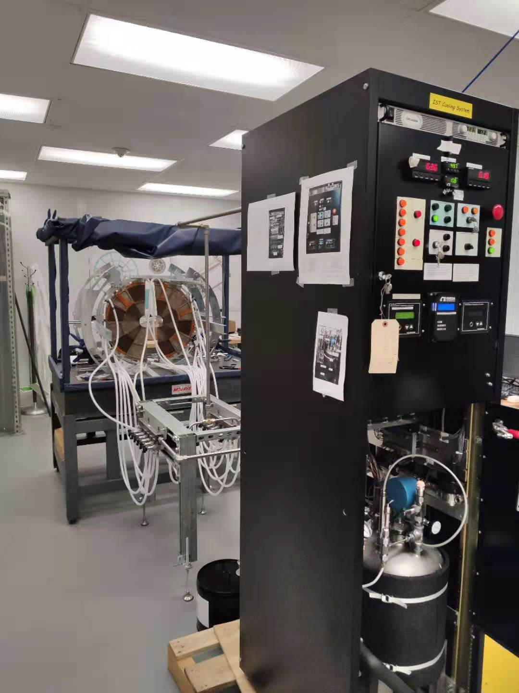
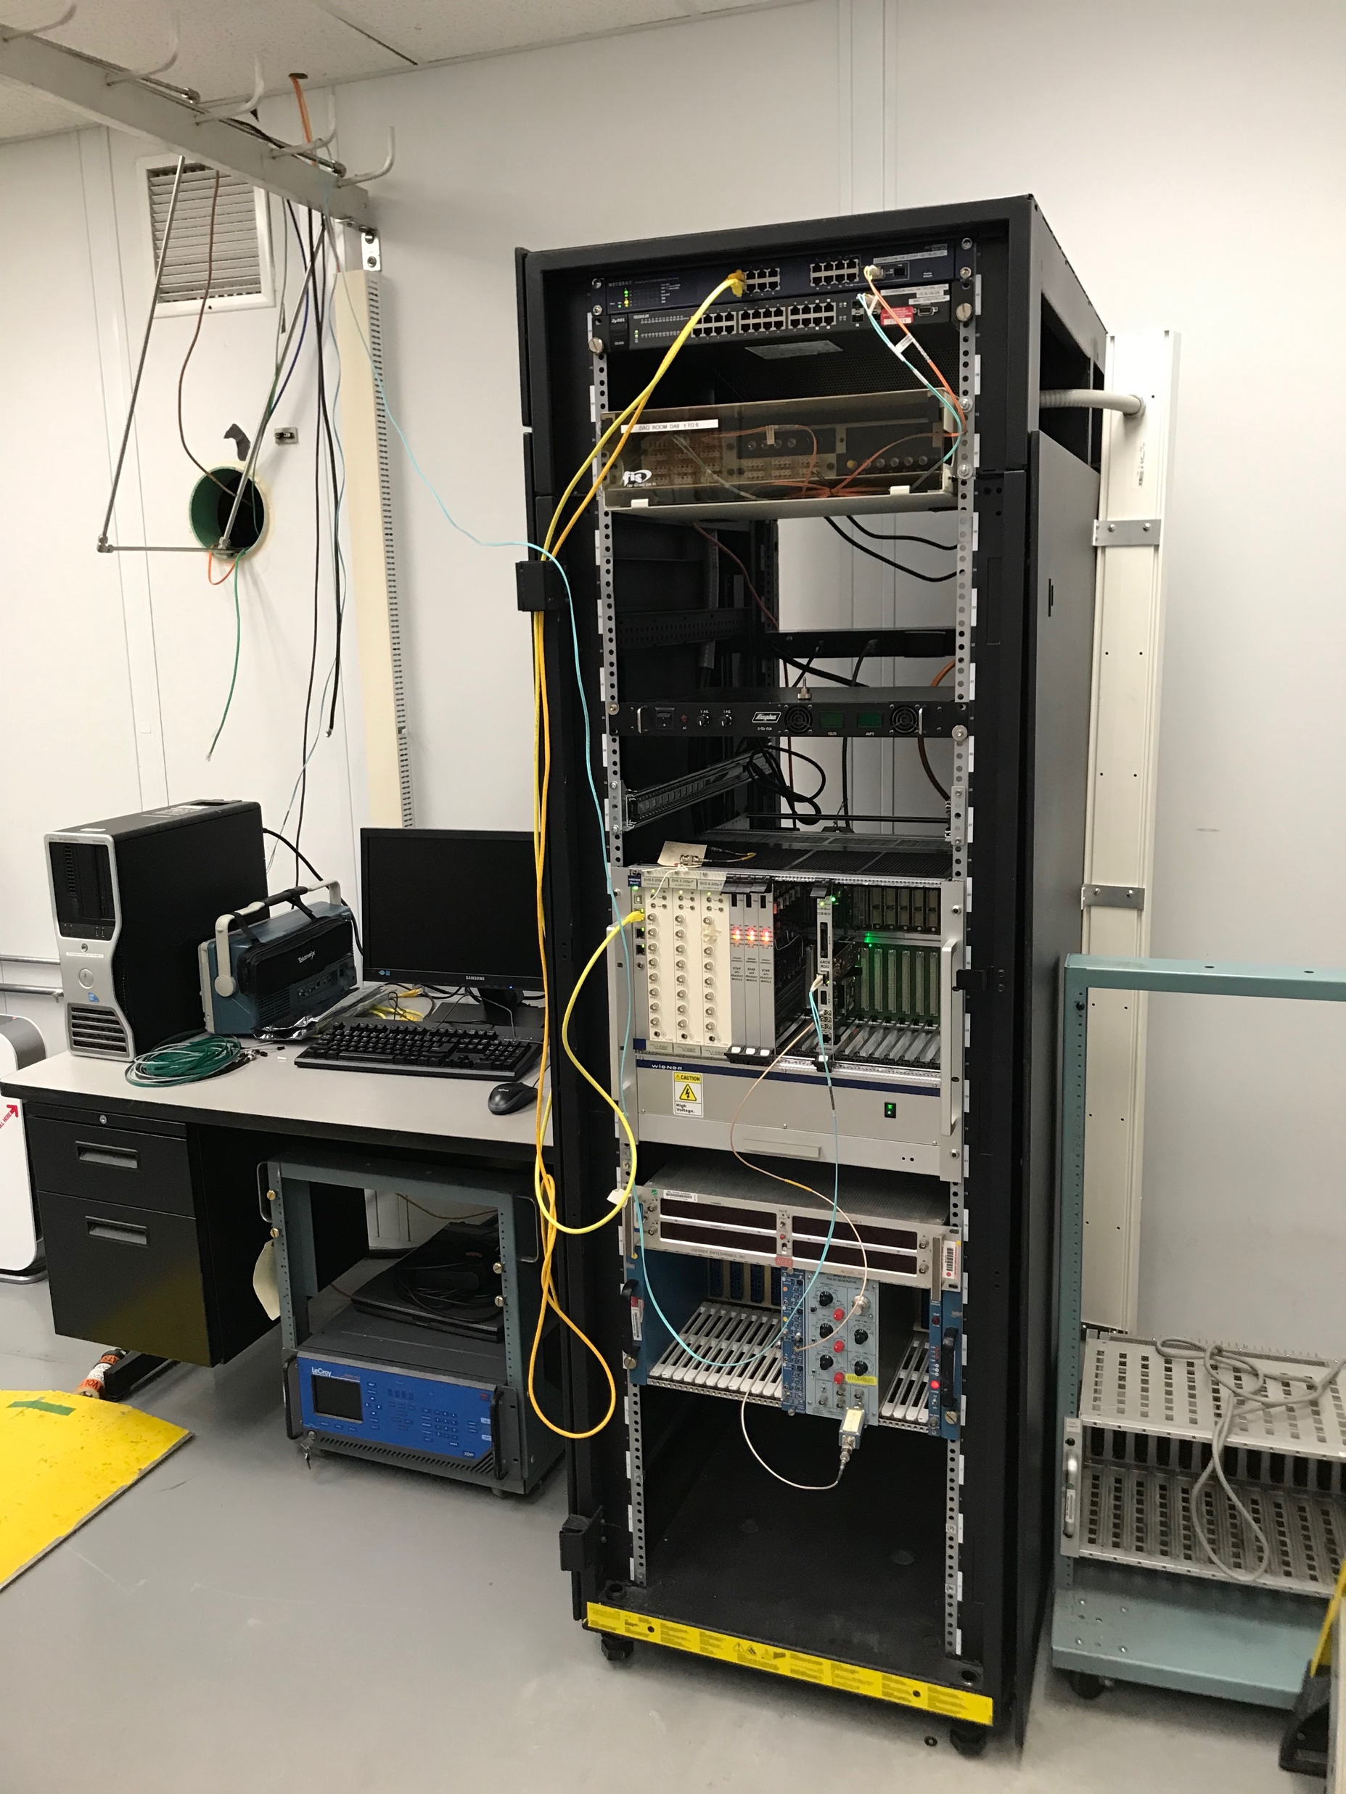
fSTAR: Silicon Tracker – Plan
6/14-6/20: mount the first 6 modules, connect cables and cooling tubes, verify status
6/21-7/18: mount the rest 30 modules, connect cables and cooling tubes, verify status
Survey: procedure and requirements to be documented, exact time to be determined
7/30-8/27: installation and commissioning

Slide 21
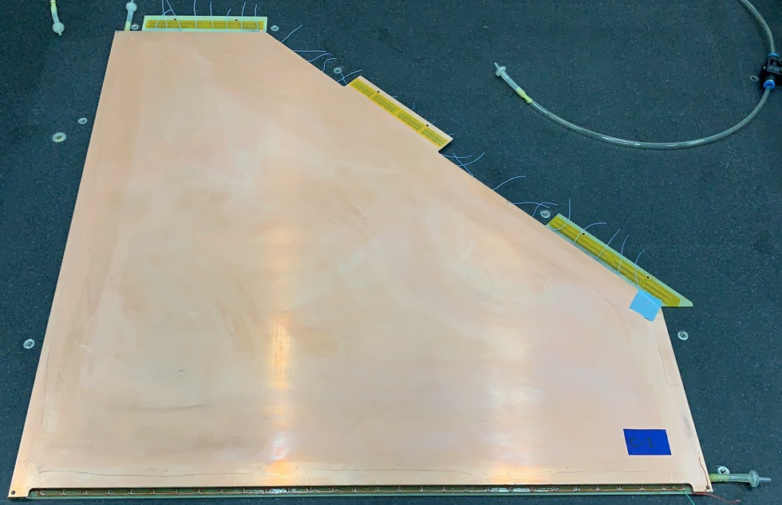
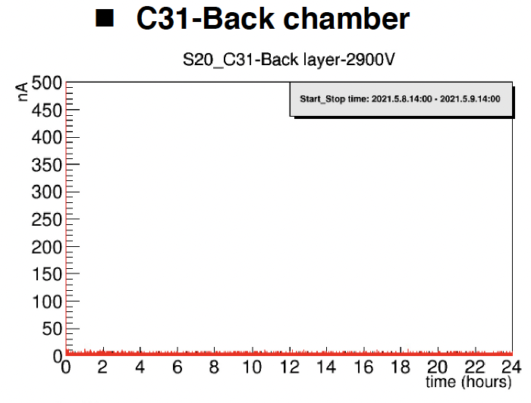
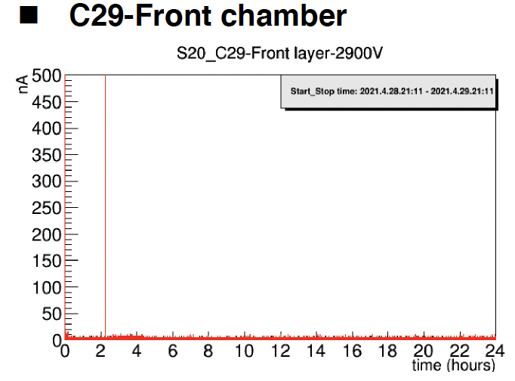
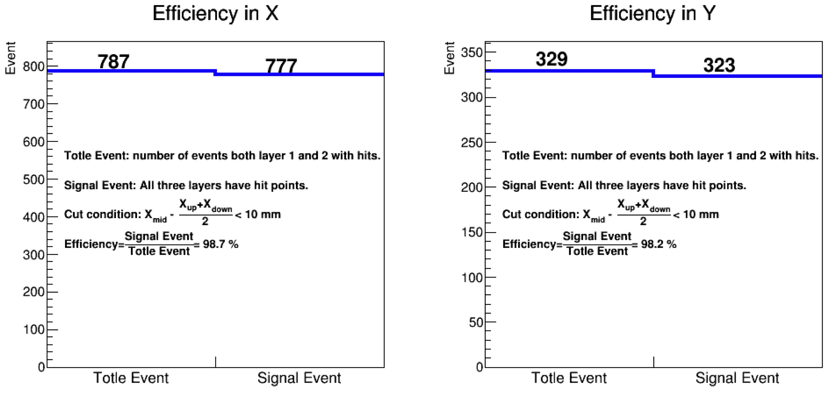

fSTAR: sTGC Module Status
STAR Collaborators:
SDU, USTC, BNL
The last module has been produced on June 8th 2021.
All module production has been completed. Performance tests are continuing.
All modules will be at BNL mid of July
Leakage current << 500nA and stable
Efficiency >97%

Slide 22


fSTAR: sTGC Readout Electronics Status
 | Finish Time
VMM3a arrival at USTC | May 29th
VMM3a test and selection | June 14th :150 VMMs for 1st Batch June 24th : 400 VMMs for 2nd Batch
FEB board production | Completed
FEB soldering and preliminary test | June 25th : 35 FEBs for 1st Batch July 10th : FEBs for 2nd Batch
FEB functionality and performance test | Middle July: good FEBs in 1st batch can be prepared. August: All the FEBs completed.
VMM chips arrived at USTC
VMM chip arrived at USTC on May 31st.
150 perfect VMM chips has been chosen for the 1st batch FEB soldering.
The schedule of electronics production will be kept based on the current VMM quality (70-75% perfect).
All FEB and ROD boards has been produced.
All RODs have been shipped to BNL.
Electronics in testing

Slide 23



fSTAR: sTGC Gas System
Use Pentane + CO2 gas mix
Gas system completed, tested and safety refuse successfully complete
Gas system and interlock functionality operated using
60 x 60 prototype installed at west platform for Run21
→ fully ready to be connected to sTGC and being operated in 2022
Front of controls cabinet
Gas cabinet
Gas distribution panel

Slide 24
fSTAR: DAQ – Slowcontrol Status
FCS readout completed and commissioned in the FY21 physics run
  electronics frontend cards (FEE) working and integrated into STAR Slow Controls
  digitizers (DEP/ADC) working
  trigger processors (DEP/IO) and fast trigger pathways with integration to STAR Trigger
  commissioned
  DAQ PCs with optical Receiver Boards all tested and integrated into STAR DAQ
STGC readout mostly complete
  frontend cards {FEB) with VMM ASICs have all been built and assembled apart from VMMs
    VMM assembly onto the FEBs in progress
  readout boards {ROD) completed and at BNL
  DAQ PCs with optical Receiver Boards commissioned and integrated into STAR DAQ
  system test with 1 FEB & 1 ROD connected to the STGC 60x60 prototype completed with real physics tracks in the FY21 OO200 RHIC run
FST readout is based on the older STAR IST readout
  system already re-tested and re-integrated into STAR DAQ
Slowcontrol complete and data monitoring close to be finalized

Slide 25
Conclusion
High Impact Cold QCD program
longitudinal polarized data taking concluded and remaining papers close to finished
Many new impactful results from transverse polarized data taking
  first impact on TMD extraction has become available -- much more to come
Clear observation of di-hadron suppression with A
  → non-linear QCD effects
results lay the foundation for the fSTAR physics program and test of factorization and universality with the EIC data
STAR forward upgrade will be fully ready for data taking for Run-22

Slide 26


Slide 27
Workforce
Several people plan sabbaticals, if COVID-19 situation allows:
Don Isenhower Oct 2020 – April 2021
Carl Gagliardi: 2021 and others
Installation supported
by CAD

Slide 28





STAR Forward Silicon Tracker - Overview
Three disks, 36(+12) modules
  Flexible hybrid (SDU/IU)
  Mechanical structure (NCKU)
  Silicon sensors (UIC/BNL)
  APV25 frontend chips (UIC)
  Assembly (UIC/FNAL-SiDet)
Integration (BNL)
  Mechanical supporting structure
  Installation tooling
Cooling system (BNL/NCKU)
  Cooling lines
  Cooling manifold
  Rack (cooler, pumps)
DAQ system (BNL/SDU/IU)
  Inner signal cables and T-boards
  Outer signal cables, patch panel boards, readout modules, readout controllers, crates
Blue: existing Red: new

Slide 29
STAR Forward Silicon Tracker – Milestones
Nov 2018
Aug 2020
June 2021
Detector Module Prototype
  Silicon sensor: 06/30/2019 -> 08/23/2019
  Flexible hybrid: 05/31/2019 -> 12/26/2019
  Inner signal cable: 01/31/2020 -> 02/05/2020
  Mechanical structure: 04/30/2019 -> 06/19/2020
  Detector module assembly: 09/31/2019 -> 07/27/2020
  Detector module testing: 12/31/2019 -> 08/15/2020
Detector Module Production
  Flexible hybrid: 03/31/2020 -> 09/21/2020 -> 10/21/2021
  Mechanical structure: 05/31/2020 -> 01/15/2021 -> 03/23/2021
  Silicon sensors: 07/31/2020 -> 02/15/2021 -> 02/08/2021
  Detector module assembly (complete): 02/28/2021 -> 06/30/2021 -> 06/09/2021
Supporting Structure and Cooling System
  Design and Fabrication 09/31/2020 -> 11/30/2020 -> 02/08/2021
DAQ System
  T-boards and inner signal cables: 12/01/2020 -> 06/30/2021
Installation
  Installed onto supporting structure: 04/30/2021 -> 07/31/2021 -> 07/18/2021
  Installed into STAR: 07/15/2021 -> 08/20/2021 -> 08/20/2021

Slide 30
Integration Plan
6/14-6/15:
  practice mounting dummy modules and problematic modules, develop the procedure
  verify status of the DAQ and cooling system, and slow control
  obtain all the pieces needed for module mounting and testing
6/16-6/18
  install 6 production modules
  identify good cables, patch panel boards
  run the cooling and DAQ over the weekend
6/21-6/25
  install 12 production modules
  identify good cables, patch panel boards
  run the cooling and DAQ over the weekend
6/28-7/2
  install 12 production modules
  identify good cables, patch panel boards
  run the cooling and DAQ over the weekend
7/5-7/9
  install 6 production modules
  identify good cables, patch panel boards
  run the cooling and DAQ over the weekend
7/12-7/16
  verify the status of all the modules, prepare for installation

Slide 31







Organizational Structure STAR Forward Upgrade
Dedicated manpower with large expertise for each subsystem
sTGC
Silicon
ECal
HCal
DAQ/Readout
Software
Integration
Calibration
Slow Controls
and the STAR collaboration, which stands enthusiastically behind the upgrade

Slide 32


Slide 33
Scope: ECal & HCal
Location: 7 m from the IP on the “FMS platform”
Readout: SiPMs
Used in Trigger
Split in 2 movable halves inside and outside of ring
Slightly projective
ECal:
reuse PHENIX PbSC calorimeter with new readout on front face → 1496 channels
  Secured one Sector (2592 towers) PbSc towers: 5.52 x 5.52 x 33 cm³ (18 X₀)
66 sampling cells with 1.5 mm Pb,
4 mm SC & Wavelength shifting fibers
HCal:
Fe/Sc (20mm/3 mm) sandwich.
520 readout channels
Lateral tower size 10 x 10 cm², ~ 4.5 λ
  in close collaboration with EIC R&D
Preshower
Use EPD → need to built splitter for the signals
Installation of entire system (HCal + ECal + Electronics) finalized by Feb 2021
~9 month to commission systems before Run-22 500 GeV pp

Slide 34

Scope: Silicon & sTGC
3 Silicon disks: at 146, 160, and 173 cm from IP
Built on successful experience with STAR IST
Single-sided double-metal mini-strip sensors
  Granularity: fine in φ and coarse in R
  Si from Hamamatsu
Frontend chips: APV25-S1 → IST all in hand
Material budget: ~1.5% per disk
Reuse
  IST DAQ system for FTS
  IST cooling system
Si
sTGC
4 sTGC disks: at 307, 325, 343 and 361 cm from IP
location inside Magnet pole tip opening
  inhomogeneous magnetic field
4 quadrants double sided sTGC → 1 layer
  diagonal strips to break ambiguities in the sTGC
Position resolution: ~200 μm
Material budget: ~0.5% per layer,
Readout: based on VMM-chips
→ following ATLAS design
Installation of entire Si and sTGC finalized by Mid of September 2021
~2-4 month to commission systems before Run-22 500 GeV pp

Slide 35

Importance of STAR forward upgrade for EIC
STAR forward upgrade: 2.5 < η < 4
rapidity coverage the same as
EIC hadron Arm
→ high-x EIC physics
HCal +SiPM readout same as
EIC-fHCAL
same rapidity as EIC
  background
small-strip Thin Gap Chambers (sTGC)
sTGC alternative technology to
EIC GEM Trackers
Si
sTGC
ECal
HCal
Barrel Hadronic calorimeter not shown
HCal
ECal
Analysis:
Learn how to reconstruct Jets close
to beam rapidity
Jet solid angle ~ R²/cosh²(η).
so for fixed jet multiplicity, dN/dΩ grows like cosh²(η)
15 times larger at η=2, 100 times larger at η=3
what are the effects of underlying event ep & eA
and √s
Si
sTGC or GEM
electrons
Training of young scientific generation:
20+ undergrads working > 2019/06
hadrons

