Slide 1



FST Integration
Rahul Sharma
Chief Mechanical Engineer (STAR)

Slide 2
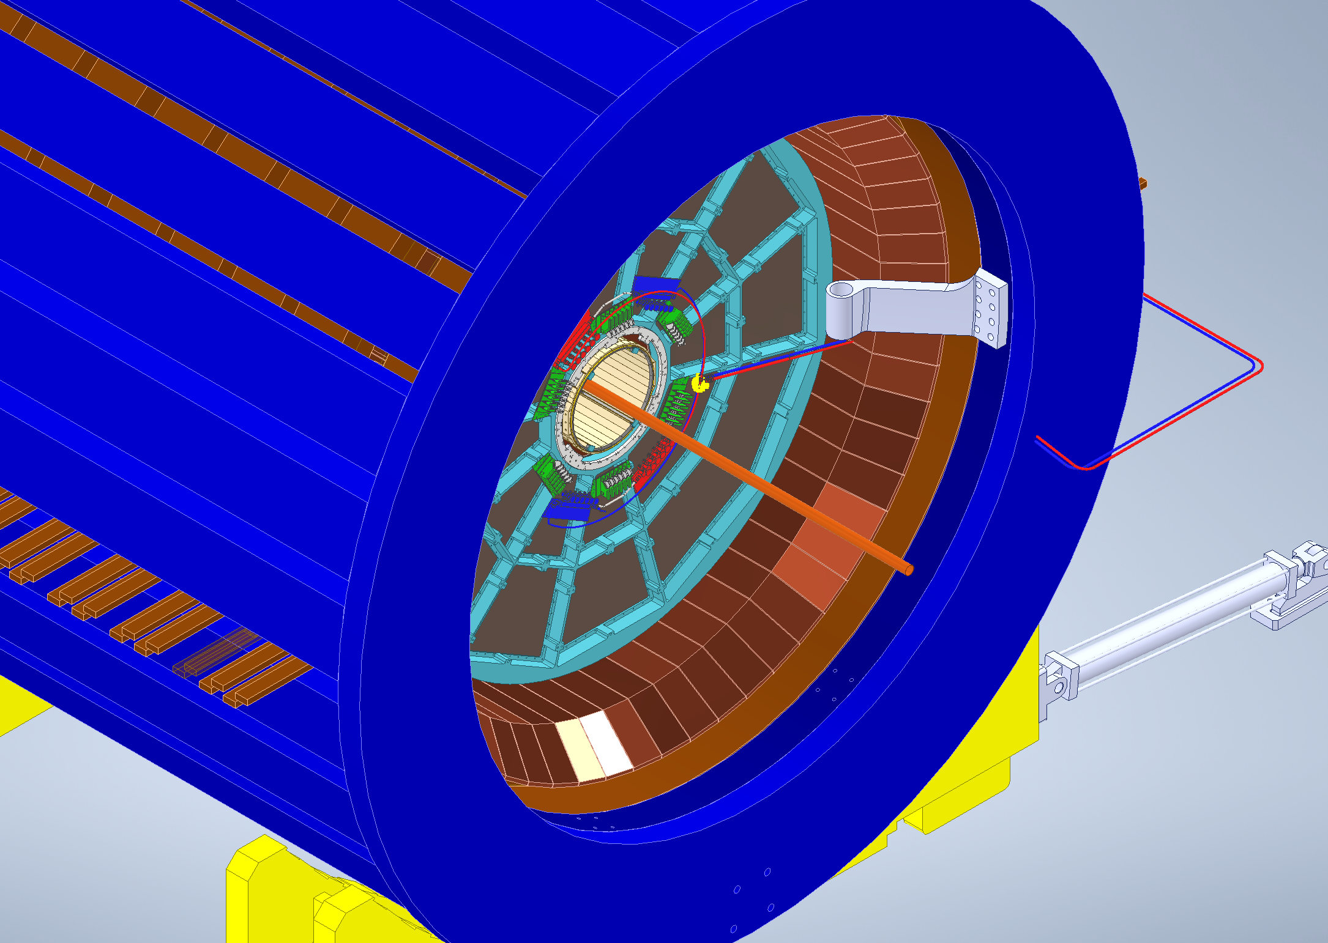
FST in STAR Magnet

Slide 3
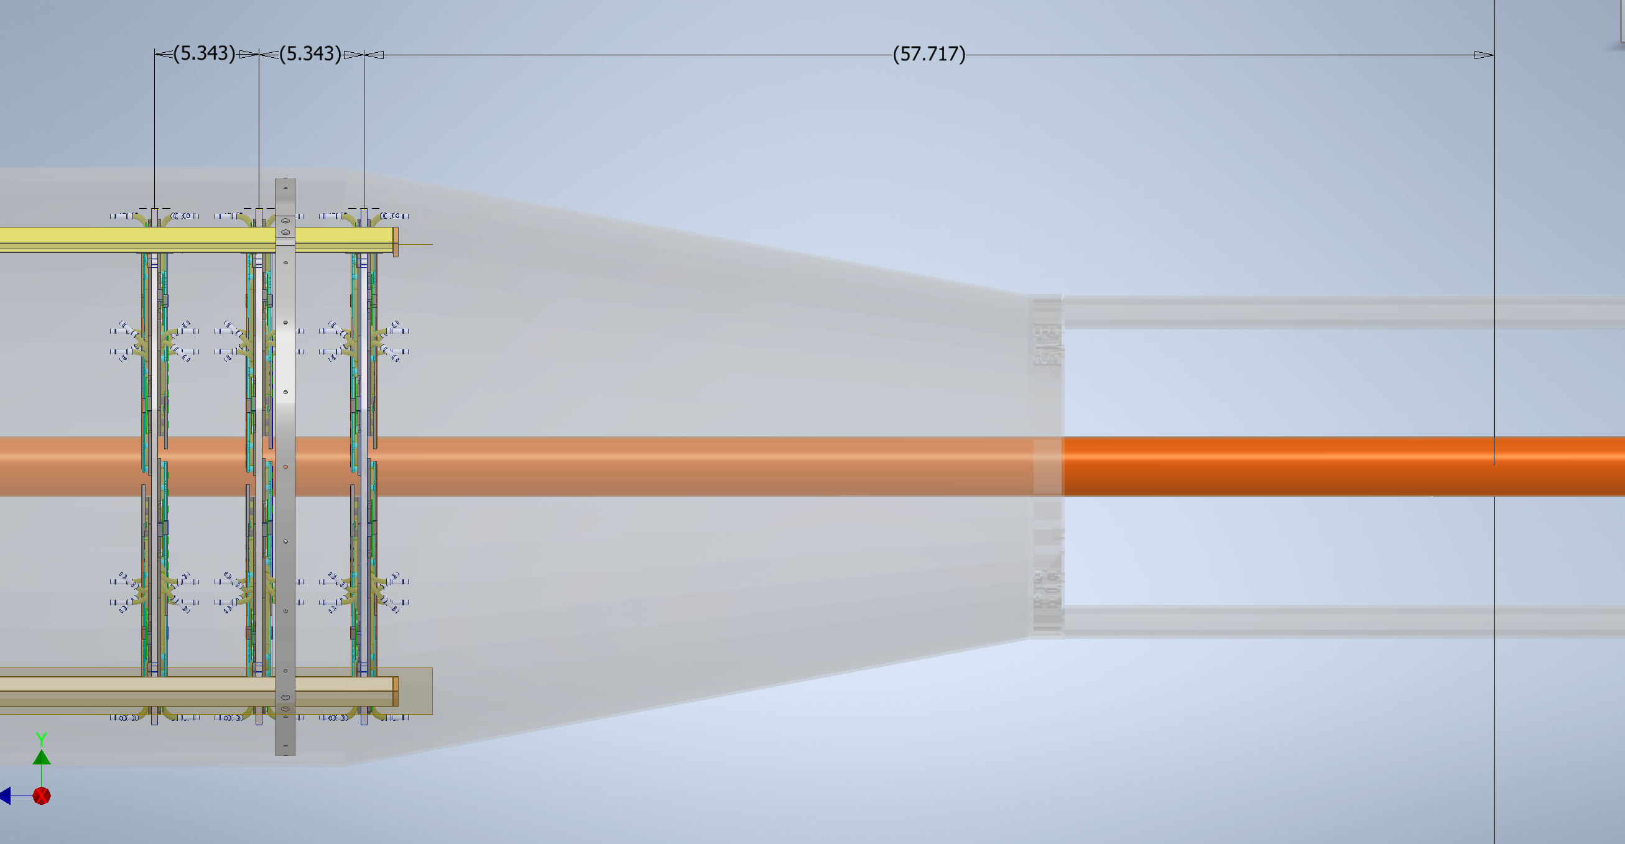
Distances From Interaction Point (IP)
Carbon Fiber IDS/Cone
Beam Pipe
FST Disks

Slide 4
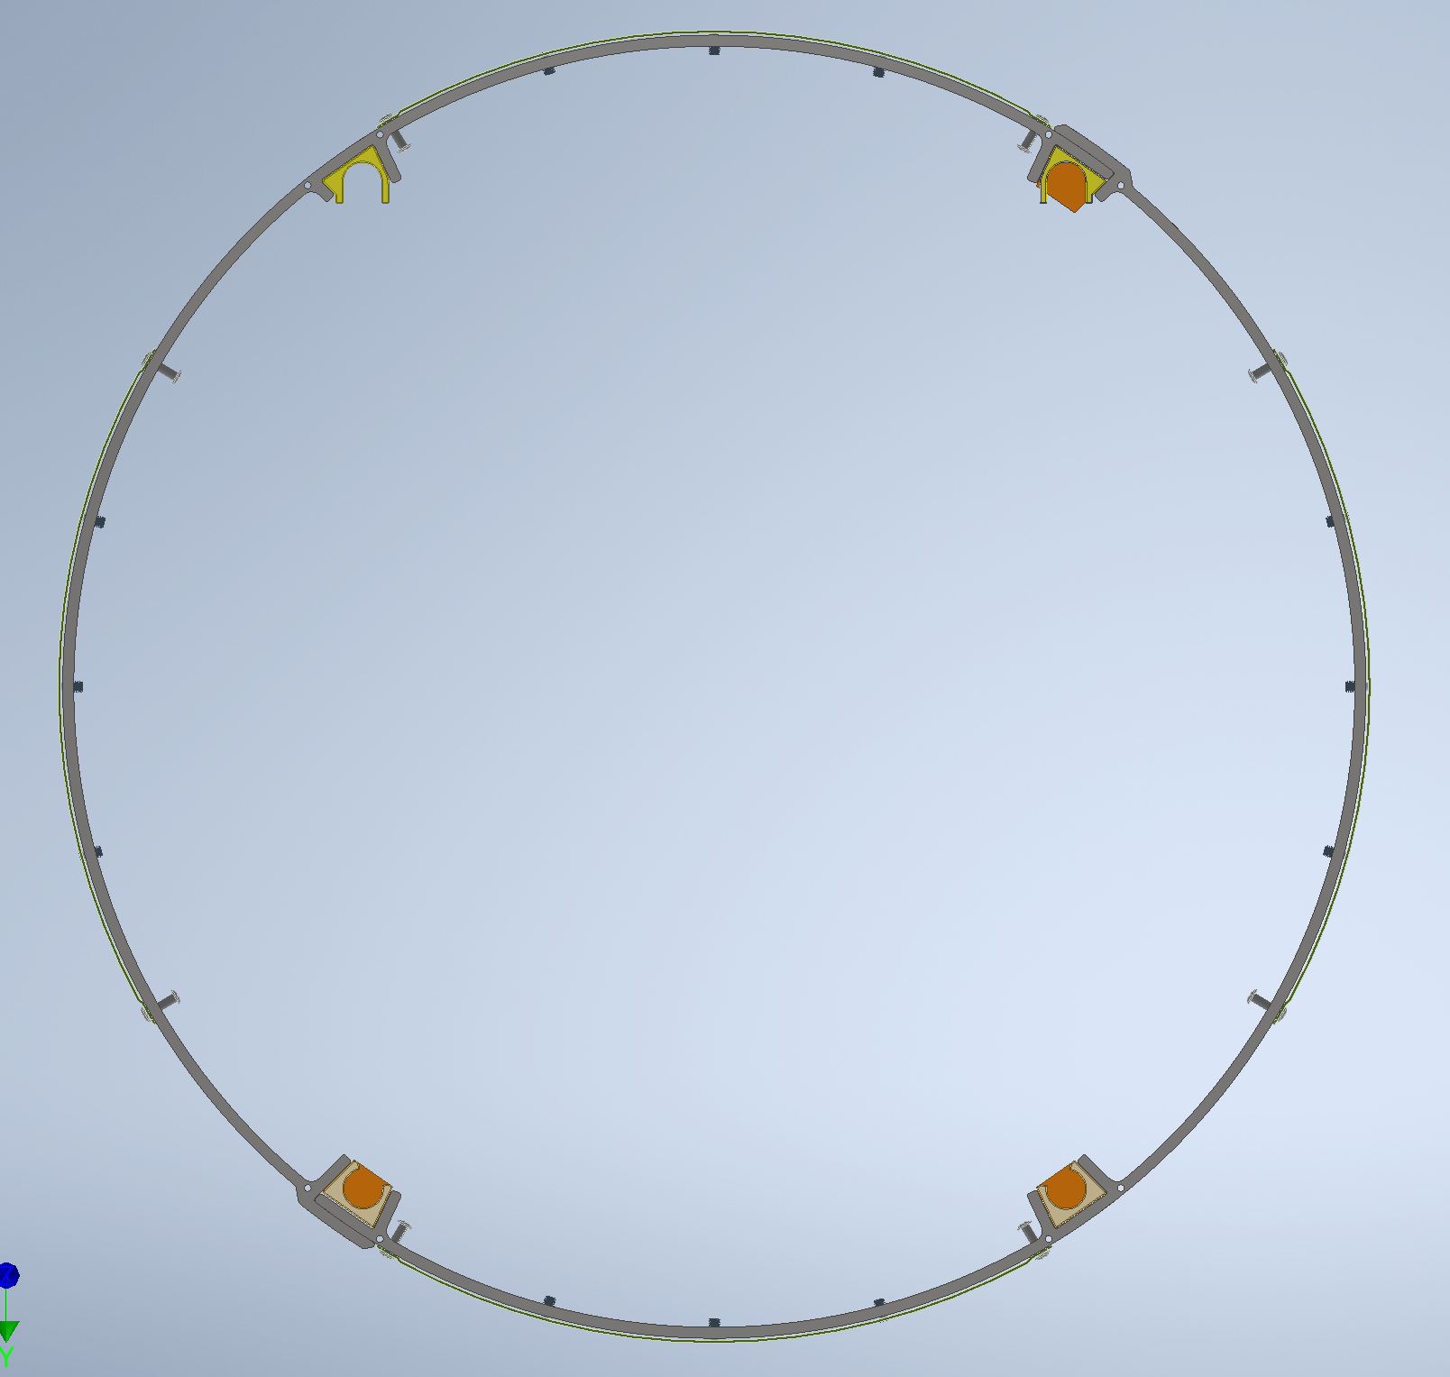
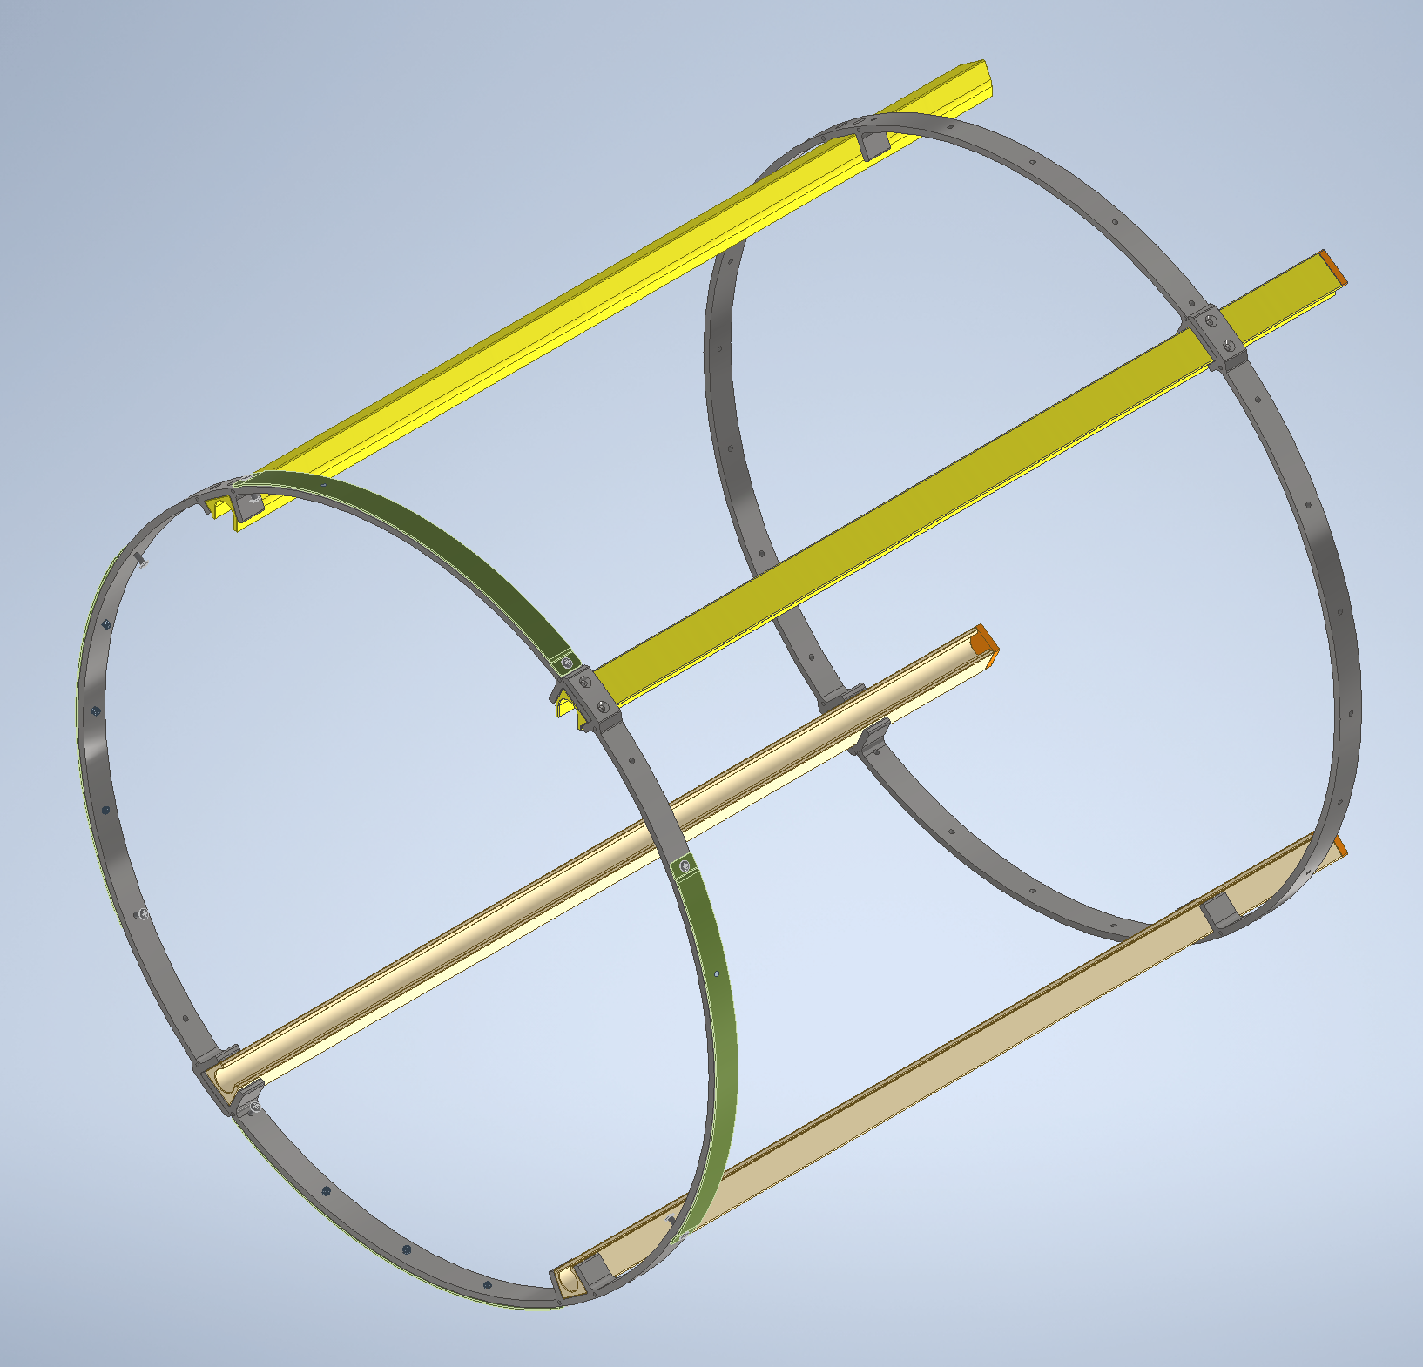
Inner Support Structure
Assembly Weight ~ 21lbs
Size: 24”W x 32”H x 19”L
Ring Diameter = 29.5”
Distance between rings= 30”
Material : Aluminum
(Both for rails and rings)

Slide 5
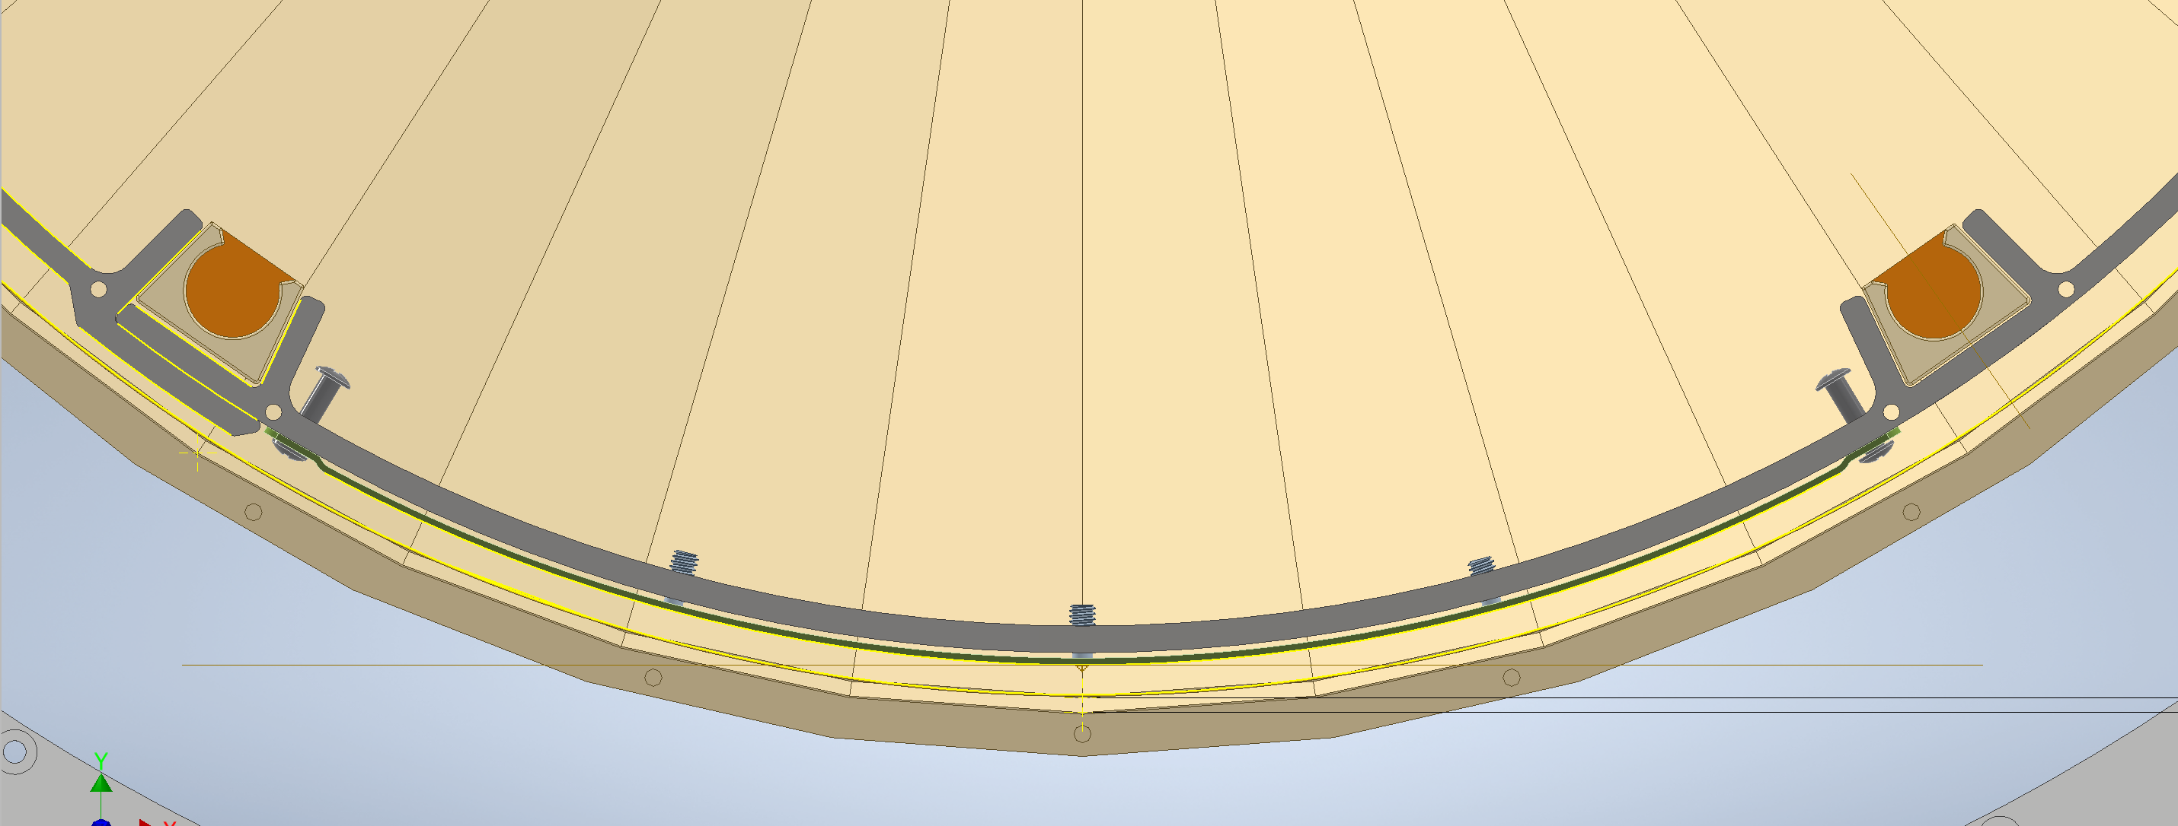
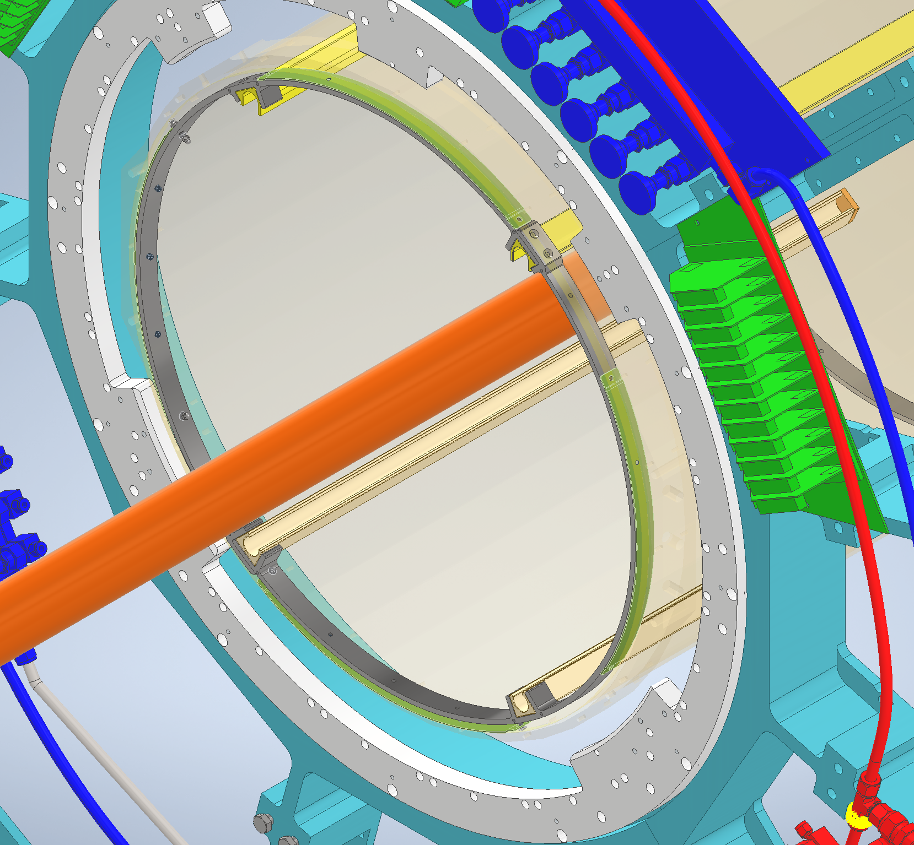
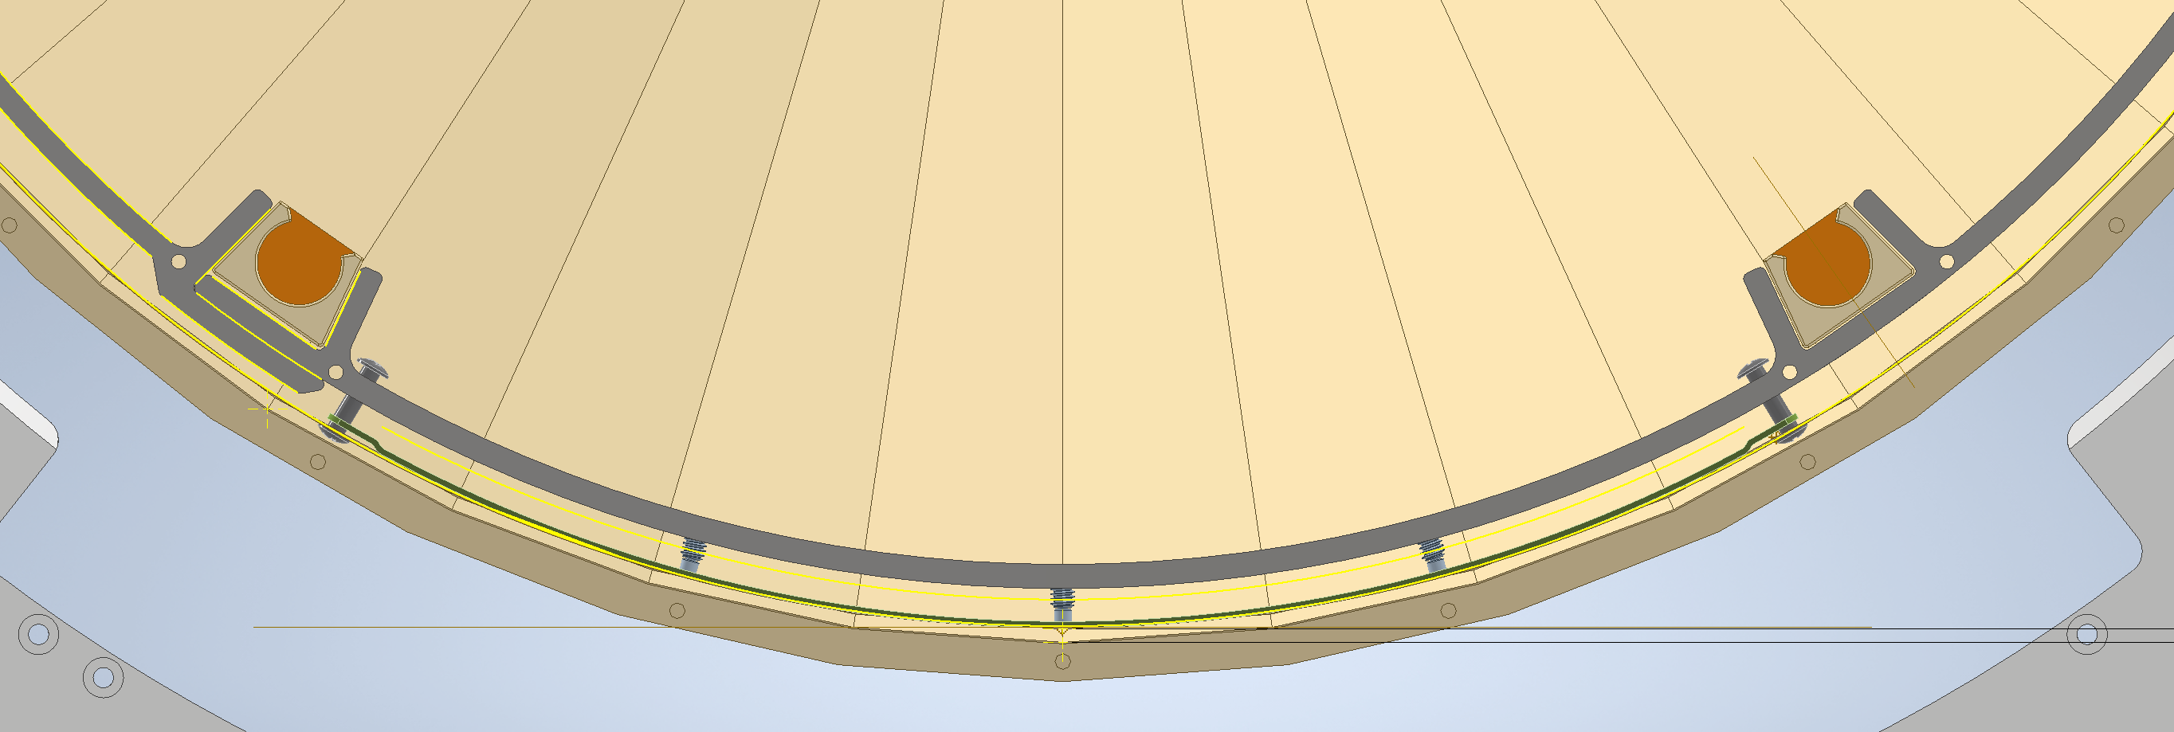
Installation in Carbon Fiber Cone
Capturing Pins
Adjustment Screws
Ring Collar

Slide 6
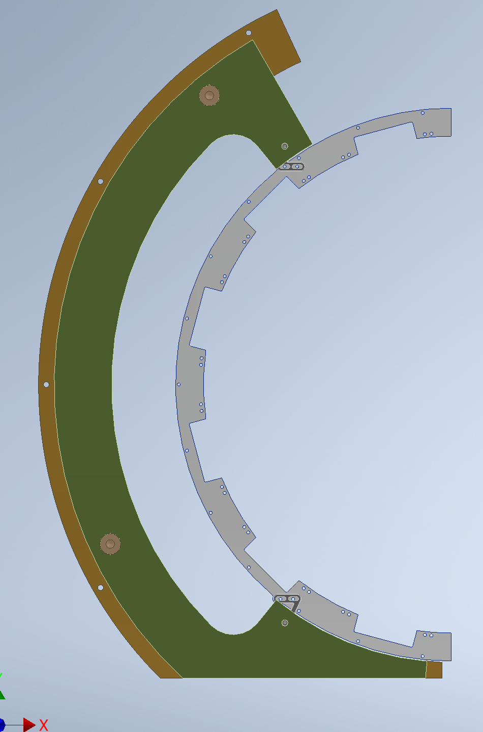
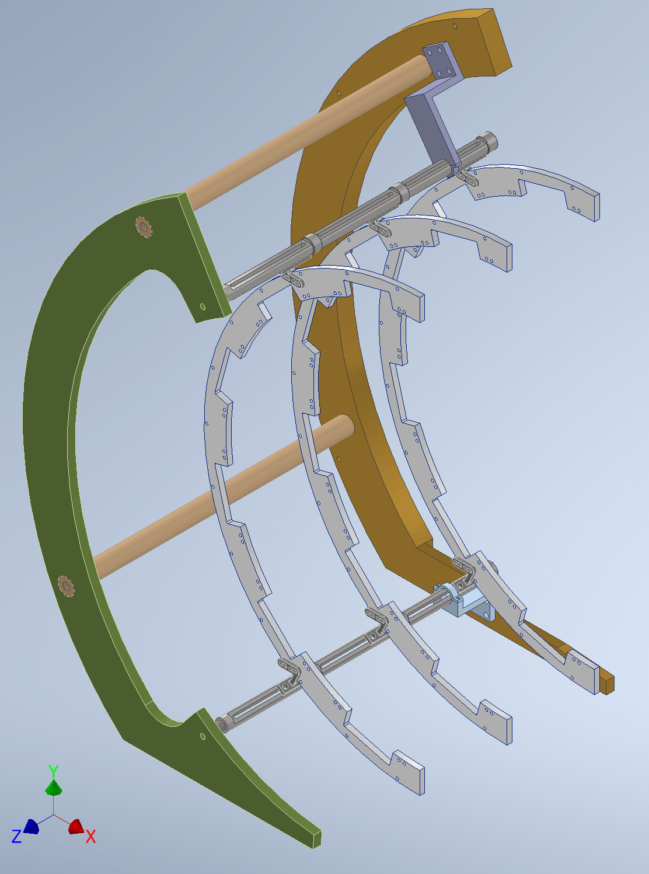
Clean room Assembly of Structure without Sectors, Electronics and Cooling lines
Mechanical Assembly will done in the clean room on a granite table to ensure that all the components fit as intended.
This will be used for the survey and adjustment of positions of the inner support structure inside the IDS/Cone.

Slide 7
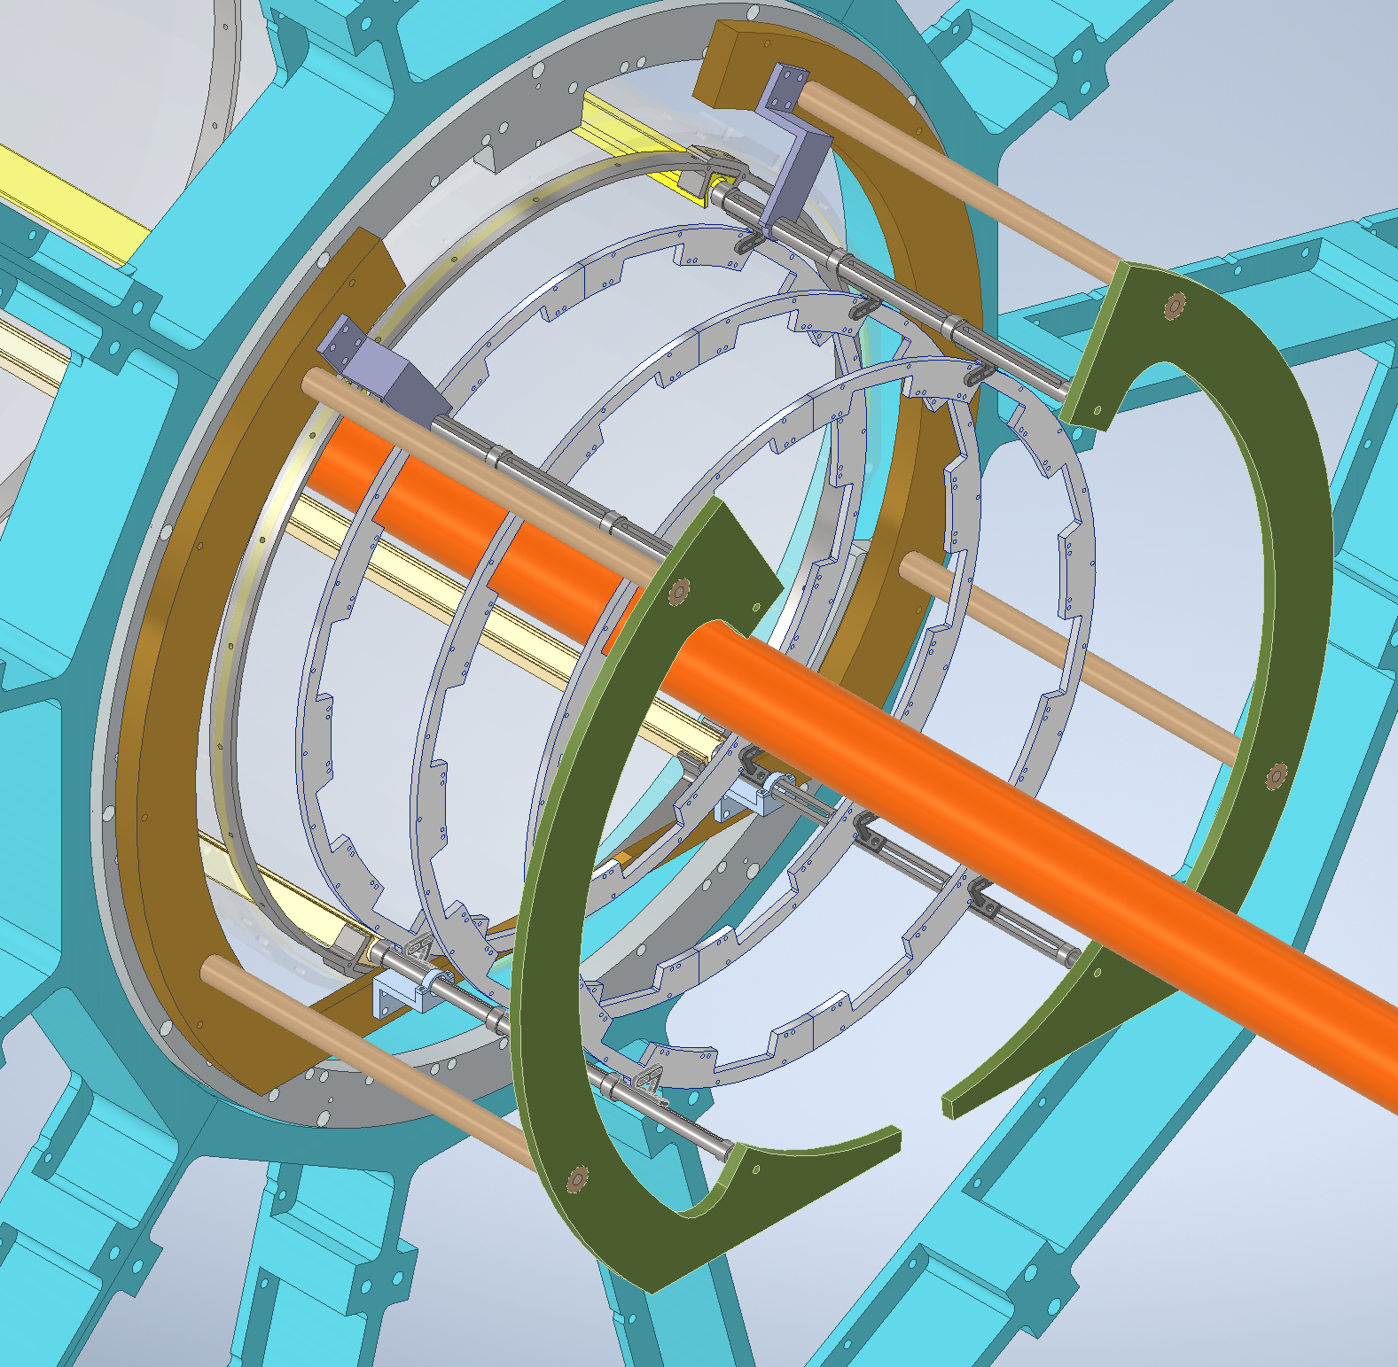
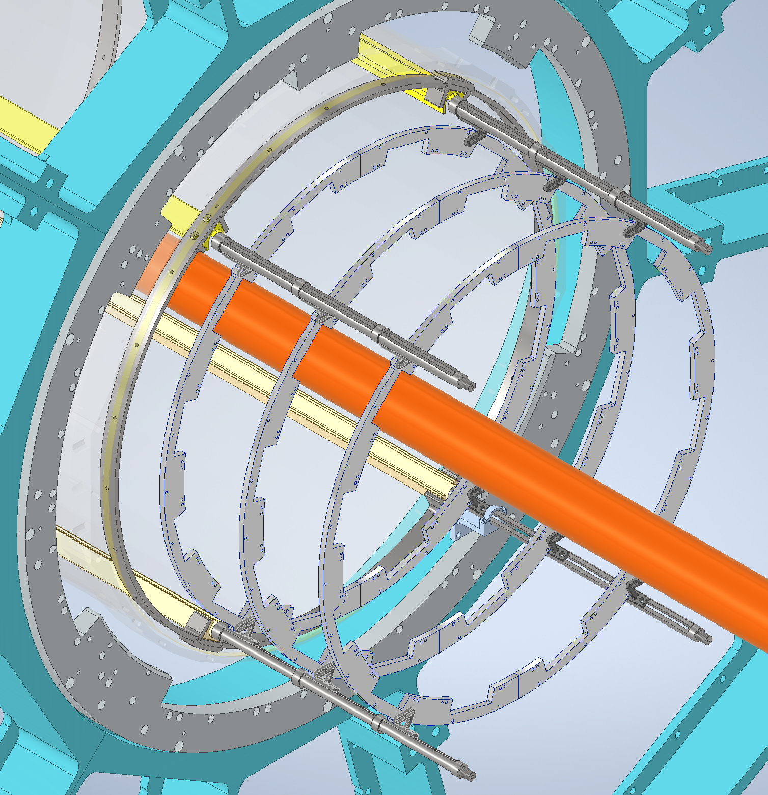
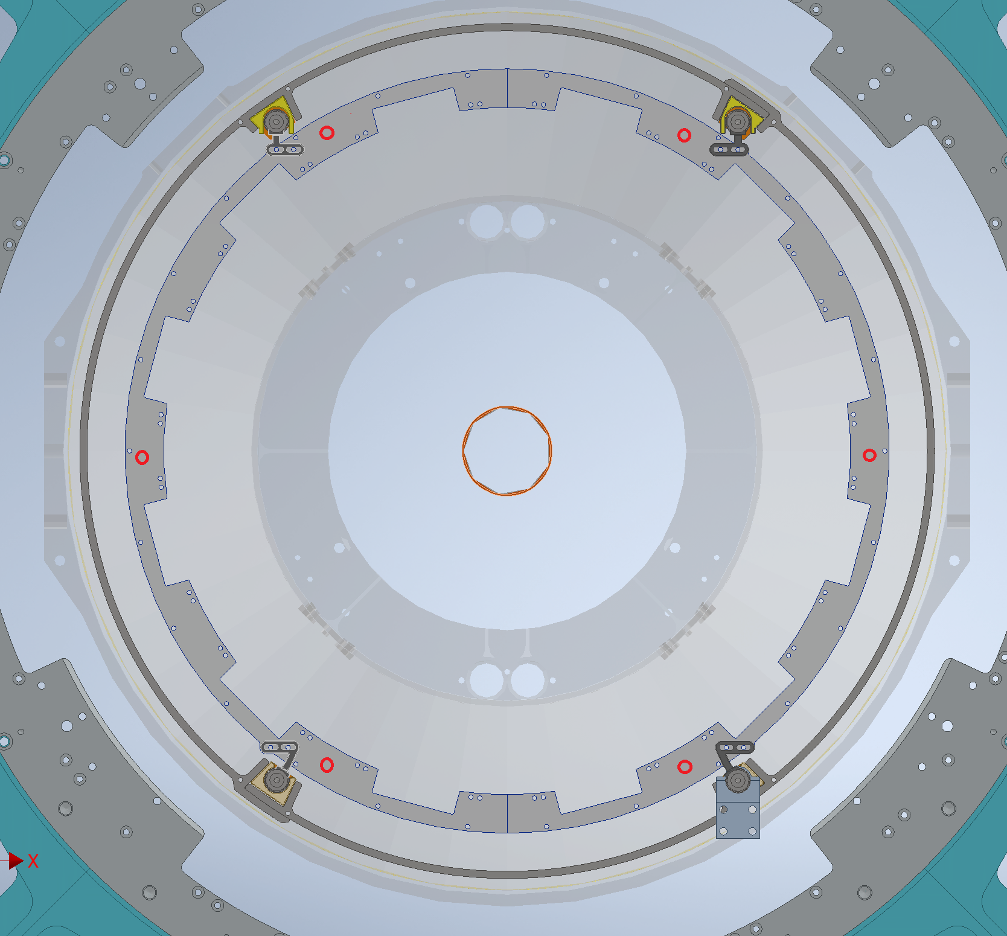
Survey During Installation of Inner Support Structure
Survey Targets
Dummy parts with dummy modules will be used for centering cage around the beam pipe to give IST group more time for assembling.

Slide 8
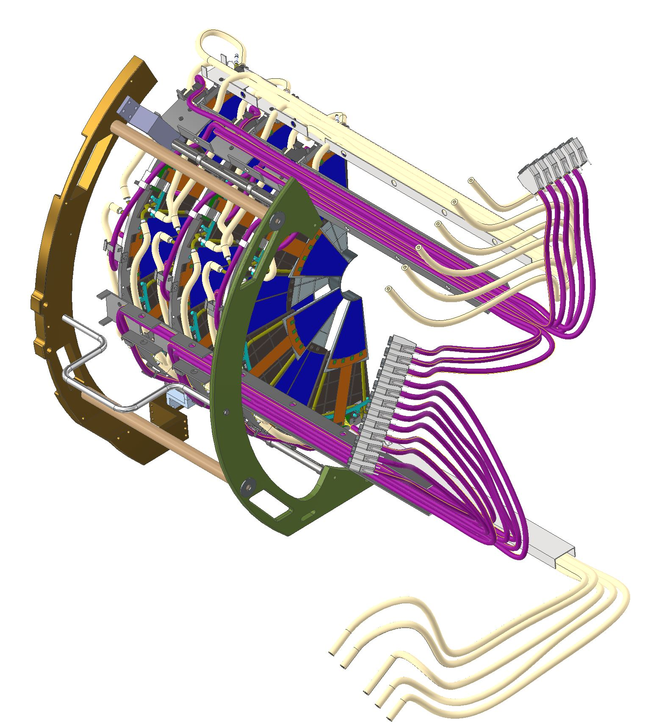
Cleanroom Assembly
BackSupport Plate
Weight ~ 40lbs
Size: 24”W x 32”H x 19”L
Survey/Accurate Measurements can be done inside clean room of disks with respect to one another.
Cleanroom Assembly will rake place on granite table.
The detector halves will be transported on a cart from cleanroom in assembly building to Experimental hall through the plug door in shield wall
It’s a pretty smooth ride with no bumps. Still a thin foam can be used on the cart to minimize vibrations.
Techs will use scissor lifts to take the halves to the first level of scaffolding
Front Support Plate

Slide 9
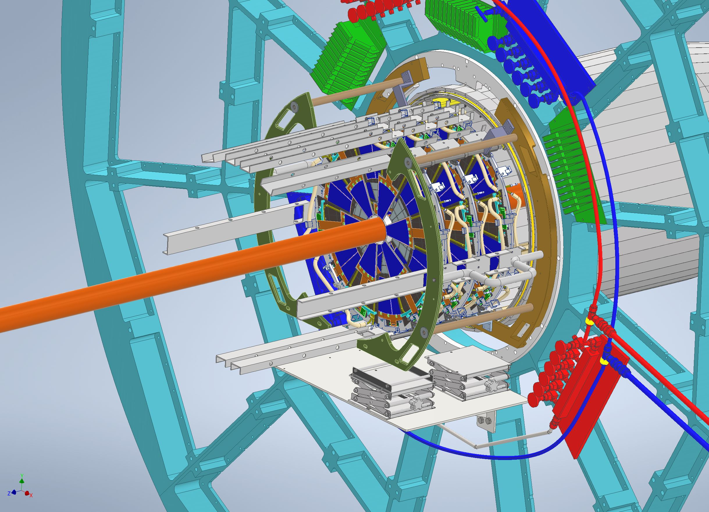
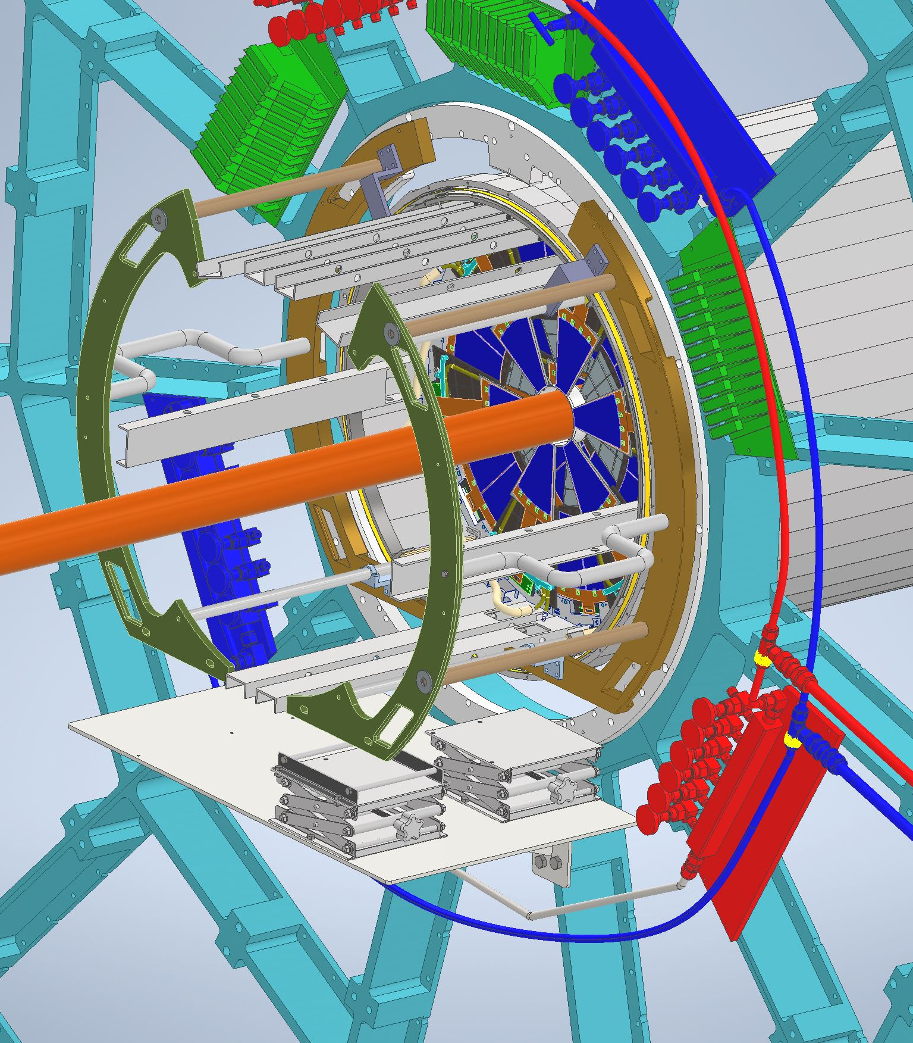
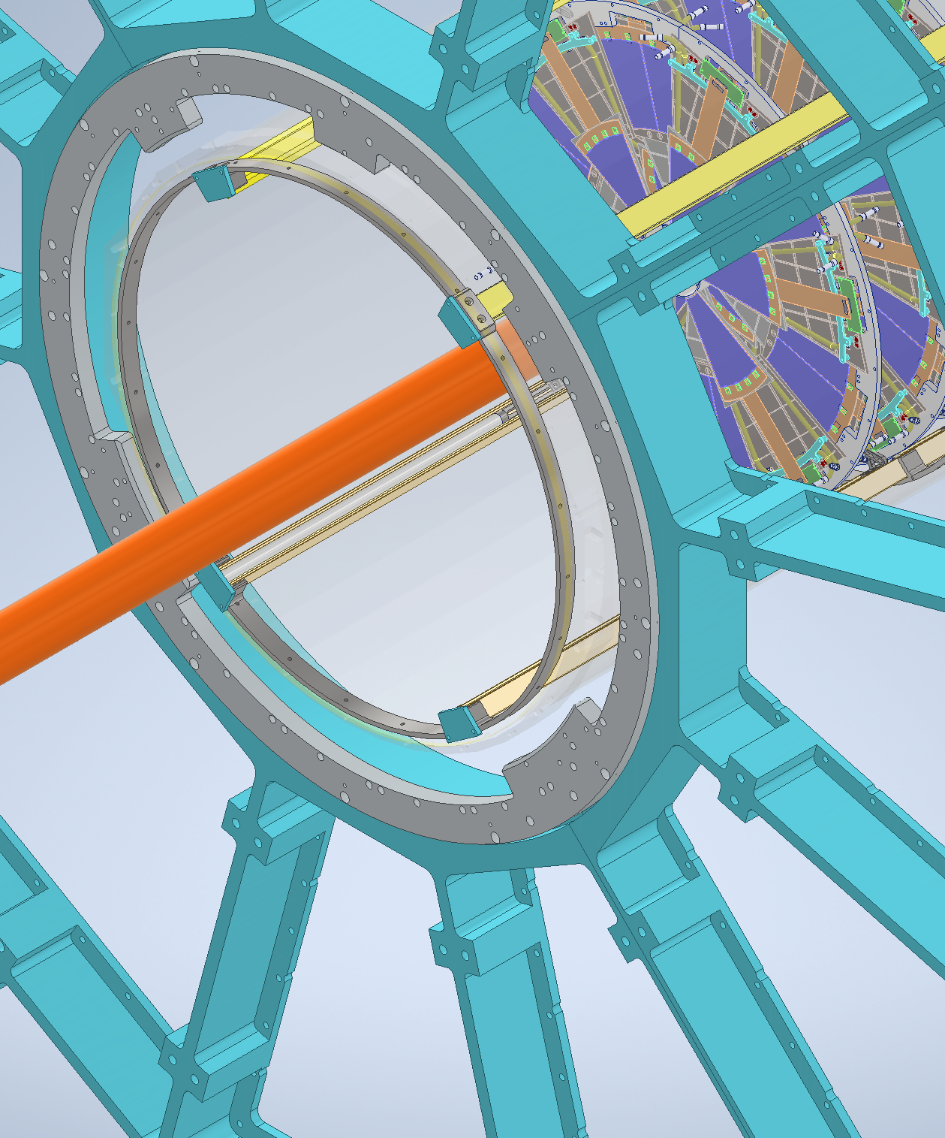
Installation

Slide 10
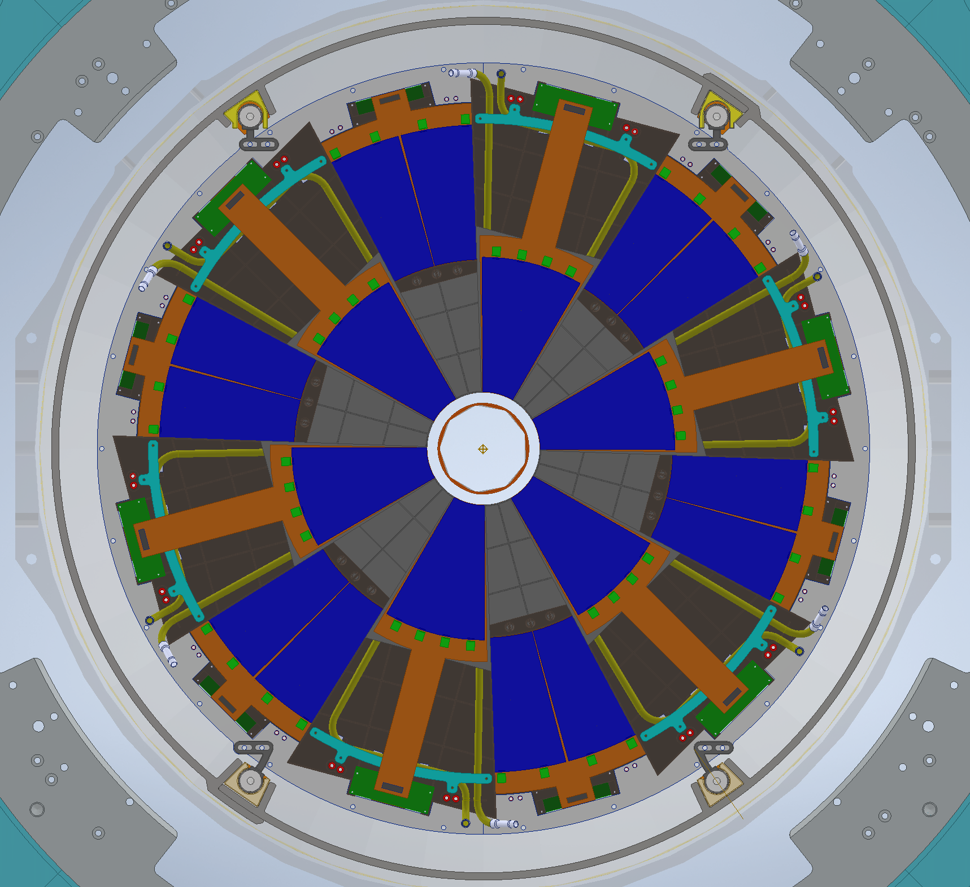
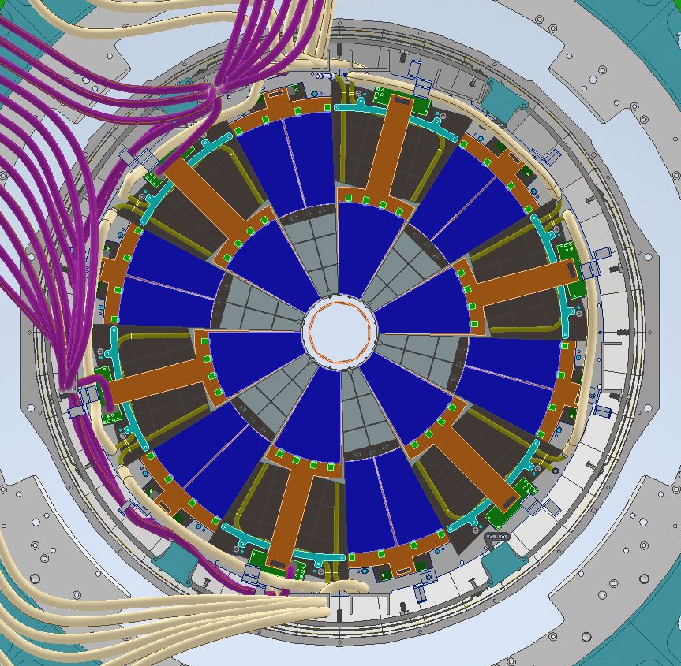
Front View (Final Survey)
Final Survey Targets
Final Survey will be performed (On front Disk) after assembly is fully installed in the IDS/Cone.

Slide 11
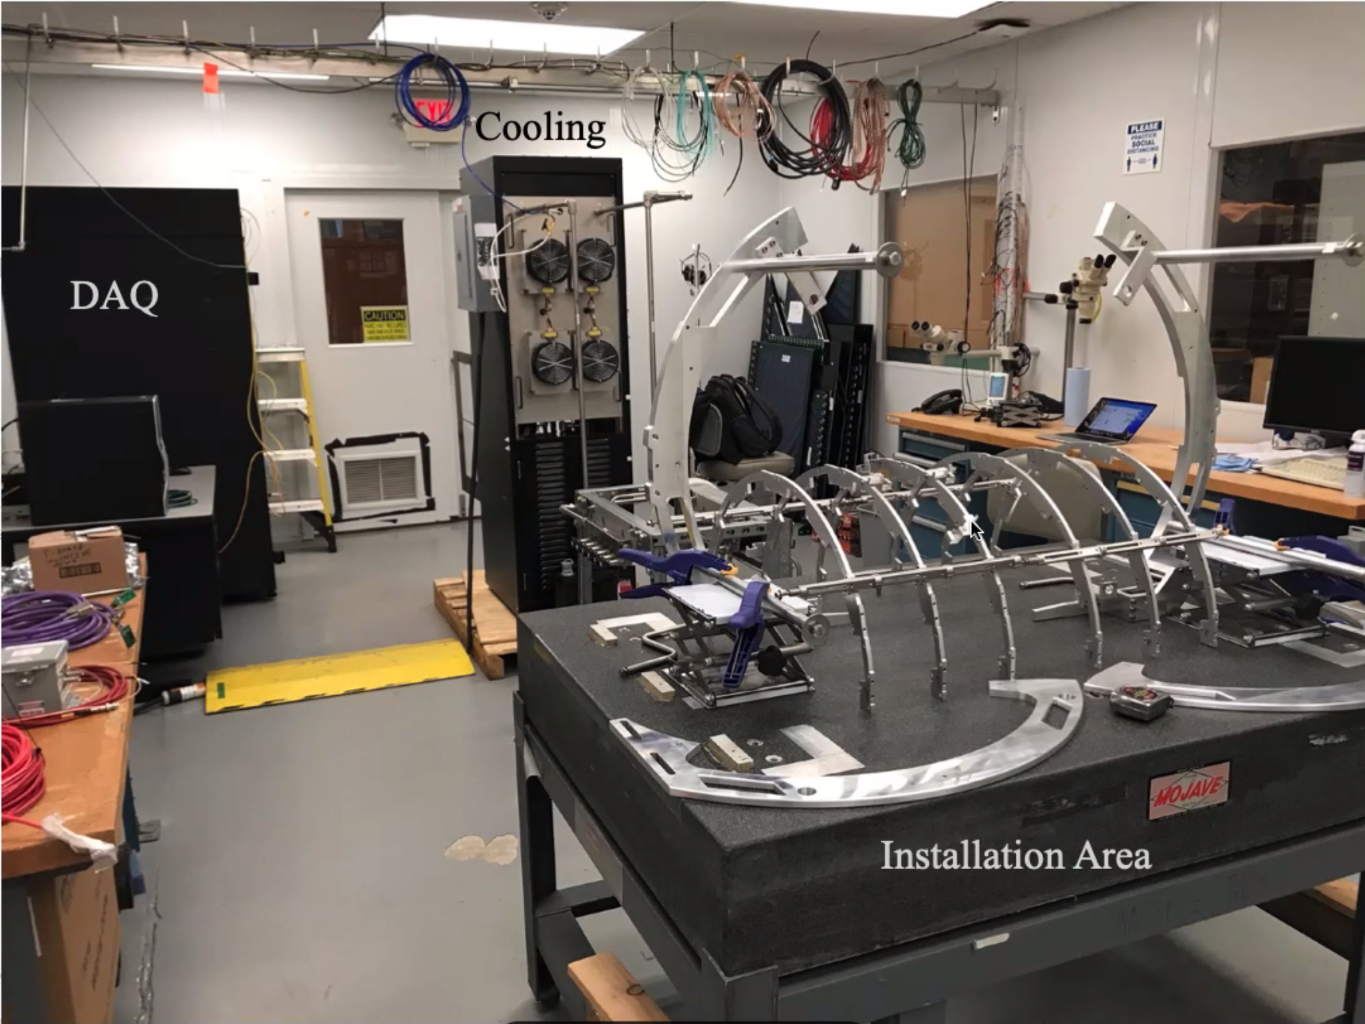
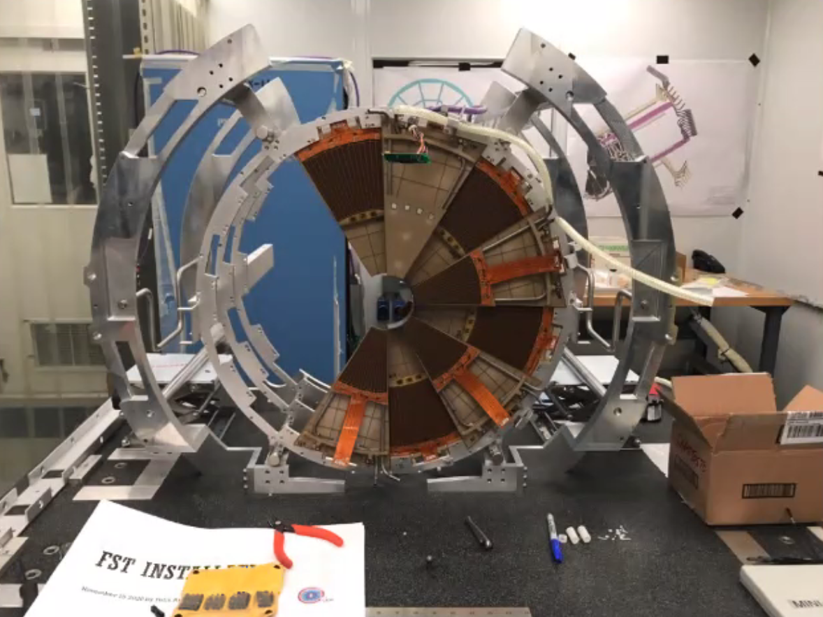
Trial Assembly of parts

Slide 12
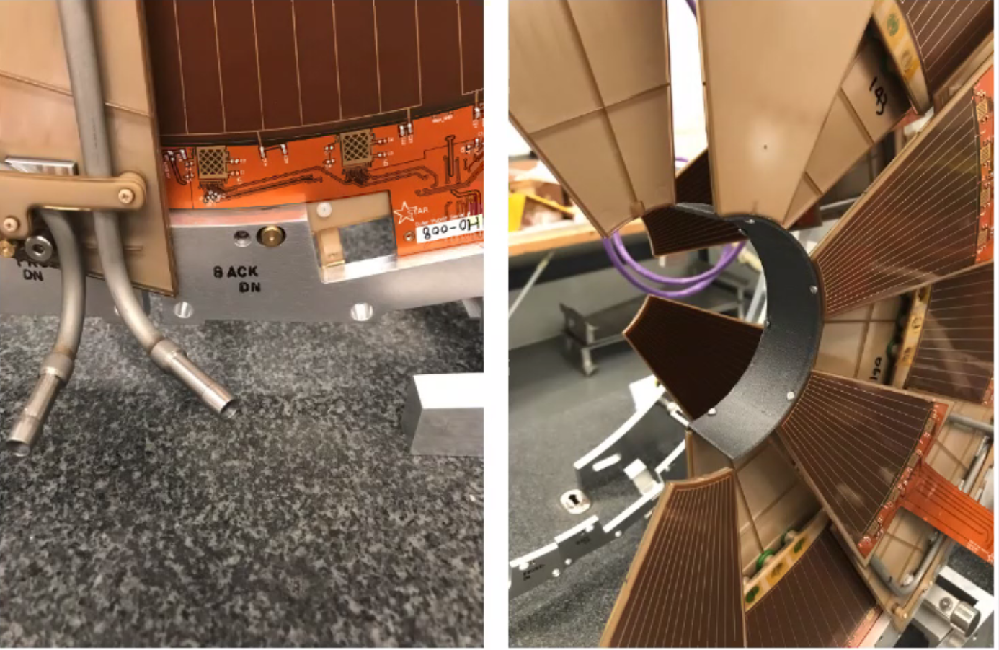
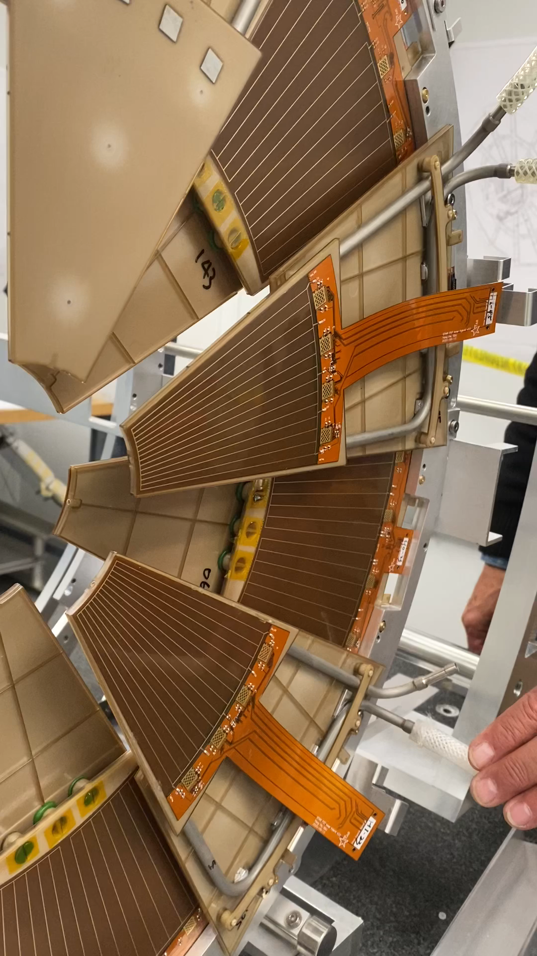
Trial Assembly of parts

Slide 13
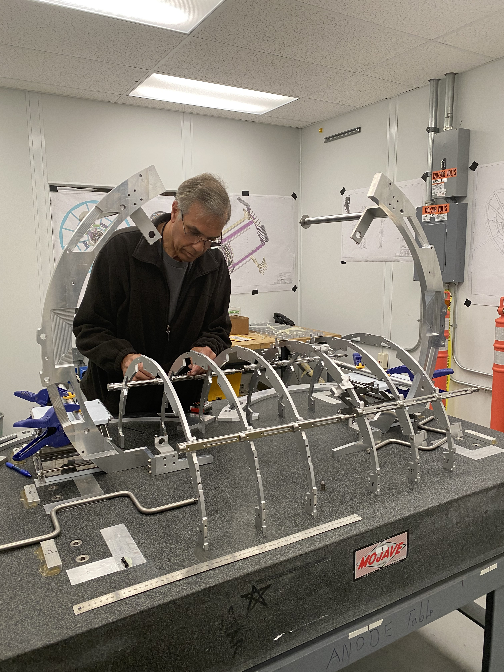
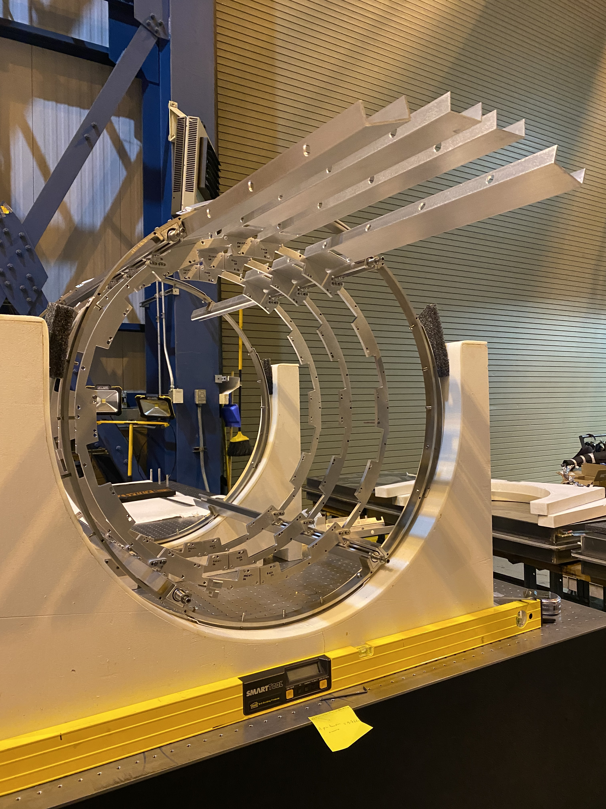
Trial Assembly of parts

Slide 14
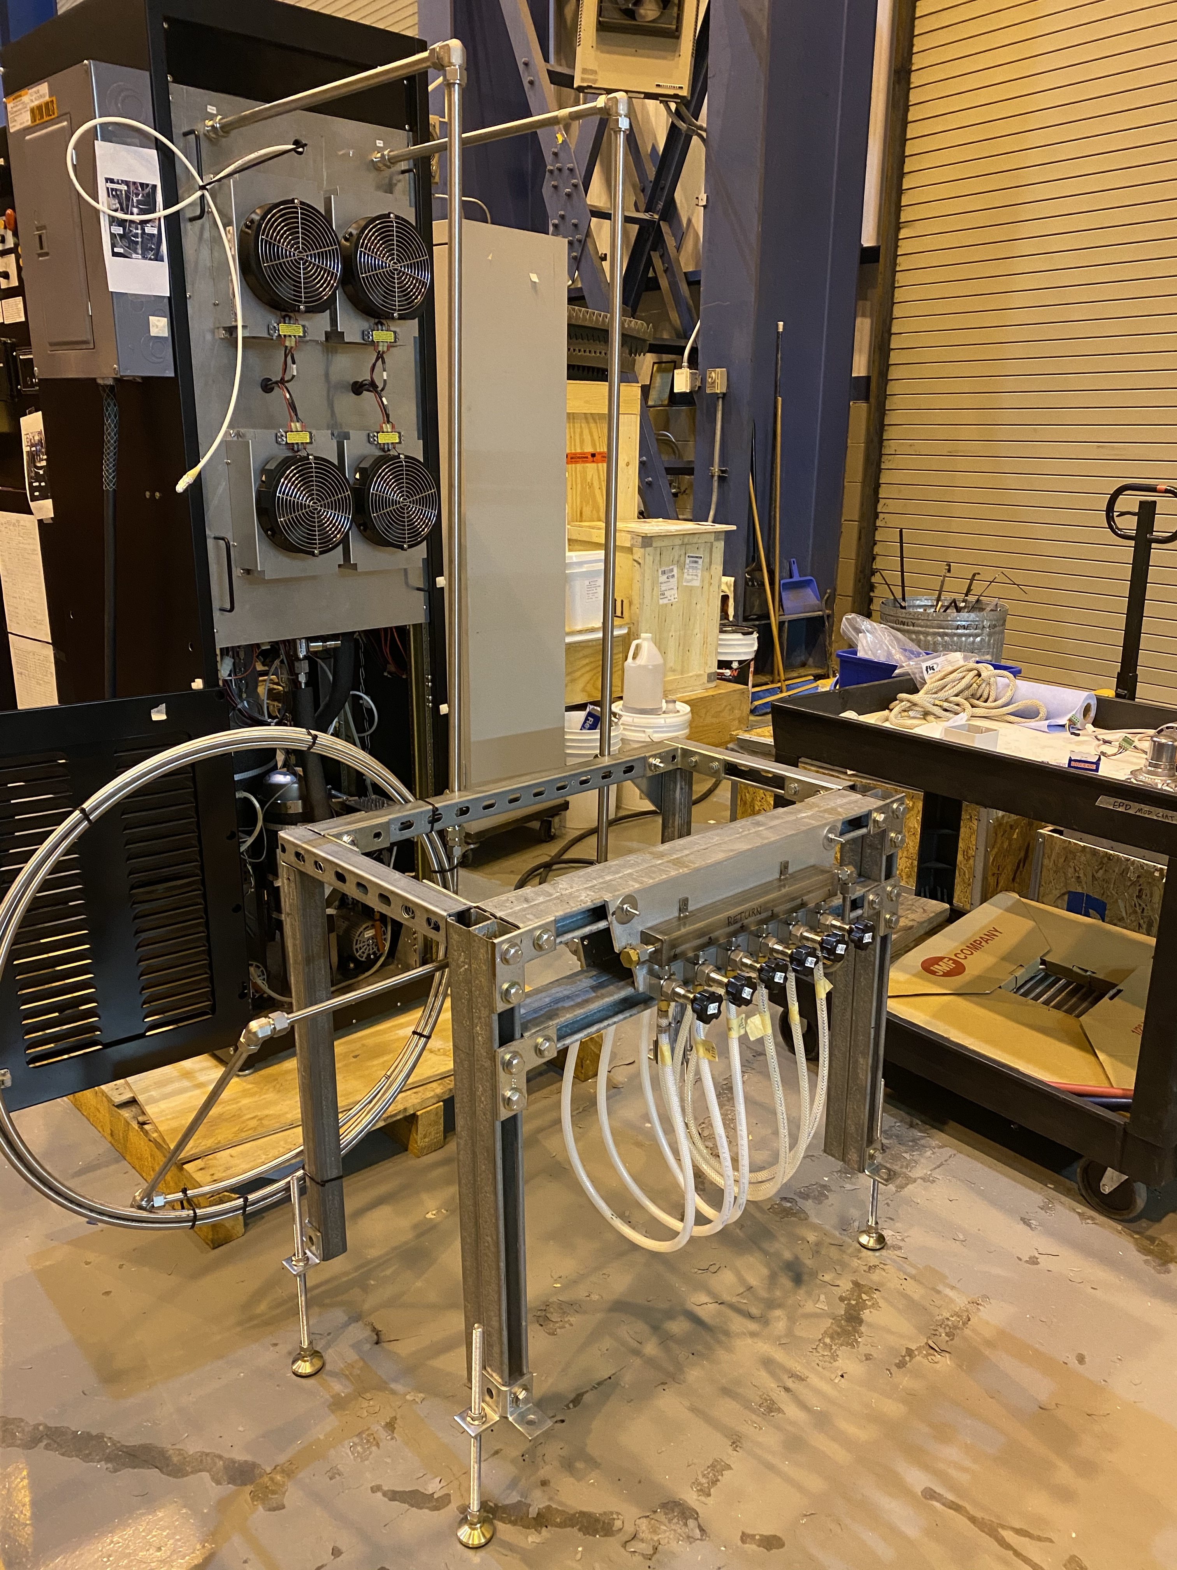
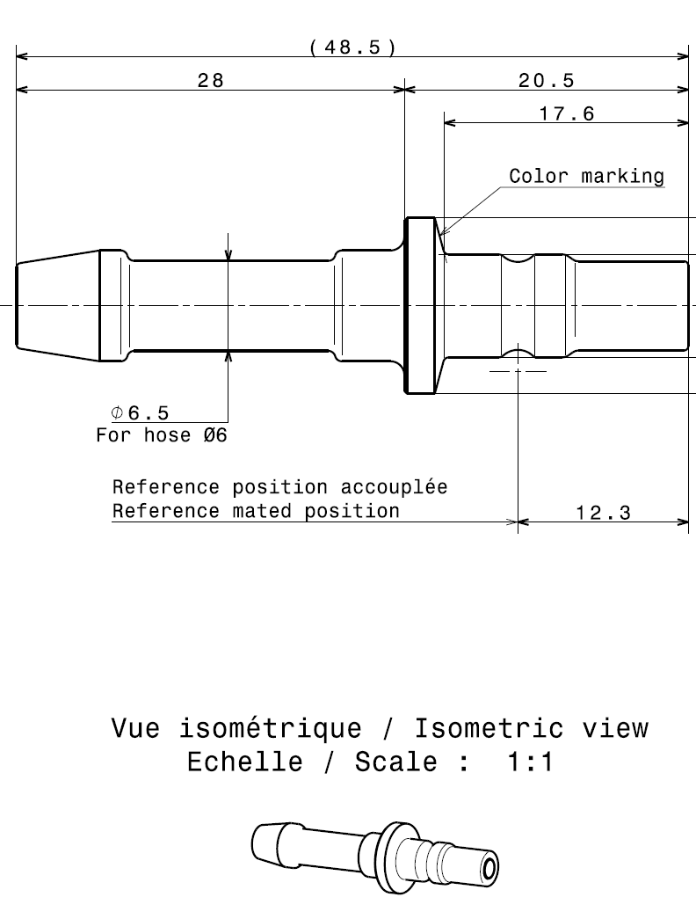
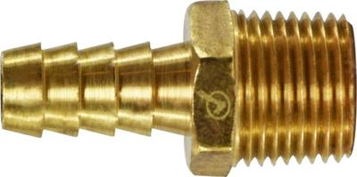
FST Cooling System
IST Novec cooling system refurbished to use for cooling FST Detector.
Replacement O-rings and spare pumps ordered.
Tygon 3370 flex hose performed well so far and no leaks detected in hoses or manifolds.
Testing Objectives:
  Testing the fitting/plug SCG03
  Testing performance of the flex tube candidate materials (Tygon 3370
Test Plan:
  We will like to do a full system test with cooling manifolds and 12 dummy modules in the cleanroom to test the connections and hoses.
  We only have 11 modules.

Slide 15
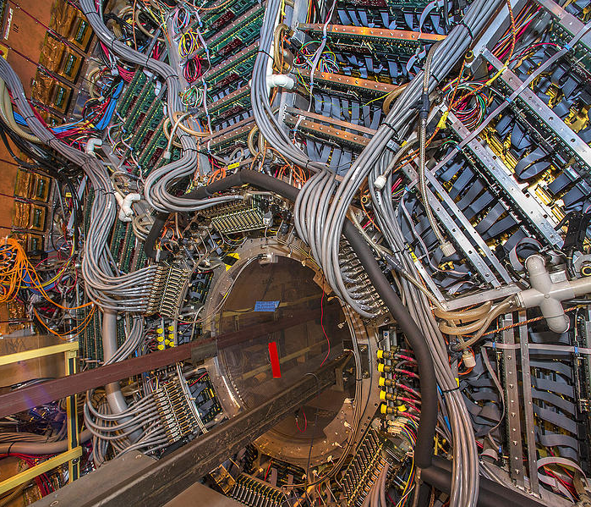
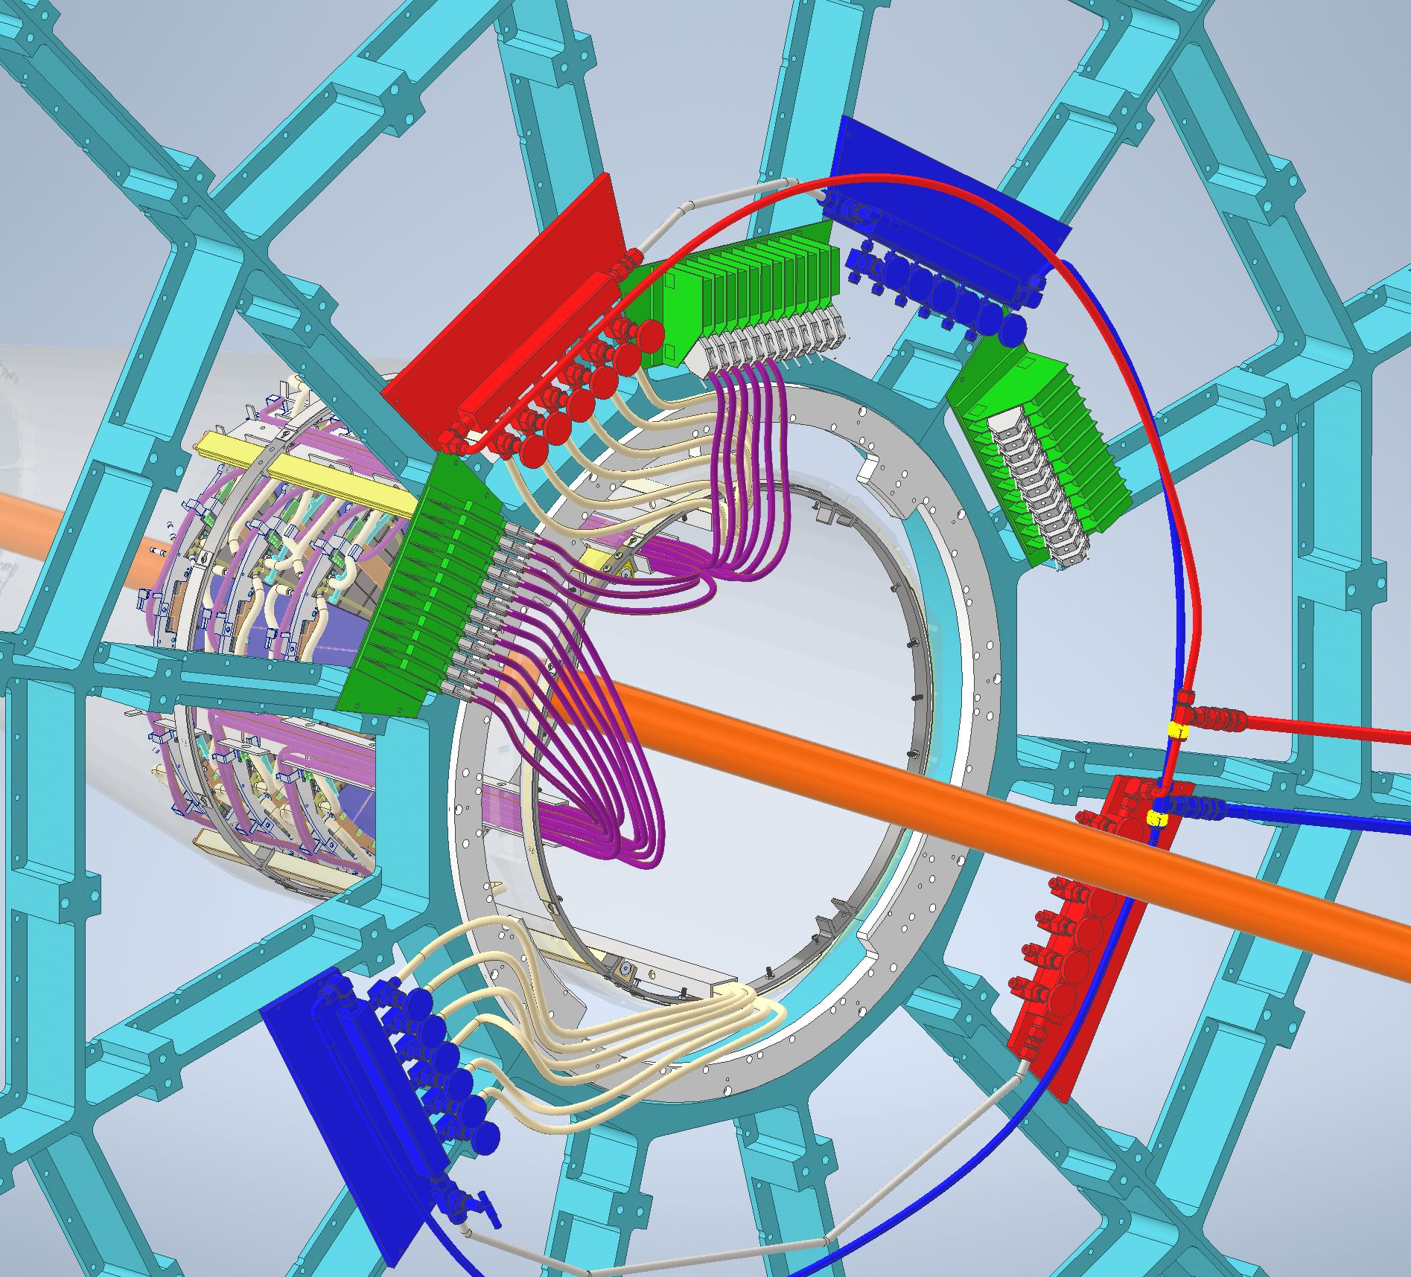
FST

Slide 16
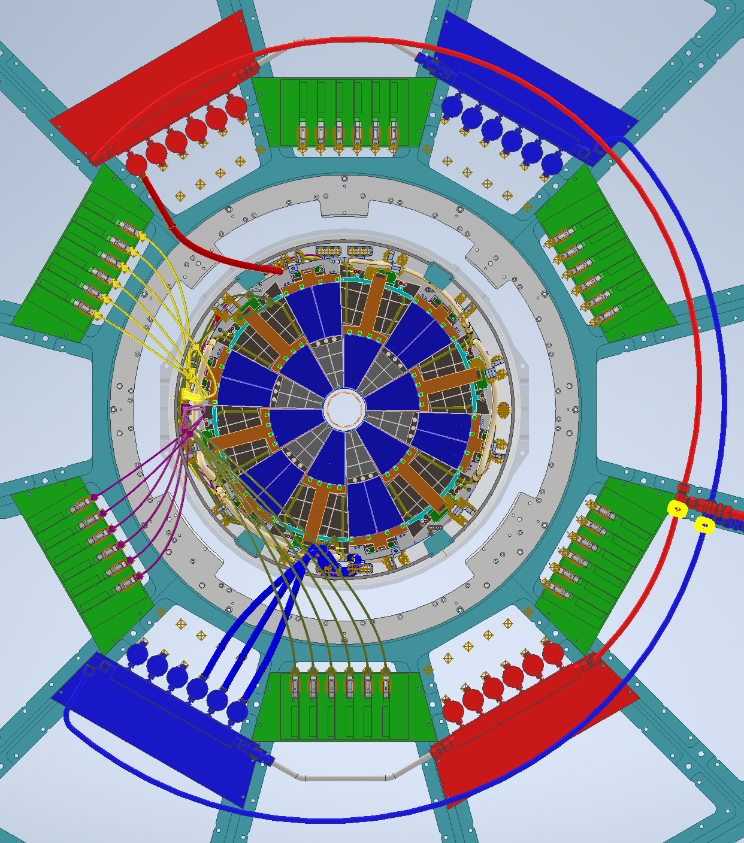
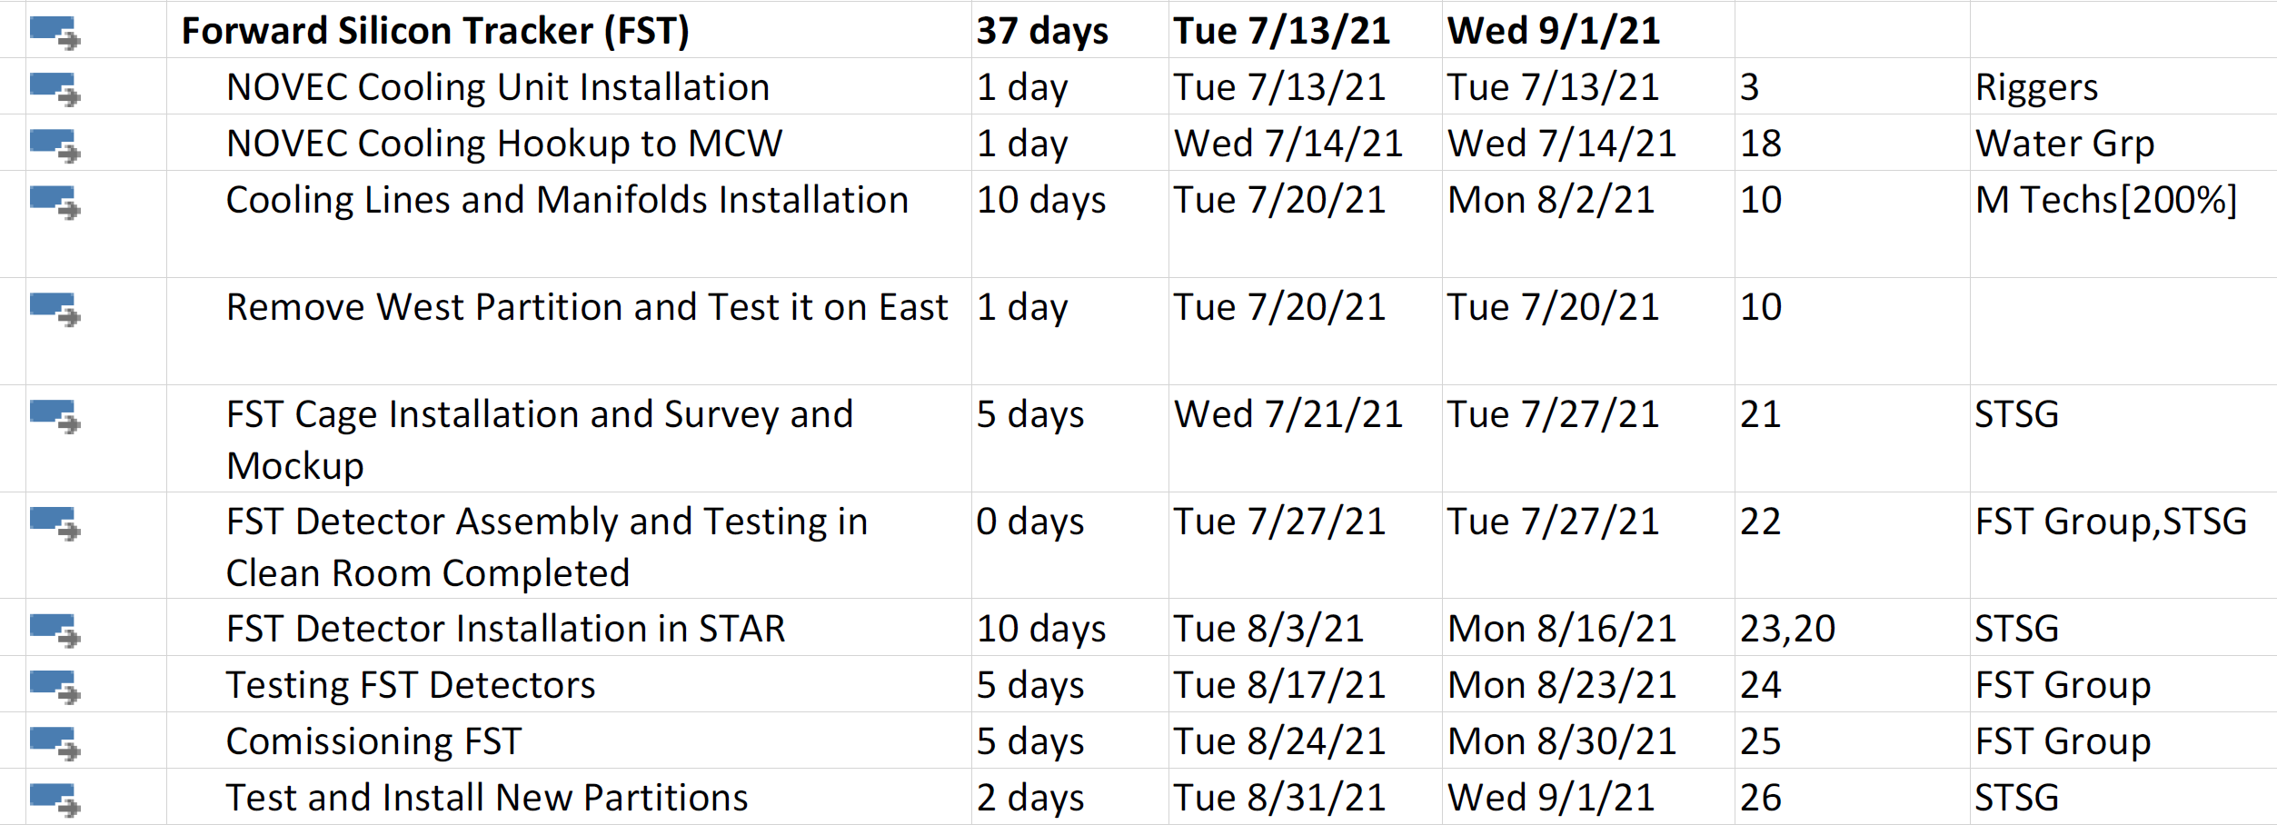
FST Schedule
Detail Design Done
All Parts in Hand : End of Feb 2021
Mockup testing inside cone: Done
Trial Assembly and installation going.
Detector installation: 7/28/2021 to 8/10/2021

Slide 17
ES&H Issues
SVT Cone load test and approval documentation not located so far
Beam Pipe has to be protected at all times.
  All parts are designed to have enough clearance around beampipe so that no scraping occurs during installation.
Flex cooling lines start leaking due to radiation hardening or due to chemical interaction with NOVEC
  Testing flex lines and connections as showin in the test plans

