Slide 1
Schedule and tasks
Flemming Videbæk

Slide 2
Tasks and Schedule
The current production of modules has already been discussed
This talk primarily discusses pre-installation tasks and items need in preparation for the summer shutdown
Activities at BNL
Preparation of clean room and test setup
Checkout of support structures
Production, modification, and checkout of items for installation, readout system
Checkout of modules, assembly of modules
Readout and cooling test of full assembly
Installation of FST (Rahul’s schedule and presentation)

Slide 3
Timeline and Milestones - preinstallation
Activity | Start date | End date | Personnel
Support Structure Assembly | 3/23 | 3/27 | RS,BS,FA
Checkout with dummy modules, cable runs | 3/27 | 4/22 | XS,YH,BS
Modify Support structure, reassemble | 4/21 | 5/14 | BS,XS
Prepare cooling system in CR | 4/20 | 4/28 | BS
Prepare test Readout system | 4/20 | 4/27 | YH, PT, XS
Checkout Modules | 4/27 | 5/11 | XS,YH
Fabricate and checkout purple cables | 4/25 | 5/22 | MC
Receive bulk of modules from UIC |  | 5/26 | ZY,GW
Assemble and test FST detector | 5/26 | 7/14 | ZY,GW,XS,YH
Checkout of Grey cables, Patch Panels, ABC boards | 4/15 | 7/14 | MC,FST-group

Slide 4
Timeline and Milestones - Installation
Activity | Start date | End date | Personnel
Determine grey cable route | 6/15 | 7/15 | STSG
Pull grey FST cables | 7/15 | 7/20 | STSG,C-AD tech ?
Dress Grey cables, FST crates | 7/20 | 7/25 | FST group
Install ARM/ARC/ABC modules in crates | 7/20 | 7/25 | FST group
Checkout Readout – slow control | 7/25 | 7/31 | YH,XS
Install Cooling unit | 7/14 | 7/16 | STSG
Install cooling lines | 7/14 | 8/2 | STSG,C-AD tech ?
Install FST detector | 8/2 | 8/13 | STSG
Survey FST | 8/14 | 8/16 | CAD survey
Testing | 8/17 | 8/30 | FST grp + STSG as need

Slide 5
Grey cables
Long grey cables from IST era is stored in basement. As some of these has shown issues when used at UIC and BNL they need to be tested before installation. This can be done in physics lab
Now to early July; FST group with guidance from Mike
Grey cable route on Platform
Available path for FST racks to west TPC face should be identified now.
Procedures for not damaging cables during pull is needed
Patch panels
One is fully ready. Two other (set of 12) needs to be assembled and checked out.
Now to early July; Mike
ABC cards
With the two HV channels per module/cable these aux cards that sit in back of ARM modules needs modification
Parts in hands. Need 3 right away, remaining 15 by end June. Mike

Slide 6
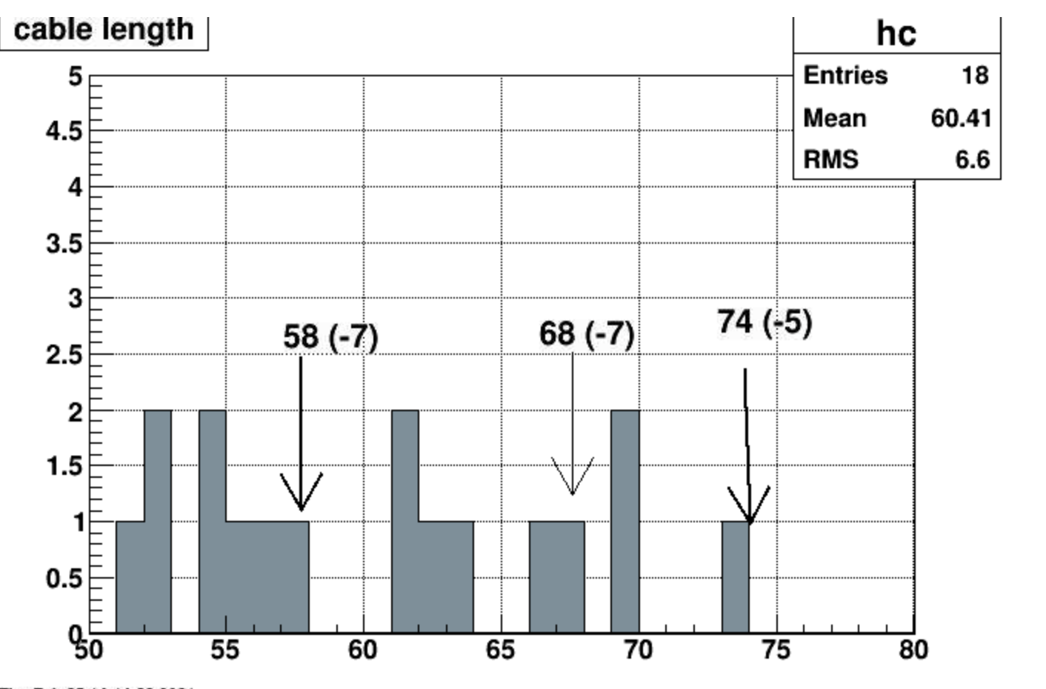
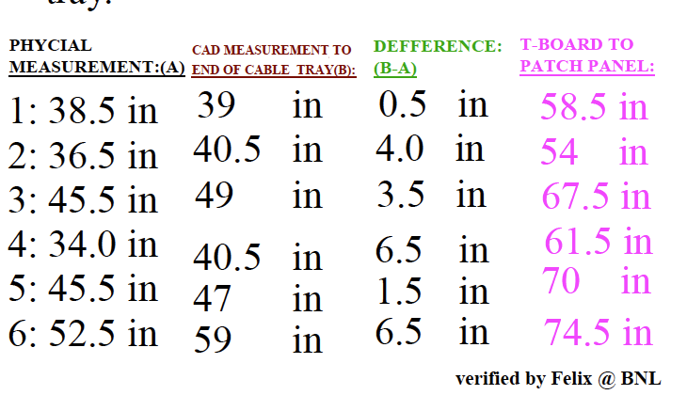
Purple Cables
The purple cables have different length. Data from CAD model.
Actual measurements by Xu indicates shorter by 0.5 to 6” which I find a bit surprising
In addition, a 4-5.5” loop was introduced to relieve stress on T-board
Will suggest to use CAD model length and add the additional loop and not take full credit for the shorter routes.

