Slide 1
Schedule for ROD and FEB
Feng Li, Shuang Zhou, Peng Miao, Naijie Zhang, Yingjie Li, Ge Jin

Slide 2
Schedule for ROD
22 ROD boards have been soldered
Under test at USTC since April 23rd
After quick test and verification, ROD boards will be sent to solder the FEAST cages(heat sink pad filled first).
To be finished in a week.

Slide 3
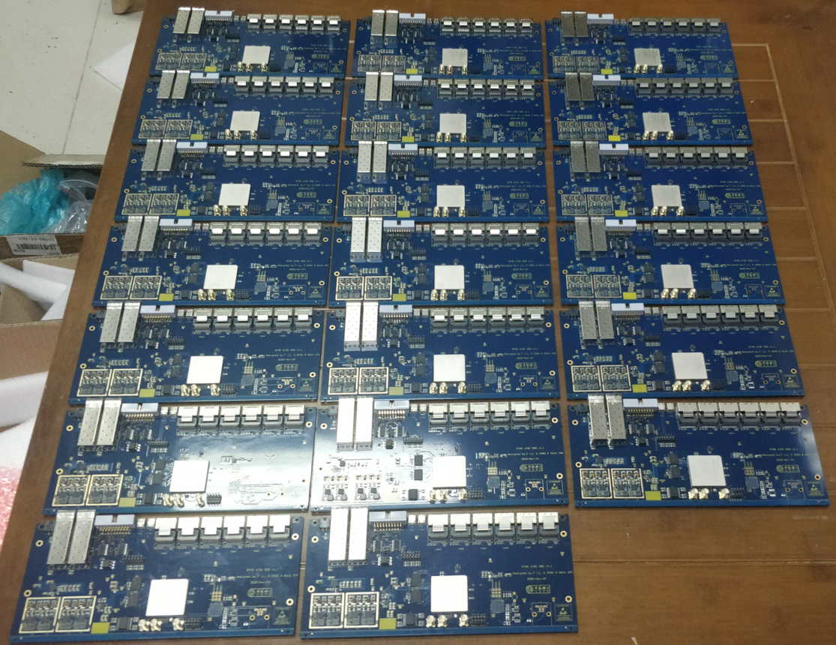
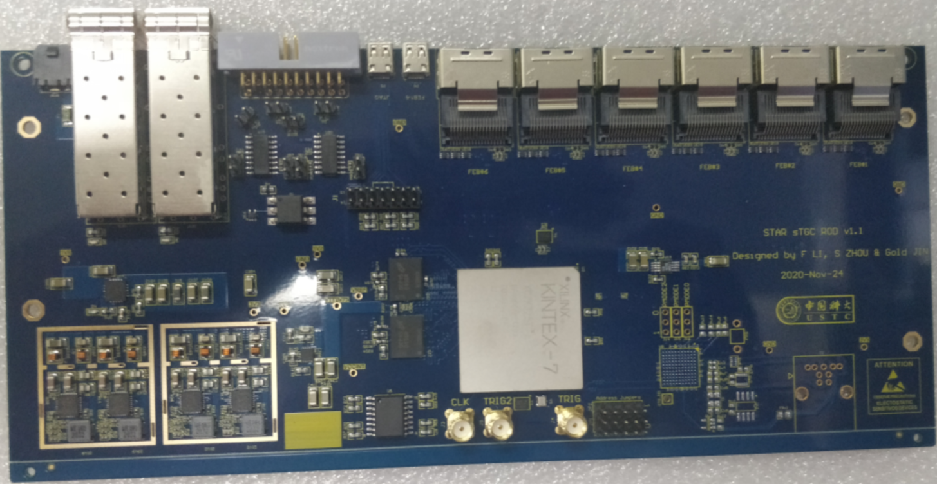
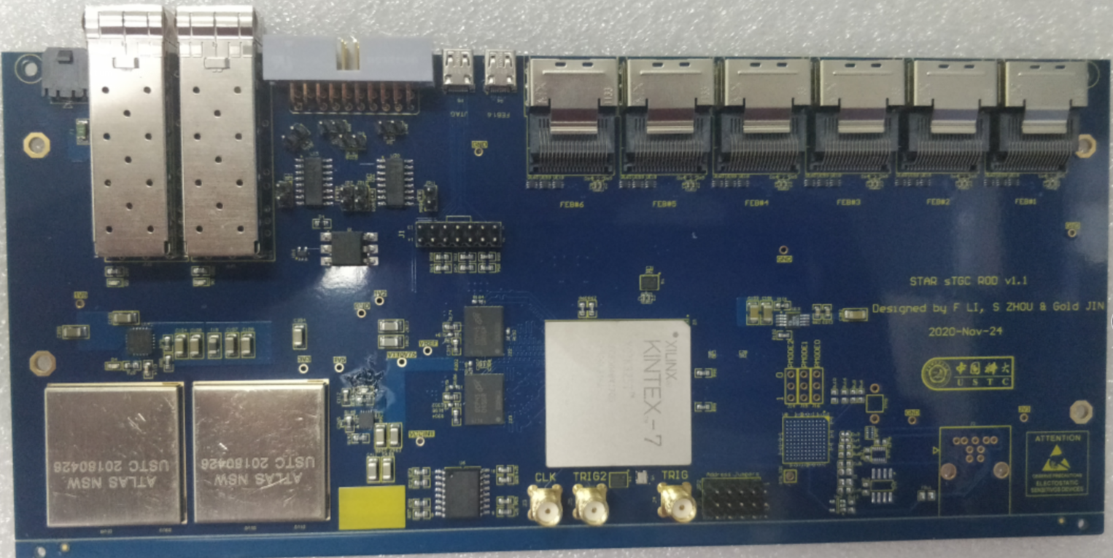

Slide 4
Newly assembled FEBs
18 FEB boards soldered and under test from April 23rd .
TEST result: 12 FEB will be sent back for repair.
13 VMMs will be replaced.
The rest 6 good FEBs(24 VMMs) have only 2 dead channels. They will be sent to solder FEAST cages.
Internal test pulse test
External test pulse test
Integration test with ROD boards
3 FEB(and 3 ROD)will be sent to SDU,
3 FEB(and 17 ROD)will be sent to BNL early May
FEB under repairing will need several weeks, they will be sent to SDU.

Slide 5
Schedule for FEB mass production
 | Finish Time
VMM3a arrival at USTC | May 20th
VMM3a test and selection | May 27th :100 VMMs for 1st Batch June 4th : 400+ VMMs for 2nd Batch ～2 weeks | At least 500 VMM3a chips will be needed for FEBs
FEB board production | May 20th | FEB boards can be produced in advance
FEB soldering | June 15th : 20 FEBs for 1st Batch June 30th : FEBs for 2nd Batch | on board performance verification for Newly produced VMM in 1st batch
FEB functionality and performance test | Early July: good FEBs in 1st batch can be prepared. In August: All the FEBs completed. | Power; Current; analog monitor output; VMM configuration and digital readout; dead channel; baseline Depends on VMM quality

Slide 6
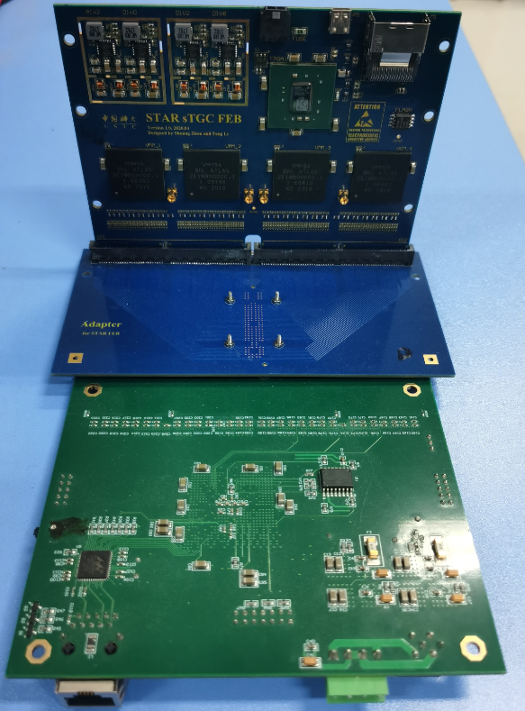
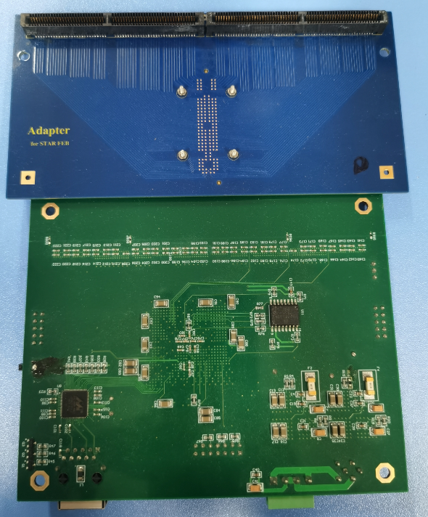
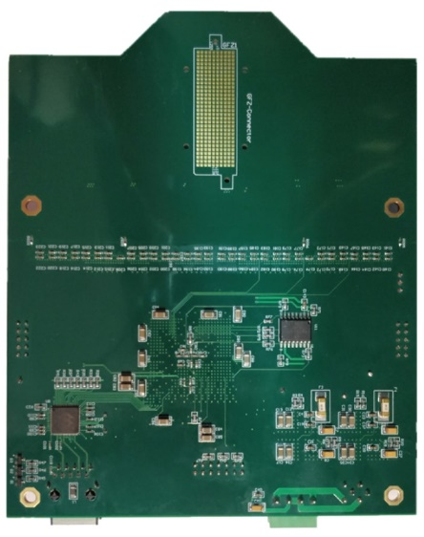
Mass test flow
Test flow:
Visual inspection before FEB powering
Check the power to see if the current is normal
FEB configuration
Check VMM MO analog signal on oscilloscope
Check VMM dead channel
Scan base line of each VMM channel
All the test above will be done for three times, to every FEB
In the assembly factory
Only good FEB boards will have the FEAST cages mounted
Internal test pulse test in the lab
External test pulse test in the lab
256 channels charge output
~400fC
Slot connectors
STAR FEB
Adapter board
External test
pulse source

Slide 7
THANKS!

